Slide 1
National Air Quality Forecast Capability: Towards prediction of fine particulate matter (PM2.5)
Ivanka Stajner¹, Jeff McQueen^{2,} Pius Lee³, Ariel Stein³, Jianping Huang^{2,5},
Li Pan^{3,6}, Daniel Tong^{3,5}, Ho-Chun Huang^{2,5}, Perry Shafran^{2,4},
Jerry Gorline⁴, Phil Dickerson⁷, Sikchya Upadhayay^{1,8}
1 NOAA National Weather Service, Office of Science and Technology Integration, Silver Spring, USA,
2 NOAA National Weather Service, National Centers for Environmental Prediction, College Park, USA,
3 NOAA Air Resource Laboratory, College Park, USA,
4 NOAA National Weather Service, Office of Science and Technology Integration, Met. Development Laboratory, Silver Spring, USA,
5 I.M. Systems Group, Inc., Rockville, USA,
6 Cooperative Institute for Climate and Satellites, University of Maryland, College Park, USA,
7 Environmental Protection Agency, USA
8 Syneren Technologies Corporation, Arlington, USA.
with contributions from the entire NAQFC Implementation Team
CMAS Conference, Chapel Hill, NC October 7, 2015

Slide 2
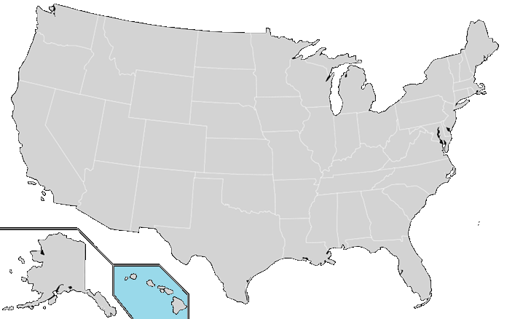
National Air Quality Forecast Capability Capabilities as of 10/2015
Improving the basis for air quality alerts
Providing air quality information for people at risk
Prediction Capabilities:
Operations:
Ozone nationwide
Smoke nationwide
Dust over CONUS
Developmental testing:
Components for particulate matter (PM) predictions
2004: ozone
2007: ozone and smoke
2012: dust
2005: ozone
2009: smoke
2010: ozone
2010: ozone and smoke

Slide 3
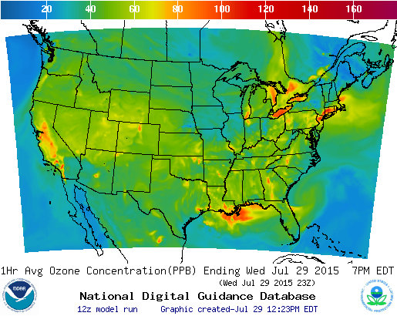
Ozone predictions
Operational predictions at http://airquality.weather.gov
over expanding domains since 2004
Model: Linked numerical prediction system
Operationally integrated on NCEP’s supercomputer
NOAA/EPA Community Multiscale Air Quality (CMAQ) model
NOAA/NCEP North American Mesoscale (NAM) numerical weather prediction
Observational Input:
NWS compilation weather observations
EPA emissions inventory
Gridded forecast guidance products
On NWS servers: airquality.weather.gov and ftp-servers (12km resolution, hourly for 48 hours)
On EPA servers
Updated 2x daily
Verification basis, near-real time: Ground-level AIRNow observations of surface ozone
Customer outreach/feedback
State & Local AQ forecasters coordinated with EPA
Public and Private Sector AQ constituents
CONUS, wrt 75 ppb Threshold
Operational
Maintaining prediction accuracy as the warning threshold was lowered and emissions of pollutants are changing

Slide 4
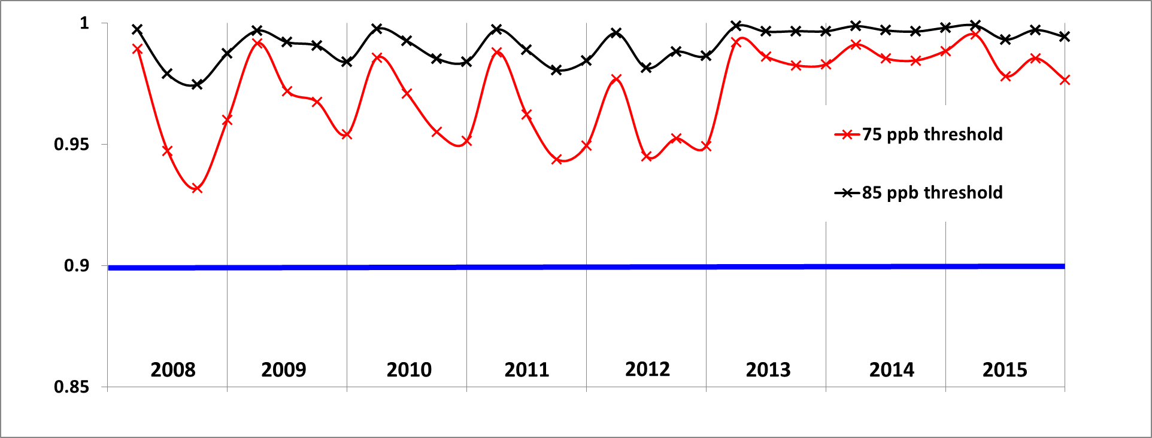
Performance of operational ozone predictions
Fraction correct for 8h daily maximum of NOAA’s operational
ozone predictions for CONUS with respect to two thresholds
showing performance for May, June, July & August for each year
Notes:
For fraction correct metric higher is better.
The goal is at least 0.9 and it has been exceeded on monthly basis since 2008.
85 ppb threshold corresponds to older ozone standard for air quality “code orange” (unhealthy for sensitive groups).
75 ppb threshold corresponds to the current ozone standard for “code orange”

Slide 5
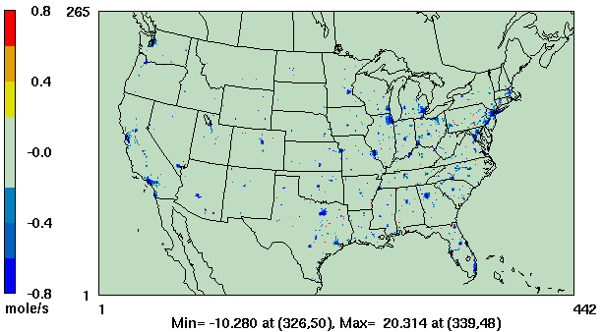
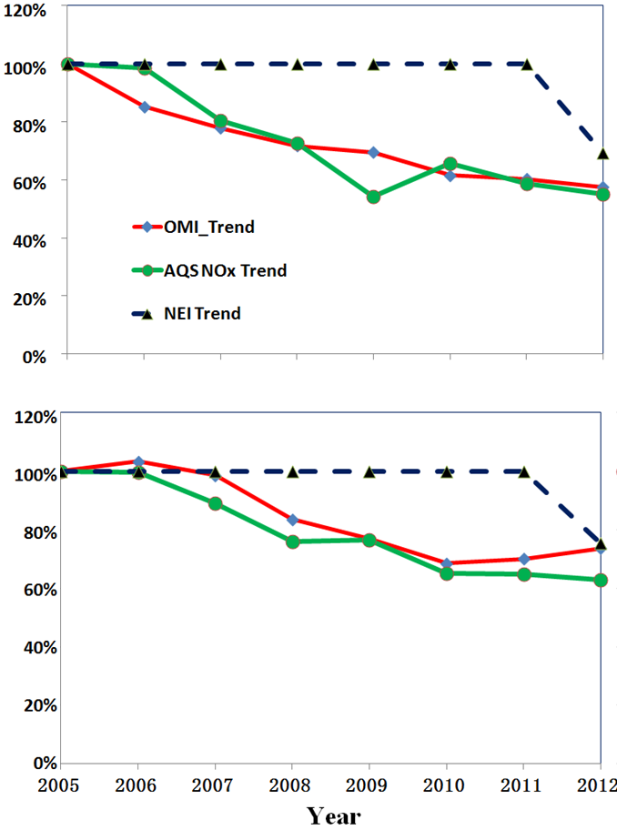
NOx changes
Comparison to 2005 values
Atlanta
OMI NO₂
AQS NO_{X}
NAQFC NO_{X} Emissions
Philadelphia
Atlanta
Comparison to 2005 values
Philadelphia
OMI = Ozone monitoring Instrument on NASA’s Aura Satellite
AQS = Air Quality System
Difference between NOx emissions used in 2012 and 2011 (blue indicates decrease in 2012).
Mobile and nonroad emissions were updated based on projections for 2012.
Comparison of projected emissions with surface and satellite observations shows that projected reductions from 2005 to 2012 are similar to observed (Tong et. al. Long-term NOx trends over large cities in US, Atm. Env. 2015).

Slide 6
Summary of emission data sources for 2015
Area Sources
US EPA 2011 NEIs;
Canada 2010 Emission Inventory;
Mexico 2012 EI for six border states;
New US residential wood combustion and oil and gas sectors;
Snow/Ice effect on fugitive dust emissions;
Mobile Sources (onroad)
2005 NEI with Cross-State Air Pollution Rule (CSAPR) projection for US sources
Canada 2010 Emission Inventory;
Mexico 2012 EI for six border states;
Point Sources (EGUs and non-EGUs)
NEI 2005 for base year;
Updated with 2013 Continuous Emission Monitoring (CEM) data for EGUs;
Projected into forecast year using DOE Annual Energy Outlook (2015) factors;
Natural Sources
Terrestrial biogenic emission: BEIS model v3.14
Sea-salt emission: CMAQ online Sea-salt emission model;
Fire emissions based on HMS fire detection and BlueSky emission model;
Windblown dust emission: Standalone version of the FENGSHA model;

Slide 7
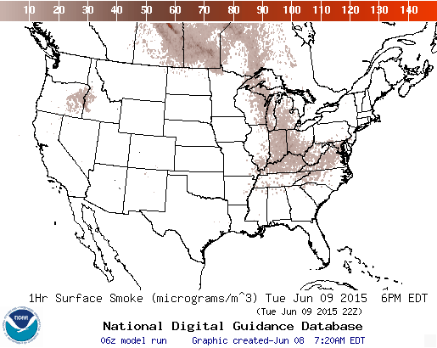
Smoke predictions
Smoke predictions for CONUS (continental US), Alaska and Hawaii
NESDIS provides wildfire locations
Bluesky provides emissions estimates
HYSPLIT model for transport, dispersion and deposition (Rolph et. al., W&F, 2009)
Increased plume rise, decreased wet deposition, changes in daily emissions cycling
Developed satellite product for verification ((Kondragunta et.al. AMS 2008)
Recent updates includes
Automated detection of fires in Canada, Mexico and Central America
3-D particle model approach (rather than horizontal puffs) to properly represent the additional fires identified with automatic fire detection
Current testing includes
Updated BlueSky System for smoke emissions

Slide 8
Verification of smoke predictions
for CONUS
Daily time series of FMS for smoke concentrations larger than 1um/m3
Figure of merit in space (FMS), which is a fraction of overlap between predicted and observed smoke plumes, threshold is 0.08 marked by red line
NESDIS GOES Aerosol/Smoke Product is used for verification

Slide 9
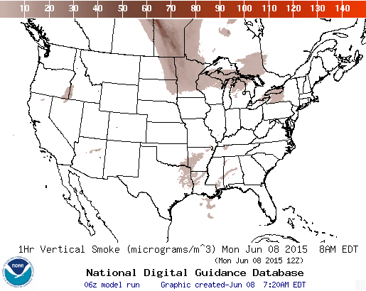
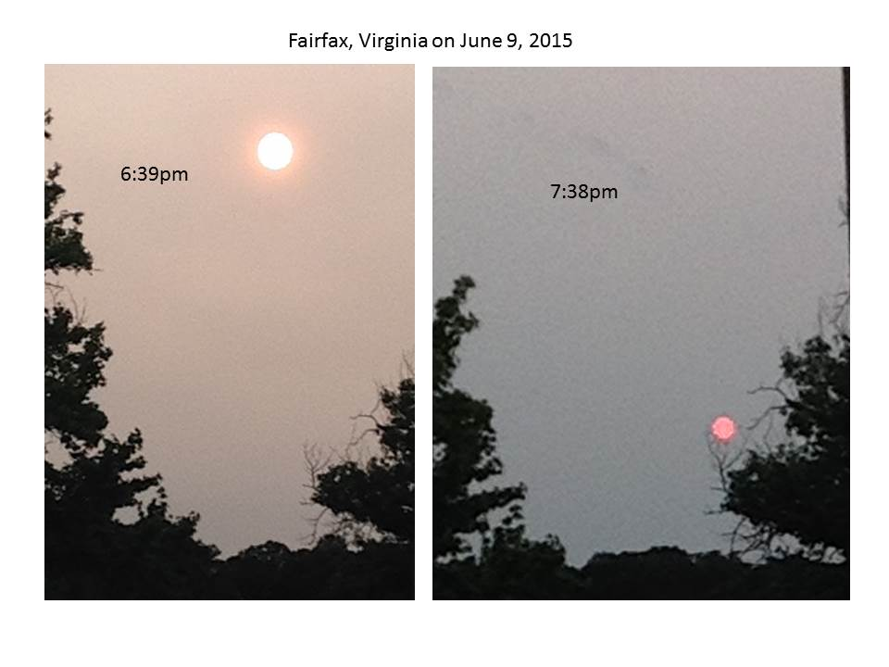
Canadian wildfire smoke 6/9/2015
NOAA/NESDIS wildfire locations and smoke detection from HMS
Canadian wildfire smoke intrusion into CONUS was captured well in NOAA’s smoke predictions

Slide 10
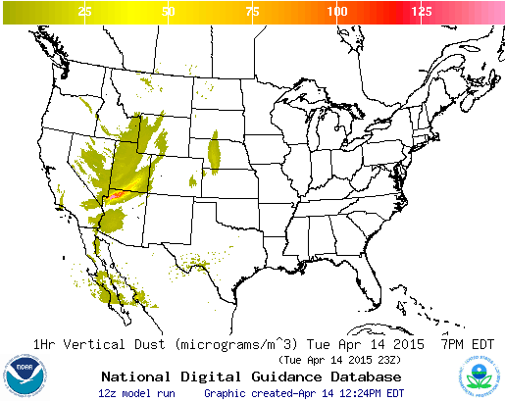
CONUS dust predictions
Operational Predictions at http://airquality.weather.gov/
Standalone prediction of airborne dust from dust storms:
Wind-driven dust emitted where surface winds exceed thresholds over source regions
Source regions with emission potential estimated from MODIS deep blue climatology for 2003-2006 (Ginoux et. al. 2010).
Emissions modulated by real-time soil moisture.
HYSPLIT model for transport, dispersion and deposition (Draxler et al., JGR, 2010)
Wet deposition updates in July 2013
Developed satellite product for verification (Ciren et.al., JGR 2014)

Slide 11
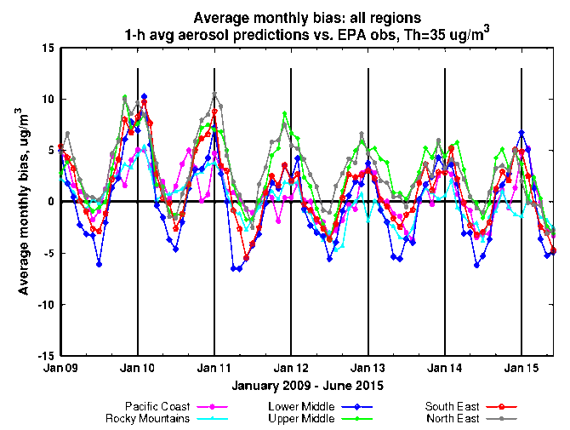
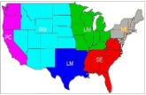
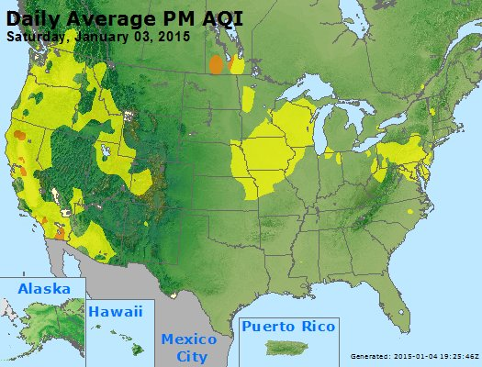
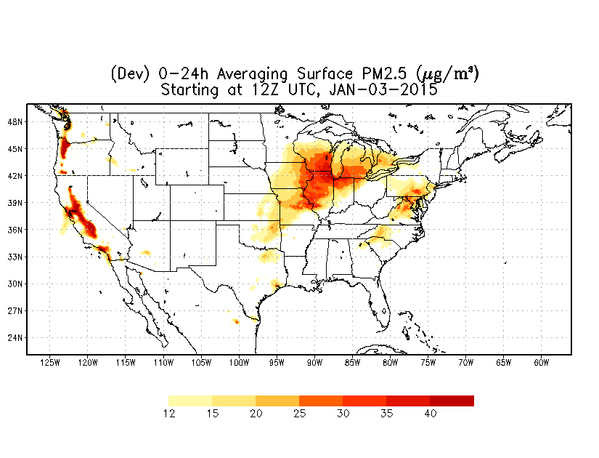
Testing of PM2.5 predictions
AQ Forecaster Focus group access only. Test predictions produced by operational air quality system since January 2015
Aerosols over CONUS
From NEI sources only before summer 2014
CMAQ:
CB05 gases, AERO-4 aerosols
Sea salt emissions
Seasonal prediction bias, testing bias correction post-processing algorithm
Forecast challenges
Improving sources for wildfire smoke and dust – in testing since summer 2014
Chemical mechanisms eg. SOA
Meteorology eg. PBL height
Chemical boundary conditions/trans-boundary inputs
NAQFC PM2.5 test predictions

Slide 12
Updates to CMAQ system for CONUS domain in January 2015
- Carbon Bond gas-phase Mechanisms (CB05) with updated rate constants and linkage with the particulate phase through heterogeneous reactions,
- Monthly varying lateral boundary conditions for 36 gaseous and aerosol species below 7 km altitude,
- Modified dry deposition velocity calculation,
- Planetary boundary layer height in the model constrained to be at least 50 m,
- Faster removal of organic nitrate from the atmosphere,
- Inclusion of particulate emissions from wild fires based on wildfire locations observed over the previous day,
- Suppression of soil emissions when terrain is covered by ice or snow,
Windblown dust emissions are included using threshold friction velocity and soil wetness fraction with climatological source composition and locations.
Simplify maintenance of AQ predictions by unifying prediction code for CONUS, AK and HI.

Slide 13
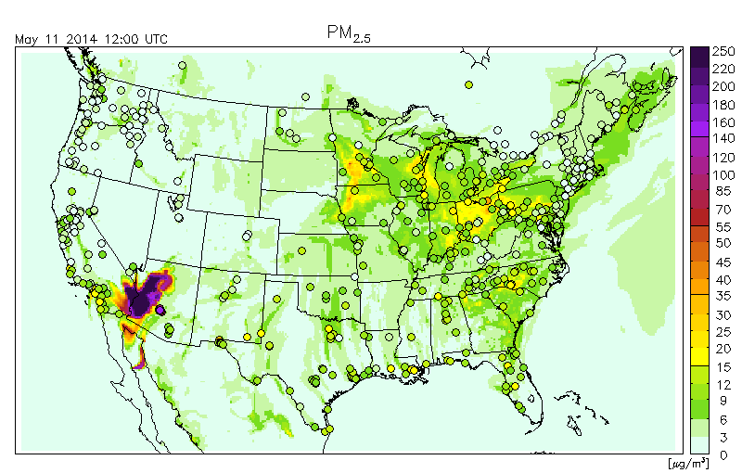
Blowing dust event in testing of PM2.5 predictions
Independent
NOAA/NESDIS
analysis narrative
based on
satellite imagery:

Slide 14
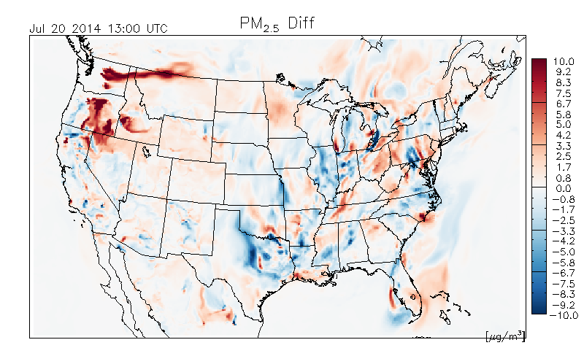
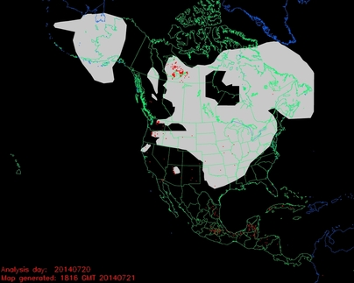
Impact of forest fires in
testing of PM2.5 predictions
Difference between two PM2.5 predictions:
with-minus-without fire emissions
NOAA NESDIS Hazard Mapping System Fire and Smoke Analysis
Detection of wildfire locations from satellite imagery

Slide 15
Snow/Ice dust modulation
UM
 | Case |  | mean | bias | NME (%) | RMSE | Corr. coef., r
UM | Jan 2015 (data-size=650) | obs | 9.42 | 0 | 0 | 0 | 1
 |  | emission updates | 15.93 | 6.51 | 69 | 11.7 | 0.48
 |  | emission updates + snow/ice cover suppression | 12.52 | 3.1 | 33 | 8.94 | 0.46

Slide 16
Current testing of CMAQ updates and near-term plans
Partial update of emissions using NEI 2011 (since May 2015)
Including lateral boundary conditions from global dust predictions
Increased vertical resolution from 22 to 35 layers
Testing analog forecast technique for PM2.5 bias correction (Djalalova I, Delle Monache L, Wilczak: PM2.5 analog forecast and Kalman filter post-processing for the Community Multiscale Air Quality (CMAQ) model, Atmospheric Environment, 2015)
Update to a newer version of BlueSky smoke emission system (further testing needed)

Slide 17
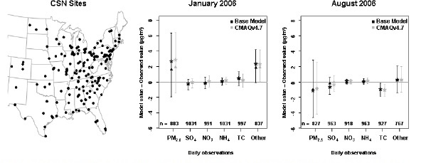
Seasonal Bias in PM2.5 prediction
Mean (star), median (triangle), and inter-quartile ranges of model bias (model value – observed value) for multiple fine-particle species measured at CSN sites in the 12km domain. The number of model/observation pairs for each species is shown above the x-axis.
The bias in the total mass of PM2.5 is dominated by overpredictions of unspecified PM in the winter and by underpredictions of carbon aerosols in the summer. (Foley et. al., Incremental testing of the Community Multiscale Air Quality (CMAQ) modeling system version 4.7, Geosci. Model Dev., 3, 205-226, 2010)
Saylor et. al. found same type of seasonal speciation biases in the CMAQ v4.6 for IMPROVE sites.
17

Slide 18
Removal of Bias in PM2.5 predictions
Quality control of the observations is essential
Five different post-processing techniques were tested
Raw: Hourly AIRNow data available in real-time
PERS: Persistence forecast
7-day: 7-day running mean subtraction
KF: Kalman-filter approach
ANKF: Analog forecast technique followed by Kalman filter approach
AN: Analog Forecast technique
KF-AN: Kalman-filter approach followed by Analog forecast technique
Unsystematic component of the RMSE (top panel) and systematic component of RMSE (bottom panel) using hourly values for the month of November evaluated at the 518 AIRNow PM2.5 sites.
I. Djalalova, L. Delle Monache, and J. Wilczak: PM2.5 analog forecast and Kalman filter post-processing for the Community Multiscale Air Quality (CMAQ) model, manuscript in preparation

Slide 19
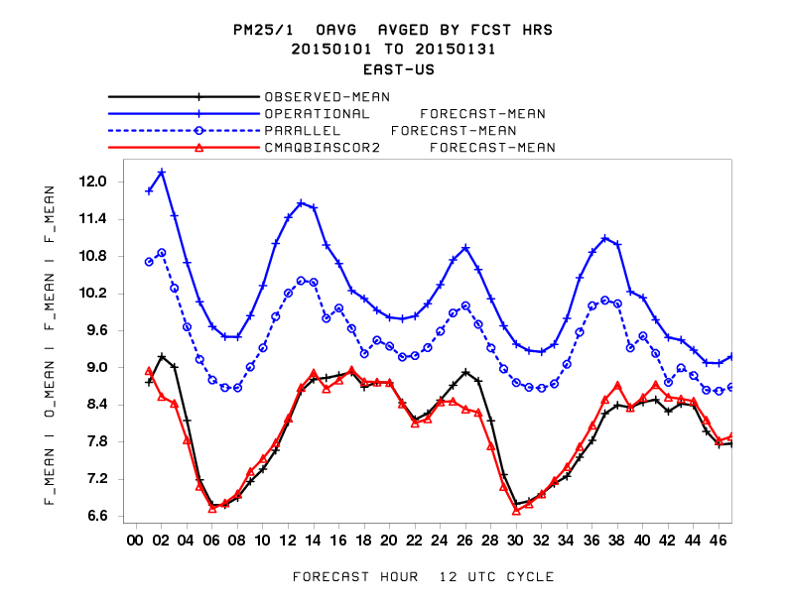
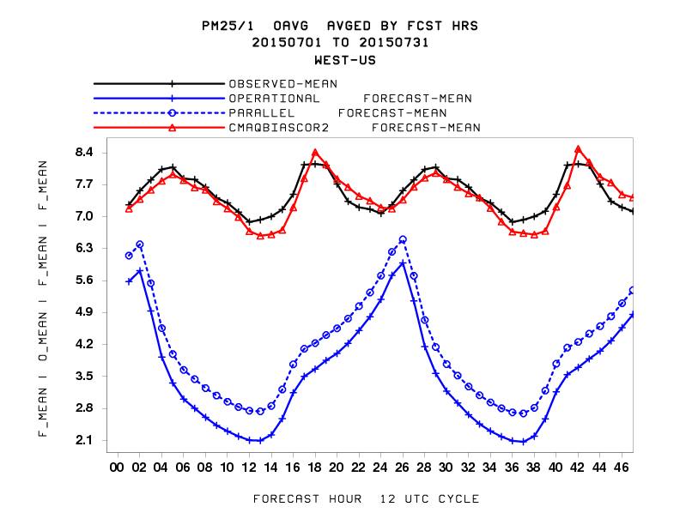
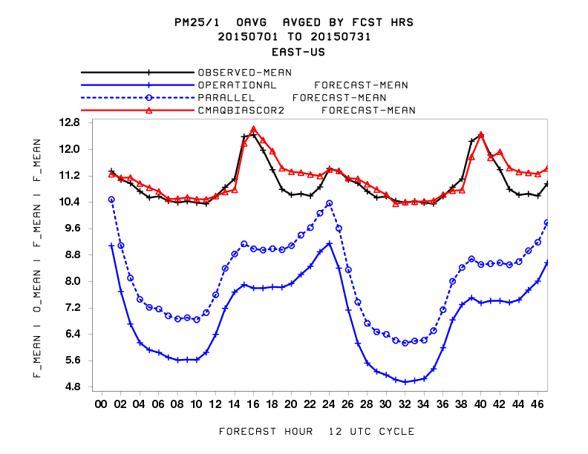
Bias Correction for developmental PM2.5 predictions
Western US
Eastern US
winter
summer

Slide 20
Summary and plans
US national AQ forecasting capability:
Operational ozone prediction nationwide; CMAQ with CB05 mechanism
Operational smoke prediction nationwide
Operational dust prediction from CONUS sources
Prototype CMAQ PM2.5 predictions with NEI, wildfire and dust emissions:
Bias correction and linkages with global dust predictions in testing
Evaluation for potential experimental (public) release.

Slide 21
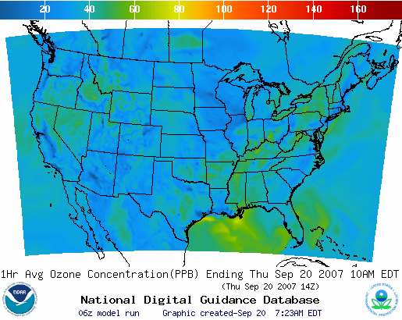
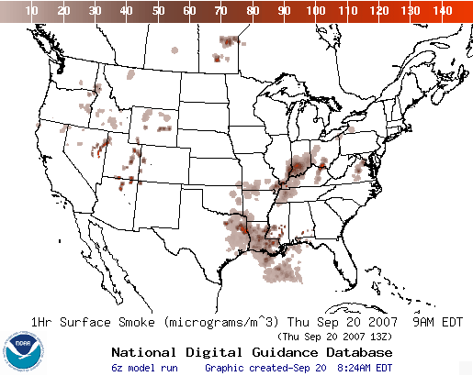
Operational AQ forecast guidance airquality.weather.gov
Ozone products Nationwide since 2010
Smoke Products Nationwide since 2010
Dust Products
Implemented 2012
Further information: www.nws.noaa.gov/ost/air_quality

Slide 22
Acknowledgments: AQF implementation team members
Special thanks to previous NOAA and EPA team members who contributed to the system development
NOAA/NWS/OSTI Ivanka Stajner NAQFC Manager
NWS/AFSO Jannie Ferrell Outreach, Feedback
NWS/OD Cynthia Jones Data Communications
NWS/OSTI/MDL Jerry Gorline, Marc Saccucci, Dev. Verification, NDGD Product Development
Dave Ruth
NWS/OSTI Sikchya Upadhayay Program Support
NESDIS/NCDC Alan Hall Product Archiving
NWS/NCEP
Jeff McQueen, Jianping Huang, Ho-Chun Huang AQF model interface development, testing, & integration
Jun Wang, *Sarah Lu Global dust aerosol and feedback testing
*Brad Ferrier, *Eric Rogers, NAM coordination
*Hui-Ya Chuang
Geoff Manikin Smoke and dust product testing and integration
Rebecca Cosgrove, Chris Magee NCO transition and systems testing
Mike Bodner, Andrew Orrison HPC coordination and AQF webdrawer
NOAA/OAR/ARL
Pius Lee, Daniel Tong, Tianfeng Chai CMAQ development, adaptation of AQ simulations for AQF
Li Pan, Hyun-Cheol Kim, Youhua Tang
Ariel Stein HYSPLIT adaptations
NESDIS/STAR Shobha Kondragunta Smoke and dust verification product development
NESDIS/OSDPD Liqun Ma, Mark Ruminski Production of smoke and dust verification products,
HMS product integration with smoke forecast tool
EPA/OAQPS partners:
Chet Wayland, Phil Dickerson, Brad Johns, John White AIRNow development, coordination with NAQFC
* Guest Contributors

Slide 23
Backup

Slide 24
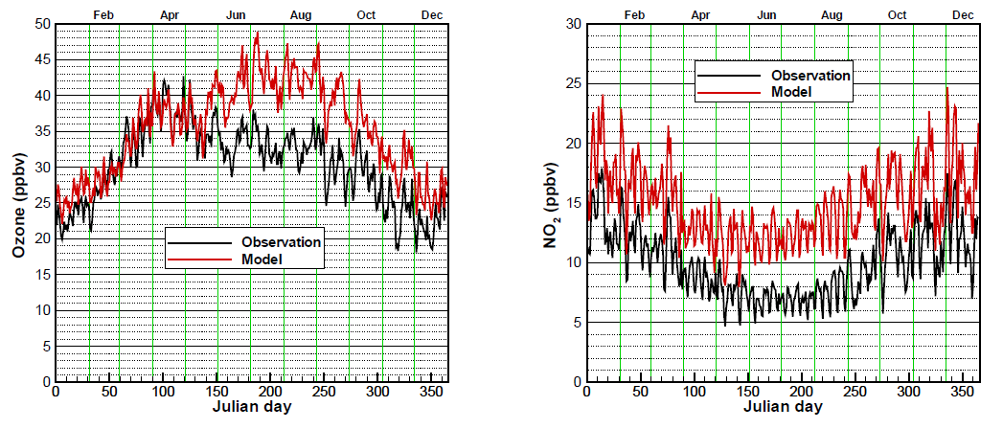
Evaluation of experimental CB05 NAQFC ozone predictions for 2010, prior to emissions update
Based on NEI 2005
T. Chai et al., Geosci. Model Dev., 2013 (http://www.geosci-model-dev.net/6/1831/2013/gmd-6-1831-2013.html)
Ozone overestimation in August is larger in rural areas, during morning hours, and in the southeast US
NO2 overestimation in August is larger at night time
Ozone biases higher on weekends, but NO2 biases higher on weekdays

Slide 25
Reduction in NOx emissions implemented in 2012
NOx emission reduction %
NO_{x} emission reduction by day of week and holiday for July compared to those used in 2011
NO_{x} emission reduction by region for July compared to those used in 2011
NOx emission reduction %
Notes:
Total is 17.2%
Weekday (18.3 - 18.8%); Friday maximum;
Weekend including July 4th (13.5 – 13.9%); Saturday > Sunday
Holiday is similar to Sunday;
Weekday > Weekend
Reducing in every regions;
Upper Middle has maximum %;
Lower Middle has minimum %;

Slide 26
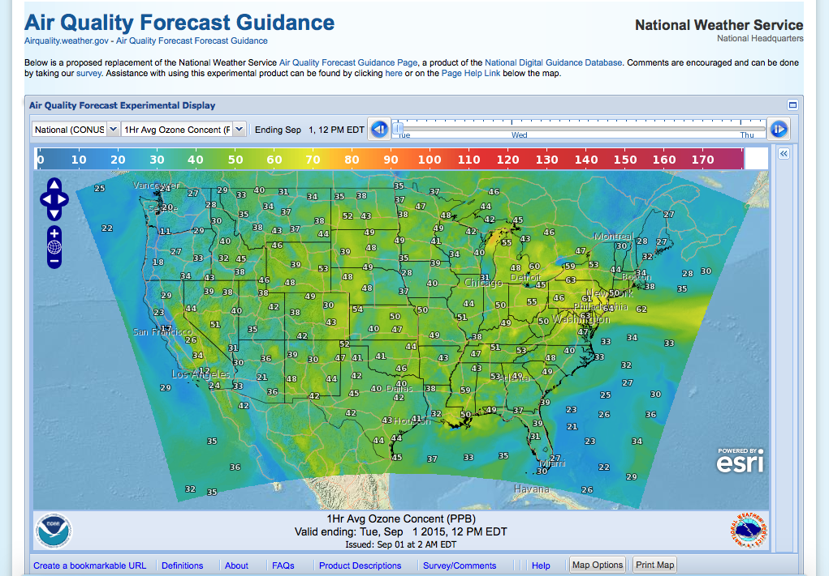
Next Generation of AQ display/distribution on the Web
Benefits/Improvements
Uses a PostgreSQL Database with PostGIS extensions to manage data
Open Geospatial Consortium (OGC) Web Mapping Service (WMS)
Possible expansion of NWS XML/SOAP Services to include Air Quality Data
Uses Open Layers with a ESRI Map Background
Very Interactive – zoom and roam/data interrogation
Faster data refresh
Mobile device support

Slide 27
Partnering with AQ Forecasters
Focus group, State/local AQ forecasters:
Participate in real-time developmental testing of new capabilities, e.g. aerosol predictions
Provide feedback on reliability, utility of test products
Local episodes/case studies emphasis
Regular meetings; working together with EPA’s AIRNow and NOAA
Feedback is essential for refining/improving coordination
Examples of AQ forecaster feedback after emissions update in 2012:
In Maryland, NOAA ozone predictions have improved since 2011: significant improvement in false alarm ratio (FAR) with some decrease in probability of detection (POD). (Laura Landry, Maryland Department of the Environment)
Updates in 2014:
In Connecticut, The late summer over-prediction has been nearly eliminated. The CB05/AERO-4 model looks good for production. (Michael Geigert, Connecticut Department of Energy and Environmental Protection)
Currently evaluating updates in ozone and testing of PM2.5 predictions

Slide 28
Impact of NOx emissions update on ozone predictions
NOx emission used in July 2012 are 17.2% lower than those used in July 2011
Peak Ozone bias in summertime is reduced with updated emissions
(Pan et. al., Assessment of NOx and Ozone forecasting performance in the US NAQFC before and after the 2012 major emissions updates, Atmospheric Environment, 2014).

Slide 29
NOx and Ozone biases over CONUS (in July 2011)
Land use | NO_{x}_Biasª (ppbv) |  | ΔNOx (New-base) | O3_Bias^{b} (ppbv) |  | ΔO3 (New-base)
 | Base | New |  | Base | New
Urban | 2.8 | 0.46 | -2.34 | 7.08 | 6.16 | -0.92
Suburban | 4.62 | 2.53 | -2.09 | 7.48 | 6.22 | -1.26
Rural | 0.75 | 0.18 | -0.57 | 7.8 | 5.93 | -1.87
a The total number of NO_{x} AQS sites is 295 including urban (101), suburban (111) and rural (83).
b The total number of ozone AQS sites is 1144 including urban (201), suburban (438) and rural (505).
Positive biases reduced for all urbanization types for NOx and ozone.
Largest improvements for NOx are in urban areas.
Largest improvements for ozone in rural areas.

Slide 30
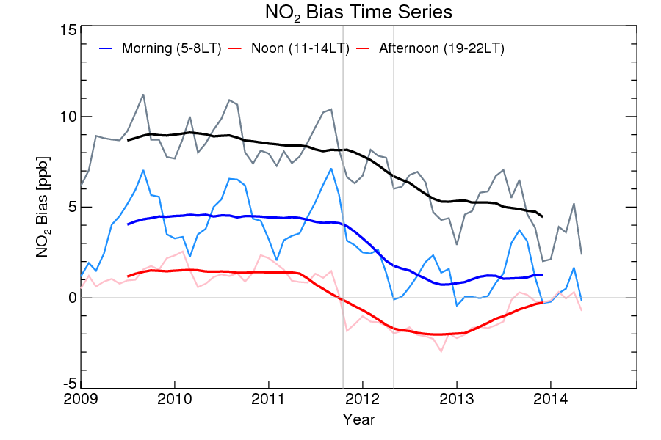
Impacts of model and emission updates on other species
NO₂ bias by time of the day was reduced following experimental model update in 2011 and emission update in 2012 (Courtesy: Hyun-Cheol Kim)

Slide 31
Impact of emission update on ozone
Comparison of mean values over the continental US of daily maximum 8-hr Ozone concentrations from surface monitor observations (circles) and collocated NAQFC predictions (red line) for years 2010, 2011 and 2012.

