Slide 1
Emission reductions needed to meet proposed ozone standard and their effect on particulate matter
Daniel Cohan and Beata Czader
Department of Civil and Environmental Engineering
Rice University

Slide 2
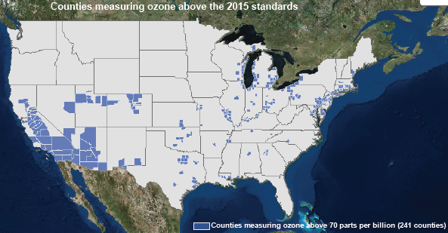
Background
EPA sets National Ambient Air Quality Standards (NAAQS) to protect health
States tasked with attainment
NAAQS for O3 reduced from 84 ppb to 75 ppb and now 70 ppb
Standard based on annual 4th highest 8-h O₃, averaged over three years
Focus: How much reduction in NO_{x} and/or VOC is needed to attain?
Notes:
If this quantity, called the design value, exceeds 75 ppb, then a monitor is in violation of the ozone NAAQS.

Slide 3
Performance of SIP model predictions for 84 ppb ozone standard
False Alarms
False Negatives
Pegues et al., JA&WMA 2012

Slide 4
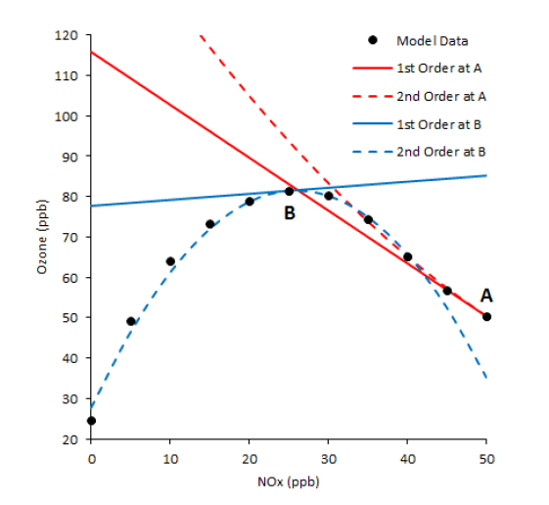
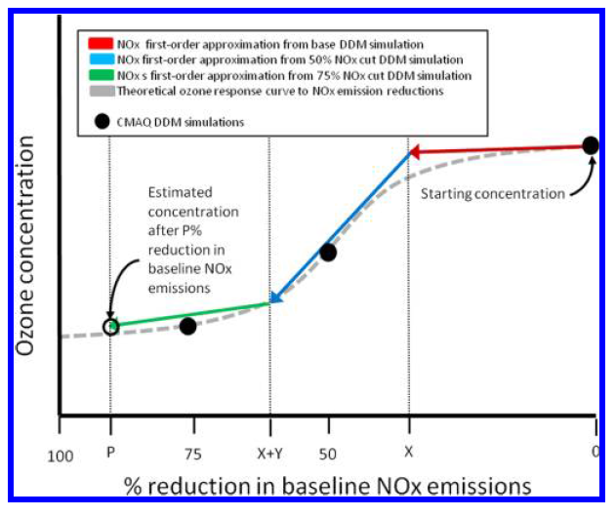
High-order Direct Decoupled Method (HDDM)
$$S^{(1)}=\frac{∂C}{∂ε}$$
$$S^{(2)}=\frac{∂^{2}C}{∂ε^{2}}$$
Sensitivity coefficients:
Innovative techniques introduced by ENVIRON (Yarwood 2013) and EPA (Simon 2013) to more accurately predict ∆O₃ for large ∆E
Source: Yarwood GMD 2013
Source: Simon EST 2013
Notes:
This first order sensitivity coefficient, Sij(t) is quite
suitable for small changes, but gives a linear response which is unlikely to represent the results
of large changes in very nonlinear chemical environments. Second (and third) order derivatives
can be calculated to give higher order sensitivity coefficients (Hakami et al., 2003). Higher order
sensitivity coefficients give the curvature and inflection points for the response curve and can
capture the nonlinearities in the response of O3 to emissions changes. Using Higher order DDM
(HDDM) allows for the sensitivities to be more appropriately applied over larger emissions
changes.
Sensitivities to different sets of parameters can be calculated in a single model simulation
but computation time increases as the number of sensitivities increases.
new concentration is estimating using modeled coefficients with the first three terms of the Taylor series expansion
Advantage -> dE is not in the input, response to a full range of emission changes can be calculated at once
Disadvantage -> because of non-linearity of ozone the method gives reliable results up to 50% emissions cut, for more reductions it has to be adjusted

Slide 5
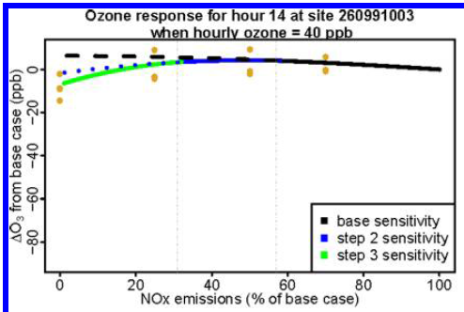
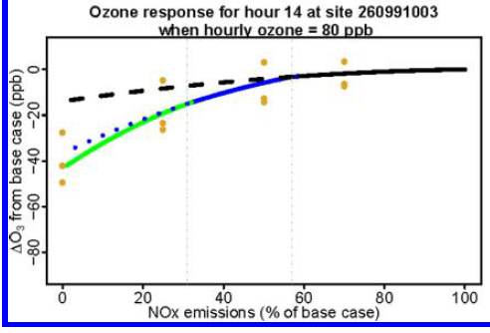
Performance of Simon HDDM approach
Simon et al., ES&T 2013

Slide 6
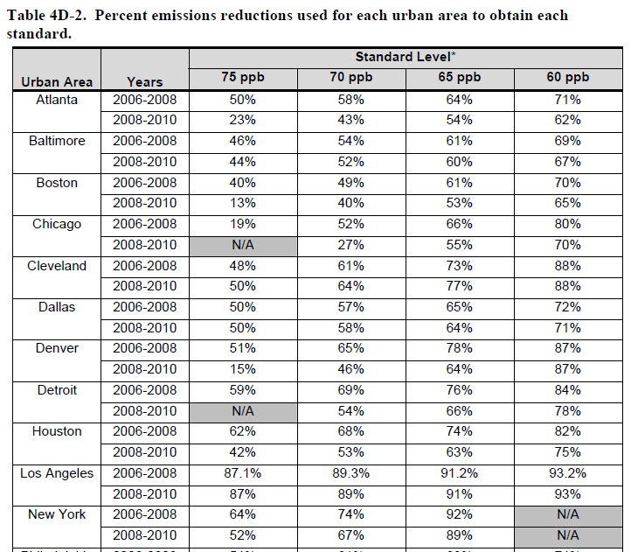
EPA REA estimates of emissions reductions needed to meet NAAQS

Slide 7
Goal of this work
Assess emission reductions needed to meet 8-hour ozone standard
Update to 2011 National Emissions Inventory
Initial REA used 2008 inventory
Compare responses on low ozone and high ozone days
How do controls targeted at peak O₃ affect O₃ at other times
PM impacts from NO_{x} and VOC controls
EPA’s RIA for O₃ NAAQS shows most health benefits from PM reductions
Compare results using two advanced HDDM methods
Notes:
EPA estimates that NOx emissions have decreased by 25% and VOC emissions have decreased by 23% between 2006 (Pouliot et al., 2012) and 2011 (EPA Trends, 2014d)

Slide 8
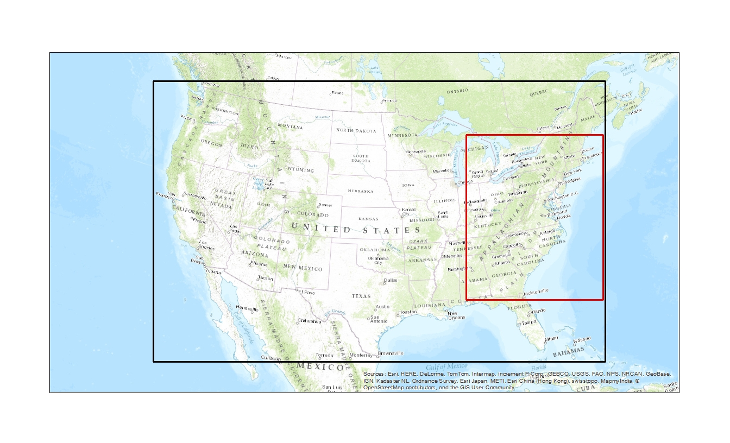
Model Set Up
CMAQ 5.0.2: CB05 chem. mech., aero6 module, chemistry in clouds, ammonia bidirectional flux
Emissions:
Anthropogenic emissions: 2011 NEI for U.S, 2006 EI for Canada, 2008 EI for Mexico
Biogenic emissions: estimated with BEIS v3.14 implemented in CMAQ (in-line option)
Grid resolution: 12km
12US2
Domain Configuration:
Columns Rows Layers
12US1 396 246 25
12NE1 120 145 25
12NE1
Modeling period:
July – August 2011
Monitoring data available at EPA's AirData website http://www.epa.gov/airdata/
487 stations in the domain
(1 did not have data for our modeling time period)
Notes:
The CMAQ model with HDDM extension is a suitable tool to simulate ozone response to emission reduction.

Slide 9
Model performance for 8-hr ozone
Metric | 8-hr daily maximum ozone
Number of data points | 29 533
Mean Observed (ppb) | 50.4
Mean Simulated (ppb) | 53.7
Mean Bias (ppb) | 3.3
Mean Error (ppb) | 8.2
Normalized Mean Bias (%) | 7.4
Normalized Mean Error (%) | 16.8
(Evaluated at 487 stations)

Slide 10
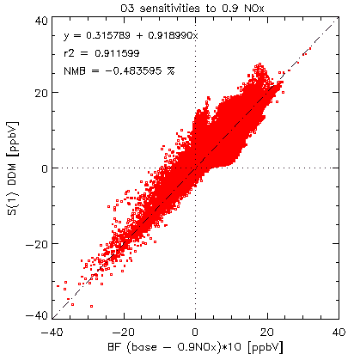
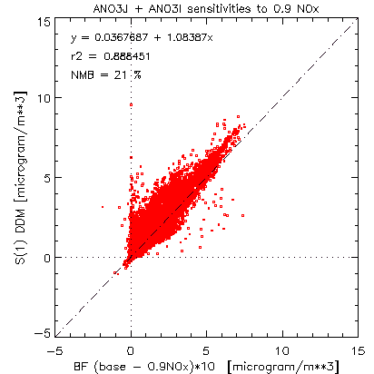
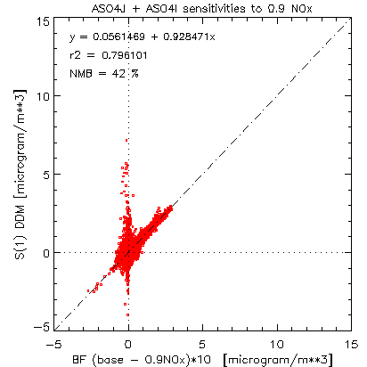
Sensitivities to -10% NOx: DDM (S⁽¹⁾) vs Brute Force (*10)
Ozone
PM
nitrate
PM sulfate

Slide 11
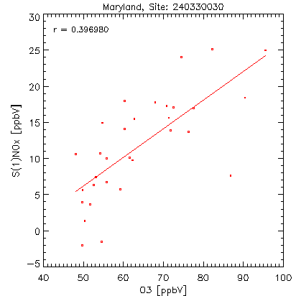
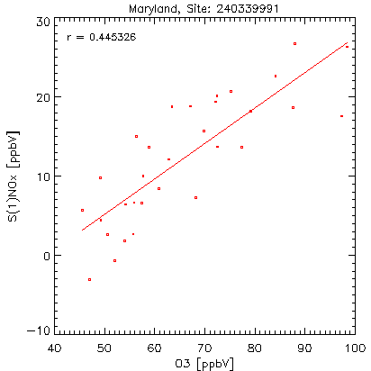
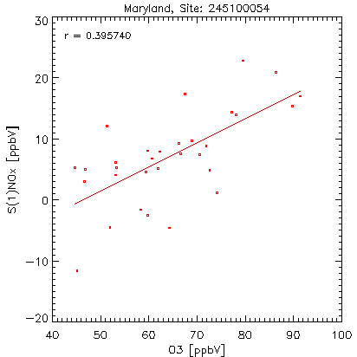
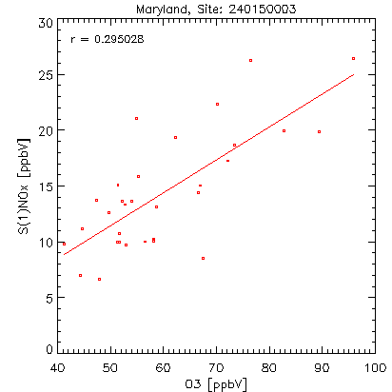
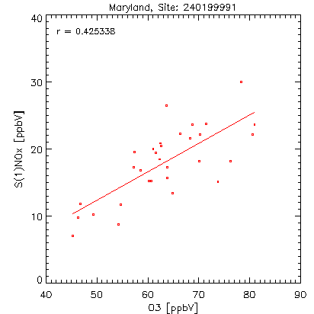
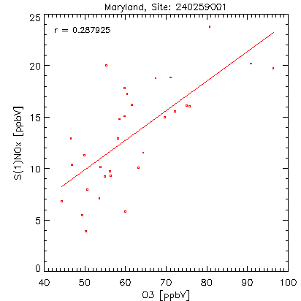
Ozone sensitivity to NO_{x} varies strongly with ozone concentrations (July 2011)

Slide 12
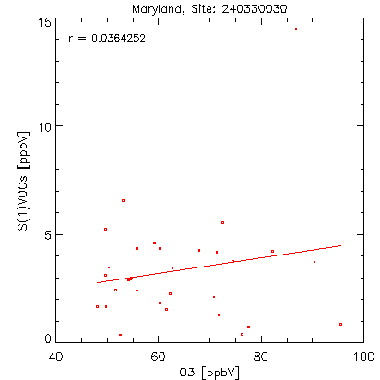
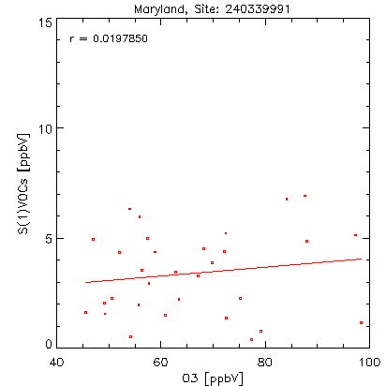
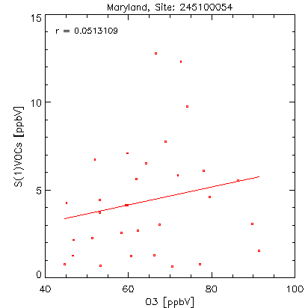
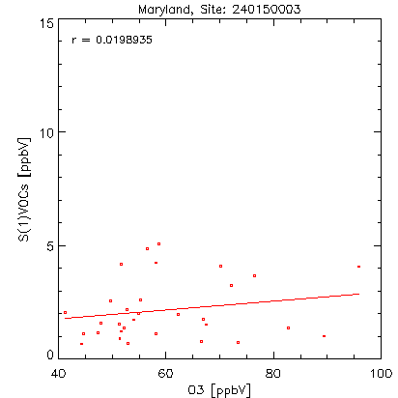
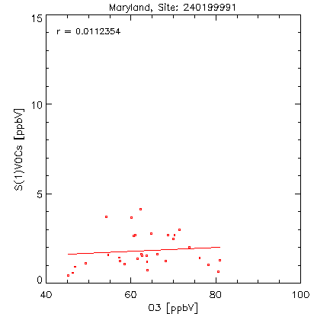
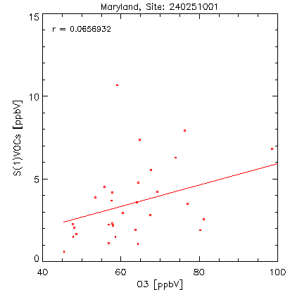
Ozone sensitivity to VOC varies little with ozone concentrations (July 2011)

Slide 13
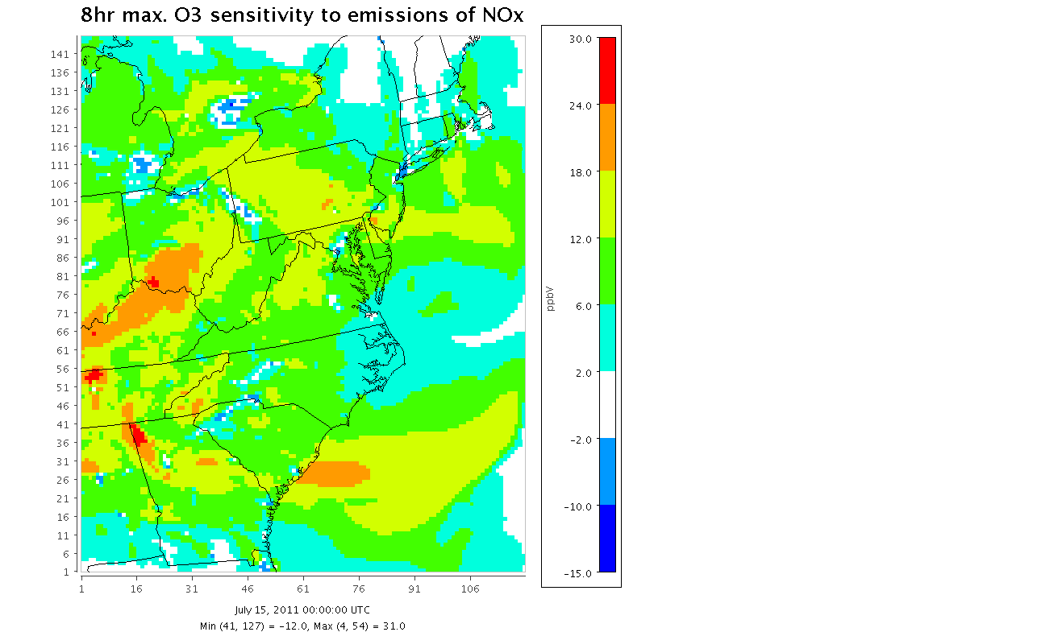
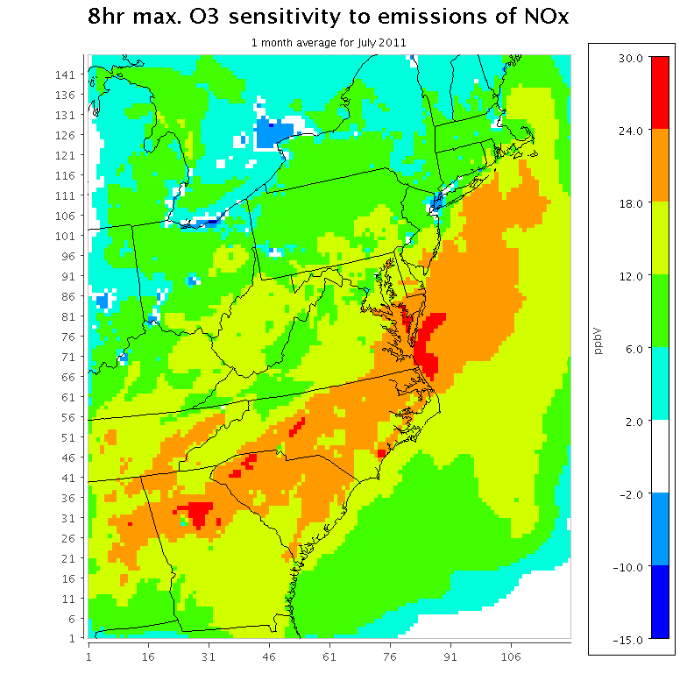
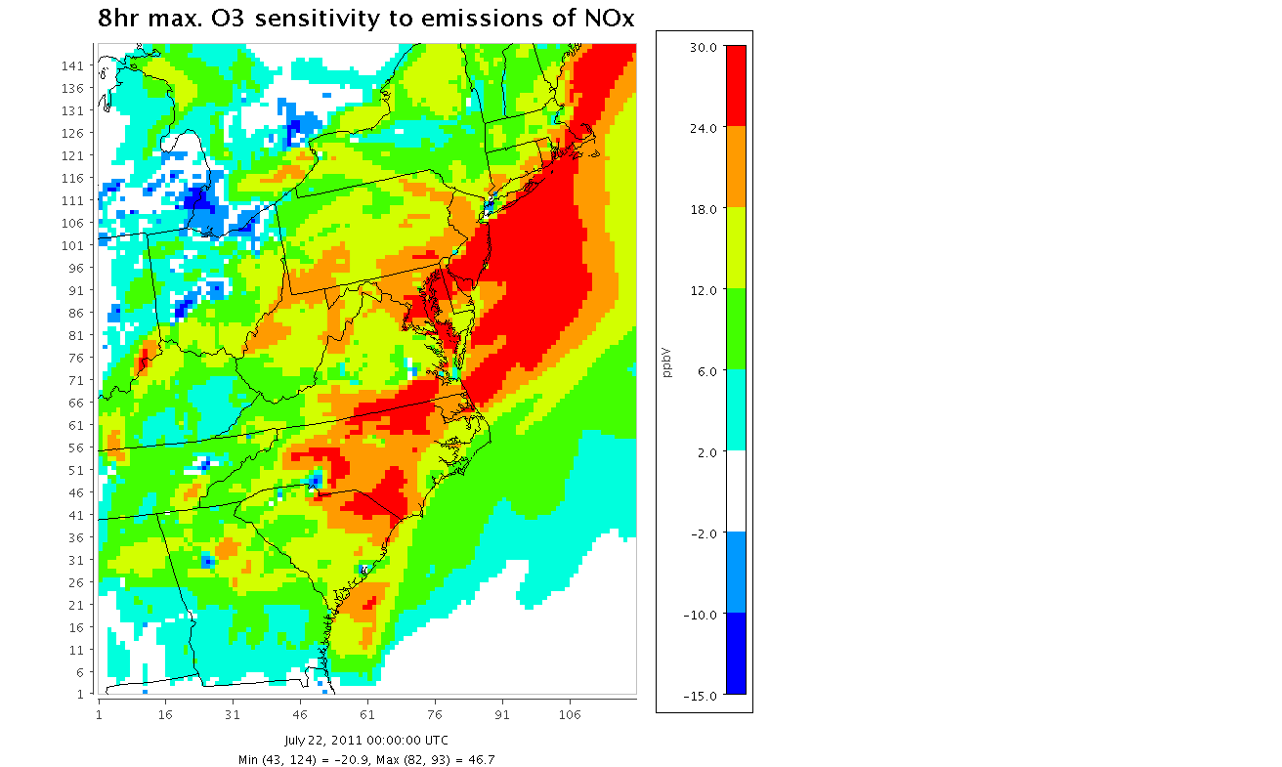
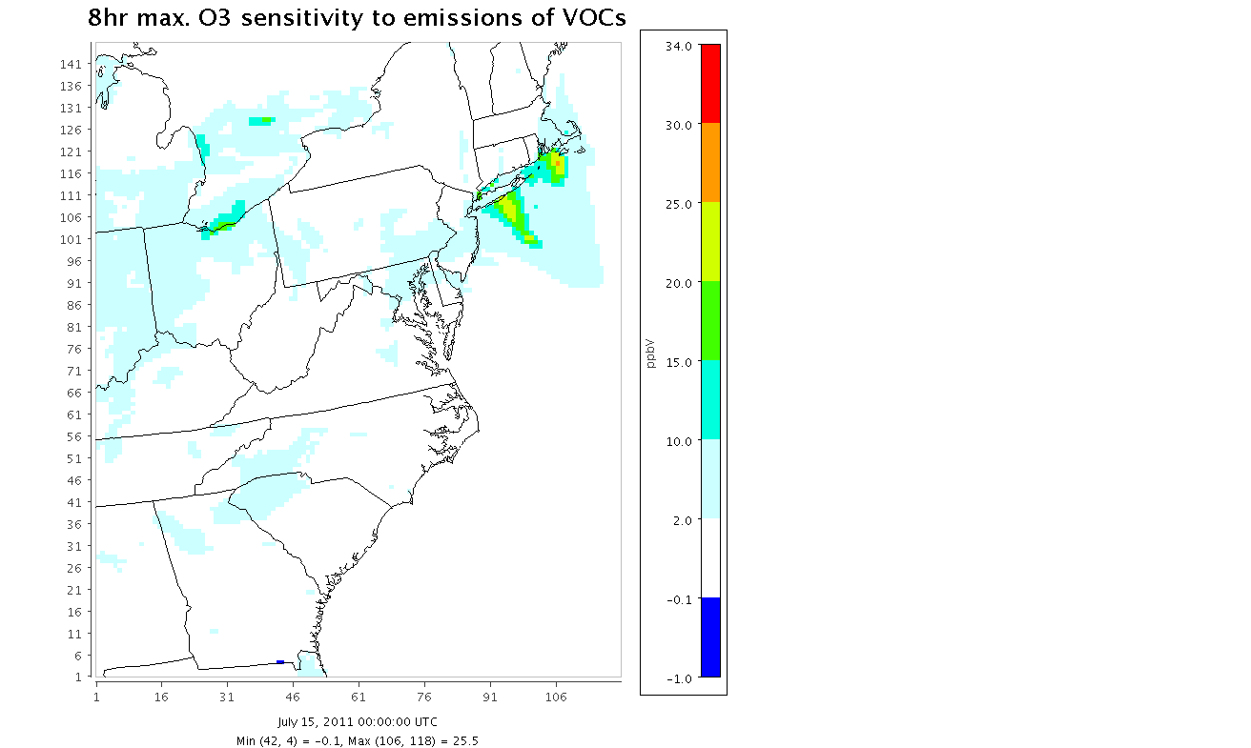
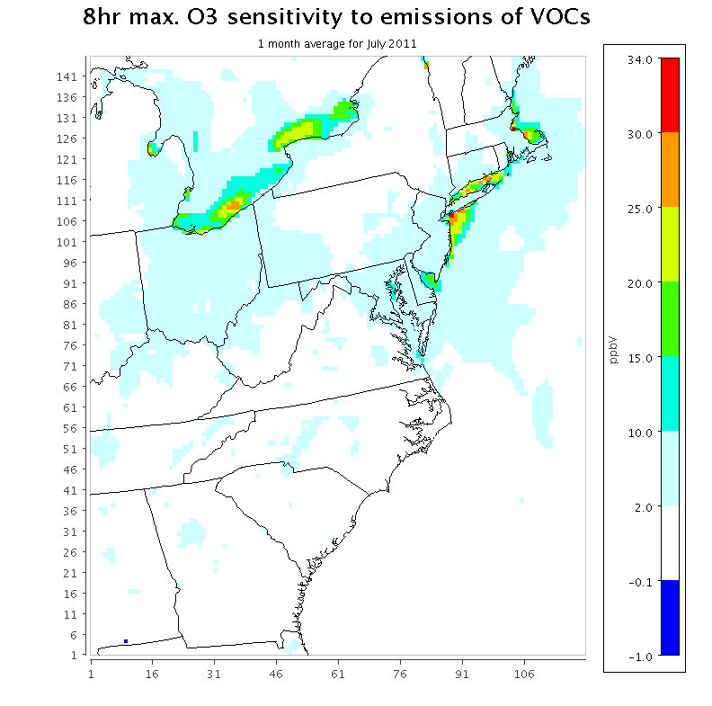
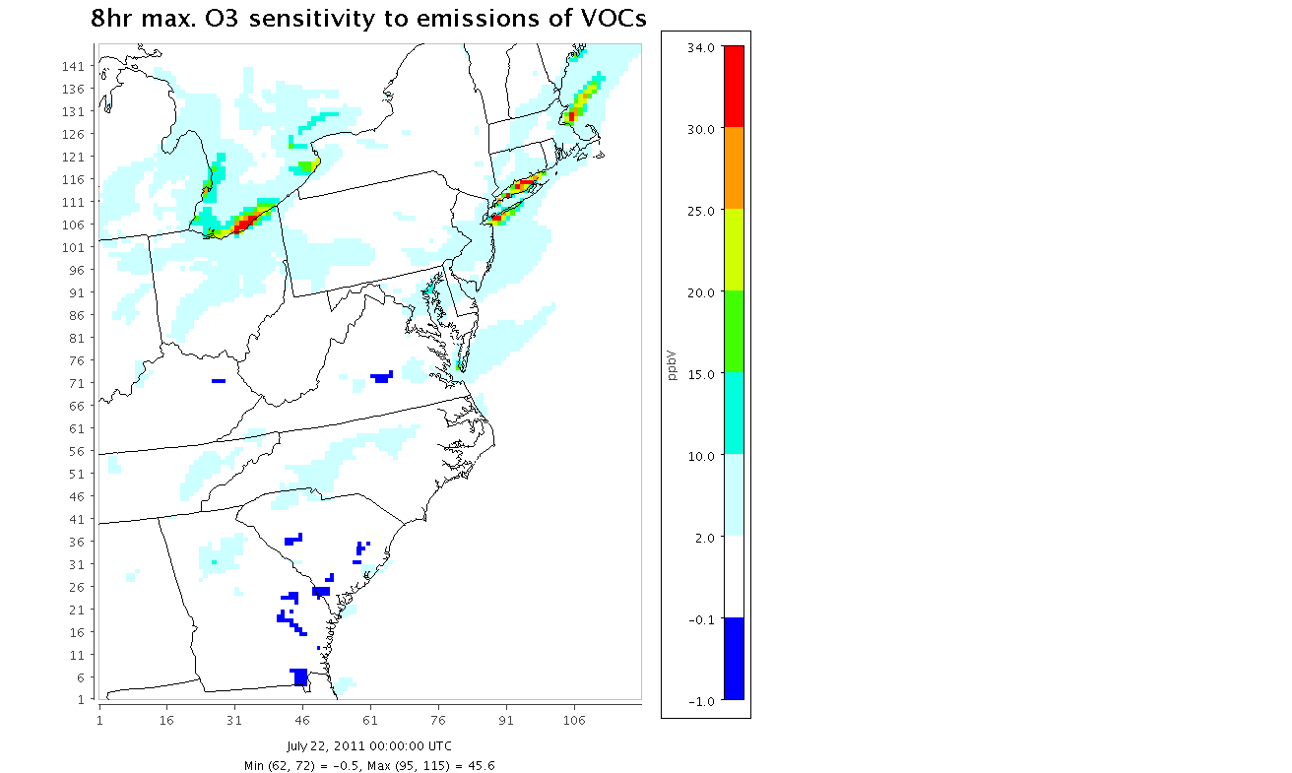
8-hr ozone sensitivity to NO_{x} (top) and VOCs (bottom)
Low ozone day
High ozone day
Monthly average

Slide 14
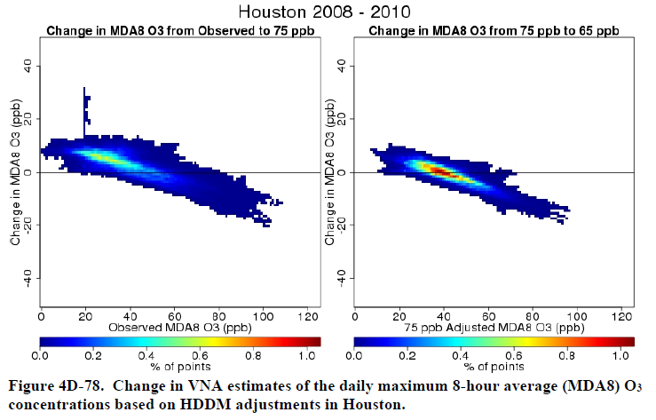
NO_{x} cuts reduce MDA8 O₃ on peak days but increase it on clean days
US EPA Health REA for ozone

Slide 15
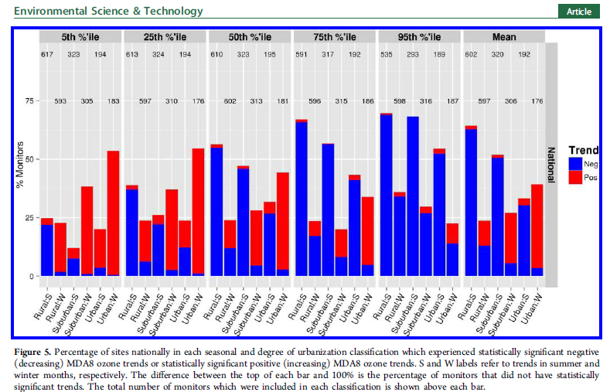
Will NO_{x} controls continue the bifurcated ozone trends??
Simon et al., ES&T, 2015

Slide 16
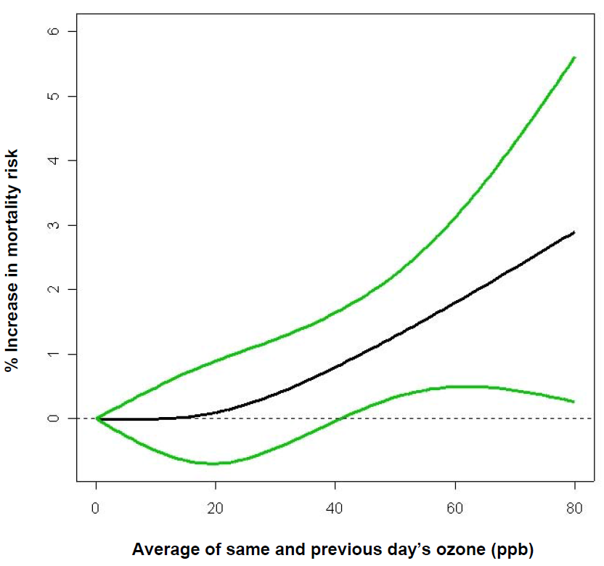
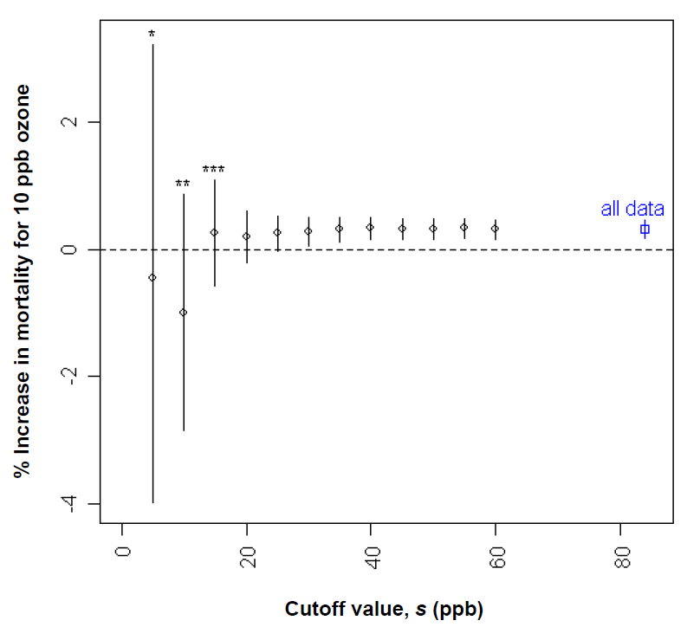
Impacts of ozone on mortality may extend nearly linearly to low concentrations
Bell et al., EHP 2006

Slide 17
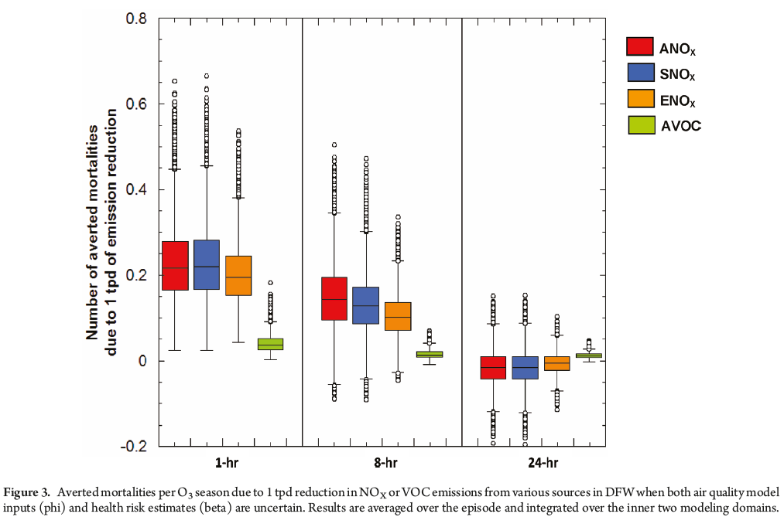
Influence of ozone temporal metric on health impacts of emission controls
Digar et al., ES&T 2011

Slide 18
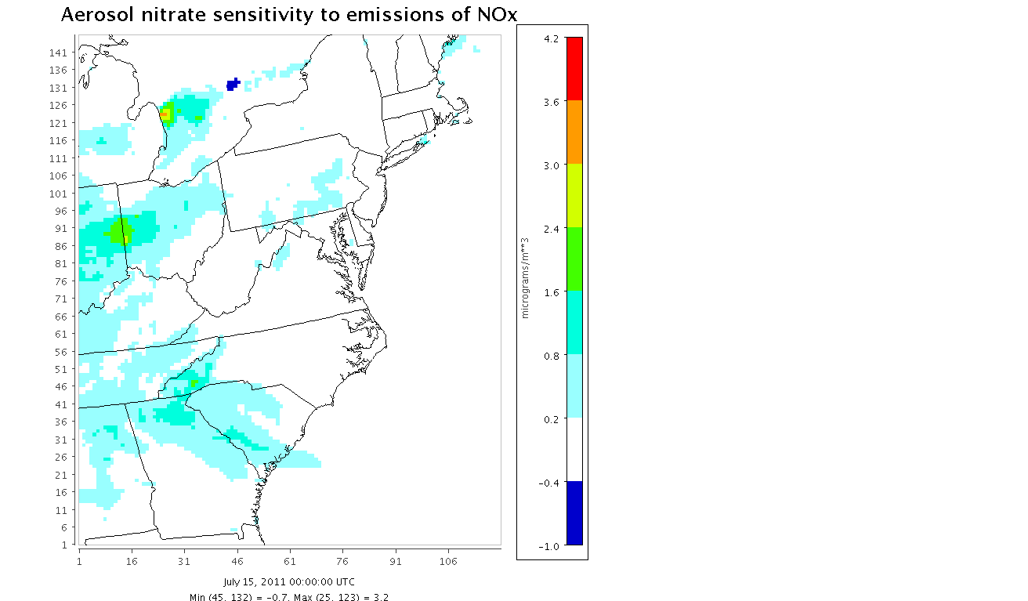
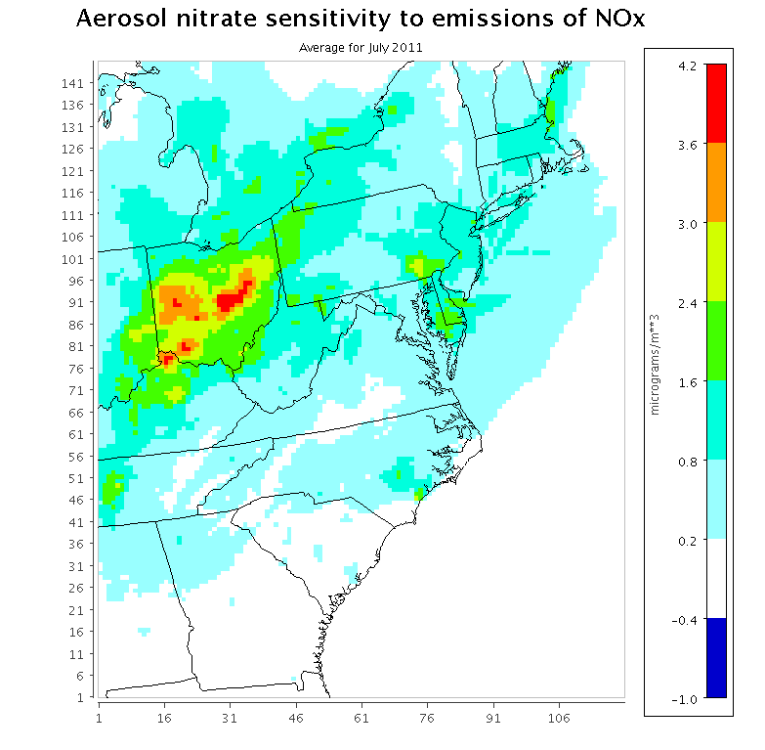
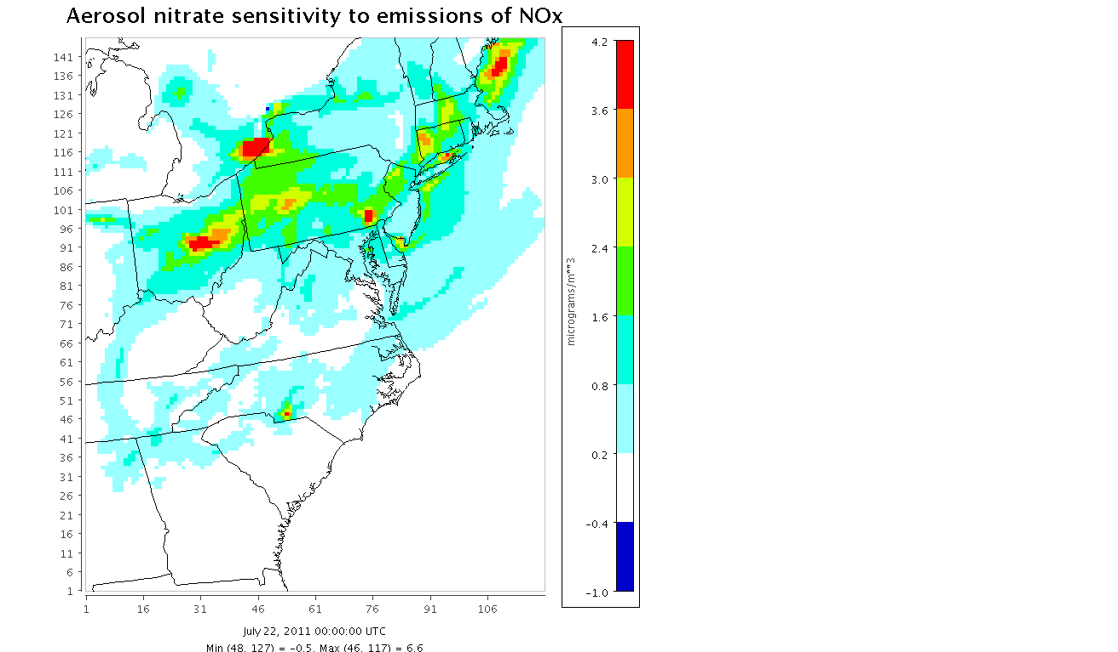
Aerosol nitrate sensitivity to emissions of NOx
Daily average for July 15
Daily average for
July 22
Monthly average
for July 2011

Slide 19
Summary
HDDM effective for probing model response of ozone to NO_{x} and VOCs
Not reliable for PM responses to NO_{x,} which dominate impacts of new ozone standard
NO_{x} cuts yield greatest O₃ reductions on high O₃ days
Mean O₃ may continue to decline far less than peak
Various approaches concur that large NO_{x} reductions are needed for attainment of peak standards
Feasible, affordable, and timely??
Impact on non-peak ozone, including winter??

Slide 20
Acknowledgments
NASA Air Quality Applied Sciences Team
Pat Dolwick, U.S. EPA
Andrew Pegues

