Slide 1



Global Particulate Matter (PM₁₀ and PM_{2.5}) Emissions from Agricultural Tilling and Harvesting
Weiwei Chen^{1,2}, Daniel.Tong^{2,3,4}
¹ Northeast Institute of Geography and Agroecology, Chinese Academy of Science, Changchun, China
² Air Resources Lab. (ARL), NOAA Center for Weather and Climate Prediction (NCWCP), College Park, MD
³ Cooperative Institute for Climate & Satellites, University of Maryland, College Park, MD
⁴ Center for Spatial Information Science and Systems, George Mason University, Fairfax, VA
Wednesday 29 October 2014, Chapel Hill, NC

Slide 2
Objectives
Developing agricultural dust emission inventory:
1. Magnitude
How much PM₁₀ and PM_{2.5} are annually released?
2. Characteristics
How are the spatial and temporal distributions of emissions?
3. Uncertainty
What are the potential challenges in the inventory?

Slide 3
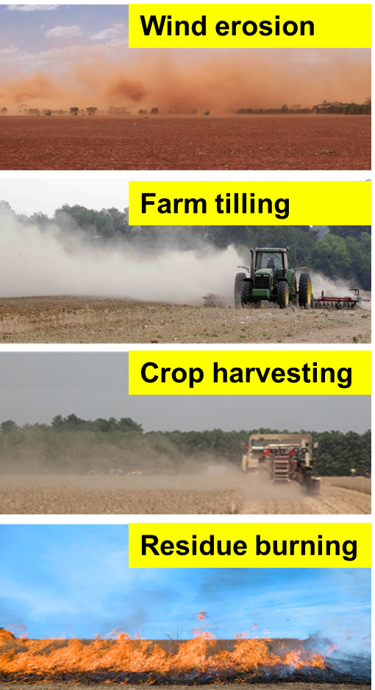
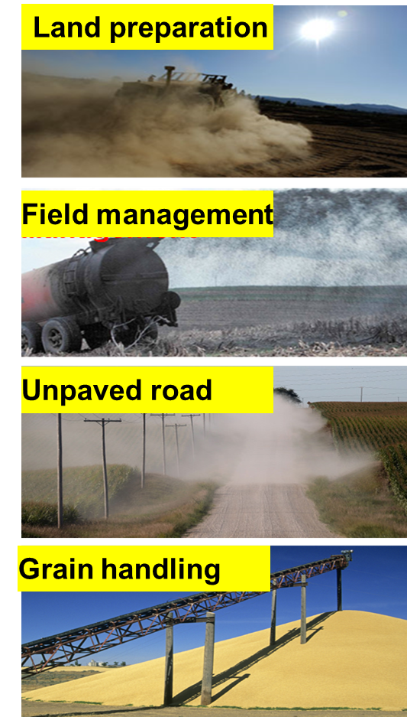
PM emissions from agricultural operations
Dust impacts:
Air quality
Climate
Human health
Soil degradation
Controlling factors:
Operation types
Soil silt
Soil moisture
Wind speed

Slide 4
Method
Emission Algorithm
EF: kg PM₁₀ per acre of operation activity; A: crop area; P: pass times; c: conservation operations; k: PM_{2.5} coefficient factor
Workflow to estimate Ag. emission
Operation specific
Emission Factors
(EF_opt)
Crop Calendar
(Number of passes)
Input Data
1. Crop areas
Wheat, corn, soybean, barley, millet, potato, rice…
2. Crop calendars
Start and end time and duration for planting and harvesting
3. Emission factors
Tilling, planting, harvesting
4. Others
soil silt, monthly soil moisture, wind speed
Crop specific
Emission Factor
(EF_crop)
Crop specific
Acres
Crop types
Crop specific
Emissions
Combined Dust Emission
Meteorology Adjustment
Agricultural Dust Emissions

Slide 5
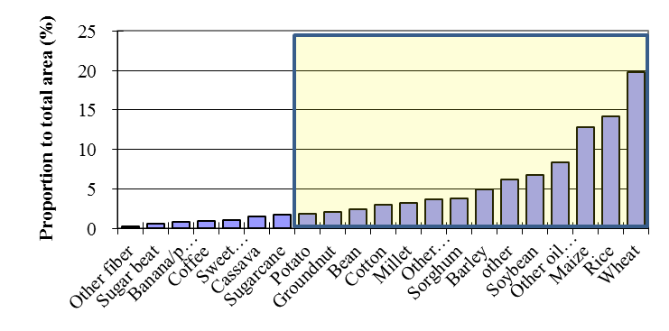
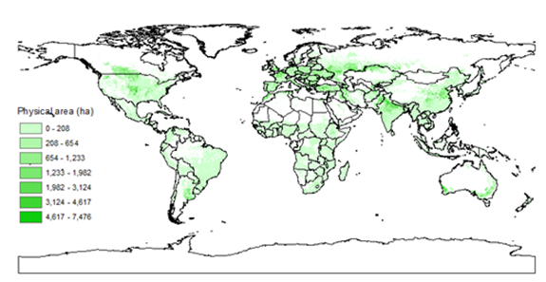
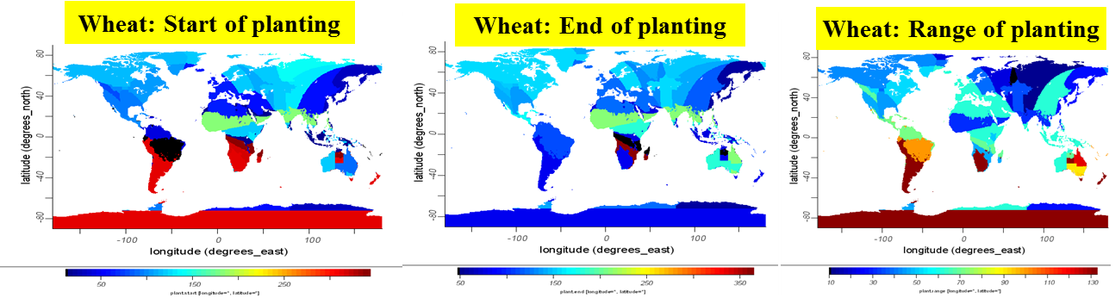
Crop Areas and Calendars
1. Crop Area: Spatial Production Allocation Model (SPAM), SPAM2000v3.02 (You L et al., 2006); crop type: 20; resolution: 5 arc-minute
Planting areas
Wheat distribution
2. Crop Calendar: Crop planting dates: an analysis of global patterns (William et al., 2010); crop type: 19; resolution: 1 degree

Slide 6
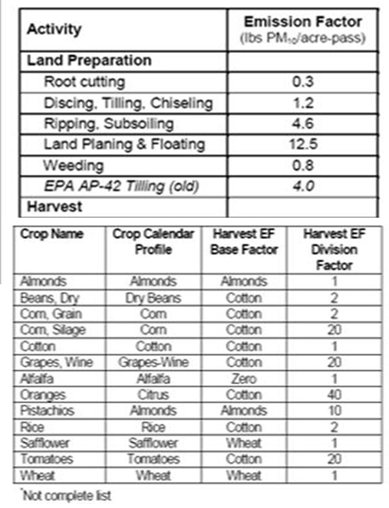
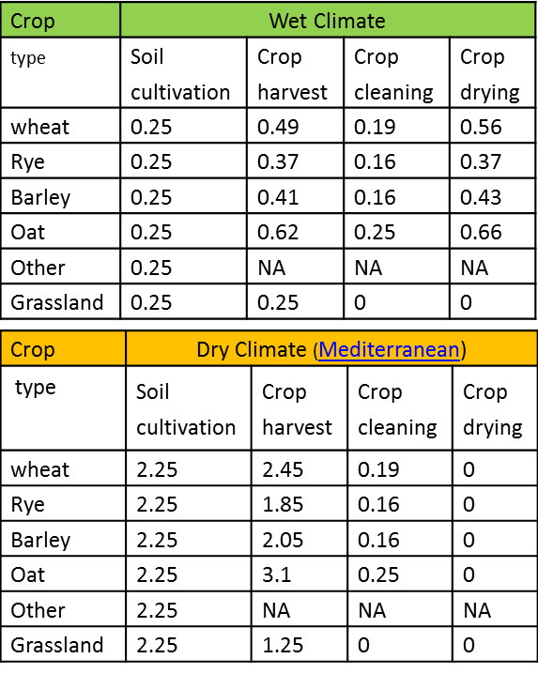
Emission Factors (EF)
EF sources: EPA ; CARB, EEA ,CA (based on field operations); publications
Large range of EF for different tilling operations: 0.1-14 kg PM₁₀ ha⁻¹
EF in dry climate are 10 or 5 times than wet climate
CARB: California Air Resource Board
EEA: Europe Environment Agency

Slide 7
EF adjustment by soil and climate factors
EFs increase with increasing soil silt, wind speed and decreasing soil moisture (Wang et al., 2010)
Soil moisture is the dominant factor for EF
Sand and clay
Emission factor
Emission factor
Silt and EF
< 10%
Soil moisture
~35%
Wind speed
6 m s⁻¹
Adjustment method: four steps
1. Basic EF: e.g., 5.17 kg ha⁻² for joint tilling operation in dry climate condition
2. soil silt content: EF_silt <- EF × soil silt^{*0.6}
3. soil moisture:
M <= 15%, CF=1.0; M > 15% & M <=20 % CF=0.6; M > 25% & M < =30%, CF=0.1; M > 30%, CF=0.1
4. wind speed:
WS >= 6 m s⁻¹, CF=1.5; WS >= 4 & WS <6, CF=1; WS >=2 & WS <4, CF=0.6; WS <=2, CF=0.3

Slide 8
Basic emission factors (kg PM₁₀ ha⁻¹ per pass) assigned to agricultural activities for different crops
Crop type | Tillage (kg PM₁₀ ha⁻¹) | Planting/Cutting (kg PM₁₀ ha⁻¹) | Harvest* (kg PM₁₀ ha⁻¹)
wheat | 5.17 | 1.35 | 6.57/2.36
Winter-wheat | 5.17 | 1.35 | 6.5/2.34
maize | 5.17 | 1.35 | 1.88/0.68
Maize2 | 5.17 | 1.35 | 1.88/0.68
soybean | 5.17 | 1.35 | 1.88/0.68
Rice | 1.35 | 0 | 1.88/0.68
Rice2 | 1.35 | 0 | 1.88/0.68
sorghum | 5.17 | 1.35 | 6.5/2.34
Winter-sorghum | 5.17 | 1.35 | 6.5/2.34
cotton | 5.17 | 1.35 | 3.77/1.36
barley | 5.17 | 1.35 | 6.5/2.34
Millet | 5.17 | 1.35 | 1.88/0.68
Potato | 5.17 | 0.34 | 1.88/0.68
Winter-barley | 5.17 | 1.35 | 6.5/2.34
Groundnut | 5.17 | 0.34 | 1.88/0.68
Pulses | 5.17 | 1.35 | 1.88/0.68
Sweet-potato | 5.17 | 0.34 | 1.88/0.68

Slide 9
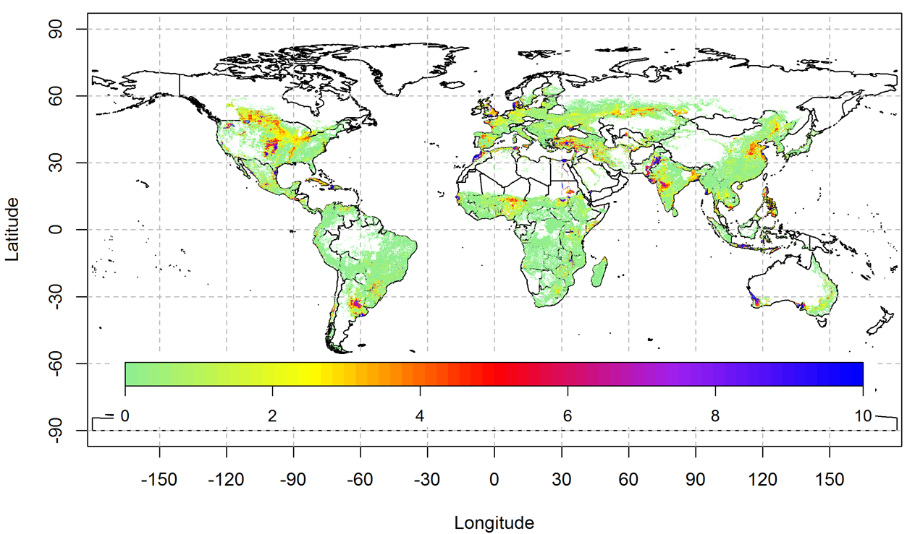
Spatial distribution for PM₁₀
Spatial distribution of agricultural PM₁₀ emissions
Intense regions:
Central US, Northern China, Pakistan, India, Turkey, Southeast Africa
ton/yr/grid (5 arc-min)

Slide 10
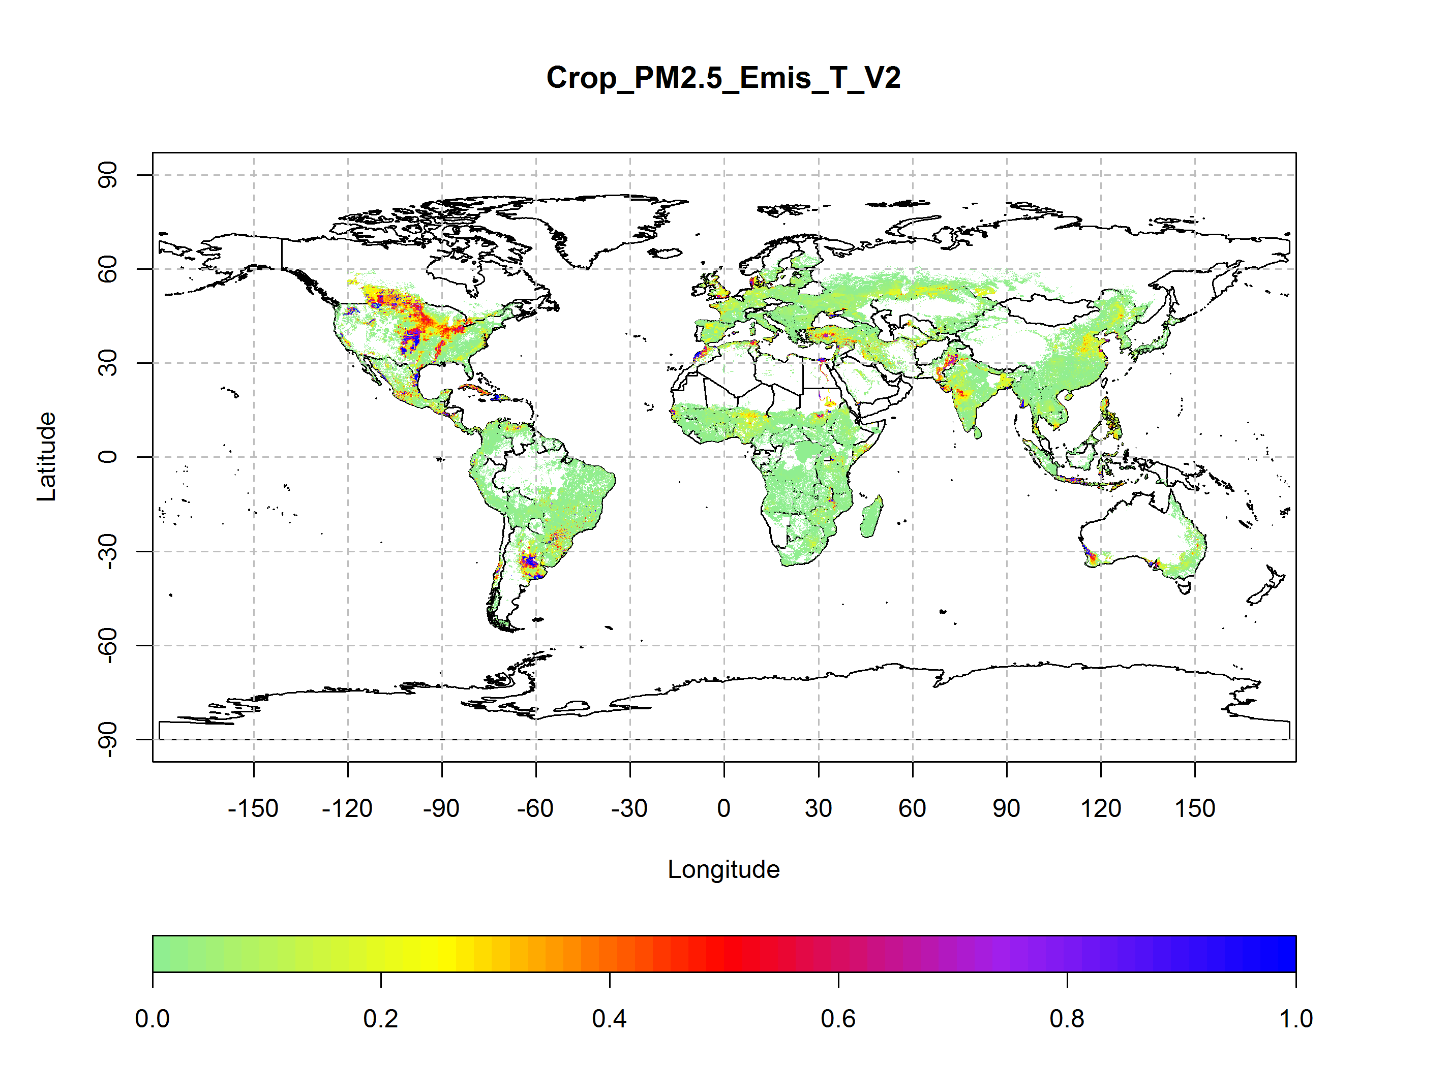
Spatial distribution of agricultural PM_{2.5} emissions
Conversion coefficients of PM_{2.5} and PM₁₀:
North and South America, 0.125 (CARB); others, 0.06 (EEA)
ton/yr/grid (5 arc-min)

Slide 11
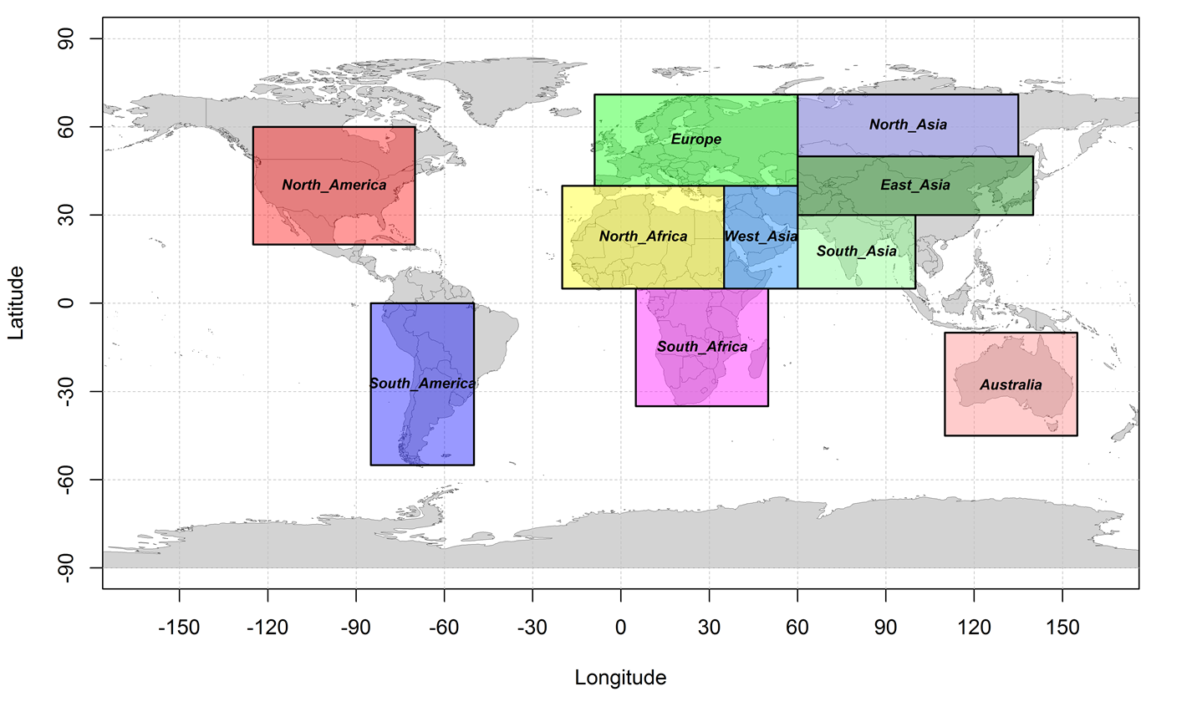
Comparison with Satellite Observations
Ten regions are divided mainly based on Paul Ginoux et al., 2012

Slide 12
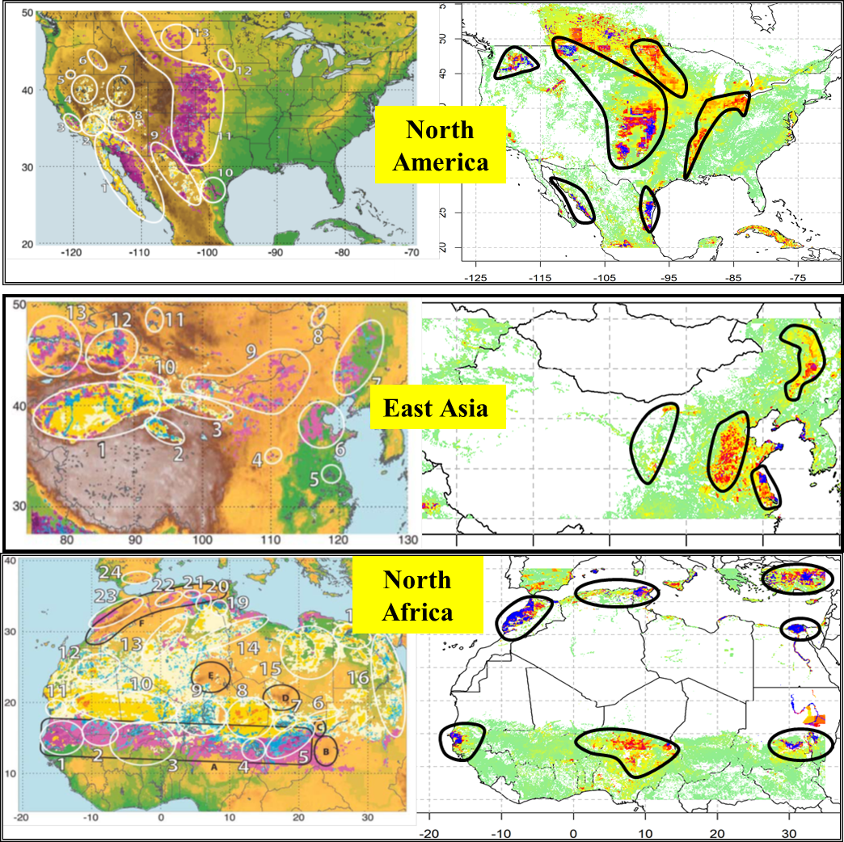
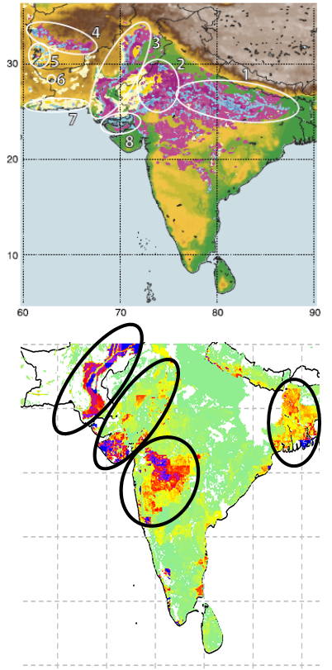
Regional Comparison
North America, East Asia, North Africa and South Asia
Left or top: satellite
Red: anthropogenic source
Yellow: natural sources
Right or down are our data
South Asia

Slide 13
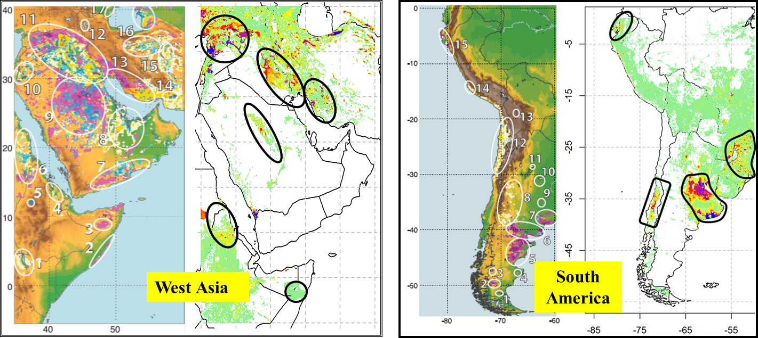
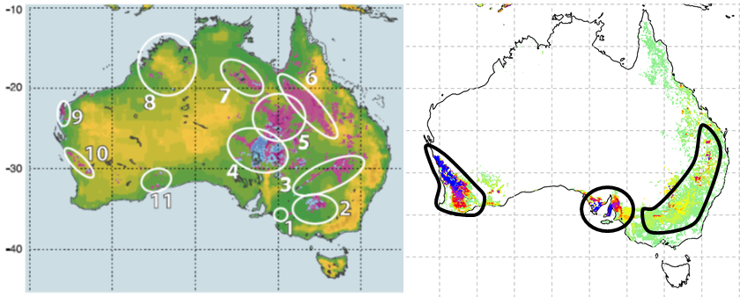
Regional Comparison
West Asia, South America and Australia
Most agricultural PM sources are similar with natural sources by AOD data
Emission sources from AOD data are always large than emission area because AOD normally represents transported aerosol plumes
No good here
Australia

Slide 14
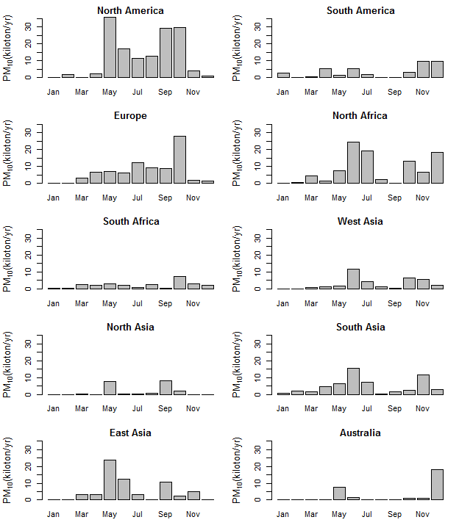
Monthly variation of agricultural PM₁₀ emission
Major emission months
North America: 5, 9, 10
Europe: 10
East Asia: 5, 6, 9
North Africa: 6, 7, 10, 12
South Asia: 6, 11
Australia: 5, 12
West Asia: 6, 10, 11
South America: 11, 12
South Africa: 10
North Asia: 5, 9

Slide 15
Annual PM₁₀ emission for regions
Order: North America > North Africa > Europe > East Asia > South Asia
PM₁₀ emission in America is approximately1/20 lower than NEI (2005)
Region | Longitude Range | Latitude Range | Tillage Emission (kiloton) | Planting/Cuting Emission (kiloton) | Harvest Emission (kiloton) | Total Emission (kiloton)
North America | 125°W-70°W | 20°N-60°N | 43.0 | 10.9 | 91.8 | 145.8
South America | 85°W-50°W | 55°S-0°S | 13.9 | 3.5 | 22.9 | 40.3
Europe | 9°W-60°E | 40°N-71°N | 41.5 | 10.8 | 31.9 | 84.2
North Africa | 20°W-35°E | 5°N-40°N | 40.8 | 9.9 | 47.0 | 97.7
South Africa | 5°E-50°E | 35°S-5°N | 13.1 | 3.2 | 9.4 | 25.7
West Asia | 35°E-60°E | 5°N-40°N | 12.0 | 3.1 | 20.5 | 35.6
North Asia | 60°E-140°E | 50°N-71°N | 8.0 | 2.1 | 9.3 | 19.4
South Asia | 60°E-100°E | 5°N-30°N | 28.1 | 5.5 | 23.9 | 57.6
East Asia | 60°E-140°E | 30°N-50°N | 31.9 | 7.6 | 24.8 | 64.3
Australia | 110°E-155°E | 45°S-10°S | 8.3 | 2.1 | 19.5 | 29.9
Total | 180°W-180°E | 90°S-90°N | 266.5 | 63.6 | 332.9 | 663.0

Slide 16
Emission uncertainty
Four aspects:
Decrease the passes for tilling operations because the use of combined tillage machine are increasing
PM from grassland productions are not involved, which may decrease PM emission in many grassland regions
Local EF values are rare around the world, especially in Asia and Africa
The classes of adjustment by soil and climate factor may give bias for inventory

Slide 17
Summary and future works
Summary
The inventory could reflect spatial distribution and temporal variation of agricultural PM emissions in major regions
North America, Europe, North Africa, East Asia and South Asia are important regions of PM emissions
Large uncertainty of magnitude due to the lack measurement of EF
Future works
Focus on national PM emission from field activities based on latest crop information by remote sensing method
Apply the emission inventory to CMAQ and test the effect on national air quality

Slide 18

