Slide 1
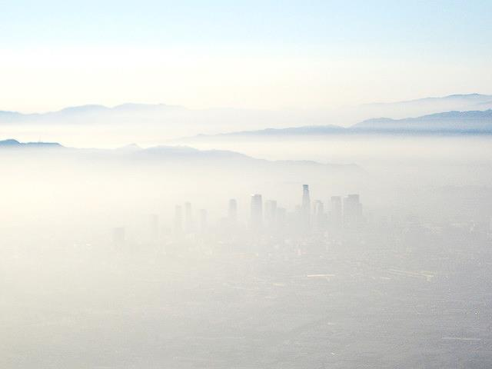
Impacts of Ozone Pollution and Reductions for Low-Income Households
Rebecca K. Saari¹
Tammy M. Thompson², Noelle E. Selin¹
October 29, 2014
CMAS Conference
1 MIT 2 CSU

Slide 2
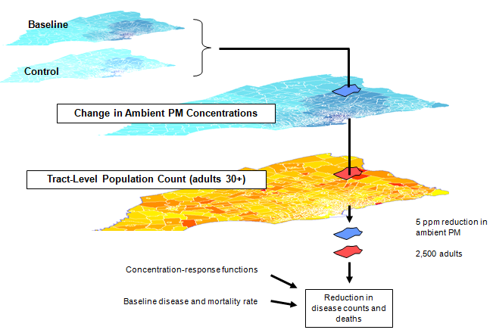
Integrated Modeling of Air Quality Co-Benefits
Air Quality
(SMOKE/CAMx)
Population
(BenMAP)
Valuation
(USREP)
Health Incidence
(BenMAP)
NEW
Policy
(USREP)
New
Change in Ambient Concentrations
Population Demographics
ozone
population
Concentration Response Functions
Baseline Health Incidence Rate
New Health Incidence Rate
Valuation (Cost of Illness, Lost Income, Contingent Valuation)
Economic Impact
(Demand for Health Services)
Thompson, T.M., S. Rausch, R.K. Saari, N.E. Selin (2014), Nature Climate Change
Saari, R.K., N.E. Selin, S. Rausch , T.M. Thompson (2014), J. Air Waste Manage. Assoc.
“Do Nothing” Future
“Do Nothing” Future

Slide 3
U.S. studies say ozone exposure can decrease with income
Study | Population | Does ozone decrease with income?
Miranda et al., 2011 | <10% of population (near monitors) | NO (smaller % living in poverty exposed)
Grineski et al., 2007 | Phoenix | YES
Marshall, 2008 | South California | NO (lower exposure for households < $50K)
Liu, 1998 | <10% of population (near monitors) | NO overall YES for urban areas NO for rural areas
Liu, 1996 Liu, 1996 | NY, PA, Houston, LA | NO (rich downwind suburbs)
Saari et al., 2014 (This Work) | Continental U.S. (Modeling experiment) | YES Pattern varies by region

Slide 4
Research Questions
How does modeled inequality in ozone exposure affect the relative economic value of reducing ozone (with EPA policies) for low-income households?
What do modeled U.S. ozone levels in 2005 imply for health outcomes by income group?
What is the economic benefit of planned ozone reductions for 2014, over time (up to 2100), and by income group? What is the relative economic effect of delaying reductions on low-income households?

Slide 5
Mortality Incidence by Income Group
What do MODELED differences in 2005 ozone levels imply for mortality rates? Only difference between income groups is modeled level of ozone.
Ozone levels in 2005 imply incidence rate of 11 deaths/100,000 people
Incidence rate is 3% higher for lowest income than highest income

Slide 6
Mortality Incidence by Income & Region
Specific regions will have decreasing, increasing, flat incidence rates

Slide 7
Research Questions
What do modeled U.S. ozone levels in 2005 imply for health outcomes by income group?
Decreasing with income due to difference in exposure, nationally, incidence rate estimated is 3% higher among low income households
Pattern of incidence with income varies by region
What is the economic benefit of planned ozone reductions for 2014, over time, and by income group? What is the relative economic effect of delaying reductions on low-income households?

Slide 8
Research Questions
What do modeled U.S. ozone levels in 2005 imply for health outcomes by income group?
Decreasing with income due to difference in exposure, nationally, incidence rate estimated is 3% higher among low income households
Pattern of incidence with income varies by region
What is the economic benefit of planned ozone reductions for 2014, over time, and by income group? What is the relative economic effect of delaying reductions on low-income households?

Slide 9
Policy-related reductions in mortality rates
Under the modeled reductions planned for 2014, ozone-related mortality incidence rates decrease by about 1.2 deaths per 100,000 people per year in 2014
(% to follow)

Slide 10
Percent reductions in mortality rates
Ozone reductions are estimated to lower ozone mortality incidence rates by 13%
This decreases with income monotonically from 13% to 12%

Slide 11
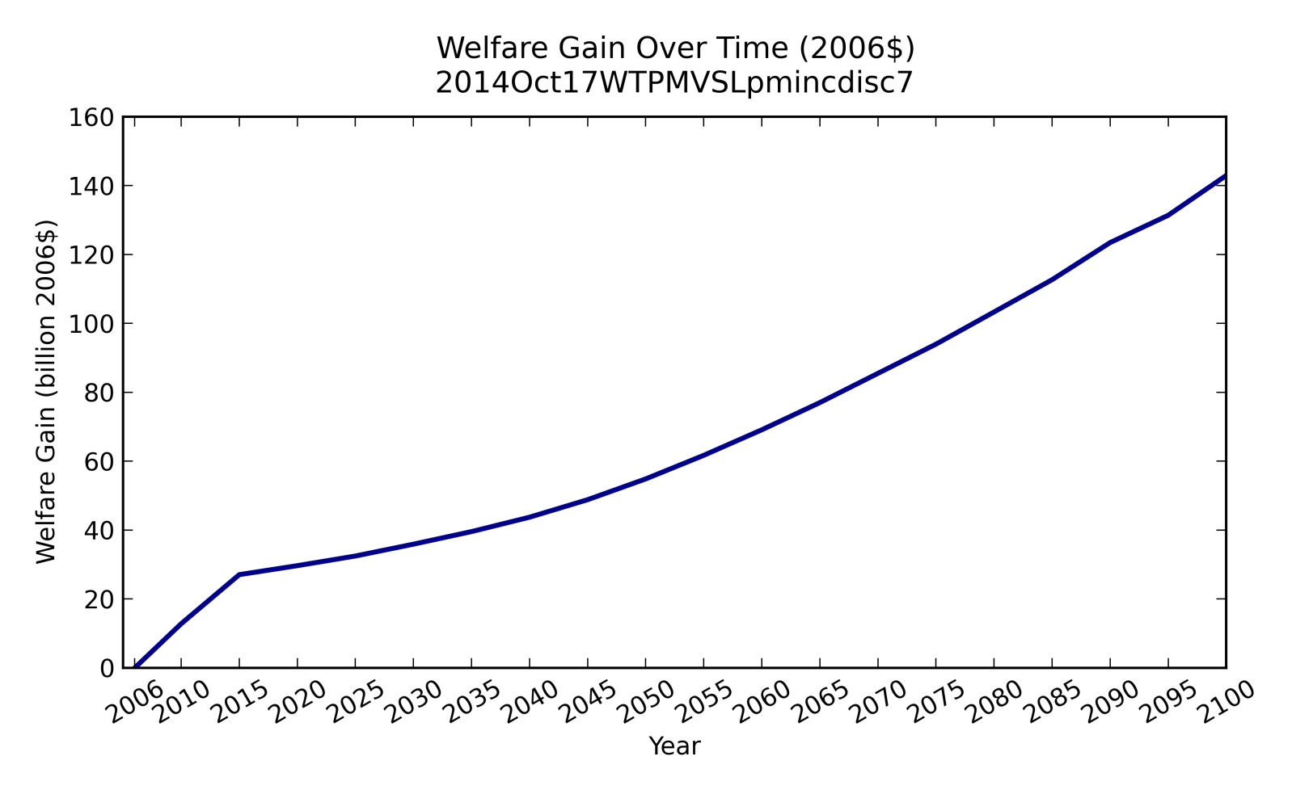
Annual gains from ozone reductions
Undiscounted annual welfare gains over time of reductions vs. 2005 ozone levels
Accounts for change in mortality as well as 4 other endpoints
Reductions implemented between 2006 and 2014
Annual gains grow from $30 billion in 2014 (agrees with BenMAP) to $150 billion by 2100

Slide 12
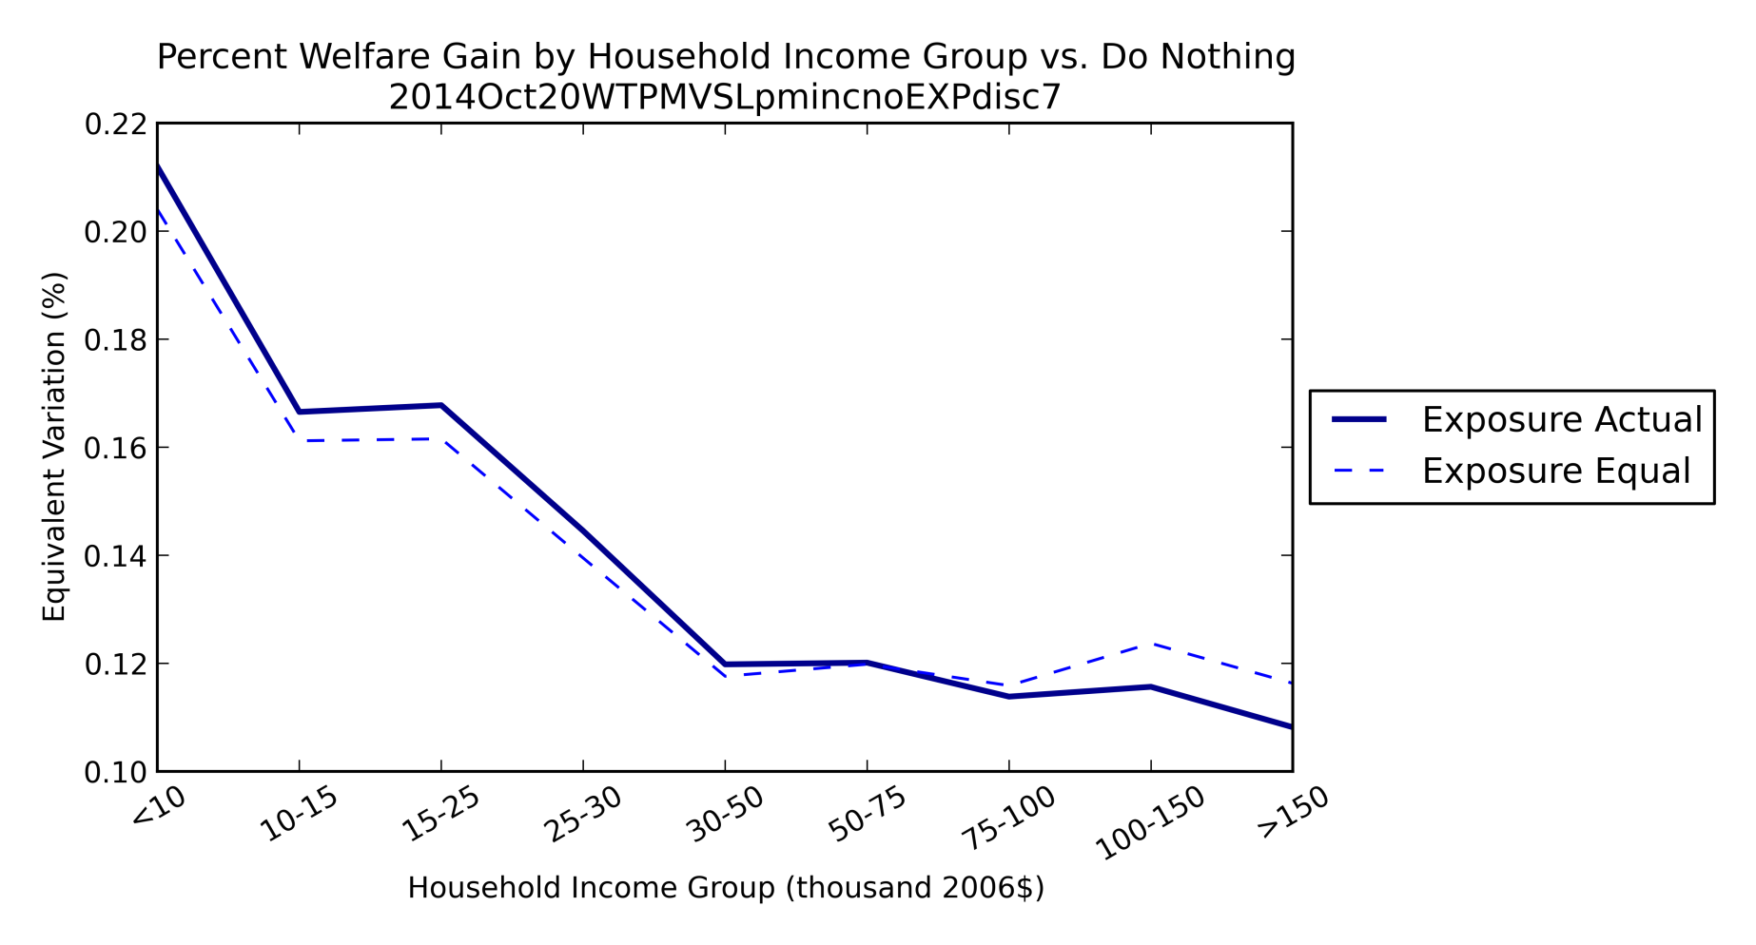
Exposure and gains by income group
Per capita welfare gain decreasing with income, up to 0.21% of per capita welfare
Lowest income households gains twice as much as highest incomes (0.21% vs. 0.11%)
Slope of relative gain determined more by underlying economics than exposure (difference between solid (exposure weighted) and dashed lines shows effect of exposure)

Slide 13
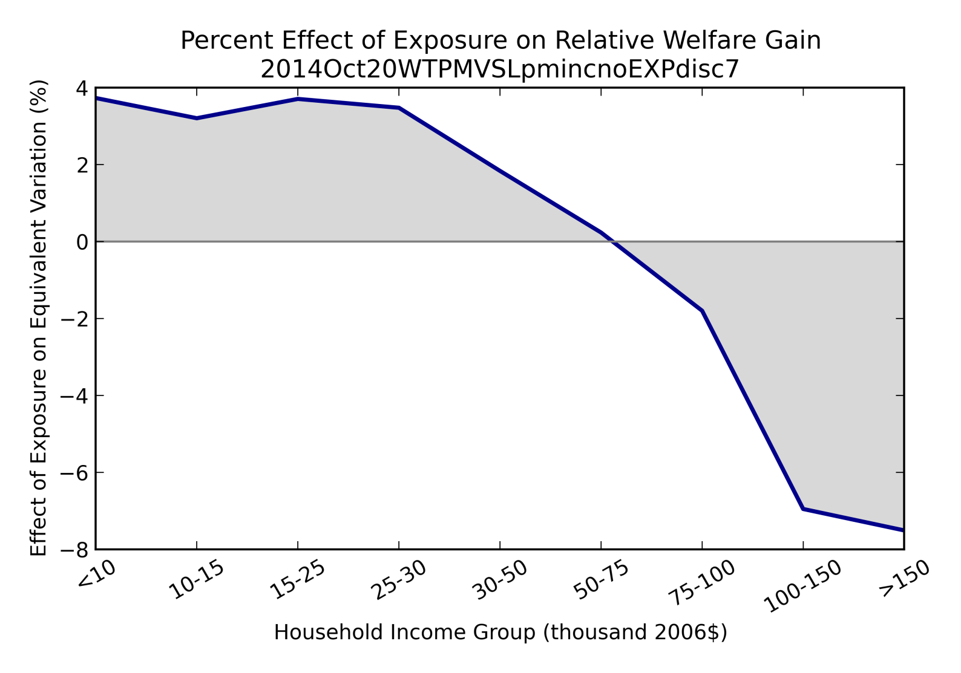
Effect of Exposure on Relative Gains
Treating exposure as equal by income group would understate relative welfare gains for the poor (by about 4%), and overstate them for the rich (by up to 8%)

Slide 14
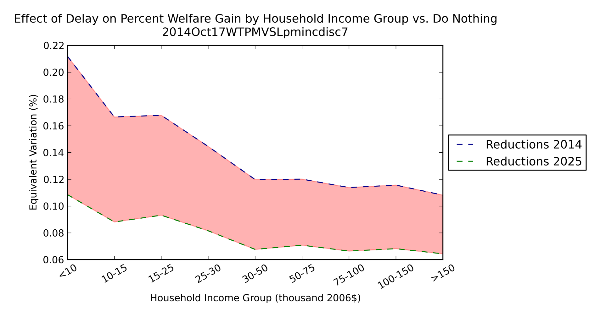
Effect of delay on relative gains
Shaded area shows loss from delaying regulations (7% discount rate)
Delay foregoes 0.1% of gains for lowest incomes, and 0.05% for highest incomes
Delay is twice as harmful in a relative sense for lowest vs. highest income households

Slide 15
Conclusions
What do U.S. ozone levels in 2005 imply for health outcomes by income group?
Exposure differences suggest mortality incidence rate is 3% higher in lowest income households than highest income households
What is the benefit of planned ozone reductions for 2014? What is the effect of delay?
Inequality in exposure makes reductions 4% more valuable, relatively speaking, for low incomes, and up to 8% less valuable for high incomes
Inequality in income and exposure together means that relative values of reductions are twice as high for the lowest as the highest incomes. Similarly, the loss from delaying regulations is twice as harmful to the lowest incomes

Slide 16
Limitations and Future Work
Limitations
Using modeled ground-level ozone to estimate exposure
Using concentration-response functions to estimate incidence rates, and these do not account for potential differences in sensitivity or behavior by income group
Categorizing households by income group (e.g., within-group variability)
Ongoing Work
95% CI to include uncertainty range in impact estimates
Exploring effect of changing valuation with income
At what point would reducing ozone benefit the high incomes instead of low incomes (how much would valuations have to increase with income?)
Future Work
Effect of CO2 reductions from existing power plants on air quality:
Use new state-level economic model to explore the effect state-level caps vs. regional trading
Can the size of the trading region create a tradeoff between the total health benefits, and the potential creation of pollution hotspots?

Slide 17
Acknowledgments
This work is partially supported by the U.S. DOE, Office of Science, the U.S. EPA STAR program, the MIT Energy Initiative, the Martin Family Society of Sustainability Fellows, and the MIT Joint Program on the Science and Policy of Global Change.

Slide 18
QUESTIONS?

Slide 19
Thank you!

