Slide 1
Initial evaluation of 2011 CMAQ and CAMx simulations during the DISCOVER-AQ period in the mid-Atlantic
13th Annual CMAS Conference: 10/28/14
Pat Dolwick, Daiwen Kang, Kirk Baker, Sharon Phillips, Norm Possiel, Heather Simon, Jim Kelly, Chris Misenis, and Brian Timin
Notes:
Thank co-authors.
Note that this will build off Daiwen’s talk that immediately preceded (and if appropriate mention relationship to D. Goldberg’s talk from earlier in the session).
Goal of talk is to briefly introduce 2011 model performance issues through the lens of a detailed field study data set.
Emphasize no firm conclusions are forthcoming in the presentation … more of a “sampler platter”.
Picture is of Alex on paddleboard @ Albemarle Sound … visual metaphor for mod perf eval (shore is a long way off)

Slide 2
Purpose / Outline
Description of EPA’s initial 2011 CMAQ and CAMx base cases
Broad summary of operational ozone evaluation
Performance in July in mid-Atlantic, relative to other months/regions
Note differences between CMAQ and CAMx
Initial investigation into performance issues in MD/DC region
Q1: Are there temporal differences in model ozone and NOx bias at the surface?
If so, do temporal differences in model ozone bias vary according to site location (urban v. rural)?
Q2: How well is the model simulating ozone aloft across the mid-Atlantic region?
Q3: How well does the model simulate observed organic nitrates aloft in the region?
Next steps / summary
Notes:
More of a sampler platter of on-going evaluation efforts … than a comprehensive evaluation.
Hope to interact w/ anyone in attendance looking at similar issues.

Slide 3
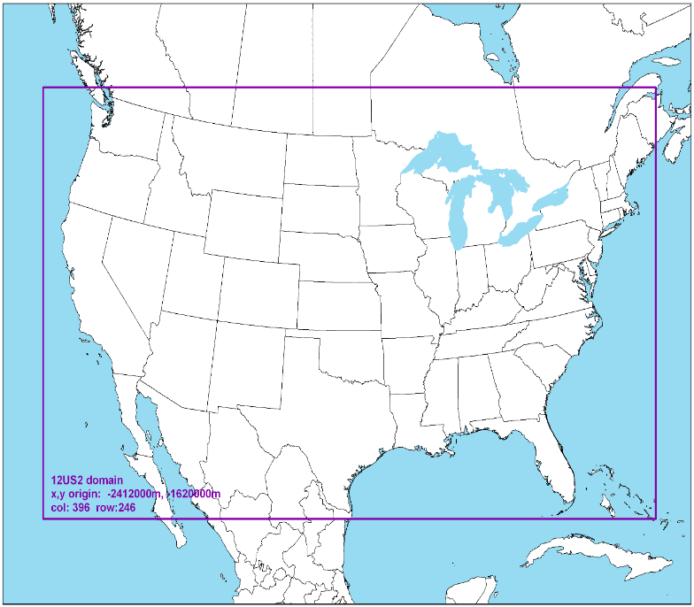
Initial EPA 2011 Modeling Platforms
CMAQ model configuration (“CMAQ-2011ef”)
Model: CMAQ v5.0.2 (AERO6/CB05-tu)
Domain: CONUS 12-km horizontal & 25 vertical layers
Emissions: 2011 NEI v1
Meteorology: 2011 WRFv3.4; GHRSST
IC/BC: 2011 GEOS-Chem v8-03-02 w/ 8-02-01 chemistry
CAMx model configuration (“CAMx-2011ef”)
Model: CAMx v6.10 (CB6r2)
Domain: CONUS 12-km horizontal & 25 vertical layers
Emissions: 2011 NEI v1
Meteorology: 2011 WRFv3.4; GHRSST
IC/BC: 2011 GEOS-Chem v8-03-02 w/ 8-02-01 chemistry
12-km CONUS domain
Notes:
Emphasize that the CMAQ and CAMx runs use similar emissions, meteorology, and boundary conditions.
Note that at some point EPA will likely be updating to 2011 NEI v2 (platforms are continually evolving)

Slide 4
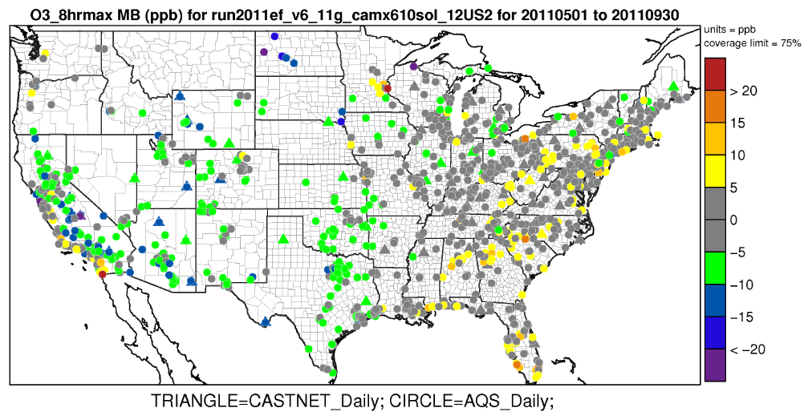
Summary of CAMx 2011 operational O3 evaluation
CAMx tends to overestimate summer MDA8 O3 in eastern U.S.
Even more severe on days w/ MDA8 < 60
Most severe in VISTAS region
CAMx tends to underestimate summer MDA8 O3 in western U.S.:
Most severe on days w/ MDA8 > 60
Most severe in May
More severe @ CASTNET sites vs AQS
May-Sep 2011 CAMx MDA8 Mean Bias (days >= 60 ppb)
Notes:
Note that want to provide a national depiction of model performance before zooming in to the local MD/DC area
May want to mention that O3N RIA modeling will use this CAMx 2011 modeling and a more detailed evaluation will be available as part of that documentation.

Slide 5
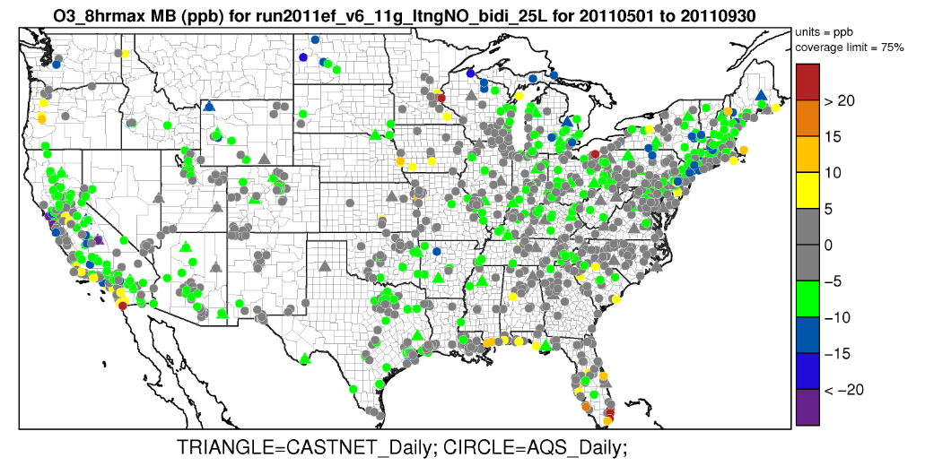
Summary of CMAQ 2011 operational evaluation
CMAQ ozone performance tends towards under-estimation in the eastern U.S.:
Immediate coastal areas are the exception
CMAQ underestimations are not as severe in the western U.S.
While not shown, both models overestimate summer NOx:
Biases are highest in the southeast, midwest, and central States.
May-Sep 2011 CMAQ MDA8 Mean Bias (days >= 60 ppb)
Notes:
Same plot as for CAMx (but only have AQS sites …)

Slide 6
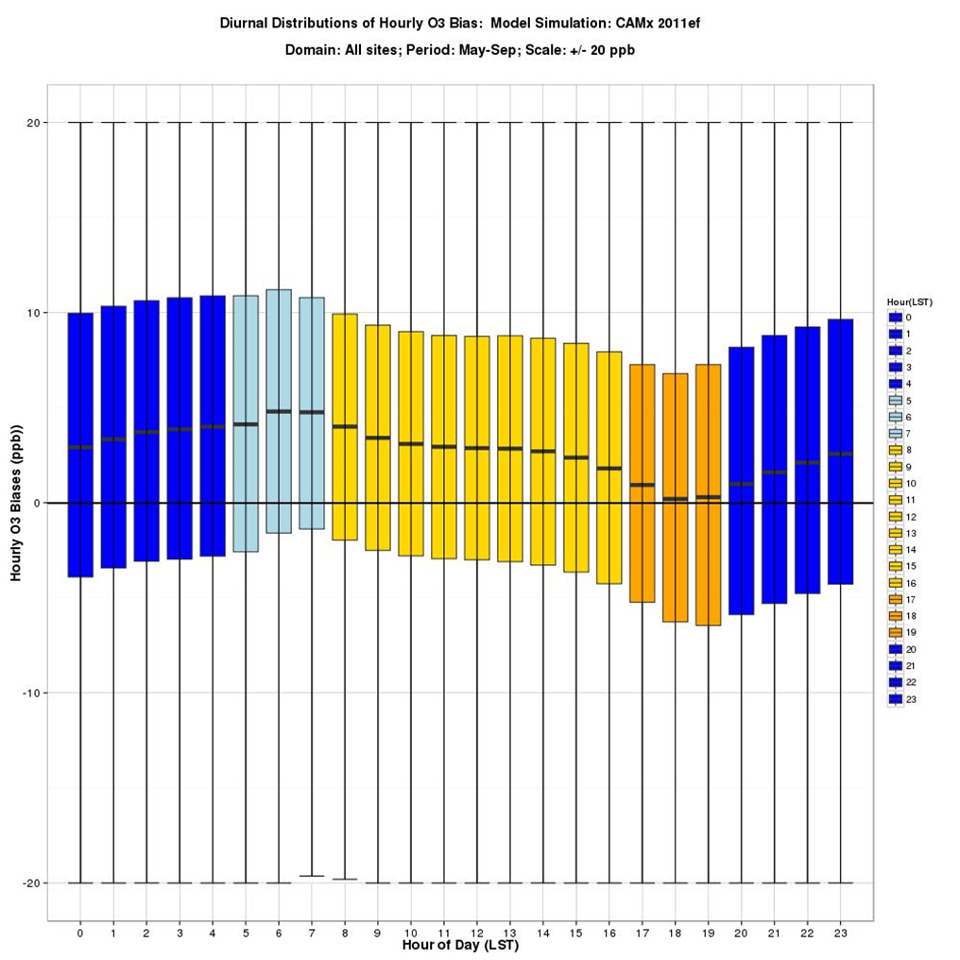
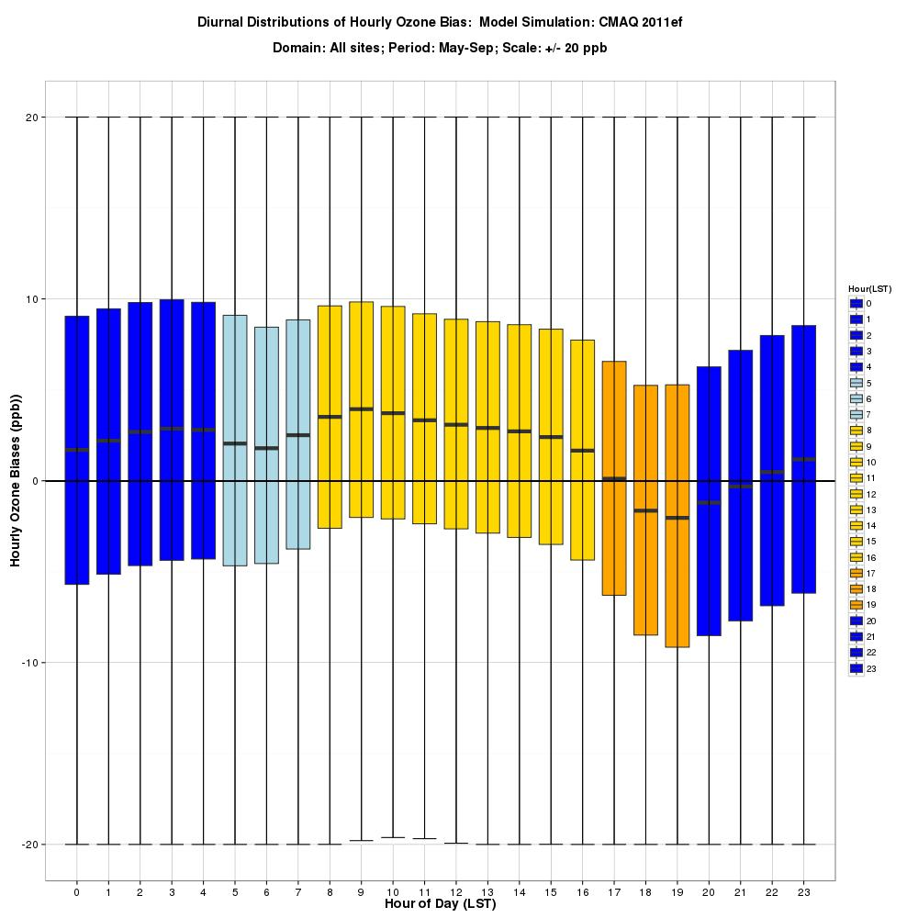
Q1: Are there temporal differences in surface O3 bias?
Summer 2011 CAMx Hourly O3 Bias
by Hour of Day (all AQS sites)
Summer 2011 CMAQ Hourly O3 Bias
by Hour of Day (all AQS sites)
Notes:
Describe plot basics first (x-axis, y-axis, distributions, color codes)
Will make the point that the O3 overprediction at night is not uncommon and probably not that important, but that we’re particularly interested in the evening transition period, where the ozone biases are different than during the rest of the day. Appears that NOx titration (decrease in pos bias) is initiating too soon, esp in CMAQ

Slide 7
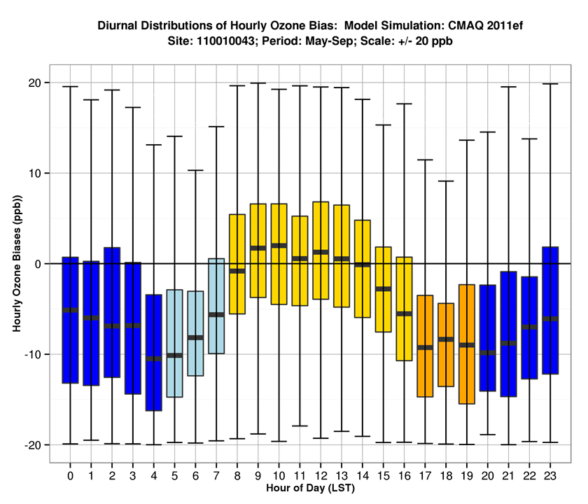
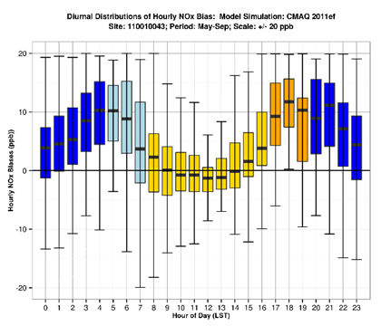
Q1: Are there temporal differences in surface biases?
Summer 2011 CMAQ Hourly O3 Bias
by Hour of Day (AQS site in DC)
Summer 2011 CMAQ Hourly NOx Bias
by Hour of Day (AQS site in DC)
Notes:
Will note the “bridge” pattern in temporal NOx biases at this site (representative of many urban sites) and the relationship btw NOx and O3.
Will speculate that evening buildup in NOx (increasing pos bias) is due to either temporal misallocation of mobile emiss or prematurely collapsing mixed layer.
Increased NOx leads to increased depletion of ozone via titration.

Slide 8
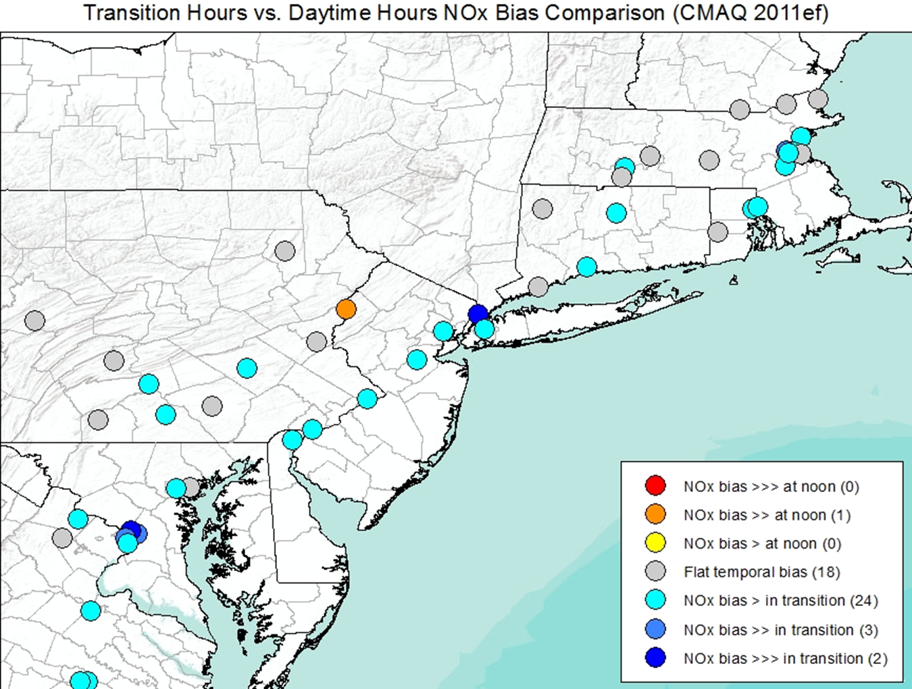
Q1: Are there temporal differences in surface biases?
Locations with strongest signals in
temporal NOx bias
Both models have a tendency to show differences in temporal bias patterns between 1700-2000 LST.
This is especially true in CMAQ
These hours are often part of the MDA8 calculation.
Sites with strongest temporal NOx biases are often correlated with sites with highest model error.
Suggests possible issues with urban mixing or temporal allocation of emissions in urban areas.
Model incommensurability may also be an important factor (12x12km cell vs. local observation).
DC site from previous slide
Notes:
Note that this pattern is seen else where as well (Houston/Dallas, South Coast).
Mention possible sensitivity runs to test how much of this “bridge” effect is driven by emissions and how much results from meteorology.

Slide 9
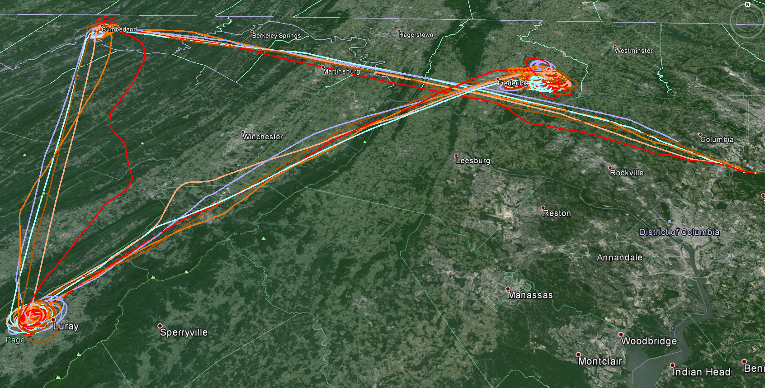
Q2: How well is the model simulating ozone aloft?
UMD flew six morning flights upwind of the Baltimore/DC area
Times varies slightly by day but generally between 0830-1200 LDT
3 spirals were made over Cumberland MD, Luray VA, and Frederick MD
Flight levels ranged from near the surface to 3km AGL.
Goal is to provide initial qualitative assessment of model ozone in the residual layer upwind of the urban area.
Frederick MD
Cumberland MD
Luray VA
Notes:
Changing to topic #2
Note that previous studies in this region have paid close attention to the amount of ozone flux coming into the region at night, w/ multiple efforts having been made to improve meteorology (LLJ).

Slide 10
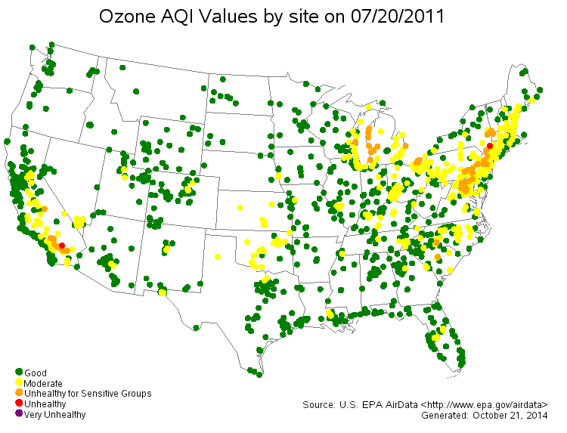
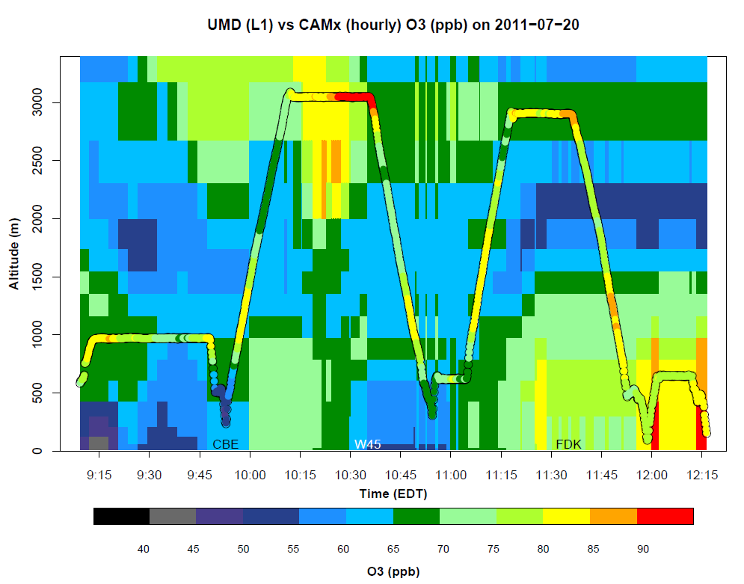
Q2: How well is the model simulating ozone aloft?
July 20, 2011 (sample day)
High O3 day during D-AQ period
Trajectories suggest little 24-hr transport
Obs O3: 70-85 ppb in residual layer
Mod O3: 55-65 ppb in residual layer
Notes:
Emphasize that time constraints allow only depiction of model performance on one sample day.
Note that chose 7/20 which had multiple 8-hr exceedances in the MD/DC area (though transport was pretty limited on this day)
Quick recap of nocturnal layer, residual layer, mixed layer conceptual model.
Note that this day had the worst model performance of the 6 UMD flight days … some days even featured small overestimates … though the aggregate bias appears to be negative.

Slide 11
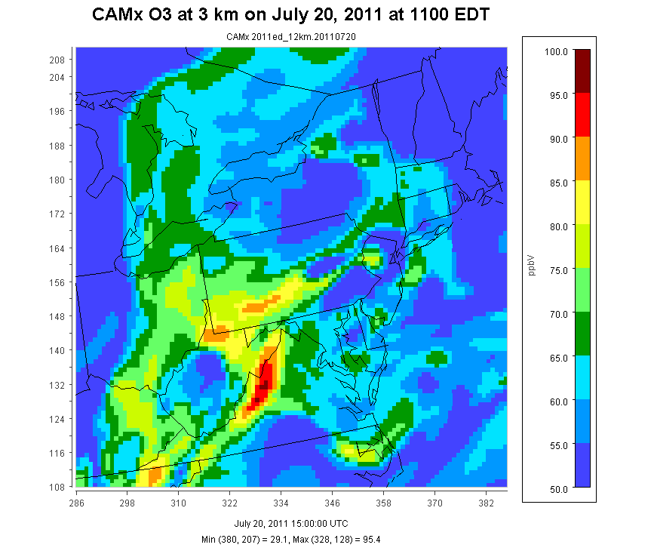
Q2: How well is the model simulating ozone aloft?
Models often contain strong spatial gradients in concentration which complicate qualitative evaluation from overlay plots.

Slide 12
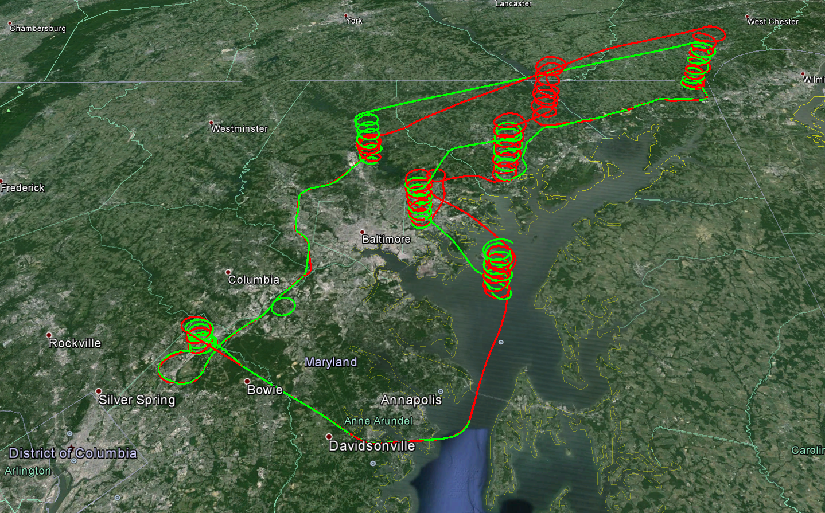
How well is the model simulating ozone aloft?
NASA flew 14 morning through afternoon flights throughout the Baltimore/DC area
Times varies slightly by day but generally between 1000-1800 LDT
Seven spirals were made over various locations
Flight levels ranged from near the surface to 5km AGL.
Goal is to provide initial qualitative assessment of model ozone in the residual layer within the urban area.
Notes:
Previous slides looked at upwind aloft O3 performance (rural areas), now transitioning to O3 aloft in the urban area (and over the Bay)

Slide 13
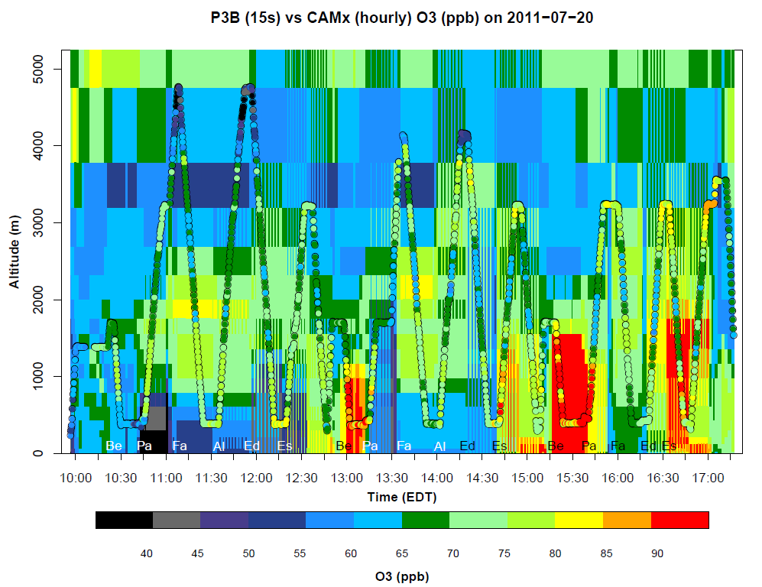
Q2: How well is the model simulating ozone aloft?
July 20th (sample day)
Model captures magnitude and vertical extent of > 90 ppb ozone between DC and Baltimore.
Mix of overestimates and underestimates in the mid layers (1-3k).
Notes:
Again emphasize just a sample day … indicative of better than average model O3 performance aloft.
Highlight areas w/ O3 > 90 ppb and the close match in the first 2 Beltsville-to-Padonia segments (overestimation of late-day O3 over the Bay)

Slide 14
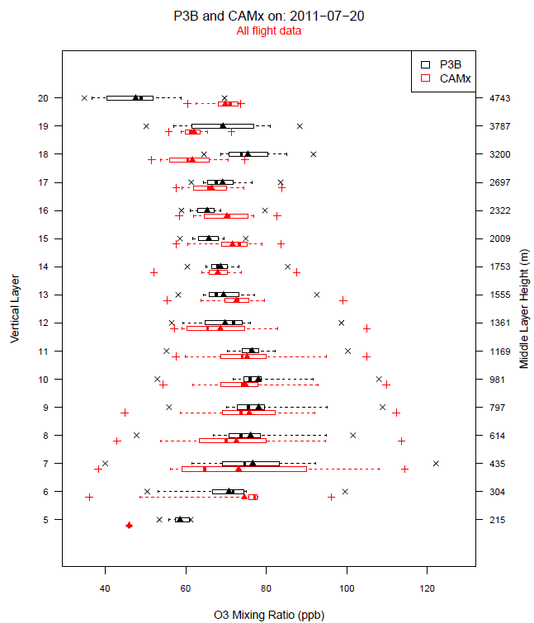
Q2: How well is the model simulating ozone aloft?
Challenging to summarize aggregate model performance via flight overlay plots
Difficult to mentally aggregate multiple plots for multiple hours and locations into a coherent understanding of model error/bias.
Vertical boxplots can provide a more complete depiction of mod/obs pairs
Need to make decision as to how much data to aggregate.
Results for sample day (July 20th)
CAMx layer median O3 closely matches median observed O3 data between 500 – 1750 m.
CAMx results tend to be more variable than what is observed by the aircraft data.
Notes:
Read bullet points.
Work is underway to provide quantitative estimates of bias/error aloft.
Also hoping to make greater use of available ozonesonde and tethersonde data in near future.

Slide 15
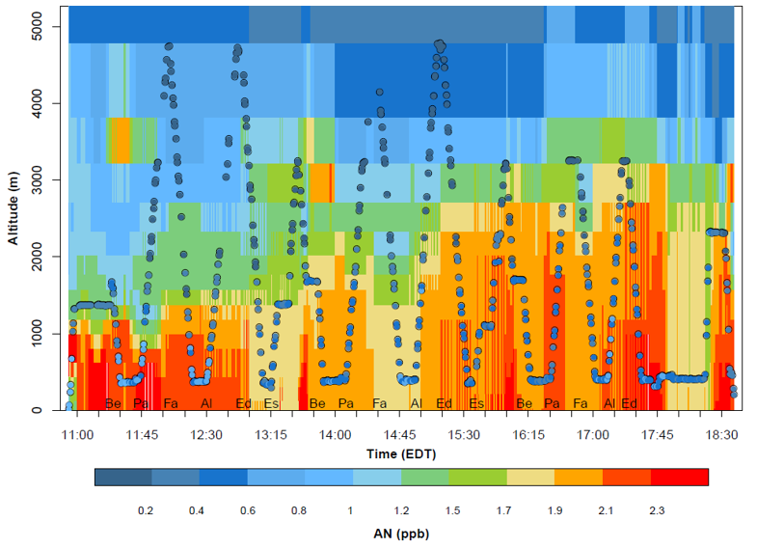
Q3: How well does the model simulate observed organic nitrates aloft in the region?
P3B / CMAQ (CB05-tu) overlay
of ANs on July 27th
Alkyl nitrates (AN) and peroxynitrates (PN) can contribute to enhanced ozone far from source emissions.
Various model treatments of AN/PN formation and yield can result in widely differing local ozone production behavior. (Beaver et al., 2012)
Other modeling groups (UMD/MDE) have expressed concerns about how well CMAQ w/ CB05 chemistry reproduces AN/PN.
Notes:
Note that sample plot is from 7/27 and represents the worst over prediction of AN on any CMAQ model day.
Note that the scale is fairly tight.

Slide 16
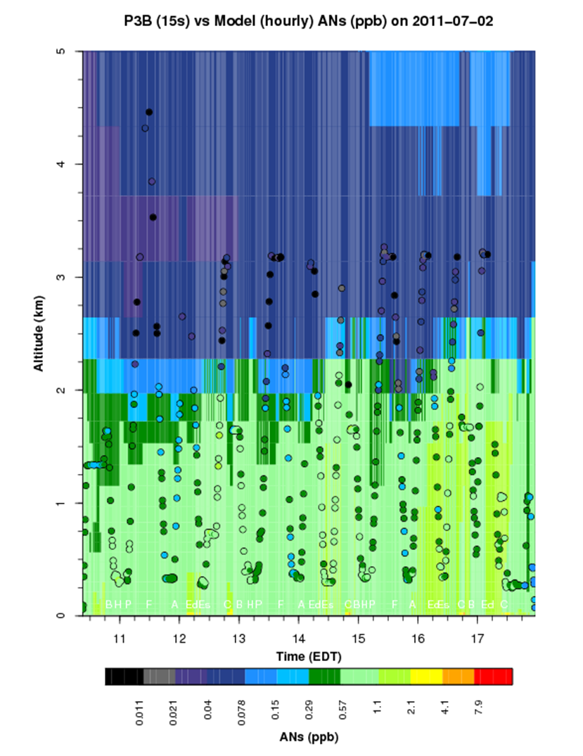
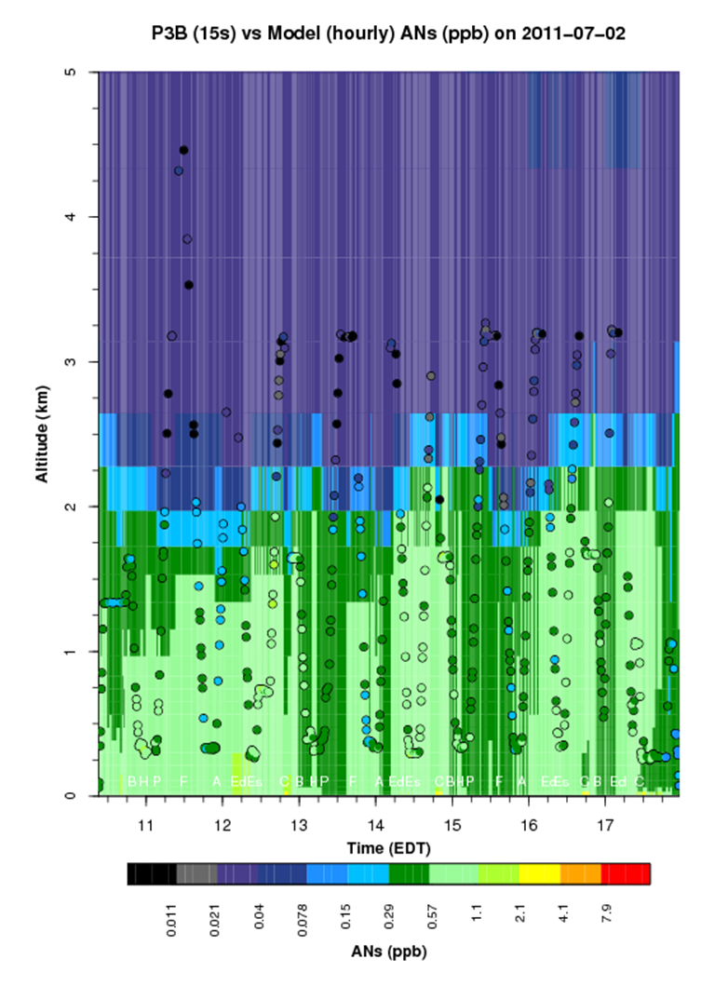
Q3: How well does the model simulate observed organic nitrates aloft in the region?
P3B / CMAQ (CB05-tucl) overlay
of ANs on July 2nd
P3B / CAMx (CB6r2) overlay
of ANs on July 2nd
Note scale has changed (much larger) from preceding slide.
CAMx CB6r2 updates organic nitrate chemistry and has been shown to better capture NOy partitioning between organic nitrates and HNO3. (Environ, 2014)
CAMx 2011 AN levels are consistently lower than CMAQ w/ CB-05 and generally better match aircraft AN measurements.
EPA/ORD is working to improve organic nitrate chemistry in CMAQ (initial test promising).
Notes:
Note that changing day and changing scale.
Still a tendency to overpredict, but not as bad on the 27th … not as bad w/ the CB6r2 mechanism as w/ CB05-tucl

Slide 17
Next steps / Summary
This presentation provided a quick sampling of some of the initial EPA 2011 model platform evaluation products:
No firm conclusions reached to date. Much work to be completed.
EPA plans to continue comparing DISCOVER-AQ data against EPA 2011 model platform output data:
Ultimate goal is to have a chapter in EPA 2011 model performance evaluation document devoted to the limited but detailed field study analyses.
Additional areas of investigation to be completed:
How well does the model perform at sites influenced by the bay breeze?
How does model performance vary as horizontal resolution varies?
Make greater use of available ozonesonde and tethersonde data?
Can we conclude anything definitive about quality of mobile NOx emissions?
So we beat on, boats against the current, borne back ceaselessly into the past
F. Scott Fitzgerald
Notes:
Mention Wyat’s talk at 2p on Wed

