Slide 1
PHOTOCHEMICAL MODELING TO ATTRIBUTING SOURCE AND SOURCE REGIONS TO OZONE EXCEEDANCES IN SPAIN
M.T. Pay^{1,*}, V. Valverde¹, J.M. Baldasano^{1,2},
R. Kwok³, S. Napelenok³, K. Baker⁴
¹Earth Sciences Department, Barcelona Supercomputing Center, Barcelona, Spain
²Environmental Modeling Laboratory, Technical University of Catalonia, Barcelona, Spain
³ORD/NERL/AMAD, U.S. EPA, Research Triangle Park, NC
⁴OAQPS, U.S. EPA, Research Triangle Park, NC
*now at: Laboratoire de Météorologie Dynamique, École Polytechnique, Palaiseau Cedex, France
13th Annual CMAS Conference, Chapel Hill, NC, October 27-29, 2014

Slide 2
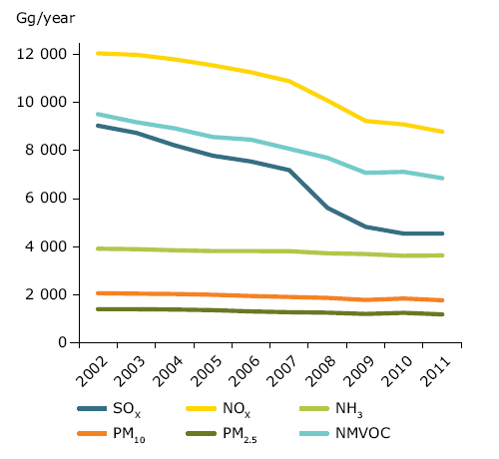
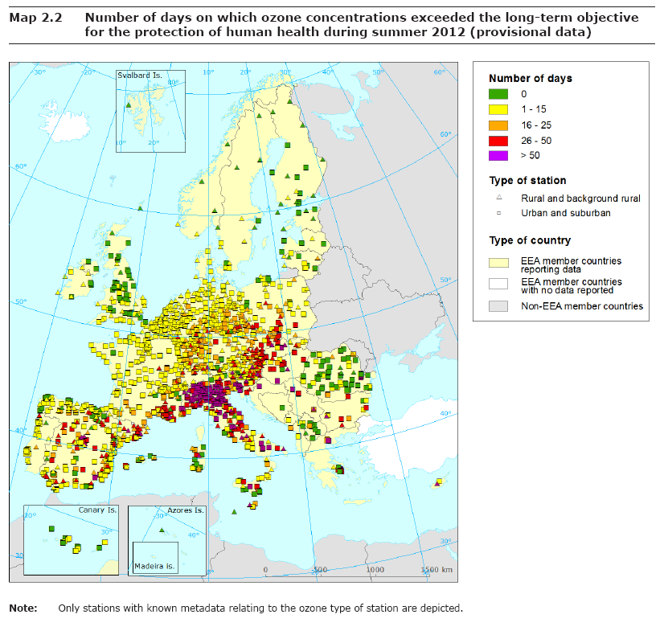
The problem of O₃ in Europe & Spain
Emission trend in Europe (EEA, 2013a)
O₃ precursors emissions have declined (27% for NO_{x} and 28% NMVOC)
High O₃ (rural background), PM and NO₂ (urban areas) concentrations are still a problem.
Discrepancy: increasing inter-continental transport of O₃ and its precursors.
Air pollution by O₃ in Europe (EEA, 2013b)
Exceedances TV (21%), LTO (85%), IT (28%) and AT (3%) summer 2012.
Regions: Medit. area > Central & E EU > NW EU > N EU
LTO exceedances in summer 2012
 | Period | EU (2008/50/EC) | WHO (2005) | NAAQS (2008)
 |  | μg m⁻³ | μg m⁻³ | μg m⁻³
O₃ | 8 h | 120^{TV} (25d/3y), 120^{LTO} | 100 | 147 (3y)
 | 1 h | 180 ^{IT} | - | 235
 | 1 h | 240 ^{AT} | -
LTO: Long-Term Objective
TV: Target Value
IT: Information Threshold
AT: Alert Threshold
Notes:
Zones where considerable ozone precursor emissions combine with stagnant meteorological conditions during the summer, when high insolation and temperatures occur.

Slide 3
Management of the O₃ problem: Source Apportionment
Ground-level O₃ concentrations are a result of the long-range transport, the stratospheric intrusions and local photochemical production from biogenic and anthropogenic VOC and NO_{x} precursors.
To develop efficient policies to mitigate O₃ exceedances, it is important to understand the sources of precursors that contribute to exceed the O₃ limit values.
Source Apportionment (SA) approaches are useful for national/regional/local authorities who have to developed cost-efficient emissions control strategies because they allow to identify the relative importance of sources that contribute to high O₃ concentrations.
Objective: Quantify the origin (sources and regions) of O₃ in Spain during a summer episode affecting Europe:
- contribution from global, regional, local scales.
- contribution from main anthropogenic sources in Spain.

Slide 4
ISAM: the Integrated Source Apportionment Method
ISAM: augmented version of CMAQv5.0.2 (AERO6, CB05)
ISAM for Particulate Matter Source Apportionment:
Applied over USA, evaluated by means brute force zero-out scenarios (Kwok et al., 2013)
ISAM for O₃ Source Apportionment:
Applied over USA, evaluated by means brute force zero-out scenarios (Kwok et al., 2014)
Based on O₃ SA from CAMx-OSAT.
Hybrid approach: using the PH₂O₂/PHNO₃ indicator ratio.
Tracers to represent NO_{x} and VOC families are based on CB05 individual species contributing to O₃ formation:
VOC (14 tracer): ALD2, ALDX, ETH, ETHA, ETOH, FORM, IOLE, ISOP, MEOH, OLE, PAR, TERP, TOL, XYL
Nitrogen compounds (9 tracers): NO, NO2, NO3, N2O5, HONO, PAN, PANX, PNA, NTR.
Notes:
Hybrid approach: of source apportionment and source sensitivity in that O₃ production is attributed to precursor emissions sources (either VOC or NO_{x}) based on O₃ chemical formation regime (NOx-limited or VOC-limited) estimated using the PH₂O₂/PHNO₃ indicator ratio.
OSAT vs. ISAM: tracers used to represent NO_{x} and VOC families: ISAM uses tracers of individual N and VOC species, but CAMx uses only two tracers. Tracer for CB05 species contributing to O₃ formation:

Slide 5
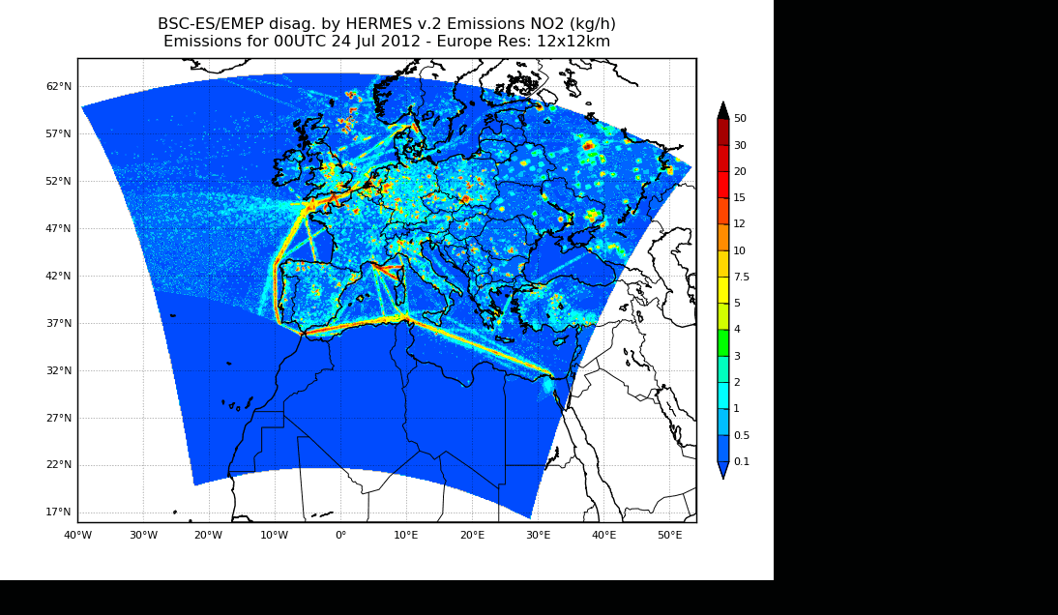
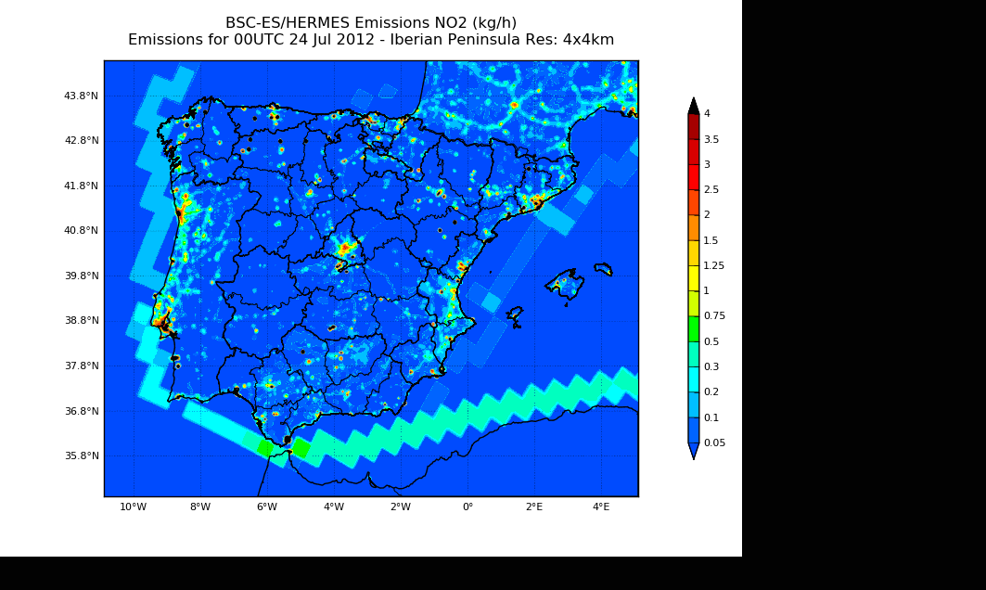
Model configuration and setup: Spanish air quality forecast system (www.bsc.es/caliope)
NO₂ emissions (kg/h)
METEO
WRF-ARWv3.5 (RRTM, WSM3, YSU, NoahLSM)
33σ / 50hPa (top)
EMISSIONS
HERMESv2.0
CHEMISTRY
CMAQv5.0.2 (ISAM, CB05TUCL, AERO6)
ICON/BCON-EU12: GFS (NCEP)
IP4: HERMES-BOUP (Spain) + HERMES-DIS (Europe)
BCON-EU12: MACC forecast
Chemical mech: CB05
Year: 2009
15σ / 50hPa (top): 1st σ = 40 m depth
BCON-IP4: nesting EU12
ICON/BCON-IP4: nesting EU12
MCIPv4.0
EU12: HERMES-DIS (EMEP data)
EU12 (12 km x 12 km)
IP4 (4 km x 4 km)
HERMES model = Guevara et al., 2014

Slide 6
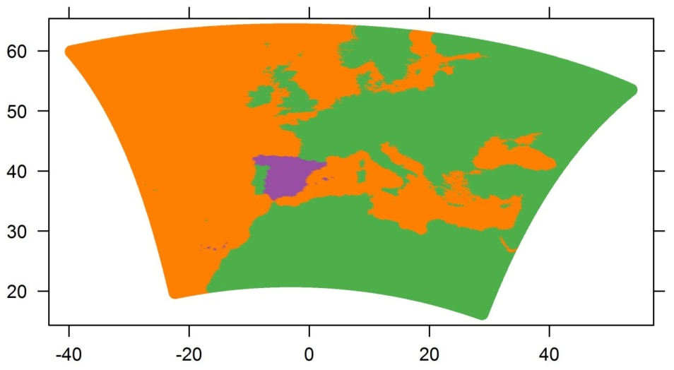
O₃ SA to track contribution: regions
ISAM-EU12 (Europe, 12 km x 12 km)
Goal: to quantify contribution of sources out side/from Spain to O₃
EURO: countries surrounding Spain*
ESP: Spain*
OTHR: Ocean
BCON: Interpolation from MACC (global O₃ transport out from EU12)
EU12
Spain* (Spanish IP + Balearic Islands)

Slide 7
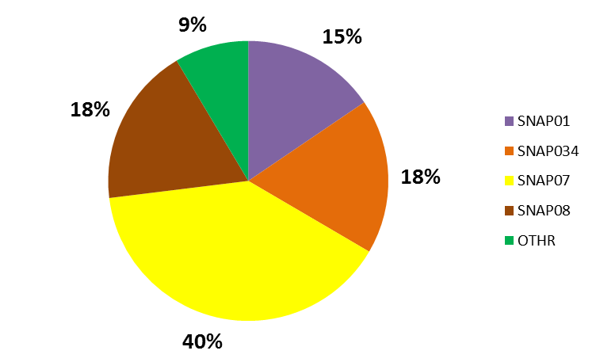
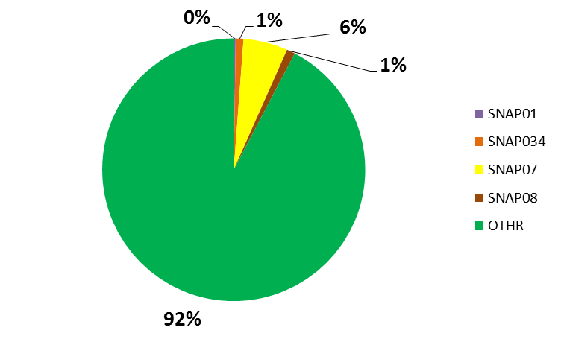
O₃ SA to track contribution: regions | main emission sources
ISAM-EU12 (Europe, 12 km x 12 km)
Goal: to quantify contribution of sources out side/from Spain to O₃
EURO: countries surrounding Spain*
ESP: Spain*
OTHR: Ocean
BCON: Interpolation from MACC (global O₃ transport out from EU12)
EU12
IP4
Spain* (Spanish IP + Balearic Islands)
ISAM-IP4 (Iberian Peninsula, 4 km x 4 km)
HERMES model (2009)
CMAQ-ISAM-IP4
Goal: to quantify contribution of main Spanish emissions sources to O₃
OTHR: other sectors
SNAP1: combustion in energy
SNAP34: non- and industrial combustion
SNAP7: road transport
SNAP8: other mobile source & agricultural machinery
BCON: nesting CMAQ-EU12
NO_{x}
NMVOC
Bio (68%)
Agri (12%)
Solvents (10%)

Slide 8
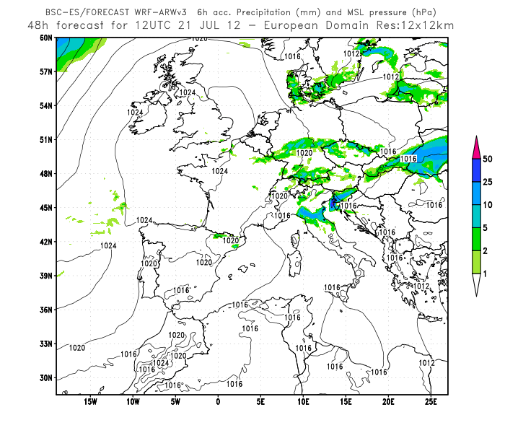
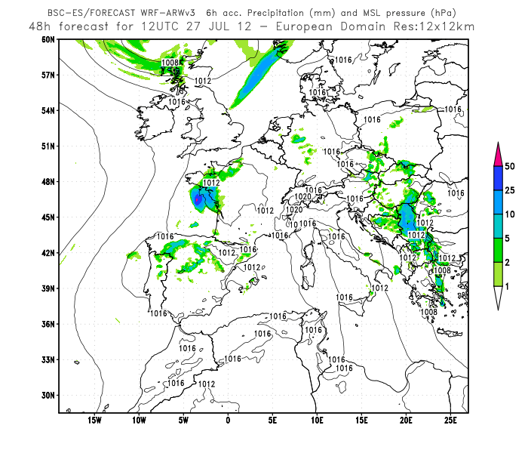
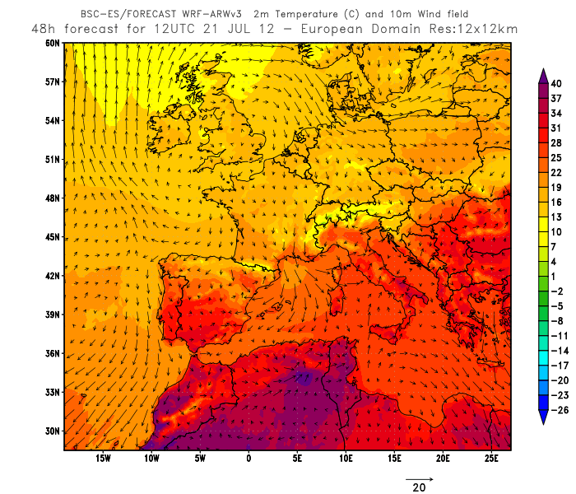
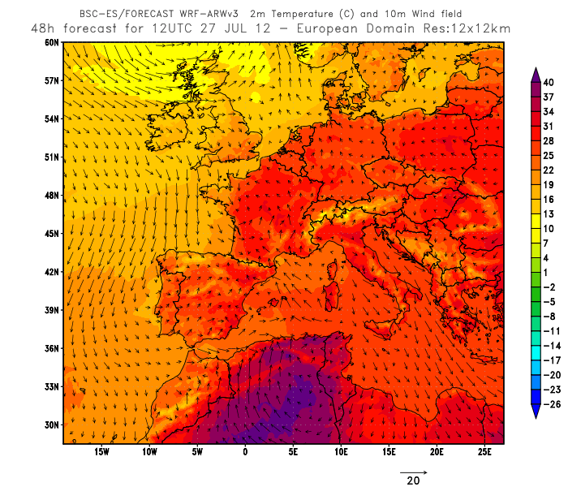
Study episode: 21-31 July 2012
21-24th = ITL
25-29th = Nwad
30-31st = ITL
ITL
NWAd
The largest O₃ episode in 2012 (24-28th July):
33% of the total number of exceedances of the IT,
32% of the total number of exceedances of the AT,
12% of the number of exceedances of the LTO.
L
L
H
H
MSL P & prep
Circulation Type Classification for 2012: most freq. patterns (Valverde et al., 2014)
 | NWad | ITL
Freq. | 22 % | 22 %
Seasonal freq (%): DJF/MAM/ JJA/SON | 2.5/37.5/ 37.5/22.5 | 15.2/20.3/ 43.0/21.5
Mean/Max persist. | 4/10 days | 3/8 days
Transitions | ITL/ W-NWad | NWad /W- NWad
Temp & wind
ITL: Iberian Thermal Low
NWad: NW advection
Notes:
Circulation type classification (CTC) derived on a climatic basis to study air quality dynamics over the Iberian Peninsula (Valverde et al., 2014 )
24-28th July: the largest O₃ episode in 2012 in terms of area affected
An 'ozone episode' is defined as follows: 'A period of usually a few days up to 2–3 weeks with high ozone concentrations, characterised by daily exceedances of the thresholds set to protect human health. Ozone episodes occur under specific meteorological conditions characterised by large stagnant areas of high pressure. Since the formation of ozone requires sunlight, ozone episodes mainly occur during summer' (EEA, 2010b).

Slide 9
Evaluation of O₃ | domains = EU12 and IP4

Slide 10
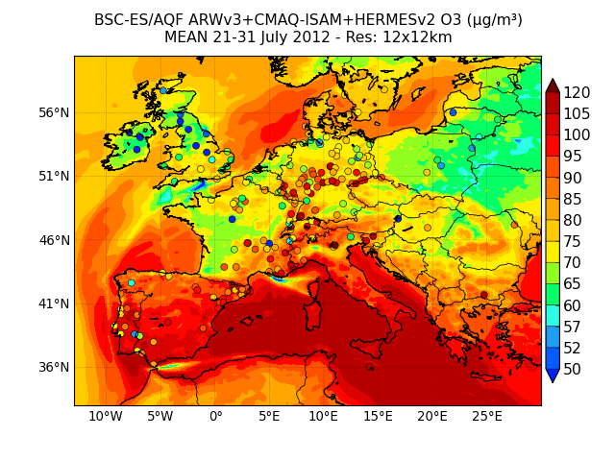
Region contribution to O₃ in Spain (EU12): Mean concentration 21-31 July 2012
EURO
ESP
TOTAL
OTHER
BCON

Slide 11
Region contribution to O₃ in Spain (EU12): NO₂/O₃ hourly concentration
LTO
O₃
EURO = 40 µg/m³ mean,
60 µm/m³ during the peak
NO₂
NWad
NO₂-BCON
NO₂-EURO
NO₂-ESP
NO₂-OTHR

Slide 12
Region contribution to O₃ in Spain (EU12): Rural background sites
LTO
LTO
EURO controls
EURO controls
LTO
LTO
Portugal controls
ESP controls
LTO
LTO
ESP controls
Portugal + ESP + Shipping controls

Slide 13
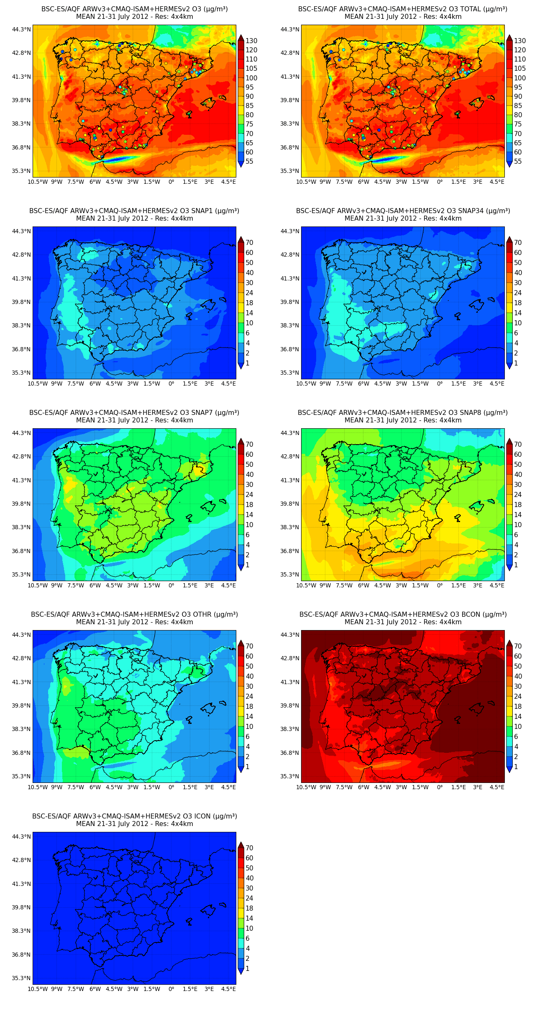
Source contribution to O₃ in Spain (IP4): Mean concentration 21-31 July 2012
SNAP1
SNAP34
TOTAL
SNAP7
SNAP8
OTHR
BCON

Slide 14
Source contribution to O₃ in Spain (IP4): Traffic in Madrid
MAD
MAD
O₃- MAD city
O₃- downwind MAD city
LTO
LTO
NO₂- MAD city
NO₂- downwind MAD city

Slide 15
Source contribution to O₃ in Spain (IP4): Shipping over southern Spain
2
1
3
4
- 1
- 2
LTO
LTO
SNAP8 = 18-24 µg/m³
SNAP8 = 14-18 µg/m³
- 3
- 4
LTO
LTO
SNAP8 = 24-30 µg/m³
SNAP8 = 14-18 µg/m³

Slide 16
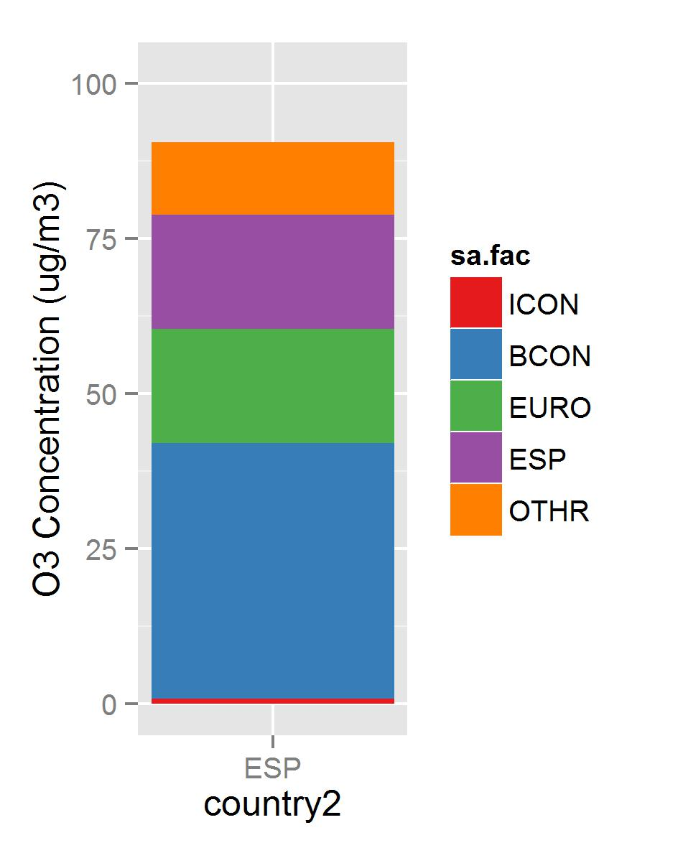
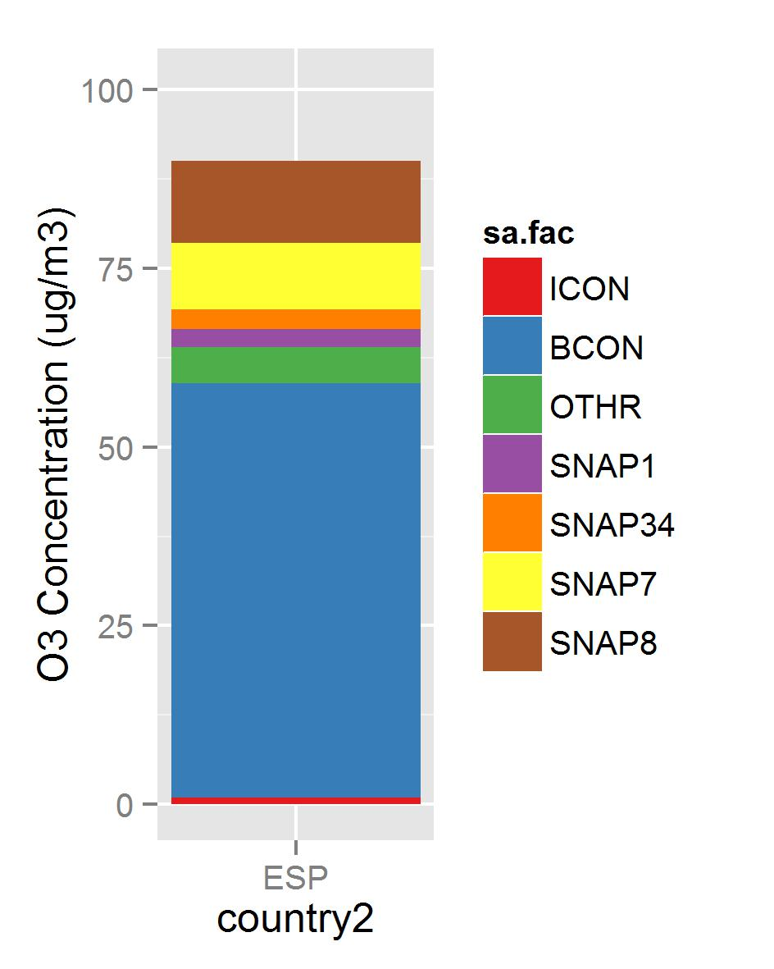
Summary of SA: regions and emissions sources
ISAM-EU12
ISAM-IP4
13% OCEAN ≈ SNAP8
20% ESP ≈ 10% SNAP7 + 6% OTHR + 3% SNAP1 + 3% SNAP34
64% non-ESP ≈ 20% EURO + 44% global
1% ICON
Notes:
ICON: 1, BCON: 64, OTHR: 6, SNAP1: 3, SNAP34: 3, SNAP7: 10, SNAP8: 13
ICON: 1, BCON: 46, EURO: 20, ESP: 20, OTHR: 13,

Slide 17
Conclusions and future work
The O₃ problem in Spain is not only local (20%), but continental, hemispheric and global (64%).
NWad brings O₃ and precursors from N EU countries and international shipping inland Spain up to 60 µg/m³ (~40-50 µg/m³) in N Spain; meanwhile central and costal areas are more affected by recirculation of local precursors.
High influence of the international shipping (13%), affecting costal areas, and southern Spain (Strait of Gibraltar): 14-24 µg/m³, up to 30 µg/m³.
The road traffic (10%) has the highest contribution at stations downwind big cites (10-15 µg/m³ the whole cycle), meanwhile at urban stations the contribution is only during rush hour.
The sector combustion in energy (3%) and industrial and non-industrial combustion (3%) has a low mean contribution 2-4 µg/m³ over Spain, maximum of 4-6 µg/m³ near NO_{x}-limited areas (W IP).
ISAM is useful as a diagnostic tool:
Overestimation of chemical boundary condition in the western domain of EU.
To test the performance emissions model, to revise station categories
The ISAM quantifies the required days to spinup the model was at least 6, ICON < 10%.
Together with source sensitivity approach (e.g., CMAQ-DDM or adjoin) allows to take more cost-efficient mitigation options.
Notes:
ISAM is applied inside the CALIOPE system to track the origin (area and sources) of O₃ in Spain under a summer episode.

Slide 18
Thank you for your attention
References:
EEA, 2013a. Air quality in Europe – 2013 report. European Environmental Agency, EEA Report, No 9/2013. ISSN 1725-9177. 112 pp.
EEA, 2013b. Air pollution by ozone across Europe during summer 2012. Overview of exceedances of EC ozone threshold values for April-September 2012. European Environmental Agency, EEA Report, No 3/2013. ISSN 1725-2237. 52 pp.
Guevara, M., Pay, M.T., Martinez, F., Soret, A., van der Gon, H., Baldasano, J.M., 2014. Inter-comparison between HERMESv2.0 and TNO-MACC-II emission data using the CALIOPE air quality system (Spain).
Kwok, R., Baker, K., Napelenok, S., Tonnesen, G., 2014. Photochemical grid model implementation of VOC, NOx, and O₃ source apportionment. Geoscientific Model Development Discussions 7, 5791-5829.
Kwok, R., Napelenok, S., Baker, K., 2013. Implementation and evaluation of PM2.5 source contribution analysis in a photochemical model. Atmospheric Environment 80, 398-407.
Valverde, V., Pay, M.T., Baldasano, J.M., 2014. Circulation-type classification derived on a climatic basis to study air quality dynamics over the Iberian Peninsula. International Journal of Climatology, doi: 10.1002/joc.4179
Webs:
Air Quality Forecasts Europe / Spain: http://www.bsc.es/caliope
Acknowledgments:
CMAS Visiting Scientist programme: Dr. Adel Hanna (UNC) and Dr. Rohit Mathur (USEPA)
Funding:
Beatriu Pinós programme (2011 BP-A 427), Severo Ochoa (SEV-2011 00067)

Slide 19
Contribution from combustion | industrial areas
1
2
3
4
LTO
- 1
LTO
- 2
- 3
- 4
LTO
LTO

Slide 20
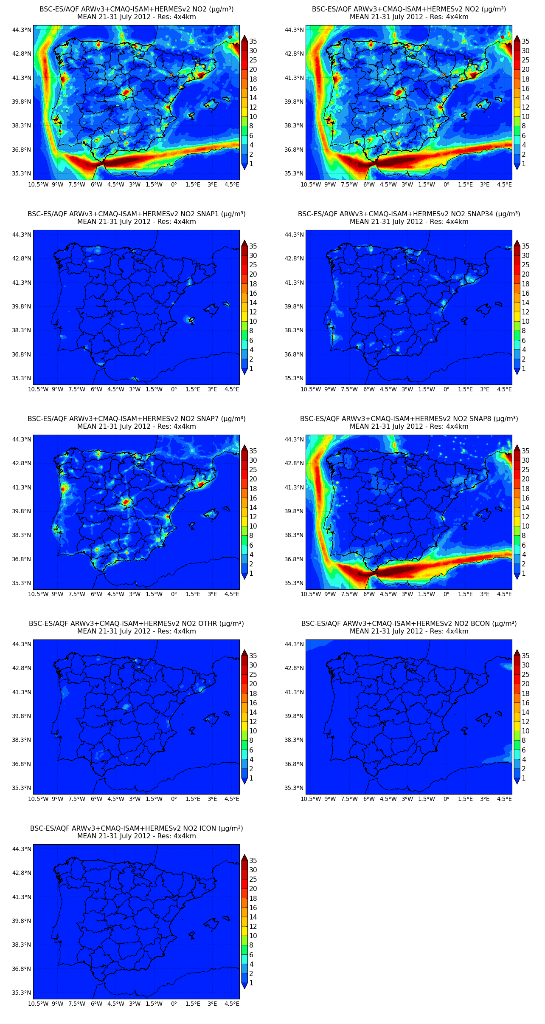
Source contribution to O₃ in Spain Mean concentration 21-31 July 2012
SNAP1 (comb. energy)
SNAP34 (combustion)
TOTAL
SNAP7 (road traff.)
SNAP8 (shipping + airport + traspot agri)
OTHR (agri + solvent + bio + fossil fuel)
BCON

Slide 21
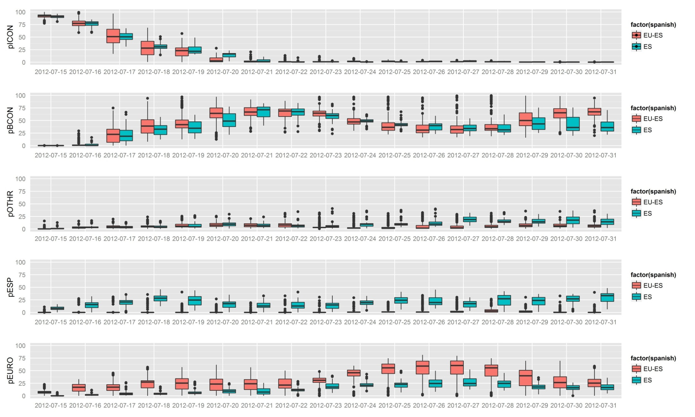
CMAQ-ISAM-EU12 | spin-up
D1 D2 D3 D4 D5 D6
D≥7, ICON < 15%
Study episode: 21-31th July 2014

Slide 22
Contribution of traffic in main cities | Barcelona
BCN
BCN
- MAD
- MAD
- BCN
- BCN
recirculation

Slide 23
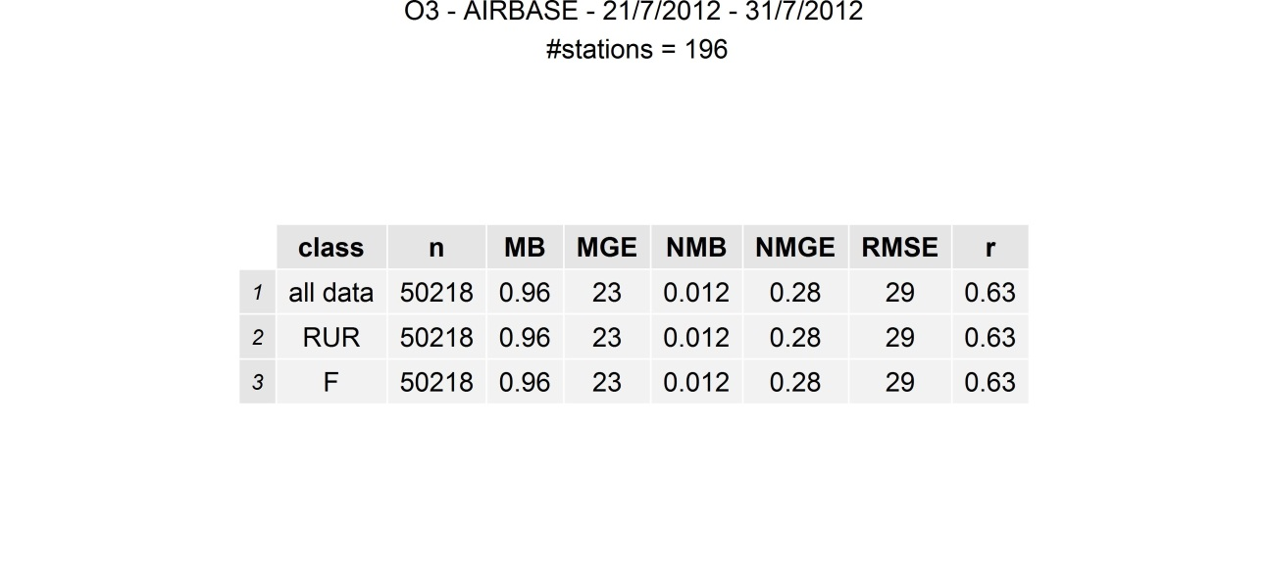
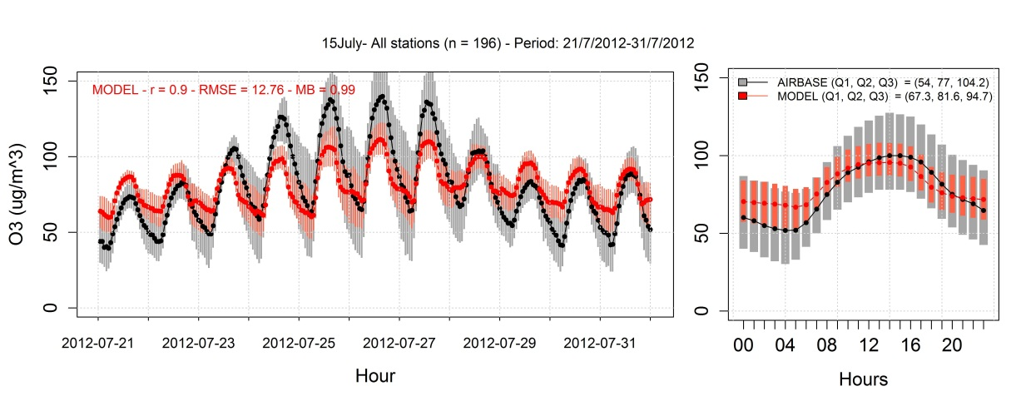
Results: Evaluation of O₃ | domain = EU12

Slide 24
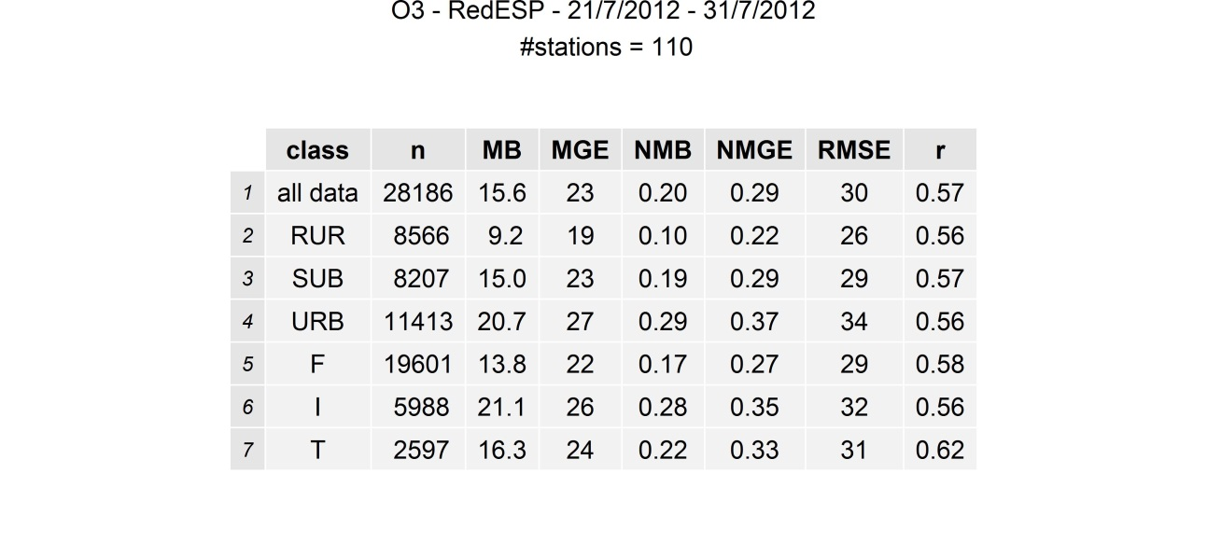
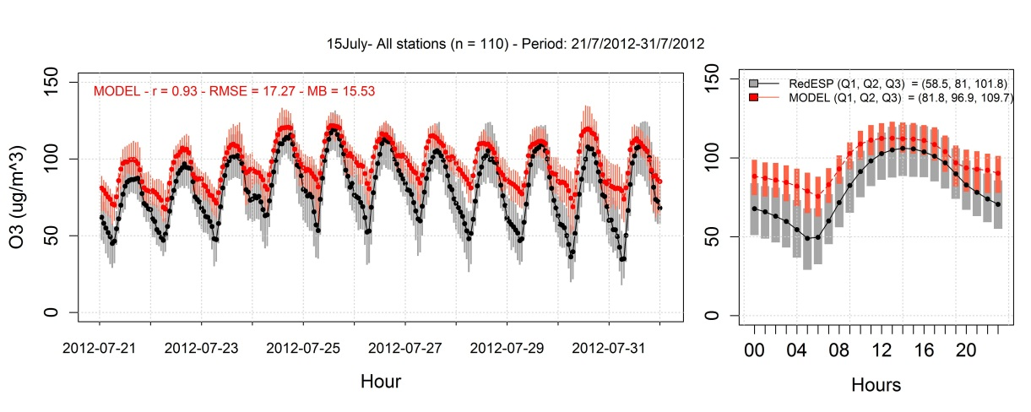
Results: Evaluation of O₃ | domain = IP4

Slide 25
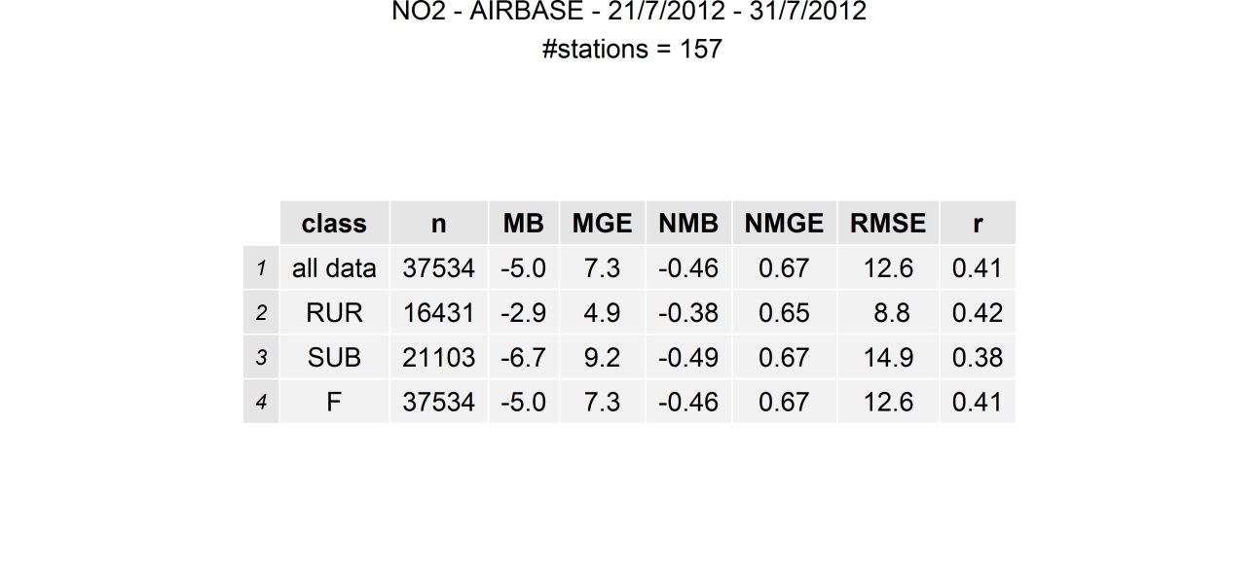
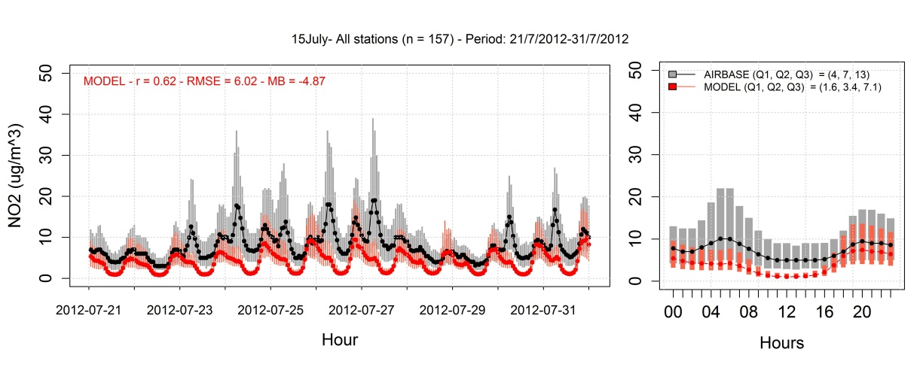
Results: Evaluation of NO₂ | domain = EU12

Slide 26
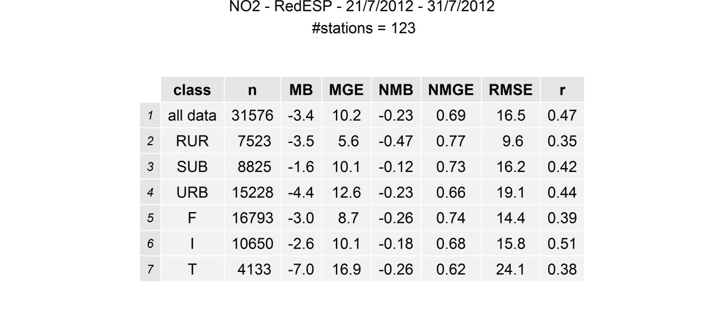
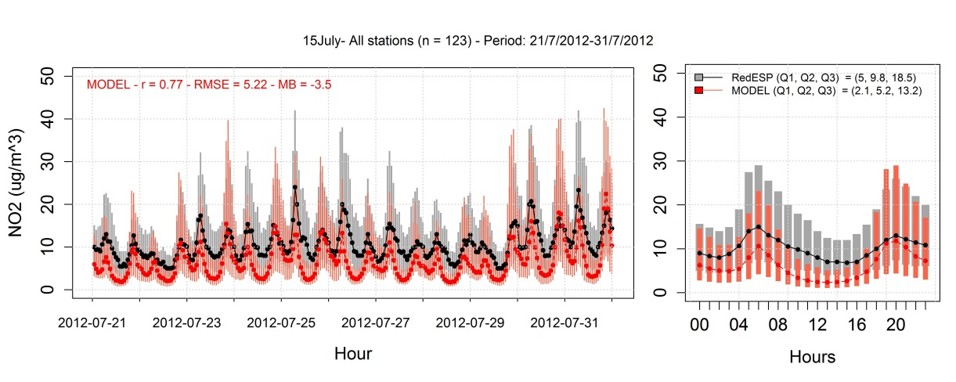
Results: Evaluation of NO₂ IP4

