Slide 1



Mesoscale meteorology modeling and sensitivity analysis for the south of Chile region using WRF-ARW model
Luis Alonso Díaz Robles, Joshua S. Fu, Alberto Vergara-Fernández, Norman Vergaray
Departamento de Ingeniería Química, Universidad de Santiago de Chile
alonso.diaz.r@usach.cl

Slide 2
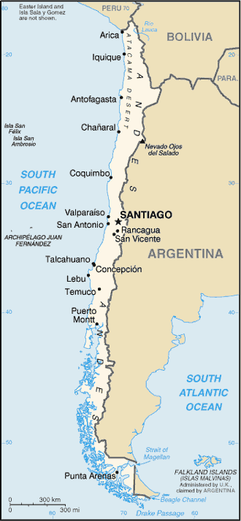
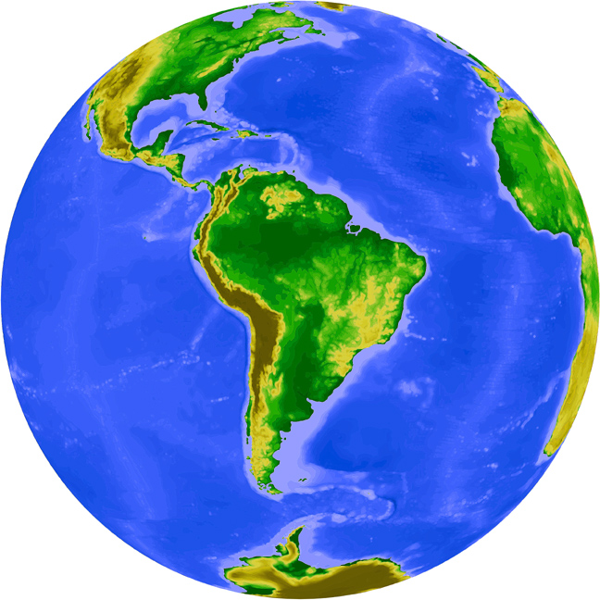

Slide 3
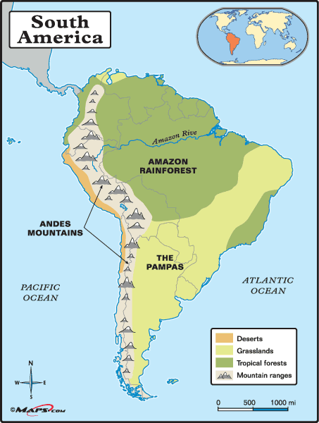
Very Complex Tarrain
and several kind
of climates

Slide 4
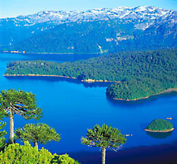
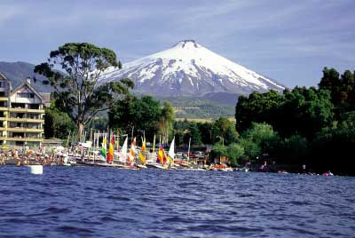
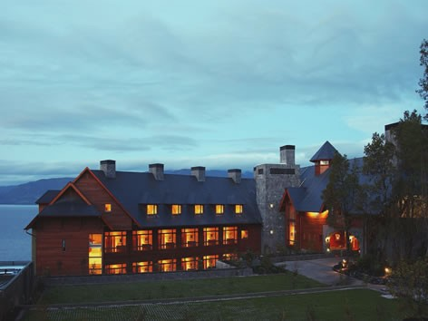
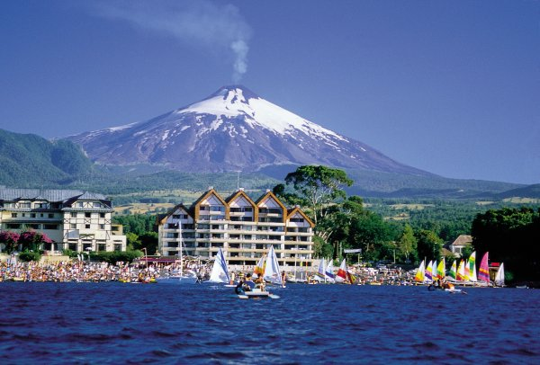

Slide 5
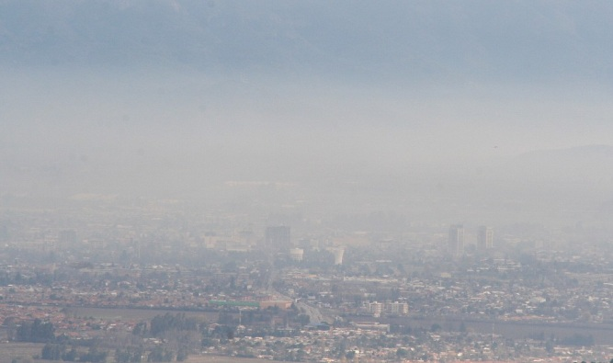
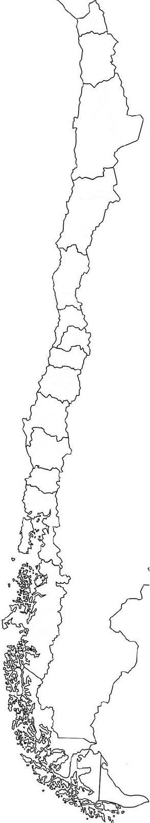
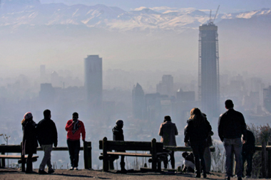
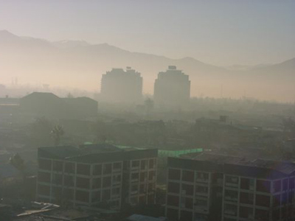
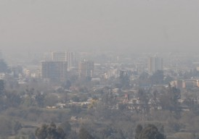
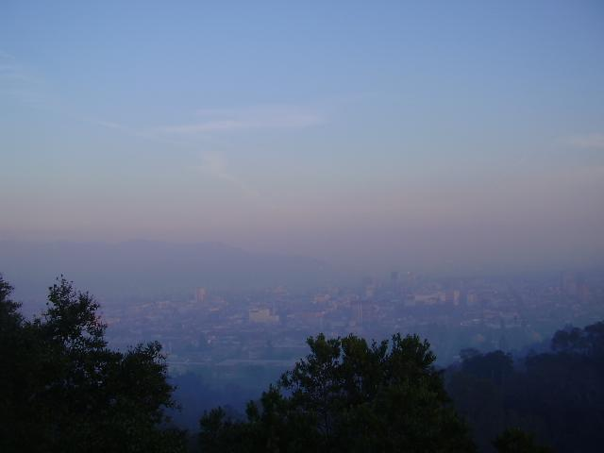
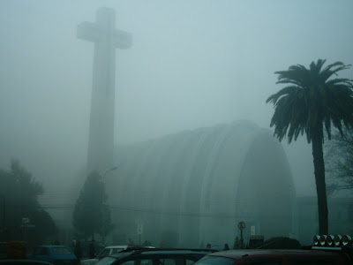
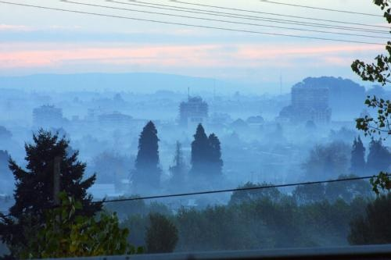
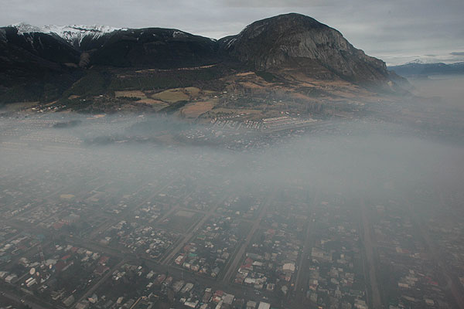

Rancagua
Santiago
PM10
PM10
Concepción
2009
1996
Talca
PM10
PM10
2007
2010
Almost 9 millions persons expose to wood smoke every year
Health Costs: 7 millions USD per year, AGIES PM2.5 from DICTUC
Temuco
PM10
2005
PM10
PM2.5
Valdivia
PM2.5
2014
2013
2013
Chillán
PM2.5
2012
Osorno
Coyhaique
PM10
PM10
PM2.5
2012

Slide 6
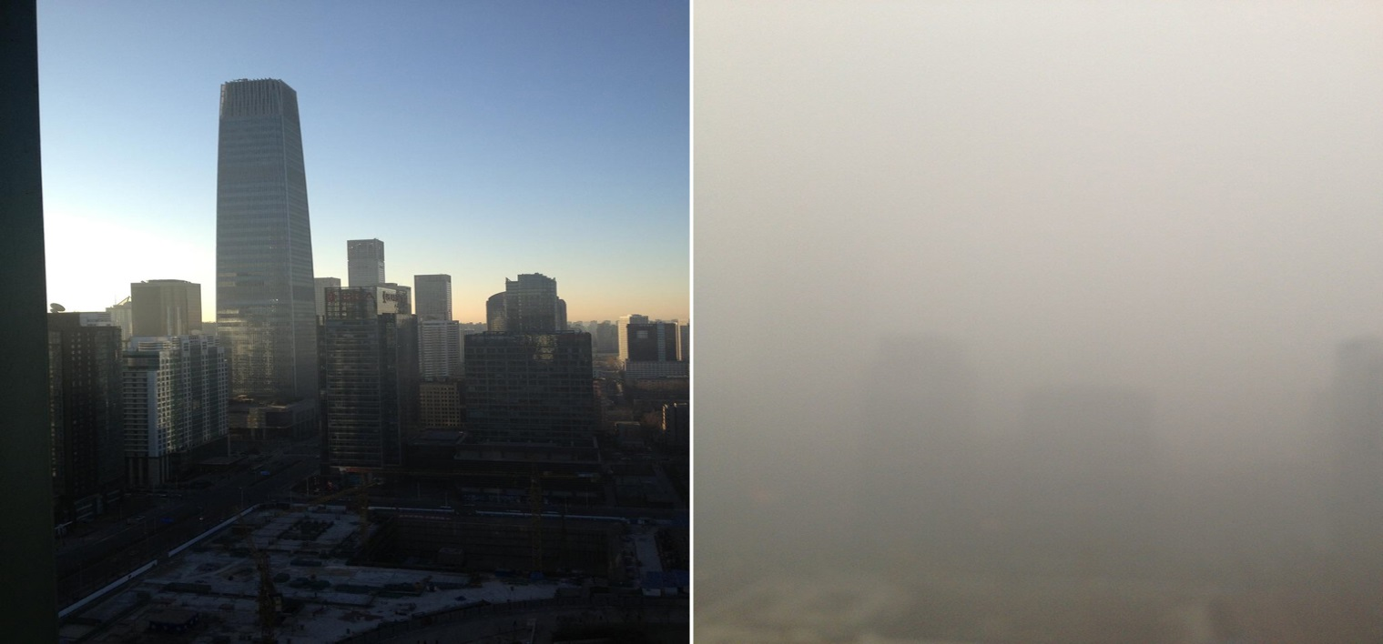
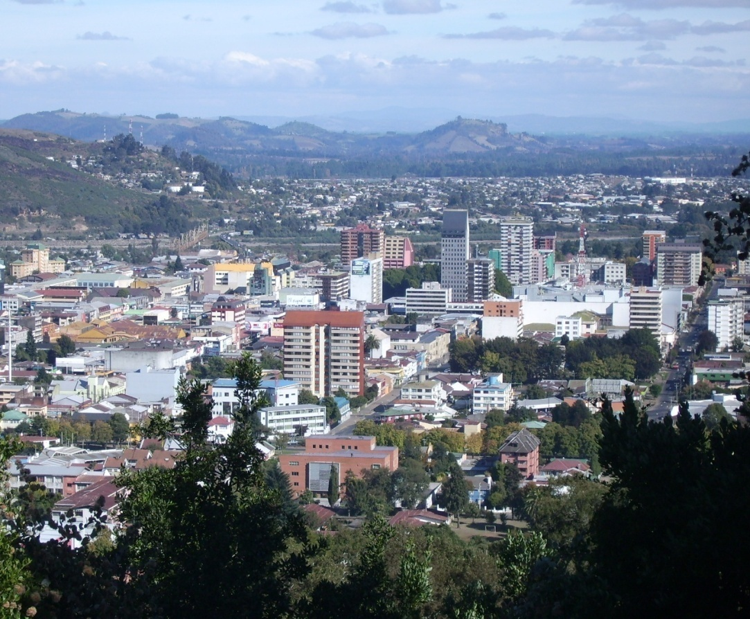
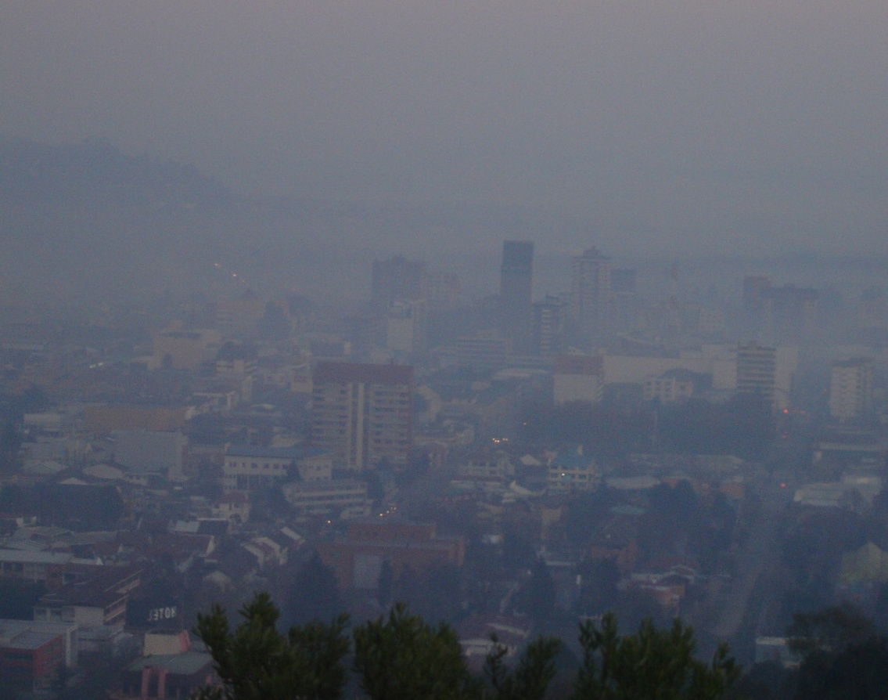
Beijing versus Temuco
Saturday, January the 12th 2013
PM2.5 = 993 ug/m3
PM2.5 = 300 ug/m3 24-hr
Friday, August 26th 2012
PM2.5 = 993 ug/m3
PM2.5 = 291 ug/m3 24-hr

Slide 7
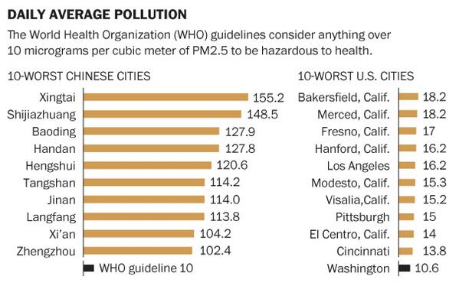

Slide 8
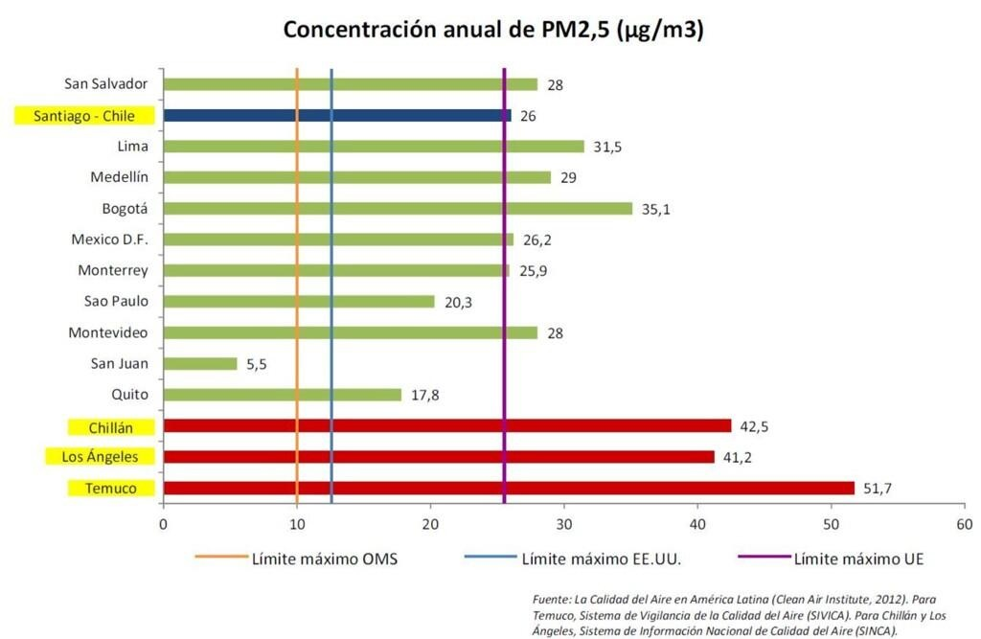
PM2.5 annual Concentration in Latin America [ug/m3]

Slide 9
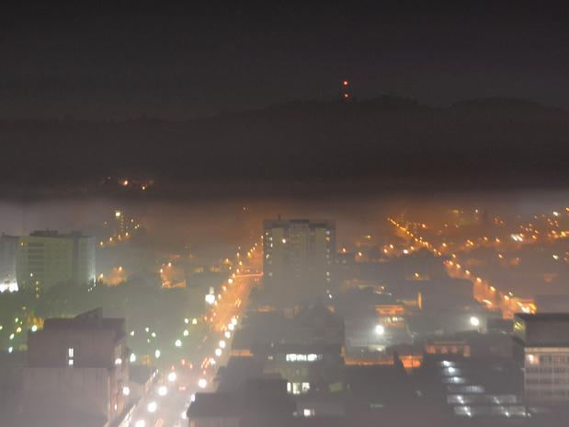

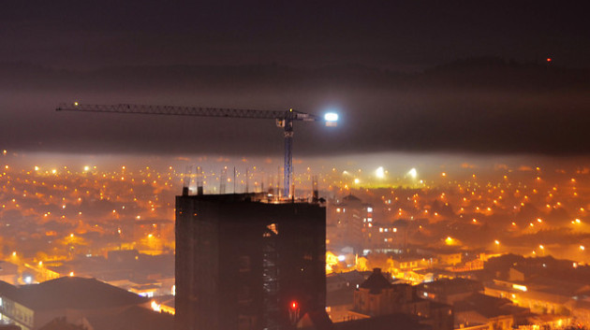
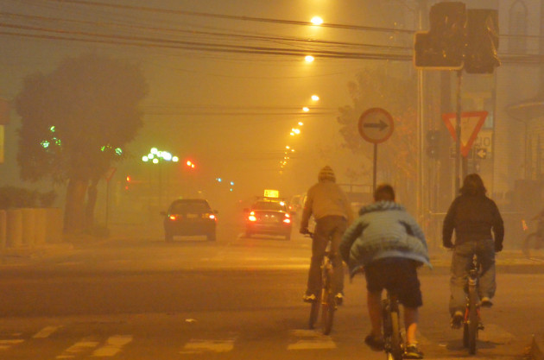
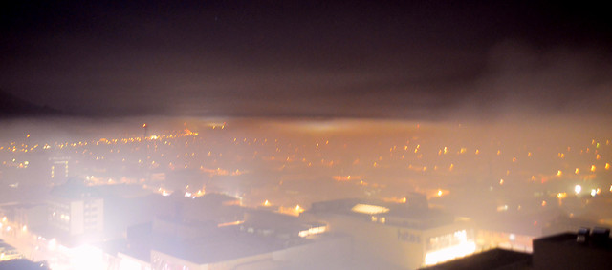
America Soccer Cup, Chile 2015

Slide 10

PM2.5 daily concentration at Temuco

Slide 11
PM2.5 Emission Inventory
Temuco, 2012
Several of them
use wood either

Slide 12
Air Quality
The Problem
High PM Emissions
Q
Poor Thermal Isolation
Q
Uninformed consumer
Incomplete combustion
Poor technology
Wet Wood

Slide 13
Fuelwood consumption per household m³ /year
Lenga, Ñirre
Ulmo, Luma, Tepú, Mañío
12.7 m³/year (2013)
South of Chile
Roble, Raulí, Aromo, Eucaliptus
8.9 m³/year (2009)
Hualle, Roble, Eucaliptus
Eucaliptus y frutales
M3/year

Slide 14
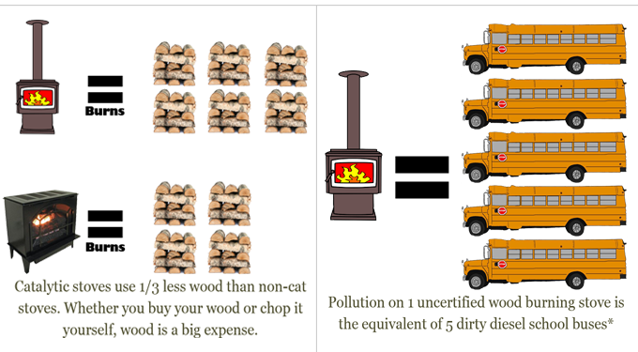

Slide 15
MP Composition
PAHs Properties
Mutagenic and carcinogenic species
WHO Recommendation: maximum BaP limit (annual average) in PM10: 1 ng m⁻³
Benzo(a)pyrene
EPA (1984). Health effects assessment for polycylic aromatic hydrocarbons (PAHs). U.S. Environmental Protection Agency, Cincinnati, Ohio, EPA 540/1-86-013.
WHO (2000). Air Quality Guidelines for Europe, 2nd Ed. WHO Regional Office for Europe, Copenhagen, Publication Nº 91.
EU (2005). Directiva 2004/107/EC del Parlamento Europeo y del Consejo, del 15 de Diciembre de 2004, relativa al arsénico, cadmio, mercurio, níquel e hidrocarburos aromático policíclicos en el aire ambiente. Diario Oficial de la Unión Europea, L 23, p. 3 (26-1-2005)

Slide 16
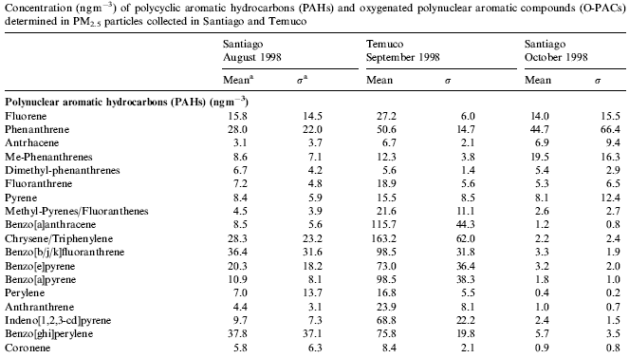
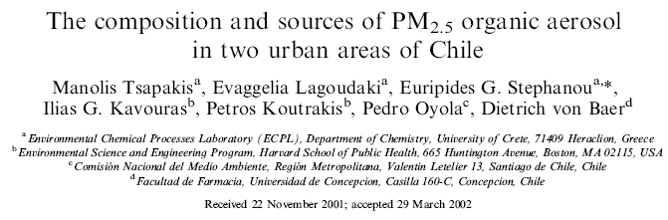

Slide 17
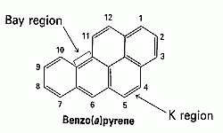
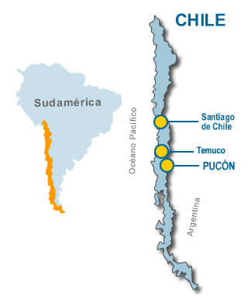

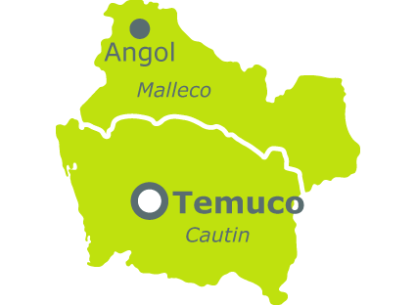

FONDECYT Project 1120791, 2012-2015
PAHs Modeling on WRF/SMOKE/CMAQ, Benzo(a)Pyrene
Cluster Newton
Cluster SANTA
PM_{2.5}
PUF

Slide 18
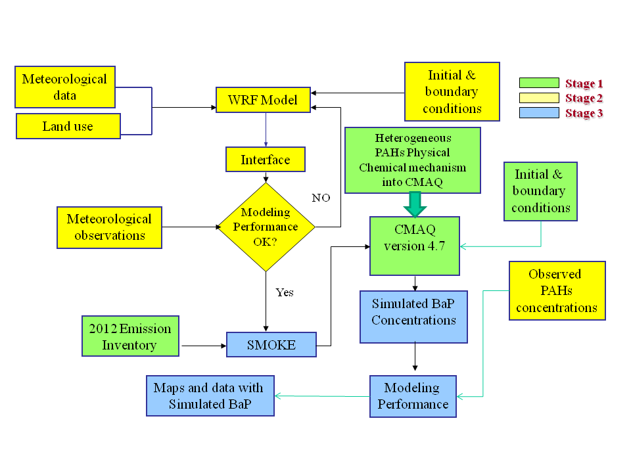

Slide 19
PM2.5 versus Benzo[a]pyrene
Temuco, Winter of 2013
EPA Method
GC/MS
WHO recommendation 1 ng/m³ annual in PM10

Slide 20
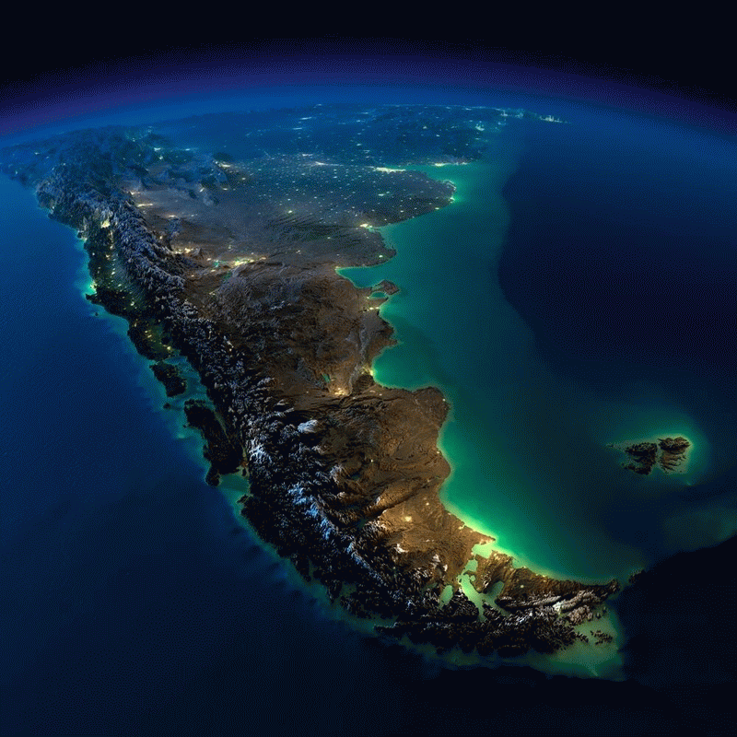

Slide 21
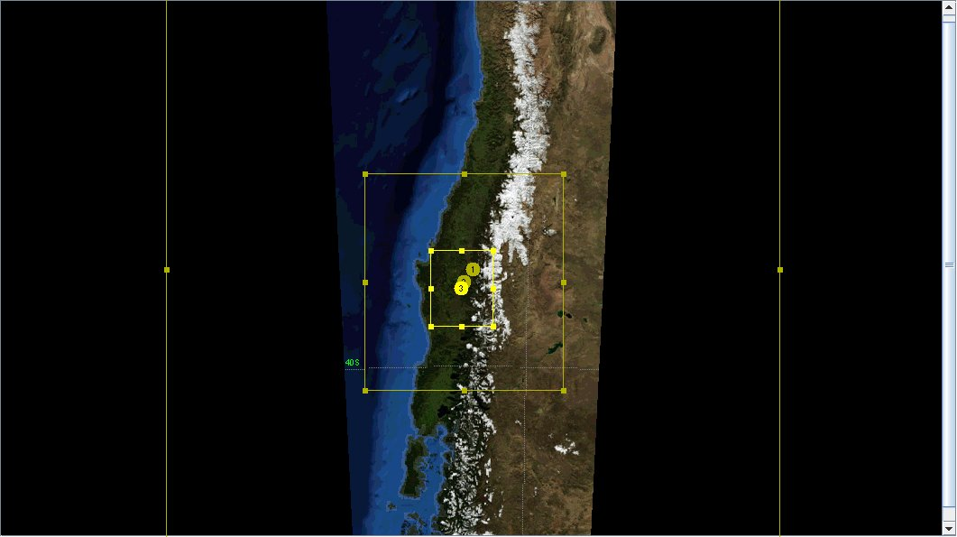
Modeling Nested Domain
18 ➔ 6 ➔ 2 km

Slide 22
Temuco city Location

Slide 23
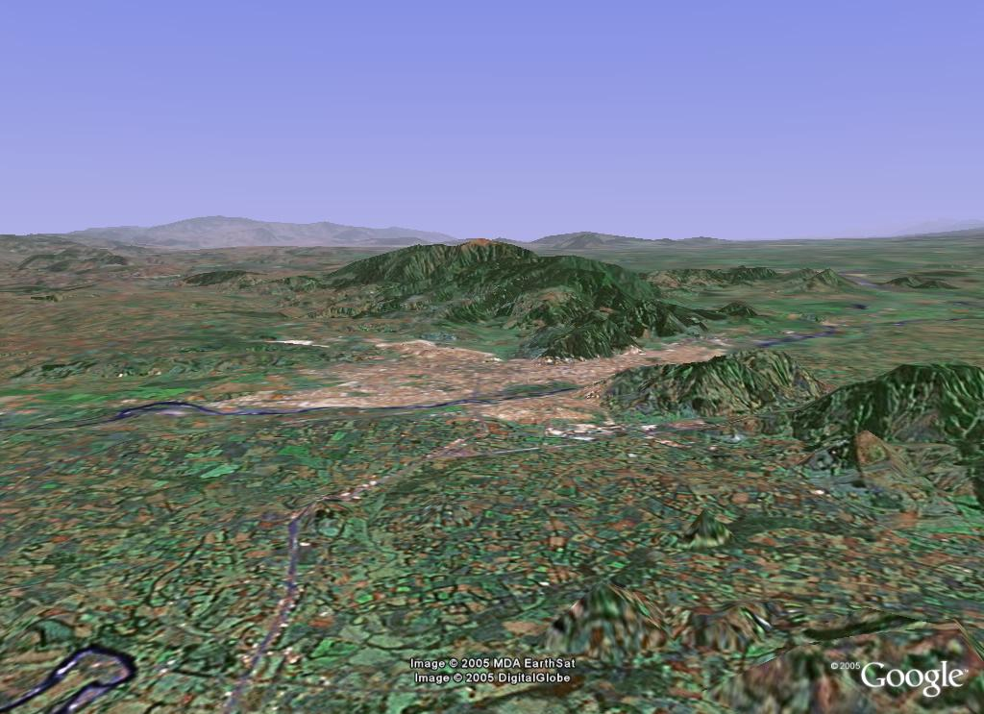
Temuco and Padre Las Casas

Slide 24
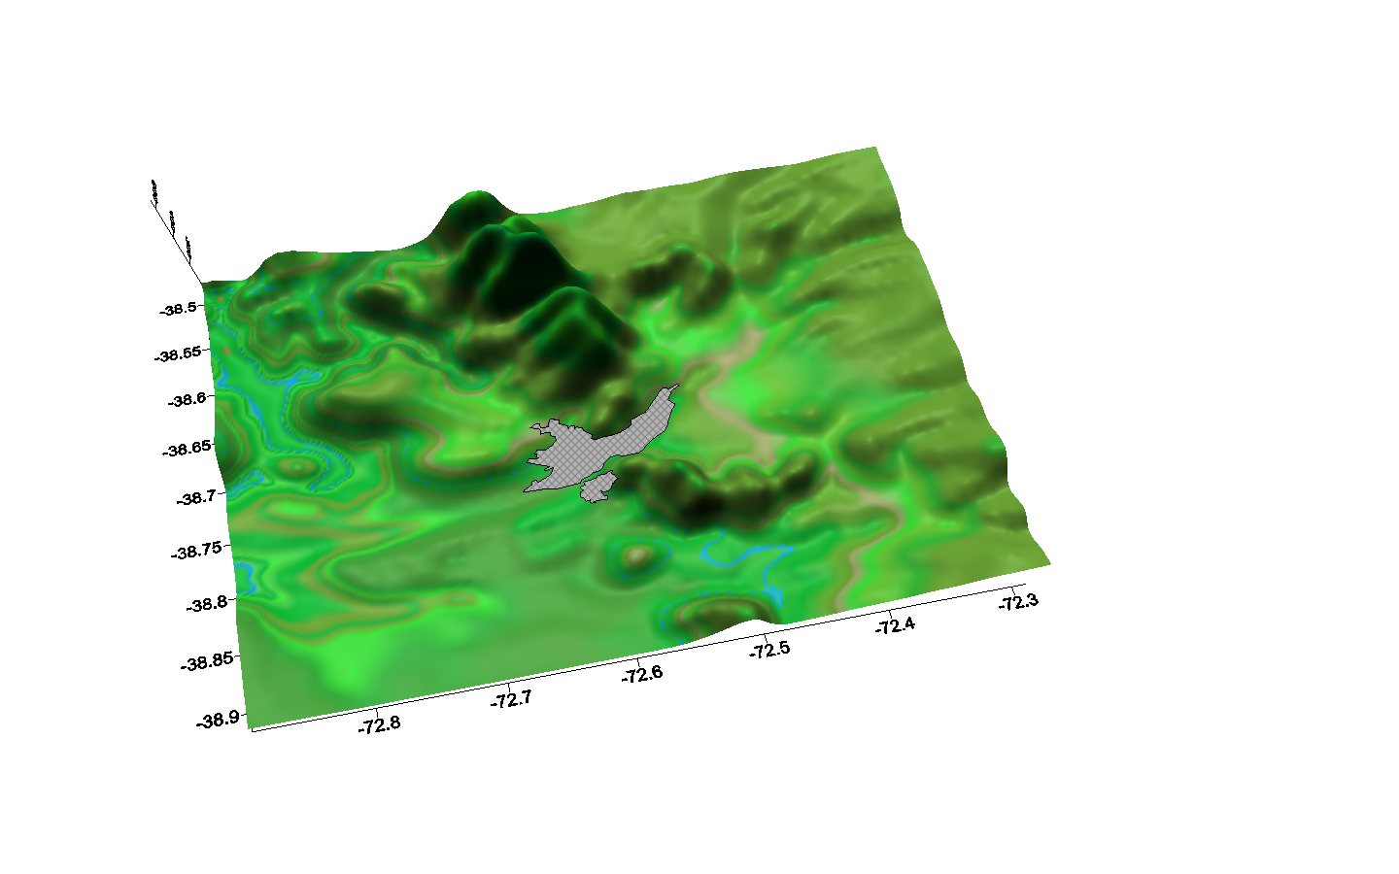
Temuco urban area, Chile
Located 800 Km south of Santiago – Chile (Latitude 38° 45’S; Longitude 72° 40’W; 100 m.a.s.l).
300,000 inhabitants.
90% of the population uses wood for heating in winter season.

Slide 25
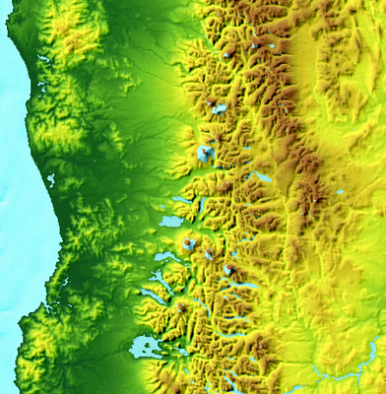
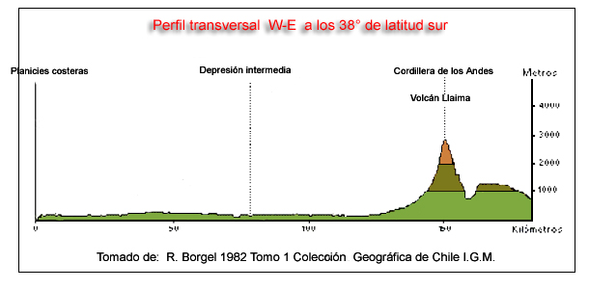

Slide 26
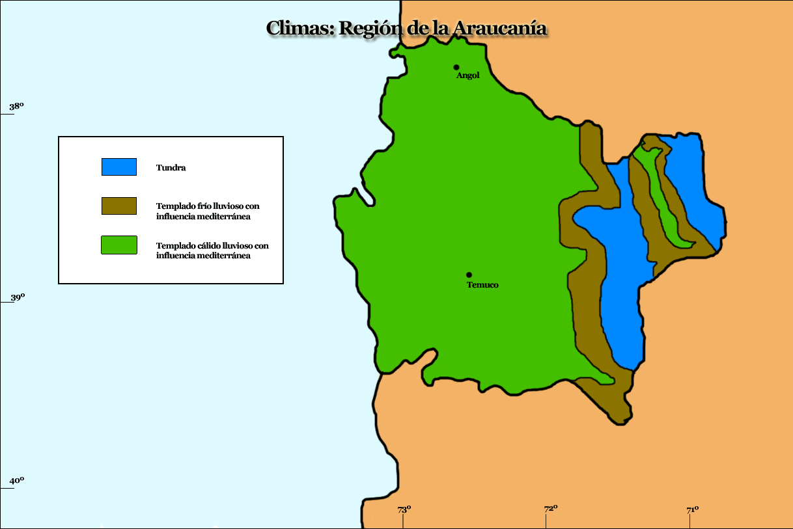
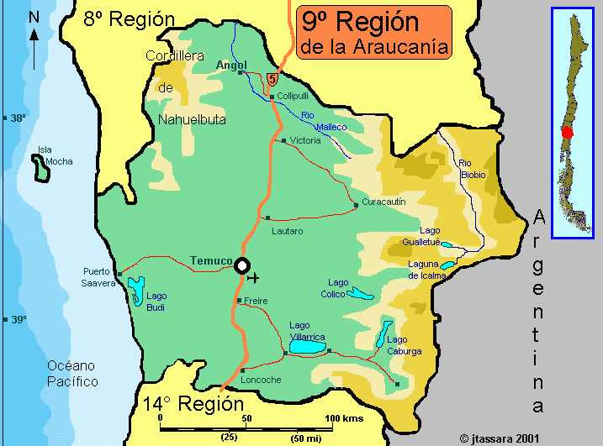
Temperate cold rainy with a Mediterranean influence
Temperate warm rainy with a Mediterranean influence

Slide 27
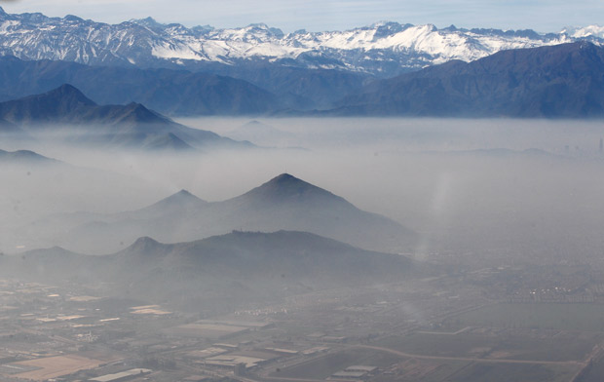
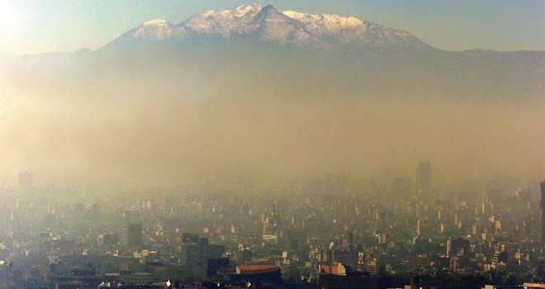
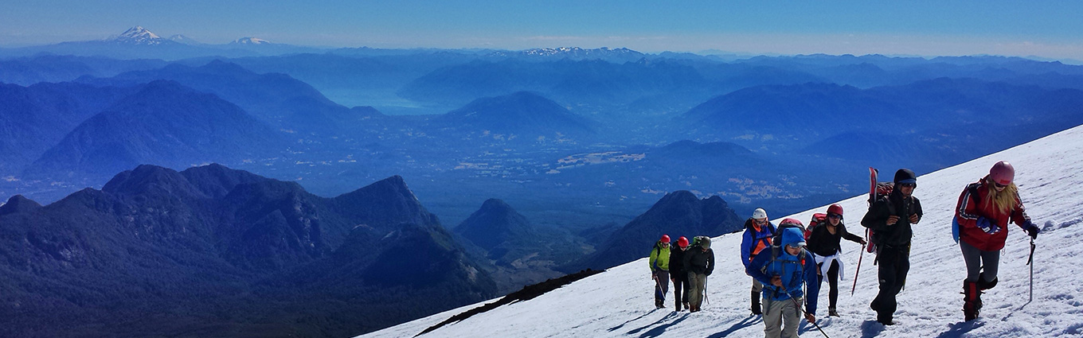

Slide 28
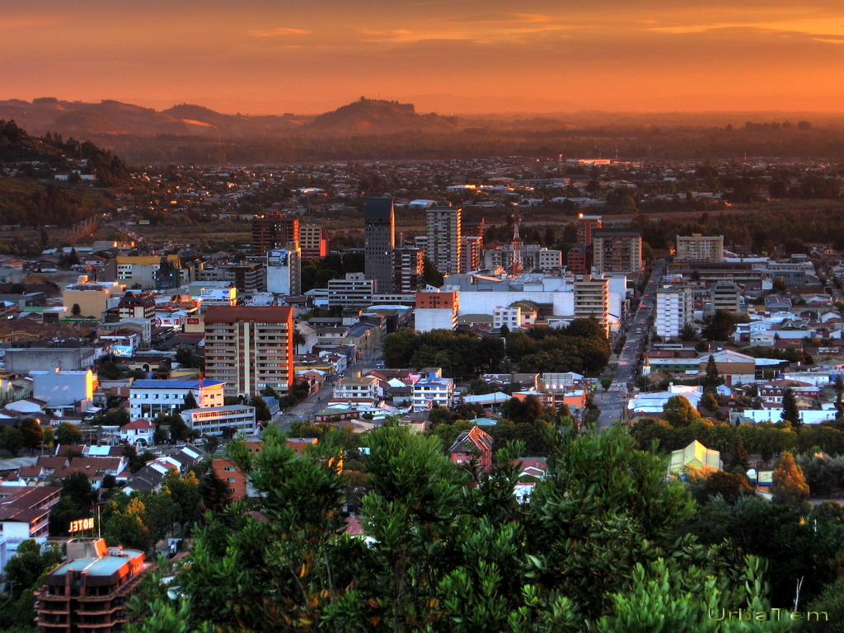

Slide 29
Experimental Design on WRF 3.4
06/11/2013 to 07/01/2013
Experiment | PBL Physics Option |  | Closure Type | Land Surface Model |  | Surface Layer Scheme
 | bl_pbl_physics | Scheme |  | sf_surface_physics | Model | sf_sfclay_physics | Scheme
1 | 7 | ACM2 | First-order closure | 7 | Pleim-Xu | 7 | Pleim-Xu
2 | 99 | MRF | Non-local-K mixing | 2 | Unified Noah LSM | 1 | Monin-Obukhov
3 | 2 | MYJ | TKE 1.5-order | 2 | Unified Noah LSM | 2 | Eta Similarity
4 | 5 | MYNN2 | TKE 1.5-order | 2 | Unified Noah LSM | 5 | MYNN
5 | 6 | MYNN3 | TKE 2nd-order | 2 | Unified Noah LSM | 5 | MYNN
6 | 4 | QNSE | TKE 1.5-order | 2 | Unified Noah LSM | 4 | QNSE
7 | 1 | YSU | Non-local-K mixing | 2 | Unified Noah LSM | 1 | Monin-Obukhov
mp_physics | 8 | Thomson
cu_physics | 1 | Kain-Fritsch
diff_6th_opt | 1 | Sixth order numerical diffusion
moist_adv_opt | 1 | Positive definite advection of moisture and scalars
ra_lw_physics | 1 | Rapid Radiative Transfer Model
ra_sw_physics | 1 | Dudhia
ITEM | D1 | D2 | D3
Geographic Projection | Lambert Conformal
Cell size (km) | 18 | 6 | 2
Number of Cells X-Y | 100-106 | 88-94 | 70-79
Number of Layers | 39 | 39 | 39
Terrain resolution | 10m | 5m | 30s
Land use data USGS
IC/BC: WRF-FNL (Wu et al., 2002)
Saide et al, 2011

Slide 30
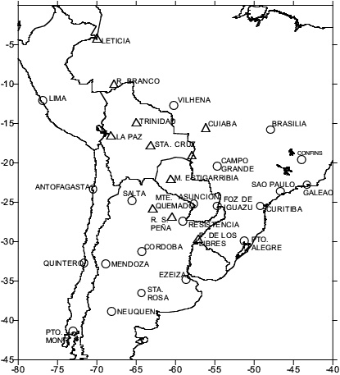
Atmospheric Sounding
More than 300 kms

Slide 31
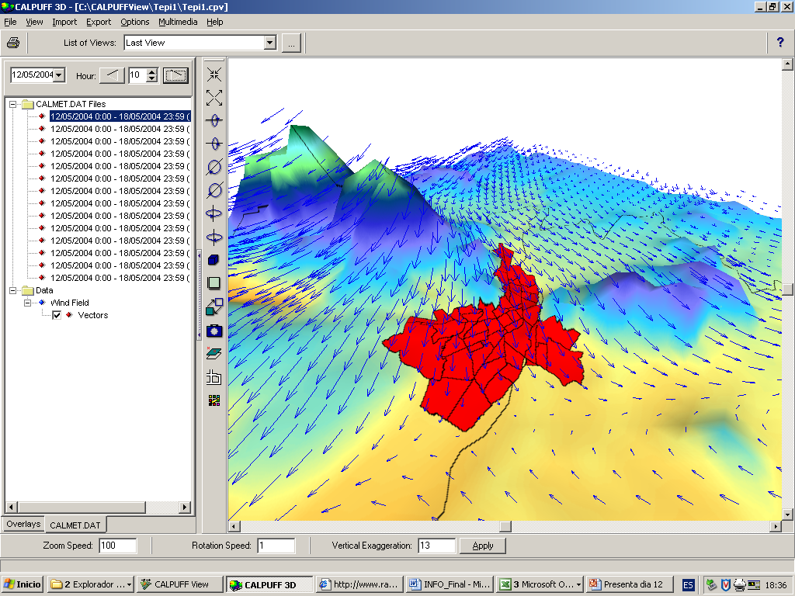

Slide 32
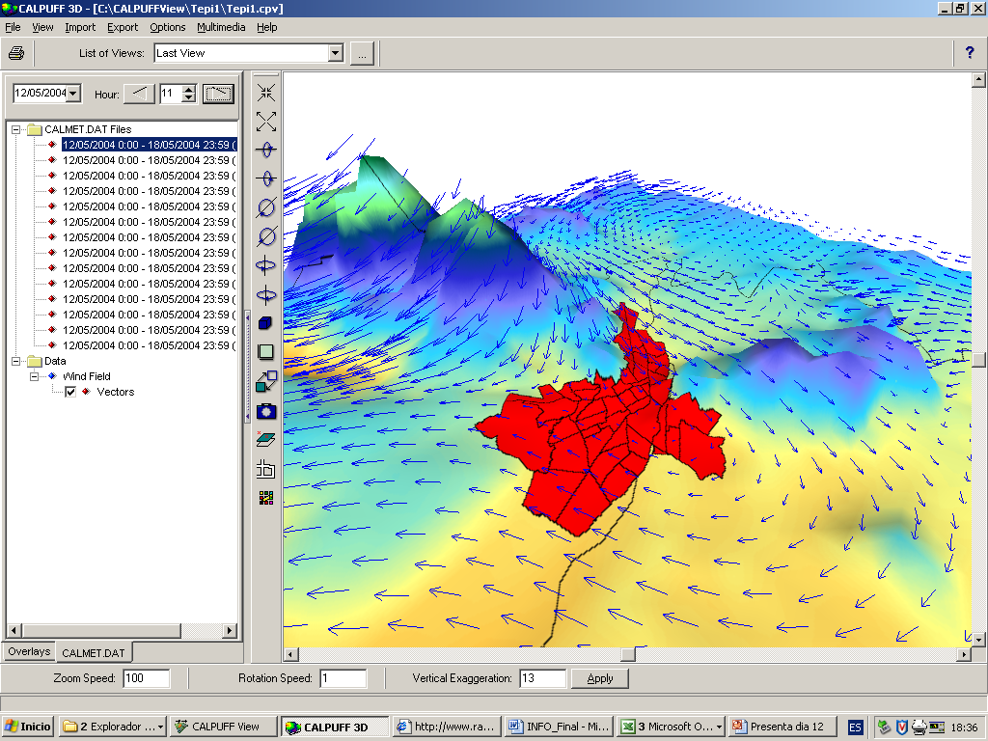

Slide 33
Temperature Performance

Slide 35
Residuals of the Temperature

Slide 36
Temperature Performance
Statistics | Exp 1 | Exp2 | Exp3 | Exp4 | Exp6 | Exp7
RSquare | 0.8237 | 0.7777 | 0.83493 | 0.79279 | 0.82113 | 0.77762
RSquare Adj | 0.8231 | 0.7769 | 0.83435 | 0.79205 | 0.82050 | 0.77683
Root Mean Square Error | 1.2123 | 1.3613 | 1.17303 | 1.31427 | 1.22108 | 1.36152
Error | 414.46 | 522.60 | 388.03 | 487.10 | 420.47 | 522.76
Observations (or Sum Wgts) | 284 | 284 | 284 | 284 | 284 | 284

Slide 38
Wind Speed [m/s]

Slide 40
Residuals of the Wind Speed

Slide 41
Wind Speed Performance
Statistics | Exp1 | Exp2 | Exp3 | Exp4 | Exp6 | Exp7
RSquare | 0.5010 | 0.4887 | 0.5512 | 0.5100 | 0.5428 | 0.5461
RSquare Adj | 0.4993 | 0.4869 | 0.5496 | 0.5082 | 0.5412 | 0.5445
Root Mean Square Error | 0.7999 | 0.8097 | 0.7586 | 0.7927 | 0.7656 | 0.7629
Error | 180.430 | 184.900 | 162.294 | 177.191 | 165.312 | 164.116
Observations (or Sum Wgts) | 284 | 284 | 284 | 284 | 284 | 284

Slide 42
PBL [m]

Slide 43
WS versus PBL

Slide 44
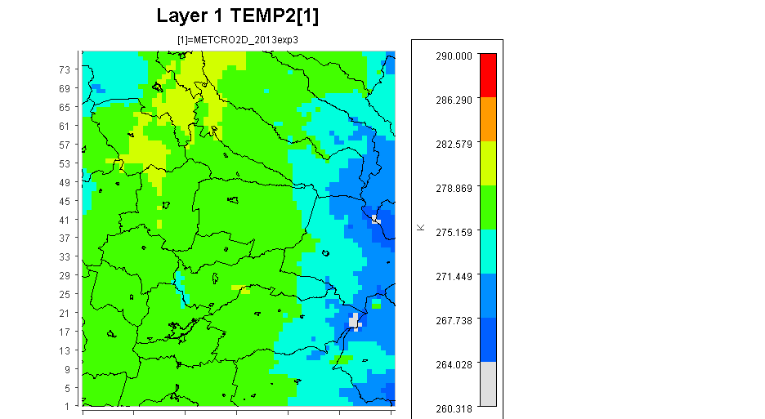
June 16th at 6 AM

Slide 45
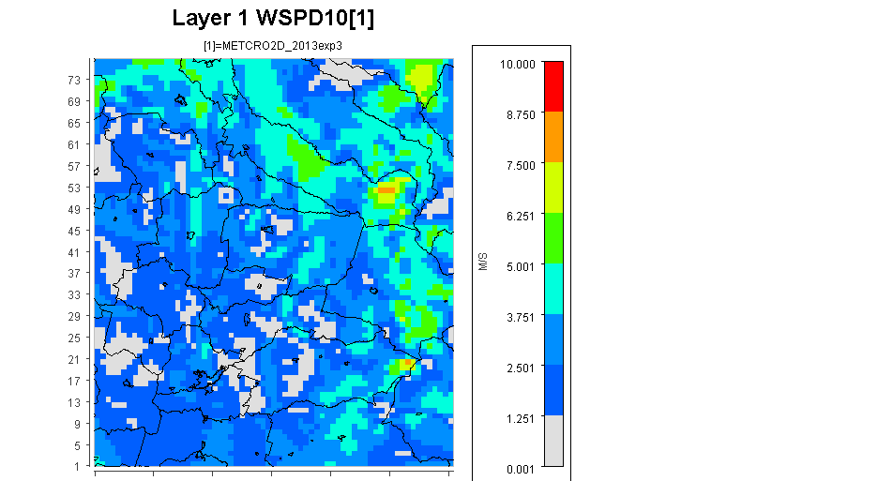
June 16th at 6 AM

Slide 46
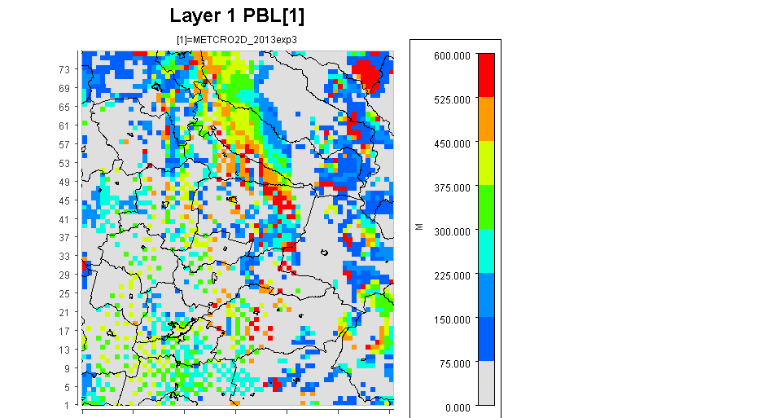
June 16th at 6 AM

Slide 47
Conclusions
Problems regarding wrong predictions could be related to different uncertainties in the model, such as the inability of the model to completely resolve the complex Andes and coast topography, and inaccuracy in meteorological initial and boundary conditions.
At least one sounding is required closer to the polluted urban areas in Chile.
The best experiment was the Exp3, which used MYJ as the PBL physics option (Janjic, 2002), Unified Noah LSM as land surface model, and Eta Similarity as the Surface Layer Scheme, however, the wind speed did not perform at all.

Slide 48
Acknowledgments
FONDECYT Project 1120791

Slide 49

Thanks!!!
Dr. L. Alonso Díaz Robles
alonso.diaz.r@usach.cl

Slide 50


Slide 51


Slide 52
ISI, Q1, índice de impacto últimos 5 años = 3.4
Número de Citas = 63

Slide 53
ISI, Q1, índice de impacto últimos 5 años = 2.8
Número de Citas = 20

Slide 54
ISI, Q1, índice de impacto últimos 5 años = 2.8

Slide 55
ISI, Q1, índice de impacto últimos 5 años = 6.4

