Slide 1
Estimating the impacts of emissions from single sources on secondary PM_{2.5} and ozone using an Eulerian photochemical model
James T. Kelly, Kirk R. Baker, Sergey Napelenok, and Shawn Roselle
U.S. Environmental Protection Agency
13th Annual Community Modeling & Analysis System Conference
29 October 2014, Chapel Hill, NC

Slide 2
Background
Modeled impacts of individual sources on secondary pollutants are useful for
NSR/PSD¹ and NEPA² permit applications
Emissions trading approaches between sources and/or pollutants
Informing control strategy development (SIPs, RIAs, etc.)
But modeling is challenging, wide range of length scales and chemical processes
Models used in permit applications often neglect nonlinear chemistry
Potential for applying Eulerian grid models with complete chemistry (e.g., CMAQ and CAMx)
¹New Source Review and Prevention of Significant Deterioration provisions of the Clean Air Act
²National Environmental Policy Act

Slide 3
Brute-Force Method
Approach
Identify impacts by subtracting results of simulation with source’s emissions removed from one with source’s emissions included
Advantages
Eulerian grid models are robust and well tested; have full chemistry
Background atmosphere is chemically realistic
Disadvantages
Instantaneous dilution of point emissions into grid cell
Inconsistent numerical errors between simulations could overshadow actual impacts for small sources

Slide 4
(Higher-Order) Decoupled Direct Method
Approach
Solve governing equations for pollutant sensitivity to source emissions
Extrapolate Taylor polynomial based on sensitivities to zero-out level
Advantages
No differencing of modeled fields
Track many sources in single run; useful for developing comprehensive response surface models
Full chemistry and background atmosphere is chemically realistic
Disadvantages
Instantaneous dilution of point emissions into grid cell
Errors from Taylor series truncation and in sensitivity calculations

Slide 5
Advanced Plume Treatment
Approach
Embed Lagrangian puff model w/ chemistry in Eulerian grid model
Treat chemical/physical evolution with puffs until ready to pass to grid
Use brute-force method to isolate impacts
Advantages
Grid cell dilution errors reduced; simulates multiple scales
Full chemistry and background atmosphere is chemically realistic
Disadvantages
Puffs disappear, need to difference fields to identify source impact
Uses met, terrain, etc. at grid scale to diffuse/transport at puff scale
Puff dumping could “shock” chemistry; use of puff leakage treatments

Slide 6
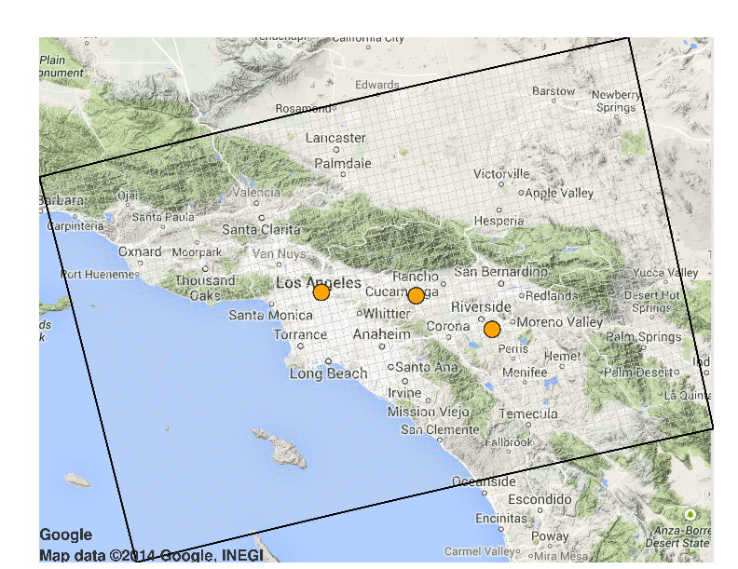
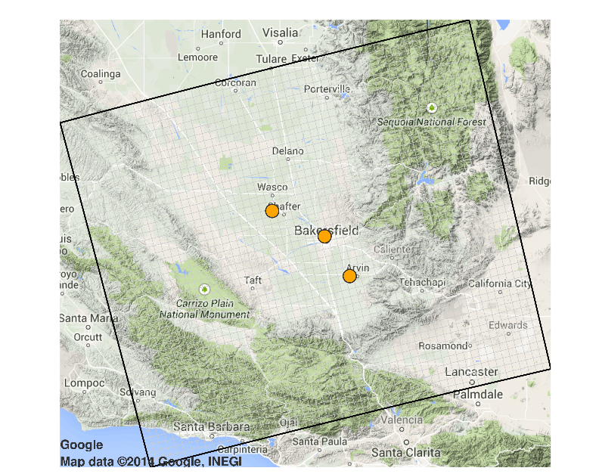
Current Study
Compare B-F, (H)DDM, and APT impacts
CMAQv5, 2007 platform, 4-km resolution
Six source locations
Individual emissions cases (e.g., NOx, VOC, SO₂)
Near-surface and aloft releases
100 and 500 tons yr⁻¹
Winter and summer cases
Parameter | n | Description
Models | 3 | CMAQ, CMAQ-DDM, & CMAQ-APT
Domains | 2 | South Coast & San Joaquin Valley
Periods | 2 | Winter & Summer (~10 days each)
Sources | 3 | SC: LA, Pomona, Riverside SJV: Shafter, Downtown Bakersfield, S. Bakersfield
Emission Species¹ | 8 | NOx, VOC, NH₃, Primary PM, SO₂, NOx-VOC, NOx-NH₃, NH₃-VOC
Emission Amounts | 2 | 100 and 500 t yr⁻¹
Release heights | 2 | Near-surface and aloft
¹Not all simulations completed for APT and DDM modeling

Slide 7
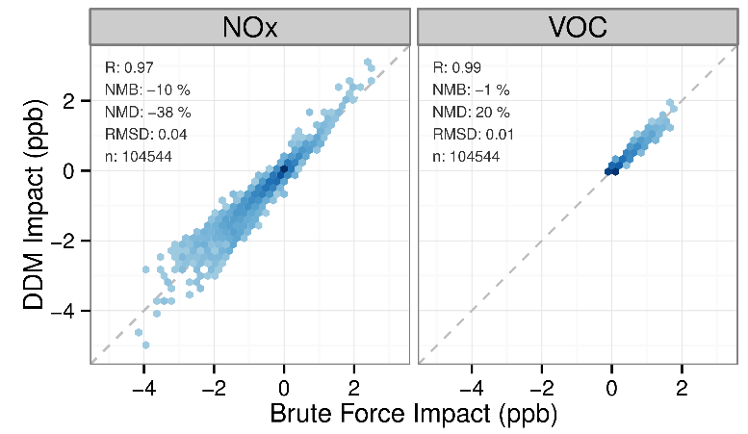
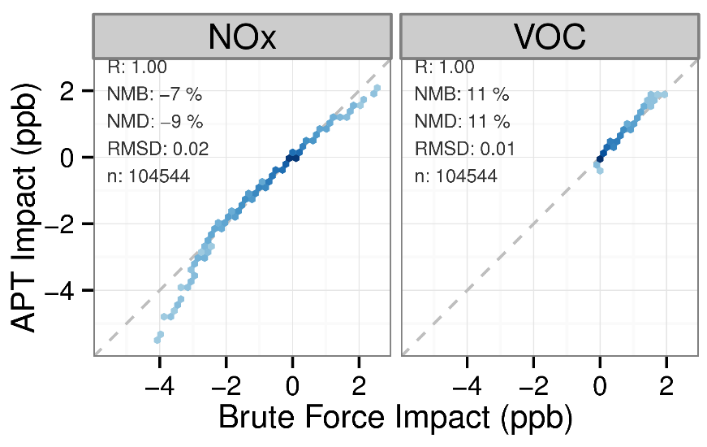
Hourly Impacts of NOx and VOC on Ozone
(H)DDM vs. B-F
APT vs. B-F
Largest impacts of NOx slightly greater for HDDM than B-F; VOC impacts relatively unbiased (left)
Largest impacts of NOx slightly less for APT than B-F; largest impacts of VOC slightly greater for APT than B-F (right)
Overall, impacts among methods highly correlated and consistent
Notes: --Only hours 10-17 PST for 1-10 July 2007 South Coast simulations shown
--APT vs. B-F comparison not matched in space and time
--Combined results shown for different emissions levels, stack characteristics, and source locations

Slide 8
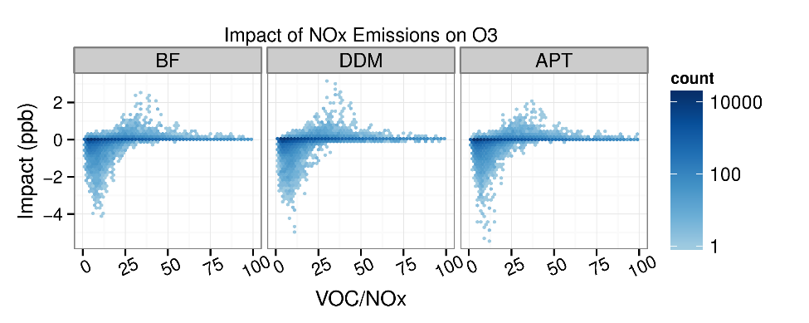
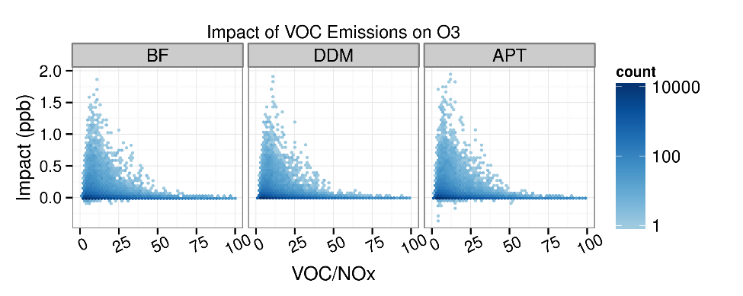
Hourly O₃ Impacts vs. Chemical Indicator
Realistic behavior for impacts with varying chemical indicator (i.e., not numerical noise)

Slide 9
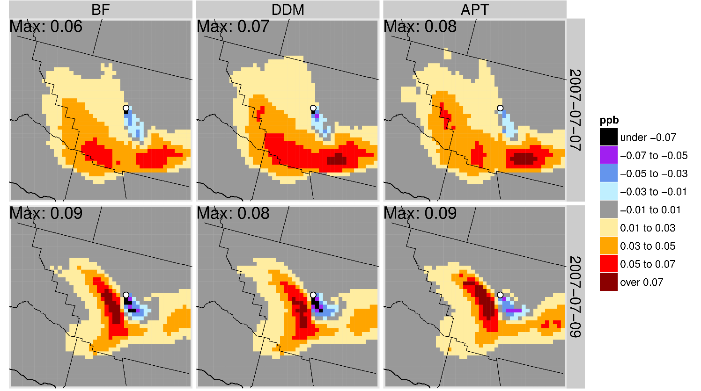
Examples of Spatial Impacts on MDA8 O₃
Aloft Bakersfield Source, 100 tons yr⁻¹ of NOx
Agreement in spatial patterns of near-source and downwind MDA8 O₃ impacts for BF, HDDM, and APT
Eulerian grid models (4 km) simulate multiple stages of plume chemistry

Slide 10
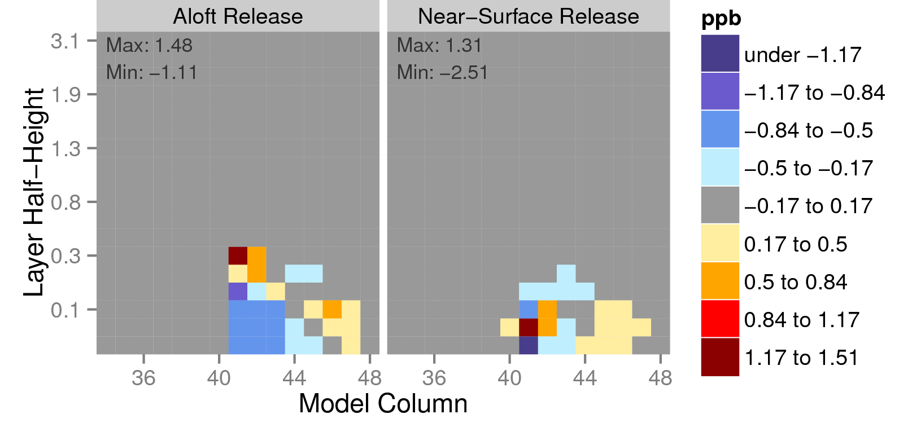
Difference in Avg Vertical Structure, APT - BF
NOy impacts (APT – BF) for Pomona NOx source
Greater impacts aloft for APT than B-F for aloft release
APT impacts peak in 2nd layer and B-F peaks in 1st layer for near-surface release
Differences in impacts originate in part from differences in initial plume placement

Slide 11
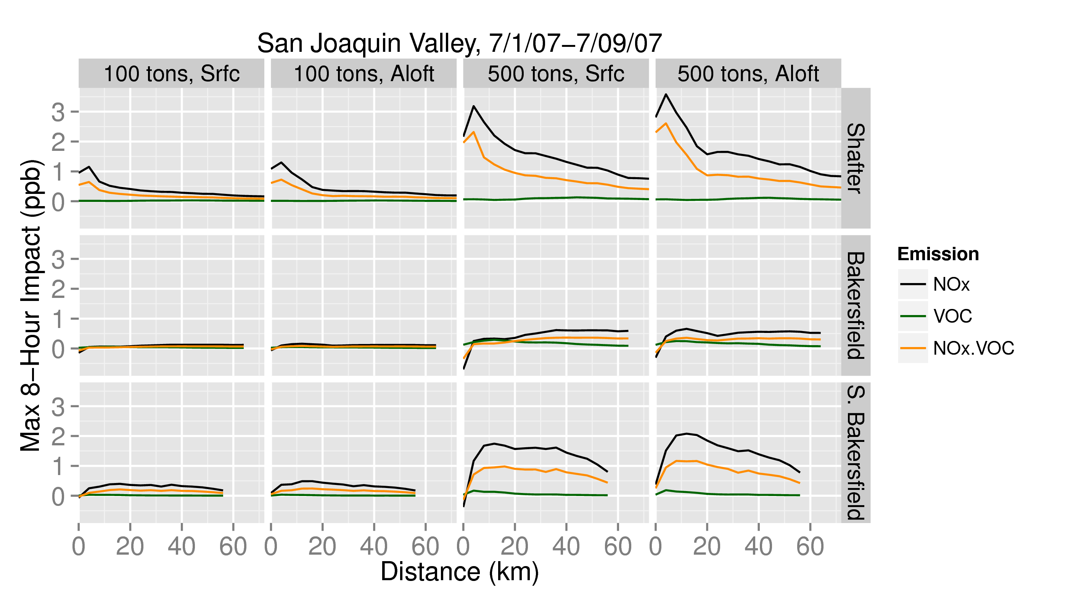
Max B-F Impacts on MDA8 O₃ vs Distance
Bakersfield source (VOC-limited) has small impacts compared with Shafter source (NOx-limited) for NOx emissions
Maximum impacts are often within 10-20 km of source
Eulerian grid B-F results are consistent with our understanding of ozone chemistry in SJV

Slide 12
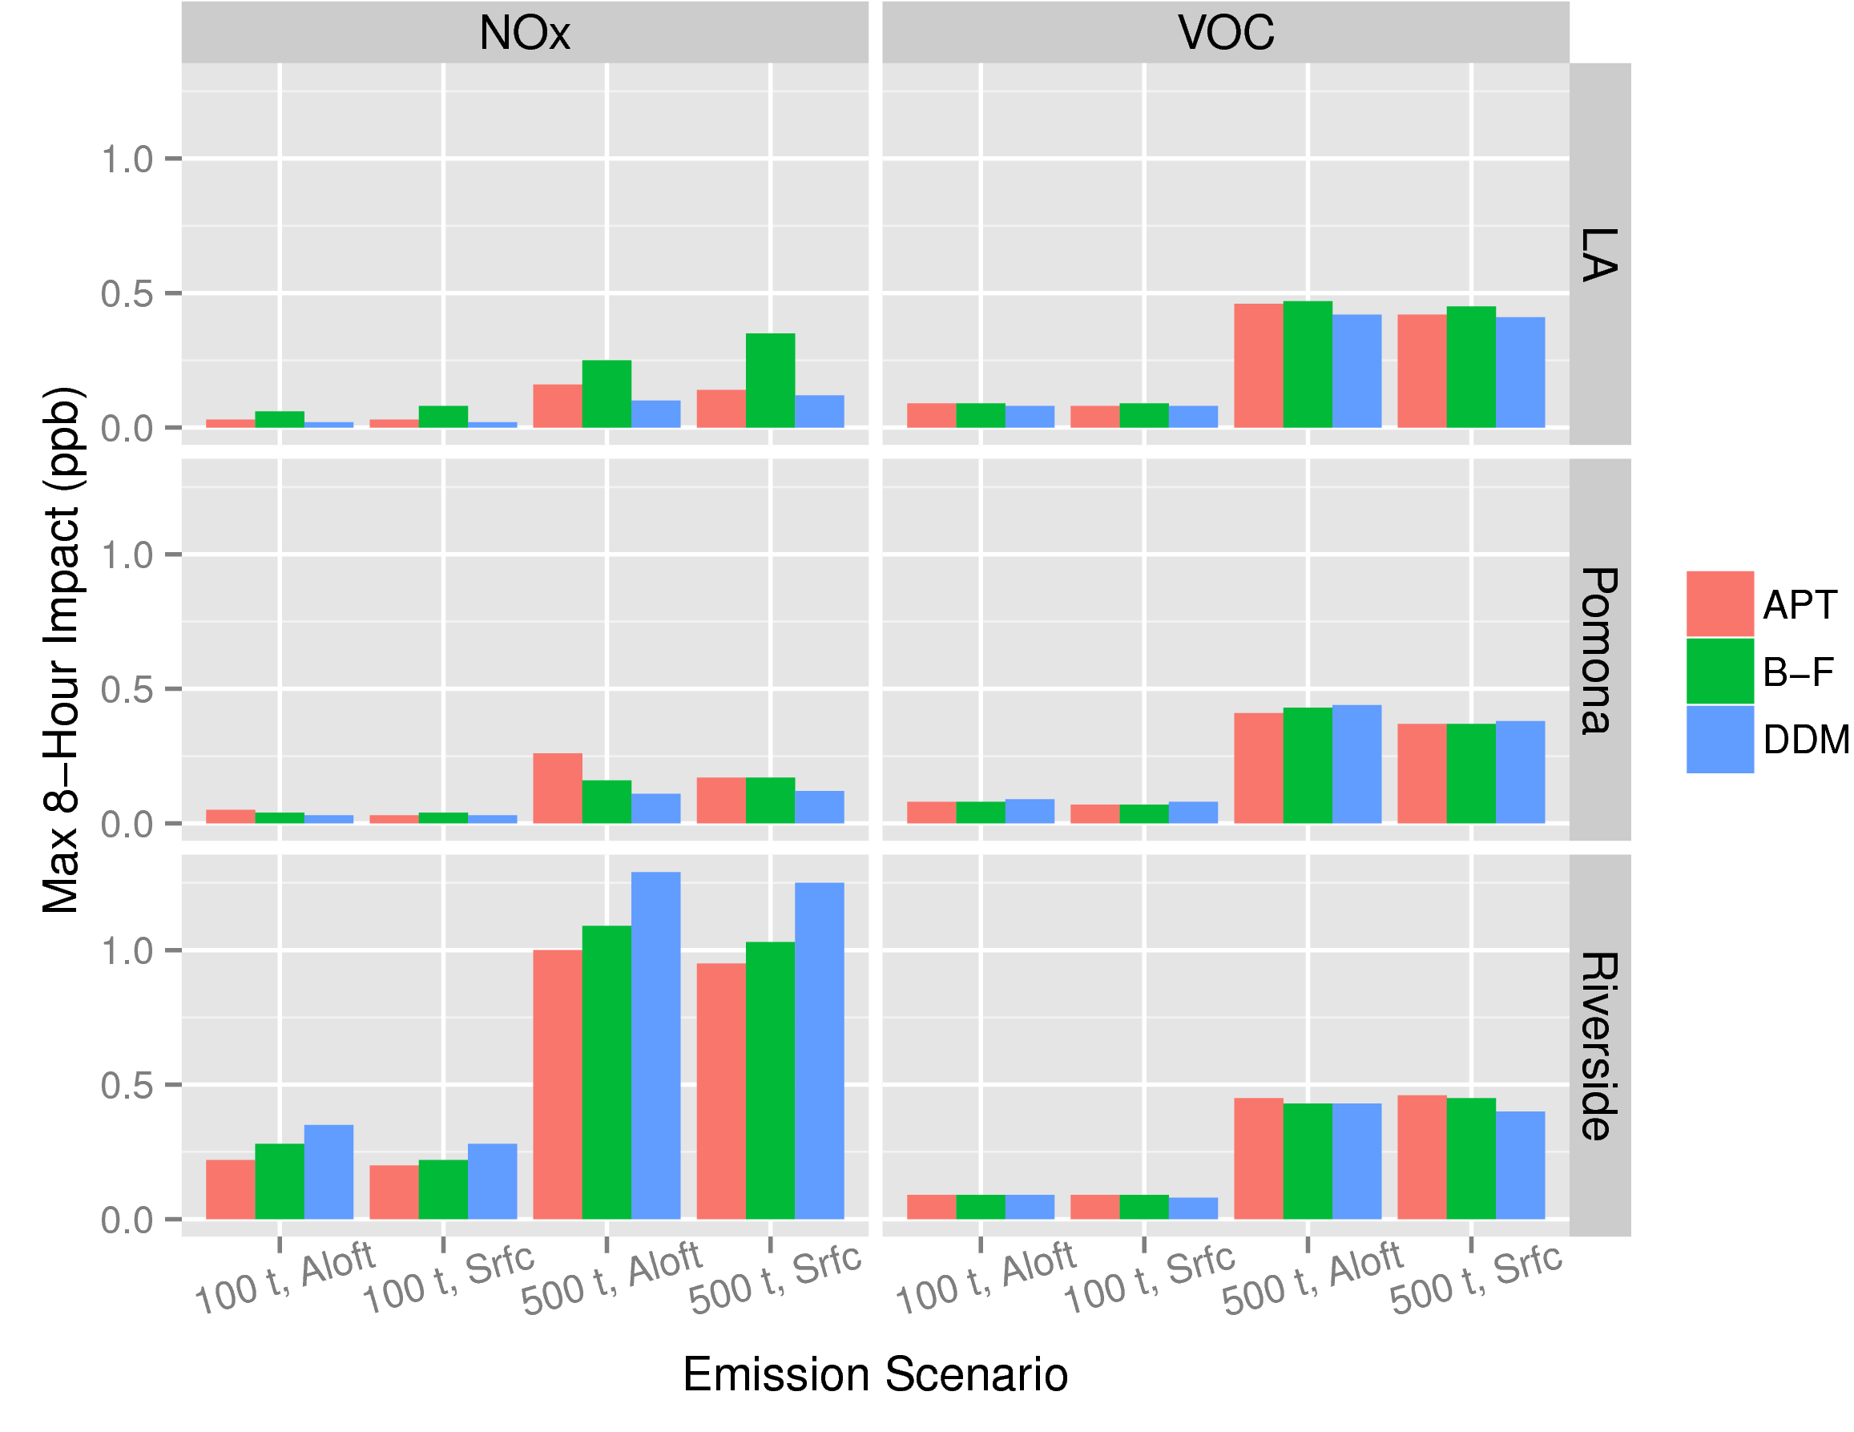
Max Impacts of NOx and VOC on MDA8 O₃
South Coast, 1-9 July 2007
VOC emissions have greater impacts than NOx for LA and Pomona sources
NOx emission have greater impacts than VOC for downwind Riverside source
Eulerian grid results are consistent with understanding of ozone chemistry in South Coast

Slide 13
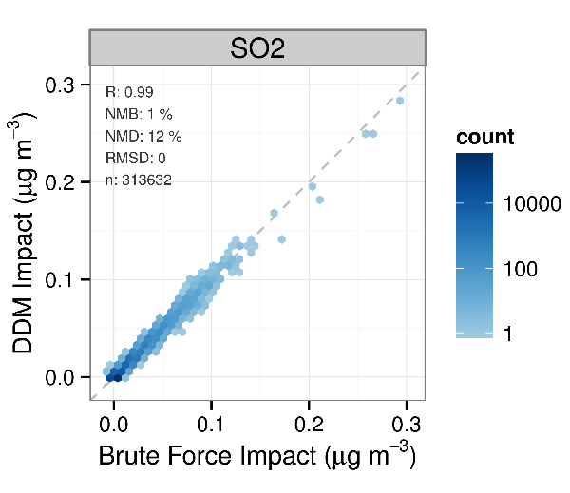
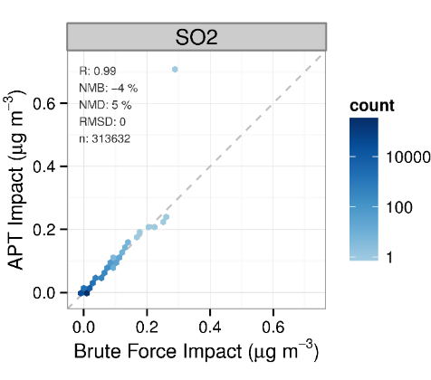
Hourly Impacts of SO₂ on PM_{2.5} Sulfate
DDM vs. B-F
APT vs. B-F
Agreement in hourly impacts of SO₂ on sulfate among methods
Notes: 1-10 July 2007 SJV cases combined across different emissions levels, stack characteristics, and source locations

Slide 14
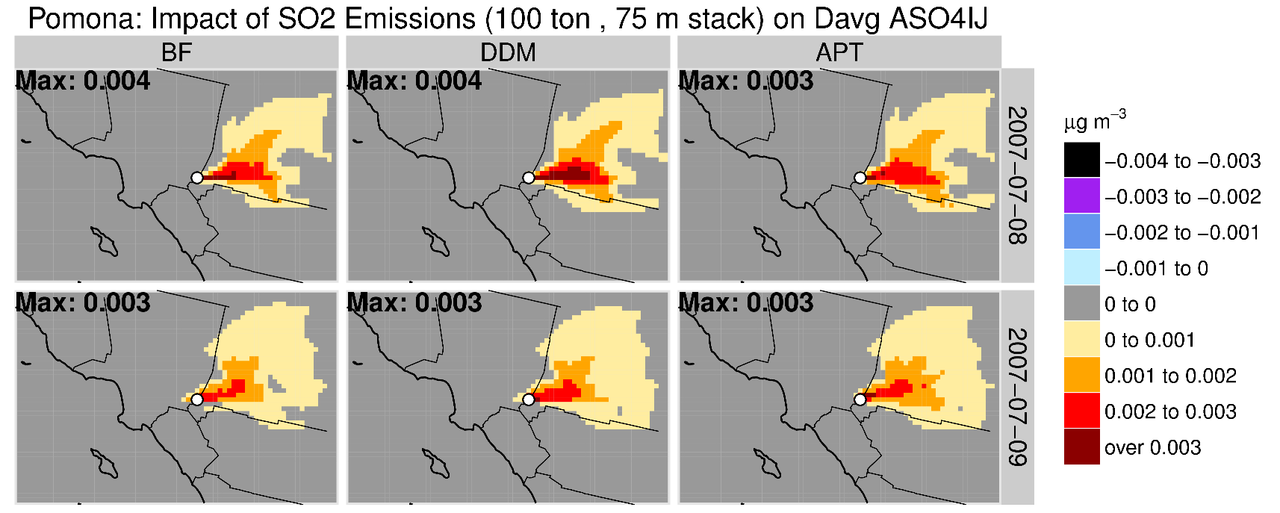
Examples of Spatial Impacts on 24-hr Sulfate
Aloft Pomona Source, 100 tons yr⁻¹ of SO₂
Agreement in spatial patterns of sulfate impacts for BF, HDDM, and APT

Slide 15
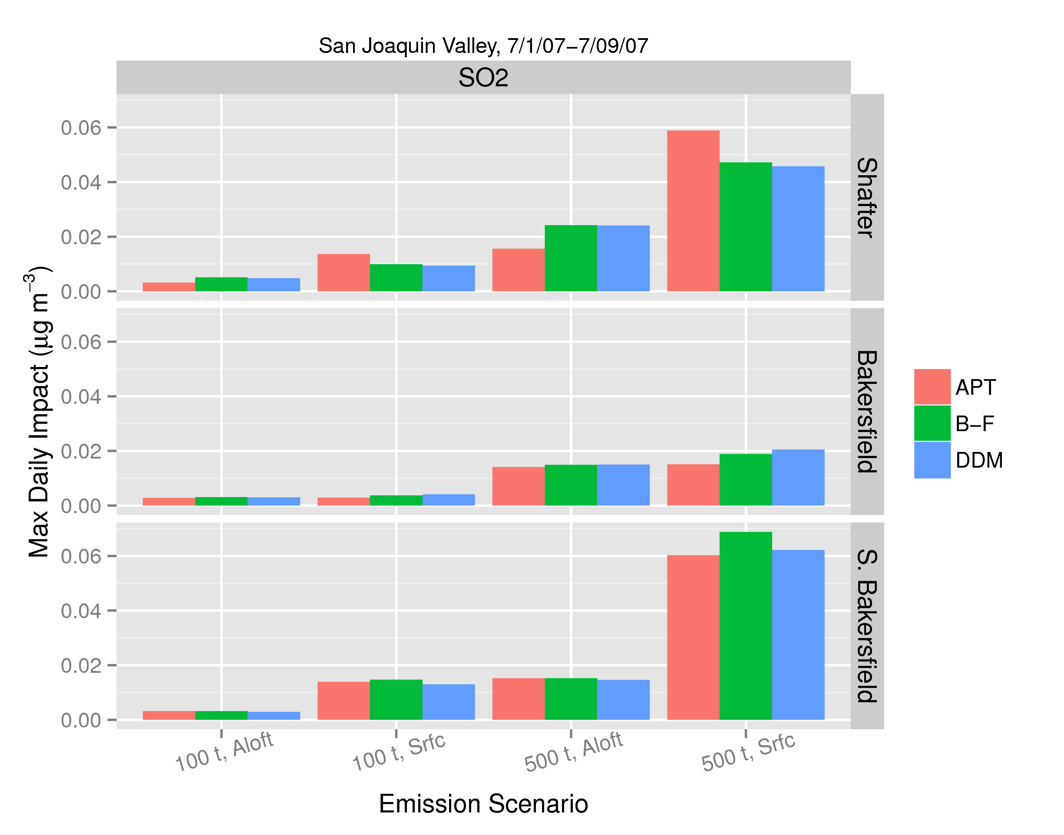
Max Impacts on 24-hr PM_{2.5} Sulfate
SJV Cases, 1-9 July 2007
Lowest impacts for downtown Bakersfield source (low OH)
Largest impacts for near-surface emissions outside of urban core
Sulfate impacts generally consistent among methods and with our understanding of SO₂ conversion to sulfate

Slide 16
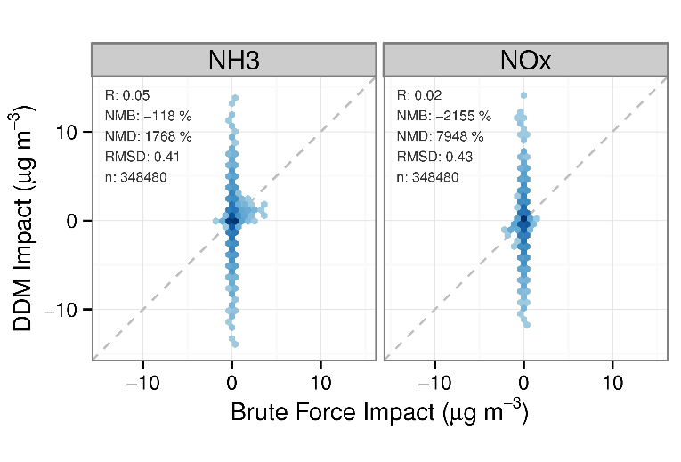
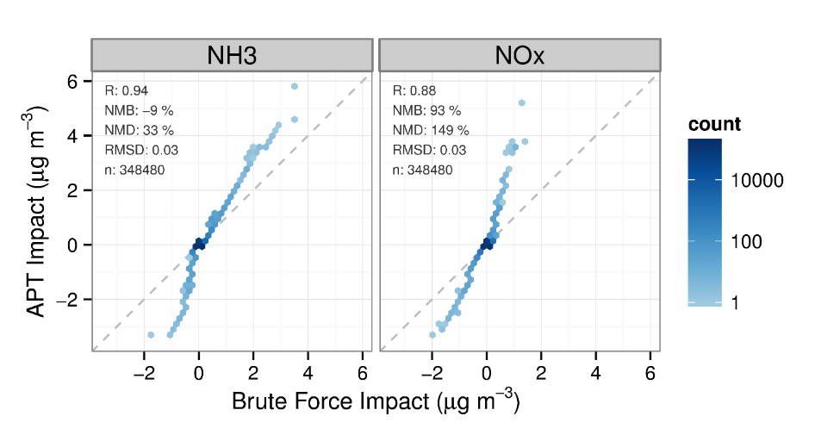
Hourly Impacts on PM_{2.5} Nitrate
DDM vs. B-F
APT vs. B-F
Numerical errors may influence DDM sensitivities for nitrate under our conditions (left)
Distribution tails differ for B-F and APT nitrate impacts (right)
Notes: --17-27 January 2007 SJV cases at different emissions levels, stack characteristics, and source locations
-- (H)DDM for nitrate works well in other modeling applications (i.e., 12-km CONUS).

Slide 17
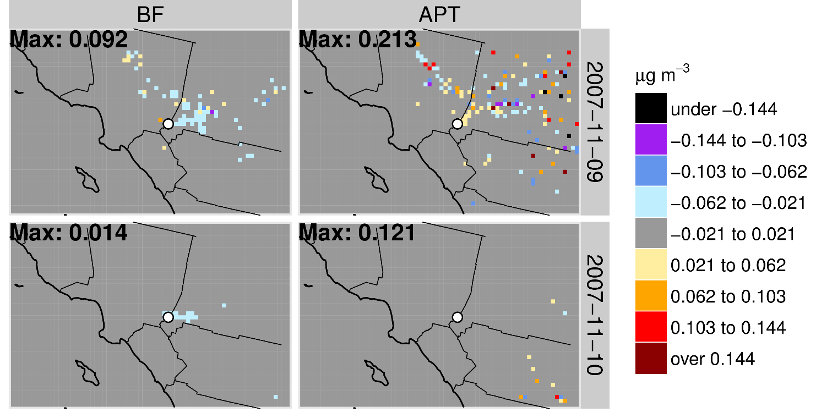
Examples of Spatial Impacts on 24-hr PM_{2.5} Nitrate
Aloft Pomona Source, 100 tons yr⁻¹ of NOx
Eulerian grid B-F results indicate nitrate reductions near-source with possible production downwind (upper left)
Possible differencing errors leading to higher APT impacts

Slide 18
Conclusions
Generally similar impacts among methods for emissions of NOx and VOC on ozone and SO₂ on sulfate
Little evidence of numerical differencing errors for ozone or sulfate impacts; results consistent with conceptual understanding of pollution processes
Maximum secondary impacts for ozone and sulfate (not shown) occur within ~20 km of source
Numerical errors significant for (H)DDM-based nitrate impacts¹; smaller errors for APT and possibly B-F
Overall, Eulerian grid photochemical models appear to be viable tools for use in single-source secondary impact assessments
¹(H)DDM for nitrate works well for nitrate in other modeling applications (i.e., 12-km CONUS). Numerical errors could be specific to current study conditions

