Slide 1
National Air Quality Forecast Capability: Recent Progress and Plans
Ivanka Stajner¹, Jeff McQueen^{2,} Pius Lee³, Roland Draxler³, Jianping Huang^{2,4}, Perry Shafran^{2,4}, Daniel Tong^{3,5}, Li Pan^{3,5}, Phil Dickerson⁶, Sikchya Upadhayay^{1,7}
1 NOAA National Weather Service, Office of Science and Technology, Silver Spring, USA,
2 NOAA National Weather Service, National Centers for Environmental Prediction, College Park, USA,
3 NOAA Air Resource Laboratory, College Park, USA,
4 I.M. Systems Group, Inc., Rockville, USA,
5 Cooperative Institute for Climate and Satellites, University of Maryland, College Park, USA,
6 EPA
7 Syneren Technologies Corporation, Arlington, USA
with contributions from the entire NAQFC Implementation Team
Outline:
Background on NAQFC
Recent progress and updates
Ozone predictions
Smoke predictions
Dust predictions
Prototype PM2.5 predictions
Outreach and feedback
Summary and plans
CMAS Conference, Chapel Hill, NC October 28, 2014

Slide 2
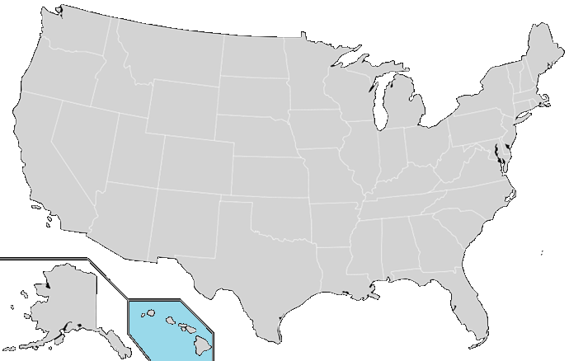
National Air Quality Forecast Capability Capabilities as of 10/2014
Improving the basis for air quality alerts
Providing air quality information for people at risk
Prediction Capabilities:
Operations:
Ozone nationwide
Smoke nationwide
Dust over CONUS
Experimental testing:
Ozone predictions
Developmental testing:
Components for particulate matter (PM) predictions
2004: ozone
2007: ozone and smoke
2012: dust
2005: ozone
2009: smoke
2010: ozone
2010: ozone and smoke

Slide 3
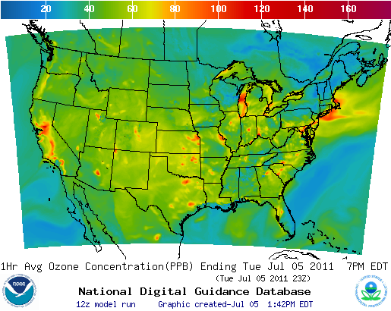
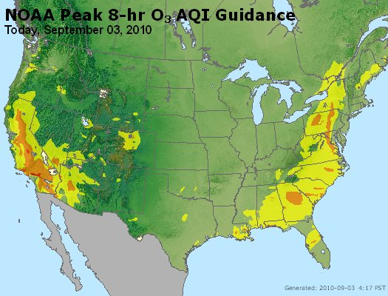
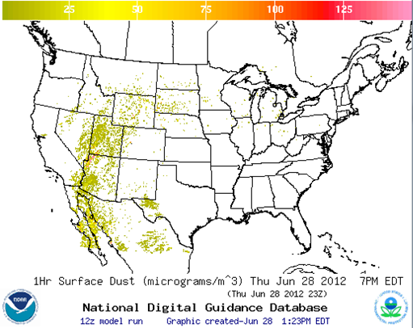
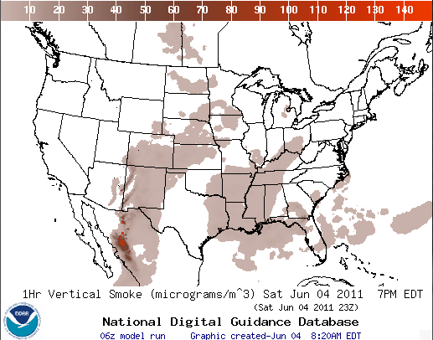
National Air Quality Forecast Capability End-to-End Operational Capability
Model: Linked numerical prediction system
Operationally integrated on NCEP’s supercomputer
NOAA NCEP mesoscale numerical weather prediction
NOAA/EPA community model for air quality: CMAQ
NOAA HYSPLIT model for smoke and dust prediction
Observational Input:
NWS weather observations; NESDIS fire locations; climatology of regions with dust emission potential
EPA emissions inventory
ozone
AIRNow
Gridded forecast guidance products
On NWS servers: airquality.weather.gov and ftp-servers (12km resolution, hourly
for 48 hours)
On EPA servers
Updated 2x daily
Verification basis, near-real time:
Ground-level AIRNow observations of surface ozone
Satellite observations of smoke and dust
Customer outreach/feedback
State & Local AQ forecasters coordinated with EPA
Public and Private Sector AQ constituents
dust
smoke

Slide 4
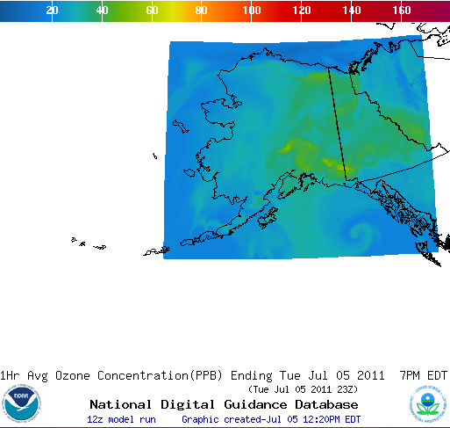
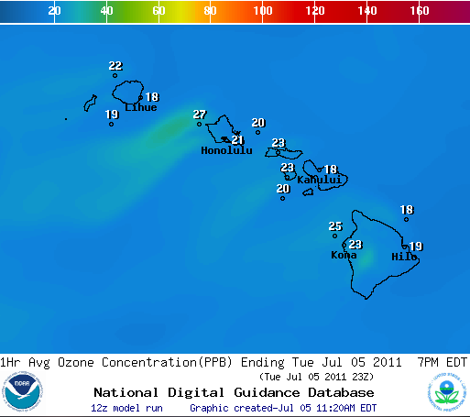
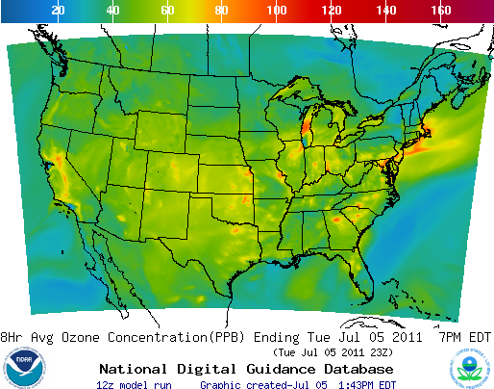
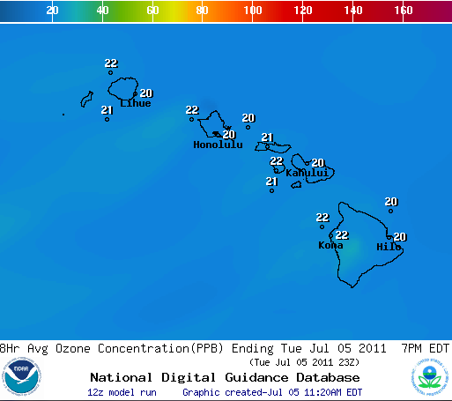
Ozone predictions
Operational predictions at http://airquality.weather.gov
over expanding domains since 2004
1-Hr Average Ozone
1-Hr Average Ozone
1-Hr Average Ozone
8-Hr Average Ozone
8-Hr Average Ozone
8-Hr Average Ozone
CONUS, wrt 75 ppb Threshold
Operational
Maintaining prediction accuracy as the warning threshold was lowered and emissions of pollutants are changing
Fraction correct of daily maximum of 8h average wrt 75 ppb threshold

Slide 5
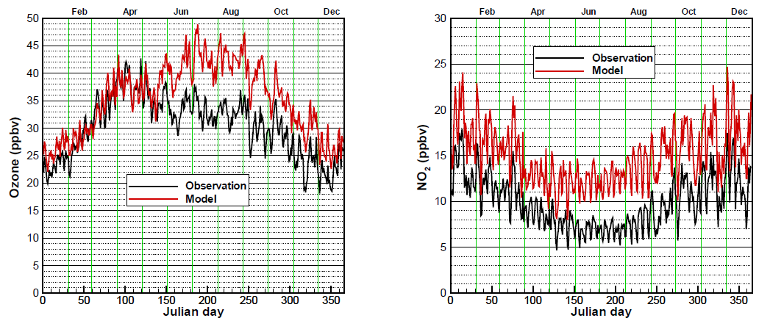
Evaluation of experimental CB05 NAQFC ozone predictions for 2010, prior to system and emissions update
T. Chai et al., Geosci. Model Dev., 2013 (http://www.geosci-model-dev.net/6/1831/2013/gmd-6-1831-2013.html)
Ozone overestimation in August is larger in rural areas, during morning hours, and in the southeast US
NO2 overestimation in August is larger at night time
Ozone biases higher on weekends, but NO2 biases higher on weekdays

Slide 6
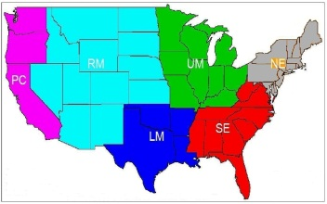
Reduction in NOx emissions implemented in 2012
NO_{x} emission reduction by day of week and holiday for July compared to those used in 2011
%
NO_{x} emission reduction by region for July compared to those used in 2011
%

Slide 7
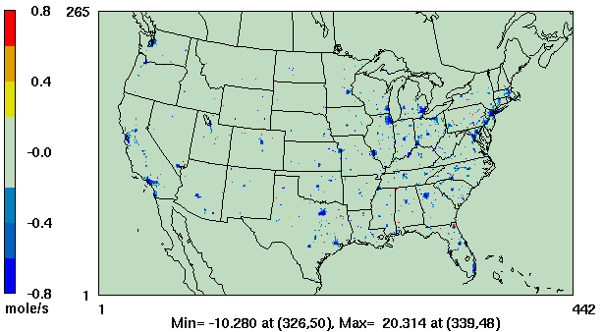
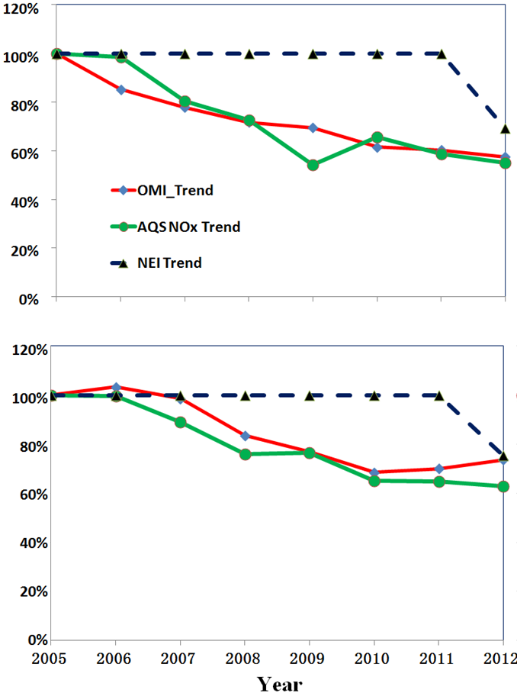
NOx Emissions
Atlanta
Comparison to 2005 values
OMI NO₂
ASQ NO_{X}
NAQFC NO_{X} Emissions
Philadelphia
Atlanta
Philadelphia
Comparison to 2005 values
Relying on projections rather than inventories for mobile sources
Comparison of projected emission with surface and satellite observations
(Daniel Tong presentation on Wednesday at 1pm)
OMI = Ozone monitoring Instrument on NASA’s Aura Satellite
AQS = Air Quality System

Slide 8
Summary of Emission Data Sources for 2014
Area Sources
US EPA Projected 2012 Nonroad + 2005 NEIs for other sectors;
Canada 2006 Emission Inventory;
Mexico 1996 EI for six border states;
Mobile Sources (onroad)
2005 NEI with Cross-State Air Pollution Rule (CSAPR) projection for US sources
Canada 2006 Emission Inventory;
Point Sources (EGUs and non-EGUs)
NEI 2005 for base year;
Updated with 2012 Continuous Emission Monitoring (CEM) data for EGUs;
Projected into forecast year using DOE Annual Energy Outlook (2014) factors;
Natural Sources
Terrestrial biogenic emission: BEIS model v3.14
Sea-salt emission: CMAQ online Sea-salt emission model;

Slide 9
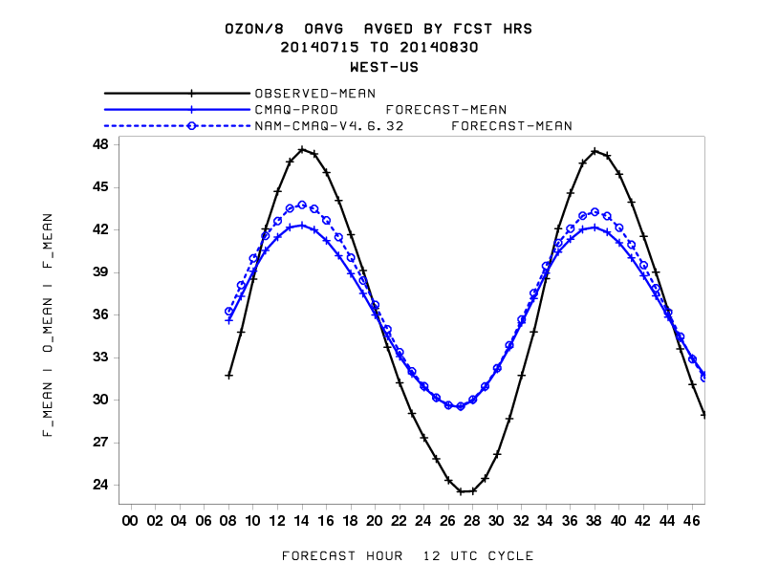
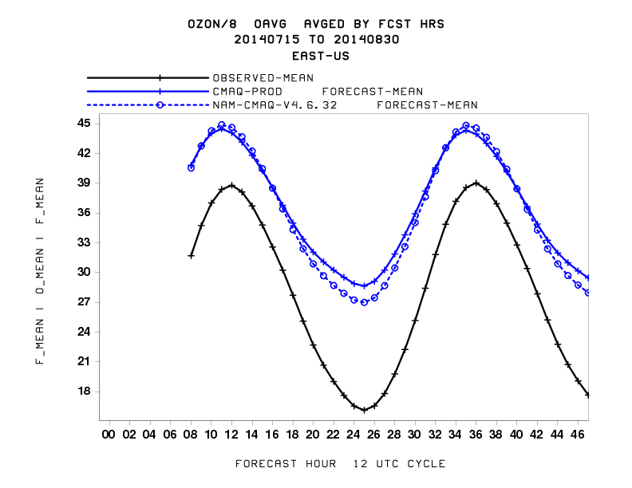
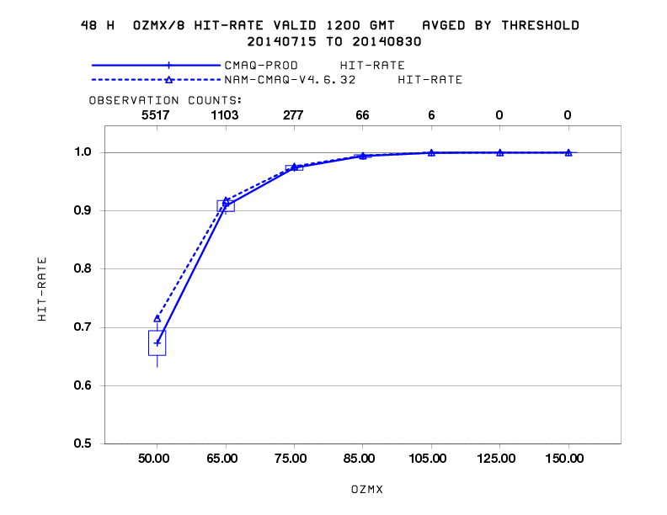
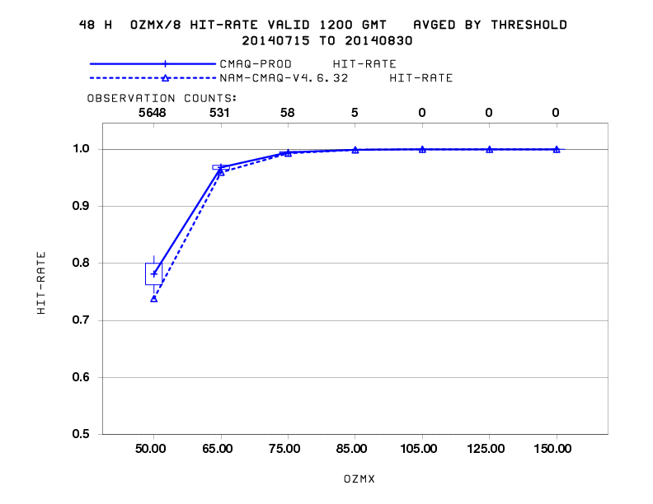
Testing of ozone prediction updates Evaluation of daily maximum of 8h average ozone
Model updates:
CB05 chemical mechanism
Lateral boundary conditions
Dry deposition
Minimum PBL height
Faster removal of organic nitrate
Western US
Eastern US
Mean
Performance:
Increased (better) diurnal variability
Increased (better) peak ozone in the Western US
Decreased (better) night-time minimum in the Eastern US
Slightly increased (worse) peak ozone in the Eastern US
Small changes in fraction correct for 75ppb threshold
Fraction correct wrt 75ppb threshold

Slide 10
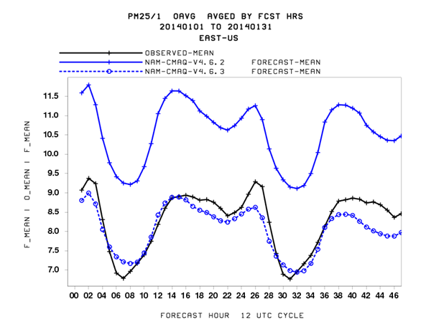
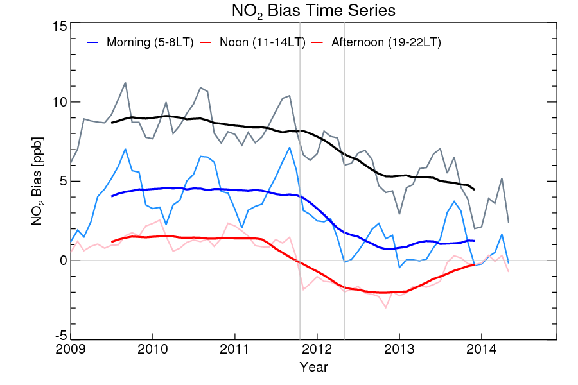
Impacts of model and emission updates on other species
PM2.5 mean and the diurnal cycle over Eastern US in January 2014 in the updated model agree well with observations (Jianping Huang poster on Monday)
NO2 bias by time of the day was reduced following
experimental model update in 2011 and emission update in 2012 (Hyun Cheol Kim presentation on Wednesday at 10:40 am)

Slide 11
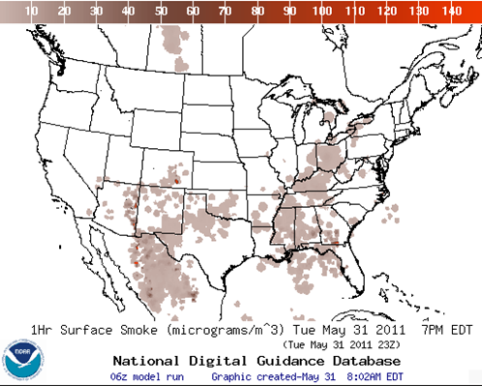
Smoke Predictions
Smoke predictions for CONUS (continental US), Alaska and Hawaii
NESDIS provides wildfire locations
Bluesky provides emissions estimates
HYSPLIT model for transport, dispersion and deposition (Rolph et. al., W&F, 2009)
Last years’ updates include increased plume rise, decreased wet deposition, changes in daily emissions cycling
Developed satellite product for verification (Ciren et.al., JGR 2014)

Slide 12
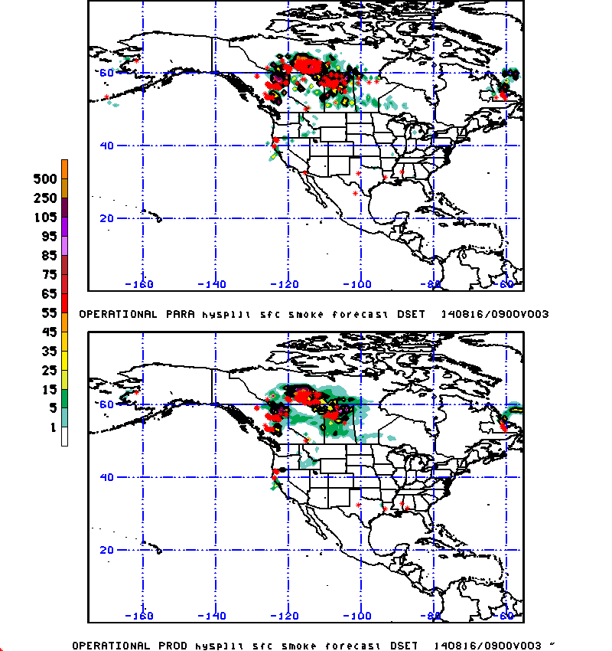
Smoke prediction updates
• Updating to use automated detection of fires in Canada, Mexico and Central America.
• Updating to use 3-D particle model approach (rather than horizontal puffs) to properly represent the additional fires identified with automatic fire detection.
• Multiple modifications were implemented in the North American Mesoscale (NAM) Analysis and Forecast System including updates to radiation, convective parameterization, microphysics, advection, hybrid variational ensemble GSI analysis, satellite bias correction, quality control of observations, satellite radiance assimilation, diabatic digital filter.

Slide 13
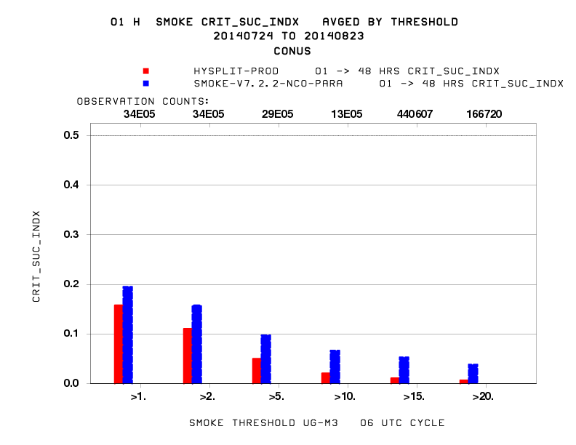
Canada/ Mexico Emission impact July –August, 2014 CONUS CSI verification
Experiment showing improved representation of transport of smoke from Canadian wildfire in Northeast US.

Slide 14
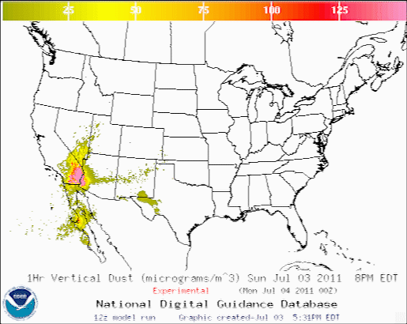
CONUS Dust Predictions
Operational Predictions at http://airquality.weather.gov/
Standalone prediction of airborne dust from dust storms:
Wind-driven dust emitted where surface winds exceed thresholds over source regions
Source regions with emission potential estimated from MODIS deep blue climatology for 2003-2006 (Ginoux et. al. 2010).
Emissions modulated by real-time soil moisture.
HYSPLIT model for transport, dispersion and deposition (Draxler et al., JGR, 2010)
Wet deposition updates in July 2013
Developed satellite product for verification (Ciren et.al., JGR 2014)

Slide 15
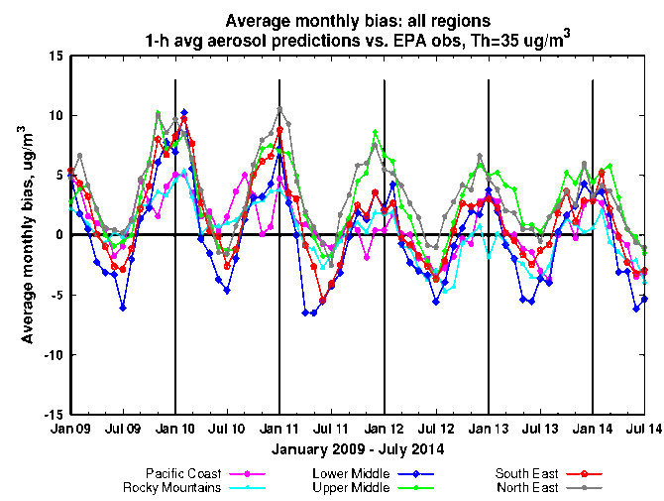
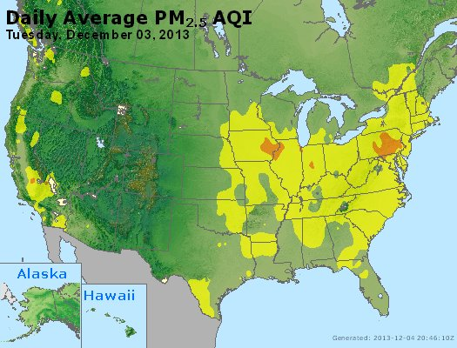
Testing of PM2.5 Predictions
AQ Forecaster Focus group access only, real-time as resources permit
Aerosols over CONUS
From NEI sources only before summer 2014
CMAQ:
CB05 gases, AERO-4 aerosols
Sea salt emissions
Show seasonal bias-- winter, overprediction; summer, underprediction
Forecast challenges
Improving sources for wildfire smoke and dust – in testing since summer 2014
Chemical mechanisms eg. SOA
Meteorology eg. PBL height
Chemical boundary conditions/trans-boundary inputs
NAQFC PM2.5 test predictions

Slide 16
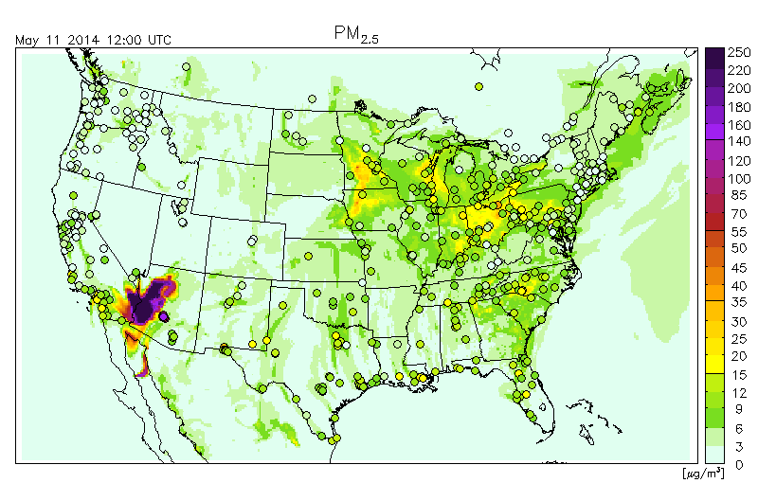
Blowing Dust Event in testing of PM2.5 predictions
Independent
NOAA/NESDIS
analysis narrative
based on
satellite imagery:

Slide 17
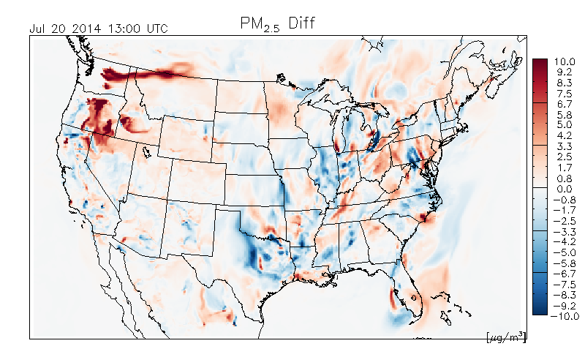
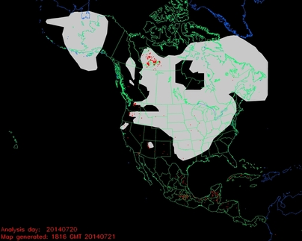
Impact of forest fires in
testing of PM2.5 predictions
Difference between two PM2.5 predictions:
with-minus-without fire emissions
NOAA NESDIS Hazard Mapping System Fire and Smoke Analysis

Slide 18
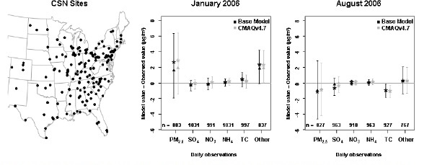
Seasonal Bias in PM2.5 prediction
Mean (star), median (triangle), and inter-quartile ranges of model bias (model value – observed value) for multiple fine-particle species measured at CSN sites in the 12km domain. The number of model/observation pairs for each species is shown above the x-axis.
The bias in the total mass of PM2.5 is dominated by overpredictions of unspecified PM in the winter and by underpredictions of carbon aerosols in the summer. (Foley et. al., Incremental testing of the Community Multiscale Air Quality (CMAQ) modeling system version 4.7, Geosci. Model Dev., 3, 205-226, 2010)
Saylor et. al. found same type of seasonal speciation biases in the CMAQ v4.6 for IMPROVE sites.
18

Slide 19
Removal of Bias in PM2.5 predictions
Quality control of the observations is essential
Five different post-processing techniques were tested
Raw: Hourly AIRNow data available in real-time
PERS: Persistence forecast
7-day: 7-day running mean subtraction
KF: Kalman-filter approach
ANKF: Analog forecast technique followed by Kalman filter approach
AN: Analog Forecast technique
KF-AN: Kalman-filter approach followed by Analog forecast technique
Unsystematic component of the RMSE (top panel) and systematic component of RMSE (bottom panel) using hourly values for the month of November evaluated at the 518 AIRNow PM2.5 sites.
I. Djalalova, L. Delle Monache, and J. Wilczak: PM2.5 analog forecast and Kalman filter post-processing for the Community Multiscale Air Quality (CMAQ) model, manuscript in preparation

Slide 20
Partnering with AQ Forecasters
Focus group, State/local AQ forecasters:
Participate in real-time developmental testing of new capabilities, e.g. aerosol predictions
Provide feedback on reliability, utility of test products
Local episodes/case studies emphasis
Regular meetings; working together with EPA’s AIRNow and NOAA
Feedback is essential for refining/improving coordination
Examples of AQ forecaster feedback after emissions update in 2012:
In Maryland, NOAA ozone predictions have improved since 2011: significant improvement in false alarm ratio (FAR) with some decrease in probability of detection (POD). (Laura Landry, Maryland Department of the Environment)
Updates in 2014:
In Connecticut, The late summer over-prediction has been nearly eliminated. The CB05/AERO-4 model looks good for production. (Michael Geigert, Connecticut Department of Energy and Environmental Protection)
Currently evaluating updates in ozone, smoke and dust predictions and updates in testing of PM2.5 predictions

Slide 21
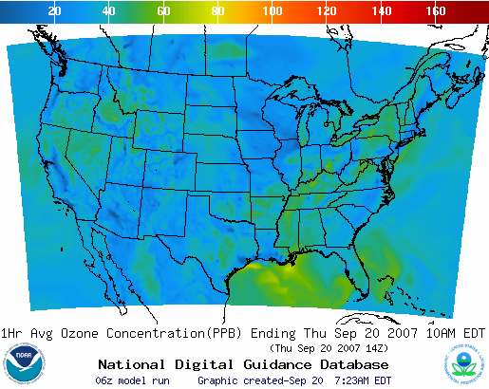
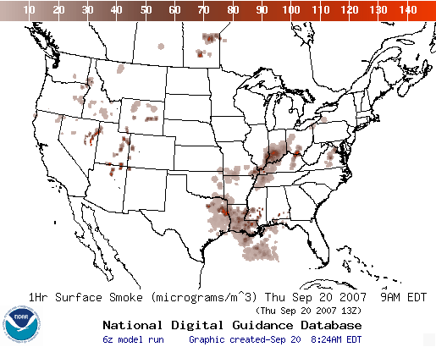
Operational AQ forecast guidance airquality.weather.gov
Ozone products Nationwide since 2010
Smoke Products Nationwide since 2010
Dust Products
Implemented 2012
Further information: www.nws.noaa.gov/ost/air_quality

Slide 22
Summary and Plans
US national AQ forecasting capability and recent updates:
Operational ozone prediction nationwide; substantial emission update in 2012
Operational smoke prediction nationwide
Operational dust prediction for CONUS sources
Experimental ozone predictions for CONUS; CB05 mechanism, updated emissions, lateral boundary conditions, deposition, NTR
Prototype CMAQ PM2.5 predictions with NEI, wildfire and dust emissions
If/when resources allow we plan to:
Maintain operational AQ predictions
Transition currently experimental ozone into operations and provide prototype PM2.5 predictions for the same system
Test/implement new display capability
Use lateral boundary conditions from global dust predictions in prototype PM2.5 predictions
Test smoke predictions with 4 km meteorology and emission updates

Slide 23
Acknowledgments: AQF Implementation Team Members
Special thanks to Paula Davidson, OST chief scientist and former NAQFC Manager and to Jim Meager former NOAA AQ Matrix Manager
NOAA/NWS/OST Ivanka Stajner NAQFC Manager
NWS/OCWWS Jannie Ferrell Outreach, Feedback
NWS/OPS/TOC Cynthia Jones Data Communications
NWS/OST/MDL Jerry Gorline, Marc Saccucci, Dev. Verification, NDGD Product Development
Dave Ruth
NWS/OST Sikchya Upadhayay Program Support
NESDIS/NCDC Alan Hall Product Archiving
NWS/NCEP
Jeff McQueen, Jianping Huang, Ho-Chun Huang AQF model interface development, testing, & integration
*Sarah Lu Global dust aerosol and feedback testing
*Brad Ferrier, *Eric Rogers, NAM coordination
*Hui-Ya Chuang
Geoff Manikin Smoke and dust product testing and integration
Dan Starosta, Chris Magee NCO transition and systems testing
Mike Bodner, Andrew Orrison HPC coordination and AQF webdrawer
NOAA/OAR/ARL
Pius Lee, Daniel Tong, Tianfeng Chai CMAQ development, adaptation of AQ simulations for AQF
Li Pan, Hyun-Cheol Kim, Youhua Tang
Roland Draxler, Ariel Stein HYSPLIT adaptations
NESDIS/STAR Shobha Kondragunta Smoke and dust verification product development
NESDIS/OSDPD Liqun Ma, Mark Ruminski Production of smoke and dust verification products,
HMS product integration with smoke forecast tool
EPA/OAQPS partners:
Chet Wayland, Phil Dickerson, Brad Johns, John White AIRNow development, coordination with NAQFC
* Guest Contributors

Slide 24
Backup

Slide 25
Testing new display of AQ predictions
http://preview.weather.gov/graphical/?dataset=aq

Slide 26
Verification of smoke predictions
for CONUS
Daily time series of FMS for smoke concentrations larger than 1um/m3
Figure of merit in space (FMS), which is a fraction of overlap between predicted and observed smoke plumes, threshold is 0.08 marked by red line
NESDIS GOES Aerosol/Smoke Product is used for verification

Slide 27
Rim Fire in California
The largest wildfire ever recorded in Yosemite National Park. Fire started on August 17.
Transport of smoke towards Reno, NV on 8/22 was confirmed by GOES-14 satellite imagery.
NWS office in Reno included smoke and haze in their forecast.
Observed PM2.5 concentrations peaked around 2 pm LST, predicted concentrations at the surface peaked at 1 pm, and the highest predicted concentration was lower than observed
http://airquality.weather.gov

Slide 28
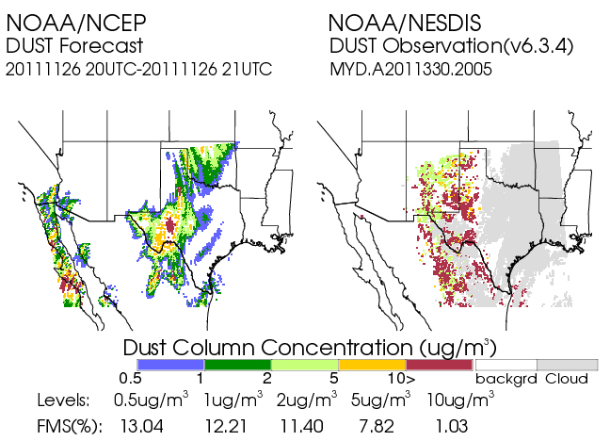
Real time verification examples
Using MODIS Dust Mask Algorithm from NOAA/NESDIS satellite imagery
“Footprint” comparison:
Threshold concentration > 1 µg/m³, for average dust in the column
Tracking threat scores, or figure-of-merit statistics:
(Area Pred ∩ Area Obs) / (Area Pred U Area Obs)
Initial skill target 0.05
28

