Slide 1


A three-dimensional refinement adaptive grid algorithm for Eulerian air quality models
Fernando Garcia Menendez
Center for Global Change Science, Massachusetts Institute of Technology
Talat Odman, Yongtao Hu
School of Civil & Environmental Engineering, Georgia Institute of Technology

Slide 2

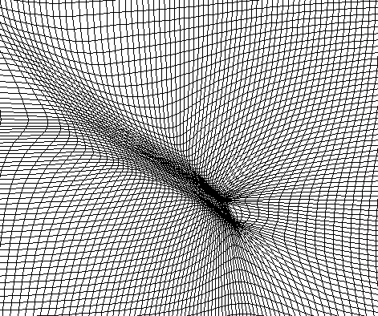
2D Adaptive Grid in CMAQ

Slide 3
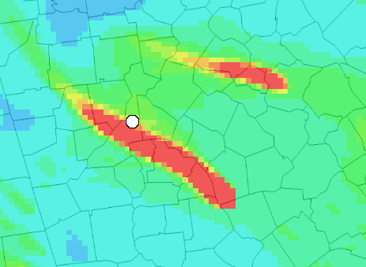
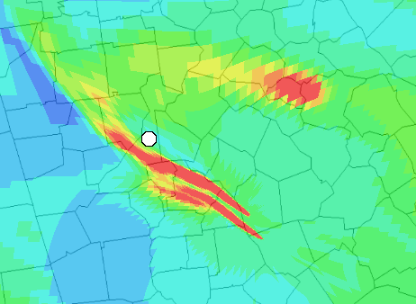
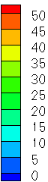
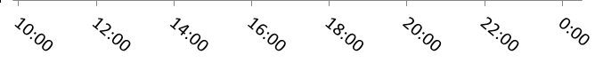
2D Adaptive Grid in CMAQ
Fixed Grid (4km)
Adaptive Grid
PM_{2.5}
(µg m⁻³)

Slide 4
Concentrated Atmospheric Plumes in CTMs

Slide 5
3-D Adaptive Grid Algorithm

Slide 6
3-D AG Algorithm: Weight Function
  Assign a weight to each cell:
z
y
ζ
η
x
ξ

Slide 7
3-D AG Algorithm: Weight Function
µg m⁻³
Adaptation Weight
µg m⁻³
Adaptation Weight

Slide 8
3-D AG Algorithm: Grid Movement
  2. Use cell weights to estimate new node positions:

Slide 9
3-D AG Algorithm: Grid Movement
Unconstrained
adaptation:
Vertically constrained adaptation:
Adaptation
Weight
Adaptation
Weight

Slide 10
Adaptive Grid Algorithm
  3. Redistribute concentration fields:
  Check convergence criteria:
  → minimum node movement
  → maximum number of iterations
E
1

Slide 11
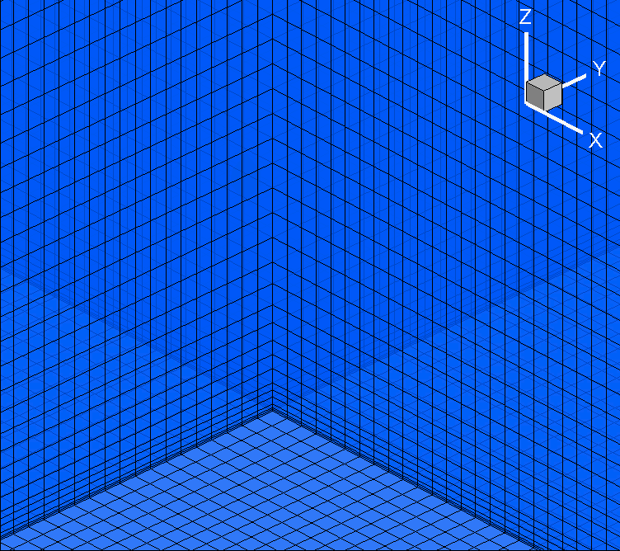
3-D Adaptive Grid Algorithm
µg m⁻³

Slide 12
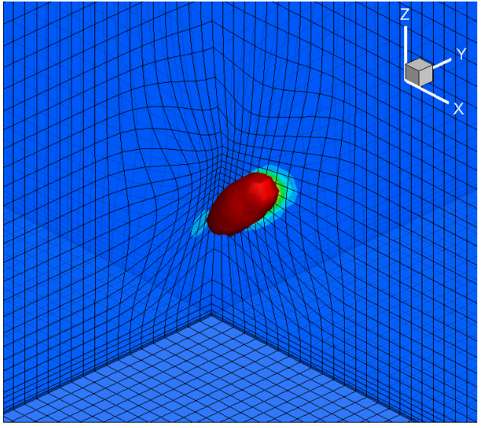
3-D Adaptive Grid Algorithm
µg m⁻³

Slide 13
3-D Adaptive Grid Algorithm
µg m⁻³
04:00
04:00

Slide 14
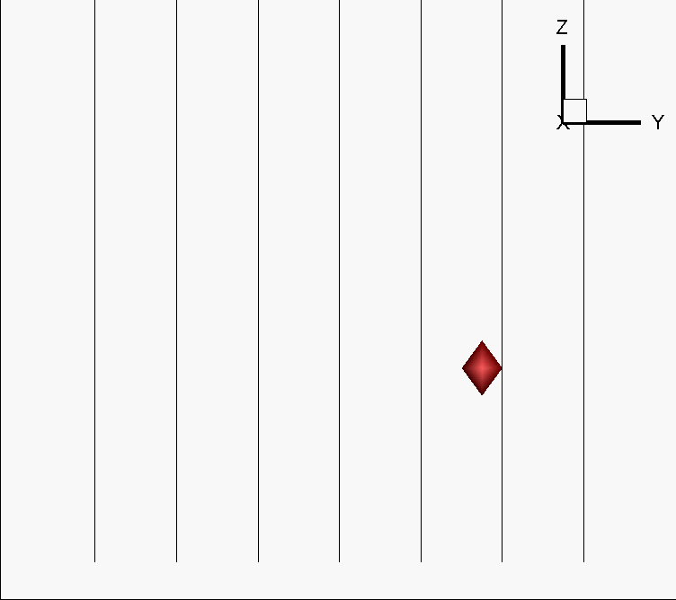
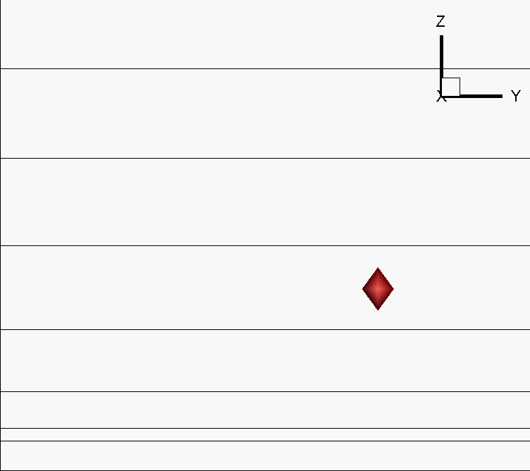
3-D Adaptive Grid Algorithm

Slide 15
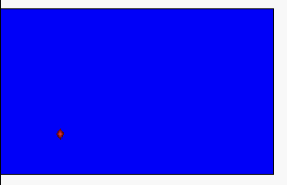

3-D Adaptive Grid Algorithm: Advection Tests
Fixed Grid
Adaptive Grid
Maximum predicted concentration:
Unconstrained
Vertically Constrained

Slide 16
3-D Adaptive Grid Algorithm: Advection Tests
PM_{2.5} (µg m⁻³ )
Fixed Grid
Adaptive Grid

Slide 17
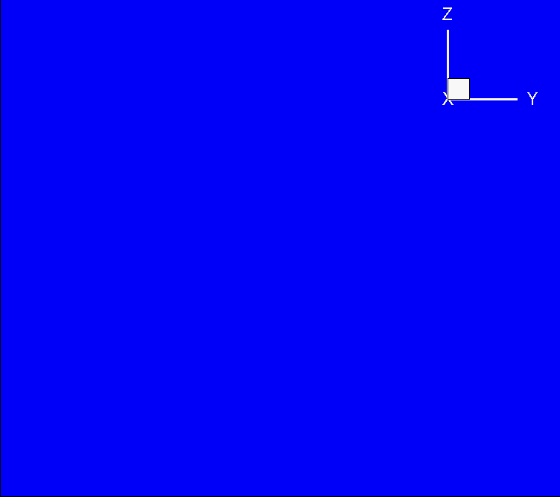
3-D Adaptive Grid Algorithm: Advection Tests
PM_{2.5} (µg m⁻³ )
Fixed Grid
Adaptive Grid
Fixed Grid
Adaptive Grid

Slide 18
Complete implementation in operational CTMs
  Recommendations and challenges:
  3-D adaptation beneficial for concentrated plumes in the free troposphere, near inversions or at the top of the PBL
  Vertically constrained adaptation may simplify implementation
  Global interpolation algorithms highly recommended for 3˗D grid adaptation
  Modeling still limited by resolution of meteorology/ emissions inputs

Slide 19


THANK YOU!

