Slide 1
HiPERiSM Consulting, LLC.
George Delic , Ph.D.
HiPERiSM Consulting, LLC
(919)484-9803
P.O. Box 569,
Chapel Hill, NC 27514
george@hiperism.com
http://www.hiperism.com

Slide 2
NEW STRATEGIES FOR IMPROVING PERFORMANCE AND PRECISION IN CMAQ AND GMI MODELS
13th Annual CMAS Conference,
Chapel Hill, NC
27 October, 2013
George Delic
HiPERiSM Consulting, LLC

Slide 3
Overview: CMAQ from HiPERiSM and the U.S. EPA with Gear solver
Overview: CMAQ from HiPERiSM and the U.S. EPA
Hardware platforms, compilers, and episode studied
Time used by science process in a 24 hour simulation
JSPARSE versus FSPARSE versions of CMAQ Gear solver
BLOCKS of cells versus single CELL versions of FSPARSE
Thread parallel performance metrics
CMAQ performance with 1 MPI process
CMAQ performance with 1-8 MPI processes
Numerical error in U.S. EPA code
Lessons learned
Conclusions
Next Steps for CMAQ development

Slide 4
Hardware platforms
Intel: 2x4-core CPU’s = 8 cores
W5590 Nehalem™
3.3 GHz
AMD: 4x12-core CPU’s = 48 cores
6176SE Opteron™
2.3 GHz

Slide 5
Software and compilers
OS
Linux 64-bit
CMAQ versions (Gear solver*)
U.S. EPA’s uses JSPARSE (serial)
HiPERiSM uses FSPARSE (parallel)
Compilers (legend)
Intel 12.1 (ifort/Intel)
Portland 13.4 (pgf90)
(*) Requires a sparse linear solver in a linear system Ax=y for chemistry solution: FSPARSE replaces JSPARSE

Slide 6
Episode studied
Grid used
279 X 240 Eastern US domain at 12 Km grid spacing and 34 vertical layers
CMAQ 4.7.1 24-hour episode
August 09, 2006, using the CB05 mechanism with Chlorine extensions and the Aero 4 version for PM modeling.
total output file size: ~ 37.7 GB (137 variables)

Slide 7
Fraction of total time in 12 x 24 calls (pgf90 on Intel node, 24hr run)
OVERALL: CHEM (60%), AERO (16%), VDIFF (14%)

Slide 8
JSPARSE version of GEAR
Order all cells in the grid into blocks of cells having similar stiffness
Disadvantage: this requires a memory copy of concentrations from an array dimensioned by column, row, and level, into a linear array (*)
Gear algorithm is applied to a block of grid cells simultaneously
Disadvantage: the convergence criterion uses an RMS error over all cells in a block.
(*) This leads to excessive data translation look-aside buffer (TLB) data cache misses that stalls the CPU

Slide 9
FSPARSE versions of GEAR
BLOCK version of GEAR-HC
Disadvantages:
applies blocking of cells and stiffness ordering
RMS error estimate for each block of cells
CELL version of GEAR-HC
Advantages:
no stiffness ordering needed
the convergence criterion is applied to each individual cell in the grid domain

Slide 10
CELL version of GEAR
Apply a thread parallel region over a grid column index
C$OMP DO SCHEDULE (DYNAMIC,MY_CHUNK)
blk_col: DO COL = 1, MY_NCOLS
blk_row: DO ROW = 1, MY_NROWS
blk_lev: DO LEV = 1, NLAYS
………[ call CHEM for a cell ]
END DO blk_lev
END DO blk_row
END DO blk_col

Slide 11
Thread parallel performance metrics
SPEEDUP:
U.S. EPA time / thread parallel time
PARALLEL SCALING:
1-thread time / p-thread time

Slide 12
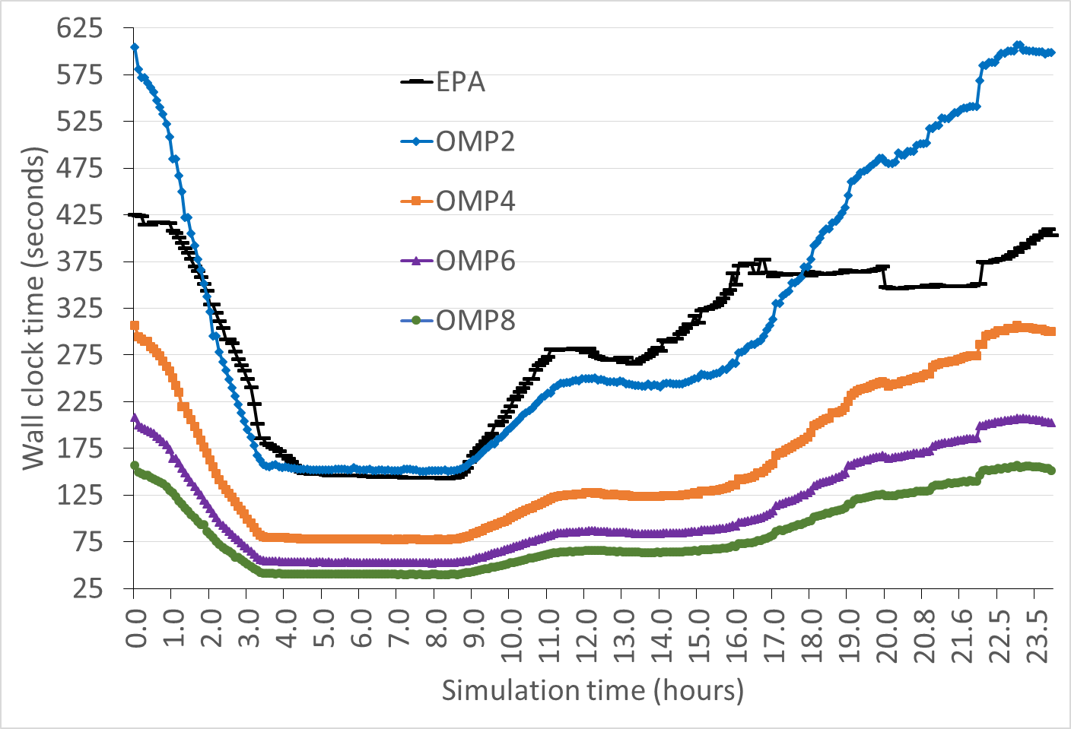
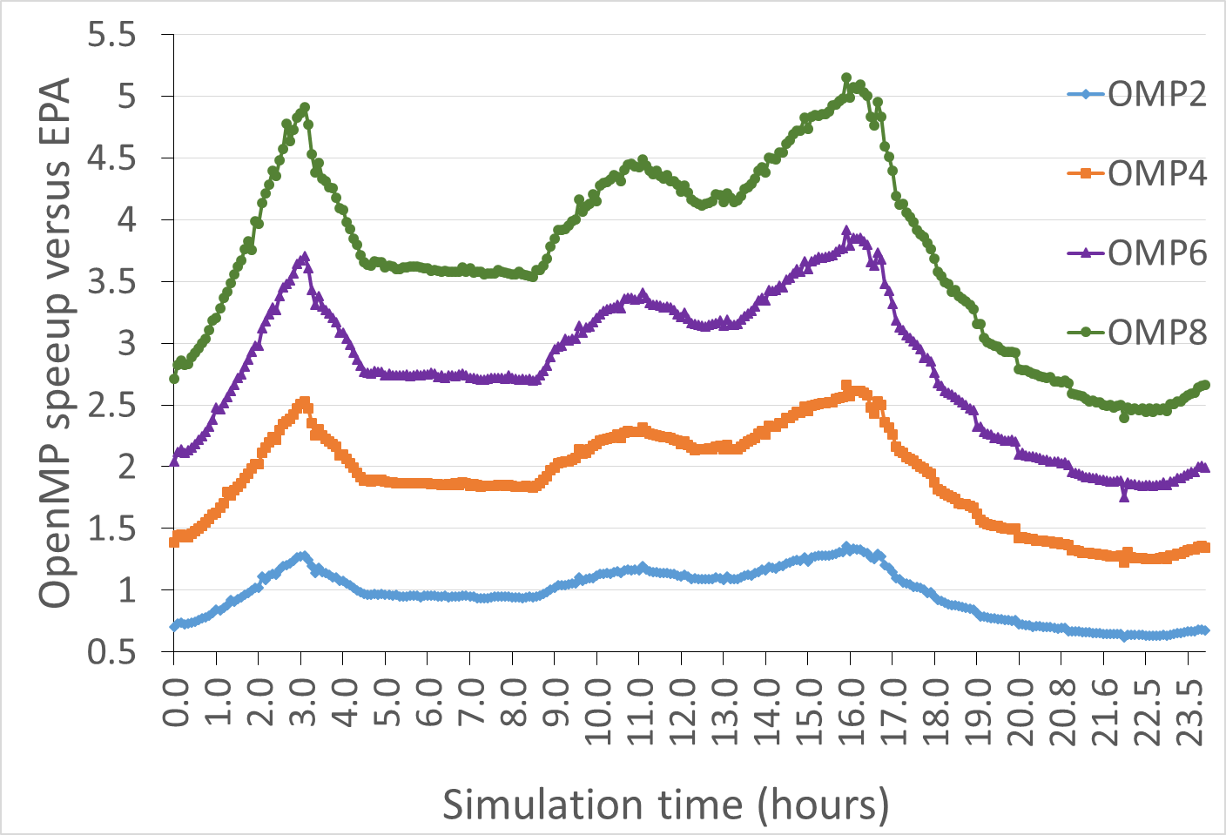
pgf90 compiler on Intel platform (24hr run 1 MPI process)
← CHEM (Gear) wall clock time (seconds) for EPA and GEAR-HC with 1 to 8 threads in CELL version
Parallel CHEM (GEAR-HC) speedup versus EPA for 1 to 8 threads →

Slide 13
pgf90 compiler on Intel platform (24hr run 1 MPI process)
← CHEM (Gear) wall clock time (hours) for EPA and GEAR-HC with 1 to 8 threads in BLOCK and CELL versions
Parallel CHEM (GEAR-HC) speedup versus EPA for 1 to 8 threads in BLOCK and CELL versions →

Slide 14
pgf90 compiler on Intel platform (24hr run 1-8 MPI processes)
← CHEM (Gear) wall clock time (hours) for EPA and GEAR-HC with 6 & 8 threads in BLOCK and CELL versions
Parallel CHEM (GEAR-HC) speedup versus EPA for 6 & 8 threads in BLOCK and CELL versions →

Slide 15
Numerical error in U.S. EPA code
Uses mixed mode arithmetic (DP & SP)
Inconsistent promotion of SP to DP for constants and variables
Worst case in CALCKS for thermal and photolytic reaction rates computed in SP
Inherited SP values amplify precision loss in solve stages
Use of ATOL = 1E-09 is moot

Slide 16
Lessons learned
Performance benefits of FSPARSE
Memory model and TLB data cache misses
Speed up over EPA version ~1.5 with 8 threads (NP=8)
Speed up over EPA ~1.7 with 6 threads (NP=4)
CELL version offers more precision in Gear convergence
BLOCK version enhances them
CELL version improves memory model and diminishes them

Slide 17
Conclusions
CMAQ computational performance shows ~1.5 to ~1.7 speedup in a thread parallel model for the Gear solver when compared to the U.S. EPA release
The FSPARSE in CELL algorithm yields more precision in a sparse matrix chemistry solver when compared to the U.S. EPA release
The FSPARSE algorithm offers performance gains that are portable across platforms and compilers

Slide 18
Next steps for CMAQ development
Short term goals
OpenMP parallel model extensions to other code portions of CMAQ
Explore port of FSPARSE to GPGPU technology
Long term goals
Plan for code architecture (re)design throughout the whole of CMAQ to change the memory footprint & increase computational efficiency

