Slide 1
The Confluence of Air Quality and Climate Change:
A Challenge to 21st Century Air Science
Dan Costa, Sc.D., DABT
National Program Director for Air, Climate and Energy
Office of Research & Development – USEPA
October 27, 2014

Slide 2

Overview
A brief ACE refresher – how data are used
A glimpse at ACE and its vision
ACE science
  A clear need for implementation research
  Model and tools are key
The challenge facing us

Slide 3
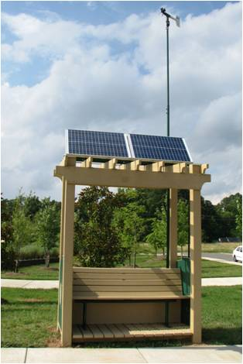

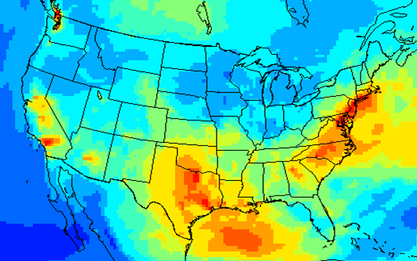
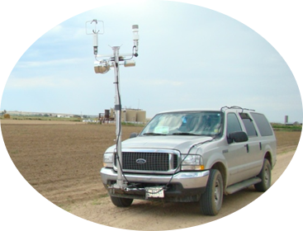


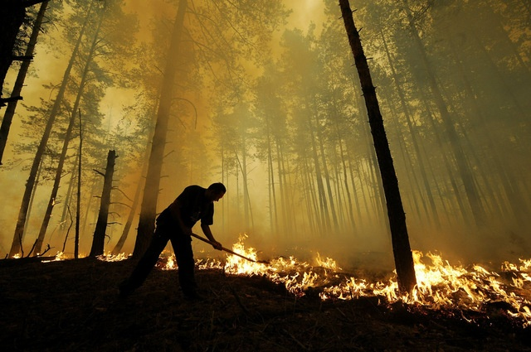

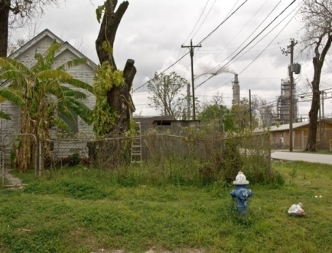
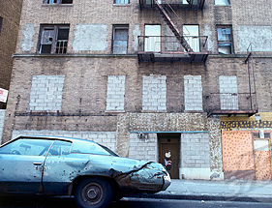
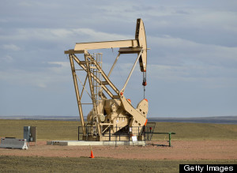
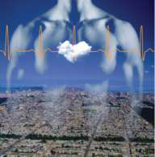


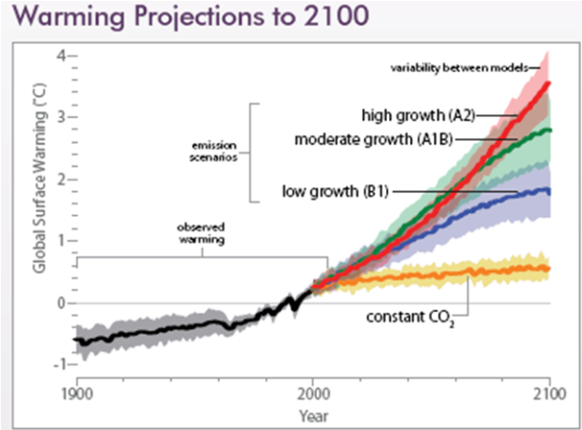

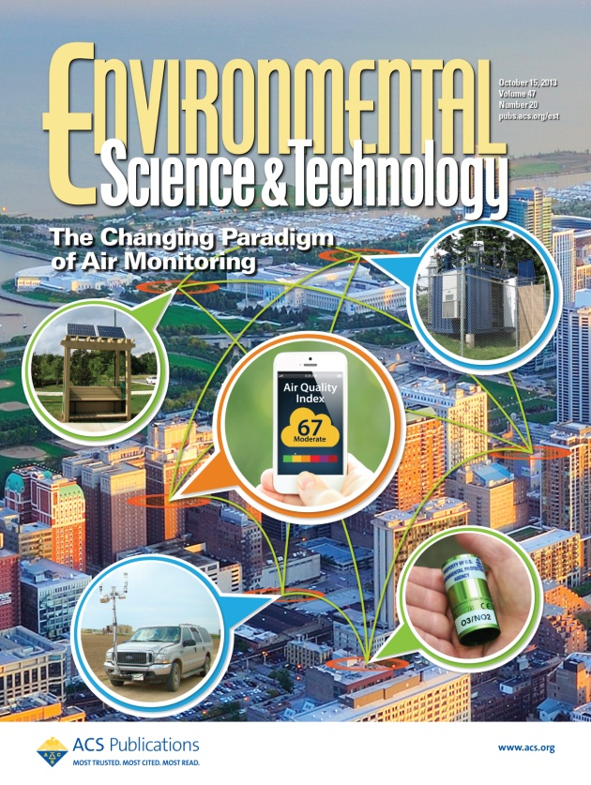
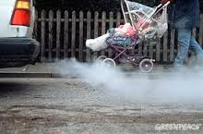
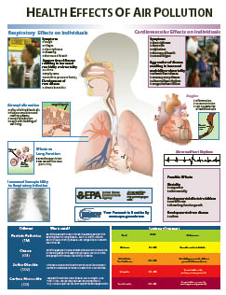
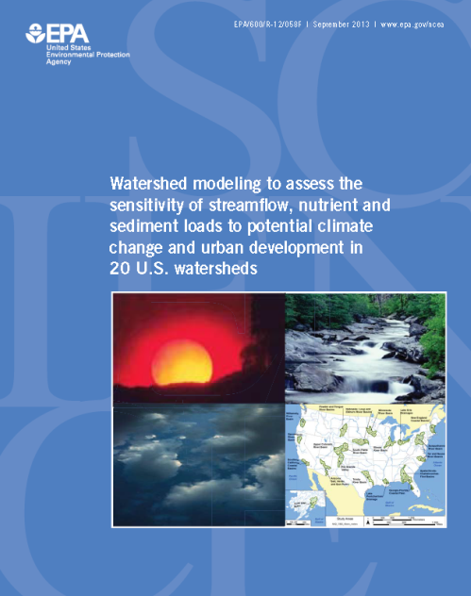


The Many Dimensions of ACE
Building a Foundation of Science to Support Policy and Solve Problems

Slide 4
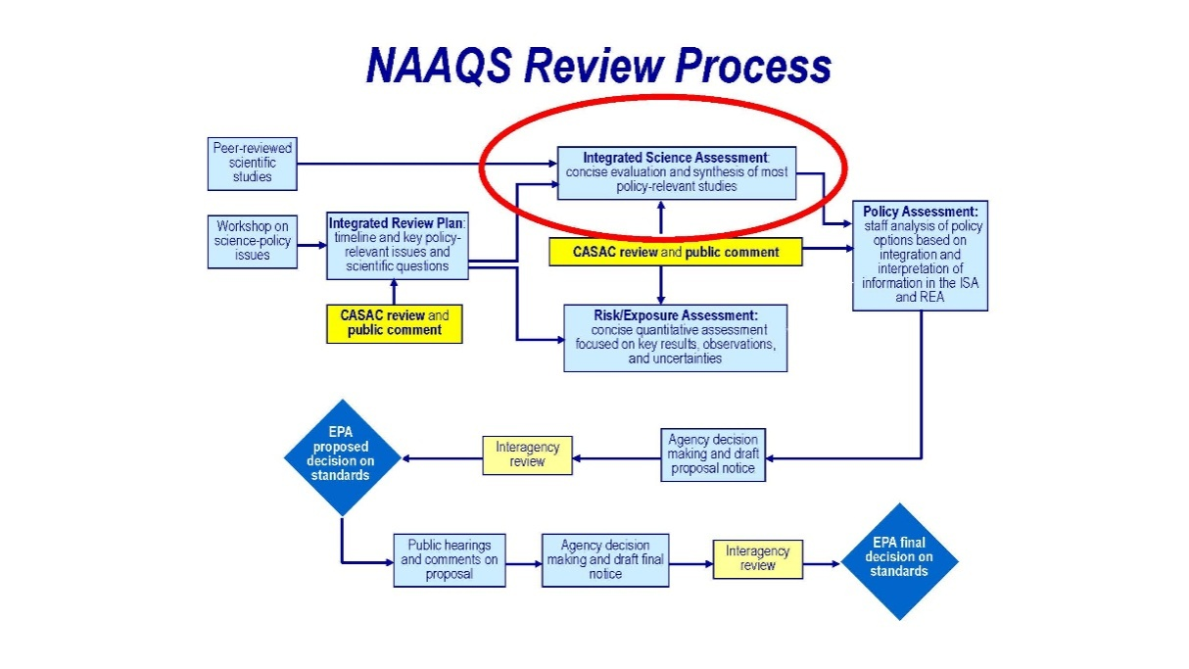
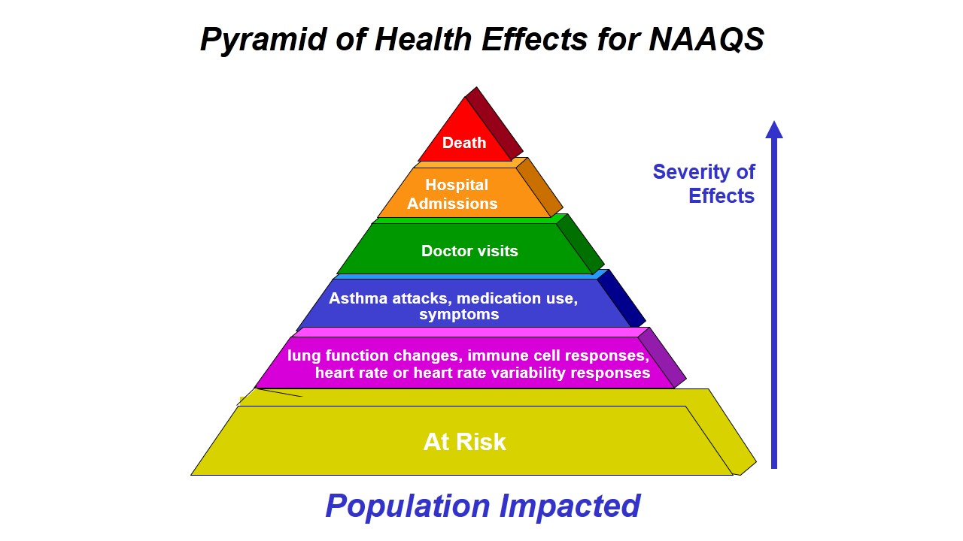
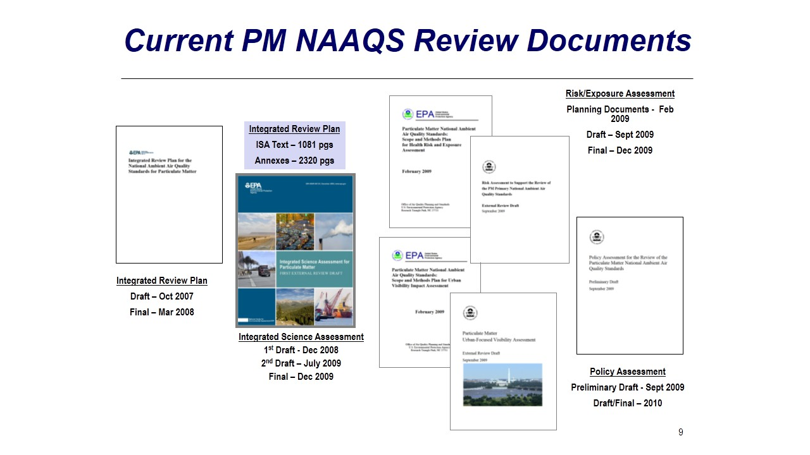
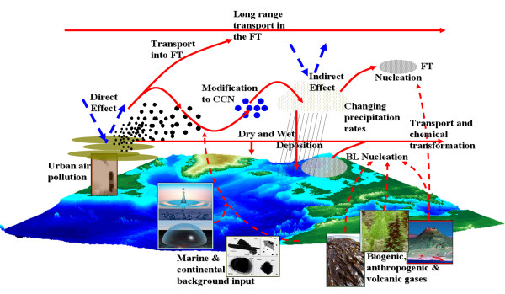
Translating the Science into Regulation
NAAQS
Atmospheric Sciences

Slide 5
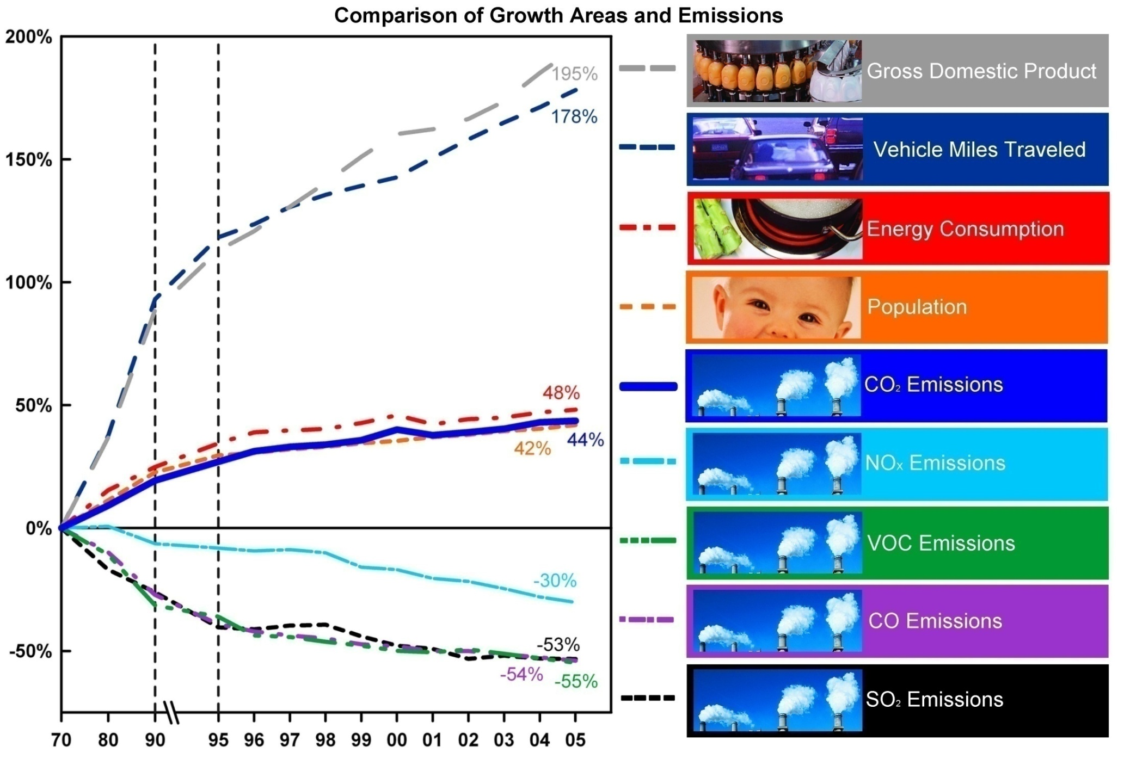
The Clean Air Act Drove Emission Reductions
Energy use
Population
CO₂
-83%
PM10 Emissions

Slide 6
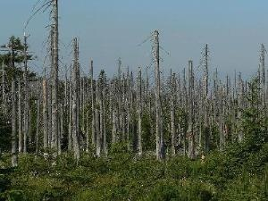
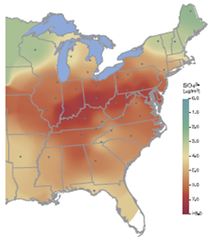
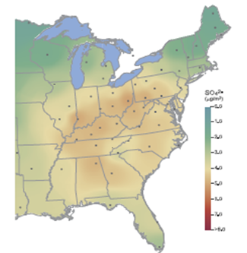
The PM Issue of the ’70s/80s was Acid Aerosols
Fine particles formed from precursors emitted and transported over 100's of miles
Visibility impairment was a major public concern.
Acid aerosols visibly damaged forests
Although acidic SO₄ was presumed to be a strong pulmonary irritant, research showed to be of minor health concern
1989
Smoke reduction & lower sulfur coal and oil led to significant improvements
The PM problem appeared to be solved!!
Ozone however was a looming problem!
2005

Slide 7

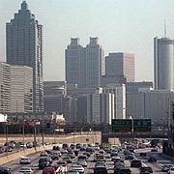
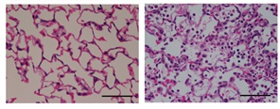
1980-1990: The Era of Oxidant Air Pollution
Ozone Reduces Lung Function
Asthma
0
Low
-20
FEV₁ as % change
-40
High
-60
Baseline
2 Hr
4 Hr
Atlanta
Healthy Lungs
Inflammation

Slide 8
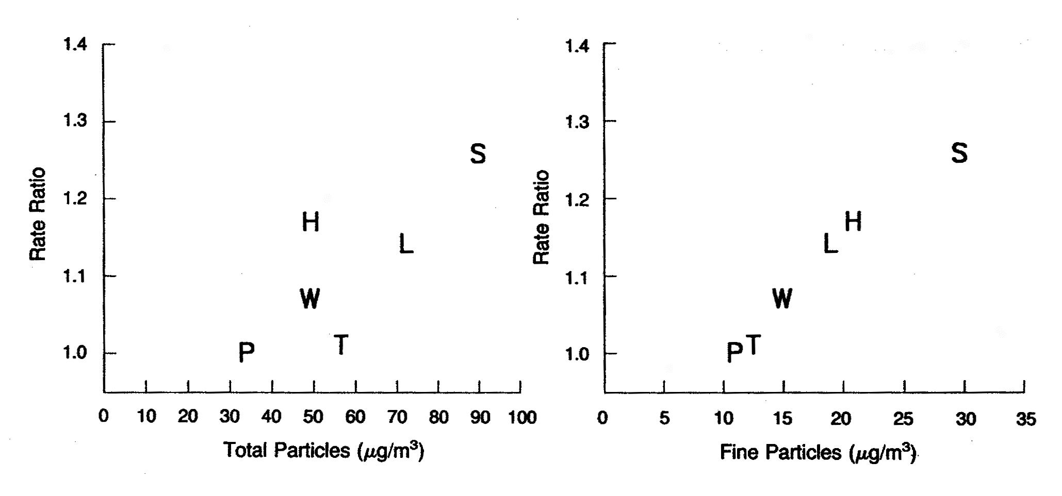
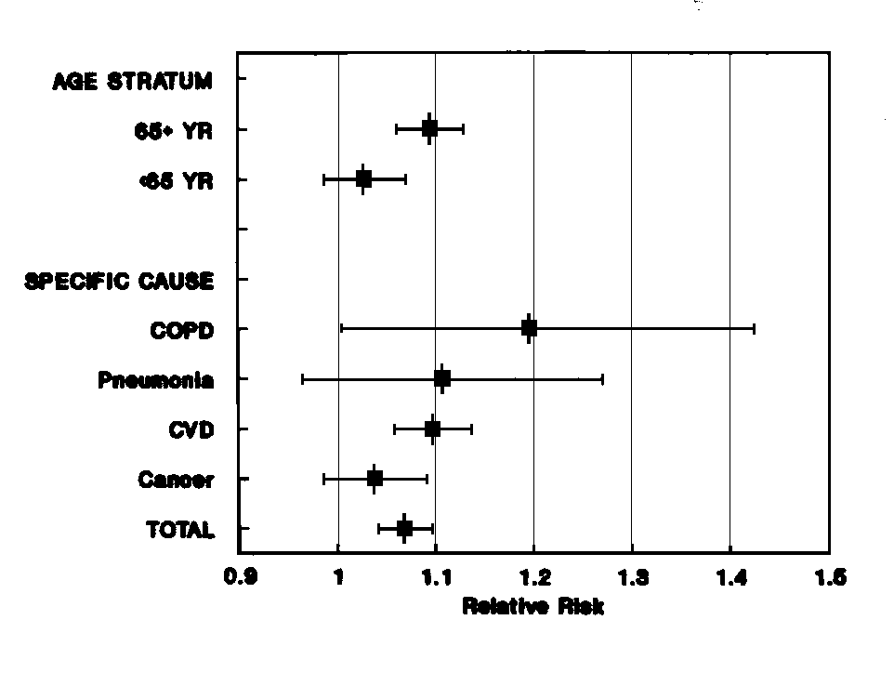
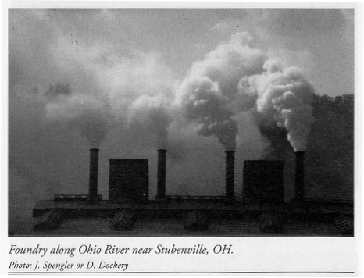
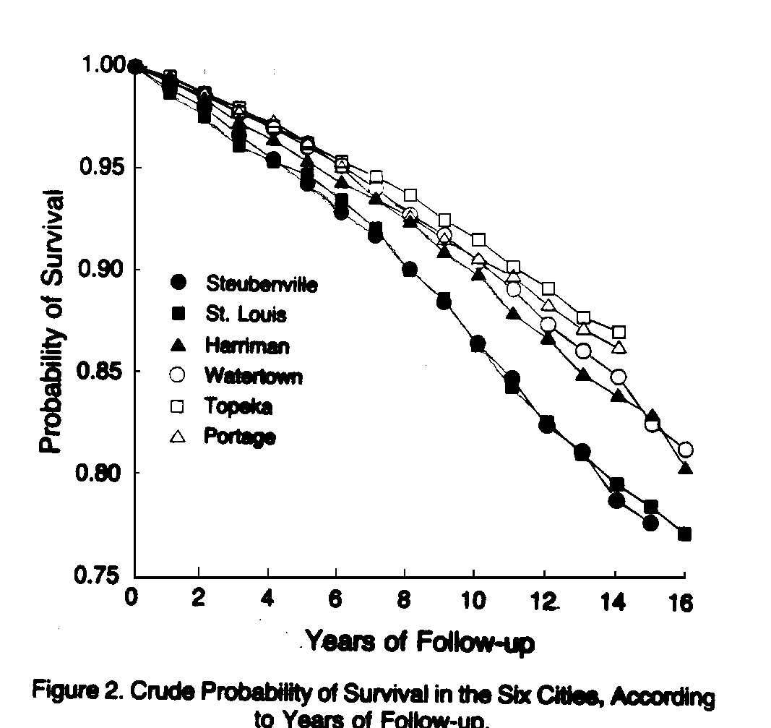
Dockery, et al., 1993
Size matters
Schwartz et al., 1992
Susceptibility
Life-Shortening
In 1997, the PM Epidemiology Was Compelling…
(but with many uncertainties)

Slide 9
2012 PM Standards – Estimated Impacts
NAAQS | 24 hr | Annual
PM_{2.5} | 35 µg/m³ | 12 µg/m³
PM₁₀ (~coarse) | 150 µg/m³ | -
EPA’s PM research has significant regulatory benefits and impacts.
  ► PM NAAQS - protect public health (2008)
    OMB - account for 63-88% of all benefits attributable to regulation
    OMB - $63 to $430 billion annual savings for years - 1996 to 2006 (emergency room / hospitalizations, lost workdays, premature deaths)
    Costs – $25-28 billion

Slide 10
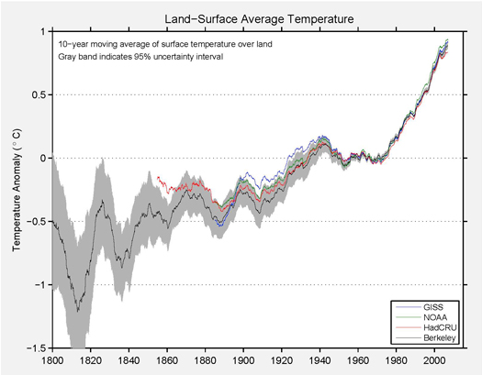
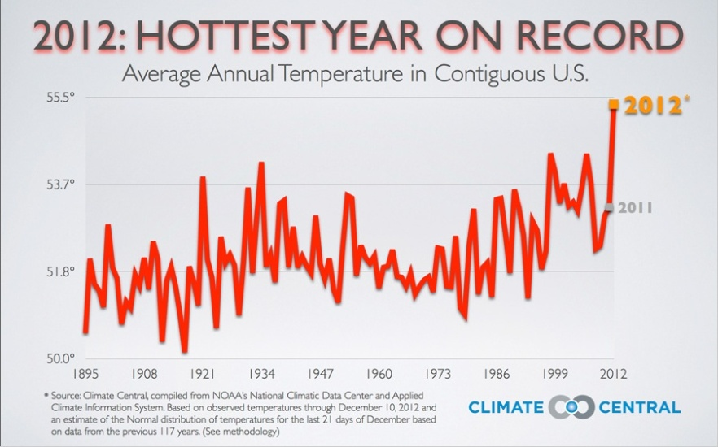
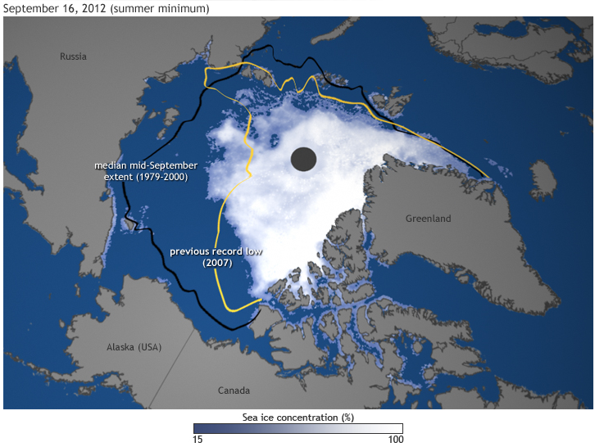
But Mounting Data Suggests …
The Berkeley Earth Surface Temperature Study (BEST), 7/2012
Arctic sea ice: 2012 record low was 18% smaller than previous record, nearly 50% below average

Slide 11
Lisa Jackson (EPA Adm) - Time Magazine April 23, 2009
There is a sense of urgency... If we don't move to address energy and climate as two sides of the same coin we will lose out.
Air Quality
There is a need for integrated systems approaches that transcend the traditional scientific disciplinary paradigm.
Human & Environmental Health
Energy
Climate

Slide 12
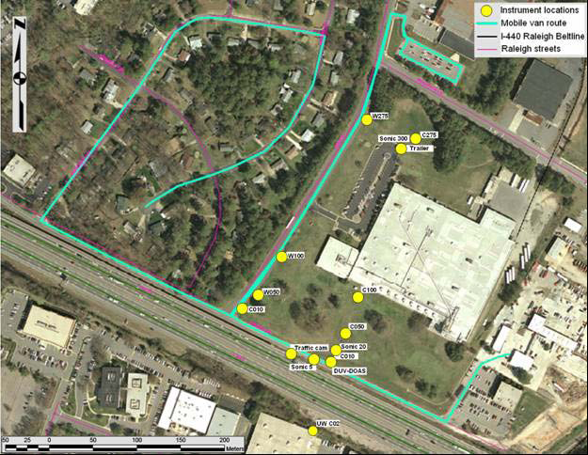
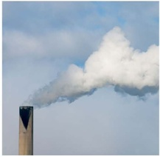
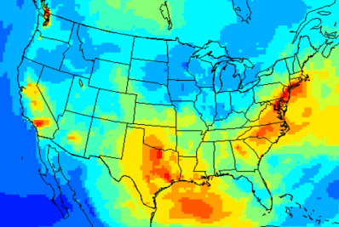


ACE Research Themes
Theme 1: Assess Impacts
  Assess human and ecosystem exposures and effects associated with air pollutants and climate change at individual, community, regional, and global scales
Near Road
  Theme 2: Prevent and Reduce Emissions
    Provide data & tools to develop and evaluate approaches to prevent and reduce emissions of pollutants to the atmosphere, particularly environmentally sustainable, cost effective, and innovative multipollutant and sector-based approaches
  Theme 3: Respond to Changes in Climate & Air Quality
    Provide human exposure and environmental modeling, monitoring, metrics and information needed by individuals, communities, and governmental agencies to adapt to the impacts of climate change and make informed public health decisions regarding air quality
Notes:
Theme 1: Assess Impacts
Assess human and ecosystem exposures/effects of air pollutants and climate change at individual, community, regional, and global scales
Inform the review of the NAAQS
Assess multipollutant exposures and effects
Innovative approaches to assess exposures/effects of pollutants in the atmosphere
Susceptible human and ecosystem populations
Theme 2: Prevent and Reduce Emissions
Provide data & tools to develop and evaluate approaches to prevent and reduce emissions of pollutants to the atmosphere, particularly environmentally sustainable, cost effective, and innovative multipollutant and sector-based approaches
Support implementation of NAAQS
Innovative technologies to support AQ management strategies
Evaluate pollution reduction and prevention solutions
Life-cycle analyses of alternative pollution reduction and energy options
Theme 3: Respond to Changes in Climate & Air Quality
Provide human exposure and environmental modeling, monitoring, metrics and information needed by individuals, communities, and governmental agencies to adapt to the impacts of climate change and make informed public health decisions regarding air quality
Evaluate alternative adaptation strategies
Devise innovative methods to inform individual- and community-level adaptation to climate change and decision making for air quality
Evaluate social, behavioral, and economic factors that influence adaptation strategies for climate change and decision making for air quality

Slide 13
ACE Themes & Research Topics
ACE Research Topics for Partner Needs
ACE Themes
Climate Impacts Mitigation and Adaptation
Theme 1:
Assess Impacts
NAAQS and Multipollutant
Theme 2:
Prevent / Reduce Emissions
Emissions and Measurements
Modeling and Decision Support Tools
Theme 3:
Respond to Changes
Sustainable Energy Evaluation

Slide 14

Stepping-up to the Challenges
Build relationships with stakeholders
Establish balance: “science with a purpose”
  Target real science program gaps and needs
  Yet promote cutting edge science & innovation
Infusing systems thinking as the foundation of sustainability
  The goal is solutions - not just problems
  Anticipatory science

Slide 15
An ACE Success Story

Slide 16
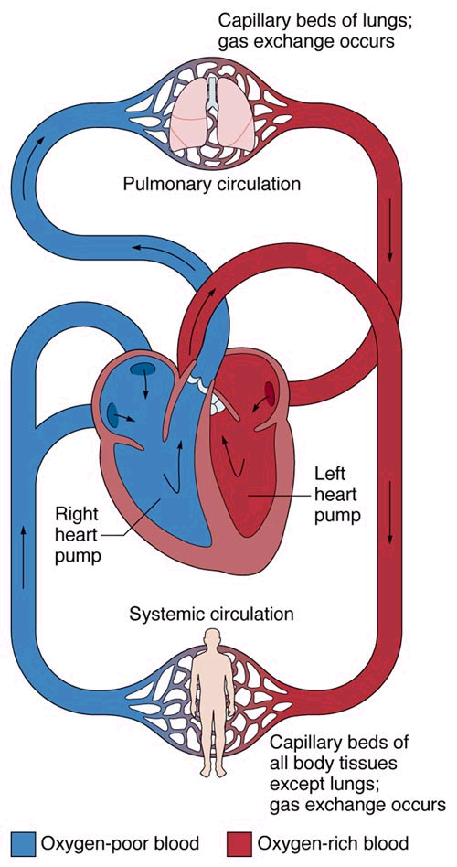
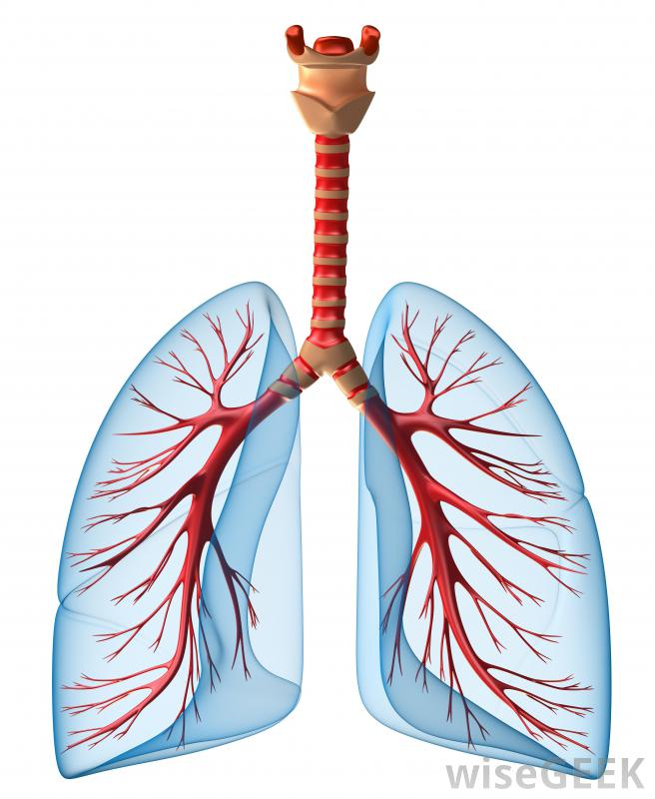
Effects Beyond the Lung

Slide 17
Air Pollution and the Heart
EPA Staff Paper 1996
PM affects the lungs….
Total Mortality
Respiratory Mortality
Cardio-vascular Mortality
Respiratory Hospital Admissions
Cardio-Pulmonary Hospital Admissions
Cough
Upper Lower
Respiratory
Adults
Children

Slide 18
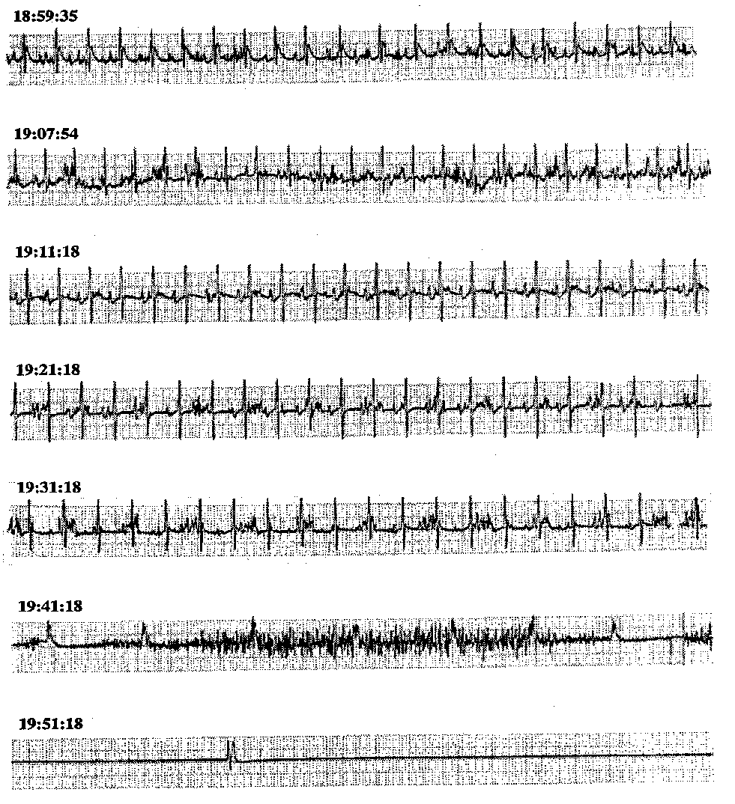
Evolution of an Outcome
1.8
Peters et al., 2001
ECG Abnormalities and death in fly ash exposed rats with vascular disease
1.6
1.4
OR for ICD Discharge
1.2
1.0
(lag 2)
0.8
0
1
2
3
Black Carbon
(µg/m³)
Defibrillator discharge w/ BC
5
Air
4
CAPS
3
Ratio CAPS / Pre
*
2
*
*
1
0
SDNN
PNN50
LF
HF
Total
Ratio
Exposure of Elderly Humans to CAPS Decreases HR Variability
Watkinson et al., 1998
Devlin et al., 2003

Slide 19
“The overall evidence is consistent with a causal relationship between PM_{2.5} exposure and cardiovascular morbidity and mortality.”
Brook RD, et al. Circulation 2010; 121: 2331-78

Slide 20


“February Declared American Heart Month”
Be Smart, Protect Your Heart from Air Pollution View the video
Learn to reduce your health risks
Join our Twitter chat w Dr. Wayne Cascio Thurs. Feb. 13 1:30 PM ET. Follow #HealthyHeart or @EPAlive
Last Decade of Research Provided Impetus / Groundwork for:
• Importance of raising awareness among health care providers
• Providing specific recommendations for clinical practice:

Slide 21
Health is Not the Whole Story

Slide 22
Implementation Research is Multidisciplinary
Health (like those for PM) provide the scientific basis for EPA’s Administrator to establish National Ambient Air Quality Standards (NAAQS).
Measurements and models are needed to implement these standards.
A few “implementation” focused research project areas within ACE

Slide 23
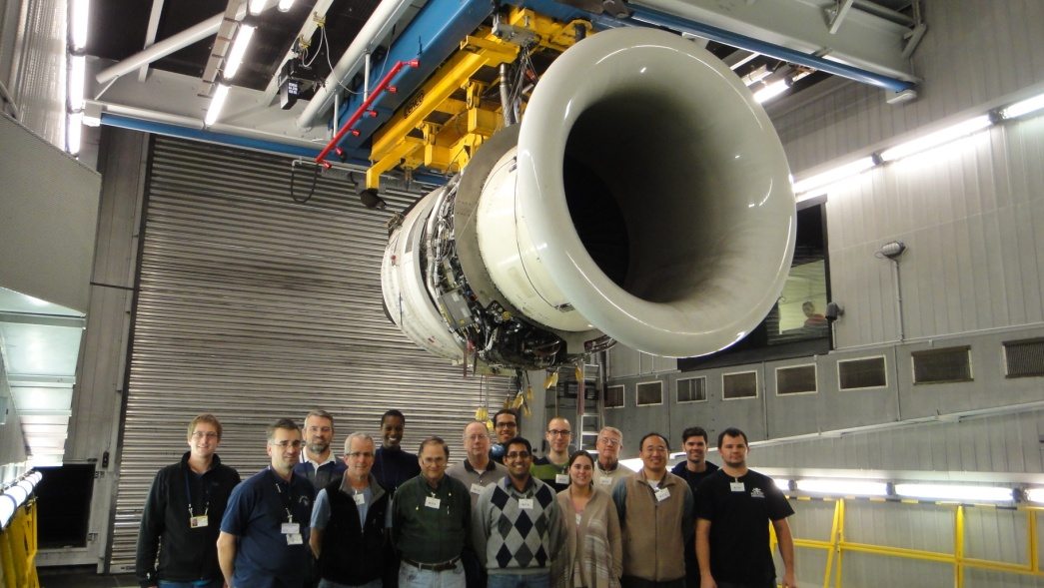
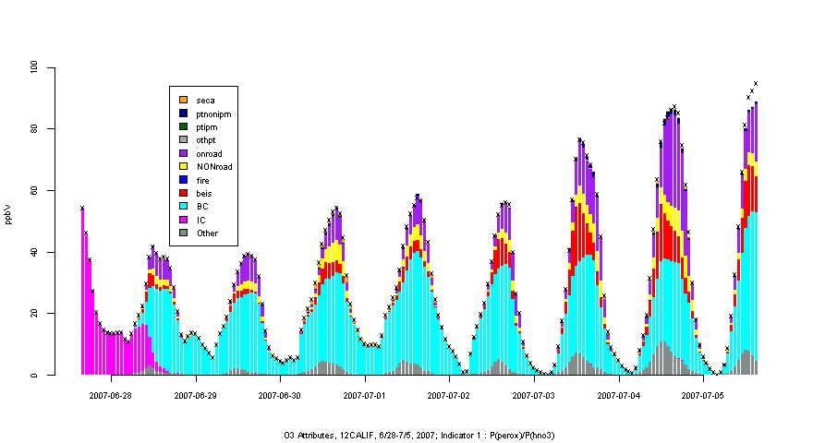
Research to Inform Implementation
Regulatory monitoring
  Federal Reference Methods (FRM) and Federal Equivalent Methods (FEM)
  Regulatory source measurements
Next generation air monitoring
  Sensor evaluations
  Village Green Project
  Facility fence line and sensor networks
Emissions
  Black carbon emissions from aircraft
  Cookstove emissions /exposure / health
  Mobile source emissions / exposure / health
Modeling
  Dispersion modeling for AERMOD improvements
  Release of CMAQ v5.1
  Instrumented tools in CMAQ
O₃ Time series of sector contributions at Sacramento

Slide 24
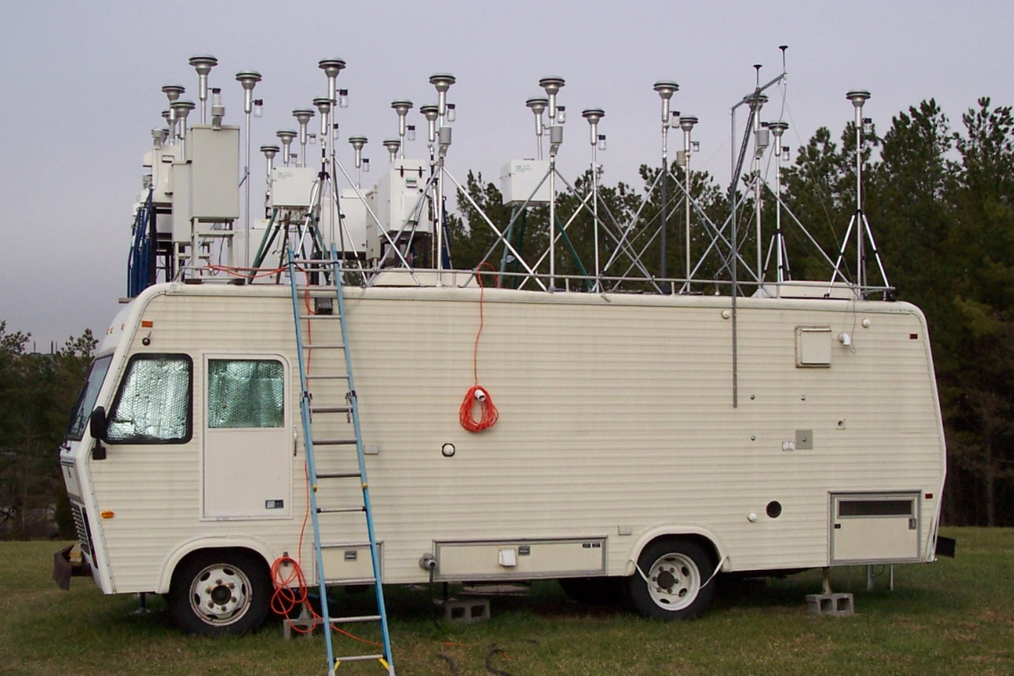
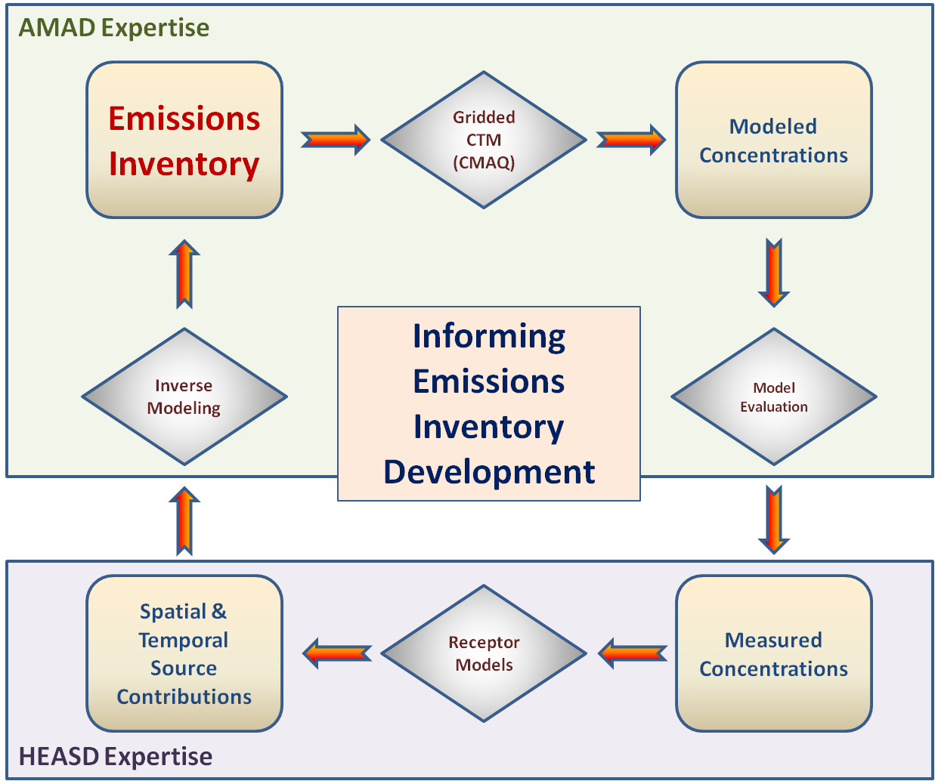
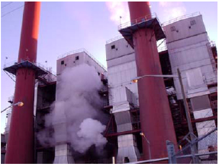
EMISSIONS AND measurements
Near Term Targeted Research |  | Long Term Mission Driven Research
Objective | Examples | Objective | Examples
Develop and evaluate regulatory methods for source and ambient air monitoring | Federal Reference Methods for NAAQS Source compliance methods | Change the paradigm for air pollution monitoring | Apps and Sensors Satellites Low cost fence line monitoring

Slide 25
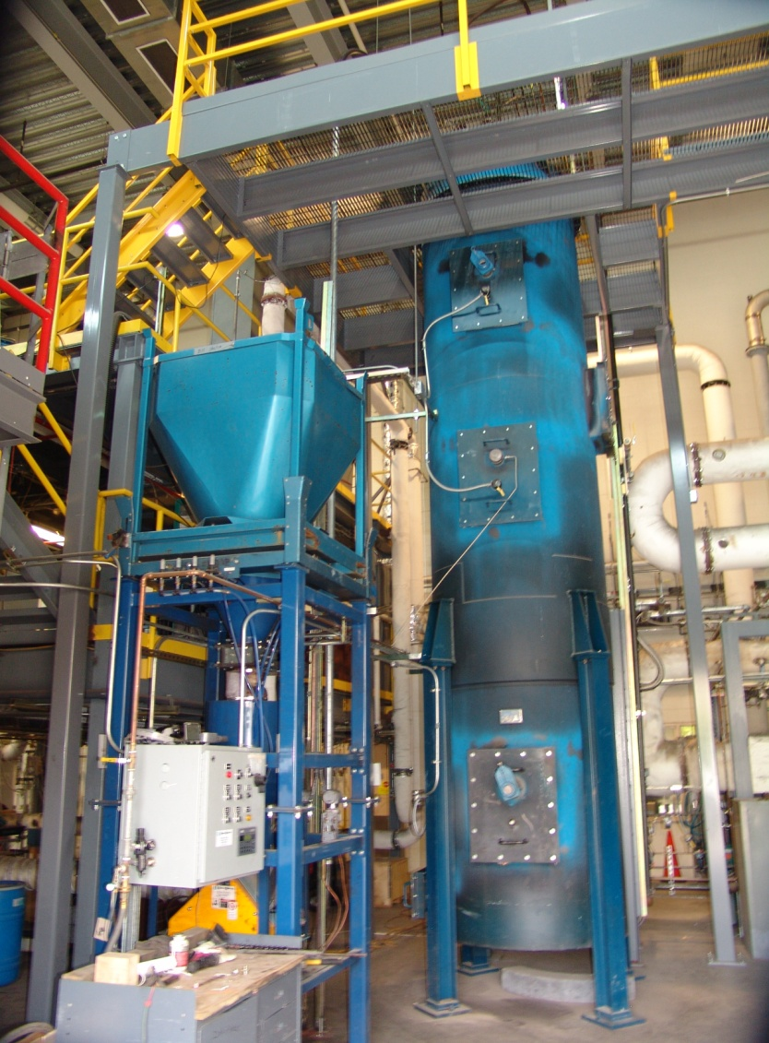
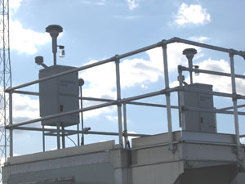
  Methods for Measurement to Inform Policy Decisions
Development of source and ambient air
monitoring methods to support development
and implementation of regulatory programs.
Near-term direction
  FRM for ozone and NO₂ and FEM applications
  Stationary source reference and continuous monitoring methods for HAPs and GHGs
  Surrogacy testing on pilot-scale coal-fired combustion facility of coal blended with various biomasses/biofuels
  Black carbon emissions from from aircraft and diesel engines
  Characterization of fugitive emissions for refineries and large area source emissions for oil and gas
Notes:
FRM:
Ozone proposal December 1
NO2
Stationary source:
CEMS=continuous emissions monitoring systems
Provide strategic technical support and emissions measurement testing to inform ever-evolving, high-priority regulatory emissions measurement needs.
Ex. Performance specifications for HCl CEMs, N₂O monitoring
Ex. Br issues associated with Hg measurements
Also consider evaluation of innovative and emerging technologies for instrumental source emissions measurements/monitoring – proactive approach
BC emissions:
Diesel gensets – direction is to examine emissions from diesel blended with DME or other synthesis gas; investigate best available technology for measurement of BC concentration from this type of source; determine emission factors of particulate and gaseous emissions
Final test method (aerospace recommended practice) in progress

Slide 26

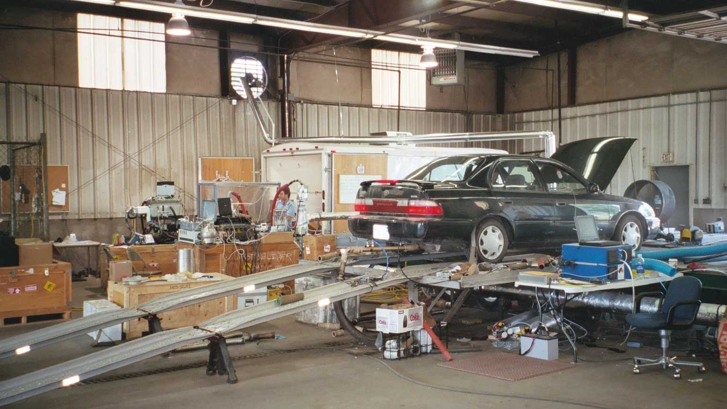
Improving Emissions Inventories
Apply measurements, analytical methods and
modeling tools to enhance emissions information.
Near-term direction
  Coordinate harmoinization across EPA
  Mobile source dynamometer studies
  Peat-burning experiments
  SPECIATE database
  Improvements in emission modeling for crop residue burning and biogenics
  Changing Emission Inventories RFA (STAR)
Notes:
Mobile source dynamometer studies – emission factors for MOVES model, including source characterization and speciation for light duty truck towing a trailer (currently there are no emission factors for this category)
Peat-burning experiments – field and laboratory simulated
SPECIATE database – release of version 4.4; continue updating with latest data available
Improvements in emission modeling for crop residue burning and biogenics
Improvements to the emission modeling of fires (Agricultural, Prescribed, Wildfires) including better representation of plume rise, emission factors
Biogenic Emission improvements with more spatially resolved land use information, best available emission factors, and latest science in estimating biogenic species
Changing Emission Inventories RFA (John Dawson)
Develop methods and expertise to build an inventory of long-term emissions that could be used by both global climate modelers and regional to local scale air quality and ecosystem modelers and researchers
Will be housed within MA-2 project
See STAR poster for this session

Slide 27
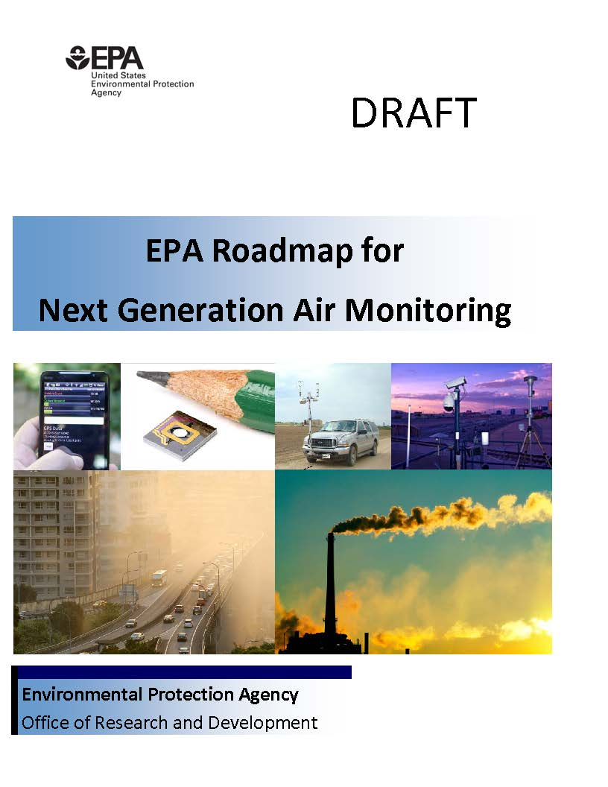
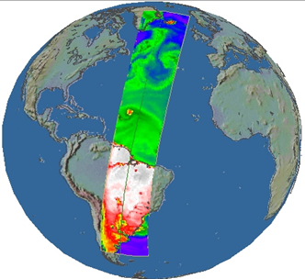
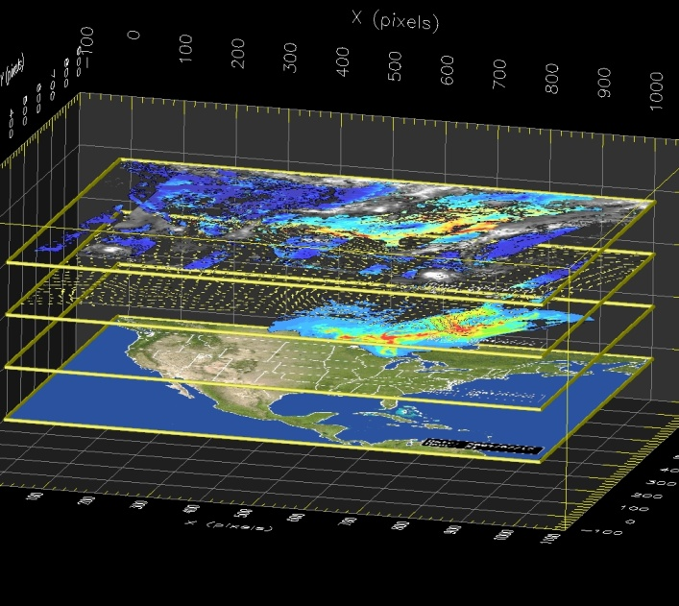
Changing the Paradigm for Air Pollution Monitoring
Developing and evaluating technology, methods and models to improve our ability to support current and future air quality monitoring needs of the Agency.
Near-term direction
  Sensor development, evaluation, application
  Satellite-based air quality measurements
  Air quality data integration and analysis
  Monitoring for communities solicitation (STAR)
Notes:
Sensor development, evaluation, application
Establish basic understanding of low cost sensor performance
Develop new air monitoring technology for communities to:
Reduce cost and complexity of long-term air monitoring in community environments
Engage communities in air pollution awareness
Advance EPA’s ability to measure and communicate air pollution information in real-time.
Open air source investigation with sensors for mobile and aerial platforms (e.g., fires, landfills, oil and gas)
Satellite-based air quality measurements
SOAS and DISCOVER AQ provide plethora of surface and satellite data – biogenic VOC
Identify and validate methods and techniques (models and equations) for use in deriving surface air quality concentrations of ozone, nitrogen dioxide, and PM from remote sensing column based techniques
Air quality data integration and analysis
PM2.5 predictions using satellite and model output
Monitoring for communities solicitation (STAR) – open summer 2014, awards planned for summer 2015

Slide 28
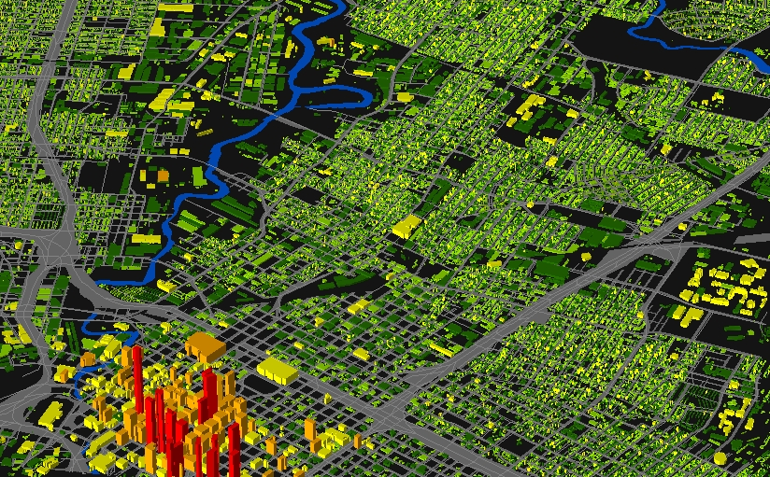
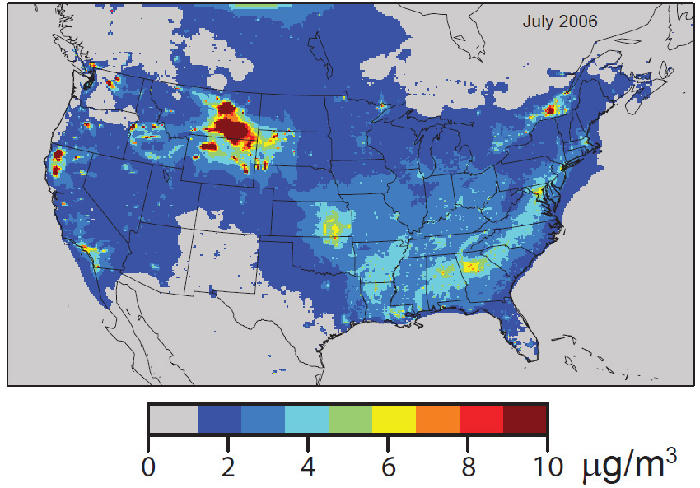
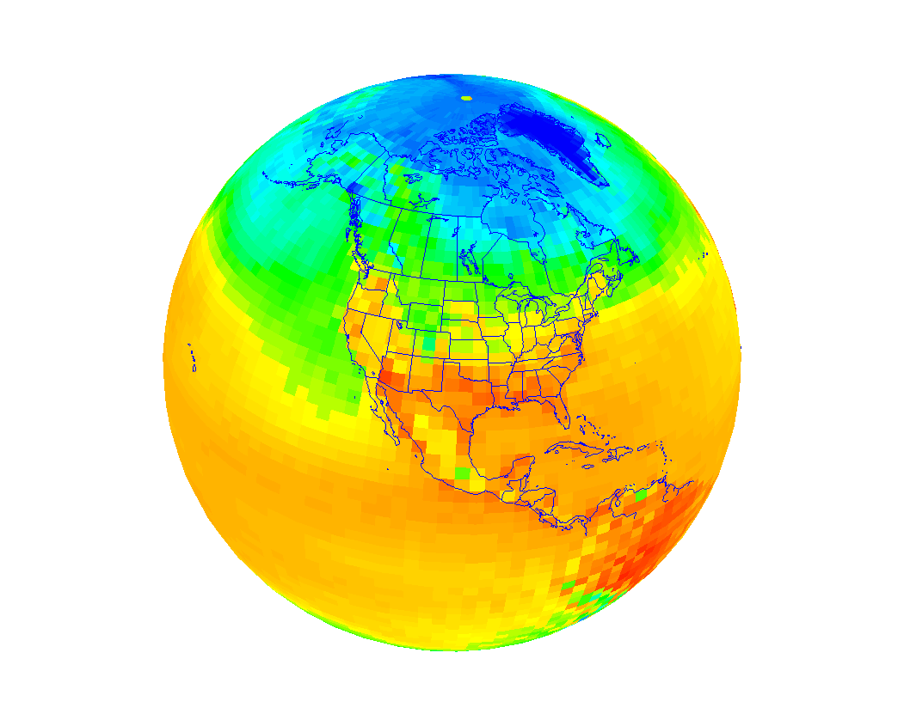

Modeling and Decision support Tools
Near Term Targeted Research |  | Long Term Mission Driven Research
Objective | Examples | Objective | Examples
Develop and evaluate local, regional, and hemispheric air quality modeling tools | CMAQ Local Scale Dispersion Models Hemispheric-CMAQ | Develop and evaluate models to integrate multimedia processes and systems | Integrated air quality and hydrological models for nitrogen

Slide 29



Local- to Urban- to State-Scale MP Air Quality Models
Development and evaluation of modeling tools to improve air quality characterization and exposure estimates at local, urban, and state scales.
Near-term direction
  Further RLINE model development for roadways
  Improvements to regulatory dispersion
  model (AERMOD)
  Continued evaluation and development
  of fine-scale CMAQ
Wind
Notes:
RLINE:
Incorporation of various roadway designs and barriers
Improvements for transportation modeling applications (i.e., gridded meteorology, linkages with MOVES)
AERMOD:
Buoyant line sources
Complex building structures
Area source emissions

Slide 30





Plume Downwash near Long, Narrow Buildings
Research Motivation
Building-induced plume downwash can cause very high short-term concentrations.
The new SO₂ and NO₂ 1-hr NAAQS are being frequently challenged near pollutant sources due to plume downwash.
Wind tunnel data provide a scientific basis for new downwash algorithm development and evaluation.
Meteorological
wind tunnel
Building-Induced Downwash
Flow
Complex horizontal flow around long buildings
Effects of wind direction
Wind Tunnel Simulations

Slide 31



Regional- to Continental-Scale MP Air Quality Modeling
Development and evaluation of regional to continental
scale air quality modeling systems for individual
pollutant and multipollutant analyses.
Near-term direction
  Next CMAQ release
  Multipollutant air quality impacts of oil and gas development
    Opportunity for further development of:
      CMAQ-ISAM
      Fine-scale CMAQ
      Meteorological modeling
      Chemical mechanisms
  Aromatic hydrocarbon chemistry
Notes:
A number of improvements/enhancements for CMAQ v5.1 including: (see Fact Sheet at poster for more detail)
Improved treatment of UF particles
Updates to mechanims to bring state-of-science to improve nitrogen cycling
Updates to biogenics model (BEIS)
Bidirectional exchange of soil NO
Improved direct aerosol effects on radiation
New O&G task
Expansion of product under emissions project looking at integrated approaches (measurements, receptor modeling tools, and CMAQ tagged source estimates)
Proof-of-concept in the Uinta Basin, Utah as a demonstration of our modeling capabilities to address the emerging and scientifically challenging topic of the impact of oil and gas operations on exposure through air.
Reason:
Ozone can be substantially above the NAAQS in some oil and gas productions areas in WY, UT, CO in the winter
CMAQ can not currently predict this, due to emissions, meteorological and chemical uncertainties.

Slide 32


Modeling Air Quality impacts on Pollutant Deposition and Water Quality
Development and evaluation of models to characterize the complete atmospheric
deposition budget for ecosystems and
provide the necessary linkage between
atmospheric deposition and ecosystem exposure.
Near-term direction
  Couple Air and Land Modeling (including land use and agricultural land management with USDA EPIC model)
  Coupled meteorology (WRF) and hydrology (VIC) modeling system
  Coupled Air System Models (WRF/VIC/EPIC/CMAQ) for N-Cascade
Notes:
Initial coupling between air and land modeling completed leading to improved state-of-science CMAQ incorporating NH3 bi-directional exchange
Coupled meteorology and hydrology for advanced climate and land use change analysis
Prototypes of model linkage for a one-environment modeling system
Case studies underway:
Acidification along the Appalachian spine (simple linkage system)
Mississippi River Basin to address nutrient loading and GOM hypoxia (complex linkage system)
Cross-program effort! SHC, SSWR, ACE
Connections to other ACE projects – MDST-4, NMP-6, MDST-2

Slide 33
Nitrogen: Air, Land and Water are Interconnected
A One-Environment Capability Can Illuminate Win-Win Cases
Greenhouse
Gas (N₂O) –
Climate
O₃, PM_{2.5} -
Health;
Visibility -
Aesthetics
Recreation -
Aesthetics;
Groundwater
Nitrate – Health;
Biodiversity
Ecosystem
Health;
Economic
Health
Agriculture
Management
NH₃
N,P Load
N₂O
Combustion
NO_{X}
VOC
Air Quality
N
Deposition
Water Quality
Meteorology
N,P
Load
Climate
Hypoxia
Hydrology
N
Deposition
Hydrodynamics
33
Notes:
This slide illustrates the multiple and cross-media environmental issues arising from the release of N-compounds to the environment as a result of various energy producing activities (both combustion and agricultural). Also illustrated are the connections between the various components and models that would need to be robustly examined to accurately model the Nitrogen cascade through the environment and examine the various linkages so that unintended consequences can be identified.
The left hand side of the figure represents much of AMAD’s current efforts to comprehensively representing and connect the atmospheric component with the land and water. Connecting to the hydrology and Ag. Mgmt. components is critical for linking the atmosphere to the water and land components.

Slide 34




Hemispheric- to Global-Scale MP Air Quality and Climate Models
Development and evaluation of
modeling systems to explore air
quality-climate interactions in the U.S. in the context of global influences.
Near-term direction
  Expansion of CMAQ to hemispheric scales
  Link meteorology and hydrology modeling to
  better address climate change on water availability and water quality
  Incorporation of cloud-radiation interactions and convective cloud microphysical processes into WRF model
Lower bias
Higher bias

Slide 35

Emerging Environmental Problems Require
Integrated Modeling Approaches
Traditional
focus
Notes:
Future regulatory actions would need to simultaneously address multiple linked-environmental issues. Modeling systems that expand and integrate current models are needed. As an example, atmospheric models have traditionally been applied to examine control strategies for single (and more recently multiple) pollutants. These models are now being expanded to link with other models to examine: (1) air quality-human health linkages; (2) atmosphere-ecosystem exposure; (3) air quality-climate interactions

Slide 36




Impacts of Climate Change
Daily Max Temp
Daily Max 8-h O₃
2030: Changes in Regional Climate
Lead to Increases in Ozone Assuming Constant Emissions
ModelE2 (RCP 6.0)
Areas of increased daily maximum
8-h average ozone largely consistent with areas of increased daily maximum temperature
Nolte et al., in prep
CESM (RCP 8.5)
Notes:
These plots are May-Sept.

Slide 37



There is a sense of urgency... If we don't move to address energy and climate as two sides of the same coin we will lose out. Time, April 23, 2009
Lisa Jackson
EPA Administrator
Out of the Headlines
Global population soars…
  1 Billion in 1804
  2 billion in 1927
  6 billion in 2000
  7 billion in 2011
  10-15 billion in 3000
People need …
  Safe food, shelter, clean water, and clean air
  But the key is cheap, “sustainable” energy

Slide 38

Energy is essential for economic
and social development
Population growth
Growing demand
Population growth
Global pop. divided into income groups:
By 2050, world population could rise to ~ 9 billion.¹
Primary energy
Developed (GDP>$12,000)
Emerging (GDP<$12,000)
10000
Developing (GDP<$5,000)
Poorest (GDP<$1,500)
8000
Shifting the development profile to a “low poverty” world means energy needs double by 2050
6000
Population, millions
4000
Shifting the development profile further to a “developed” world means energy needs triple by 2050
2000
Base case
Low
Poverty
Prosperous
world
0
Source: WBCSD adaptation of IEA 2003
2000
2050
Notes:
38
References for statistics in this slide
¹UN 2002. World population prospects.

Slide 39
An Example of the Challenge Before Us
David Douglas of Sun Microsystems
  In 15 years the global pop. increases 1B
  Give each a 60W light bulb
    0.7 oz. = 20K metric tons = 15K Priuses
    Turned on = 60K megawatts
    Use 4hrs / day == 10K megawatts
  Power needed: 20 500 megwatt coal fired(?) power plants
Just to turn the lights on!!
From Tom Friedman, Hot, Flat and Crowded 2009

Slide 40
Global Warming Impacts of these Plants
More efficient plants emit less pollution and CO2
Natural gas plants have lower emissions than corresponding coal plants.
A 33% efficient coal plant: releases 2.1 lb of CO2 for every kWh generated.
A 50% efficient coal plant: releases 1.4 lb of CO2 for every kWh generated.
A 50% efficient natural gas plant: releases 0.76 lb of CO2 for every kWh generated.

Slide 41



1964
The times they are a changin’

Slide 42


Questions?
http://www.epa.gov/research/airscience/

