Slide 1
Investigating Ambient Ozone Formation Regimes in Neighboring Cities of Shale Plays in Northeast U.S. and Texas, 2007-2013
Chih-Yuan Chang, Eric Faust, Xiangting Hou, Dr. Kuo-Jen Liao
Department of Environmental Engineering
October 28, 2014
Notes:
Good afternoon! I am Andy, a PhD student at Texas A&M University-Kingsville.
My advisor is KJ Liao, and he has to teach today. So I am presenting this study on behalf of him.
This presentation includes our most recent study regarding ozone formation in neighboring cities of shale plays in NE U.S. and Texas.

Slide 2
Introduction
As of July 2014, there were more than 200 ozone nonattainment counties in the U.S.
Since 2010, technological advances, mainly hydraulic fracturing and horizontal drilling in shale, have significantly increased domestic production of unconventional oil and gas in the U.S.
To develop effective air quality management strategies currently and in the future, the objective of this study is to investigate ozone formation regimes in neighboring cities of shale plays.
We combine CMAQ-DDM sensitivity analysis and satellite retrievals of air pollutants to investigate ozone formation regimes in neighboring cities of major shale plays in the U.S.
Notes:
Based on EPA data, there are more than 200 nonattainment areas in the U.S.
Since 2010, fracking and horizontal drilling have significantly increased oil and gas production in the U.S. However, such shale oil and gas development could increase air pollutant emissions.
Therefore, to develop effective air quality management strategies, The objective of this study is to investigate ozone formation regimes in neighboring cities of shale plays.
To achieve the objective, we combine CMAQ-DDM sensitivity analysis and satellite retrieved HCHO and NO₂ columns to investigate ozone formation regimes.
To??? At?? In?? the end, we hope the results of this study can provide useful information for decision makers developing air quality management strategies in the U.S.
________________________________________________________________________________________________________
Add associated with shale oil and gas
From studies in Northeast U.S. and Texas, these activates could increase air pollutant emissions
Therefore to develop effective air quality management strategies , the objective……..
…..To the end, we hope the results of this study can provide useful information in urban areas they are close to shale plays

Slide 3
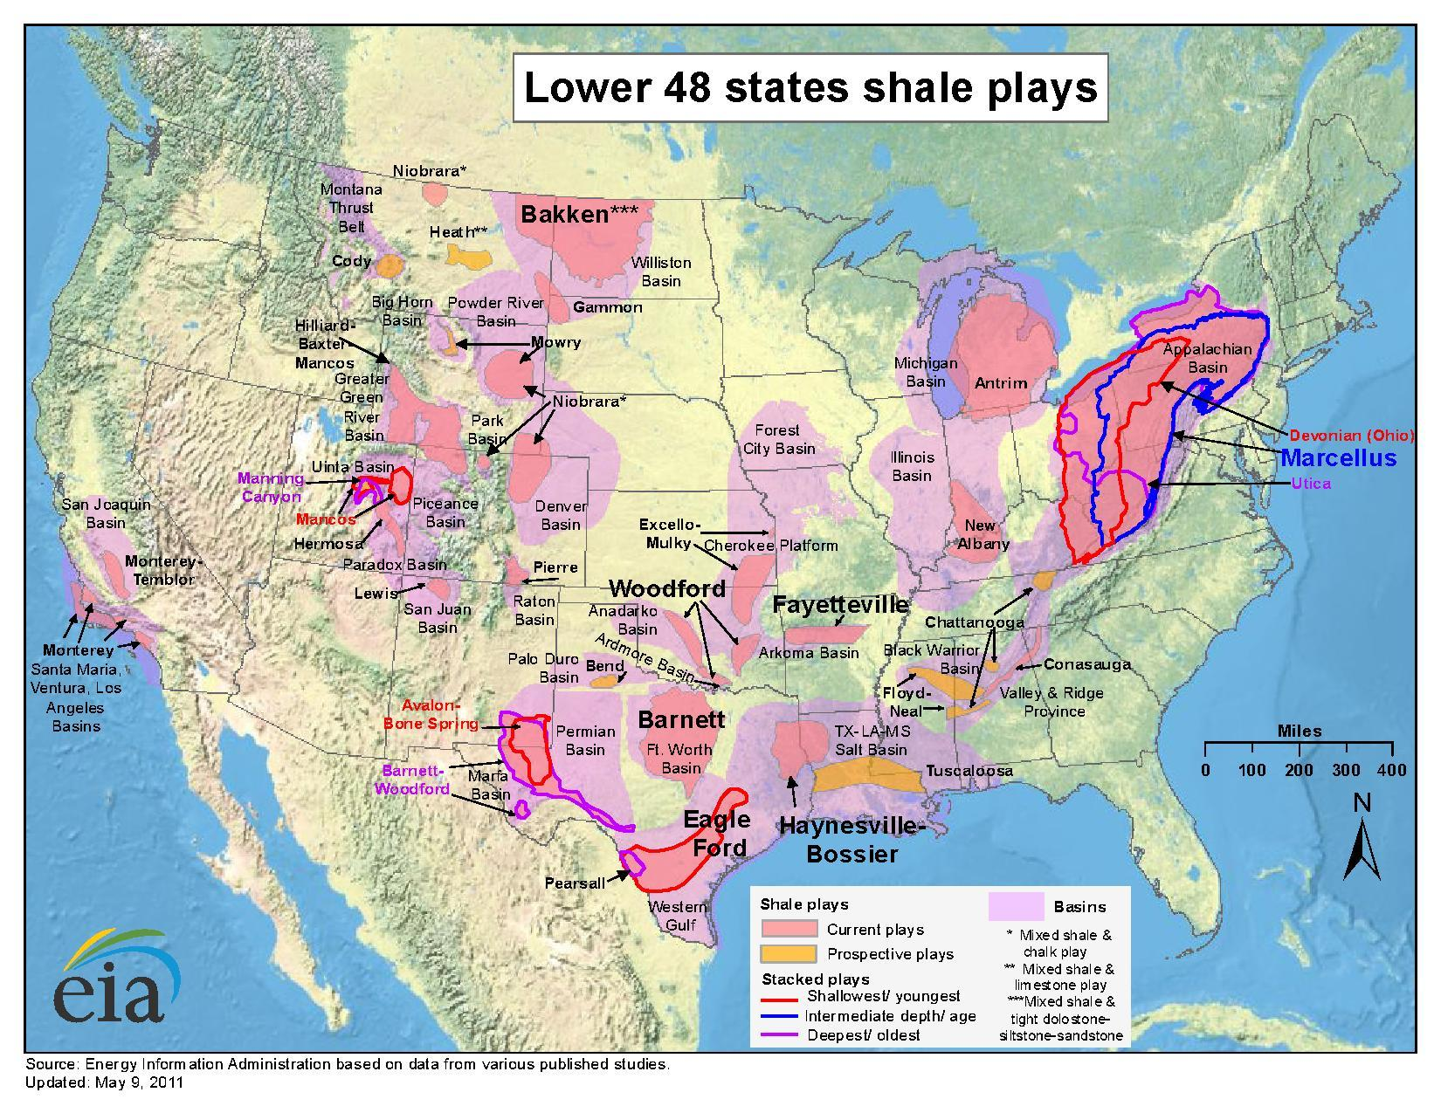
Locations of Shale Plays in the U.S.
Notes:
This map from U.S. Energy information administration shows locations of shale plays in the U.S.
We focus on Marcellus Shale in Northeast U.S. which has the largest shale gas production in the U.S. and is close to several urban areas with nonattainment ozone air quality.
In Texas, Eagle Ford Shale has the largest shale oil production in the U.S., and other two important shales Barnett Shale and Haynesville Shale also have significant oil and gas production. Several cities close to the three shales are ozone air quality nonattainment areas or their ozone concentrations are close to the standard.
______________________________________________________________________________
We focus on Marcellus (big gas), Eagle Ford (big oil) and other two important shales

Slide 4
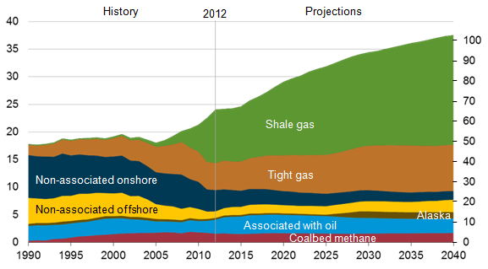
Shale Gas Production Leads Growth in Production Through 2040
The annual production of shale gas is expected to increase nationally from 40% to 53% of total natural gas production in the United States from 2012 to 2040. (U.S. EIA, 2014)
(Trillion cubic feet)
Natural gas production
Source: U.S. EIA, Annual Energy Outlook 2014
Notes:
This is another figure from U.S. EIA, and it shows that annual shale gas production is projected to increase from 40% to 53% of total natural gas production in the U.S. from 2012 to 2040.
If we look at total amount of shale gas production, the production will double in 2040 compared to 2012.
Base on this projection, we think air pollutant emissions associated with shale gas related activities are likely to increase and affect regional air quality in the future

Slide 5
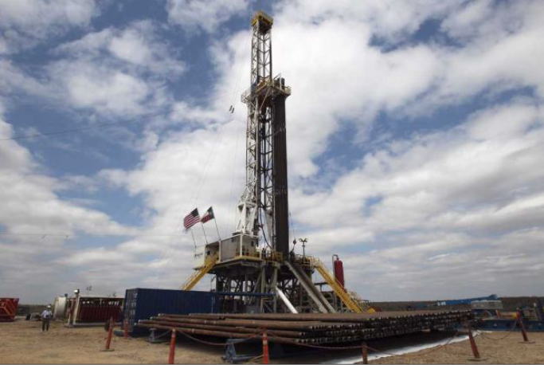
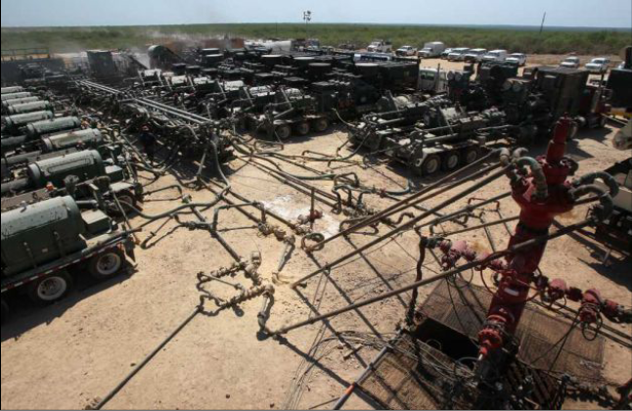
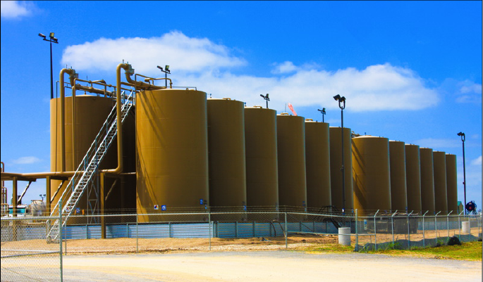
5
Source : U.S. EPA
Notes:
We got this figure form USEPA, and it is used to show you potential air pollutant emission sources associated with oil and gas activities.
For the drilling phase, main air pollutant emission sources are rigs and diseal-fuel electricity generators.
For the hydraulic fracturing phase, main air pollutant emission sources are flares and pumping trucks.
For the production, emissions are from storage tanks and engine combustions.

Slide 6
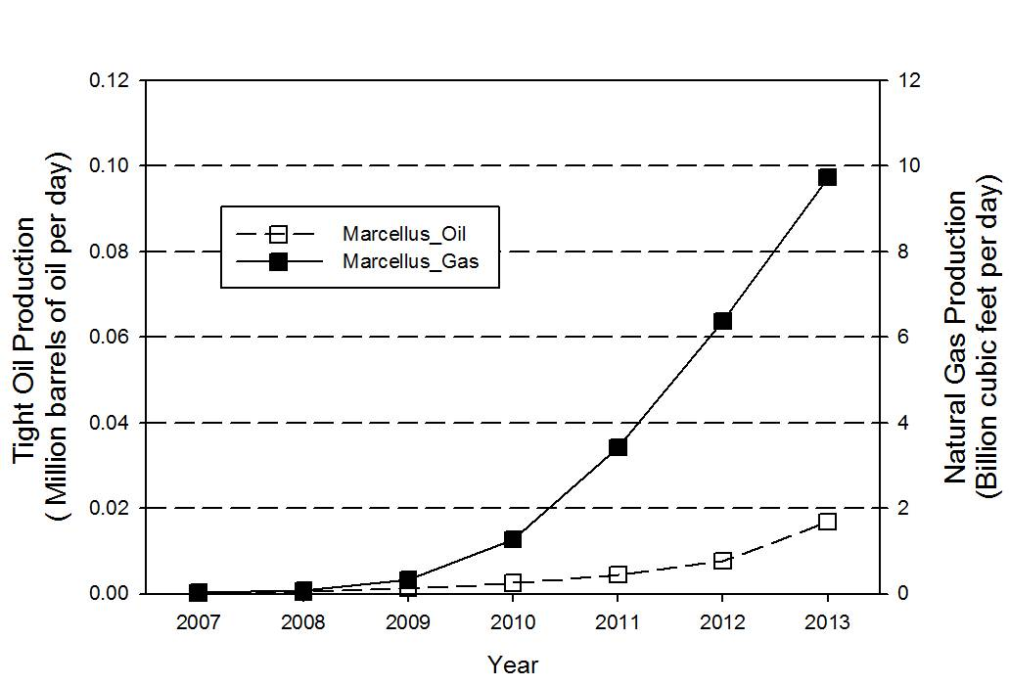
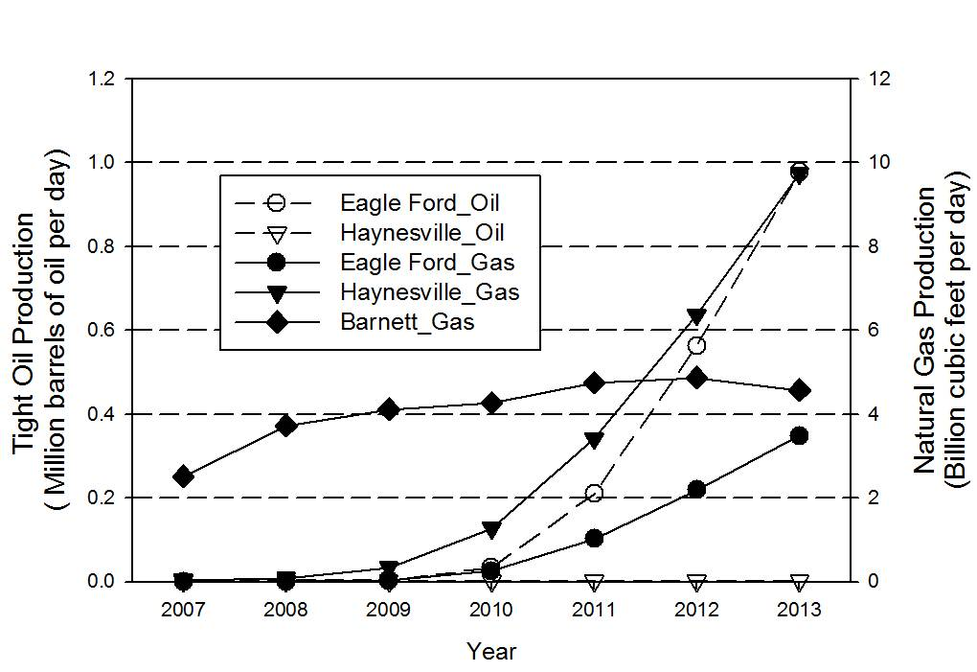
Studying Areas and Oil and Gas Production
(a)
(c)
Marcellus Shale
(b)
(d)
Barnett Shale
Haynesville Shale
Eagle Ford Shale
Notes:
As I mentioned earlier, we focus on Northeast U.S. and Texas. The cities we consider in Northeast U.S. are Boston, New York, Philadelphia, DC, and Pittsburgh. You can see the natural gas production in Marcellus Shale was high.
In Texas, cities we considered are Austin, Corpus Christi, Dallas, Houston and San Antonio. As you can see oil production form Eagle Ford Shale was very high.
_______________________________________________________________________________________________

Slide 7
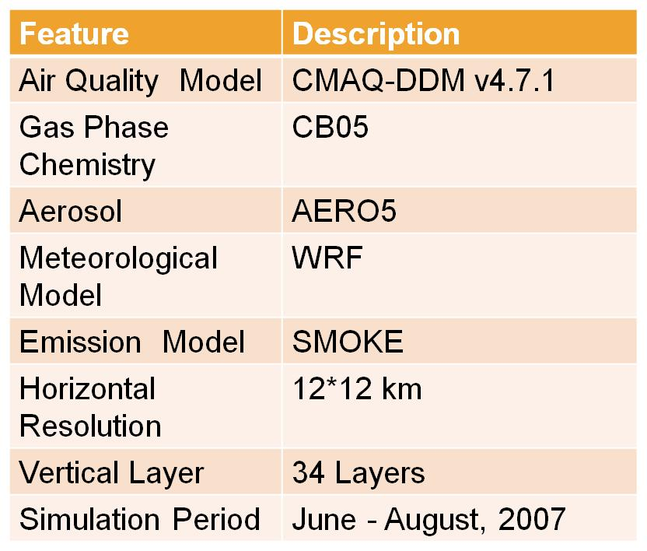
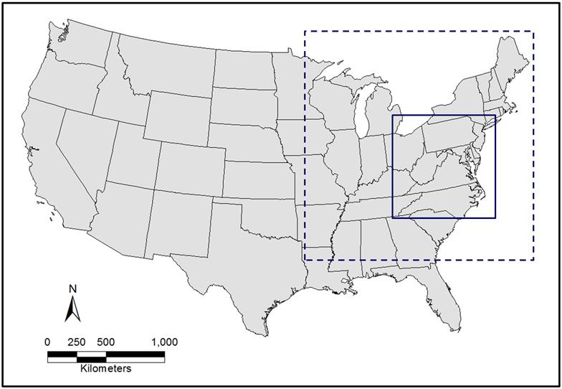
Photochemical modeling and ozone sensitivity
The emission inventory used for this study was the 2007 Mid-
Atlantic Regional Air Management Association (MARAMA) Level 2 Inventory. (Vickers et al., 2011)
The decoupled direct method 3D (DDM-3D) in CMAQ v. 4.7.1 was applied to investigate sensitivities of ozone concentrations to precursor emission changes.
Cities: Boston, Pittsburgh, Philadelphia, New York and Washington, D.C.
Notes:
As I mentioned in the beginning, we used CMAQ-DDM sensitivity analysis and satellite retrievals in this study. The dash rectangle is our modeling domain and it covers the eastern U.S.
The spatial resolution is 12x12 km, it has 34 vertical layers. The modeling episode is the 2007 summer.
In the CMAQ-DDM results, we specifically look at sensitivity of 8 hr ozone to ozone precursor emissions for 5 cities in Northeast U.S.

Slide 8
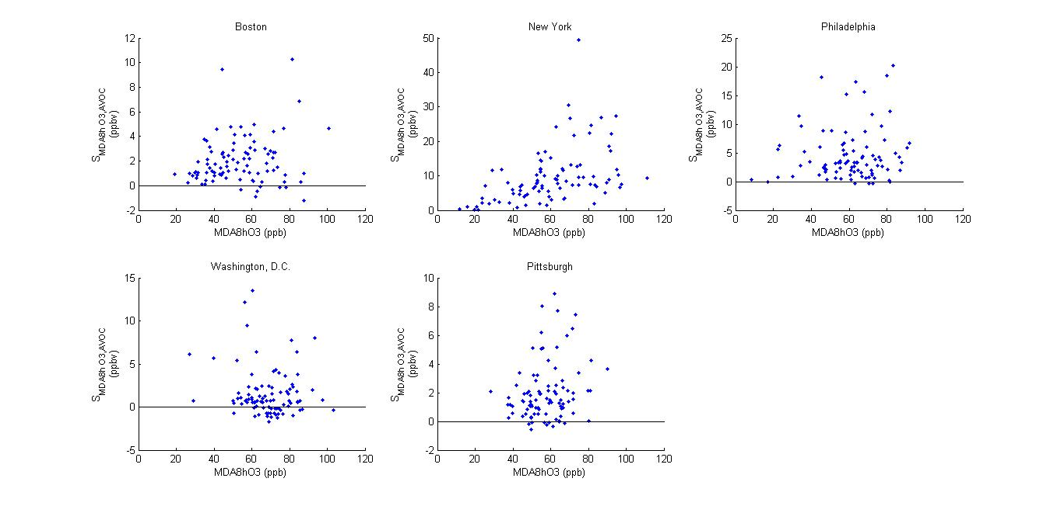
Response of Ozone Formation to VOC Emissions
Boston
New York
Philadelphia
Washington, D.C.
Pittsburgh
Sensitivities of ozone to VOC emissions were positive
Notes:
2. In these cities, sensitivities of MAD8h O3 to VOC emissions were positive during the modeling episode, which mean reductions in VOC emissions would decrease ozone concentrations.
3. In New York, ozone sensitivities were up to 30 ppb. It means that VOC emissions had significant contributions to ozone formation.
___________________________________________
**In D.C., ozone sensitivities were closed to zero.
________________________________________________________________________________________________________________
Which mean reuduction in VOC emission would decreased ozone concentrations
In New York, sensitivey of MADOO3 were up to 30 ppb. It means that VOC emissions had signifcant contribution to ozone formtion.

Slide 9
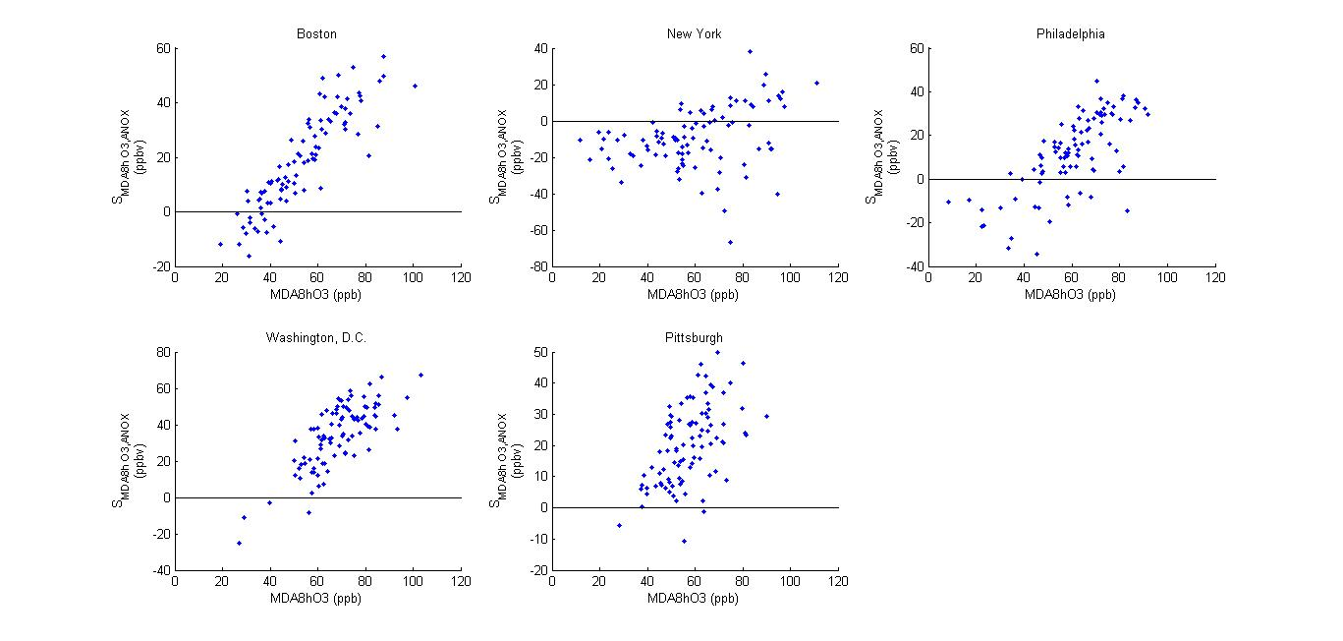
Response of Ozone Formation to NO_{x} Emissions
Boston
New York
Philadelphia
Washington, D.C.
Pittsburgh
Sensitivities of ozone to NO_{x} emissions were much larger than VOC emissions in most of cities except of New York.
Notes:
These figures show ozone sensitivities to emissions of NOx which is another important ozone precursors.
The results show that ozone sensitivities to NOx emissions were much larger than VOC emissions in Boston, Philadelphia, Washington, DC and Pittsburgh, and it means that ozone formation was mainly limited by NOx emissions.
In New York, most sensitivities were negative, and it means reductions in NOx emissions would increase ozone concentrations.

Slide 10
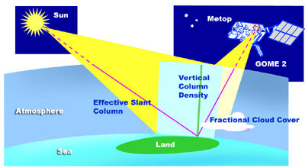
Global Ozone Monitoring Experiment–2 (GOME-2)
Two purposes:
To help understand long term changes in NO₂ and VOC concentrations in the cities.
To combine GOME2 retrievals with the results of sensitivity analysis to diagnose ozone formation regimes.
Both summertime (i.e., June - August) tropospheric NO₂ and formaldehyde (HCHO) column densities measured through GOME-2 were used for 2007 - 2013.
Source: European Space Agency
Notes:
In addition to sensitivity analysis , we used GOME2 retrievals in this study.
There are two purposes:
The first one is to help understand long term changes in NO2 and VOC concentrations.
The second purpose is to combine GOME2 retrievals with the results of sensitivity analysis to diagnose ozone formation regimes in the cities.
Both summertime (i.e., June - August) tropospheric NO₂ and formaldehyde (HCHO) column densities measured through GOME-2 were used for 2007 - 2013.

Slide 11
Time Series of GOME-2 Retrieved HCHO Columns in Cities
Northeast U.S.
Texas
Notes:
These figures show column densities of HCHO in the cities in Northeast US and Texas from 2007 to 2013.
There was no clear trends of HCHO column densities, but these variations could be influenced by local emissions and transported VOC.

Slide 12
Time Series of GOME-2 Retrieved NO₂ Columns in Cities
Northeast U.S.
Texas
NO₂ column densities are positive correlative with changes in NO_{x} emissions.
12
Notes:
These figures show column densities of NO2 in the cities in Northeast US and Texas from 2007 to 2013.
Many studies show that variations in NO2 column densities are positive correlative with changes in NOx emissions.
So, the changing in NO2 column densities means lower NO2 emissions in the cities in Northeast U.S. The reductions in NOx emissions were attributed to stringent standards and regulations such as CAIR and SIPs.
In Texas, only Houston had significant NOx emission reductions. It is because Houston was an ozone nonattainment area and its NOx emissions were required to control by SIPs.
_____________________________________________________________________________
Texas: other state-lev el regulations , SIPs
Houston nonattainment area,

Slide 13
HCHO/NO₂ Column Ratio as an indicator
New York
New York
Ratio < 1
VOC-Limited Regime
13
Notes:
Here, we combined the results of sensitivity analysis and satellite retrievals to develop a threshold of HCHO/NO2 ratios, they can be used to diagnose NOx and VOC-limited ozone formation regimes.
From the results of sensitivity analysis I showed you, VOC –limited regime occurred in New York, at the same time the ratio of GOME2 retrieved HCHO and NO2 columns was less than 1, so we defined that VOC-limited regime occurred when the ratio is less than 1.

Slide 14
HCHO/NO₂ Column Ratio as an indicator
Boston
Boston
2 > Ratio > 1
Transition Regime
14
Notes:
The results of sensitivity analysis show that reductions in both NOX and VOC emissions would decrease ozone formation in Boston, at same time the ratio of HCHO andNO2 columns was between 1 and 2 .
So, we defined that transition regime occurred when the ratio is between 1 and 2.
When the ratio was larger, ozone formation is sensitive to NOx emissions. So, we defined that NOx-limited ozone formation regime occurred when the ratio is larger than 2.

Slide 15
Time Series of HCHO/NO₂ Ratios in Cities
Northeast U.S.
Texas
Variations in ratios were mainly influenced by HCHO column densities.
NO_{x}-limited
NO_{x}-Limited Threshold
Transition limited
VOC-Limited Threshold
VOC-limited
Notes:
By using thresholds we developed, we can understand changes in ozone formation regimes during 2007 and 2013, for the cities in NEUS and Texas.
Variations in ratios were mainly influenced by HCHO column densities changes since the changes in HCHO columns were larger than the changes in NO2 column densities .
In Northeast U.S., transition regimes occurred in most cities before 2010 which means reductions in both VOC and NOX emissions could decrease ozone formation.
After 2010, ozone in some cities became NOx-limited regimes, and reductions in NOX emissions, including those from shale oil and gas related activities, would decrease ozone formation.
The NOx limit regime occurred during 2007 and 2013 for all the cities in Texas which means reductions in NOx emissions could decrease ambient ozone concentrations.

Slide 16
Conclusions
Implication for regional air quality management:
Control of NO_{x} emissions will be effective for improving ozone air quality in Texas if HCHO/NO₂ does not change significantly in the future.
Controls of both NO_{X} and VOC emissions will be effective for improving ozone air quality in most of the Northeast U.S. cities.
With projected increases in production of O&G in the U.S., emissions from shale O&G-related activities can have a potential to affect ambient ozone formation.
Controls of air pollutant emissions from shale O&G-related activities should be considered as a potential strategy for mitigating ozone air pollution in the future.
The thresholds of HCHO/NO₂ for VOC-limited and NO_{X}-limited regimes are 1 and 2, respectively. The ratio of HCHO and NO₂ columns between 1 and 2 is the transition regime.
In Northeast U.S., the transition regime occurred in most of the cities before 2010, and ozone in some cities became the NO_{x}-limited regime after 2010.
The NO_{x}-limited regime occurred in neighboring cities of the shale plays in Texas during 2007-2013.
Notes:
The thresholds of ratios of GOME-2 retrieved HCHO and NO₂ columns for VOC-limited and NO_{X}-limited ozone formation regimes are 1 and 2, respectively. The ratio of HCHO and NO₂ columns between 1 and 2 is the transition regime.
In Northeast U.S., the ozone formation transition regime occurred in most of the neighboring cities of Marcellus Shale before 2010, and ozone formation in some cities became the NOx-limited regime after 2010.
The NO_{x}-limited ozone formation regime occurred in the neighboring cities of the shale plays in Texas during 2007-2013.

Slide 17
Acknowledgements
U.S. EPA STAR grant R835218
NSF RD-0734850
Eagle Ford Center for Research, Education and Outreach (EFCREO) at Texas A&M University-Kingsville.
Texas Advanced Computing Center (TACC) providing High-Performance Computing (HPC) resources.

Slide 18
Thank you!! Questions?? Contact information Dr. Kuo-Jen Liao Kuo-Jen.Liao@tamuk.edu 361-593-3898

Slide 19
Time Series of GOME-2 Retrieved HCHO and NO₂ Columns in Shale Areas
(a)
(b)
HCHO
NO₂

Slide 20
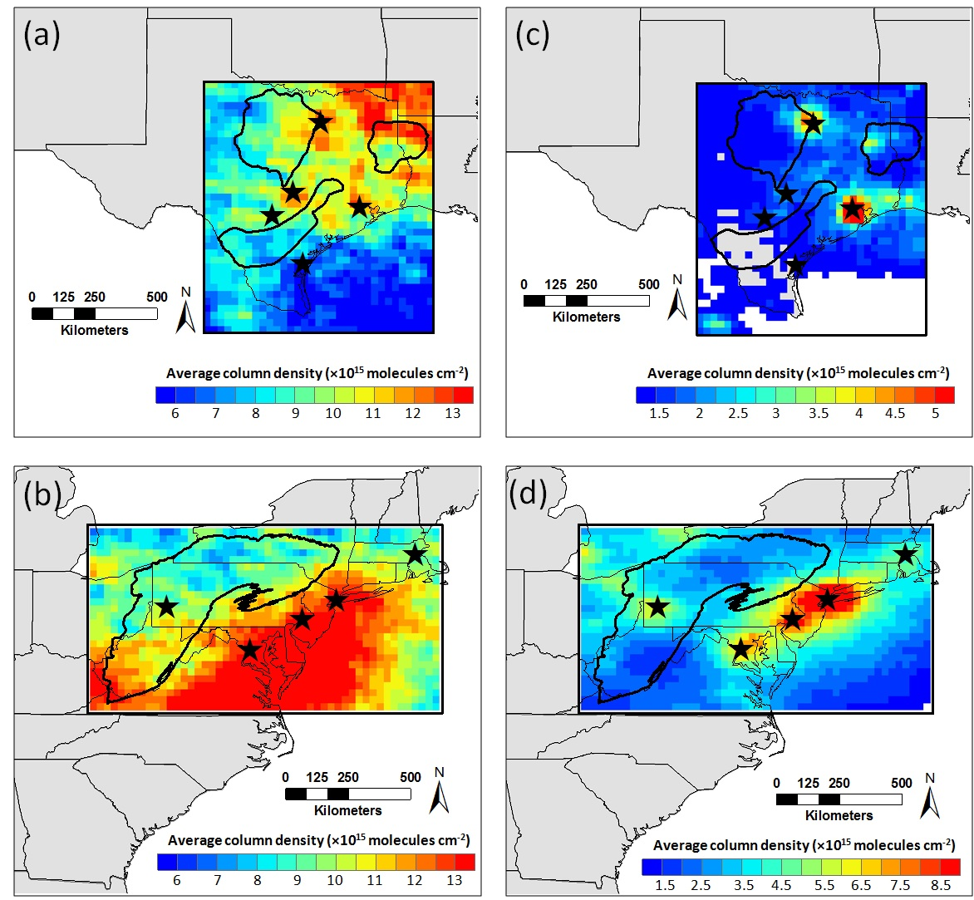
GOME-2 Retrieved NO₂ and HCHO in 2007
HCHO
NO₂
HCHO
NO₂
Notes:
Figure 2. GOME-2 retrieved summertime (June-August) average (a, b) HCHO, (c, d) NO₂ column densities in 2007 in Texas and Northeast U.S. White areas in maps mean values < 1.0×10¹⁵ molecules cm⁻² for NO₂ (Figure 2c,d).

Slide 21
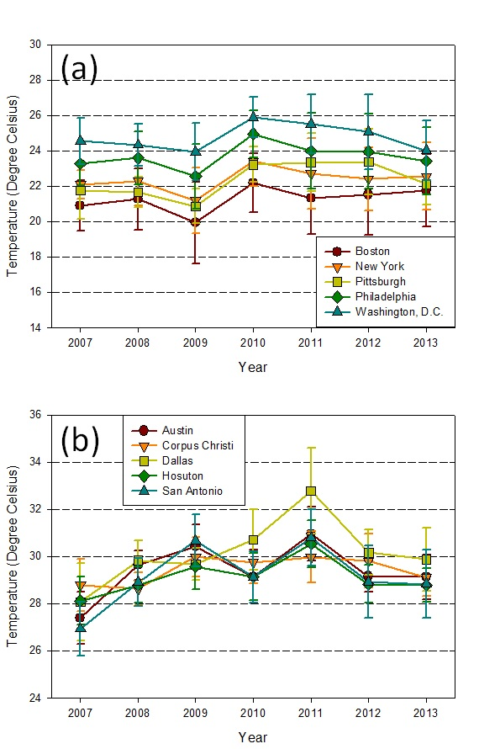

Slide 22
Figure S2. Land cover characteristics data in the U.S. (Source: U.S. Geological Survey National Land Cover Database 2006)

Slide 23
Table S1. Emission factors of major land covers in Texas and Northeast U.S.
 | Isoprene | ORVOC* | Nitric Oxide
Land cover | (g C/km²-hr) | (g C/km²-hr) | (g N/km²-hr)
Cropland/Grassland Mosaic | 28 | 29 | 34
Cropland /Woodland Mosaic | 2650 | 29 | 21
Deciduous Broadleaf Forest | 6707 | 22 | 2
Dryland Cropland and Pasture | 28 | 22 | 34
Evergreen Needleleaf Forest | 7918 | 39 | 2
Grassland | 49 | 22 | 27
Mixed Forest | 7729 | 32 | 2
Savanna | 1765 | 7 | 27
Shrubland | 600 | 29 | 2
Urban | 10 | 7 | 6
*ORVOC: Other Reactive Volatile Organic Compounds

Slide 24
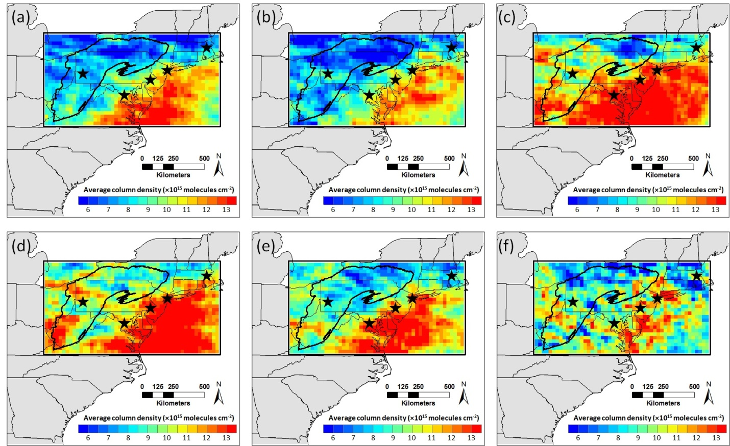
GOME-2 Retrieved HCHO in Northeast U.S. during 2008-2013
2008
2009
2010
2011
2012
2013
Notes:
Figure 6. GOME-2 retrieved summertime (June, July, and August) average HCHO column densities in (a)2008, (b)2009, (c)2010, (d)2011, (e)2012, and (f)2013 in Northeast U.S.

Slide 25
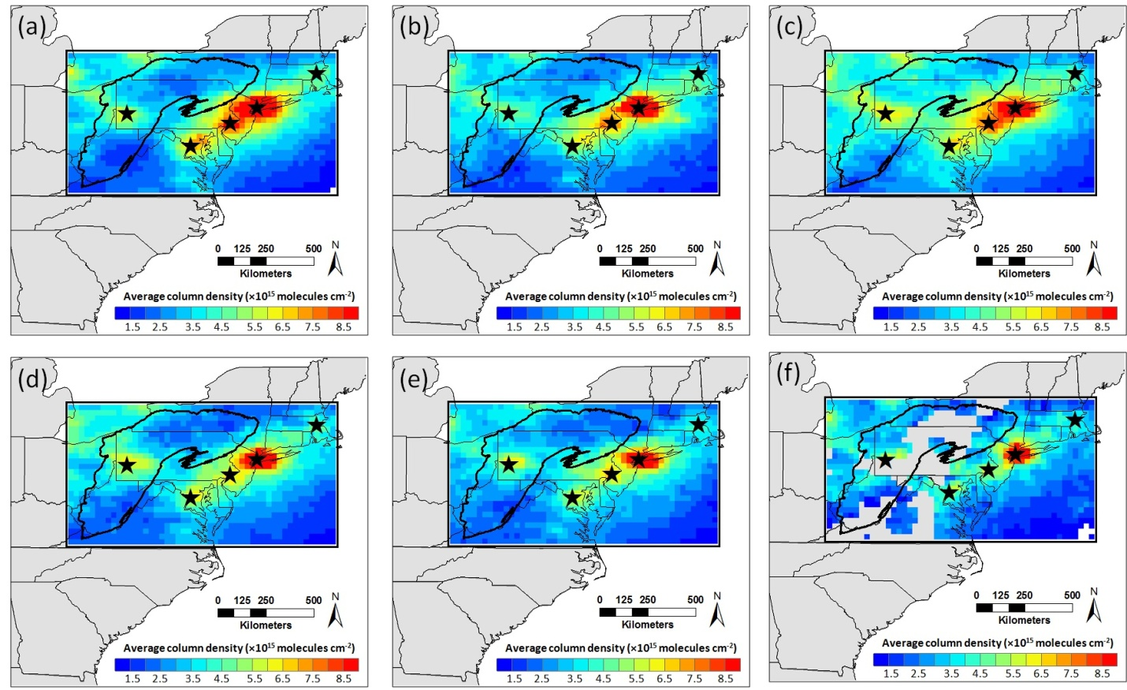
GOME-2 Retrieved NO₂ in Northeast U.S. during 2008-2013
2008
2009
2010
2011
2012
2013
Notes:
Figure 7. GOME-2 retrieved summertime (June, July, and August) average NO₂ column densities in (a)2008, (b)2009, (c)2010, (d)2011, (e)2012, and (f)2013 in Northeast U.S.

Slide 26
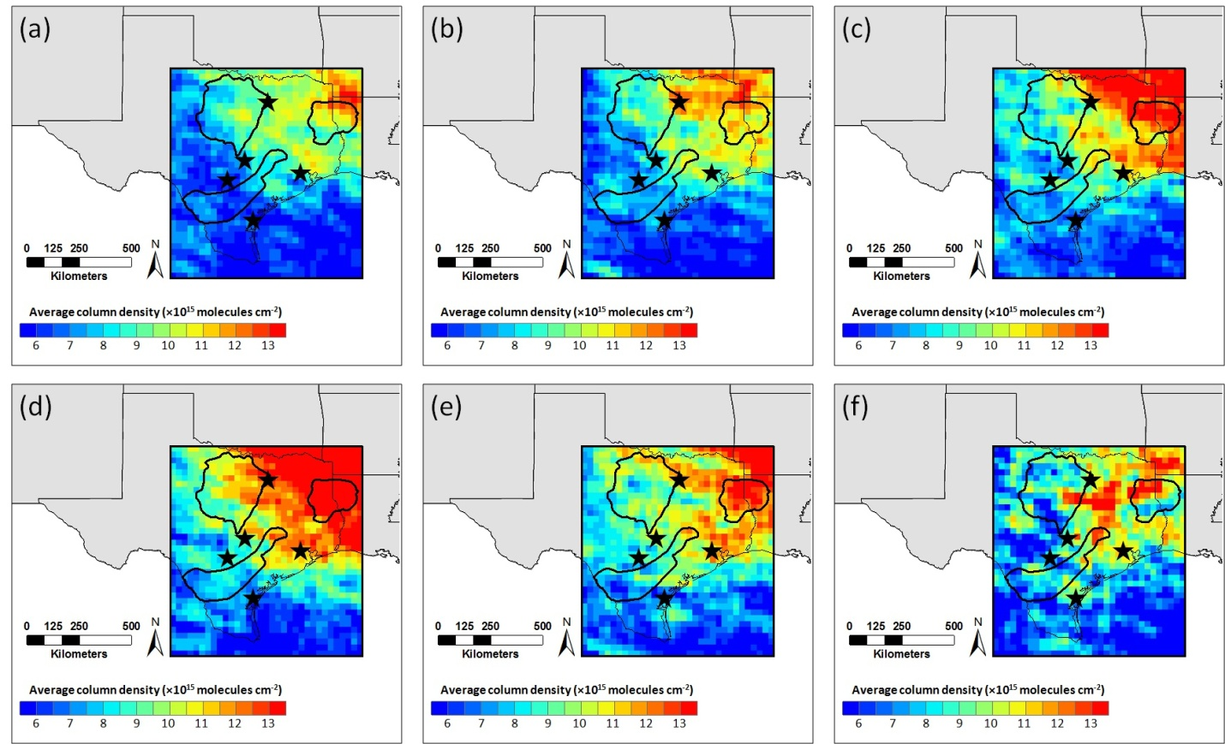
GOME-2 Retrieved HCHO in Texas during 2008-2013
2008
2009
2010
2011
2012
2013
Notes:
Figure 3. GOME-2 retrieved summertime (June, July, and August) average HCHO column densities in (a)2008, (b)2009, (c)2010, (d)2011, (e)2012, and (f)2013 in Texas

Slide 27
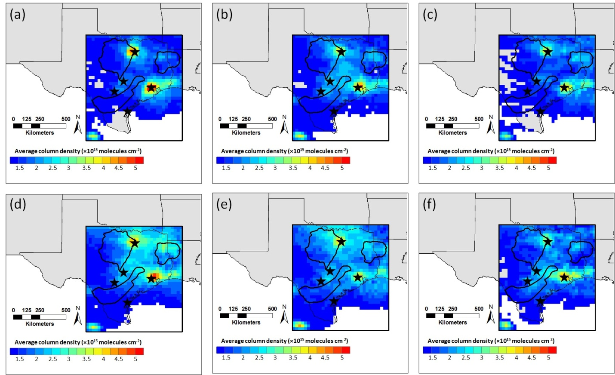
GOME-2 Retrieved NO₂ in Texas during 2008-2013
2008
2009
2010
2011
2012
2013

