Slide 1
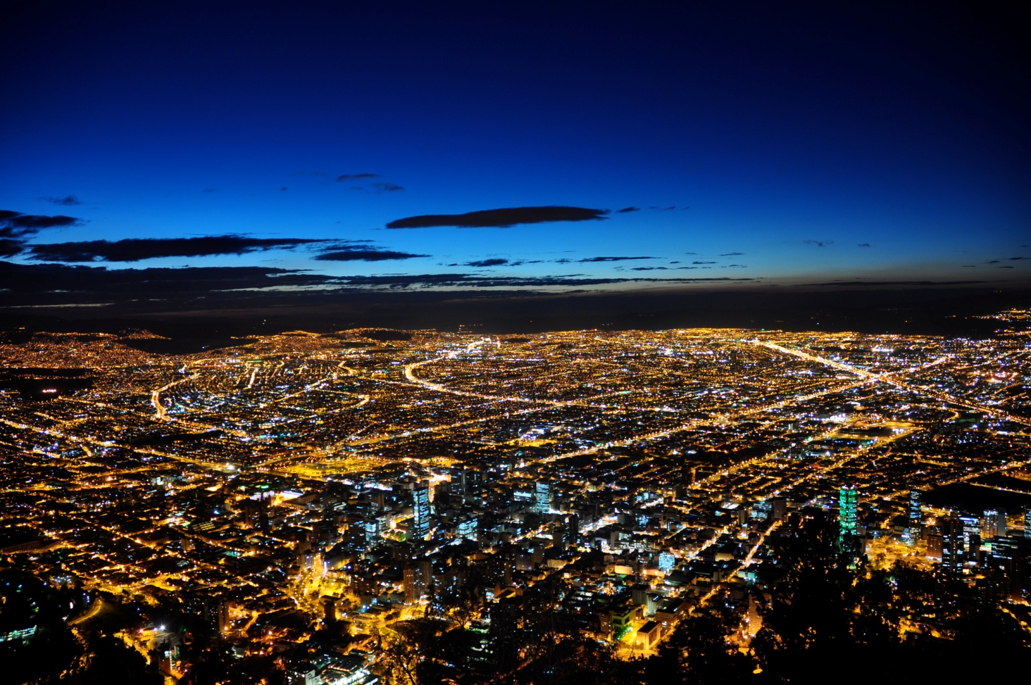
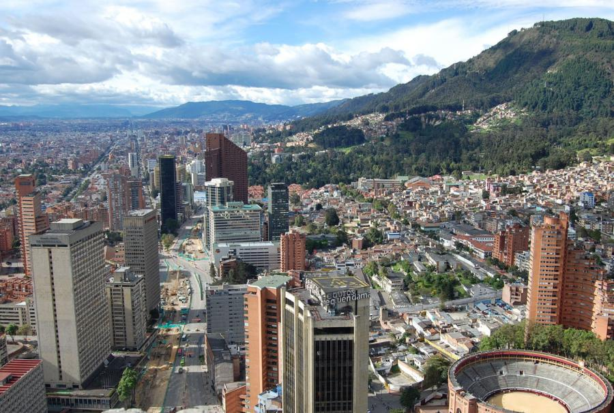
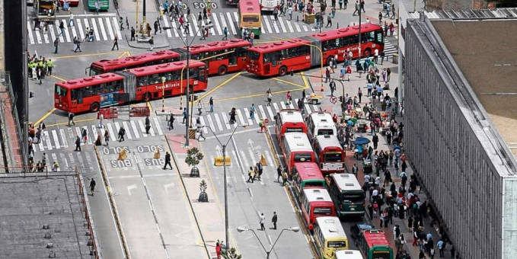


ANALYSIS OF THE AIR QUALITY IN BOGOTA COLOMBIA IN THE LAST DECADE
Boris Galvis¹, Jorge E. Pachon¹, Barron H. Henderson², Edison Ortiz³
1 Universidad de La Salle, Department of Environmental Engineering, Bogota, Colombia
2 University of Florida, Department of Environmental Engineering, Gainesville, FL
3 Universidad de La Salle, Centro Lasallista de Investigación y Modelación Ambiental CLIMA
CMAS
October 29 2014
CLIMA
CENTRO LASALLISTA DE INVESTIGACION Y MODELACION AMBIENTAL

Slide 2
Outline
Motivation
Statistics for the City
Monitoring network description
Winds
PM₁₀ trends
Ozone trends
Normalized variations
Why pollutants concentrations have improved?
Summary

Slide 3
Motivation
Bogota has achieved a significant improvement in its air quality during the last decade, however particulate matter concentrations in the city are still above WHO guideline values.
In this work we analyze the data reported between 2002 and 2012 by Bogota's Air Quality Monitoring Network (RMCAB), using OpenAir tools.
This project was funded by the Bogota’s district secretary for the environment (SDA), under Contract 1467 de 2013 "Development and Implementation of an Air Quality Model for Bogota".

Slide 4
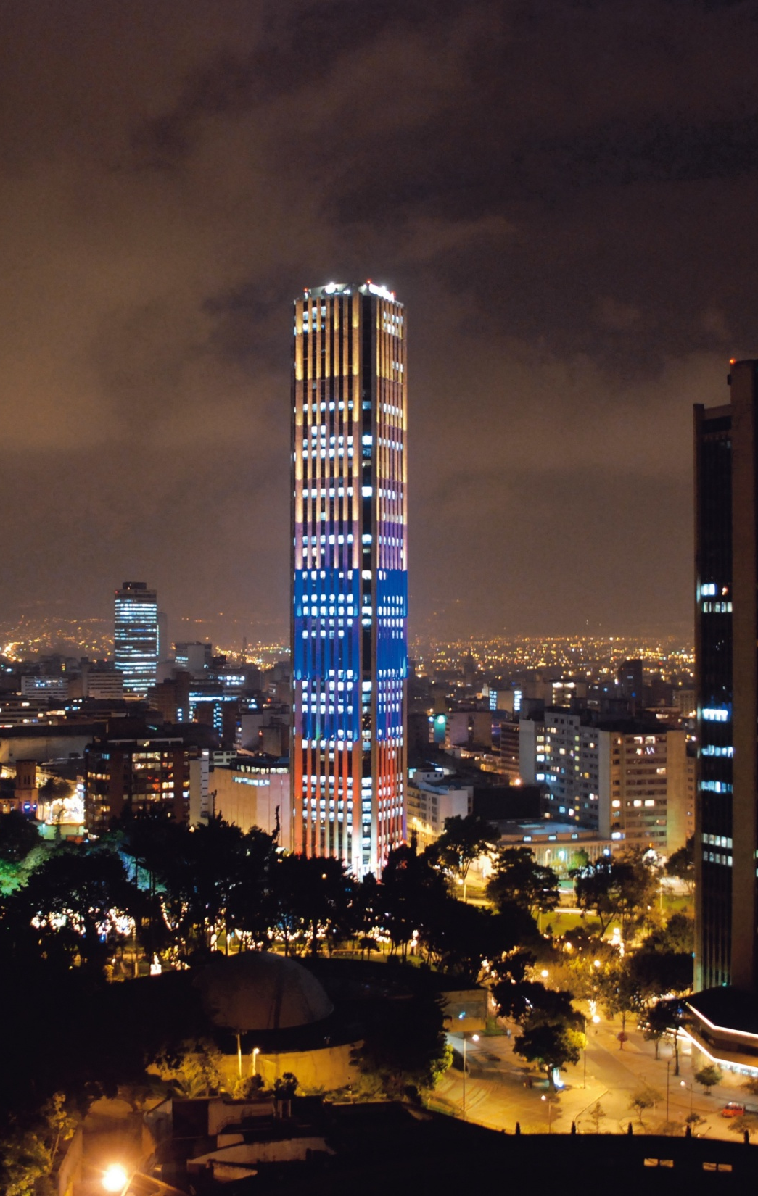
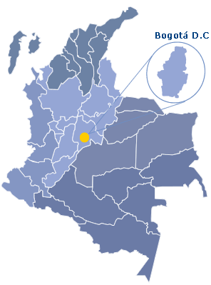
Statistics for the City
2600 m.a.s.l.
8.5 million inhabitants
16 000 inhabitants /km²
16 000 km of roads
16 000 USD GDP per capita, 25% of Colombia’s GDP
15 °C average temperature, min 6 °C, max 24 °C
500 to 1000 mm / year of rain
Notes:
The city is high up in the Andes (8500 feet), it is densely populated, humid, with two distinct rain periods in April- May and October-Novemeber

Slide 5
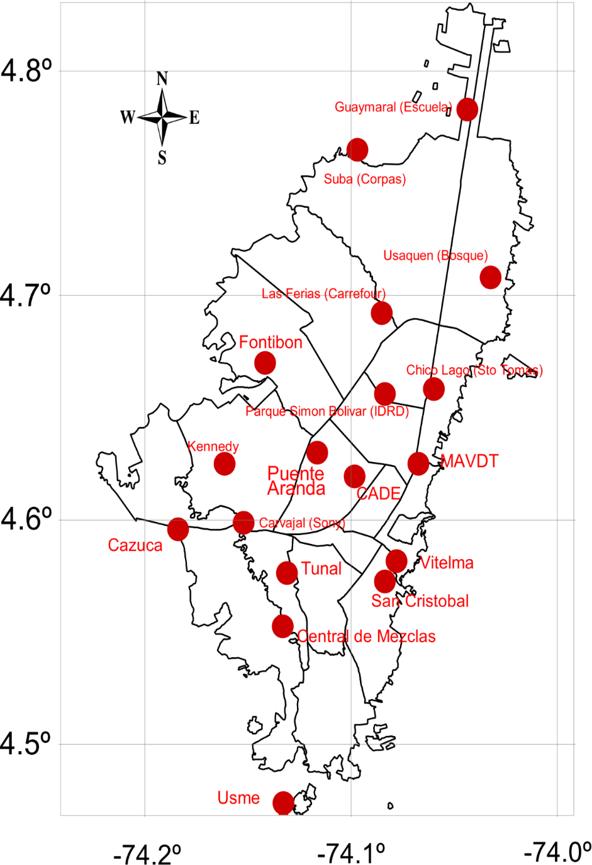
Bogota’s air quality network (RMCAB)
Spatial Coverage
19 sites had been use to monitor concentrations across the city in the past decade
Currently the network 14 active monitoring sites with automatic monitors
Active
Bolivia
Inactive
Site | PM₁₀ | TSP | PM_{2.5} | O₃ | NO₂ | CO | SO₂
Guaymaral | X |  |  | X | X
Usaquén | X |  | X | X |  | X
Suba | X |  |  | X | X |  | X
Bolivia | X |  |  | X |  | X | X
Las Ferias | X |  | X | X | X | X | X
P. Simón Bolívar | X |  | X | X | X | X | X
Sagrado Corazón | X |  |  | X
Fontibón | X |  |  | X |  | X | X
Puente Aranda | X |  |  | X | X | X | X
Kennedy | X |  | X |  | X | X | X
Carvajal | X | X | X | X |  | X | X
Tunal | X |  | X | X | X | X | X
San Cristóbal | X |  |  | X |  | X | X
Móvil | X |  |  | X | X | X | X
Mobile Site
Notes:
Many monitoring sites have change location over the years.
There has not been a continuous effort to speciate particulate matter so far.
PM2.5 mass staerd to be measured city wide only from 2014
leyenda

Slide 6
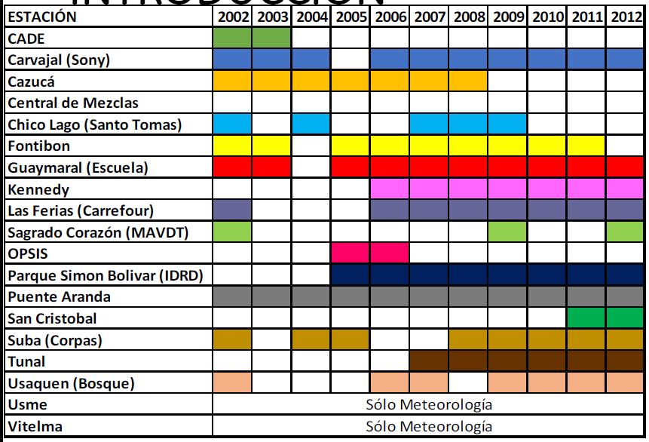
Bogota’s air quality network (RMCAB)
Time coverage
The network has been monitoring since 1997 with ups an downs in its operation
In 2008 there was a major technological update of the monitoring network
Years with sufficient time coverage for PM₁₀
Notes:
Budget and technical problems make the data sometimes sparse.

Slide 7
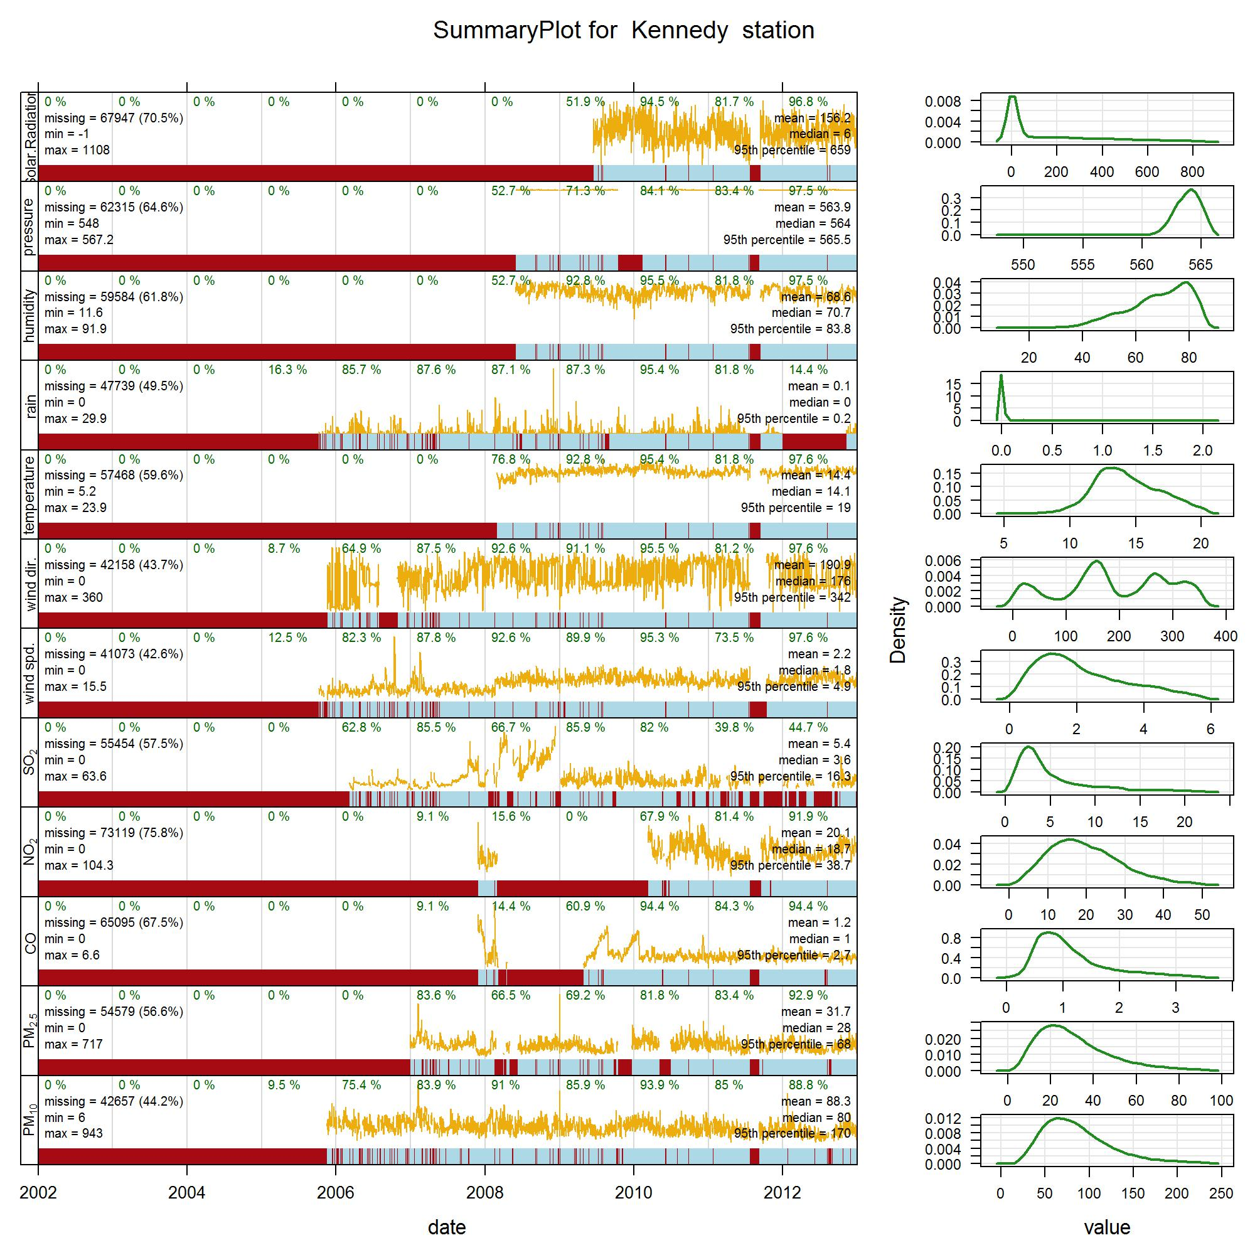
Bogota’s air quality network (RMCAB)
Time coverage
In general, instruments to measure gases have scarcer data while particulate monitors (BAMs) have been more reliable.
S R
P
RH
R
T
WD
WS
SO₂
NO₂
CO
PM_{2.5}
PM₁₀
Notes:
Budget and technical problems make the data sometimes sparse.
Poner labels a las variables

Slide 8
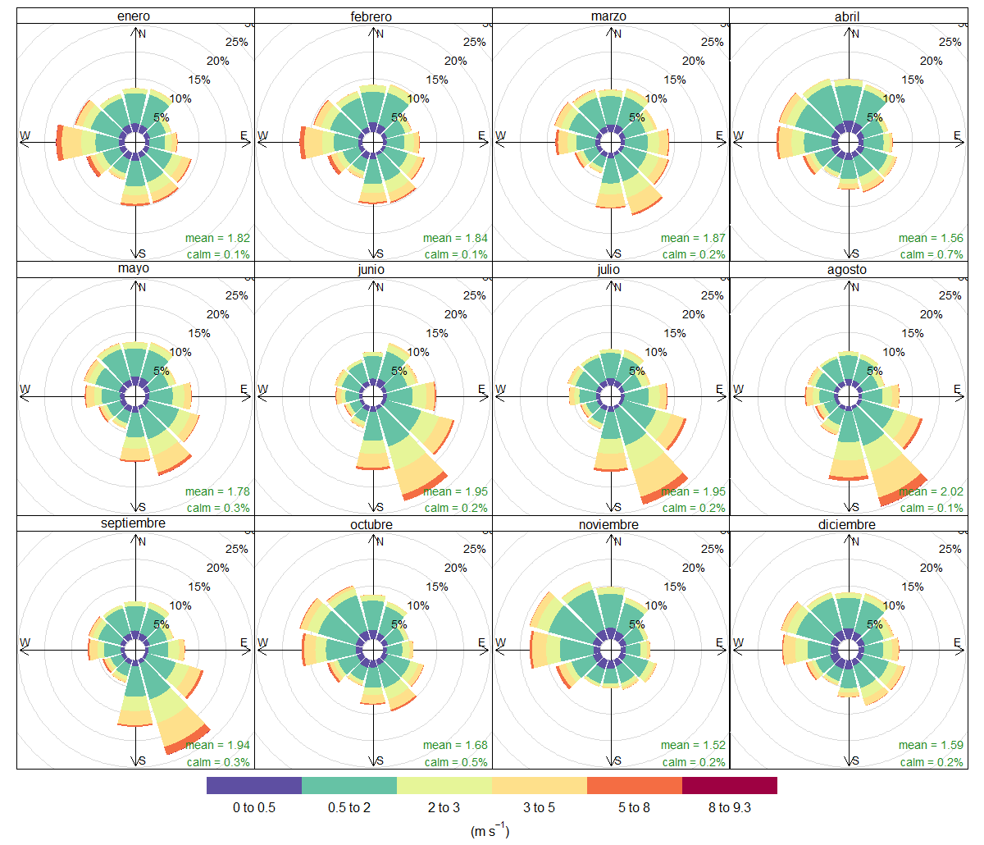
Winds
We found considerable variability specially for wind directions across de city

Slide 9
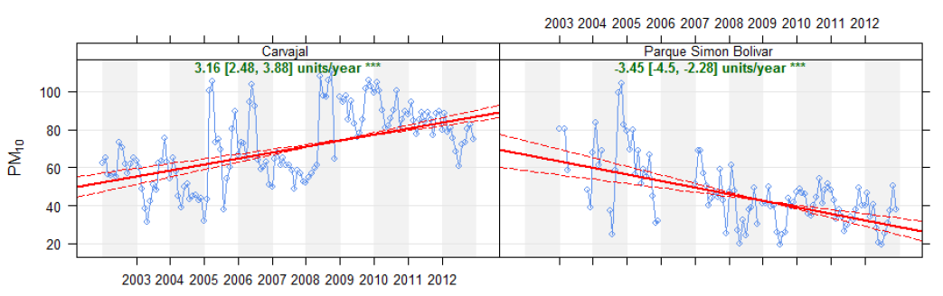
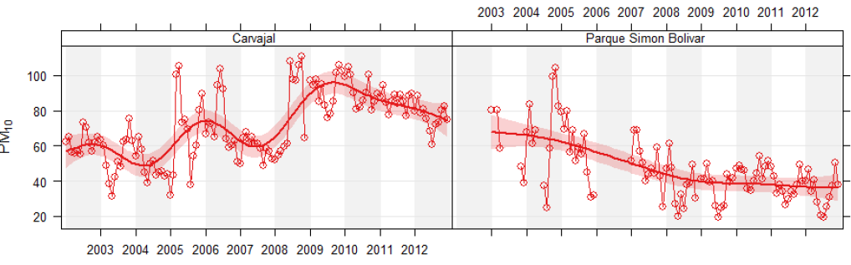
PM₁₀ trends
Traffic - Industrial
Urban scale
Notes:
PM10 concentrations have decreased or stabilized in most areas of the city since 2008, except in one industrial area were they might be still growing as Theil-Sen trends show.
This specific area of the city has intense heavy duty truck traffic , and industrial activity , a lot with a lot of dust from unpaved sidewalks, and eroded vicinities

Slide 10
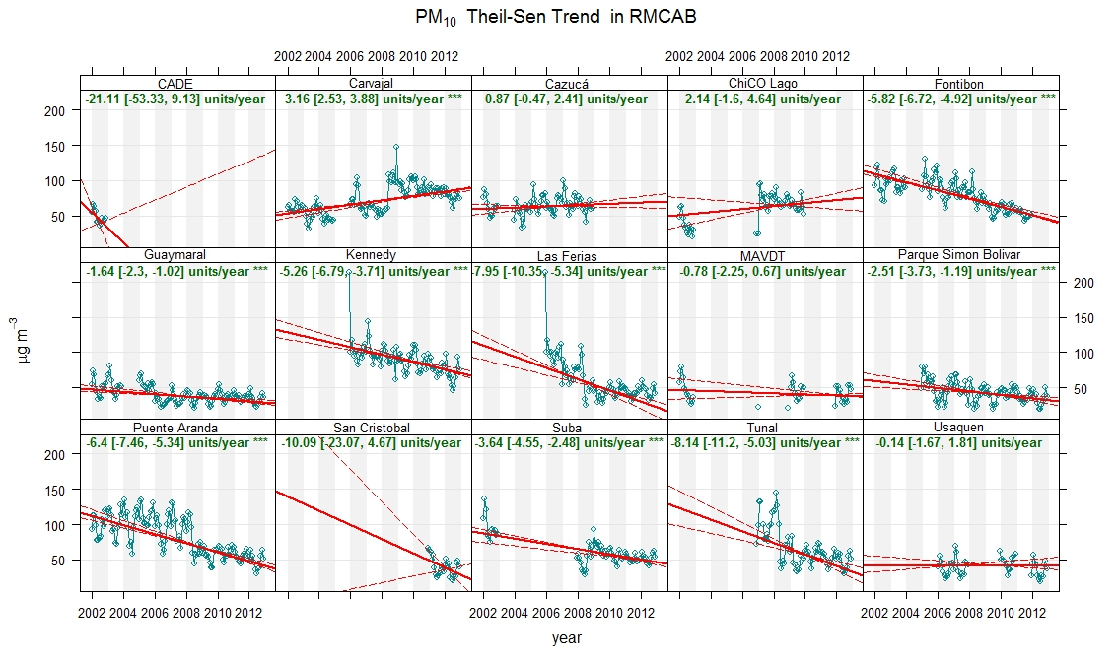
PM₁₀ trends
Traffic
Industrial
Industrial
Urban scale
Residential
Industrial
Industrial
Residential
Notes:
PM10 concentrations have decreased or stabilized in most areas of the city since 2008, except in one industrial area were they might be still growing as Theil-Sen trends show.
This specific area of the city has intense heavy duty truck traffic , and industrial activity , a lot with a lot of dust from unpaved sidewalks, and eroded vicinities
Si se están colocando logos para cada una de las estaciones, no debería haber para todas? Los reportes en la SDA las clasifican a todas

Slide 11
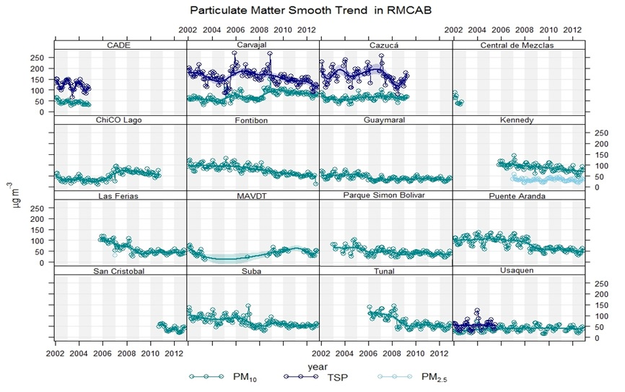
Particulate trends
Industrial
Industrial
Industrial
Smooth trends show improvement across the city
Notes:
Smooth trends show improvement across the city, however PM10 concentrations are still around 80 ug/m3 at industrial zones and 50 ug/m3 at residential areas. PM2.5 at industrial areas is close to 50 ug/m3.

Slide 12
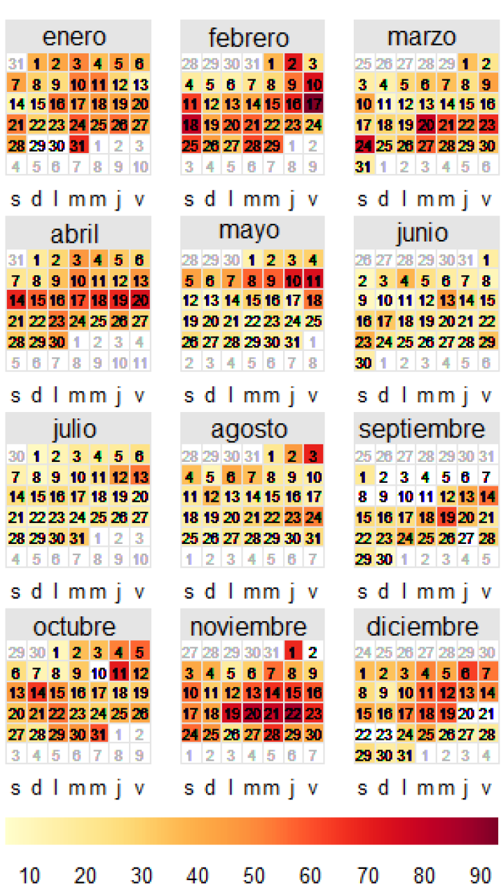
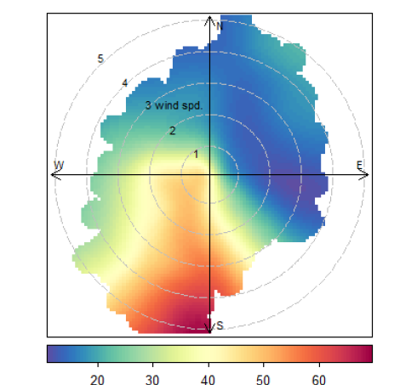
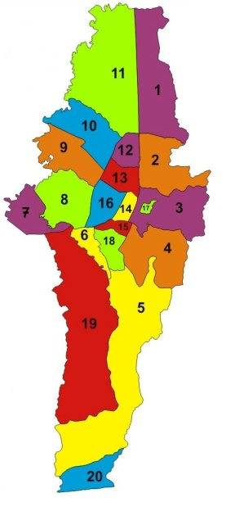
Winds and particulate
Calendar plot
Parque Simon Bolivar
2012
Polar plot
Annual average PM₁₀ (ug/m³)
PM₁₀ (ug/m³)

Slide 13
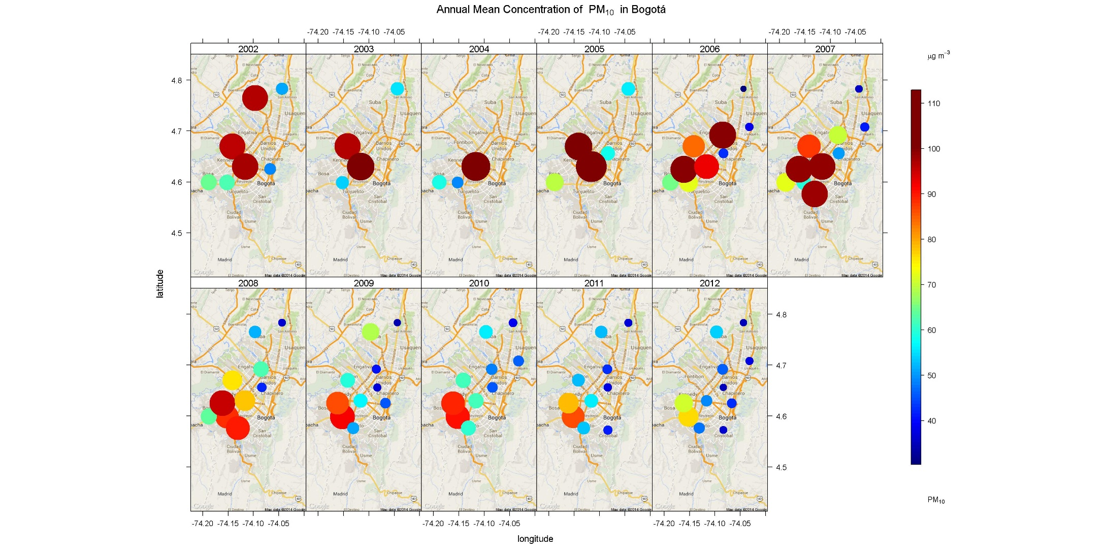
Annual PM₁₀ mean concentrations
N
Notes:
West areas impacted by high PM10 concentrations are in the west, were emissions from industries, mobile sources and roads and neighboring areas meet, favored by wind.
Make no mistake , PM10 concentrations have diminished but are sill around an annual average of 40-50 ug/m3.

Slide 14
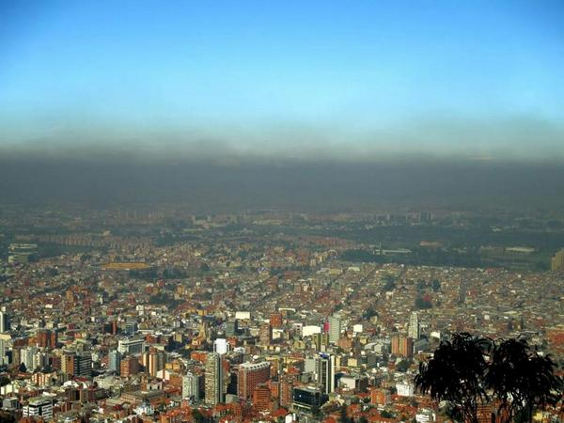
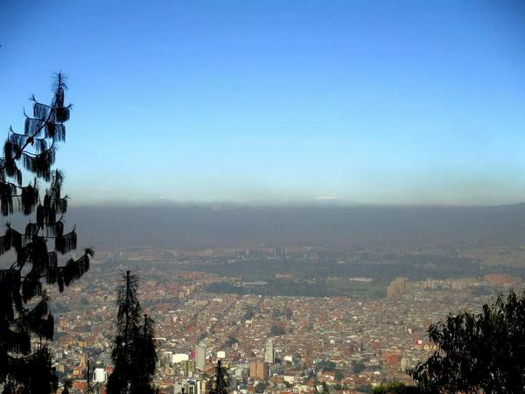
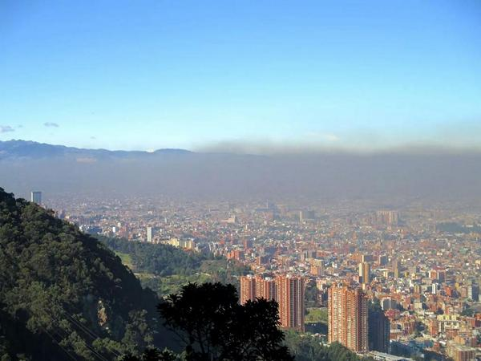
A layer of particulate on a weekday
Notes:
Esta foto la tomo ud? Sino mejor yo le paso una, para no tener problemas con derechos de autor

Slide 15
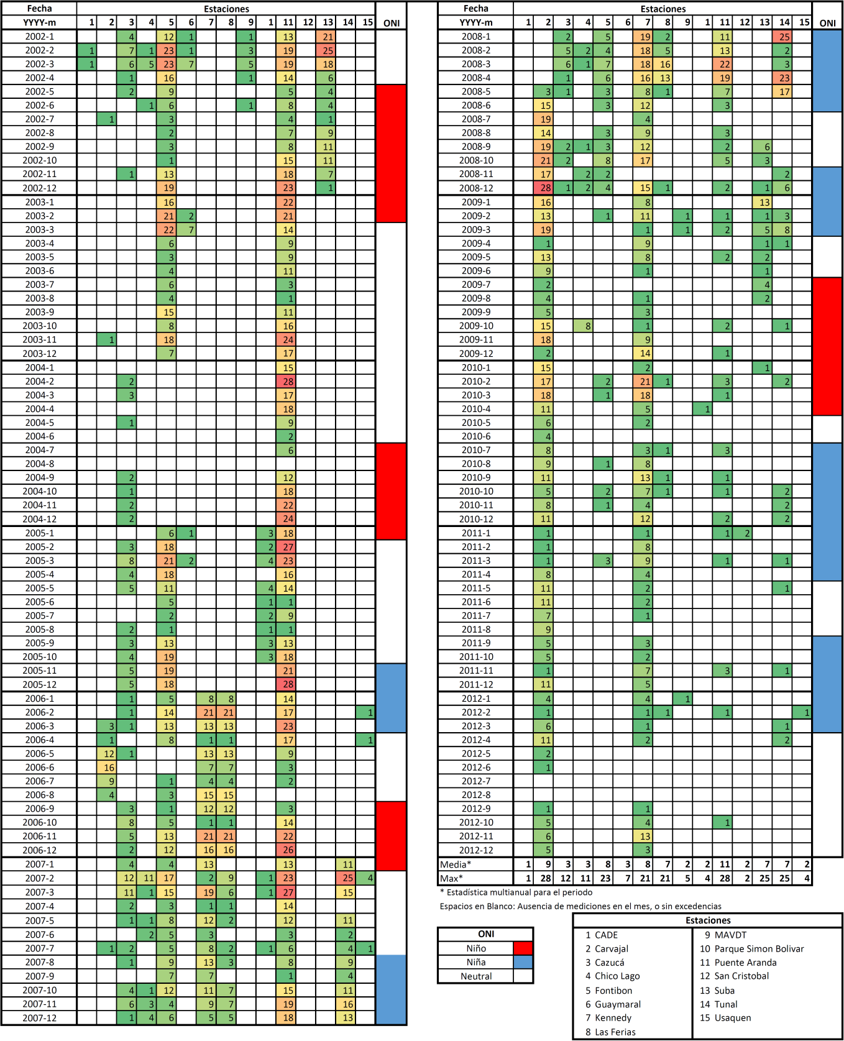
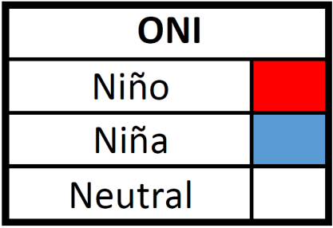
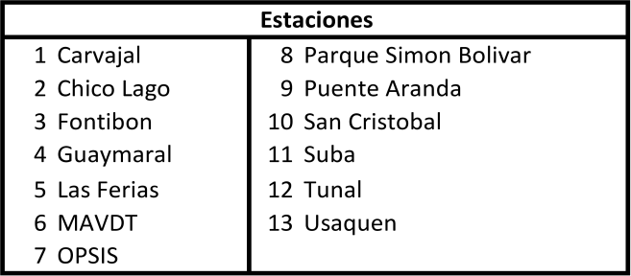
PM₁₀ EXCEDANCES
(24 HOUR STANDARD 100 µg/m³)
ONI
Monitoring Sites
Notes:
During "El Niño", when there is intense solar radiation and dry conditions PM10 excedances might be expected

Slide 16

O₃ EXCEEDANCES (8 HOUR STANDARD 41 ppb)
ONI
Monitoring Sites
Notes:
The last time we had some problems with Ozone was back in September October 2010 during la Niña period

Slide 17
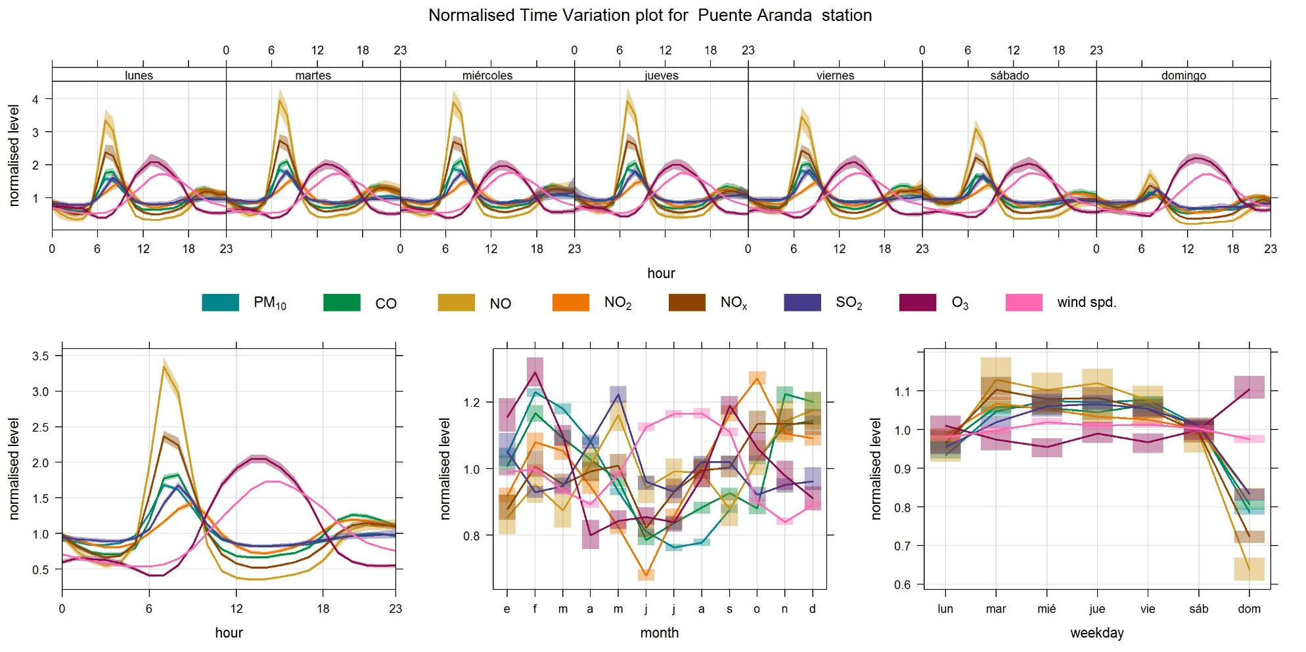
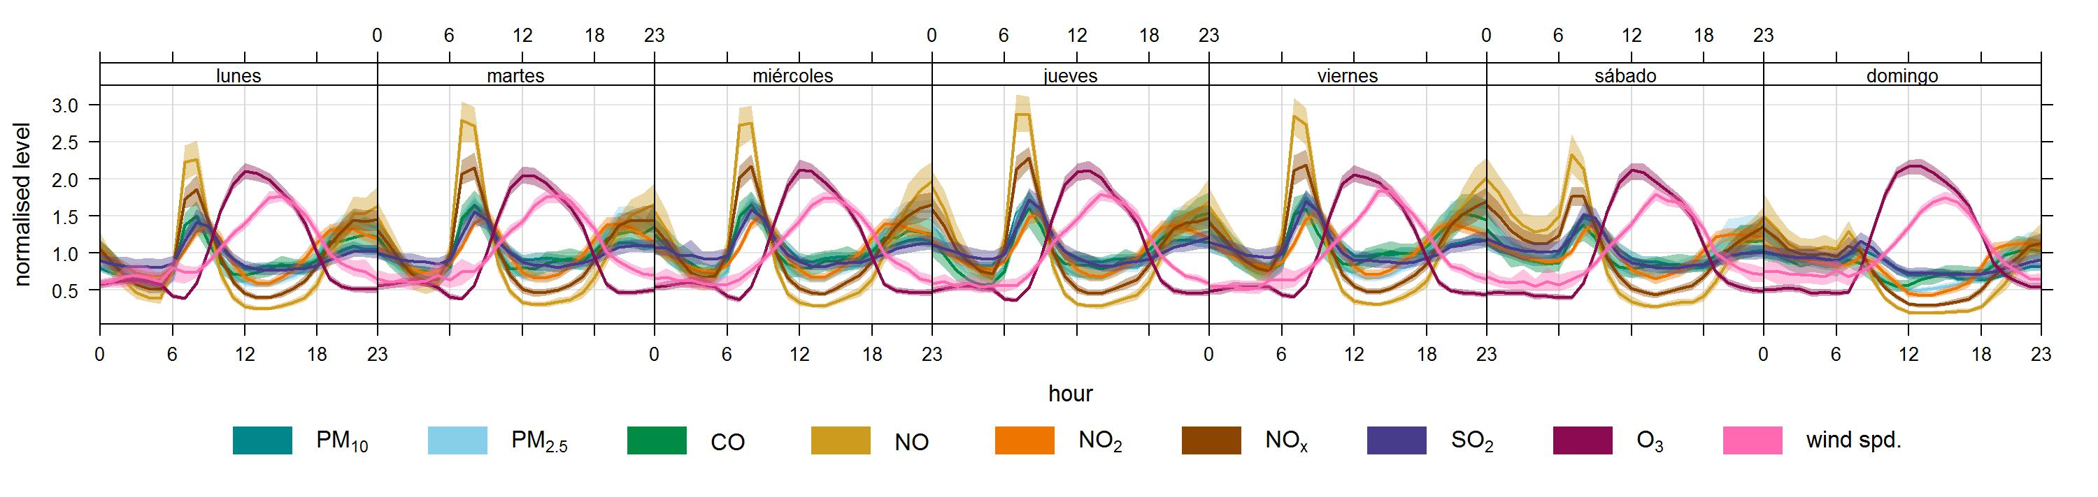
Normalized variations
MON
TUE
WED
THU
FRI
SAT
SUN
Normalized Level
site: Puente Aranda
Normalized Level
site: Parque Simon Bolivar
There are stronger and softer peaks for PM₁₀, PM_{2.5}, CO, SO₂ and Nox between 07:00 and 11:00 and between 18:00 and 22.00 respectively
As expected the peak of ozone occurs around noon.
Notes:
between 07:00 and 11:00 and between 18:00 and 22.00 there are stronger and softer peaks for PM10, PM2.5, CO, SO2 and Nox respectively
As expected the peak of ozone occurs around noon.

Slide 18
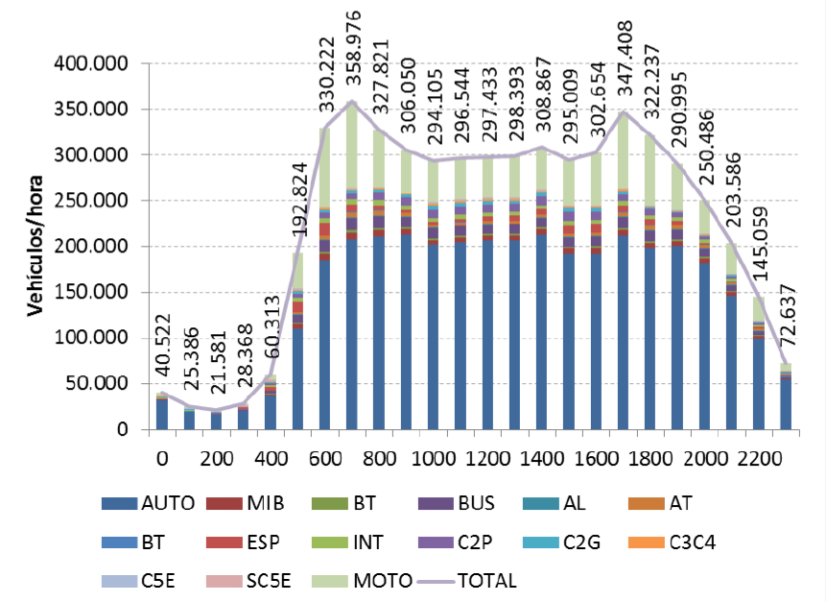
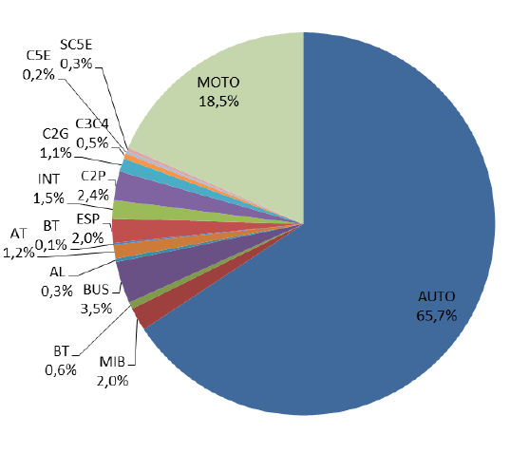
Traffic counts on weekdays
People goes to work around 6 am and comes back around 5, traffic is heavy all through the day

Slide 19
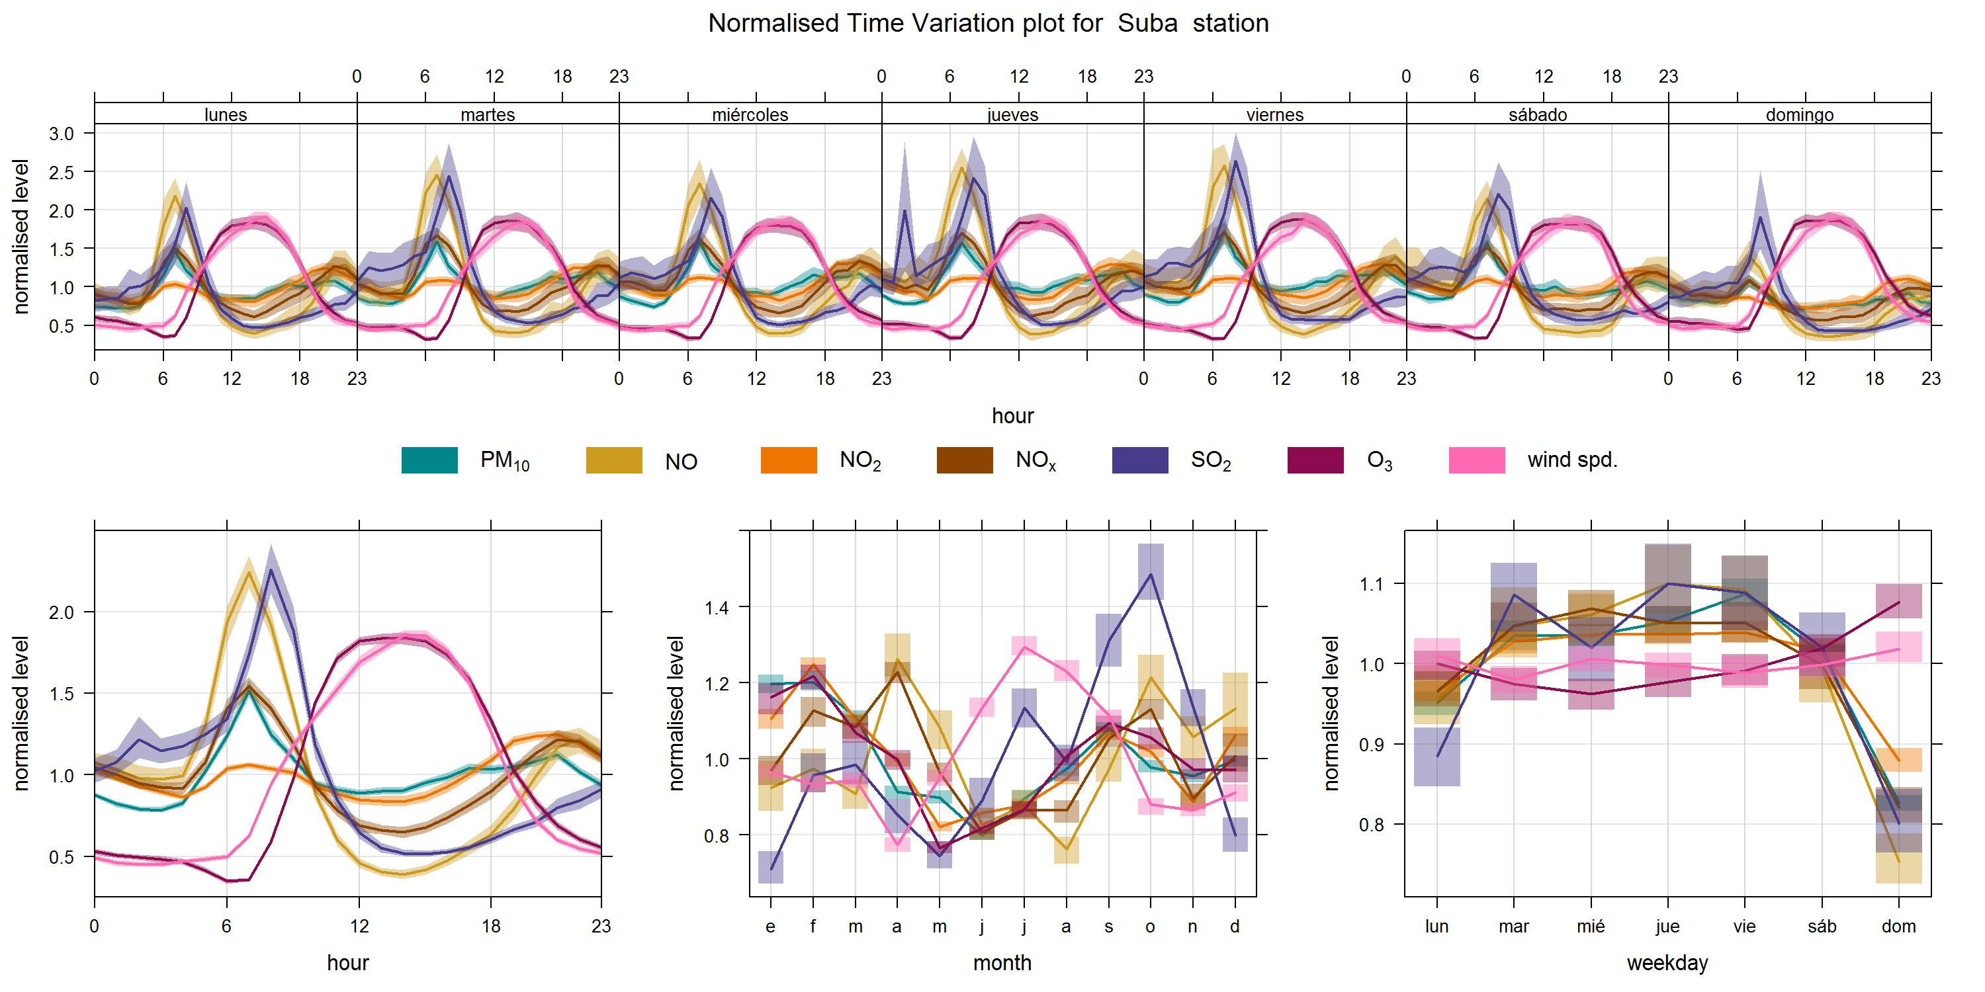
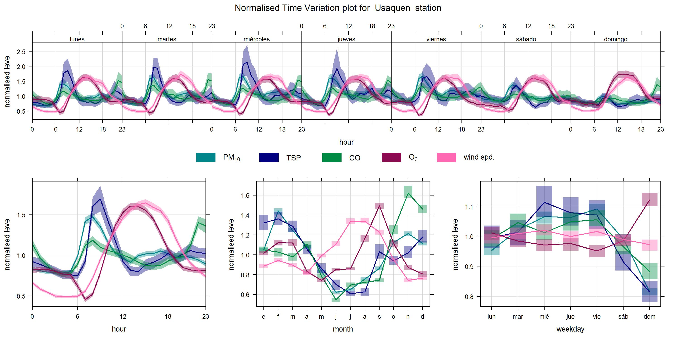
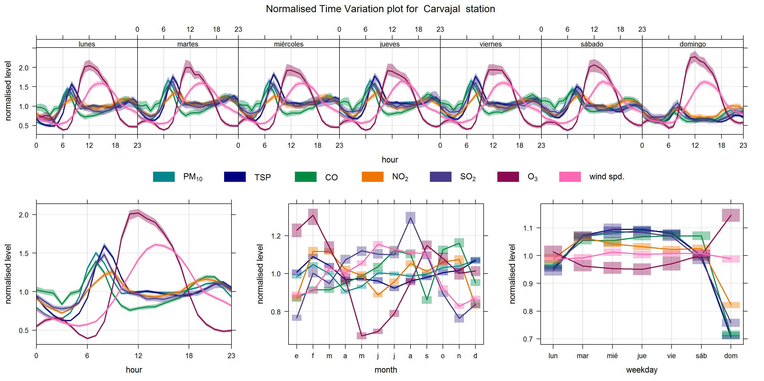
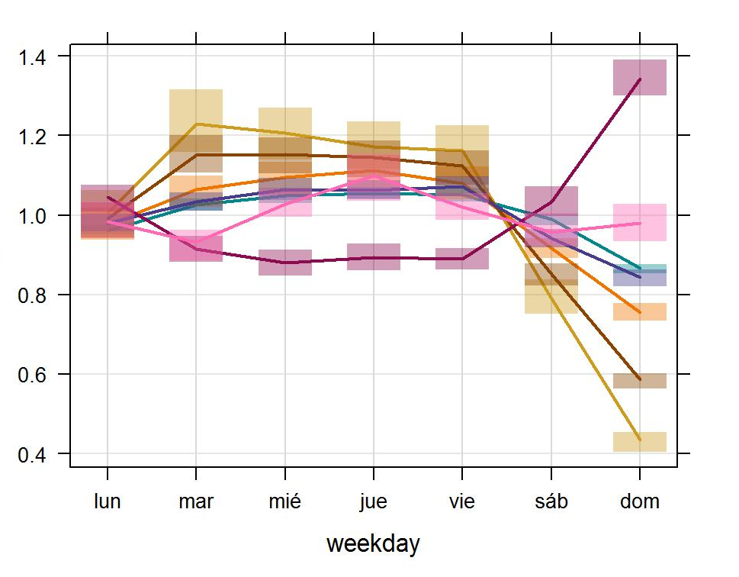
Daily variations
SUBA
USAQUEN
Normalized Level
Normalized Level
MON TUE WED THU FRI SAT SUN
CHICO
MON TUE WED THU FRI SAT SUN
CARVAJAL
Normalized Level
Normalized Level
MON TUE WED THU FRI SAT SUN
MON TUE WED THU FRI SAT SUN
Ozone has higher concentrations on Sundays
Notes:
Un Sundays vehicle activity decreases significantly, NOx emissions should also decrease, ozone however has higher than average concentrations. This makes us think we are in a VOC limited region

Slide 20
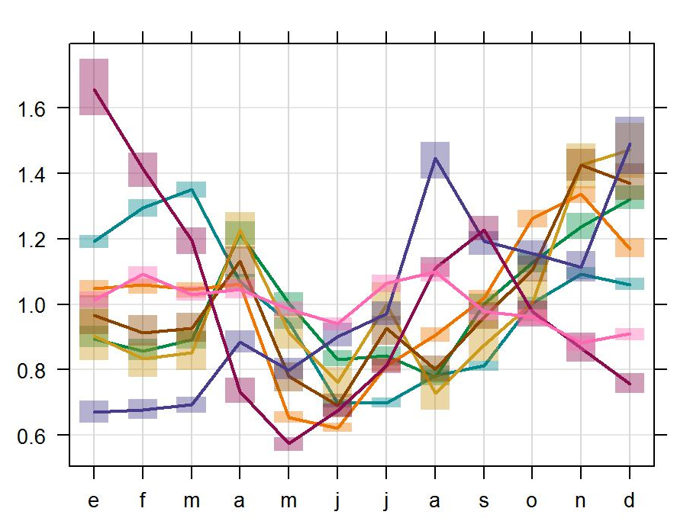
Monthly variations
SUBA
USAQUEN
Normalized Level
Normalized Level
CARVAJAL
J F M A M J J A S O N D
TUNAL
J F M A M J J A S O N D
Normalized Level
Normalized Level
J F M A M J J A S O N D
J F M A M J J A S O N D
June, July and August have the lowest pollutant concentrations
Notes:
In June, July and August we have the lowest pollutant concentrations, thank to improved ventilation caused by trade winds, whereas in November, December and January, where there is a lot of sun and nut much rain pollutants concentrations increase.

Slide 21
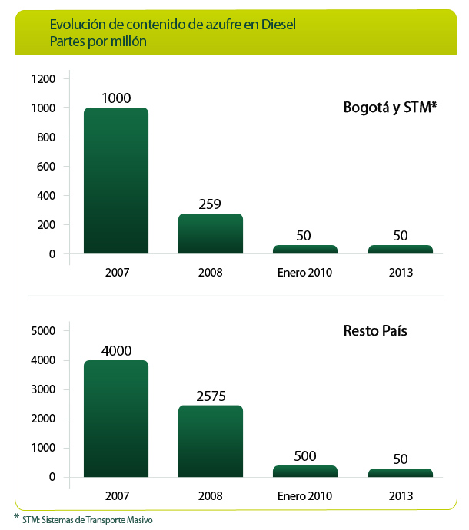
Why pollutants concentrations have improved?
Improved diesel quality may have had an impact
Tougher emission standards for mobile and industiral sources and actually enforcing them has also help to curb emissions
Diesel Sulfur content
PPM
Notes:
Whether or not this measures have been effective, still a subject of study.
La presentacion esta en la seccion de Air Quality Measurements and Observational Studies, sera que es Bueno hablar de emisiones?

Slide 22






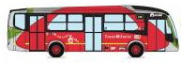
Why pollutants concentrations have improved?
Integrated transport system (SITP) implementation
Notes:
Removing old buses, organizing the transportation system and gradually upgrading the technology has likely had an important part in the improvement in air quality conditions. Traffic however has gotten more chaotic over the years.
La presentacion esta en la seccion de Air Quality Measurements and Observational Studies, sera que es Bueno hablar de emisiones?

Slide 23
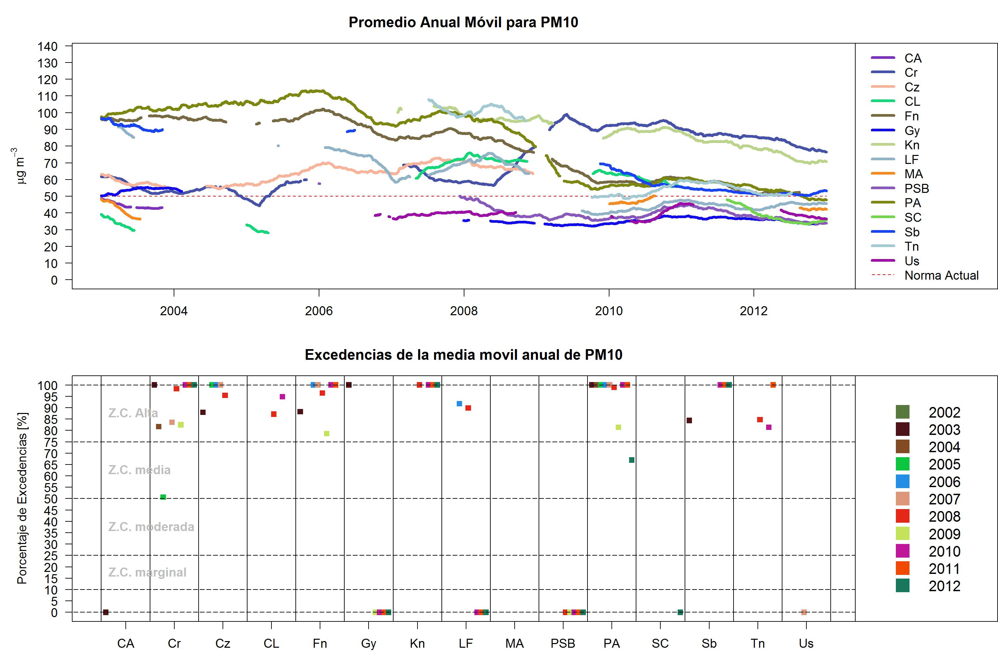
PM₁₀ concentrations
Moving averages
Colombia’s NAAQS
WHO Guideline
Tougher standards for mobile and industrial sources
Clean Diesel
Public transportation
improvements

Slide 24
Summary
PM₁₀ concentrations have gone down in the last decade
Particulate matter are still above WHO guideline values
During El Niño periods we can expect higher PM and Ozone concentrations
We are maybe in VOC limited regime
Introduction of lower sulfur fuels and improvement of public transportation might have had a

Slide 25
Thanks
CLIMA
CENTRO LASALLISTA DE INVESTIGACION Y MODELACION AMBIENTAL

Slide 26
Questions?
CLIMA
CENTRO LASALLISTA DE INVESTIGACION Y MODELACION AMBIENTAL

