Slide 1
A Tracer Study to Assess Transport of Cruise Altitude Aircraft Emissions to the Surface at Continental and Hemispheric Scales
Lakshmi Pradeepa Vennam¹, Saravanan Arunachalam¹, B.H.Baek¹, Mohammad Omary¹, Francis Binkowski¹, Rohit Mathur²
^{A1}University of North Carolina, Chapel Hill, NC
²U.S. Environmental Protection Agency, RTP, NC

Slide 2
Background
Aviation is fast growing transportation sector with projected growth of 2.2 % per year for next 20 years (2013 – 2033) (FAA Terminal Area Forecast,2013)
Earlier studies (Kasibhatla P., 1993, Brasseur et al., 1996, Wauben et al., 1997) emphasized the role of aviation NO_{x} in atmosphere and performed tracer studies
Recent studies indicate range of impacts – from negligible on surface air quality (AQ) (Whitt et al., 2011, Lee et al., 2013) to non-negligible, where 80% of aircraft impacts on premature mortality are due to cruise emissions (Barrett et al., 2010)
60 – 80% of aviation emissions occur at cruise altitude (9 – 11km) (Wilkerson et al., 2010, Olsen et al., 2013)
  - CMAQ domain upper layer goes till ~17-20km
Between 10 – 12 km, geographical location of NO_{x} emissions plays a important role in both climate change (Kohler et al., 2008 ) and surface AQ (Tarrason et al., 2004)
  Climate change : O₃ impact (+ 30 mWm⁻²) and lifetime change of CH₄ (-19 mWm⁻²)
  non-LTO emissions affect surface AQ (Europe) significantly (5-10% increase in O₃ for 40ppbV threshold and 30% increase for 60ppbV threshold) than LTO (Landing and Take-off) emissions due to predominance of non-LTO emissions (95%) over LTO NO_{x} emissions
2

Slide 3
Cruise aviation emissions
Source: Wilkerson et al., 2010
Global Spatial Distributions:
- Higher emissions at cruise altitudes (10-12km) and mid latitudes
Vertical profile from full-flight aircraft emissions for US
Goal : To study the potential impact of cruise aircraft emissions on air quality and understand the transport of these emissions to surface at regional and hemispheric scales
Notes:
Cruise emissions profile

Slide 4
Spatio-temporal scales of Transport Processes
Global horizontal transport timescales in troposphere (Daniel J. Jacob 1999)
Vertical transport timescales (Daniel J. Jacob, 1999)
Notes:
NO_{x}, for instance, has a local lifetime of <1 day in the lower troposphere, but >5 days in the upper troposphere; and both times are less than the time required for vertical mixing of the troposphere. In this case emission of NO_{x} into the upper troposphere will produce a larger atmospheric burden than the same emission into the lower troposphere.

Slide 5
Methodology
Performed tracer runs at continental (CONUS, 36km) and northern hemispheric domain (NH, 108km) using CMAQv4.7.1 for winter and summer months
FAA’s AEDT (global chorded inventory) aircraft emissions and WRF based meteorology data for 2005 year
NO_{x}- like tracer emissions only in cruise layers (10 – 12km), zeroed out remaining layers emissions
Performed tagged tracer runs for hemispheric domain (NH) by considering three subdomains (North America (NA), Europe(EU), East Asia(EA)) emissions and tagged the emissions with respective subdomain name
Model runs
Domain | Runs | Description
CONUS | Winter (JFM), Summer (JAS) | No chemistry and cloud processes, only transport
HEMI | Winter (JFM), Summer (JAS)
HEMI (tagging) | Winter (Jan), Summer (Jul)
5

Slide 6
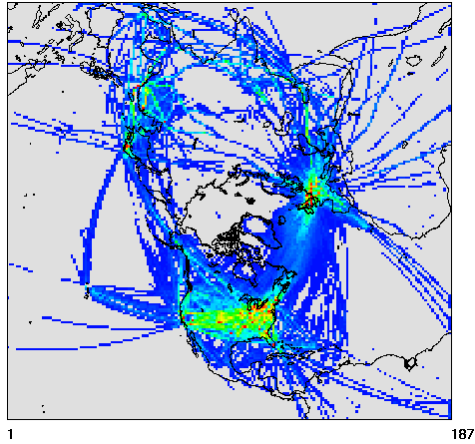
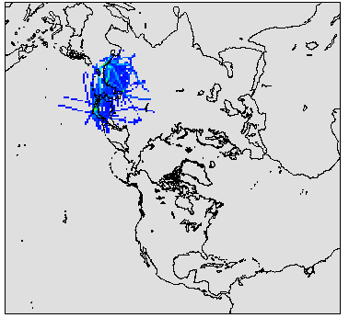
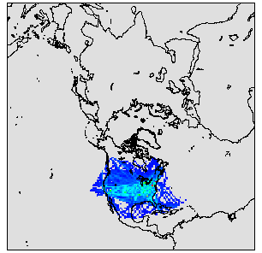
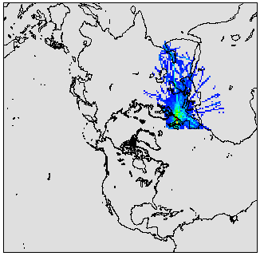
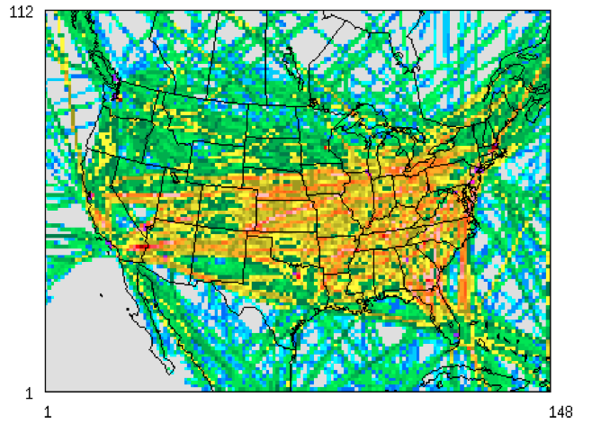
Model Domain and Aircraft NO_{x} (Tracer) Emissions
Hemispheric domain
3 tagged subdomains (only Jan, July)
EA
NA
EU
CONUS cruise emissions for one day
CONUS domain
Domain emission totals at cruise altitude
Domain | NOx (tons/month) | NOx (tons/month)
 | Jan, Feb, Mar | Jul, Aug, Sep
CONUS_36km | 498, 514, 649 | 624, 709, 620
HEMI_108km | 1432, 1736, 1505 | 2410, 2447, 2275

Slide 7
MODELING RESULTS

Slide 8
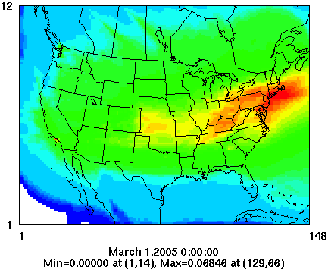
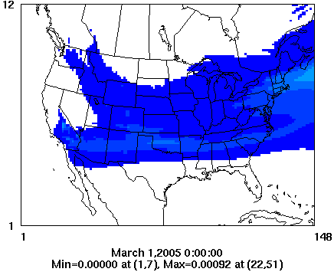
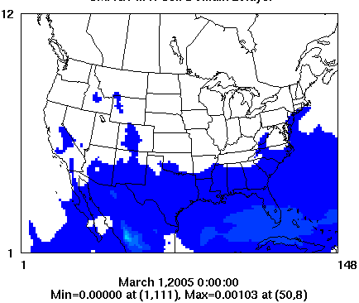
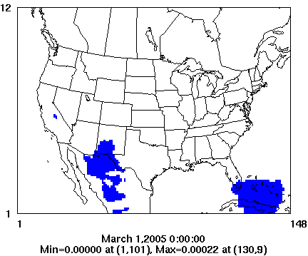

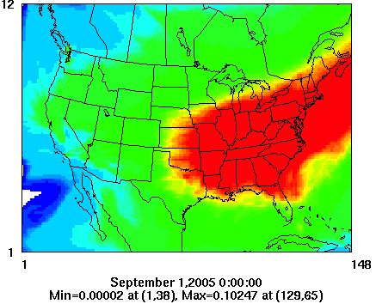
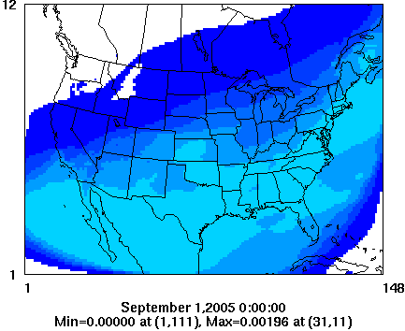
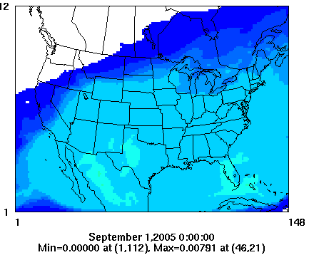
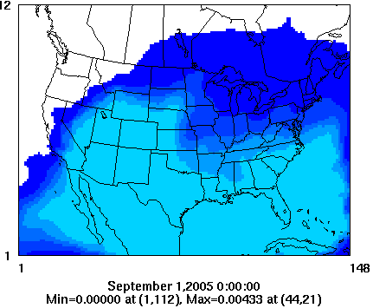
Tracer concentrations in ConUS domain (Monthly average)
March
Cruise layer (10km)
LS layer (16-18km)
FT layer (2.5km)
Surface layer(40m)
September
Higher concentrations observed on the surface layer near Southern US in summer (but quantitatively very low, 0.004ppbV)
Horizontal transport dominates compared to vertical transport (particularly during winter) due to high jet stream

Slide 9
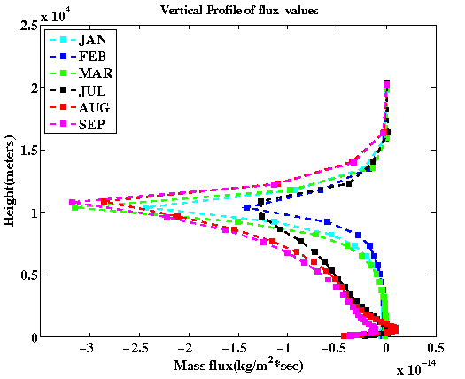
Vertical Tracer Profiles – ConUS Domain
Month | Surface NO_{x} tracer (molecules/m²)/Total NO_{x} tracer column (molecules/m²) (%)
March | 0.008
September | 0.09
Higher mass transported to surface in summer due to high atmospheric mixing
Small amount of cruise emissions also transported to upper layers (14-16km) during summer due to upward movement of hotter air parcel in the atmosphere
Negative vertical flux during summer month near surface indicates downward transport
9
Notes:
(hotter air parcel moves up and cools down after reaching certain altitude)

Slide 10
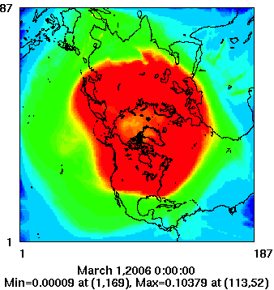
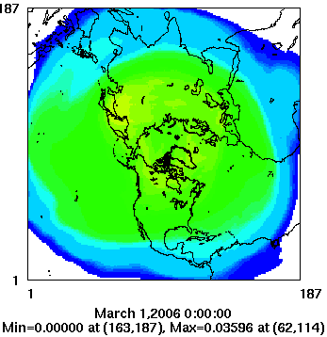
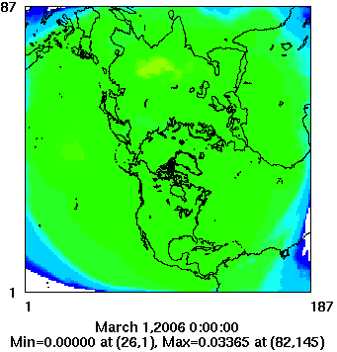
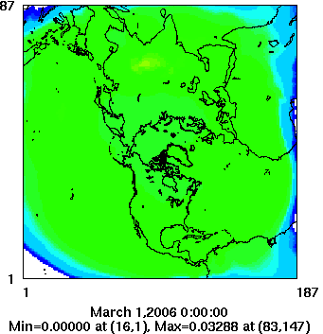
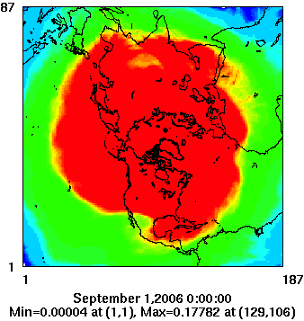
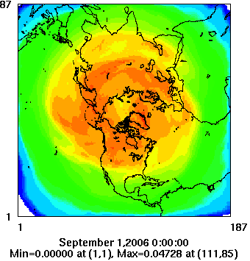
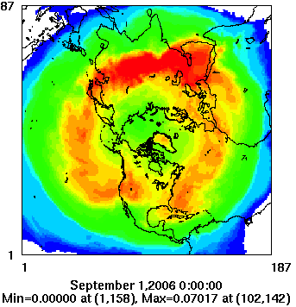
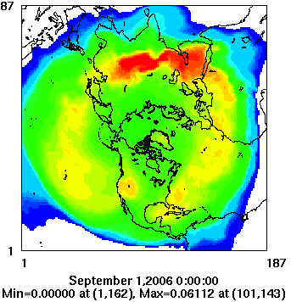
Tracer concentrations in NH domain (Monthly average)
March
Cruise layer (10-11km)
LS layer (20km)
FT layer( 2.5km)
Surface layer(30m)
September
Higher surface concentrations observed in hemispheric scale than in CONUS scale due to intercontinental transport
Above the cruise layer, concentrations transported towards the Arctic. In summer, concentrations are high near equatorial regions

Slide 11
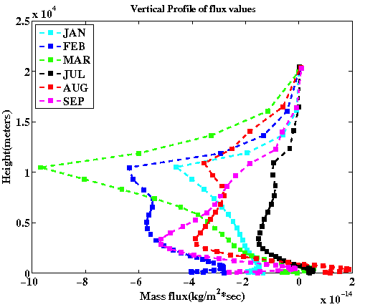
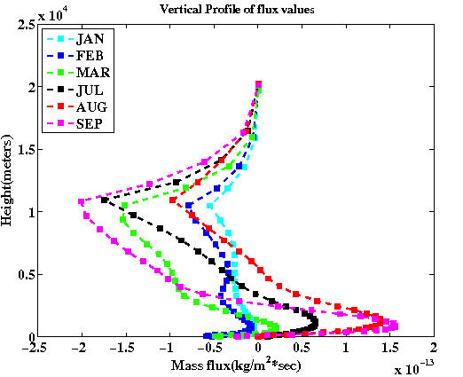
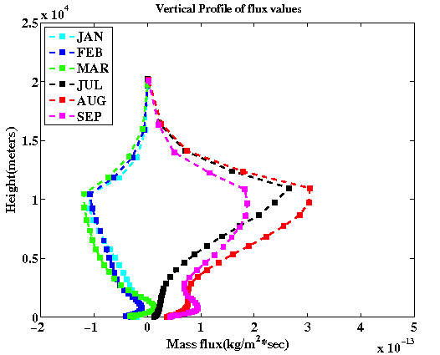
Vertical Tracer Profiles – NH Domain
NA
EU
EA
Sub-regions | Surface NO_{x} tracer (molecules/m²)/Total NO_{x} tracer column (molecules/m²) (%)
 | March | September
NA | 0.17 | 0.17
EU | 0.19 | 0.17
EA | 0.20 | 0.17
In Hemispheric scale, global circulation and high jet stream in winter causes
slightly higher surface impacts (during winter) in all sub regions (EA, EU, NA)
11
Notes:
EA --- different , EU- flights below tropopause, NA -

Slide 12
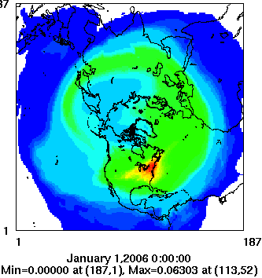
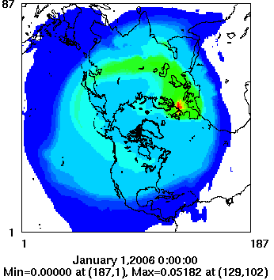
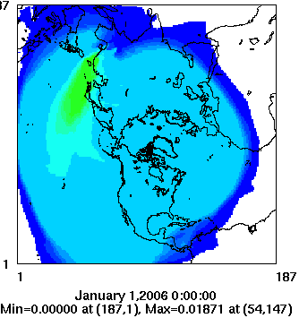

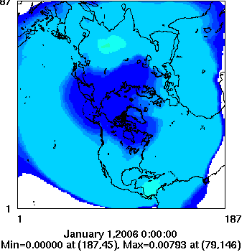
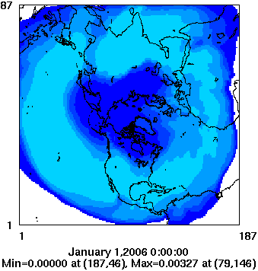
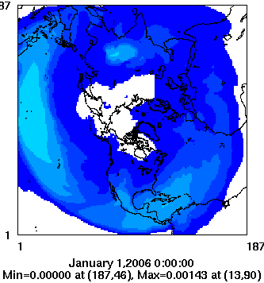
Emission Tagging Case – NH Domain (January average)
Cruise layer
TR_NA
TR_EU
TR_EA
NO_{x}
Surface layer
North America and Europe emissions can be transported to remote regions in North Africa and Asia but the overall magnitudes are low
12

Slide 13
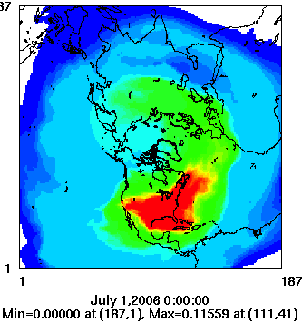
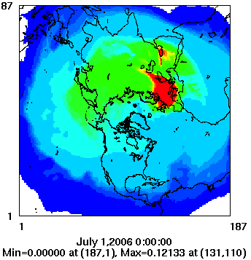
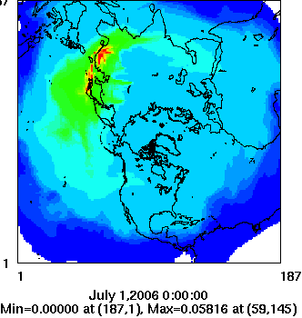
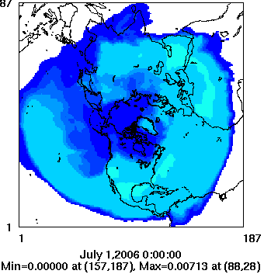
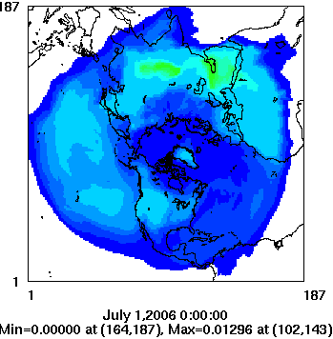
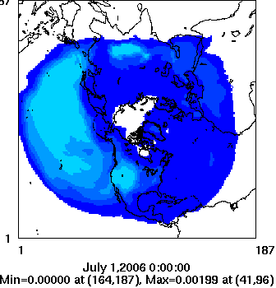
Emission Tagging Case – NH Domain (July average)
Cruise layer
TR_NA
TR_EU
TR_EA
NO_{x}
Surface layer
Evidence of westerlies and global circulation impact on intercontinental transport of cruise emissions
13

Slide 14
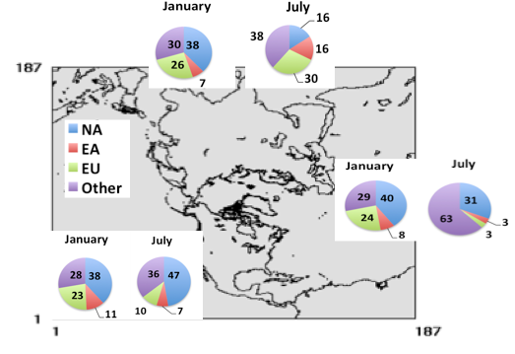
Tagging Model Run Contributions
Calculation: (Surface TR_NA/Surface total TR in NA domain) *100 gives us the percentage of surface contributions from cruise emissions over NA to model concentrations in NA domain
NA subdomain: Contribution of NA emissions to total surface tracer concentrations observed in NA subdomain higher than contributions from EU and EA emissions
EU subdomain: Contribution of NA emissions to total surface tracer concentrations observed in EU subdomain is higher than those from EU and EA
EA subdomain: Contribution of both NA (winter) and EU (summer) emissions to total surface tracer concentrations observed in EA subdomain is higher than those from EA itself

Slide 15
Discussion
Transport of aircraft cruise emissions in idealized case was assessed in CMAQ at continental and hemispheric scales.
Tracer impacts due to transported cruise emissions on CONUS surface layer and NH surface is low
Impacts on surface in NH domain is 1-2 orders of magnitude higher than those in ConUS domain, emphasizing significance of contribution from intercontinental transport.
Vertical fluxes varied by season and geographical location. Summer concentrations ~2 times higher than winter throughout the model domain.
Surface monthly average tracer concentrations (transported from cruise altitudes) are in the range of 0.01 – 0.1% the column burden in regional scale and relatively higher in hemispheric scale (2 – 10 x)
NA (North America) and EU (Europe) cruise emissions can be transported to the surface in remote regions in both Africa and Asia
15

Slide 16
Future Work
Conduct sensitivity modeling by turning on cloud module and update to CMAQv5.0
Conduct separate LTO and non-LTO tracers analysis
Analyze the results based on atmospheric static stability and study the spatial concentration on isentropic levels (UTLS emissions get transported mostly on isentropic surfaces (Chen et al., 1995; Hoor et al., 2010) )
Analyze vertical profiles based on the thermal tropopause relative heights to capture the details near the tropopause
16

Slide 17
Acknowledgements
The emissions inventories used for this work were provided by U.S. DOT Volpe Center and are based on data provided by the U.S. FAA and EUROCONTROL in support of the objectives of the International Civil Aviation Organization Committee on Aviation Environmental Projection CO2 Task Group. Any opinions, finding, and conclusions or recommendations expressed in this material are those of the author(s) and do not necessarily reflect the views of the U.S. DOT, Volpe Center, the U.S, FAA, EUROCONTROL or ICAO
Special Thanks
Sarav Arunachalam (Research Advisor, UNC – IE), Mohan Gupta (FAA)
Frank Binkowski (UNC-IE), Mohammad Omary (UNC-IE), Baek BH(UNC-IE)
MAQ/CHAQ group
17

Slide 18
References
FAA, Terminal Area Forecast Summary Fiscal Years 2013-2033, available at: http://www.faa.gov/about/office_org/headquarters_offices/apl/aviation_forecasts/aerospace_forecasts/2013-2033/media/Forecast_Highlights.pdf
Lee et al., 2013, Atmos. Chem. Phys., 13, 689–727.
Barrett et al., 2010, Environ.Sci.Technol., 44, 7736-7742.
Barrett et al., 2012, Environ.Sci.Technol., 46 (8), 4275-4282.
Whitt et al., 2011, J. Geophys. Res., 116, D14109, doi: 10.1029/2010JD015532.
Kasibhatla P., 1993, Geophys Res.Lett., 20,1707-1710.
Lamarque et al., 1996, J. Geophys. Res., 101,22,955- 22,968.
Brasseur et al., 1996, J. Geophys. Res., 101,1423-1428.
Wauben et al., 1997, Atmospheric Environment, Vol.31, 1819 – 1836.
Chen, P. (1995), J. Geophys. Res., 100, 16,661–16,673.
Hoor et al., 2010, Atmos. Chem. Phys., 10, 12,953–12,991.
Tarrason et al., 2004, available at: http://ec.europa.eu/environment/air/pdf/air_quality_impacts_finalreport.pdf
Wilkerson et al., 2010, , Atmos. Chem. Phys., 10, 6391–6408, 2010.
Olsen et al., 2013, Atmos. Chem. Phys., 13, 429–441, 2013.
18

Slide 19
Thank You
Questions ??

Slide 20
Extra Slides

Slide 21
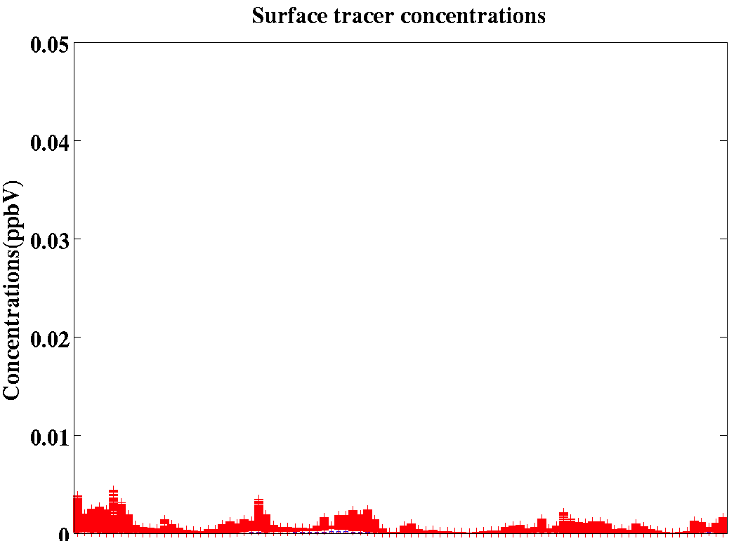
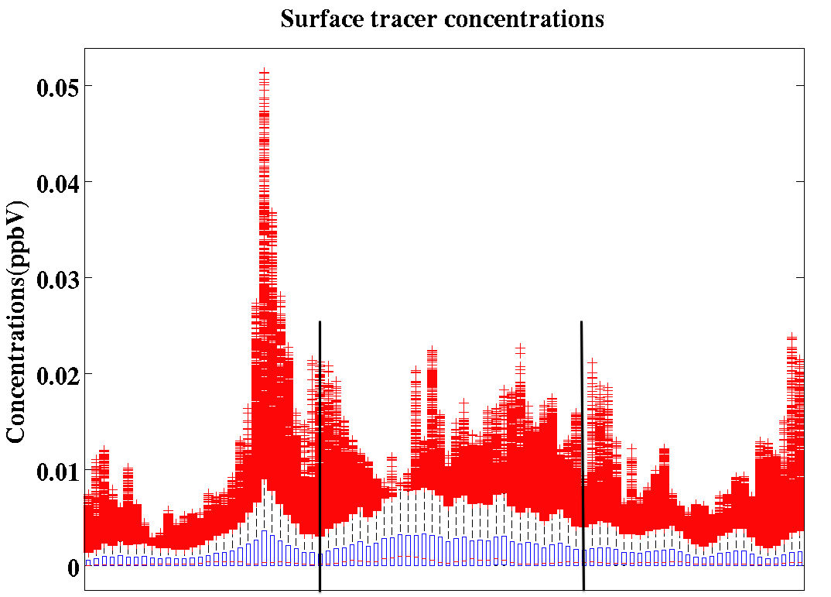
ConUS Domain
Winter
30 days
60 days
Summer
Higher values than mean concentrations still exist even after three month simulations Peak concentrations occurred after 20 days

Slide 22
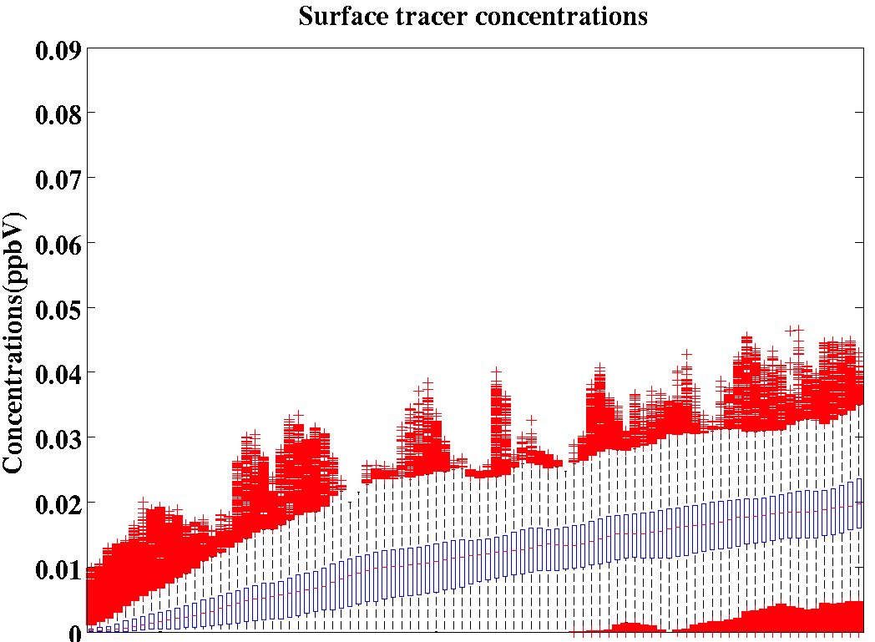
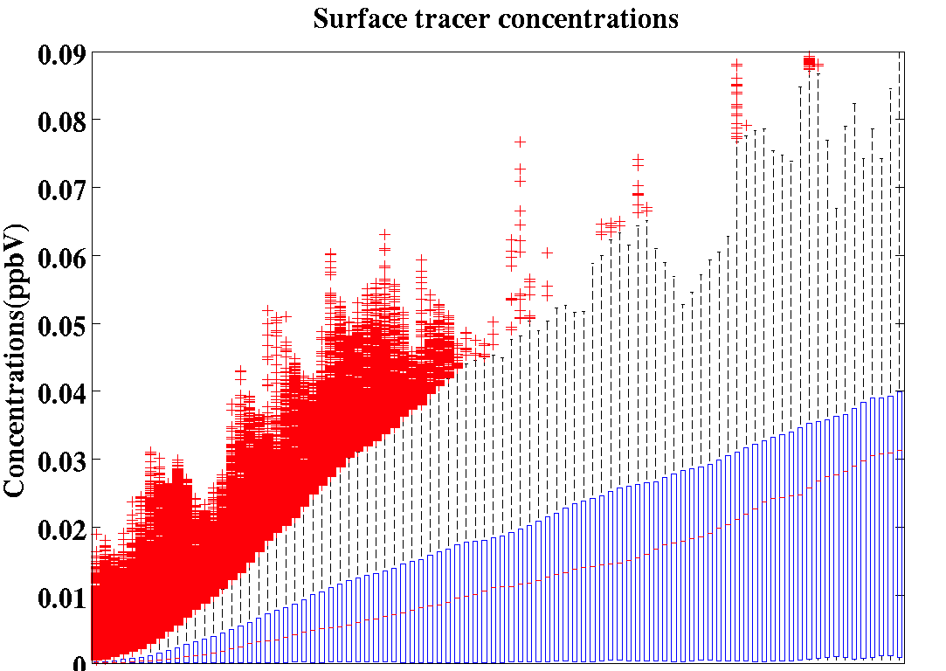
NH Domain
Winter
30 days
60 days
Summer
Complete mixing occurred after 60 days (particularly in summer month)
Notes:
Due to higher jet stream in winter season, did not see complete mixing even after 90 days

Slide 23
Tagging Model Run Contributions
Calculation Example:
(Surface TR_NA in EA subdomain)/( Total TR_NA in total hemi domain) * 100 gives the percentage of NA (North America) cruise emissions in hemispheric domain transported to the surface of EA (East Asia) region
Receptor Region | Source Region
 | % in Jan (NA, EU, EA) | % in July (NA, EU, EA)
NA | 3.1, 4.0, 3.1 | 5.8, 1.8 , 2.9
EU | 3.1, 3.9, 2.0 | 5.4, 0.8, 1.9
EA | 3.0, 4.3, 1.8 | 1.2, 3.3, 3.7
NA and EU emissions transported outside the emission region (in EA region (3.0%, 4.3%)) in winter; but in summer due to atmospheric mixing NA emissions contributed 5.8% in NA surface region
EA emissions transported to NA during winter ( 3.1%)

