Slide 1
Modeling Dispersion of Traffic-Related Pollutants in the NEXUS Health Study
Michelle G. Snyder, Vlad Isakov, David Heist
U.S. EPA, Office of Research and Development, National Exposure Research Laboratory, Atmospheric Modeling and Analysis Division, 109 T.W. Alexander Drive, Research Triangle Park, NC 27711
Sarav Arunachalam, Kevin Talgo, Alejandra Valencia, Brian Naess
Institute for the Environment, The University of North Carolina, Chapel Hill, NC
Stuart Batterman
Environmental Health Sciences, School of Public Health, University of Michigan, Ann Arbor, MI
CAAA
Community Action Against Asthma, Community Partner at Large, Detroit, MI
12th Annual CMAS Conference
October 28-30, 2013
Chapel Hill, NC USA
Wednesday October 30, 2013

Slide 2
Presentation Outline
NEXUS Design and Objectives
Modeling Mobile Sources using a Dispersion Model and Emissions.
Sensitivity of Line Source Dispersion Model to Emissions Inputs
Preliminary Modeling Results
Conclusions

Slide 3
NEXUS Design & Objectives
Objective: Study effects of traffic-related air pollution on the respiratory health of asthmatic children in Detroit.
NEXUS Participant Locations
Primary research question: Do children with asthma living near major roadways with high traffic have greater health impacts associated with air pollutants than those living farther away, particularly for those living near roadways with high diesel traffic?
Health outcomes: Aggravation of asthma symptoms, inflammation and other biological responses, and respiratory viral infections.
Modeling objective: Provide pollutant surfaces capturing spatial and temporal variability across health study domain for all participants for each hour of the 29-month period. This includes background, stationary source and mobile source estimates.
Vette, et al. 2013. The Near-Road Exposures and Effects of Urban Air Pollutants Study (NEXUS): Study design and methods. Science of The Total Environment, 448, 38-47.

Slide 4
Modeling Mobile Sources:
RLINE – Research LINE source model
RLINE is EPA -ORD's research dispersion modeling tool for near roadway assessments.
based on a steady-state Gaussian formulation
currently formulated for near-surface releases
contains new formulations for the vertical and lateral dispersion rates
includes treatment of receptors very near line sources
accounts for low wind meander
includes M-O similarity profiling of winds near the surface
uses the surface meteorology provided by AERMET
includes user-friendly input requirements for road network
Snyder, M. G., Venkatram, A., Heist, D. K., Perry, S. G., Petersen, W. B. & Isakov, V. RLINE: A Line Source Dispersion Model for Near-Surface Releases. Atmospheric Environment (in press, 2013).

Slide 5
.
Combining Emissions and Dispersion Modeling for Mobile Sources
The total emission factors (EF_{i}) and traffic activity (A_{i}) inputs are combined to create hourly emissions, (E_{i}) for each roadlink (i) in the Detroit road network.
The concentration is estimated by , where is the dispersion from each roadlink, i, to each receptor generated by RLINE with unit emission rate.
This two step process is used so the most time intensive step, the dispersion model, would only need to be run once, then the emissions could be applied and emissions can be easily modified.
Cook, R., et al. 2008: Resolving Local-Scale Emissions for Modeling Air Quality near Roadways. Journal of the Air & Waste Management Association, 58, 451-461.

Slide 6
Estimating Mobile Source Emissions
Meteorology (hr of day, temp)
Detroit Airport: local measurements
Link-based network(AADT, speed)
SEMCOG: local DOT
TAFs (vehicle type, month, day of week, hr of day)
NEI/SMOKE: National
Emission Factors (temp, speed, vehicle type, month)
MOVES 2010: National w/ regional variability
Fleet Mix (nfc class, vehicle type)
FHWA :National w/ regional variability
AADT
HD/HT 9% Diesel
Fleet Mix
LD/HT 5% Diesel
Emission Factors

Slide 7
Meteorological Conditions
RLINE was run with unit-emissions for one line source and the wind direction perpendicular to the source.
Representative Met. Parameters from Fall 2010 in Detroit, MI.
Condition | u*(m/s) | L (m) | U (m/s)
Neutral | 0.734 | -1220 | 4.63
Convective | 0.229 | -12.9 | 1.65
Very Stable | 0.093 | 12.8 | 1.03
Stable | 0.254 | 105 | 2.66
WIND
All conditions fall off as you get away from the roadway, some fast than others.
Notice that stable, convective, and neutral met hours have concentration <1μg/m³ per g/m/s of emissions.
Very Stable hours can produce extremely low dispersion rates, and high concentrations.
Stable conditions are very important in model results because of high concentrations and slower decrease in concentration as distance from the roadway increases.

Slide 8
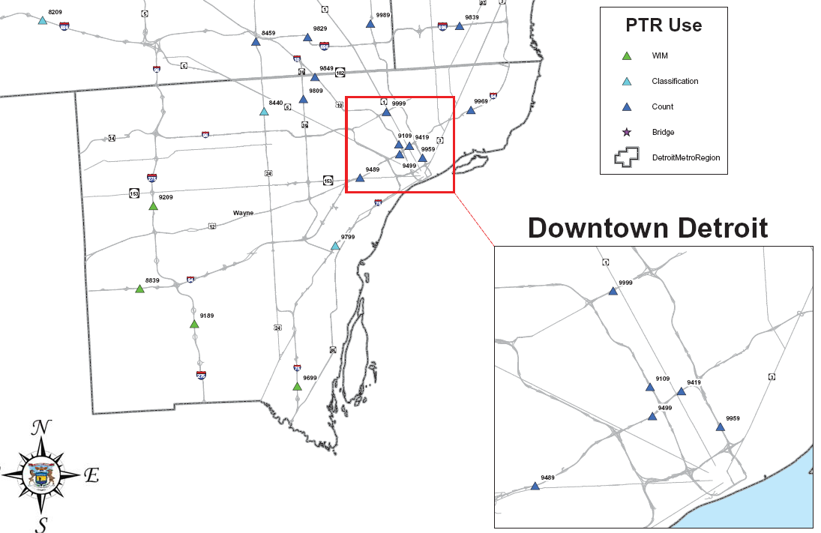
Emissions: Hourly Variation
Permanent Traffic Recorders (PTR)
Temporal Allocation Factor (TAF) contain the traffic pattern. These vary by time of day, day of week, and month of year.
Traffic patterns and meteorology have temporal variation, thus capturing this correctly is essential to estimating air quality.

Slide 9
Emissions: Roadway Type & Fleet Mix
NEXUS Participant Locations
Modeled Roadways
NFC = 11 are High Traffic/High Diesel (Interstates)
NFC = 12 are High Traffic/Low Diesel (Highways)
All others are local roadways
Meteorological conditions are assumed to be the same for all participants, so the only hourly variability between participants is EMISSIONS.

Slide 10
Emissions: Roadway Type & Fleet Mix
HT/HD 9% Diesel
Fleet Mix
HT/LD 5% Diesel
Roadlink characteristics for average NFC 11 and 12 roadlinks in Detroit domain.
NFC | 11 | 12
Avg AADT | 30900 | 32900
Avg Speed | 46 | 48
Max. Speed | 65 | 65
Min. Speed | 20 | 27
11 12
HT/HD HT/LD
Ratio of emissions for NFC 11 and 12 roadways, dispersion is NOT considered (based on average values for August 2010).
Pollutant | Ratio of Emissions: NFC 12/11
 | Min. Speed | Avg. Speed | Max. Speed
PM_{2.5} | 0.639 | 0.655 | 0.663
EC_{2.5} | 0.558 | 0.567 | 0.574
CO | 1.06 | 1.06 | 1.06
Emissions contain the distinction between high diesel (11) and low diesel (12) roadways, therefore modeling results should contain a distinction between these roadways. (This puts added emphasis on the roadway classifications.)

Slide 11
Emissions: Roadway Type & Fleet Mix
Michigan DOT - Measurements
CAADT/AADT *100
FLEET MIX
Interstates
nfc 11 – 9% diesel
Highways
nfc 12 – 5% diesel
5%
5%
5%
5%
9%
 | Interstates (NFC 11) |  |  | Highways (NFC 12)
 | I-75 | I-94 | I-96 | M10 | M39
NFC class (Diesel Percentage) | 9% | 9% | 9% | 5% | 5 %
SEMCOG measurements (CAADT/AADT) | 9% 5% (north of downtown) | 9% 5% (east of downtown) | 9% 5% (north of downtown) | 5% | 5%
9%
In the Detroit domain interstates are all classified the same, thus the same fleet mix, however local traffic measurements suggest there is a large discrepancy in commercial traffic between roadways.

Slide 12
Emissions: Roadway Type & Fleet Mix
 | Interstates (NFC 11) |  |  | Highways (NFC 12)
 | I-75 | I-94 | I-96 | M10 | M39
NFC class (Diesel Percentage) | 9% | 9% | 9% | 5% | 5 %
SEMCOG measurements (CAADT/AADT) | 9% 5% (north of downtown) | 9% 5% (east of downtown) | 9% 5% (north of downtown) | 5% | 5%
FLEET MIX
nfc 11 – 9% diesel
nfc 12 – 5% diesel
Ratio of emissions for NFC 11 and 12 roadways, dispersion is NOT considered (based on average values for August 2010).
Pollutant | Ratio of Emissions: NFC 12/11
 | Min. Speed | Avg. Speed | Max. Speed
PM_{2.5} | 0.639 | 0.655 | 0.663
EC_{2.5} | 0.558 | 0.567 | 0.574
CO | 1.06 | 1.06 | 1.06
Misclassifying roadways can lead to a nearly 40% overprediciton in particulate concentrations for some traffic-related pollutants .

Slide 13
Emissions: Traffic Volume
PTR DATA
Local DOT (SEMCOG) uses Travel Demand models to estimate traffic volumes on all roadway links.
HIGHWAYS
INTERSTATES
Local measurements of traffic volumes are needed to verify the accuracy of the TDM estimates for major roadways.

Slide 14
Preliminary Modeling Results: Spatial Variability
NEXUS Participant Locations
Results are for MOBILE sources ONLY in FALL2010 period.

Slide 15
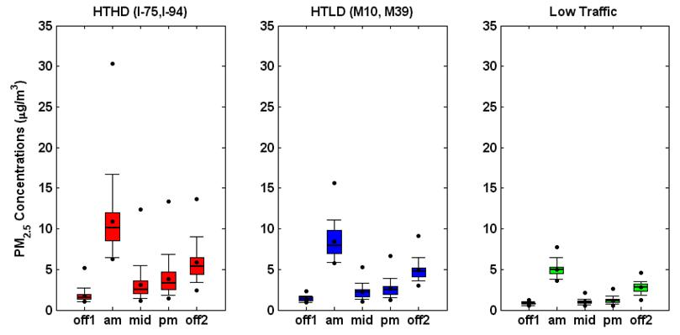
Preliminary Modeling Results: Temporal Variability
NEXUS Participant Locations
Results are for MOBILE sources ONLY in FALL2010 period.

Slide 16
Conclusions
The key factors in modeling air pollutant concentrations due to mobile sources are
Meteorological conditions & dispersion modeling (especially stability).
Emissions (including roadway classification, fleet mix, and traffic volume).
Local measurements (verifying traffic characteristics).
In general…
Road-link based activity (traffic, speed, vehicle mix, etc.) is hard to generate.
Meteorological conditions are applied to a large spatial range, where boundary layer characteristics may vary.
Local measurements are needed to verify general characteristics in traffic patterns and volumes.
Air quality modeling is computationally resource intensive, but captures temporal and spatial variability with accurate emissions and meteorological inputs.

Slide 17
Special thanks to the NEXUS team
Source Apportionment and Field Study
Gary Norris, Matt Landis, Ali Kamal, Sarah Bereznicki, David Olson, Bob Willis, Ram Vedantham
Air Quality Modeling
Vlad Isakov, David Heist, Steve Perry, Michelle Snyder, UNC Institute for the Environment: Brian Naess, Alejandro Valencia, and Mohammad Omary
Exposure Modeling
Janet Burke, Mike Breen, Kristin Isaacs, Kathie Dionisio
Sample Chemical Analysis
Teri Conner, Kasey Kovalcik, John Turlington
Residential Mold Analysis
Steve Vesper, Ali Kamal
Toxicology (NHEERL)
Ian Gilmour, Todd Krantz, Marsha Ward
Epidemiology and Health Study (University of Michigan)
Stuart Batterman, Toby Lewis, Tom Robins, Laprisha Berry-Vaughn, Chris Godwin, Rajiv Ganguly, Graciela Mentz, Bhramar Muhkerjee
NCER Project Officer
Sherri Hunt
Study Planning
Alan Vette (currently NHEERL)
Although this work was reviewed by EPA and approved for publication, it may not necessarily reflect official Agency policy.

