Slide 1


Dynamical Evaluation of Model Suitability for a Retrospective Analysis of Ozone Formation
Douw Steyn¹, Bruce Ainslie^{1,2},
Christian Reuten^{1,3}, Peter Jackson⁴
¹ Department of Earth, Ocean and Atmospheric Sciences, The University of British Columbia, Vancouver, BC, Canada.
² MSC, Environment Canada, Vancouver, BC, Canada.
³ RWDI AIR Inc., Calgary, AB, Canada.
⁴ Natural Resources & Environmental Studies Institute, University of Northern British Columbia, Prince George, BC, Canada.

Slide 2
Agenda
Setting the stage
How we evaluated the modeling system (and why we did it that way)
Some results

Slide 3
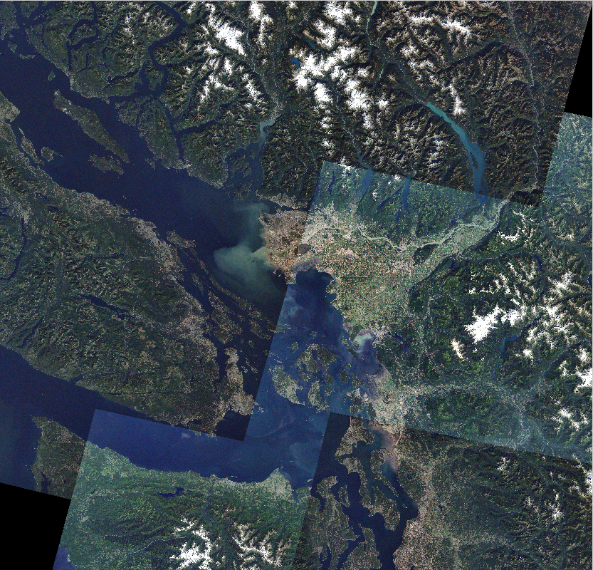
Setting the Stage: The Lower Fraser Valley (LFV)
Triangular valley
~2 million people

Slide 4
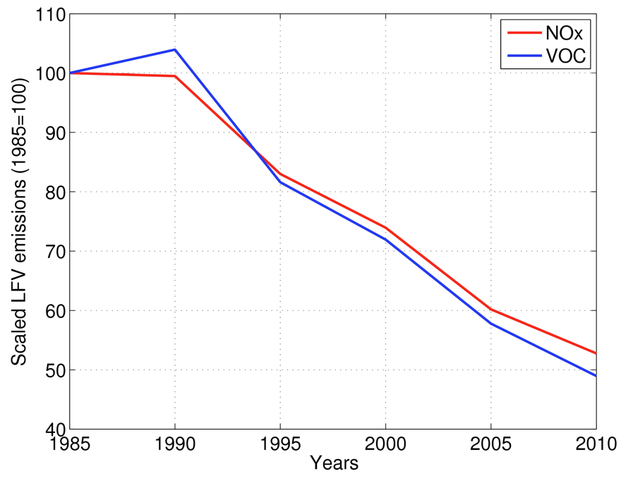
Valley-Wide NO_{x} and Anthropogenic VOC Emissions

Slide 5
Spatio-Temporal Changes in Ozone Concentrations
T29
Observed ambient ozone reductions not uniform across LFV
T09
T12
T15

Slide 6
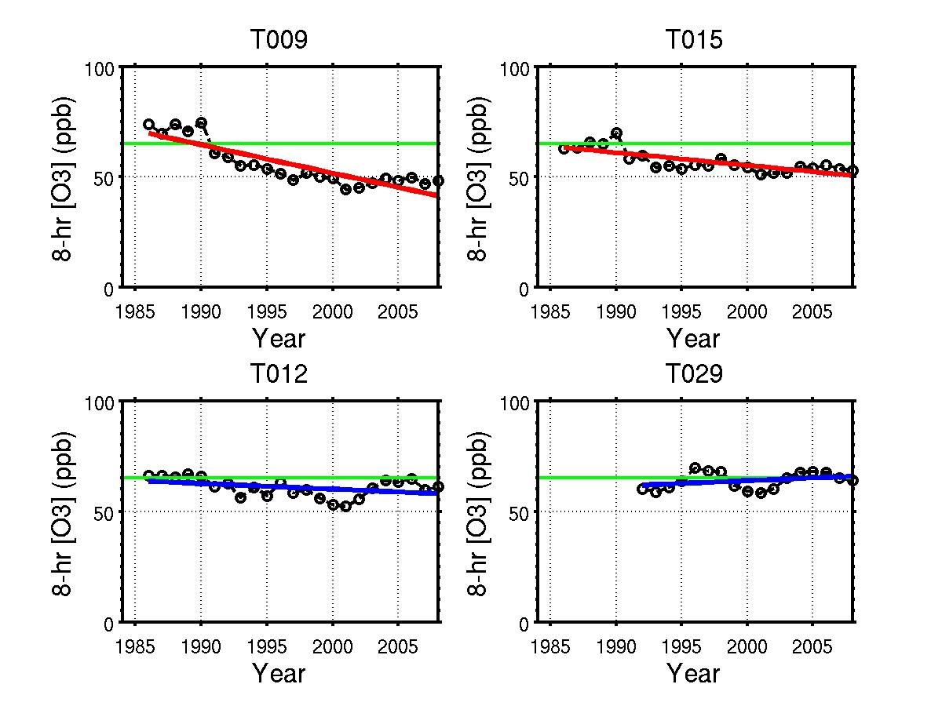
Ozone Trends in Western and Eastern LFV
3-year running averages of annual 4th highest of daily maximum 8-hour running averages
Calculated according to Canada-wide Standard
Green line: CWS threshold (65 ppb)
Trend lines: red significant, blue insignificant at 95% confidence
West
East

Slide 7
Unintended Full-Scale Experiment
Background ozone and precursors generally from North Pacific and quite low.
Documented small increase in background ozone.
Little or no impact from precursor emissions upwind of LFV during ozone episodes.
Shift in the population patterns over last 25 years.
No noticeable change in meteorology.
→ Ozone formation in LFV almost entirely caused by local emissions.
→ Observed change in behaviour of ozone formation must arise from reductions in precursor emissions.

Slide 8
Numerical Modeling System
WRF: Meteorology
SMOKE + MEGAN: Emissions
CMAQ: Chemical transformations

Slide 9
Agenda
Setting the stage
How we evaluated the modeling system (and why we did it that way)
Some results

Slide 10
How We Evaluated the Modeling System
NOT: Research-based model evaluation.
BUT: Evaluated if the model is suitable to answer policy-relevant research questions:
  Cause for relative decline in ozone air quality in Eastern LFV (Abbotsford to Hope) over past 20 years?
  Importance of changes in reactivities and amounts vs. spatial density shifts in emissions?

Slide 11
Comparison of Research-Based and Policy-Relevant Model Evaluations
 | Research-Based | Policy-Relevant
Approach | Objective, thorough | Pragmatic, good enough
Meteorology | Optimization | Cherry picking
Chemistry | Best and newest | Most established
Emissions | Important | Critical

Slide 12
Criteria for Choosing Ozone Events
Span period of greatest emission change.
Include all meteorology typical of ozone events.
Coincide as much as possible with previous research.
Started off with 7 events.

Slide 13
Meteorology Typical of Ozone Events
Ainslie and Steyn (2007):
Four meso-scale circulation regimes typically found during LFV ozone events.

Slide 14
Agenda
Setting the stage
How we evaluated the modeling system (and why we did it that way)
Some results

Slide 15
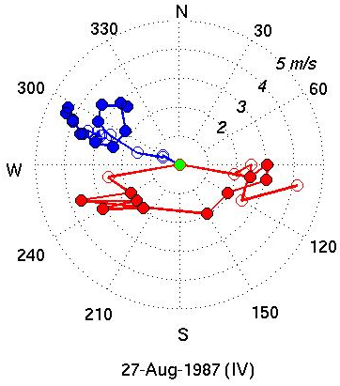
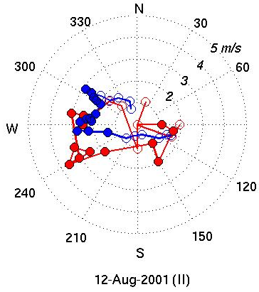
Meteorological Modeling
Coastal (YVR) hodographs

Slide 16
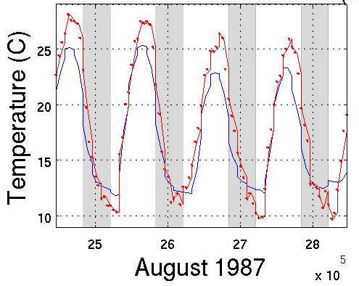
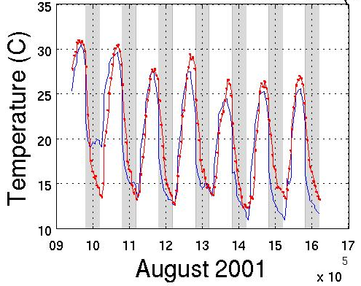
Meteorological Modeling
Cherry Picking
Inland (YXX) temperature time series.
Blue: Model.
Red: Observations.

Slide 17
Model Runs
4 events, each run with 1985 and 2005 emissions:
Year | Dates | Regimes | Notes
1985 | July 18-22 | I-IV-IV | Beginning of period; event modeled by NRC, SAI and UBC
1995 | July 16-20 | III-III-III | Aircraft based observations
2001 | August 9-13 | II-II-II | Pacific 2001 field campaign
2006 | June 23-27 | I-I-I | End of period

Slide 18
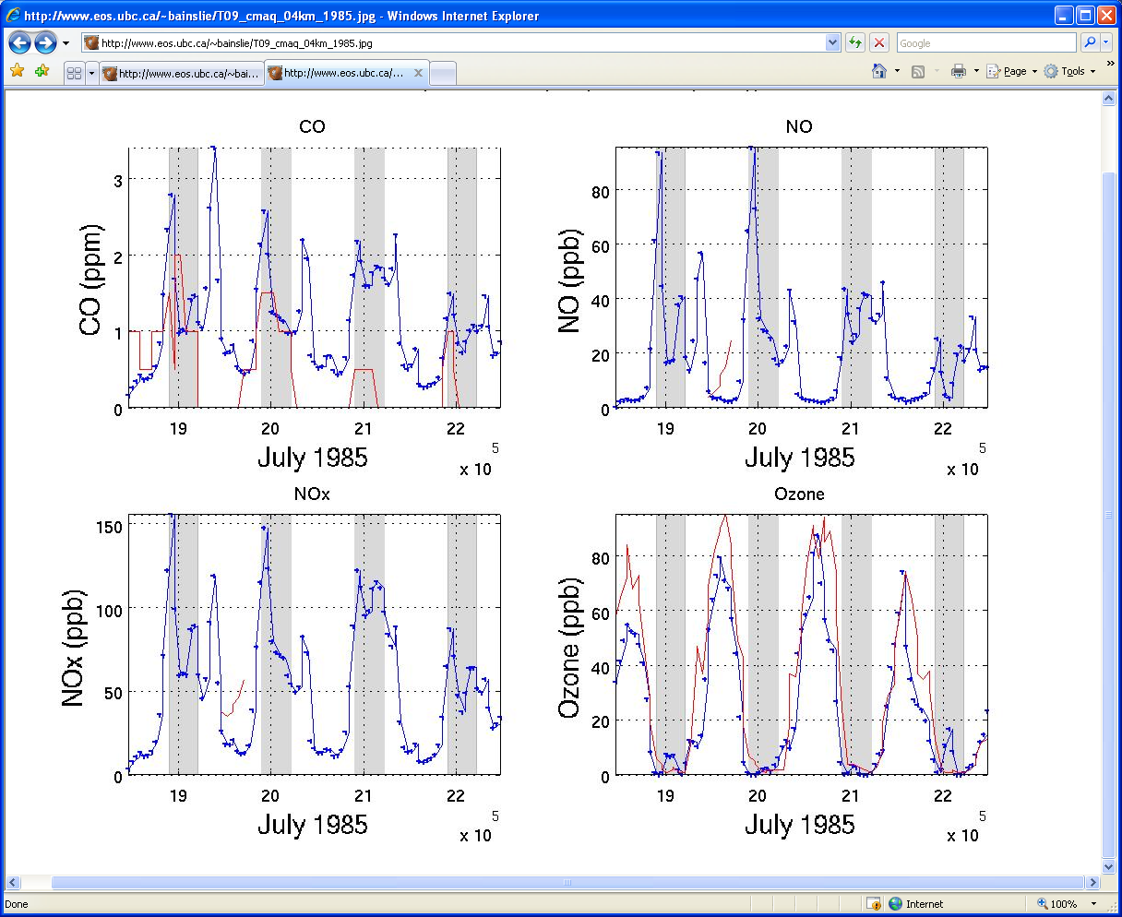
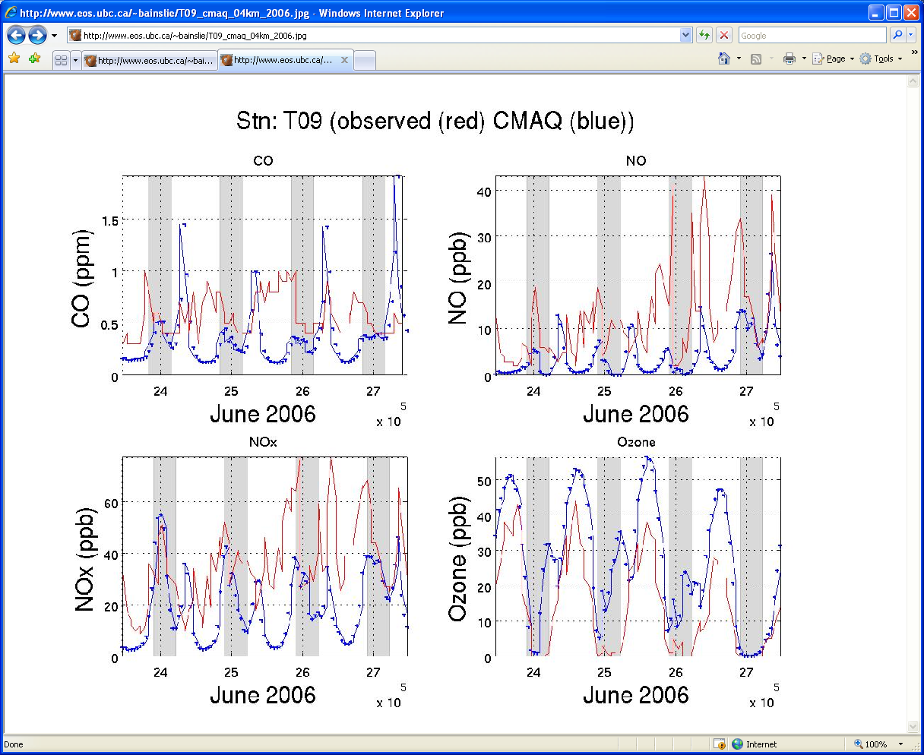
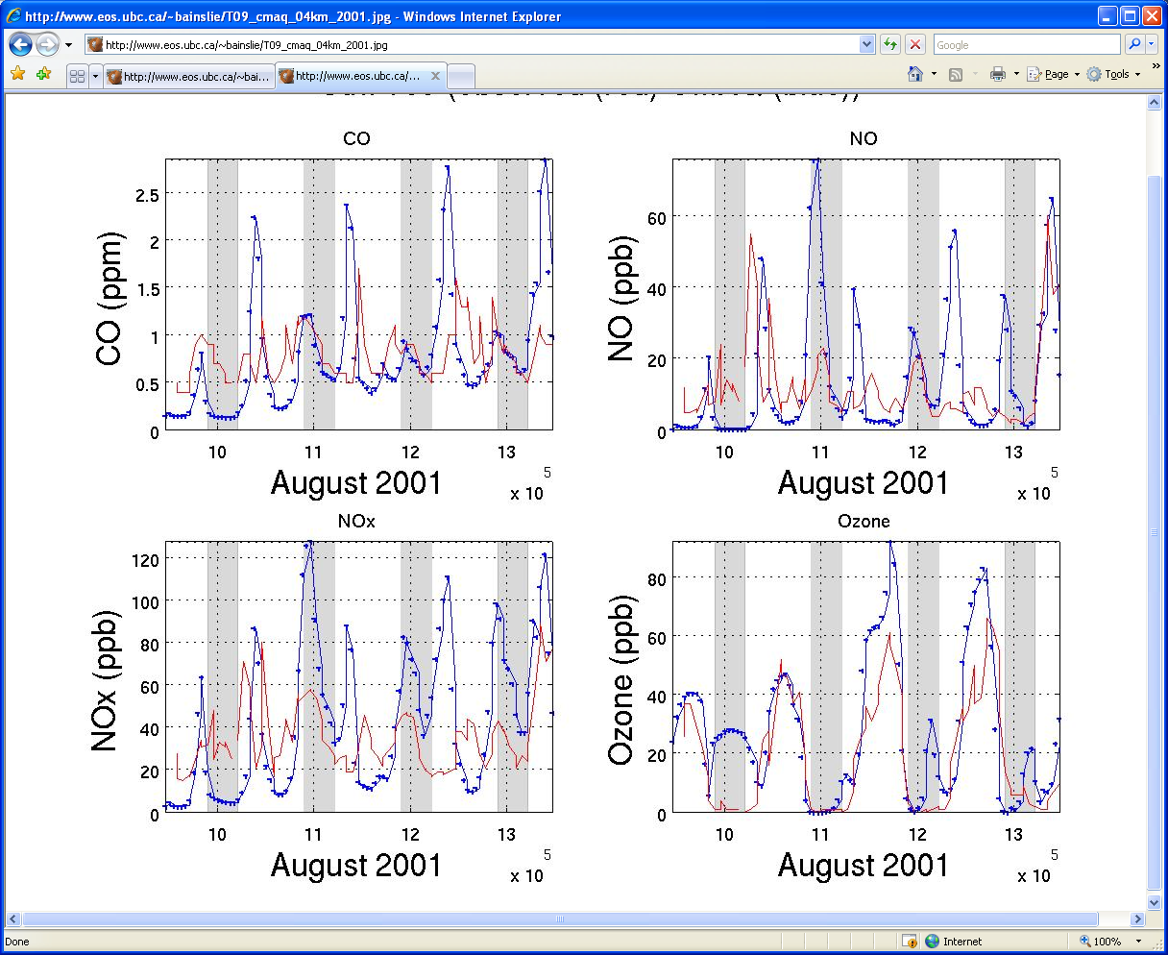
Ozone Modeling
T09 observed (red) and modeled (blue):
1985: Good agreement
2001: Okay
2006: Poor
No cherry picking!

Slide 19
Emissions Modeling
SMOKE:
  Annual NO_{x}, VOCs, CO emission totals from present (2005) and backcast (1985) inventories.
  Spatial surrogates adjusted based on changes in population density.
  Inventories for: LDV&HDV (via MOBILE 6.2 and MOBILE 6.2C), off-road, railroads, aircraft, marine, other mobile sources, biogenic emissions, point, and area sources.
MEGAN: Biogenic emissions held fixed over 20-year (1985-2005) analysis period.

Slide 20
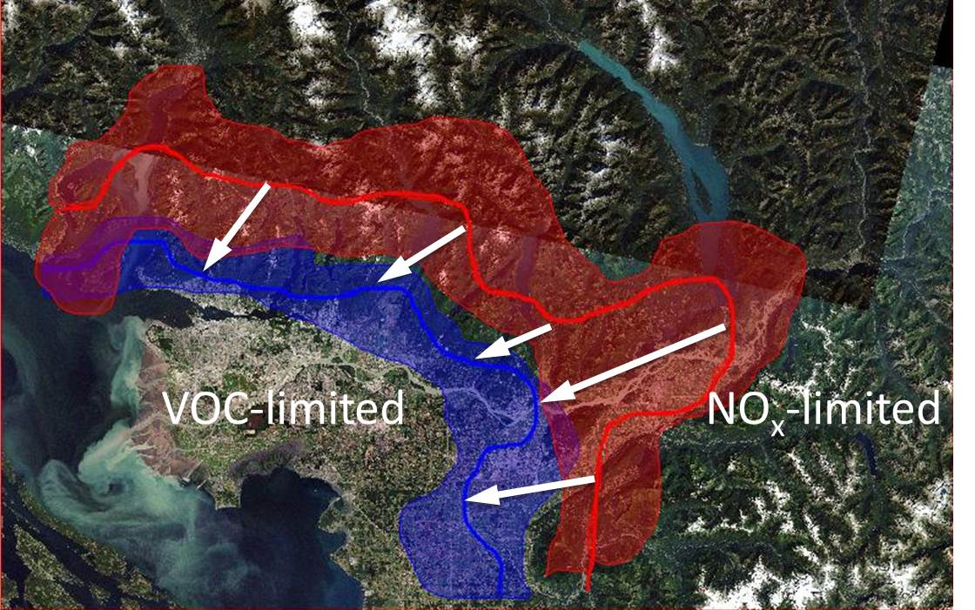
Identification of Sensitivity Regime Changes
VOC-to-NO_{x} transition regions from precursor sensitivity tests using indicators in CMAQ model output.
Red: 1985 emissions.
Blue: 2005 emissions.
Shaded regions: estimated extent of variability from varying met conditions.

Slide 21
Policy-Relevant Findings
VOC emission reductions:
effective in reducing ozone in western LFV;
partly offset by NO_{x} emissions reductions;
likely little effect in eastern LFV.

Slide 22
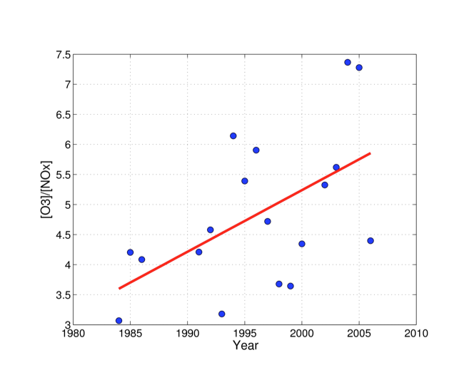
Reactivity Changes
Observations:
  Rate of ozone production per NO molecule increased from 1985-2005.
  Likely offset some NO_{x} emission reductions.
  Efficiency gains greater in East than West.
Modelling:
  Increased NO_{x}-efficiency.
  But: uniform across LFV.
8-hr average [O3]/[NOx] ratios at Chilliwack (East) with trend line; 8-hr averages of the seven days with the highest hourly ozone concentrations in each year

Slide 23
Additional Evaluations
Temperature
NO_{x} fields
VOC spot measurements
Previous modeling exercises
Field campaign data

Slide 24
Model Caveats
City of Vancouver (West):
  Ozone consistently over-predicted.
  Daytime NO_{x} consistently under-predicted.
Eastern-most LFV: Ozone under-predicted.
→ Consistent with a deficiency in NO_{x} emissions.
Slightly changing ozone bias over time.
→ Uncertainties in the emissions backcasting.

Slide 25
Conclusions of Model Evaluation
Model responsive to changes in emissions from 1985-2005.
Magnitude of the response comparable to observed changes in LFV ozone plume.
Model results generally as good or better than previous modeling efforts.
→ Modeling system is suitable for analyzing mechanisms linking spatio-temporal shifts in LFV emissions to observed spatio-temporal shifts in LFV ozone plume.

Slide 26
Acknowledgements
Metro Vancouver (AQ data, support to BC Clean Air Research Fund)
Fraser Basin Council and Fraser Valley Regional District (support to BC Clean Air Research Fund)
NSERC (grants to D. Steyn and P. Jackson)

Slide 27
References
Steyn D G, Ainslie B, Reuten C, Jackson P L, 2012: A retrospective analysis of ozone formation in the Lower Fraser Valley, British Columbia, Canada. Part I: Dynamical Model Evaluation. Atmosphere-Ocean, 51, 153-169.
Ainslie B, Steyn D G, Reuten C, Jackson P L, 2012: A retrospective analysis of ozone formation in the Lower Fraser Valley, British Columbia, Canada. Part II: Influence of emissions reductions on ozone formation. Atmosphere-Ocean, 51, 170-186.
Reuten C, Ainslie B, Steyn D G, Jackson P L, and McKendry I, 2011: Impact of climate change on ozone pollution in the Lower Fraser Valley, Canada. Atmosphere-Ocean, 50, 42-53.
Ainslie B and Steyn D G, 2007: Spatiotemporal trends in episodic ozone pollution in the Lower Fraser Valley, British Columbia, in relation to mesoscale atmospheric circulation patterns and emissions. Journal of Applied Meteorology and Climatology, 46, 1631-1644.

