Slide 1

Intercomparison of secondary organic aerosol models based on SOA/O_{x} ratio
Yu Morino, Kiyoshi Tanabe, Kei Sato, and Toshimasa Ohara
National Institute for Environmental Studies, Japan
ーContentsー
１．Introduction － SOA modelling in Tokyo
２．Methodology － Box model settings
３．Results － Model evaluation / Source contributions
４．Summary
ーAcknowledgementー
Funds： Grant-in-Aid for Scientific Research from the Japan Society for the Promotion of Science (23710024)
Environment Research and Technology Development Fund (C-1001)
Obs. data： Prof. Y. Kondo and Prof. N. Takegawa (Univ. Tokyo)
The 12th Annual CMAS Conference, October 29, 2013

Slide 2
PM_{2.5} in Japan (2001-2010, annual average)
１．Introduction
Urban (N=12)
Rural (N=5)
Roadside (N=16)
2001 2002 2003 2004 2005 2006 2007 2008 2009 2010
PM_{2.5} environmental standard in Japan (Sept. 2009 ‒)
Annual mean: 15 μg m⁻³
Daily mean: 35 μg m⁻³
Ministry of Environment [2012]

Slide 3
１．Introduction
PM_{2.5} in Japan (2010-2013, monthly average)
④Autumn
①Winter
④Autumn
①Winter
③Summer
②Spring
②Spring
②Spring
②Spring
②Spring
Western Japan
# daily PM_{2.5}
> 70 μgm⁻³
# Stations×day
% daily PM_{2.5}
> 35 μgm⁻³
①Average PM_{2.5} was higher than 15 μgm⁻³ in western Japan
Monthly average
PM_{2.5} (μgm⁻³)
Eastern Japan
(including Tokyo Metropolitan Area)
Ministry of
Environment [2013]
②Daily PM_{2.5} exceeds environmental standard in all the seasons.
2010
2011
2012
2013
Notes:
http://www.env.go.jp/air/osen/pm/conf/conf01-04/mat01_2.pdf

Slide 4
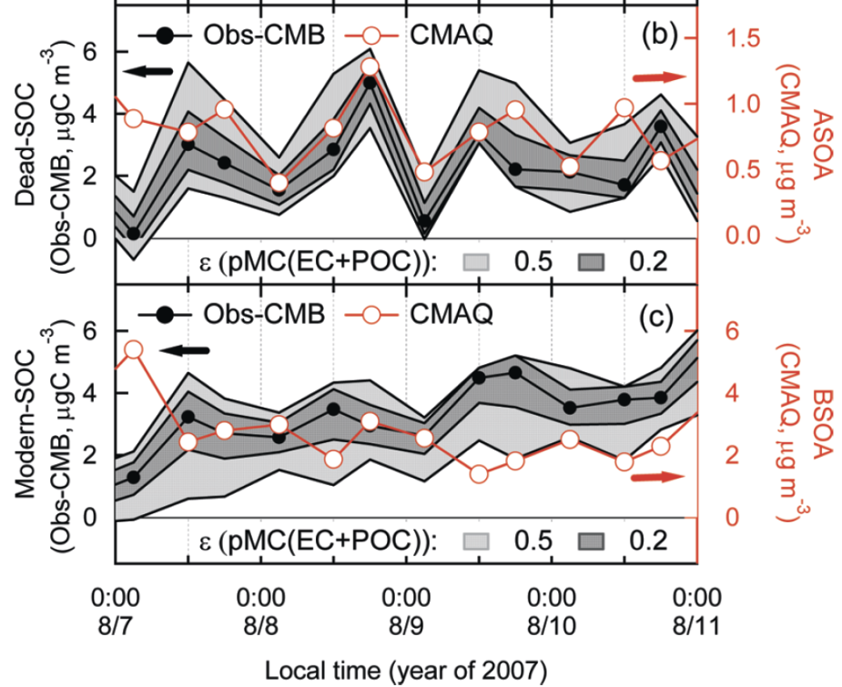
SOA modelling in Tokyo Metropolican Area (Case study in summer 2007)
１．Introduction
K
Model intercomparison of PM_{2.5} species (Morino et al., JSAE, 2010)
(CMAQ v4.7.1 and CMAQ 4.6 were used.)
Model evaluation of fossil- and biogenic SOA (Morino et al., ES&T, 2010)
(CMAQ –MADRID was used.)
Fossil-SOA: Underestimation by a factor of 6-8
Organic aerosol
S1: Komae, S2: Kisai, S3: Maebashi, S4: Tsukuba
All models significantly underestimated OA.
Biogenic-SOA: Underestimation by a factor of 1.5 - 2

Slide 5

１．Introduction
SOA model development – Volatility basis-set (VBS) model
VBS model
SOA (I/S)
Yield model
POA
cond./
evapo.
cond./
evapo.
Merit 1
emis.
SVOC3
SVOC1
aging
Emission sources
SVOC2
aging
emis.
SVOC3
SVOC2
emis.
oxidation
aging
aging
Merit 2
SVOC1
cond./
evapo.
VOC
cond./
evapo.
SOA (V)
Merit 1：
Merit 2：
Simulate primary emissions and oxidation (aging) of SVOC/IVOC (semi-/intermediate- VOC)
Simulate aging processes of oxidation products from VOCs

Slide 6
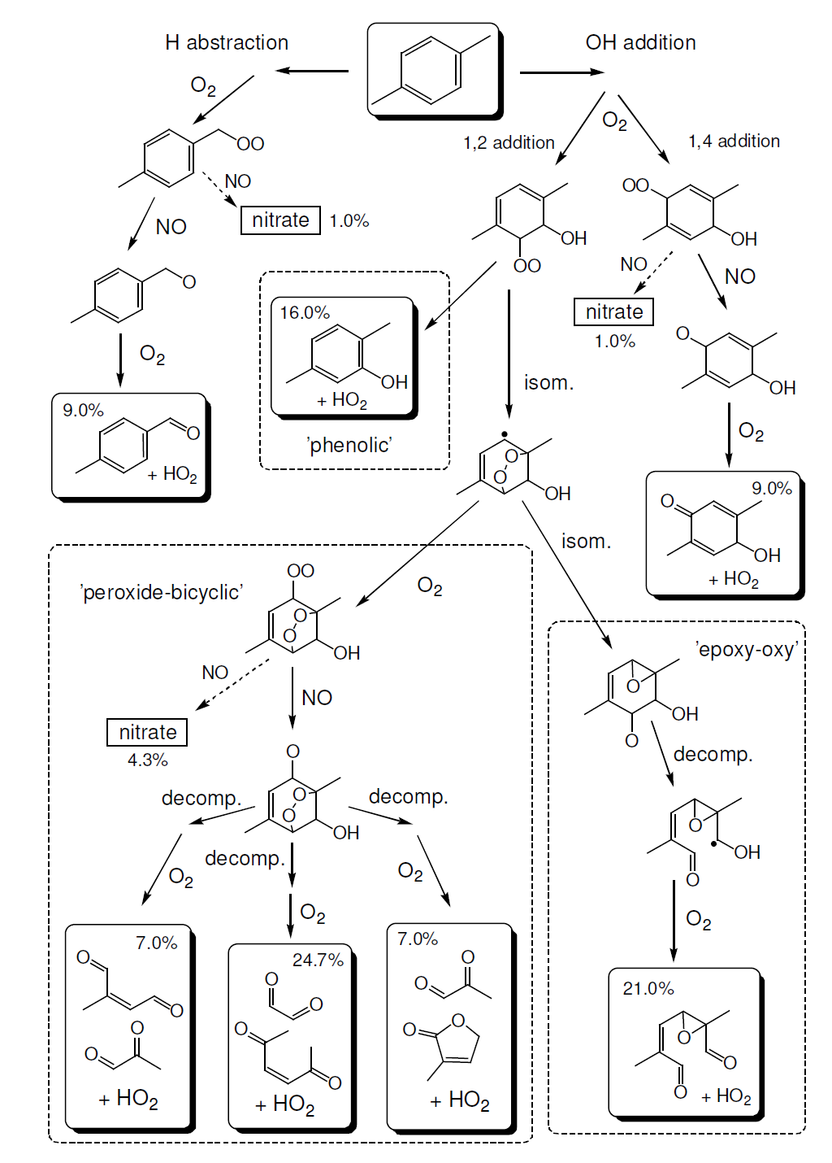
１．Introduction
SOA model development – Chemical modules
Yield model
(SAPRC99-AERO4)
ARO1 + OH = 0.224*HO2 + 0.765*RO2_R + 0.011*RO2_N + 0.055*PROD2
+0.118*GLY + 0.119*MGLY + 0.017*PHEN + 0.207*CRES
+ 0.059*BALD + 0.491*DCB1 + 0.108*DCB2 + 0.051*DCB3
+0.071*TOLAER1 + 0.138*TOLAER2
Near-explicit model
–Explicitly simulate multi-generation reactions
MCM
(master chemical mechanism)
CACM (caltech chemical mechanism)
UR24
UR25
UR26
etc.

Slide 7
１．Introduction
Objectives
Intercomparison of five SOA models (of different frameworks) to evaluate their characteristics and performance
Preliminary evaluation of volatility basis-set (VBS) model on OA simulation in Tokyo Metropolitan Area
Characteristics of this study
Intercomparison of SOA models | A few previous studies of SOA model intercomparison (particularly including both MCM and VBS models)
Box model simulation | Many sensitivity simulations can be made (advantage for MCM calculations)
Evaluation using SOA/O_{ｘ} ratio | Model evaluation less affected by uncertainties of meteorological fields
Comparison for Tokyo data | OA was accurately measured by AMS/sunset-TOT Good correlation between O_{ｘ} and SOA Behaviors of VOC and O₃ are well understood

Slide 8
SOA models
2. Methodology
Five SOA models simulated in this study
 | # Gas | # reaction | # SVOC | # primary VOCs | Aerosol model | References
MCM v3.2 | 5731 | 16933 | 1902^{#2} | 105 , | Pankow | Jenkin et al., 2003; Saunders et al., 2003
CACM-MADRID2 | 366 | 366 | 43 | 17 , | MADRID2 | Griffin et al., 2002; Pun et al., 2002
SAPRC99-AERO4 | 79 | 214 | 10 | 24 , | AERO4 | Binkowski and Roselle, 2003
SAPRC99-AERO5 | 88 | 224 | 12 | 24 , | AERO5 | Carlton et al., 2010
SAPRC99-VBS | 92 | 214^{#3} | 9 | 33 , | VBS | Tsimpidi et al., 2010
#1: estimate of this study、#2: C* ≤ 100 μgm³、#3: exclude aging reactions
MCM, CACM-MADRID: explicitly simulate multi-generation oxidation.
  - Vapor pressures used in the MCM model was calculated by EPI-Suite (Stein and Brown method). K_{p} was multiplied by a actor of 500 (Johnson et al., 2006).
AERO4, AERO5: Yield model
VBS: Grouping of SVOC and IVOC based on volatility (~vapor pressure).
  - Speciation of emitted SVOC/IVOC and aging reaction rates was the same with Tsimpidi et al. (2010).
from CMAQ-MADRID
CMAQ v4.6
CMAQ v4.7.1

Slide 9
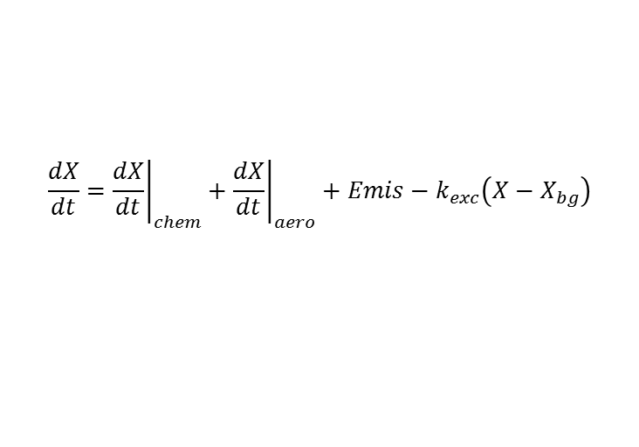
Box model framework
2. Methodology
Processes | One box model (domain: 30 x 30 km², Fig.) including chemical, aerosol, emission, and air mass exchange.
Target period | July 22 – August 12, 2004
Other conditions | Meteo. param. (T, RH, WS, BLH): observational data Background: 20 ppbv for O₃, NMHC is from Morino et al. (2011)
$$\frac{dX}{dt}={\left.\frac{dX}{dt}\right|}_{chem}+{\left.\frac{dX}{dt}\right|}_{aero}+Emis−k_{exc}\left(X−X_{bg}\right)$$
Emissions | EAGrid2000 (Kannari et al., 2007)
Speciation of VOC | Vehicles：JATOP (2012) Evaporative：Ministry of Env. (2003) # VOC emission data are firstly classified for MCM. Then, SAPRC/CACM data are prepared.
Observetion | Period: July 24 – Aug 14, 2004 Site: RCAST, Tokyo Univ # OA and OOA were measured by AMS (Takegawa et al., 2006).
Obs. site
Domain

Slide 10
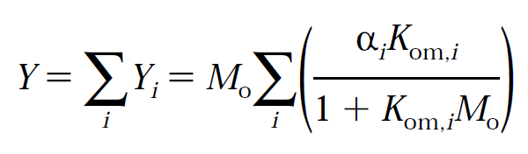
Comparison of experimental data and model simulation
—high NO_{x} condition
3. Results
Y_{i}: SOA production yield K_{om,i}：Partitioning coefficient
M₀: OA concentration a_{i}: stoichiometric coefficient
m-xylene
toluene
○Standard
×No aging
VBS
AERO4
AERO5
Obs.
Model simulation of chamber experiment (aromatics VOC + NO_{x} + HONO)
Aging process enhanced SOA production yield was enhanced by a factor of 1.3 ~ 1.5.

Slide 11
Comparison of experimental data and model simulation
—high NO_{x} condition
3. Results
Y_{i}: SOA production yield K_{om,i}：Partitioning coefficient
M₀: OA concentration a_{i}: stoichiometric coefficient
m-xylene
toluene
○Standard
×No aging
■reduced Y_{i}
VBS
AERO4
AERO5
Obs.
Model simulation of chamber experiment (aromatics VOC + NO_{x} + HONO)
Aging process enhanced SOA production yield was enhanced by a factor of 1.3 ~ 1.5.
→ Y_{i} should be reduced by 30-50% to avoid double counting.

Slide 12
3. Results
Model evaluation in ambient condition – gaseous species
O₃
OH
HO₂
NO
NO₂
HNO₃
O₃ and NO_{x} were well reproduced.
OH were reproduced, while HO₂ were underestimated.
→ should be examined in future studies.
HNO₃ were overestimated. (dry deposition)

Slide 13
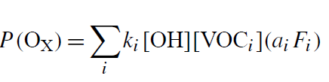

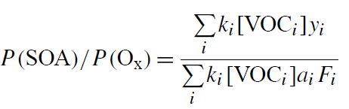
3. Results
Model evaluation using SOA/O_{x} ratio
Under VOC limited condition (e.g., urban area), VOCs+OH reactions are rate-limiting for O_{x}(=O₃+NO₂) and SOA production.
O_{x} production rate:
SOA production rate：
Ratio of SOA and O_{x} production rate
K_{i} : VOC+OH reaction rate
Α_{i} : # of HO₂,RO₂ generated from VOC+OH reaction
F_{i} : Fraction of RO₂ which produce NO₂
Y_{i} : SOA production yield
SOA formation potential of VOC
O_{x} formation potential of VOC
=
Obs.
S=0.155 μgm⁻³/ppbv
Obs.
S=0.155 μgm⁻³/ppbv
VBS —Standard
S=0.108
VBS
S=0.108
VBS —Reduced yield
S=0.084
CACM
S=0.046
AERO5
AERO4
MCM
S=0.004
AERO5 S=0.016
AERO4 S=0.010
VBS —No aging
S=0.005

Slide 14
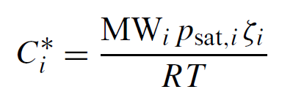
3. Results
Intercomparison of volatility (C*) distributions
SOA
(aerosol)
SOA+SVOC
(total)
SVOC
(gas)
SOA
SOA+SVOC
(aerosol/total)
Saturation concentration
Saturation concentration
Continuous C* distributions in VBS and MCM.
MCM simulated very small [SOA+SVOC] with C*<10 μgm⁻³.

Slide 15
3. Results
Contributions of precursors/sources to O_{x} and SOA
Contributions of precursor VOCs were estimate from sensitivity simulations (20% recuction of each VOC).
Contributions of
each precursor VOC
ARO
ALK
ARO
OLE
others
OLE
SVOC
Contributions of
emission sources
Vehicles
Vehicles
Fugitive
Paint
Print
Paint

Slide 16
Summary
4. Summay
Five organic aerosol models (MCM, CACM SAPRC99-AERO4, SAPRC99-AERO5, SAPRC99-VBS) were compared using a box model.
Aging reactions enhanced SOA production yield by a factor of 1.3 ~ 1.5 under conditions of chamber experiments. SOA production yield should be reduced by 30-50% to avoid double counting.
SOA/O_{x} ratio was well reproduced by the VBS model, while other models significantly underestimated the observed ratio.
Source contributions to ambient SOA concentration largely differed among the five models. Choice of SOA model is critical in the source apportionment of SOA.

Slide 18
３．結果 －ボックスモデル計算結果、寄与解析
モデルー観測データの比較 (VOC成分)
NMHC濃度の観測値とモデル計算結果
(期間平均濃度、ppbv)
VOC成分の日変動
上記の比較を基に、VOCの排出量を補正。右図は補正後のVOC濃度。測定成分(C₅H₈を除いた14成分)のみ補正した点に注意
MCM, CACM, SAPRC99で芳香族濃度が異なるのは、グルーピングが異なり、OHとの反応速度も異なるため

