Slide 1
12th annual CMAS conference
Impact of Biomass Burning Aerosols on Regional Climate over Southeast US
Peng Liu, Yongtao Hu, Armistead G. Russell, Athanasios Nenes
Georgia Institute of Technology, Atlanta, GA, 30332
10-30-2013
DOEesm

Slide 2
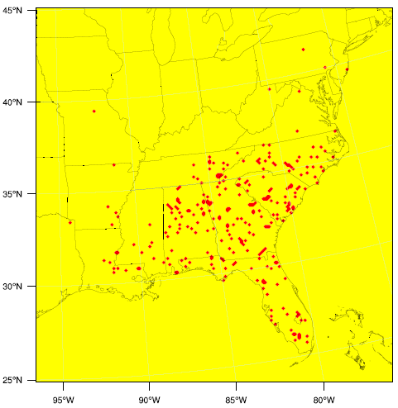
Motivation
Biomass burning aerosols may contributes significantly to the PM and CCN (IN?) concentrations in the southeastern US.
Locations where burning occurred during the May 2007
Notes:
Bio aerosol is a big contributor to the particular matter in the southeastern US. Here is a plot showing all the locations where burning occurred during the month of May 2007 to give you a general ideal of how many fires (although most of them may be small fires) we could have even for a non prescribed burning season

Slide 3
Motivation: Aerosol-cloud interactions
The aerosol-cloud-climate interaction, known as aerosol direct and indirect effect, is important, however complex.
Increasing aerosol loading tends to make clouds that are “whiter”, precipitate less (persist longer) and potentially cover larger areas of the globe.
Challenge: difficult to untangle “direct” radiative forcing from cloud contribution, as one affects the other.
Notes:
Aerosols may affect the local and regional climate in a complicated way , known as direct and indirect effect . Complexity exist in both the processes involved and the consequent impact on the meteorological fields, which may in return change the air quality, especially by precipitation. For example briefly talk about how the CCN may change the cloud properties . Increasing aerosol loading tends to make clouds that are “whiter”, precipitate less (persist longer) and potentially cover larger areas of the globe.

Slide 4
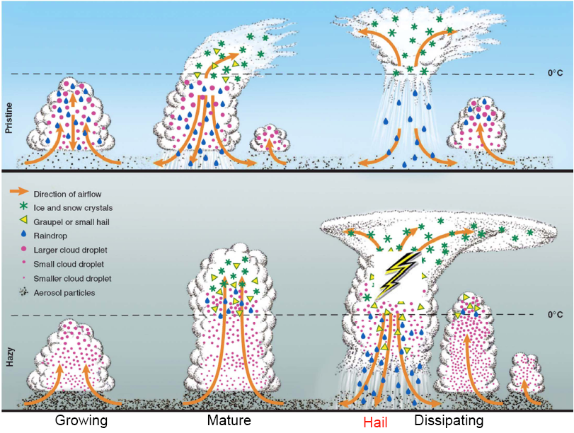
Motivation: Aerosol-cloud interactions
More aerosols reduce drizzle.
More water reaches the freezing level.
More latent heat is released during freezing.
Convective envigoration.
Dynamical feedbacks from aerosol effects can change cloud
structure/precipitation patterns (cloud feedbacks).
Notes:
Aerosols may affect the local and regional climate in a complicated way , known as direct and indirect effect . Complexity exist in both the processes involved and the consequent impact on the meteorological fields, which may in return change the air quality, especially by precipitation. For example briefly talk about how the CCN may change the cloud properties . Increasing aerosol loading tends to make clouds that are “whiter”, precipitate less (persist longer) and potentially cover larger areas of the globe.

Slide 5
Goals
Attempt to identify the relative contribution of aerosols direct and indirect effect to the shortwave radiation reaching the surface.
Investigate the factors that may affect the relative contribution.
See if biomass burning aerosol induces cloud microphysical feedbacks on precipitation, liquid water content and ice.
Notes:
We will focus on radiation and precipitation.

Slide 6
Initial focus: aerosol direct radiative impacts on cloud fields
Modeling Tools: WRF3.3 WRF3.3-CMAQ5.0.1 (aerosol only directly affects radiation)
Potential Methods:
?
aerosol
direct effect on radiation
(WRF-CMAQ ensemble average) - (WRF ensemble average)
Issue : The clouds respond to changes in the radiation balance from the aerosol direct forcing. Important to quantify if we are to detangle aerosol direct from indirect radiative effects on clouds.
Methods We Designed Based on :
1: cloud optical properties depend on liquid water content (LWC), ice water content (IWC) and effective radius of liquid and ice cloud, respectively .
2: little change in cloud distribution of both liquid and ice clouds in WRF3.3 RRTMG SW scheme.
SW at surface ~ A * (LWC ) + B*(IWC ) + C (Multilinear regression)
Notes:
When without the aerosol and only run WRF alone, SW at the surface is APPROXIMATELY the linear combination of LWC and IWC

Slide 7
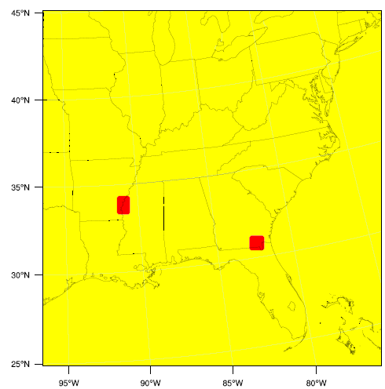
Simulation Design
Experiments : WRF 4 ensemble members
WRF –CMAQ with coupled shortwave radiation
scheme for aerosols
Settings: grid nudging on (above PBL ) ; Morrison microphysics ; RRTMG SW & LW ;KF cumulus scheme; Noah LSM; CB05-AERO6
Driving fields : NARR
Domains and Period :
southeastern US,
12 km resolution,
May 06 ~ 31,2007
Focus on two Biomass
Burning events
CASE 2 CASE 1
Notes:
In both two groups of experiment, we turned on the grid nudging .

Slide 8
Results
Table: Time averaged column total cloud hydrometers by WRF (kg/m2)
and column averaged shortwave radiation reaching the surface(w/m2)
 |  | Liquid Cloud | Ice Cloud | SW at surface
CASE1 | Ensemble 1 | 0.003333 | 0.015263 | 549.5
 | 2 | 0.003669 | 0.015626 | 547.5
 | 3 | 0.0034 | 0.015619 | 548.9
 | 4 | 0.003702 | 0.015331 | 549.2
CASE2 | Ensemble 1 | 0.004514 | 0.038656 | 524.5
 | 2 | 0.00557 | 0.040267 | 519.5
 | 3 | 0.004724 | 0.041781 | 522.1
 | 4 | 0.005269 | 0.037914 | 522.3
Recall: SW at surface = A * (LWC ) + B*(IWC ) + C
Results:
 | Coefficients | Standard Error | t Stat | P-value
C | 575.8 | 1.9 | 299.7 | 7.E-12
A | -3900.9 | 707.2 | -5.5 | 0.0027
B | -859.8 | 47.3 | -18.1 | 9.2E-06
statistically significant, and will be used to estimate the SW change when only cloud mass changes
Notes:
We got statistically significant regression results, which can be used to estimate on a longer period base (not instanteneousely) the SW reaching the surface when only cloud play a role, including both liquid and ice cloud mass respectively, with default values in RRTMG SW for effective radius.

Slide 9
Results
Figure:
Phase 1 Phase2
Table: Estimate the impact of fire on the surface SW (w/m2) in CASE2 area
 | Averaged SW at surface over the studied area (w/m2)
 | WRF ensemble average | WRF-CMAQ | WRF –CMAQ cloud But free of aerosol
Phase 1 | 529.7 | 516.5 | 520.6
Phase 2 | 511.9 | 497.9 | 518.5
Phase2 – phase 1 | -17.8 | - 18.6 | - 2.1
SW =A * (LWC )
+ B*(IWC )
+ C
Notes:
Let’s first look at the case2, which is affected by fire emission only begin from the second half of the simulation period at shown by Fig.1

Slide 10
Results
 | Averaged SW at surface over the studied area (w/m2)
 | WRF ensemble average | WRF-CMAQ | WRF –CMAQ cloud But free of aerosol
Phase 1 | 529.7 | 516.5 | 520.6
Phase 2 | 511.9 | 497.9 | 518.5
Phase 1 – phase 2 | -17.8 | - 18.6 | - 2.1
Direct effect: important impacts on cloud amount; this would impact any subsequent indirect effects
Total aerosols (row 1 &2)
Without Adjustment With Adjustment
direct effect (change in cloud forcing) phase1 - 13.2 (NA) - 9.1 (-4.1)
phase2 - 14.0 (NA) - 20.6 (+6.6)
Fire aerosols (row 3 = phase2 – phase1)
direct effect ( change in cloud forcing) - 0.8 (NA) - 16.5 (+15.7)
Notes:
Let us look at the table more carefully . Without adjustment, the net effect will be taken as the direct effect .

Slide 11
Introducing microphysical couplings…
Summary: Up till now we only looked at “bulk” cloud responses to aerosol radiative forcing
(i.e., “semi-direct” effects and other direct impacts).
Next step: include aerosol-cloud microphysical link and quantify the aerosol indirect effects:
Impacts: Cloud effective radius (droplet and/or ice), by changing number concentrations.
Cloud LWC/IWC due to changes in autoconversion and accretion.
Method:
Establish microphysical link between the aerosol and cloud by through the process of cloud droplet activation (Fountoukis and Nenes, 2005; Barahona and Nenes, 2010)
The nucleation source is directly used by the two-moment Morisson microphysics and affects autoconversion (precipitation) and ice production in convective clouds.
No direct aerosol-ice links (yet).
The modified droplet number is also linked to the radiation scheme by changing the effective radius
R_{eff} = R_{v}(k) ^{1/3} where R_{v}= $\sqrt[3]{\frac{3∗LWC}{4∗Nπρ}}$ , N: cloud droplet number (from microphysics)
k: droplet distribution “shape factor: 0.67-0.8 (depending on LWC and N)

Slide 12
First Results
Results for CASE 1
 | Default WRF –CMAQ | WRF –CMAQ with activation of cloud droplet
Liquid cloud(kg/m2 ) | 0.00372 | 0.00151
Ice cloud (kg/m2 ) | 0.01592 | 0.01578
SW at surface (w/m2) | 522.4 | 525.2
Area total non-convective rain (kg) | 63.5 | 9.5
SW increase due to less clouds = 8.7 w/m2(when effective radius = default case )
(RECALL ∆SW at surface = A * (∆LWC ) + B*(∆IWC )
Feedbacks from the indirect effect tends to mitigate most of the original signal in this case.
We need to study a much larger cloud set to gain a better statistical understanding of direct- indirect effects in the coupled system.
Notes:
If using effective radius of the activation case, the SW reaching the surface should be even bigger. But now it is only about 3w/m2 increase. Why?
Because much less non-convective rain, much less aerosol removed from the atmosphere. In short, direct effect get enhanced due to the change of cloud properties. “Direct effect induced by indirect effect may compensate most of the indirect effect. “ may get stronger when more aerosols. Or more brown/black
Carbon.

Slide 13
Conclusions & Future Work
A method developed to separate the magnitude of aerosol direct and indirect effects.
Feedbacks are important and tend to mitigate most of the original signal in the case studied.
Ensemble runs and analysis of a much larger cloud set is important for better statistics of aerosol-cloud-precipitation feedbacks.
Aerosol-ice cloud coupling is also important and is ongoing work.
THANK YOU!

