Slide 1
Wang Jiandong¹, Wang Shuxiao¹, Zhao Bin¹, Wang Long¹, David Wong², Jonathan Pleim², Hao Jiming¹
1. Tsinghua University, Beijing, China
2. U.S. EPA, NC, USA
Interactions between Particulate Matter and Meteorology: a Modeling Study Using Two-way CMAQ in China

Slide 2
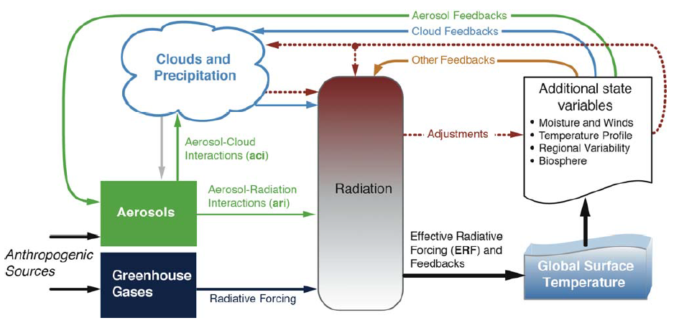
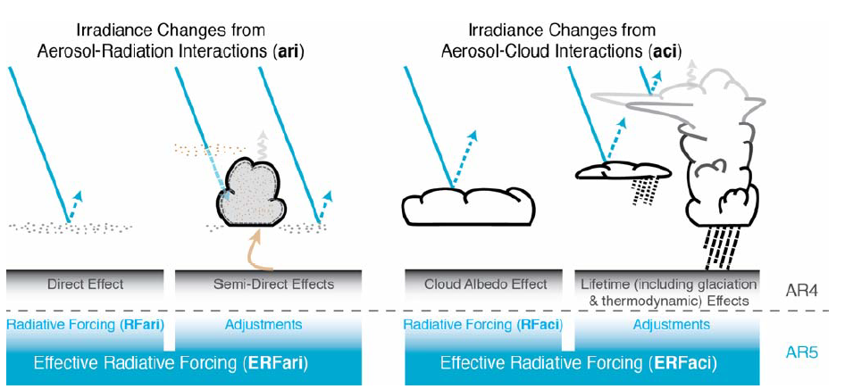
Interaction Between Particulate Matter and Meteorology
IPCC AR5, 2013.
Notes:
The influence of aerosols, on regional and global climate is widely investigated. It includes extinction, effect on cloud and resulting in the change of radiation balance. but only a very limited number of studies reports their impacts on everyday weather. Air pollution and weather forecast are traditionally considered as two separate topics of interest in the field of atmospheric science.

Slide 3
Interaction Between Particulate Matter and Meteorology
Ding, A. J. et al, ACPD, 2013
Notes:
The interaction between particulate matter and meteorology may have potential impact on regional weather and air quality. This interaction mainly acts as 3 cycles. First, the extinction will reduce the surface solar radiation and the surface temperature, which leading to a more stable PBL. Then the diffusion pollutants are reduced and pollutants accumulated in the PBL. Second, the decreased RH, caused by lower temperature, will lead to a hygroscopic grow of particulate matter. Third, the effect on cloud properties. In this study, two way CMAQ model was used to quantify the first process.

Slide 4
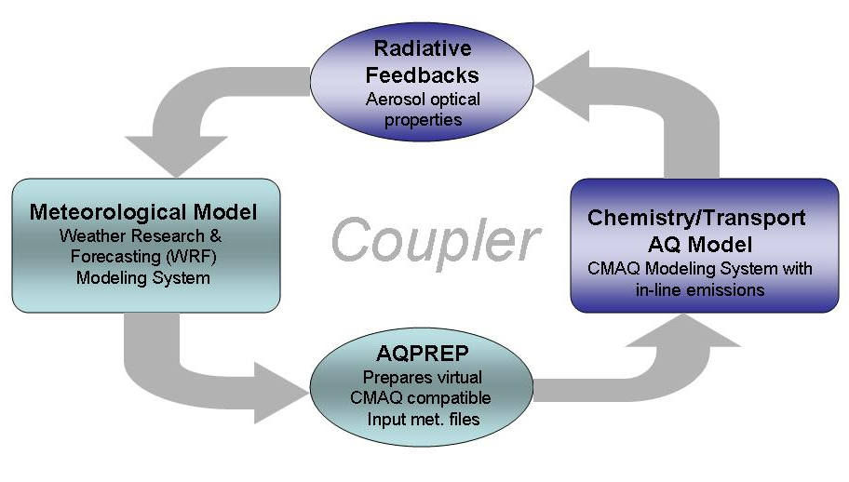
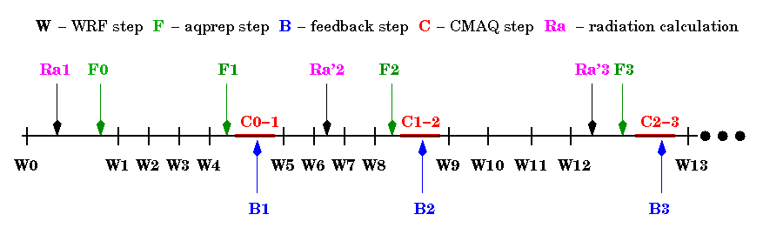
Two-way Model Introduction
D.C. Wong et al, Geosci. Model Dev, 2012
Notes:
Traditionally, air quality model is an one-way process, which means, the air quality model result won’t effect on the meteorology model. To take account into the aerosol-radiation interaction, an in-line model with radiative feedback was developed by U.S. EPA.

Slide 5
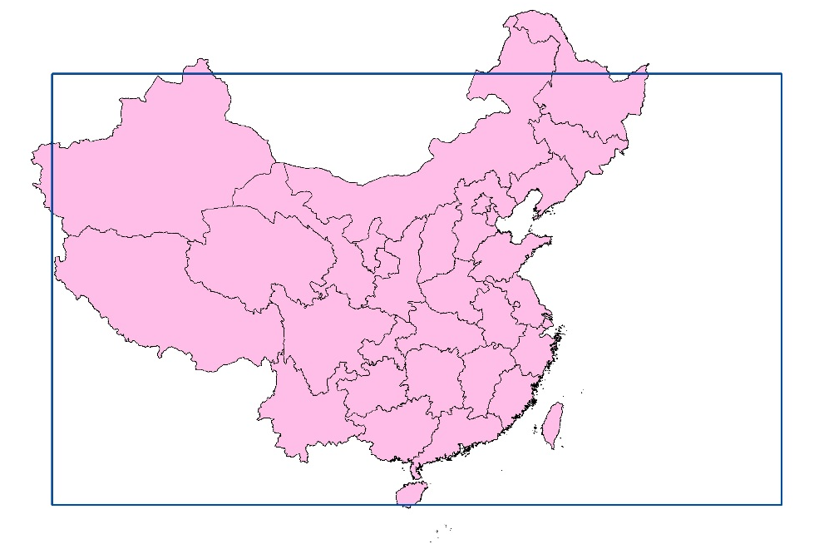
Model Configuration
Simulation System
  WRFV3.3/CMAQ5.0
Mechanism
  Land surface mechanism: PL-X
  Radiation mechanism: rrtmg/cam
  Gas-phase/aerosol CB05&AERO6
modeling domain
  China
Horizontal Resolution:
  36km×36km
Vertical layers
  23 layers
Time Period:
  December 2010
Scenario 1
  Without feedback (NF)
Scenario 2
  Feedback by using RRTMG
Scenario 3
  Feedback by using CAM
Notes:
This study is a application of Two-way CMAQ in China. WRF of version 3.3 and CMAQ of version 5.0 is employed. The grids of 36km horizontal resolution and 23 vertical layers, which covers most of China, were used. The simulation time period is December 2010. 3 scenarios were designed. They are scenario without feedback, with a symbol NF, scenario with feedback by using rrtmg radiation mechanism and by using CAM mechanism.

Slide 6
Inventory
2010 (t/km²)
SO₂
NO_{X}
24.4 Mt in total
26.1 Mt in total
2010 (t/km²)
PM_{2.5}
NH₃
11.8 Mt in total
18.3 Mt in total
  Zhao B. et al, AE, 2013
Notes:
The inventory of 2010 was developed in Tsinghua University and validated in Zhao Bin’s reference. The total emission and spatial distribution were shown here. We can see that the majority of eastern China, and some areas in the middle reach of the Yangtze River have contributed most.

Slide 7
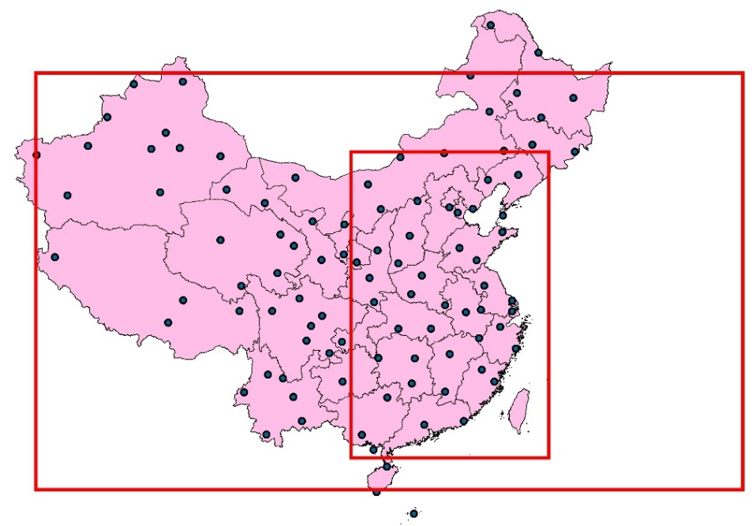
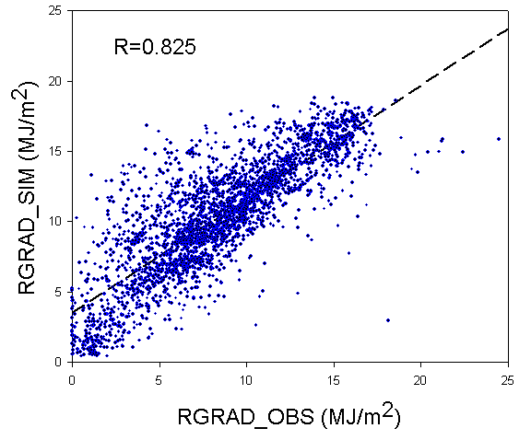
Validation of Radiation Data
With feedback mechanism, the overestimation of radiation simulation is reduced.
EAST
China Radiation Day Value data sets
 | OBS | No feedback | RRTMG | CAM
Mean (MJ/m²) | 8.48 | 11.20 | 10.38 | 9.78
Mean_EAST (MJ/m²) | 5.20 | 6.02 | 5.89 | 5.78
R |  | 0.79 | 0.825 | 0.805
NMB |  | 0.32 | 0.22 | 0.15
NMB_EAST |  | 0.16 | 0.13 | 0.11
Notes:
Then we go to the validation part. To validate the radiation result, the observation data from 95 stations was used. The correlation coefficient is about 0.8. The NMB, which represent the bias, decrease from 32% in NF to 15% in CAM, which implies by using feedback mechanism, the overestimation of radiation is reduced in simulation.

Slide 8
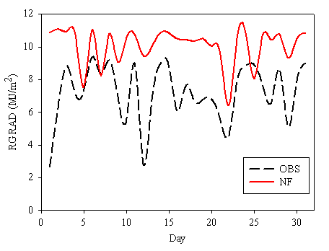
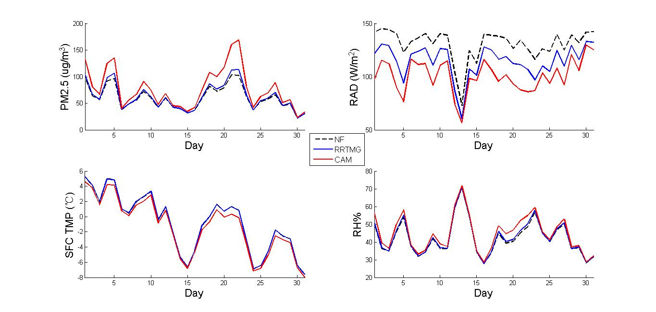
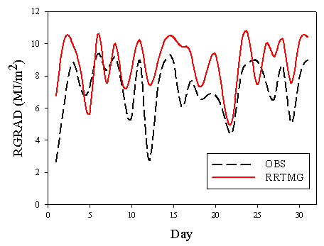
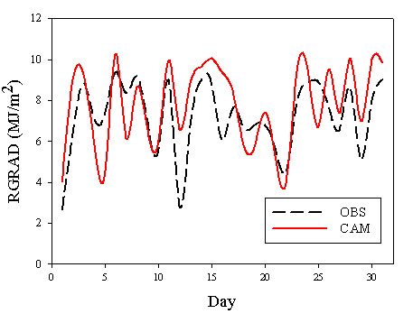
Validation of Radiation Data
NF
Beijing
By using feedback mechanism the simulation of radiation significantly improved during the heavily polluting period.
NMB=0.40
RRTMG
CAM
Beijing
Beijing
NMB=0.23
NMB=0.08
Notes:
To take insight into this reduction, the time-series data of Beijing station was shown as an example. The radiation result in scenario NF is overestimated for about 40%. The NMB is decreased to 23% in RRTMG and 8% in CAM. What’s more, during the period with high concentration of PM2.5, it matches much better. It implies by using feedback mechanism the simulation of radiation significantly improved during the heavily polluting period.

Slide 9
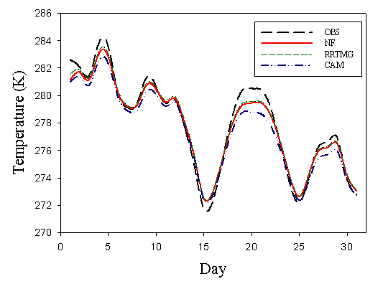
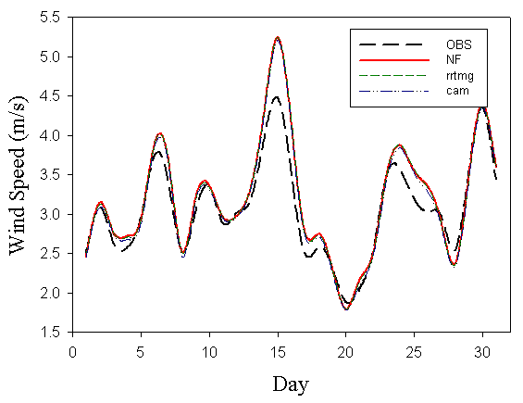
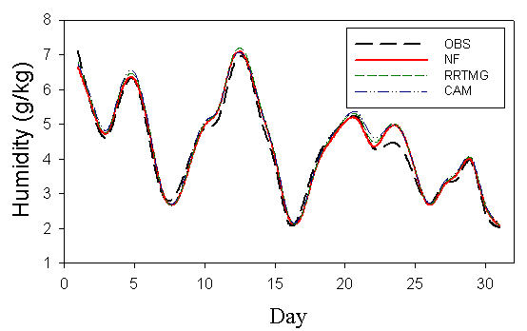
Validation of Meteorological Condition with NCDC Data
BIAS | NF | RRTMG | CAM
Temperature (K) | -0.17 | -0.05 | -0.57
Wind speed （m/s） | 0.13 | 0.13 | 0.09
Humidity (g/kg) | 0.07 | 0.07 | 0.13
Notes:
We also validated the temperature, wind speed and humidity with NCDC data. It contains the observation data of the stations in east of China. Most of the meteorological parameters agree well with observation.

Slide 10
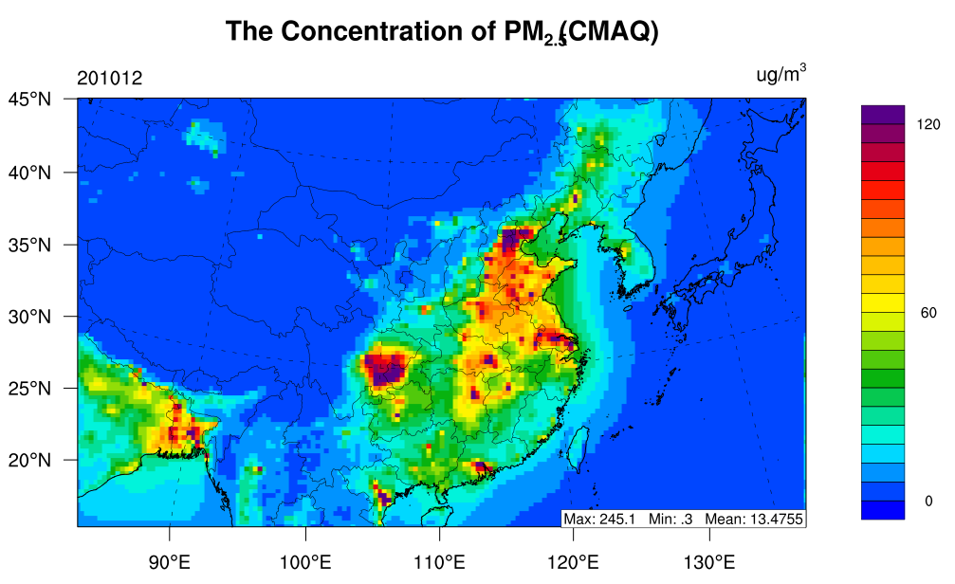
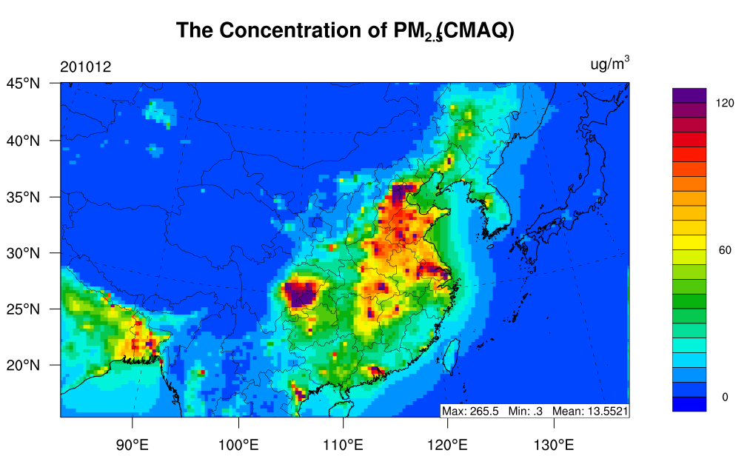
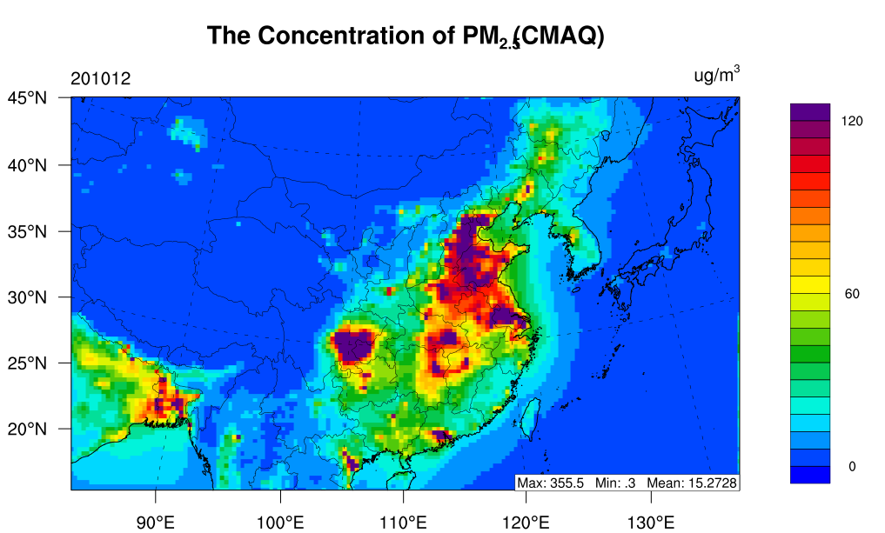
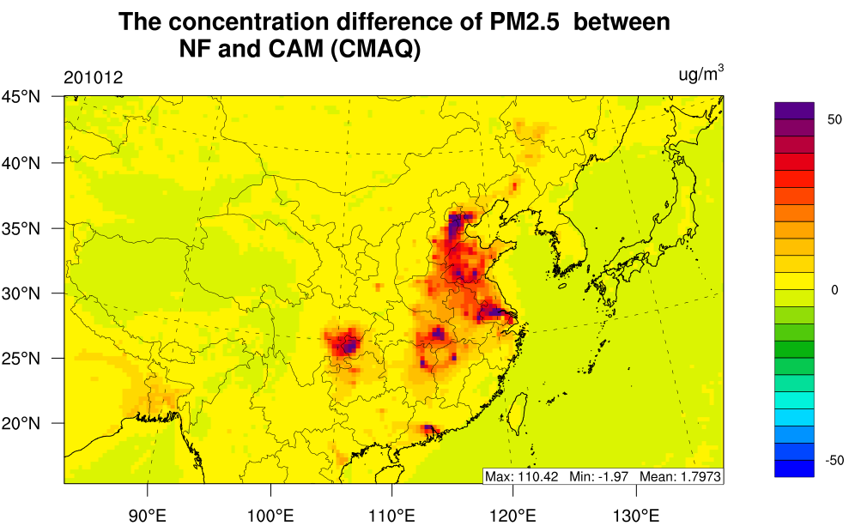
The Pollutant Distribution Comparison
NF
RRTMG
For the concentration of PM_{2.5}
CAM > RRTMG > NF
Heavily polluting areas showed a larger difference.
CAM
Notes:
OK. Now the spatial distribution of fine particulate matter is shown here. The purple color shows area whose mass concentration is greater than 120 micrograms per cubic meter. We could find that, the result of RRTMG scenario is a little higher than NF. But for CAM scenario, the purple color covers most of North China Plain. To make it clear, the difference of NF and CAM is shown in the fourth graph. The purple of difference shows the similar distribution with heavily polluted areas. Which means Heavy polluting areas shows a larger difference between NF and CAM.

Slide 11
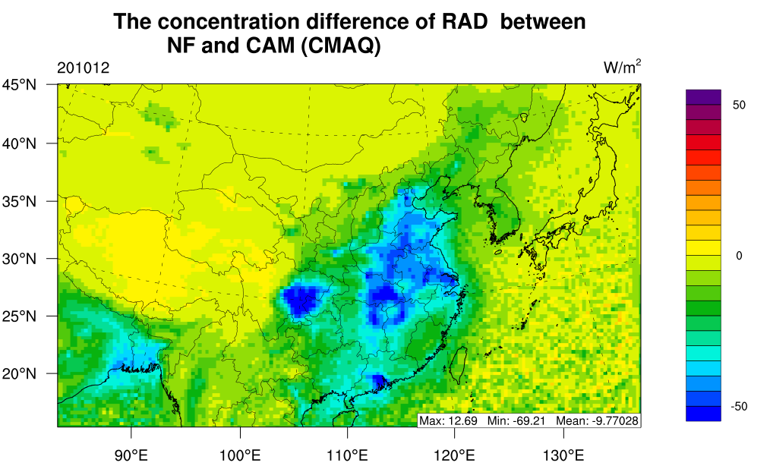
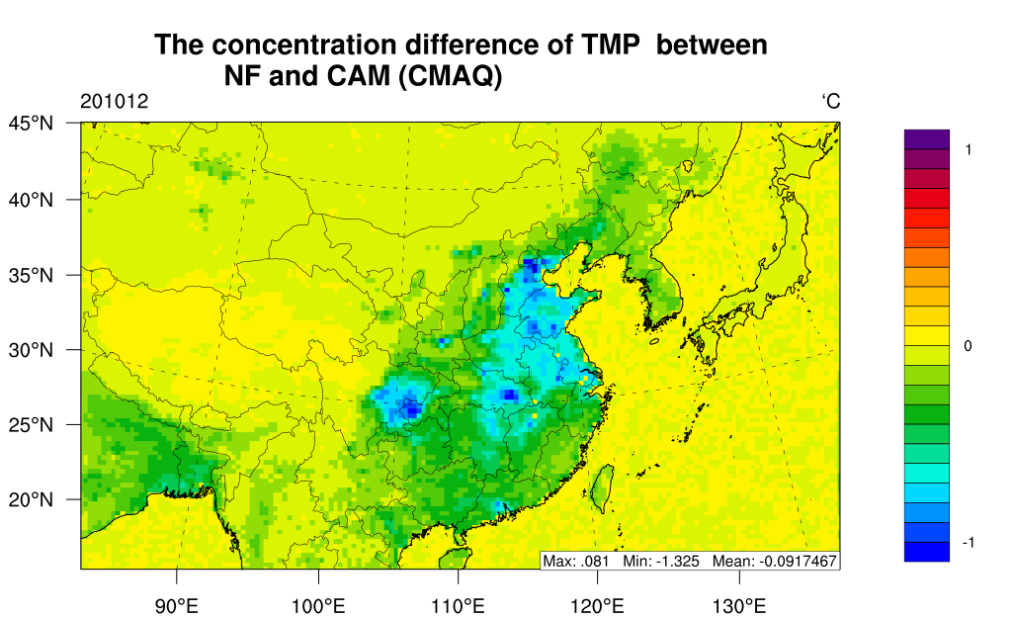
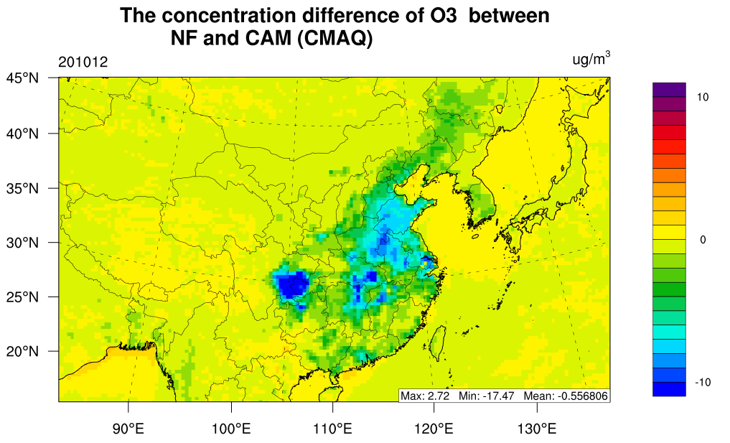
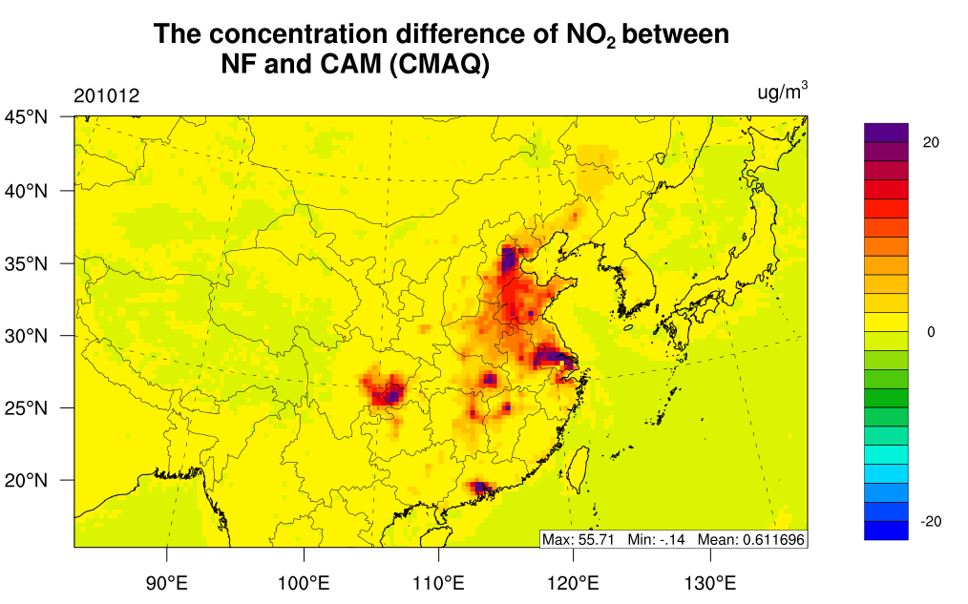
The Pollutant Distribution Comparison
North China Plain
Compared with the scenario NF, scenario CAM shows a decrease of solar radiation, which leading to a decrease of surface temperature and O₃. Contract to O₃, other gas pollutant increases, such as NO₂.
Notes:
These four graph shows the difference of NF and CAM for radiation, surface temperature, ozone and NO2. Compared with the scenario NF, scenario CAM shows a decrease of solar radiation, which leading to a decrease of surface temperature and O₃. In contract to O₃, other gas pollutant, such as NO2, increases in CAM. To take insight into this process, the time-series analysis was done in North China Plain.

Slide 12
Impact of Particulate Matter on Meteorology on North China Plain
The increase of PM due to the radiation reduction is a nonlinear process.
NF_{max}=103.4
RRTMG_{max}=113.4
CAM_{max}=168.7
NF_{mean}=130.7
RRTMG_{mean}=114.6
CAM_{mean}=100.8
Notes:
From these four graphs, we can get two conclusions. First, the effect of feedback is more obvious in high concentration of particle matters. Second, if we compare the results from NF to RRTMG and RRTMG to CAM, we find the difference of radiation is similar, but difference of the particle matters can be 4 times. It indicates that the positive feedback can be very strong if we emit enough particle matters and this feedback will lead to a fast growth of the atmospheric concentration of particles.

Slide 13
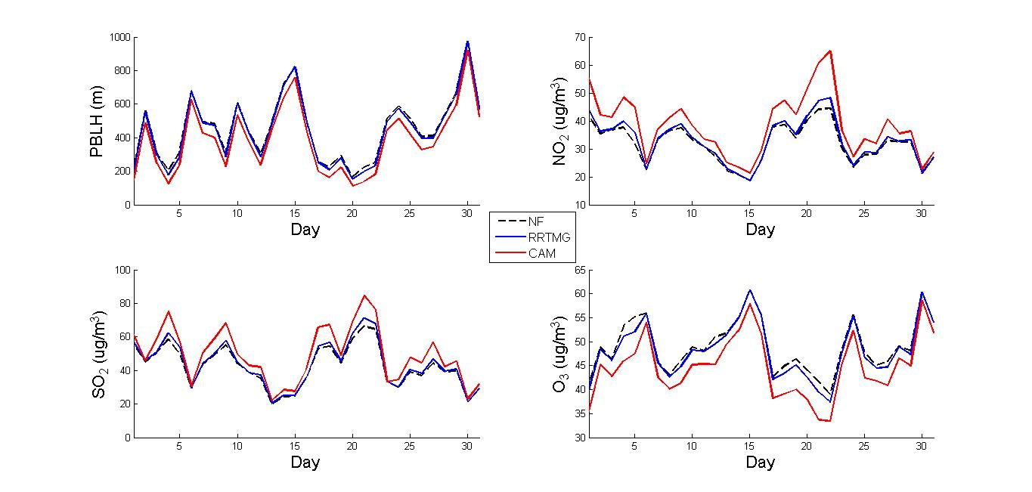
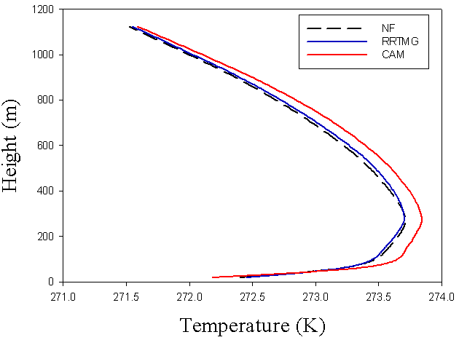
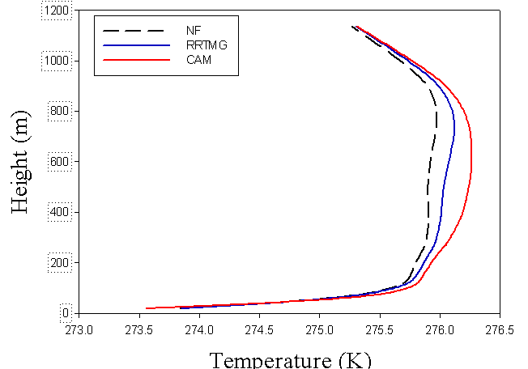
Radiation Effects of Particulate Matters Enhanced the Temperature Inversion
Dec. 17
Dec. 18
Notes:
If we plot the vertical temperature profile, we could find a strong temperature inversion occurs during the heavily polluting process. The effect of aerosol extinction enhanced the temperature inversion and decreased the PBLH. It finally leads to a accumulation of particle matters.

Slide 14
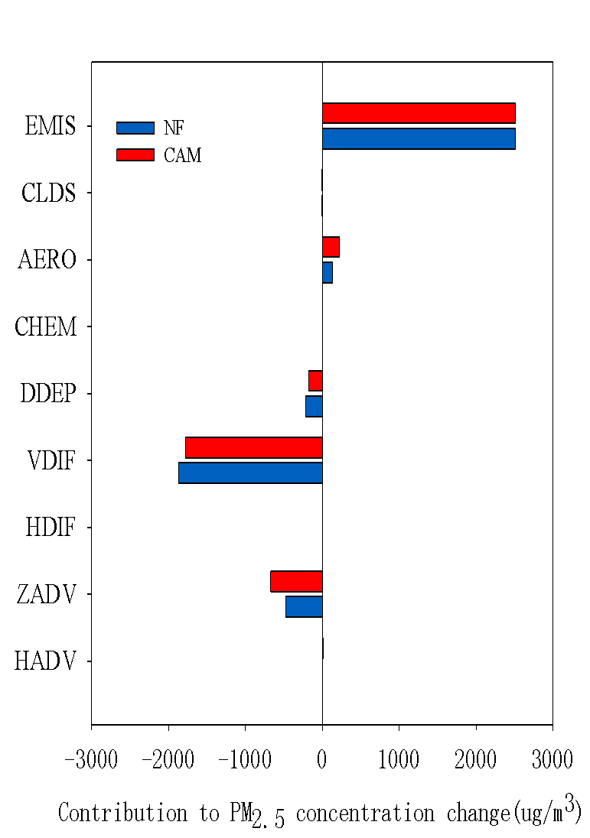
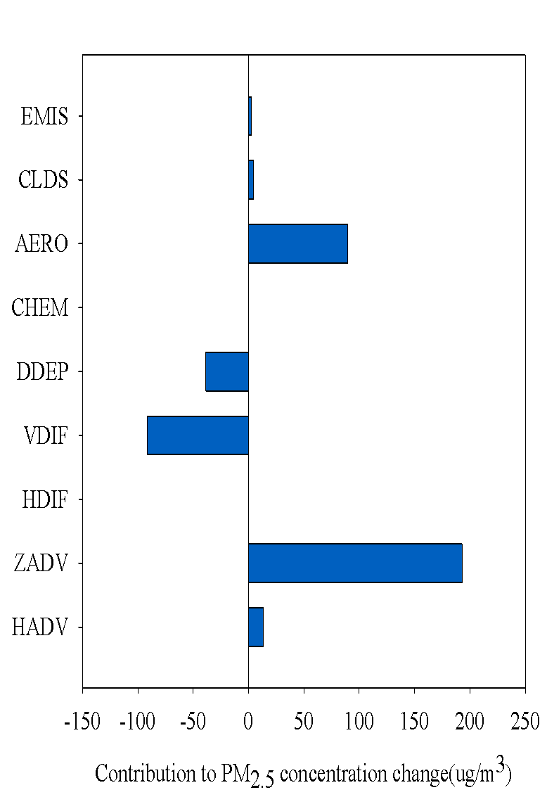
Process Analysis
Except the meteorological parameter changing, the generation and growth of particle matters also plays an important role.
Notes:
En, is it the only reason? To make a better understanding, process analysis is done for the first vertical layer during that period. It shows that aerosol process almost account for the same contribution with the reduction of vertical diffusion. .Advection.

Slide 15
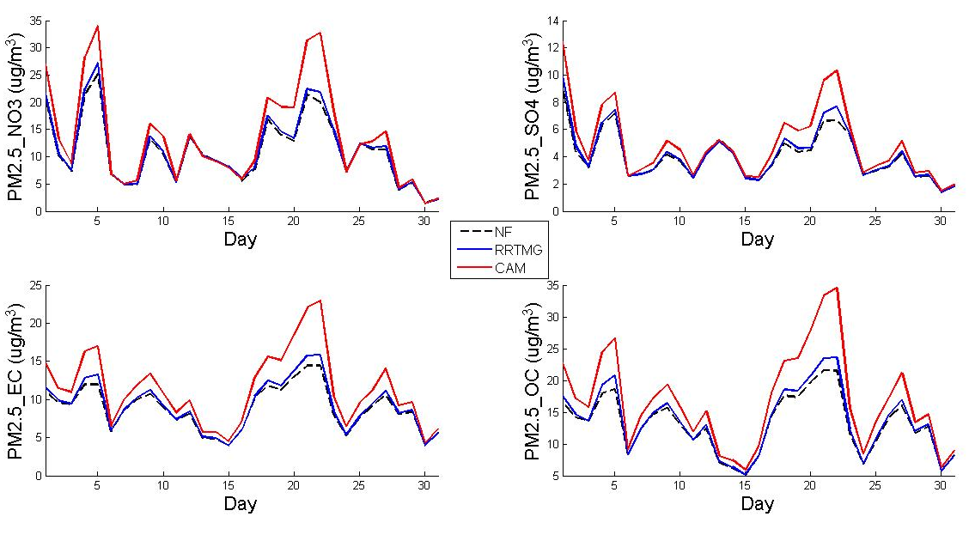
Particle Matter Species
Notes:
The result of particle matter species also support this conclusion. The change of surfer is not as much as Nitrate, EC and OC. If the change is due to PBL, they should show the same trend. Then, what happened in aerosol process?

Slide 16
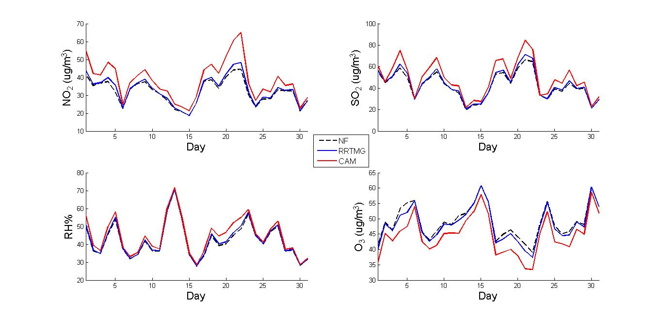
The Factors Effects on Aerosol Chemistry
The precursors of particle matter concentration increased due to the change of PBL.
Notes:
First, the precursors of particle matter concentration increased due to the change of PBL. Second, the change of radiation, and atmospheric oxidation effect on the chemical reaction balance, especially photochemical reaction. Third, the change of temperature and RH. To quantify the contribution of each factors, more analysis is still needed.

Slide 17
The Factors Effects on Aerosol Chemistry
The precursors of particle matter concentration increased due to the change of PBL.
The change of radiation and atmospheric oxidation impacted on the chemical reaction balance, especially photochemical reaction.
Notes:
First, the precursors of particle matter concentration increased due to the change of PBL. Second, the change of radiation, and atmospheric oxidation changes the chemical reaction balance, especially photochemical reaction. Third, the change of temperature and RH. To quantify the contribution of each factors, more analysis is still needed.

Slide 18
The Factors Effects on Aerosol Chemistry
The precursors of particle matter concentration increased due to the change of PBL.
The change of radiation and atmospheric oxidation impacted on the chemical reaction balance, especially photochemical reaction.
The change of temperature and RH impact on the chemical reaction balance.
Notes:
First, the precursors of particle matter concentration increased due to the change of PBL. Second, the change of radiation, and atmospheric oxidation effect on the chemical reaction balance, especially photochemical reaction. Third, the change of temperature and RH. To quantify the contribution of each factors, more analysis is still needed.

Slide 19
Conclusion
By using feedback mechanism the simulation of radiation significantly improved during the heavily polluting period.
The increase of PM due to the radiation reduction is a nonlinear process. The heavily pollutant period and area showed a larger difference. The max difference can be 65% in North China Plain.
The difference is due to change of PBL height and aerosol process. They each accounted for about 50% in the first layer.
To quantify the contribution of each factors, more analysis is still needed in the future research.

Slide 20
Thank you!

