Slide 1
Overview and Evaluation of AQMEII Phase 2 Coupled Simulations over North America
Christian Hogrefe, George Pouliot, Shawn Roselle, Rohit Mathur, U.S. EPA
Paul Makar, Environment Canada
Christoph Knote, NCAR
Yang Zhang, North Carolina State University
Stefano Galmarini, European Commission Joint Research Centre
CMAS Conference, October 30, 2013

Slide 2
Past and Present AQMEII Activities
Phase 1: 2010 – 2012
Annual regional air quality simulations over North America (NA) and Europe (EU) for 2006
Results published in July 2012 special issue of Atmospheric Environment
Phase 1 database available for ongoing research
Phase 2: 2012 – 2014
Focus on evaluating coupled meteorology/chemistry models
~20 participating groups from EU and 4 from NA
Common emission inputs (U.S. EPA, and Environment Canada, TNO) and chemical boundary conditions (ECMWF-MACC)
Prepare inputs for both 2006 and 2010 – enable dynamic evaluation studies

Slide 3
AQMEII Phase 2 Timeline
May 2012: Kick-off workshop in Utrecht
January 2013: Inputs and experiment specifications available
Fall 2012 – Spring 2013: collection of observational datasets and preparation of TSD at JRC
Spring-Summer 2013: simulations by participating groups
Summer 2013: Most simulations are completed and data have been / are being uploaded to JRC’s ENSEMBLE system
August/September 2013: Workshops in Miami (in conjunction with ITM) and Ranco (in collaboration with COST 1004)
Fall 2013 – Spring 2014: Joint and individual analyses, sensitivity simulations, preparation of manuscripts
April 2014: Submission of manuscripts to a special issue of Atmospheric Environment (~20 tentative manuscripts to date)

Slide 4
Phase 2 Participating Groups and Models from North America
Environment Canada - GEM-MACH
15 km resolution; 42 gas species, 9 particle species including water, 12 size bins
Direct and indirect aerosol radiative effects; Simulations for 2006 & 2010
Contact: Paul Makar, Paul.Makar@ec.gc.ca
NCAR - WRF/Chem
24km resolution; MOZART; MOSAIC 4-bin with simplified SOA treatment
Direct and indirect aerosol radiative effects; Simulations only for 2010
Contact: Christoph Knote, knote@ucar.edu
North Carolina State University - NCSU WRF/Chem
36 km resolution; CB05+MADE/VBS+AQCHEM
Direct and indirect aerosol radiative effects; Simulations for 2006 & 2010
Contact: Yang Zhang, yzhang9@ncsu.edu
U.S. EPA – WRF/CMAQ
12 km resolution; CB05-TU gas-phase mechanism; 3 lognormal modes
Direct aerosol radiative effects; Simulations for 2006 & 2010
Contact: Christian Hogrefe, hogrefe.christian@epa.gov

Slide 5
U.S. EPA WRF/CMAQ Simulations Used for Illustrative Analyses
WRF3.4/CMAQ5.0.1 two-way coupled model (Wong et al., 2012)
Feedback: shortwave direct effects only in this application
WRF:
RRTM radiation, Morrison 2-moment microphysics scheme, Kain-Fritsch (new ETA) cumulus scheme, Pleim/Xu ACM2 PBL scheme and land/surface scheme
Reduced nudging strength compared to stand-alone WRF simulations
CMAQ: CB05-TU chemistry, aero6, in-line photolysis calculations
Simulations:
2006 and 2010 annual simulations at 12 km over the continental U.S. with direct feedback effect
June-August 2006 and 2010 sensitivity simulations without feedback

Slide 6
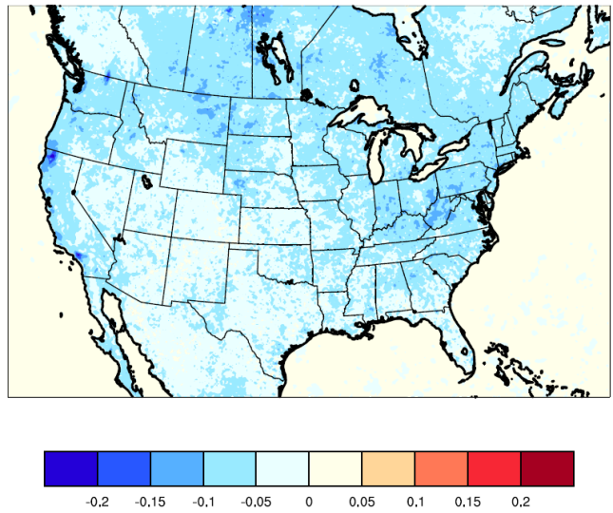
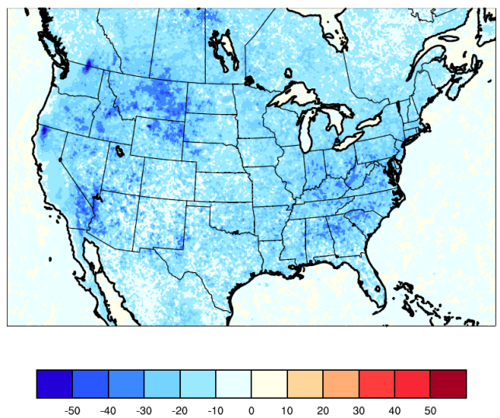
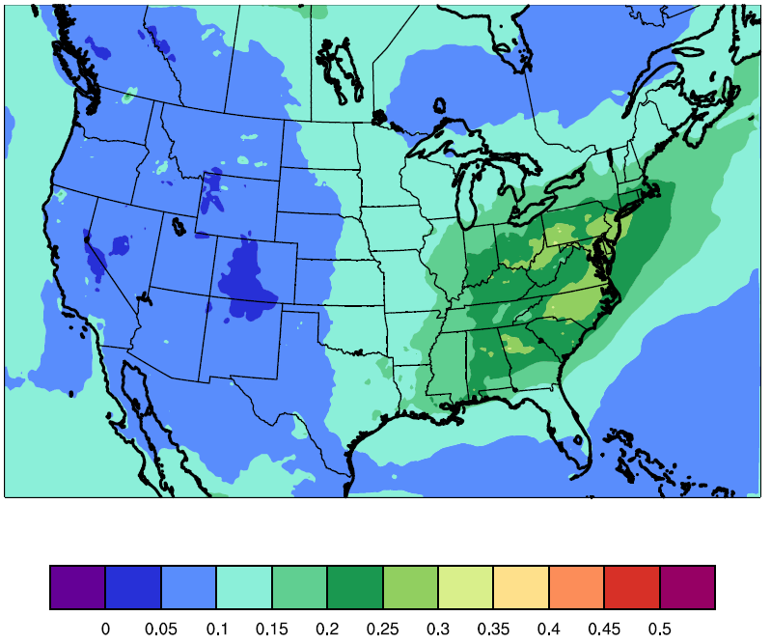
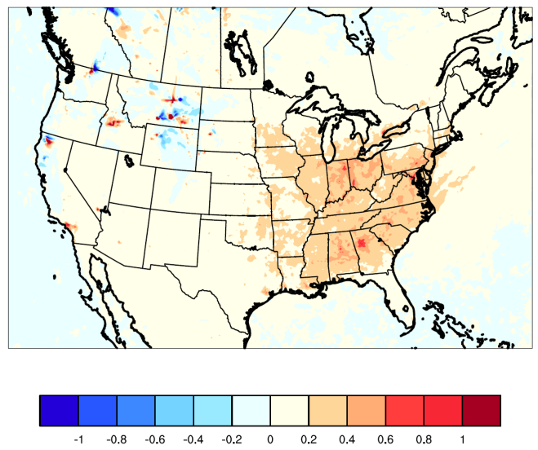
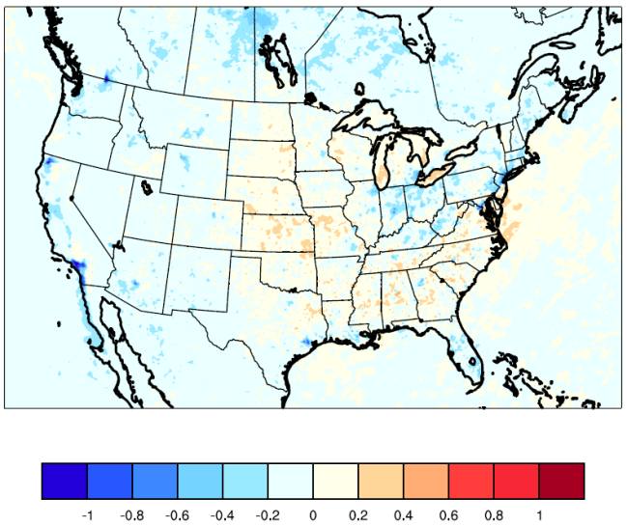
WRF/CMAQ Sensitivity Simulations With and Without Feedback
Differences Feedback – No Feedback, June-August, 2006, Daytime Hours
2m Temperature (°C)
PBL Height (m)
AOD (Feedback Run)
PM_{2.5} Concentrations (µg/m³)
O₃ Concentrations (ppb)
What is the strength of the direct feedback effect for other models?
Approaches for determining common time period for sensitivity runs across groups?

Slide 7
Aerosol Impacts on Radiation PBL Height, and CDNC Jul. 2006, NCSU WRF/Chem Simulations (Courtesy of Y. Zhang, NCSU)
Overall Effects
Direct Effects
Indirect Effects
Net Shortwave Solar Radiation
PBL Height
Cloud Droplet Number Concentration
What is the strength of direct and indirect effects for other models?

Slide 8
Case Studies of Feedback Effects (courtesy of P. Makar)
Methodology: Compare hourly model outputs by determining the R² correlation coefficient between “feedback” and “no-feedback” runs. Times with lowest correlation coefficients selected for further study, comparison to observations, etc.
Example at left: GEM-MACH PM_{2.5} no feedback (top) and feedback (bottom) output for February 10, 2006, California Coast -> substantial differences in simulated PM_{2.5} patterns and maximum values between the feedback and no feedback runs
Max: > 100 μg/m³
Max: 50 to 80 μg/m³

Slide 9
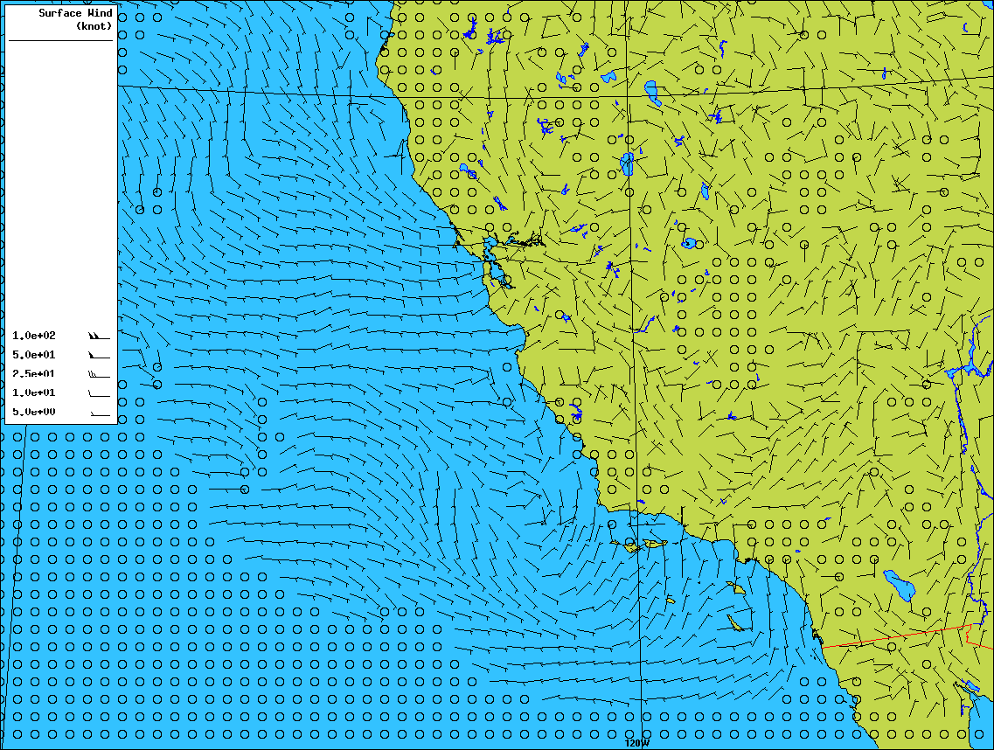
GEM-MACH San Francisco Surface Wind Difference (Feedback – Base Case) (courtesy of P. Makar)
Residual surface wind field shows that the feedback simulation has an added 0 to 5 knot wind which carries the pollutants out to sea, linked to changes in radiative transfer.

Slide 10
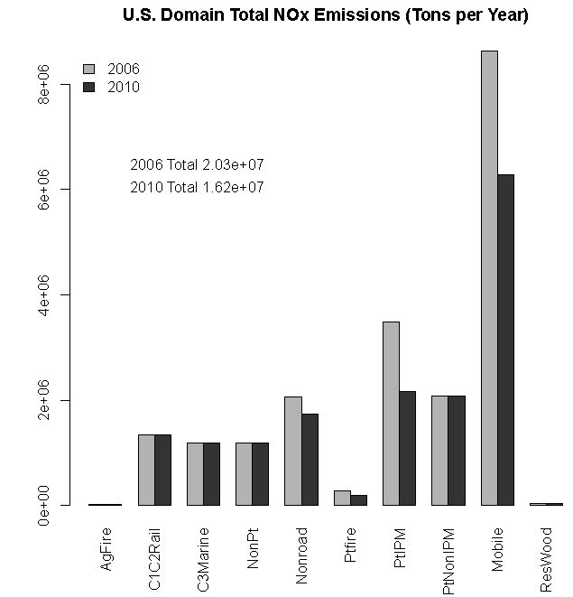
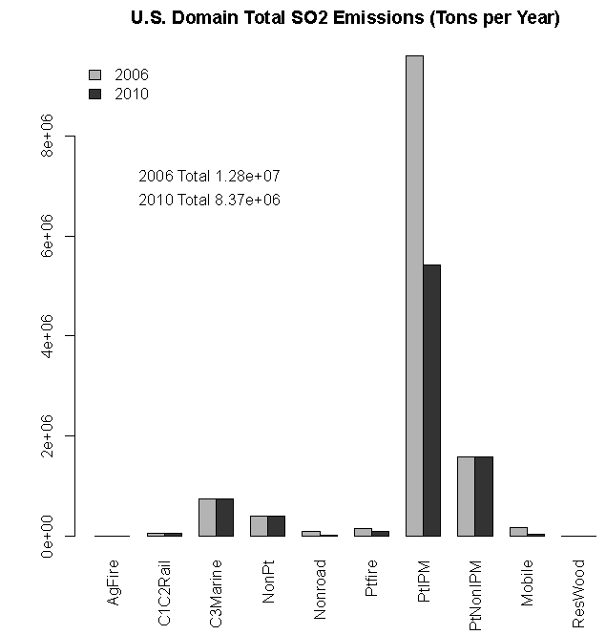
AQMEII Phase 2 Inputs – 2006 and 2010 Emissions
U.S. Domain Total NO_{x}
U.S. Domain Total SO₂
-20%
-35%
Power Plants
Mobile
Power Plants
Additional details were provided in the presentation by G. Pouliot on Tuesday

Slide 11
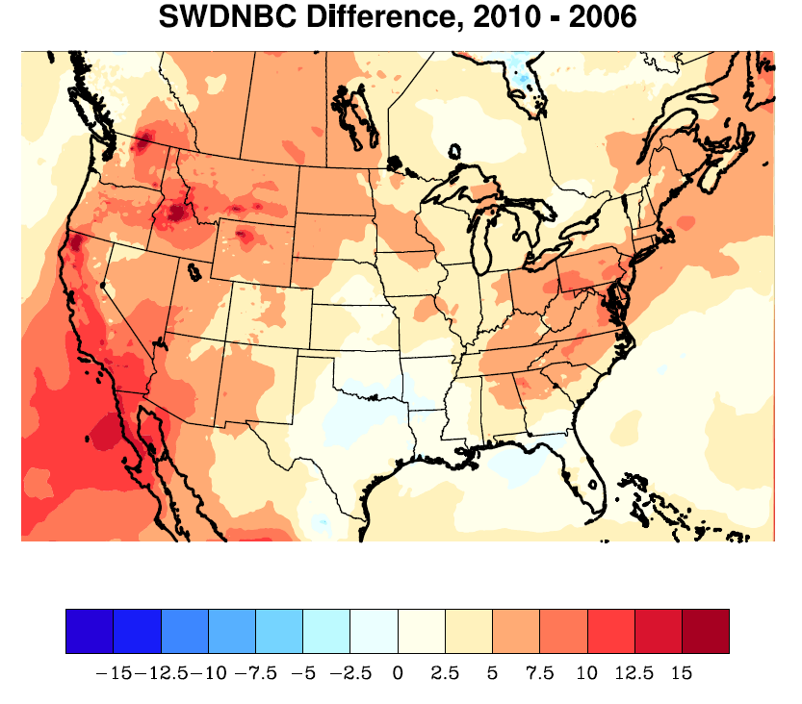
Model Predicted Changes in PM_{2.5} and Radiation Between 2006 and 2010
May – September, All Hours
2006 PM_{2.5}
2010 PM_{2.5}
2010 – 2006 PM_{2.5}
2010 – 2006 Clear-Sky Shortwave Radiation at the Surface
Modeled surface PM_{2.5} concentrations decreased substantially between 2006 and 2010 in many areas
These decreases generally lead to increases in modeled clear-sky shortwave radiation at the surface
Future analysis will consider the modeled PM_{2.5} vertical distribution and composition and will compare the effect simulated by WRF/CMAQ to other models

Slide 12
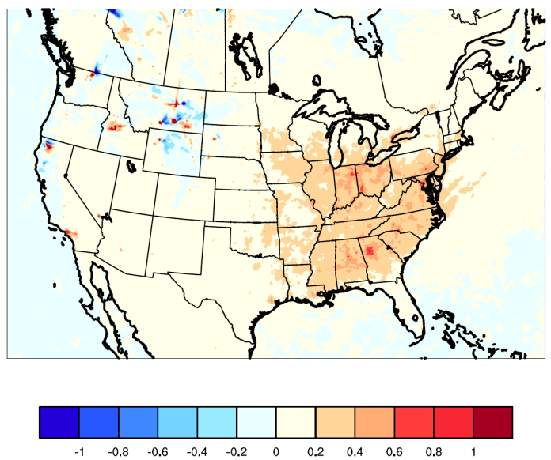
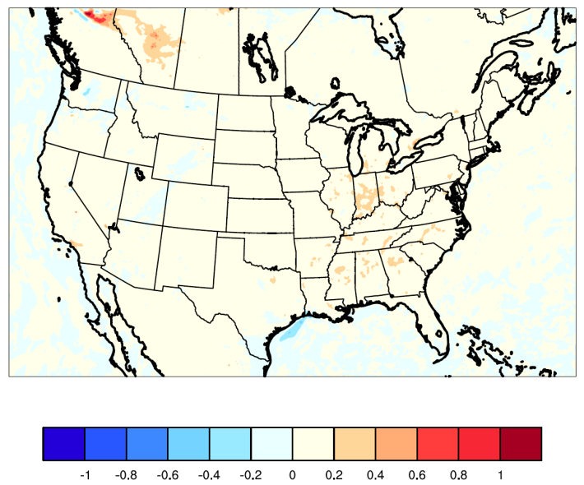
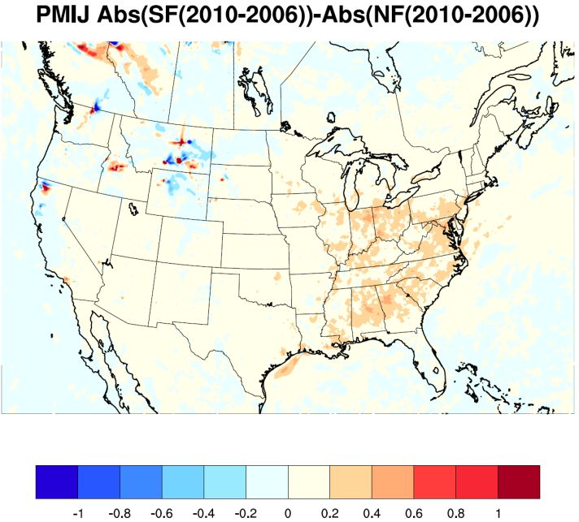
Impact of Feedback Effects on WRF/CMAQ Simulated 2006→2010 Changes in June – August Daytime Average PM_{2.5}
Feedback – No Feedback, 2006
Feedback – No Feedback, 2010
Abs (2010-2006, FB) – Abs (2010-2006, NF)
Considering feedback effects has an impact on the simulated change in PM_{2.5} concentrations between 2006 and 2010

Slide 13
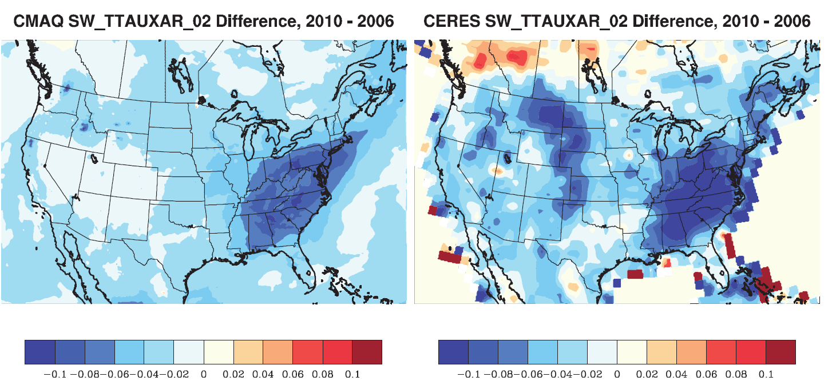
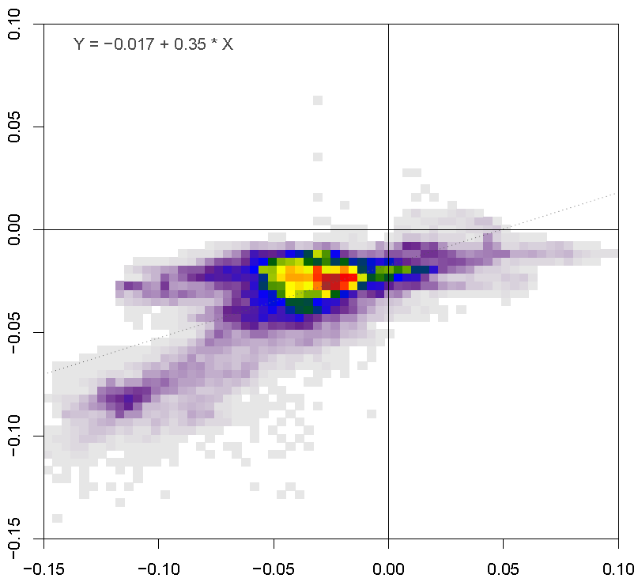
Observed (MODIS) and WRF/CMAQ Changes in AOD, May – September, 2010 Minus 2006
WRF/CMAQ
MODIS
WRF/CMAQ
MODIS
WRF/CMAQ generally captures the spatial pattern of changes in AOD between 2006 and 2010 but underestimates the magnitude of the change

Slide 14
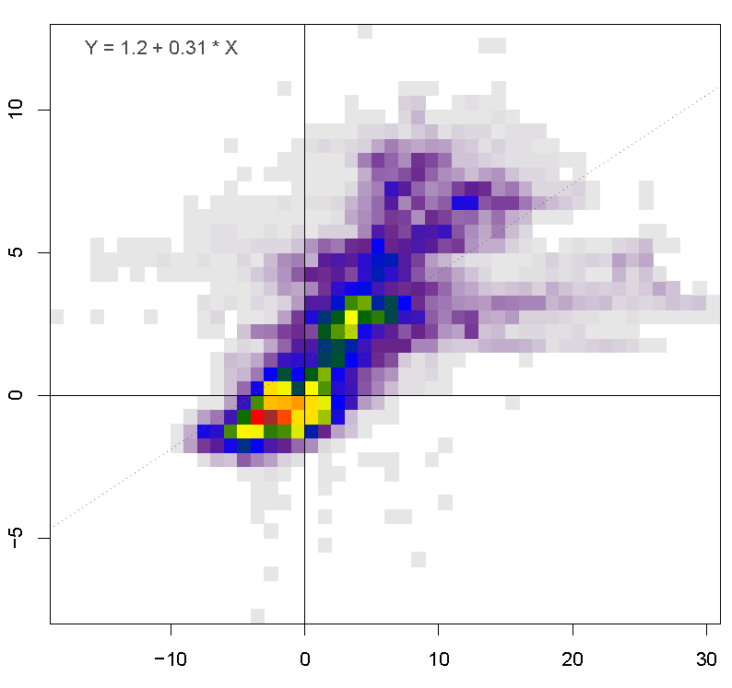
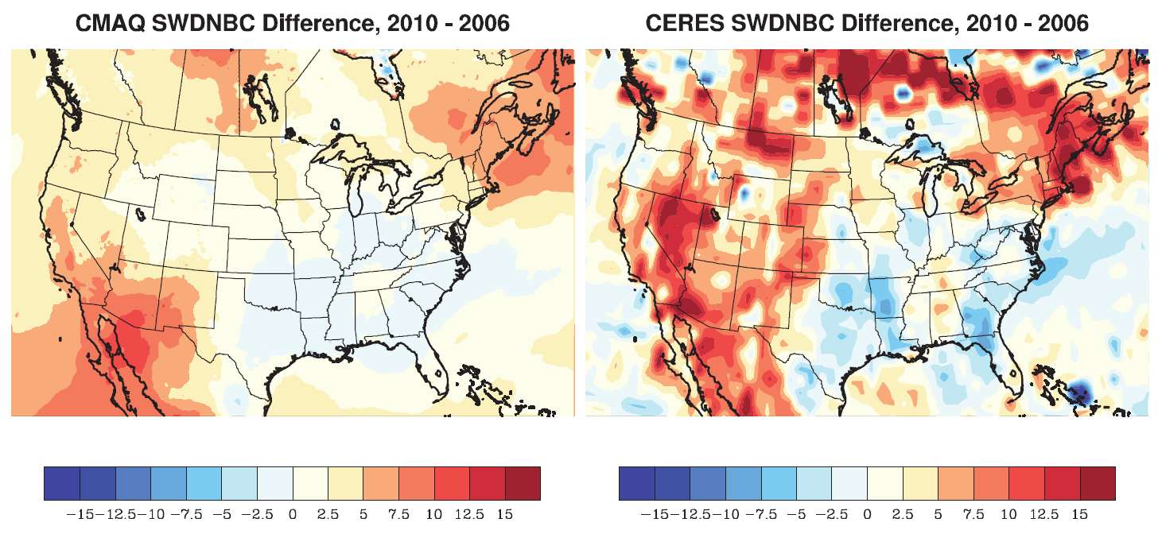
Observed (CERES) and WRF/CMAQ Changes in Clear-Sky Shortwave Radiation at the Ground, May – June, 2010 Minus 2006
WRF/CMAQ
CERES
WRF/CMAQ
CERES
WRF/CMAQ generally captures the spatial pattern of changes in clear-sky shortwave radiation at the ground between 2006 and 2010 but underestimates the magnitude of the change
How do other models perform in capturing this observed change?

Slide 15
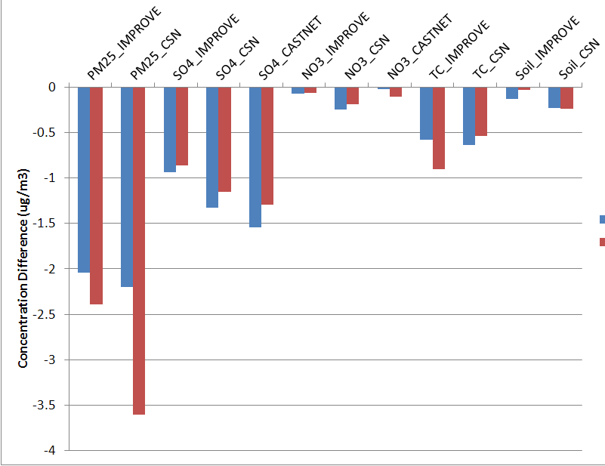
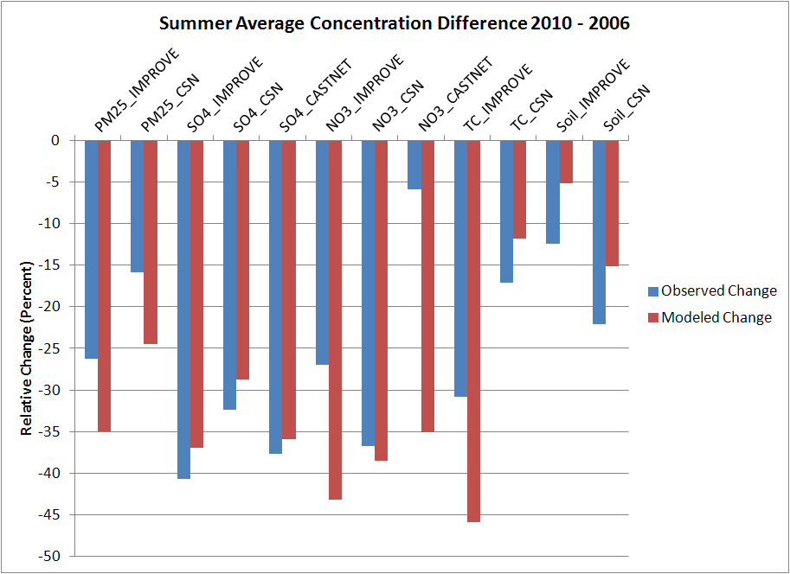
Changes in Observed and Modeled Summer Average PM_{2.5} Concentrations, 2010 - 2006
Absolute Changes (ug/m3)
Relative Changes (%)
How do simulated changes in composition compare across the models?

Slide 16
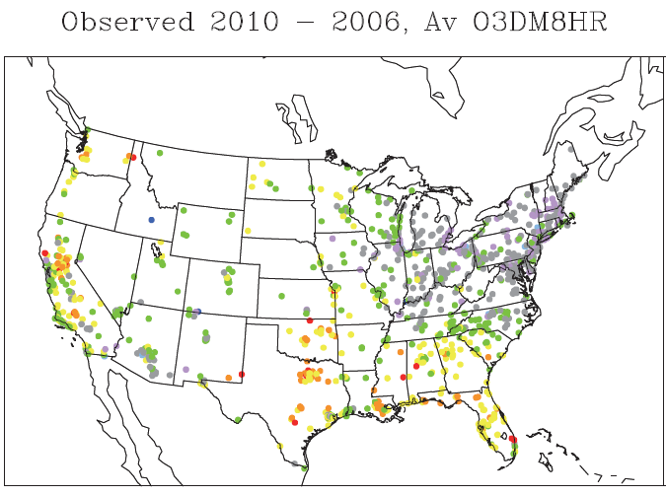
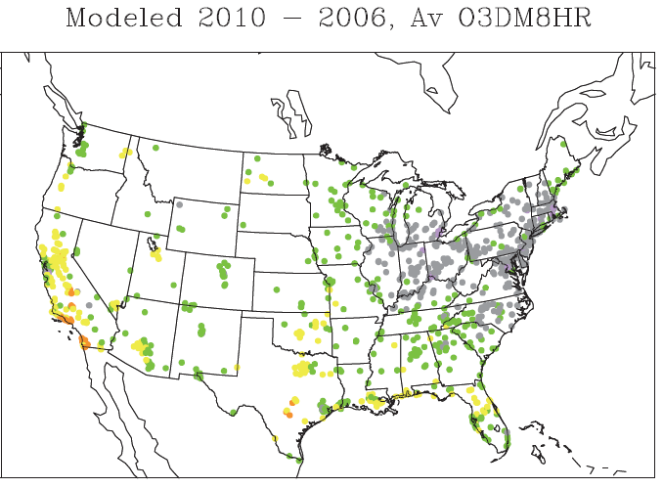
Observed and WRF/CMAQ Changes in Daily Maximum 8-hr O₃
May – September, 2010 Minus 2006
Observed Ozone Change (ppb)
WRF/CMAQ Ozone Change (ppb)
WRF/CMAQ generally captures the spatial pattern of changes in daily maximum 8-hr O₃ between 2006 and 2010 but tends to underestimate the magnitude of the change → investigate the impacts of emissions, meteorology, boundary conditions
How do other models perform in capturing this observed change?

Slide 17
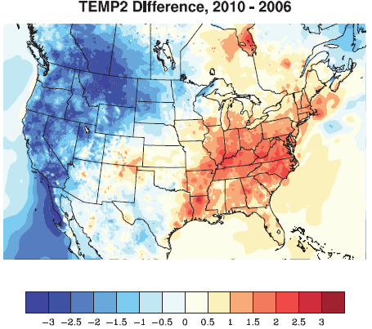
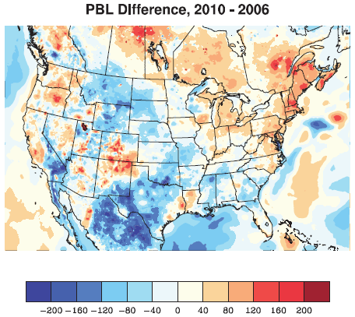
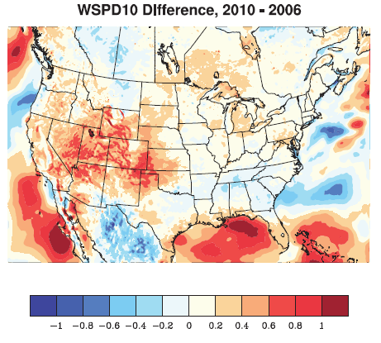
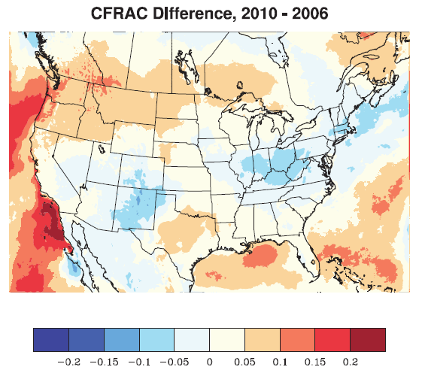
Differences in Summertime Meteorological Fields; 2010 - 2006
2m Temperature (°C)
PBL Height (m)
10m Wind Speed (m/s)
Cloud Fraction
Changes in meteorology likely counteracted some of the emission effects on ozone in parts of the Eastern U.S. and enhanced them in the Western U.S.
Future analyses will aim to quantify the impact of changes in meteorology on pollutant concentrations

Slide 18
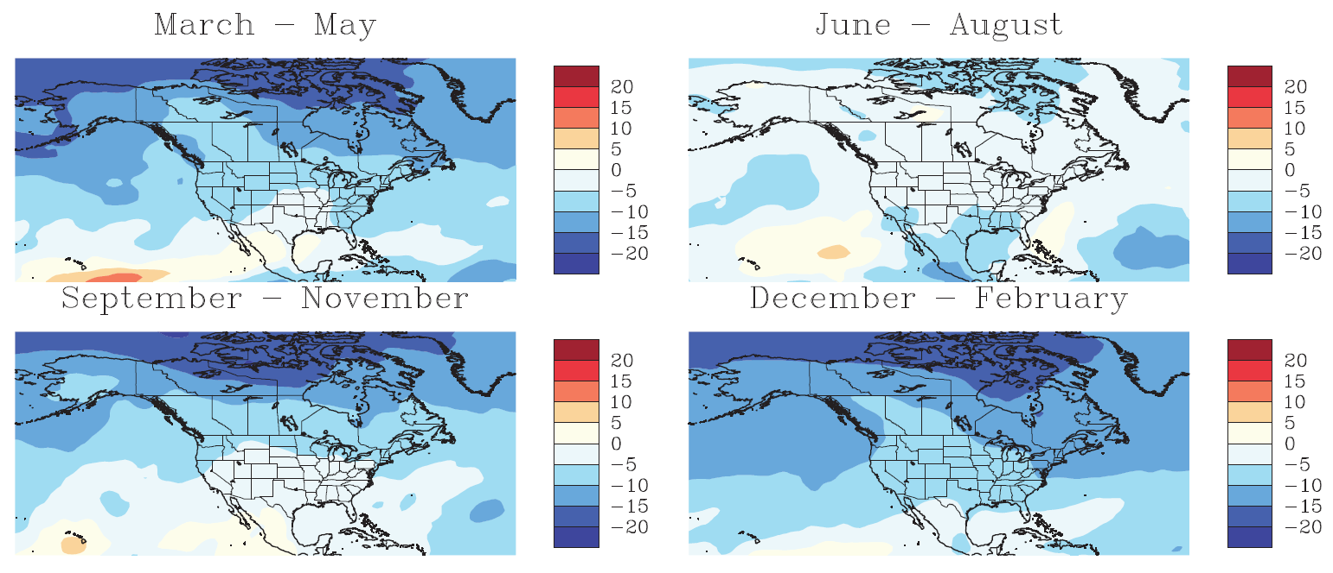
Impact of Boundary Conditions: 2010-2006 Differences in MACC 750mb Seasonal O₃ Fields
Mid-tropospheric MACC O₃ fields are lower for 2010 than 2006, especially during the non-summer seasons

Slide 19
Impact of Boundary Conditions on Regional-Scale Simulations:
DM1HR O₃ Bias for WRF/CMAQ and MACC
2006 Bias
2010 Bias
Wintertime O₃ bias for WRF/CMAQ generally tracks bias for MACC fields
Low wintertime O₃ bias in 2010 likely driven by MACC fields

Slide 20
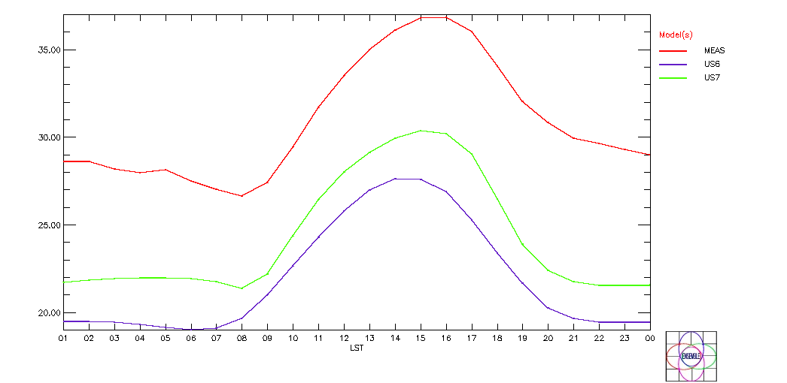
O₃ Diurnal Cycle, Average Across All Rural Sites, January 1 – February 28, 2010
Observations
WRF-CHEM
WRF-CMAQ
MACC LBCs affects both WRF-Chem and WRF-CMAQ background O₃ → it is important to include MACC fields in the analysis to help interpret results from the regional-scale simulations

Slide 21
Summary and Outlook
AQMEII Phase 2 focuses on evaluating and intercomparing online coupled meteorology/chemistry modeling systems using operational, diagnostic, dynamic, and probabilistic evaluation techniques
Initial NA simulation results were used to illustrate some of the planned analysis approaches
Joint analyses will be performed by JRC, and additional analyses will be performed by participating groups
Through all of these analyses and the AE special issue, it is envisioned that AQMEII Phase 2 will document the state of science in coupled regional-scale modeling and help to determine the value of including feedback effects in different model applications

Slide 22
Extra Slides

Slide 23
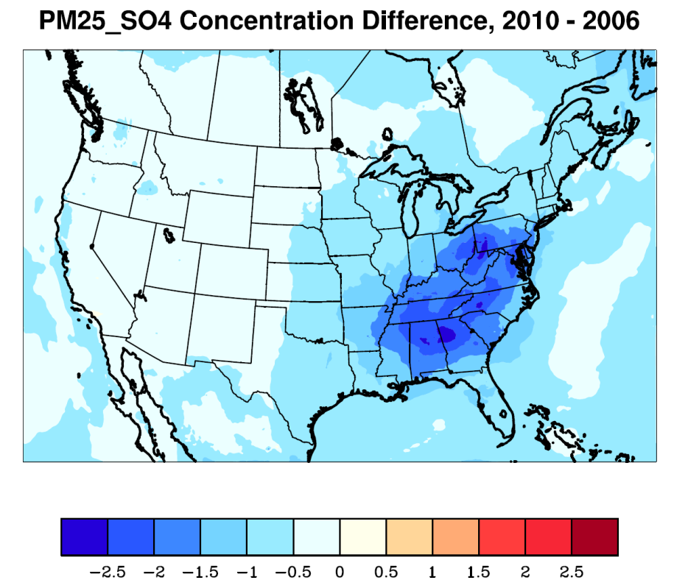
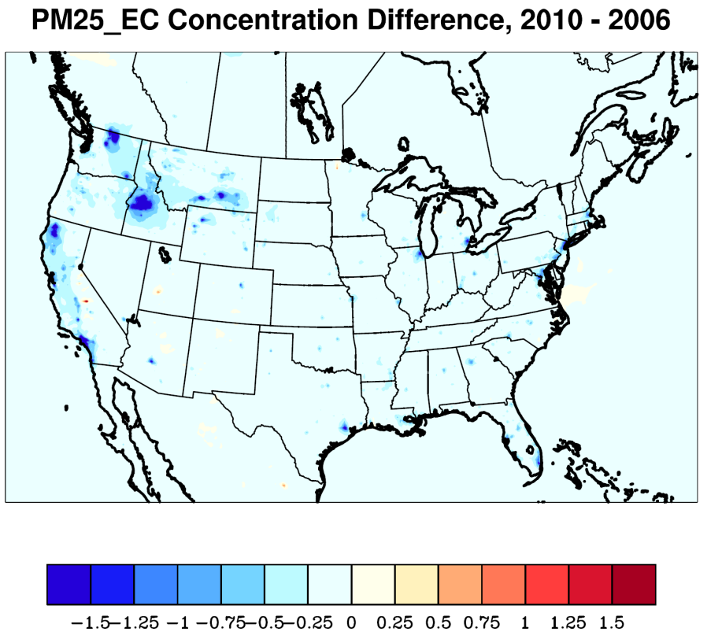
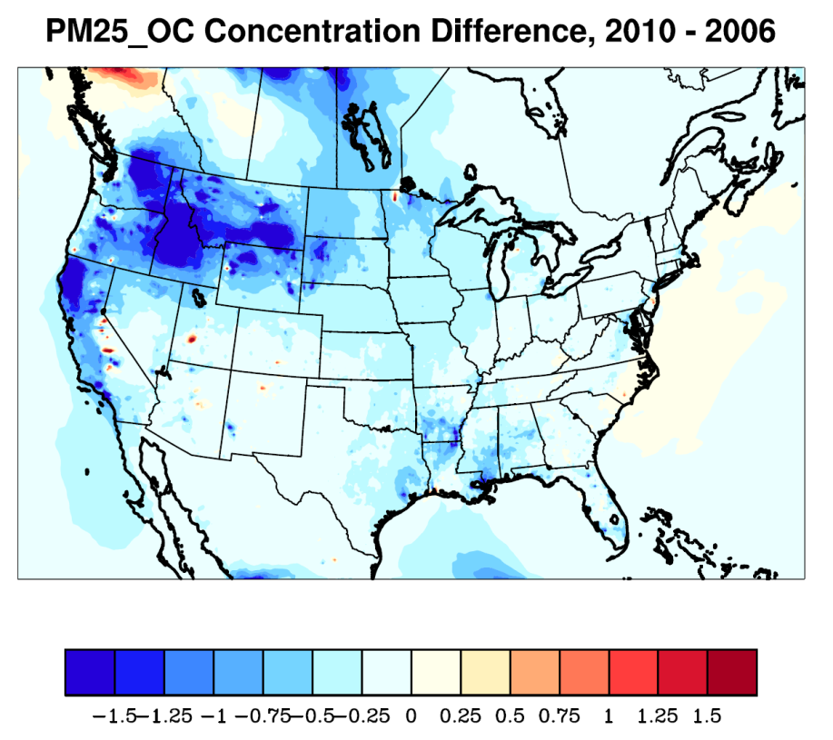
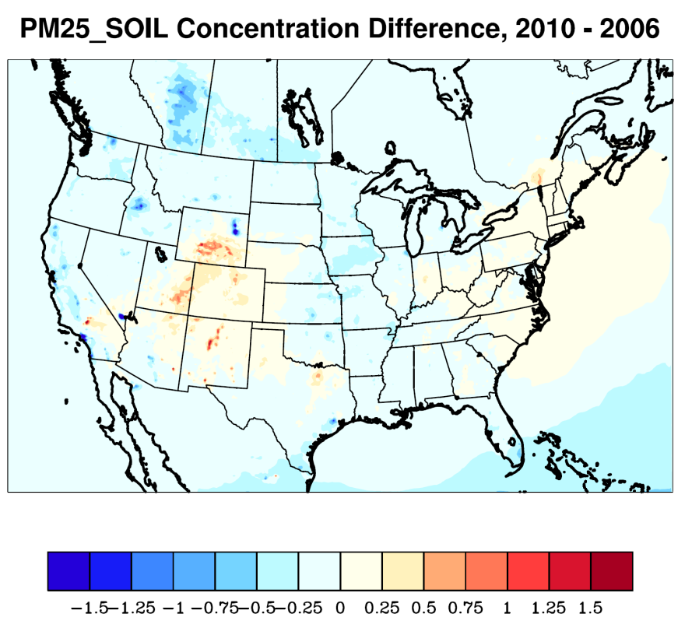
Model Predicted Changes in PM_{2.5} Species Between 2006 and 2010
May – September, All Hours
Sulfate 2010 – 2006
Elemental Carbon 2010 – 2006
Reductions in SO₂ Emissions
Changes in Wildfire Emissions
Changes in Mobile Emissions
Organic Carbon 2010 – 2006
Soil 2010 – 2006
Changes in Wildfire Emissions
Changes in Windblown Dust Emissions

Slide 24
Case Studies of Feedback Effects (courtesy of P. Makar, Environment Canada)
Use GEM-MACH model to identify case studies from 2006, 2010 North American simulations where feedbacks between meteorology and chemistry have the greatest effect on model results.
Assist in determining case study periods for groups that can’t run the entire year with and without feedback effects.
Identify periods when the entire group of models shows the greatest effect of feedbacks on model results..
→ Are there periods when all models show a significant role of feedbacks?
→ What are the characteristics (meteorological, chemical) of those situations?
→ During these periods, does the incorporation of feedbacks improve the models’ simulations relative to observations?
→ What are the processes that govern these situations?

