Slide 1
Updates to CAMx Plume-in-Grid Model
Chris Emery, Bonyoung Koo, Tan Sakulyanontvittaya,
Greg Yarwood
ENVIRON International Corporation
12th Annual CMAS Conference
October 30, 2013

Slide 2
Background
Plume-in-Grid (PiG) → Lagrangian puff model
  Treat physical and chemical evolution of point source plumes when smaller than grid resolution
    Puffs transfer (dump) mass to grid when they reach grid scales
  CAMx GREASD PiG focuses on NOx plumes
    Early plume stage when NOx suppresses oxidant production
    Puffs dump to grid when oxidant production > termination
  CAMx PiG uses “incremental chemistry” concept
    Applies full photochemical mechanism (e.g., CB05) twice:
      Background (grid) concentrations
      Puff + background concentrations
    Cumbersome when tens of thousands of puffs are tracked
    Some occasional chemical instabilities have been noted
Difference is new puff increment
(can be negative)

Slide 3
Objectives
This study improved GREASD PiG efficiency and stability
  Introduced a condensed chemical mechanism
    Specific reactions applicable during early plume stages
    Plume-only NOy chemistry (no background step)
  Reduced nocturnal minima for certain growth parameters
    Based on in situ aircraft measurements
    Puff size important in chemically aging plume NOx
Sensitivity tests analyzed speed, concentration impacts relative to no PiG and original PiG

Slide 4
Approach
Box Model Testing
Emulated puff growth, dilution, entrainment
  2-step CB05 incremental chemistry
We found a growing NOy imbalance
  Increased up to 30% after 4 simulation hours
  Traced to the incremental chemistry approach
    Specifically in reactions that depend non-linearly on NO₂
  Setting background NOy = 0 eliminated the problem
  Reasonable for young plumes when puff NOx > ambient NOy

Slide 5
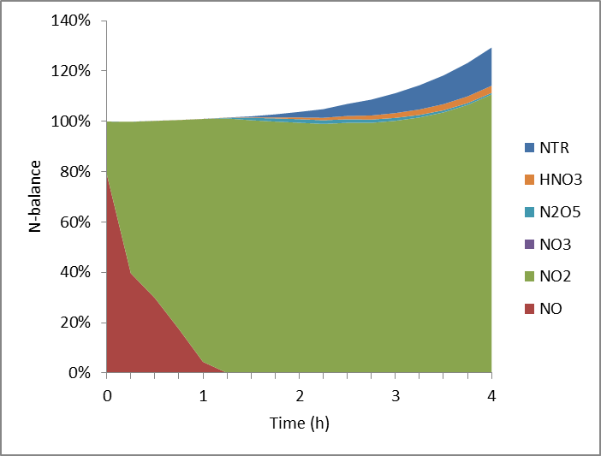
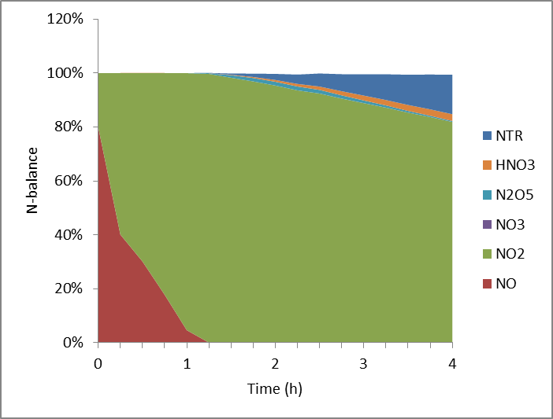
Approach
Puff NOy Conservation
Using Incremental Chemistry
Zero background

Slide 6
Approach
Condensed GREASD PiG Mechanism
23 gas-phase reactions based on Karamchandani et al. (1998)
  No background chemistry step
  Zero contribution from background NOy
  Entrains background O₃, CO, formaldehyde as source of oxidants (incremental: can be < 0)
In-cloud SO₂ → SO₄ and N₂O₅ → HNO₃ using RADM mechanism (Chang et al., 1987)
  Entrains background H₂O₂ as source of oxidant
  SOA, inorganic PM partitioning ignored until puff mass is transferred to the grid

Slide 7
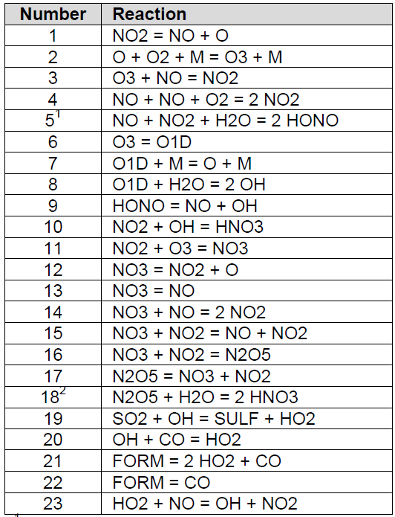
Approach
Condensed GREASD PiG Mechanism
NO-NO₂-O₃ photo-stationary state
NO self-reaction
OH production by photolysis of O₃, HONO, formaldehyde
Production of HNO₃ in sunlight
Formation of NO₃, HNO₃, N₂O₅ at night
Production of sulfuric acid in sunlight
Removal of OH by CO
HO₂ conversion to OH

Slide 8
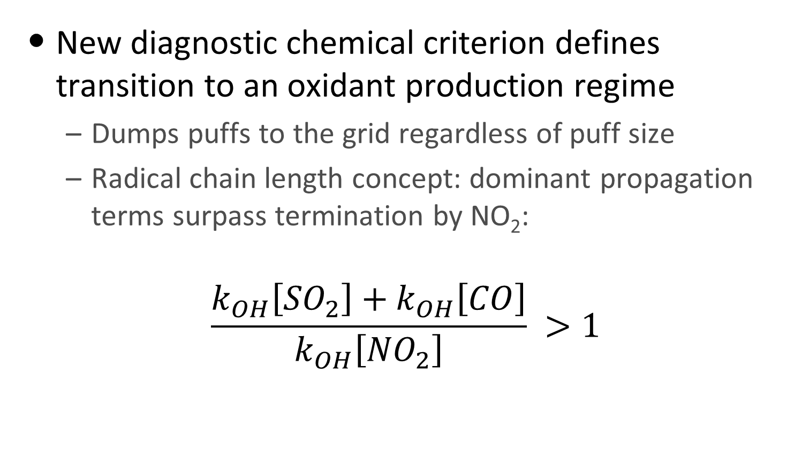
Approach
Condensed GREASD PiG Mechanism
New diagnostic chemical criterion defines transition to an oxidant production regime
  Dumps puffs to the grid regardless of puff size
  Radical chain length concept: dominant propagation terms surpass termination by NO₂:
$$\frac{k_{OH}\left[{SO}_{2}\right]+k_{OH}\left[CO\right]}{k_{OH}\left[{NO}_{2}\right]} >1$$

Slide 9
Approach
Condensed GREASD PiG Mechanism
Can be run in tandem with any of photochemical mechanisms used for grid chemistry
  CB05, CB6 variants, SAPRC99
  Reaction rates taken directly from corresponding grid mechanism
Box model tests show good agreement against CB05 incremental chemistry
New mechanism reduces PiG computational time by 80-85% in regional coarse grid application
  Reduced overall CAMx runtime by 25-30%
  Runtime improvements depend on many factors

Slide 10
Results
Testing Nocturnal Power Plant Plume Size
Color contours: plume simulated on 200 m grid, good agreement with measured 1-2 km widths
Aircraft transect at 14 km
Grey puffs: original PiG, growth is too fast (2-5x larger than measured)
Black puffs: new PiG, good agreements with measured widths
Aircraft transect at 30 km

Slide 11
Results
Testing Nocturnal Power Plant Plume Chemistry
Incremental concentrations above ambient background
Modeled total O₃≈40 ppb
Measured total O₃≈25 ppb

Slide 12
Results
Testing Nocturnal Power Plant Plume Chemistry
Incremental concentrations above ambient background
Conversion to PM nitrate?
Proper NOz delay in low-growth puff
In-plume N₂O₅ suppression

Slide 13
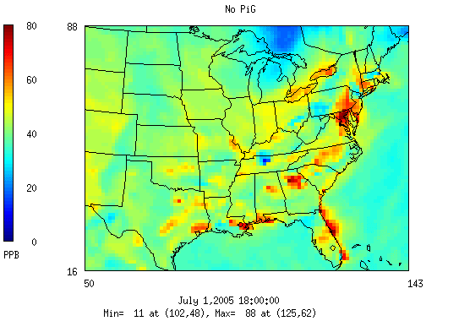
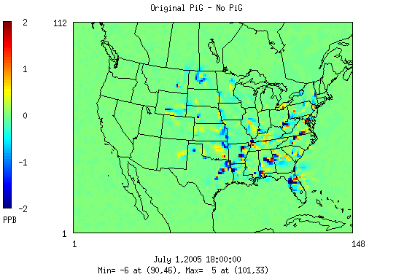
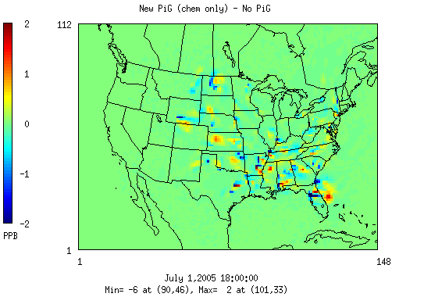
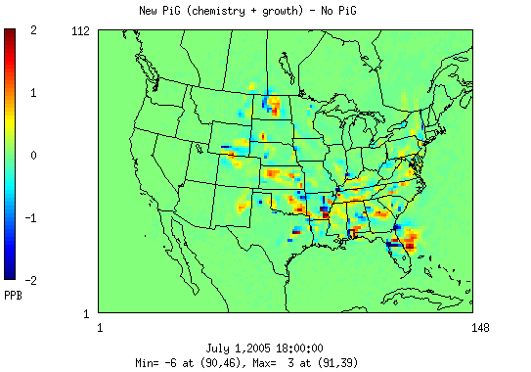
Results
Regional Response – Ozone

Slide 14
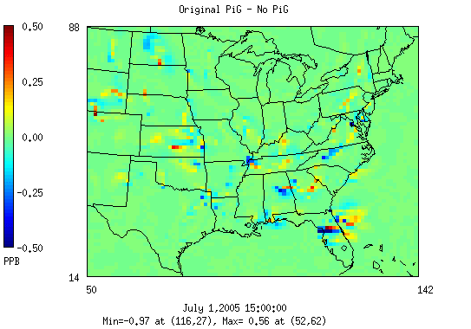
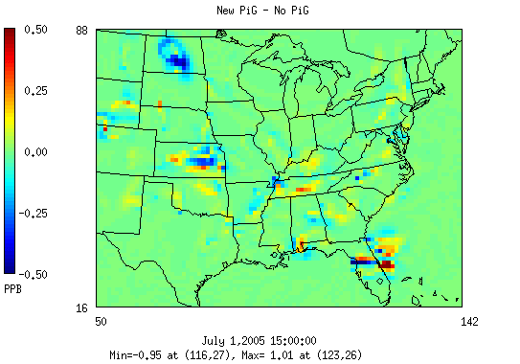
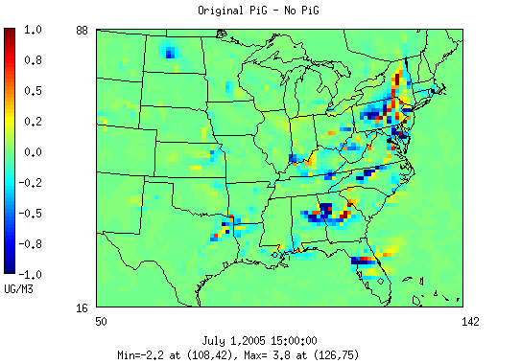
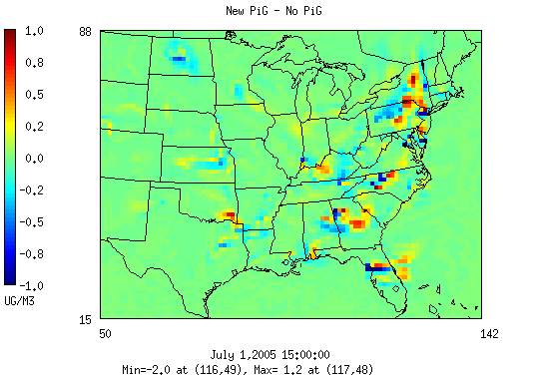
Results
Regional Response – NOz & Sulfate
NOz (nitric acid)
Sulfate

Slide 15
Summary
New PiG mechanism performs similarly to CB05
  Corrects NOy mass balance
Reduced puff growth rates better match:
  Measured plume widths
  Measured conversion of NOx to NOz
Major reductions in PiG processing time
  50-80+ % in our tests with various grid configurations
  Overall CAMx runtime impact depends on many factors
Ozone impacts consistent with full incremental chemistry

Slide 16
Summary
Ozone, NOy & SO₄ impacts largest for coarse grids
  Revised chemical dumping criterion and reduced growth rates
    Increases puff population overnight by ∼2
    Extends puff ages from ∼ 2 hours up to 6 hours
  CAMx runtimes marginally impacted by a few percent
Negligible time, concentration impacts in fine grids
  Puffs dump quickly by size constraints
  More plume chemistry is handled directly on grid

Slide 17
Acknowledgements
This work was funded by the Texas Commission on Environmental Quality
EPA provided the regional modeling database
Aircraft data were provided by NOAA ESRL Chemical Sciences Division

