Slide 1
Does ozone model performance vary as a function of synoptic meteorological type?
Pat Dolwick, Christian Hogrefe, Mark Evangelista, Chris Misenis, Sharon Phillips, Norm Possiel, Shawn Roselle, Brian Timin, and Ben Wells
2013 Annual CMAS Conference: 10/29/2013
Sensitivity of Air Quality Models to Meteorological Inputs

Slide 2
Introduction
While photochemical grid models have improved considerably in their ability to reproduce observed ozone in retrospective simulations over the past two decades, it is not uncommon for substantial biases and errors to exist at specific locations and times.
The goal of this analysis is to assess the value of partitioning days by their meteorological “synoptic type” when evaluating ozone model performance.
If a signal can be found that relates poor model performance to certain synoptic meteorological patterns, then additional attention can be devoted to those specific patterns when the meteorological inputs are prepared.
2

Slide 3
Background
Previous studies have shown some value of binning meteorological patterns into specific synoptic types and assessing how well air quality models capture the sensitivity of air pollution to varying meteorology:
Eder et al., 2006
Hogrefe et al., 2013 (submitted for publication)
Most of the previous studies have been constrained to relatively short modeling periods, typically one year or less.
This analysis assesses how CMAQ ozone model performance for a multi-year simulation period varies as a function of several discrete mean sea-level pressure patterns over the eastern U.S.
3

Slide 4
Typing Methodology
A climatology of synoptic types were developed for the eastern U.S. based on meteorological data from 1979-2011
ECMWF reanalysis data (ERA-interim)
Patterns are determined based on mean sea-level pressure patterns
Analysis focuses on warm season (May-September)
A type was established only if > 1% of the days could be assigned to it
Days with MSLP correlations of > 0.7 were assigned to a type
Ultimately, 15 synoptic types were identified to represent the most frequent summer meteorological patterns over the eastern U.S.
73 percent of days were assigned to a specific type
4

Slide 5
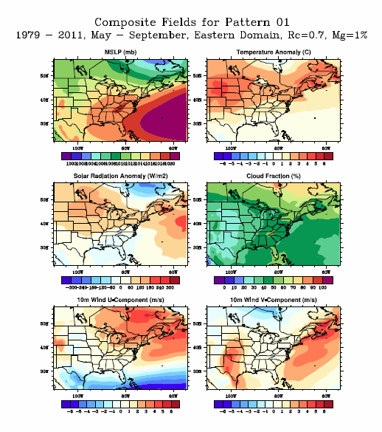
Sample synoptic type: Average conditions
For each of the 15 types we summarized the average meteorological conditions associated with the type
Pattern #1 shown to left
Strong Bermuda high
Was determined to represent 8.3% of days
While averages are smooth, note that day-to-day variations exist within same type

Slide 6
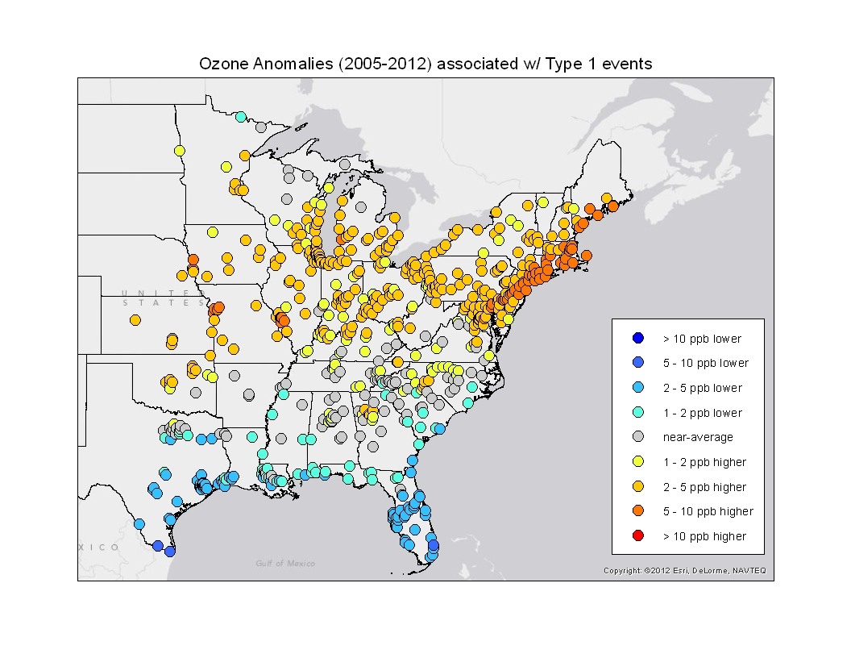
Sample synoptic type: Average O₃ anomaly
Additionally, for each of the 15 types we determined the average ozone anomaly associated with the type
Pattern #1 shown on left
Higher than usual ozone in the Northeast US
Because of the improving trend in O₃ levels in the EUS over time, anomalies only used days from 2005-2012

Slide 7
Ozone Modeling
Methodology
Four years of CMAQ modeling were completed using a national domain with 12-km resolution domain (24 vertical layers)
Four annual simulations were completed for 2007-2010
CMAQ version 4.7 (specific versions could vary by year)
Emissions are NEI-based (specific versions could vary by year)
WRF meteorology (specific versions/configuration could vary by year)
IC/BC from year-specific GEOS-Chem global model
Modeling and base evaluation summarized more completely at:
http://www.epa.gov/heasd/research/cdc.html.
This additional evaluation (MDA8 bias by synoptic type) uses available AIRS and CASTNET ozone sites w/ 75% data capture during May-Sept periods of 2007 and 2010.
7

Slide 8
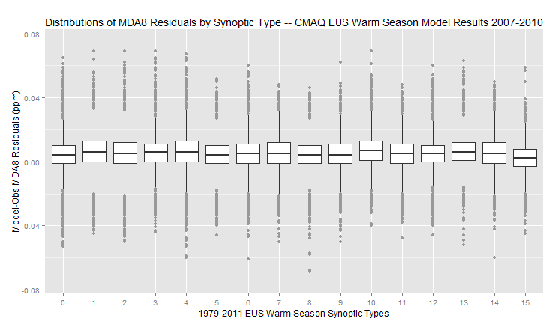
Model Performance by Synoptic Type
Plot shows how model performance differs as a function of synoptic type
Distributions of MDA8 residuals (mod-obs)
Warm season: May-Sept
All types exhibit slight overprediction
Days that do not fall into one of the 15 identified types are lumped together as “Type 0” days

Slide 9
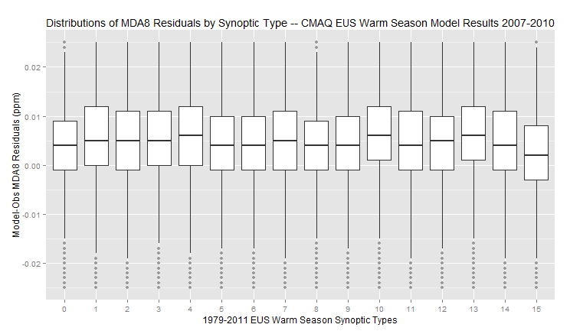
Model Performance by Synoptic Type
Same plot as before but with smaller scale to draw out subtle differences
Types 4, 10, and 13 tend to feature slightly more positive bias.
Type 15 and the “untyped” days (Type 0) tend to have the least bias.

Slide 10
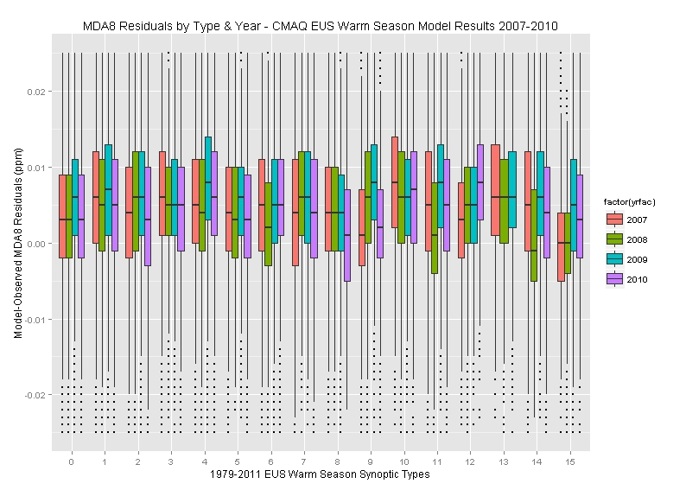
Model Performance by Synoptic Type/Year
Same plot as before but breaking out MDA8 residual distributions by year
MDA8 O₃ residuals are consistent across years
2009 most overpred
Some interesting type-year dependencies (e.g., 2008 Type 14), but generally consistent

Slide 11
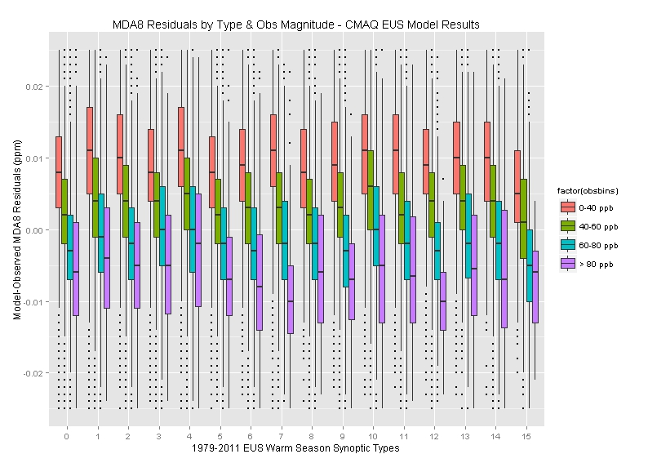

Slide 12
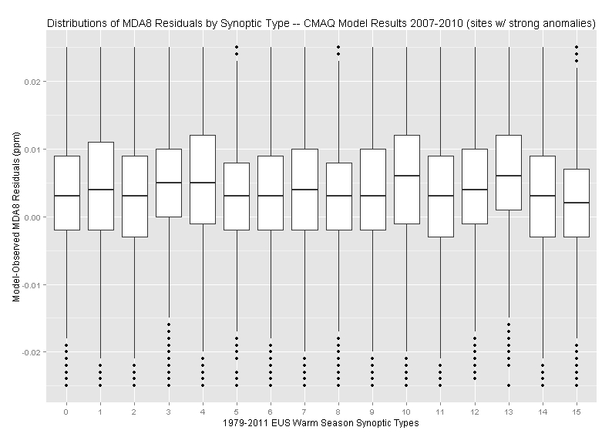
Model Performance by Synoptic Type (only sites w/ large anomalies)
Same plot as before but only considering sites w/ strong anomalies.
Strong anomalies were sites in which there was at least a 15 ppb difference between the most and least conducive synoptic types

Slide 13
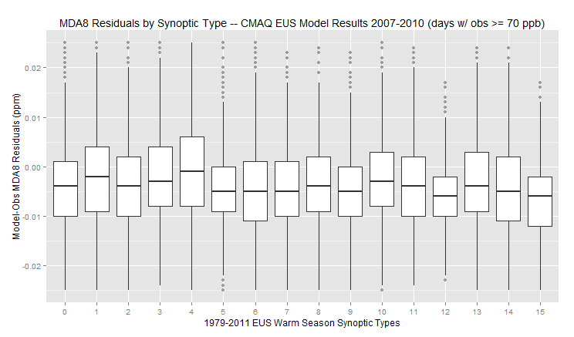
Model Performance by Type (high O₃ days)
About 5% of the total modeled site-days have observed MDA8 >= 70 ppb
Limiting analysis to these high days indicates model underpredictons are more likely across all synoptic types
Again Type 4 has the highest median value
Least bias in this case
Larger-than-normal spread in residuals

Slide 14
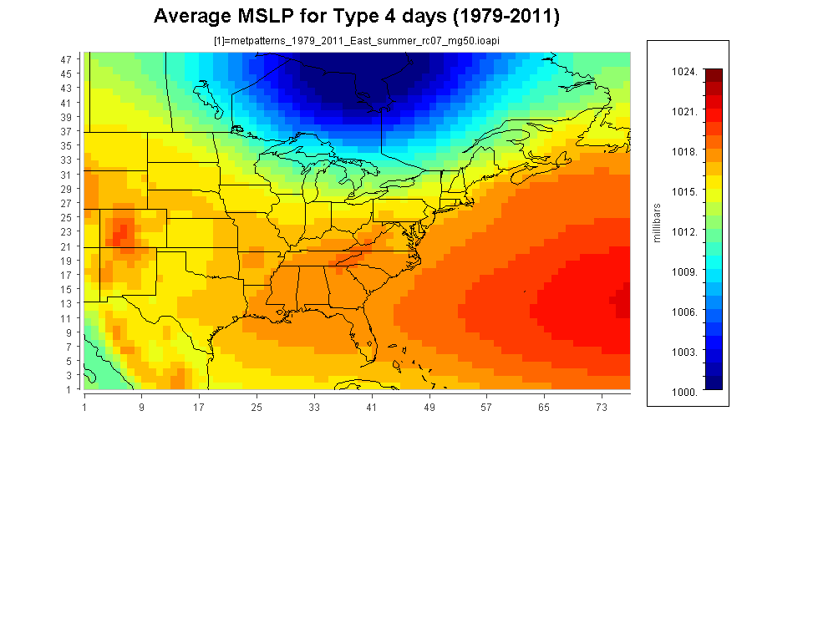
Synoptic Type 4:
FROPA through MW

Slide 15
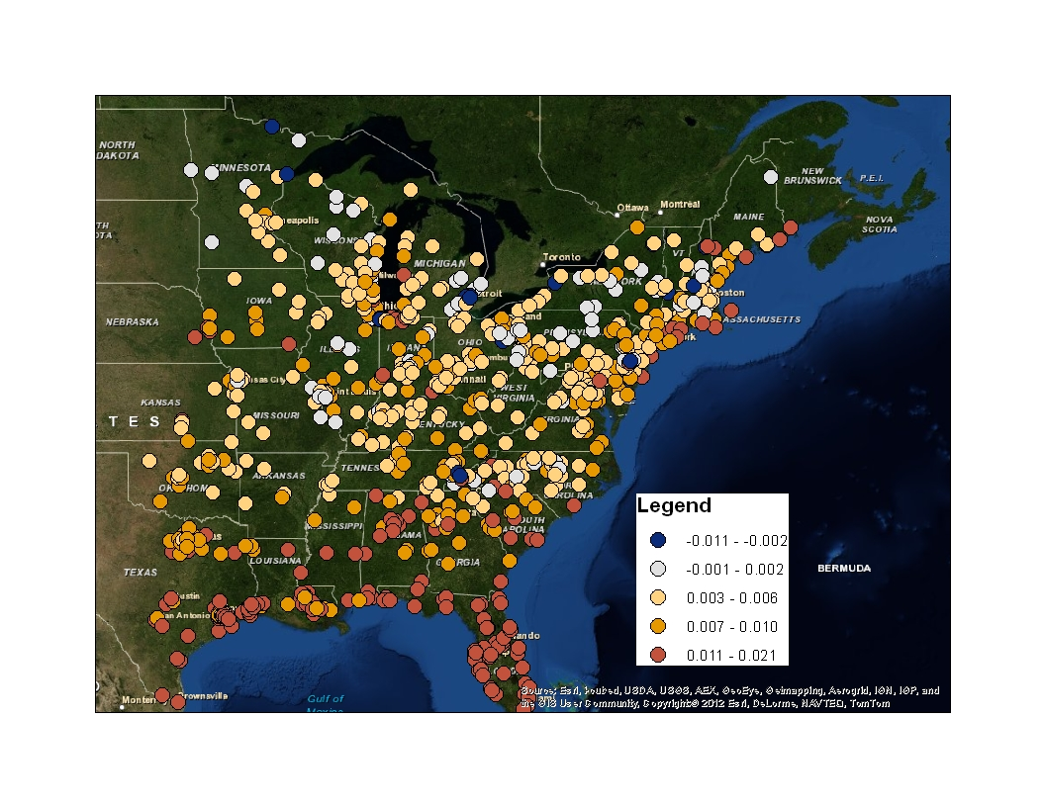
Mean MDA8 Residuals for Type 4 days

Slide 16
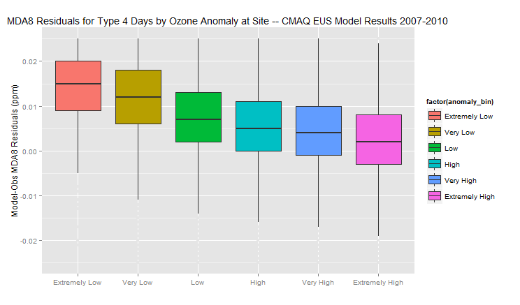
Model Performance on Type 4 days (binned by site anomaly)

Slide 17
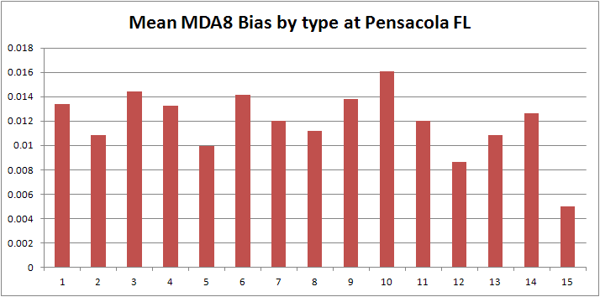
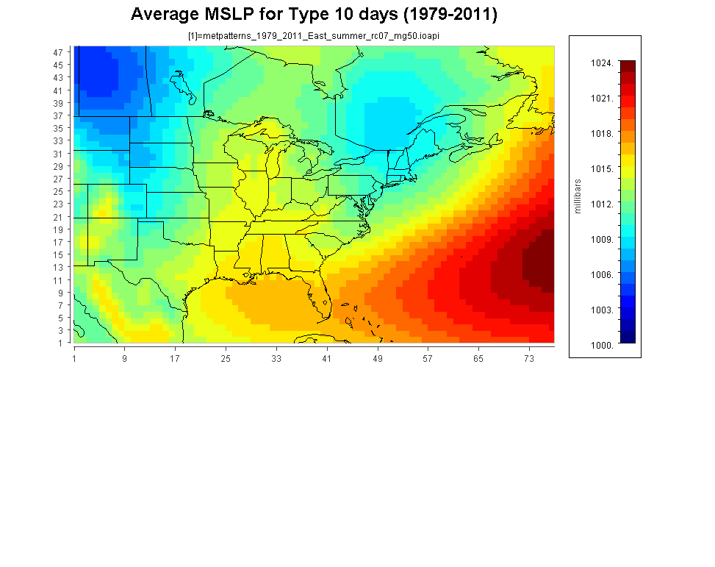
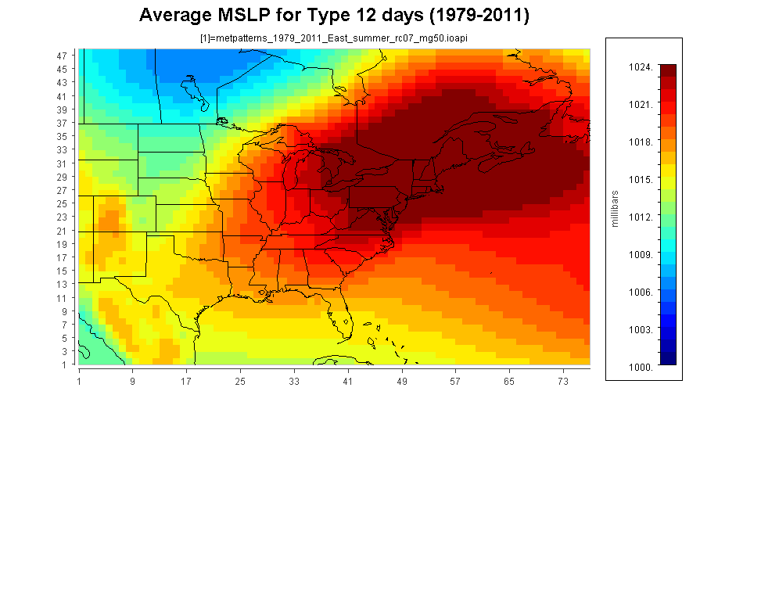
Model performance by type
(sample site)
Model biases can vary by a factor of 3 or more across synoptic type
This particular location suggest that model overpredictions are worse when trajectories are associates w/ long fetch from south/east boundary
Confirmed via separate evaluations by upstream trajectory direction

Slide 18
Summary / Next steps
More work needed to assess which sites at which there is a meaningful relationship between synoptic types and model performance.
Early suggestion that approach has potential value.
Will test other periods / domains.
Other possible uses of synoptic typing aside from model performance:
Climate trends
Meteorological adjustment

Slide 19
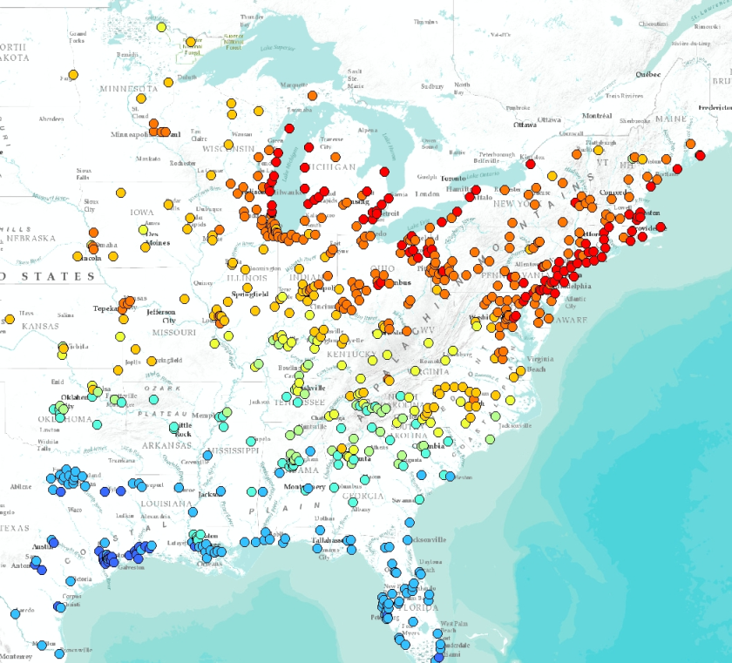
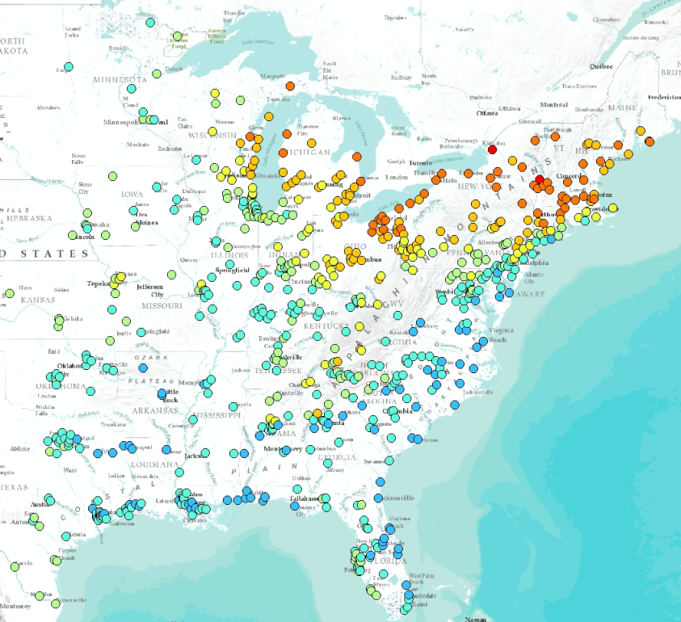
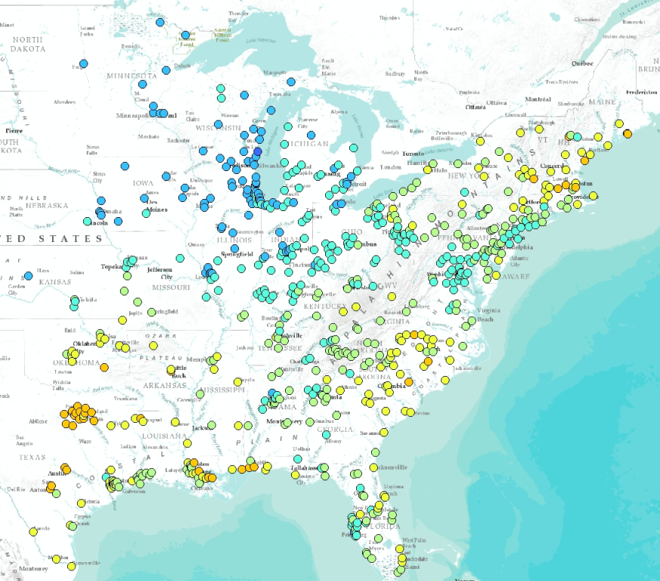
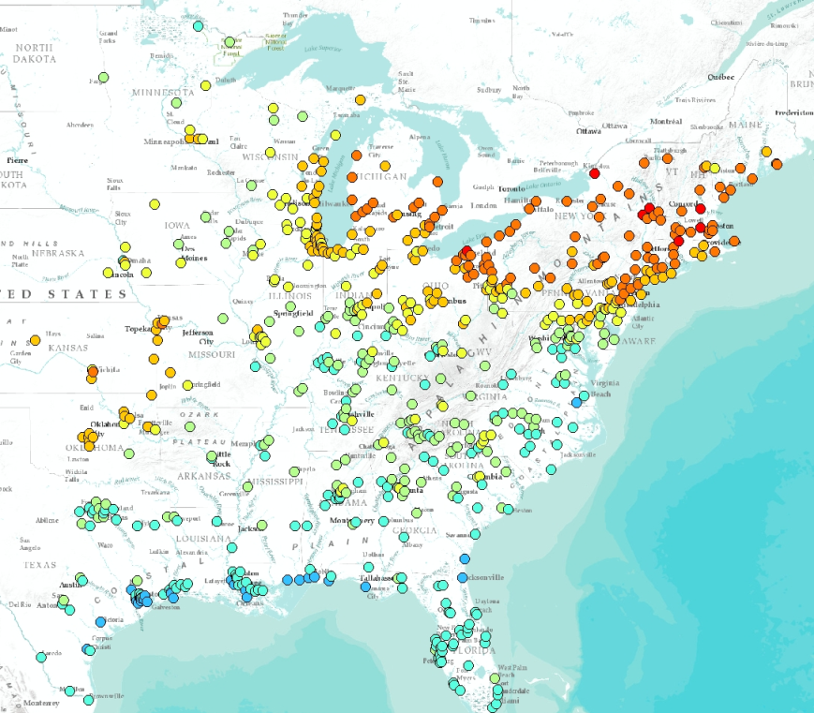
Screening-level analysis of meteorological severity
By combining recent year ozone anomalies with synoptic type frequencies, one can get a “first-glance” picture of which summers were more/less conducive to ozone formation
1988
2004
2009
2012

