Slide 1
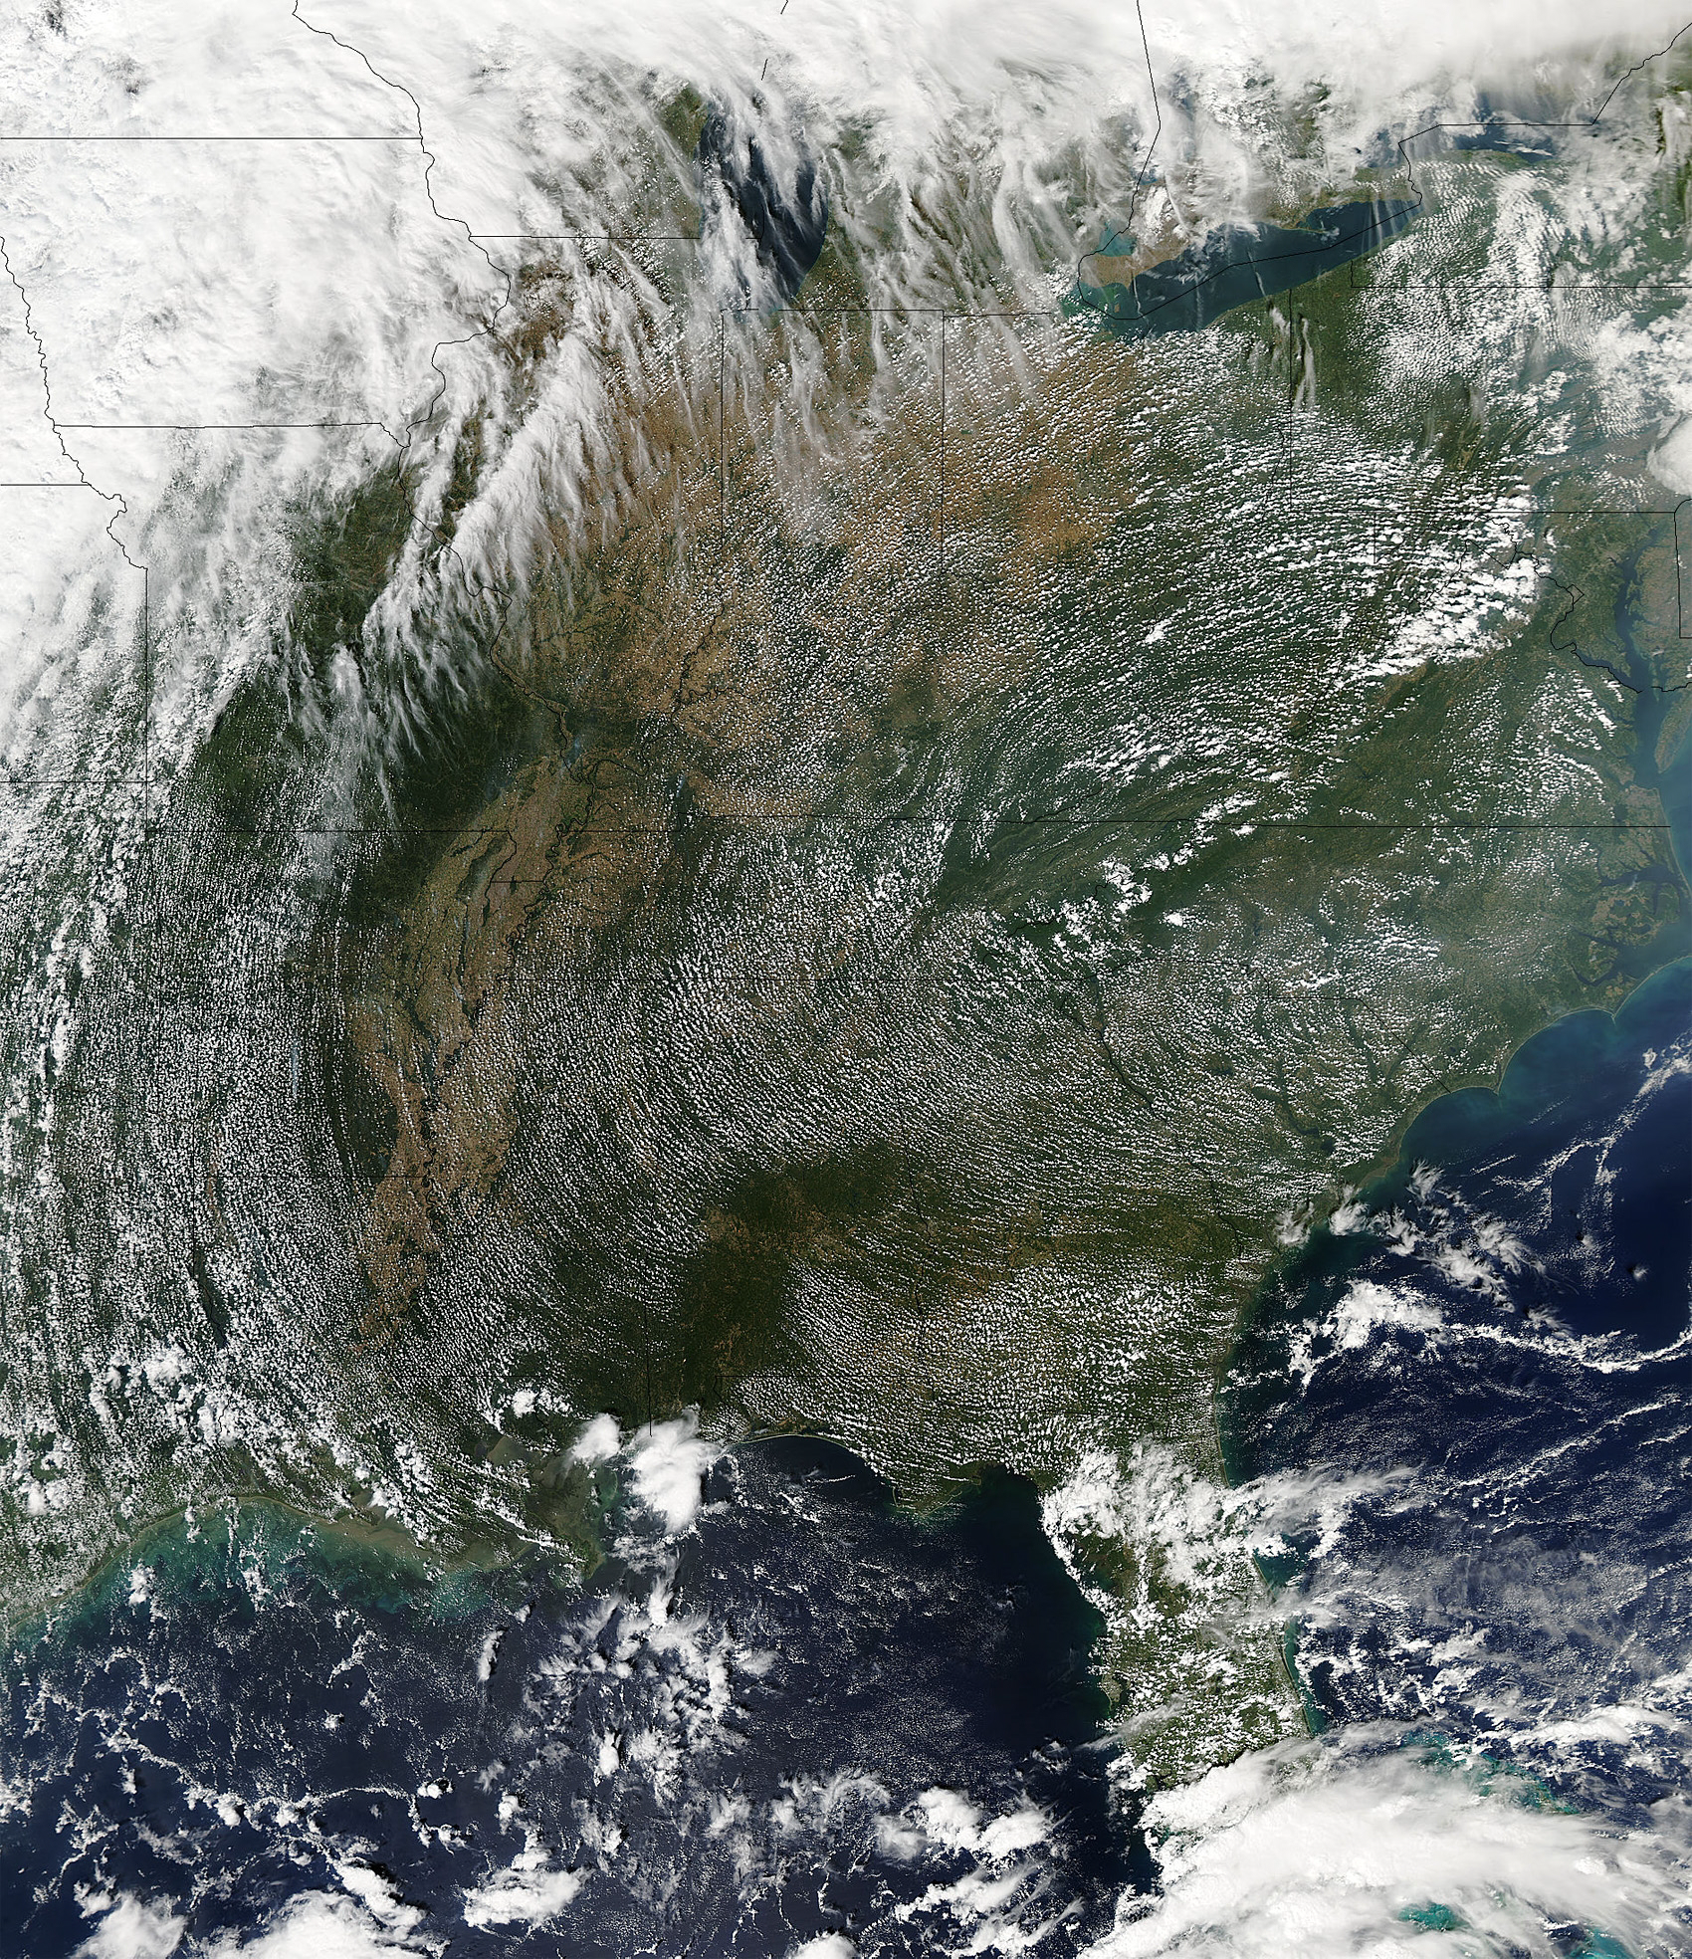
Mesoscale meteorological modeling at kilometer scale grid meshes for air quality simulations
Jason Ching
CMAS 2013
Chapel Hill, NC

Slide 2
Motivation for study
Computational capabilities is making feasible the use of increasingly finer grid meshes- allowing improved resolution of features in mesoscale flows and AQ concentration fields.
Mesoscale and air quality modeling community user numbers are expanding, e.g., Downloads of WRF and CMAQ models on the increase and there are application needs that will require use of finer grid meshes:
HOWEVER: Fundamental problems are associated with fine grid mesh simulations of the convective BL. An awareness of such issues is needed
Produces (Spurious???) mesoscale Convectively-Induced Secondary Circulations “CISCs”
Who Cares?? Implications for air quality, urban applications modeling

Slide 3
A Collaborative Investigation
NCAR Mesoscale Modeling Group was approached to help characterize, determine the scope of and develop a plan of study to address the problem.
Convened a 6 month on-site study program at NCAR for a research collaboration.
Collaborators:
  Rich Rotunno- MM Division Director
  Peggy Lemone- mesoscale field and modeling expert
  Alberto Martilli- CIEMAT Urban scale modeling
  Branko Kosovic – LES expert
  Pedro Jiminez- Mesoscale modeler
  Jimy Dudhia- WRF science options

Slide 4
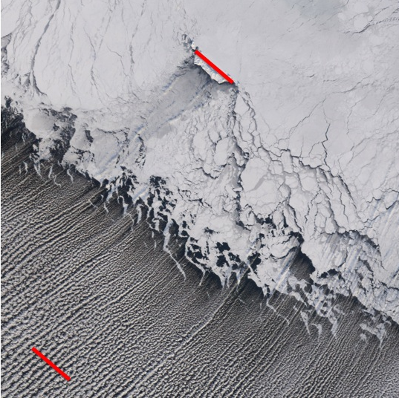
Key Observation
Convectively Induced Secondary Circulations – CISCs
PBL convectively-generated cloud fields in undisturbed flow conditions. Imagery from MODIS Aqua (ascending) and Terra (descending) satellite platforms at approximately local noon
Over Land
Outflow from Iceland over Bering Sea
St Matthew’s Island
52 km long
CISCs are widely occuring, ubiquitous in relatively undisturbed
synoptic flows, Conducive to “pollution storm” situations.

Slide 5
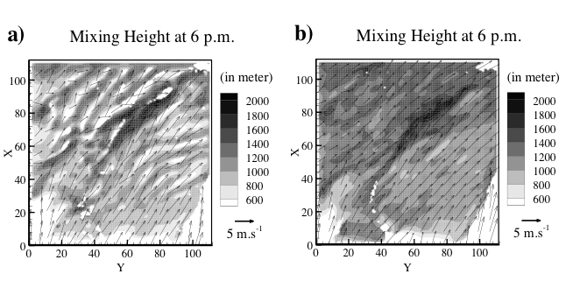
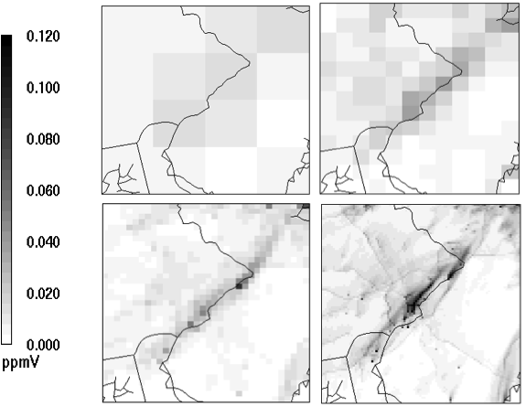
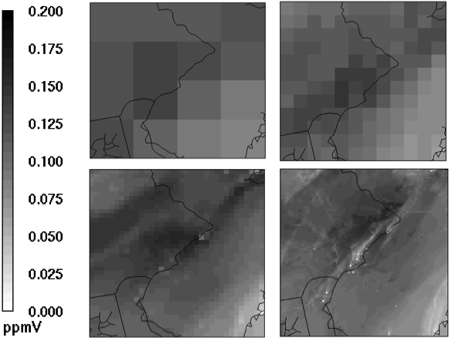
MM5 and CMAQ Simulations
Philadelphia Domain
LHS: Mixing Heights and wind vectors
Bottom: CMAQ meshes:
36, 12, 4 and 1.3 km
Are these features “real”
NOx
Ozone
Resolution of
Concentration
Features increases
With decreasing
grid meshes

Slide 6
Mesoscale simulations are sensitive to
choice of PBL parameterization options
WRF simulations of vertical velocity in the PBL (125-m, Level 10) for 20 UTC August 4 over Houston-Galveston area
Satellite image is fromTerra 17:20 UTC, 500-m pixels:
PBL schemes 1: Vertical fluxes are proportional to local vertical gradients:
BouLac
MYJ
QNSE
MYNN2
PBL schemes 2: Vertical fluxes using non-local closure schemes: MYNN3
YSU
ACM-2

Slide 7
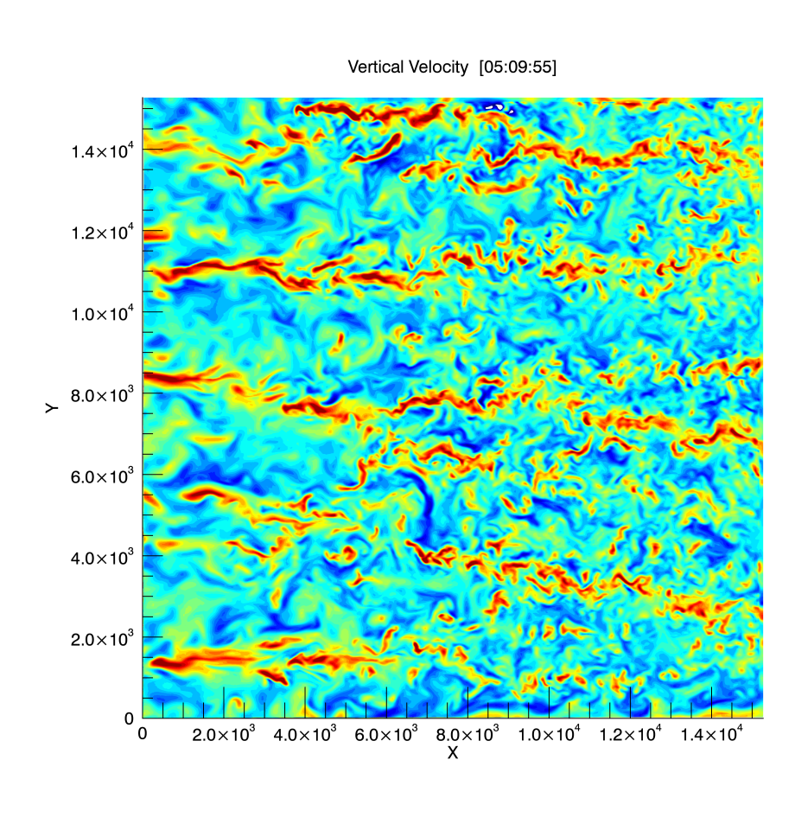
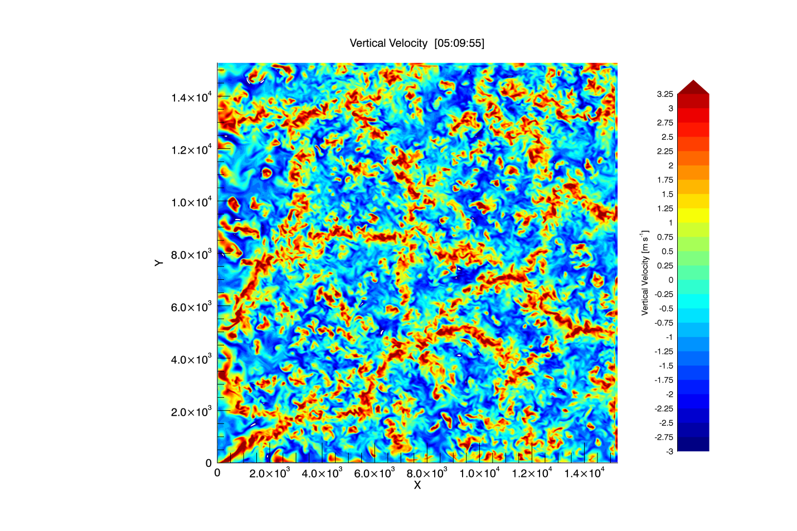
LES can generate CISCs
Contours of vertical velocity at a horizontal plane approximately 400m above the surface. Idealized conditions; note the scales are the same for both.
Convective-roll regime: - z_{i}/L=10 Convective-cellular regime: -z_{i}/L=100

Slide 8
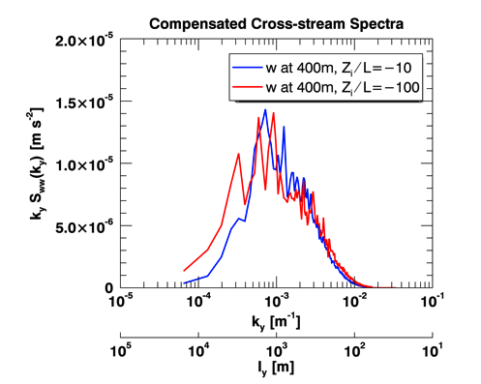
LES generated cross-wind vertical velocity Spectra @400m Idealized Flow conditions: Wavenumber weighted so area under curve is proportional to energy;
Cells
Rolls

Slide 9
What exactly is the Problem??
Schematic of spatial regimes including the “terra incognita” for grid sizes in mesoscale and LES models relative to turbulent eddy structures, with peak eddy size represented by l.
Turbulent transport is
parameterized for the
mesoscale models
Trying to resolve turbulent motions

Slide 10
IMPLICATIONS:
Mesoscale LES
Increasingly finer grids encroaches into terra incognita regime
Part of turbulence spectrum is being resolved while also being parameterized
Can introduce unrealistic mesoscale size features larger than grid mesh size in convective conditions (CISCs)
Needs explanation!!!!
LES is not impacted by terra incognita
Spectra of mesoscale has realism, inertial subrange somewhat truncated at high wavenumbers
Generates mesoscale features (CISCs) during convective conditions
Mesoscale features (CISCs) under -Z_{i}/L control

Slide 11
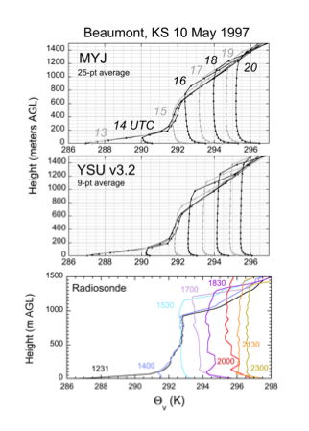
A clue!
Example of mesoscale modeled and observed sequences of
temperature soundings at Beaumont (CASES- 97: 10 May 1997)
Modeled and observed
superadiabatic
lapse rates

Slide 12
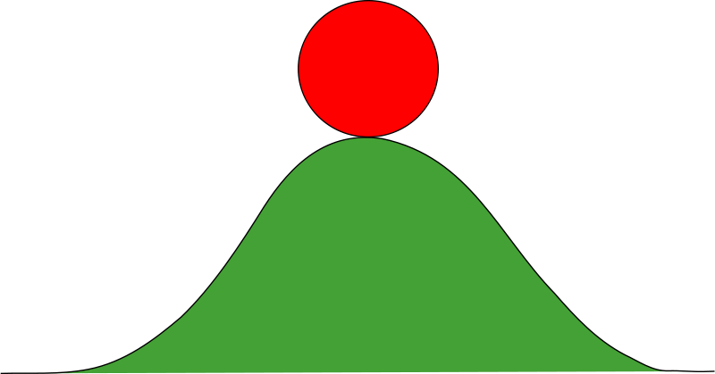
Concept by Rayleigh (1916)
Surface heating causes
Superadiabatic Lapse Rate
(Introduces Potential Energy)
Condition is unstable and
converts to flow Kinetic Energy
When exceeded,
instability occurs
Potential Energy
to
Kinetic Energy

Slide 15
Results : Nondimensional GROWTH RATE vs nondimensional wavelength
Rayleigh theory (1916) for the instability of a superadiabatic layer
H is depth of Super-
adiabatic layer
Viscous fluid: (Ra=1.16x10⁴ )
vertical diffusion only
Inviscid fluid
Viscous fluid: Ra=1.16x10⁴

Slide 16
Introduction of potential temperature perturbation (shaded) and vertical velocity (contour) at t=0 and t= 20 min
Base-state superadiabatic potential temperature profile shown on side panel (WRF default YSU parameterization).
When growth exceeds LCL, CISC type clouds form
Initial quiescent state
YSU parameterization
Initial quiescent state
Gamma 3x normal
20 minutes later
YSU parameterization
20 minutes later
Gamma 3x normal

Slide 17
Idealized case (previous figure)using YSU
Evolution of the maximum potential temperature perturbation. Thin dashed lines indicate that the motion has reached nonlinear saturation; thus outside range of validity of the linear theory.
Real case (CASES 97) using MYJ
Maximum absolute value of w as a function of time for a domain centered over Beaumont, Kansas, for three simulations with grid sizes 1, 3, and 9 km. Least-squares best-fit lines correspond to the growth rates for each curve. Straight lines mark the time over which growth rate calculated.
Rate of growth decreases with grid size

Slide 18
What we have learned thus far…
Mesoscale (M-CISC) LES (L-CISC)
Mesoscale models generates CISCs during convective conditions when Ra_{crit} is exceeded
M-CISC generation more pronounced as grid mesh size decreases
M-CISC characteristics dependent on modeled lapse rates and in turn on its PBL scheme
Realism of M-CISCs is suspect
L-CISC not impacted by T-I
LES can simulates CISCs
Characteristics of L-CISCs depend on Z_{i}/L
LES has potential to be an important tool for developing improved mesoscale modeling PBL parameterization schemes in the T-I regime

Slide 19
WAY Forward approaches:
PBL parameterization exploratory experiments
Controlling Rayleigh number schemes: Maintain or force Ra to remain sub-critical. But are we giving up the baby with the wash?
Non-Local closure schemes: Proven to be effective means to remove heat from the surface layer; thus impact modeled lapse rates and M-CISCs
The impact of urban canopy modeling on MM-CISCs needs to be examined- may be a mitigating factor?
Accept MM-CISCs predictions but account for limitation during interpretation (e.g., RANS as Ensemble vs Volume averaging operations.
Exploiting LES?

Slide 20
Exploring means (2 approaches) to Control (Suppress) M-CISCs
I. Controlling the Rayleigh number
Given: (1) Critical Rayleigh Number
(2) Critical Rayleigh Number
in terms of grid mesh size
Approach: Maintain RA at Sub critical
Value; Application of Prandtl number
Control effectively increasing the
vertical thermal diffusivity:
II. Regulating Non Local Closure scheme
Recall:
Maintain Prandtl Number =1

Slide 21
Options towards suppressing M-CISCs:
Shown are evolution of maximum vertical velocity for the various simulations.
Line type indicates the resolution; symbols indicate the parameterization option.
Γ₅₀₀
No Suppression
PR3-D
Γ₁₀₀₀

Slide 22
Horizontal section of vertical velocity at z_{i}/2 at 1600 LST.
The color scales are all different.
Std1000
Std500
(e)
PR3D500
(e)
Very effective, look at scale
-2
3
-2.5
4
-0.01
0.01
(b)
Γ₁₀₀₀
Γ₅₀₀
Γ₂₅₀
-0.003
0.002
-0.7
0.8
-1.5
2.7
Gamma features, circulation magnitudes significantly changes with decreasing grid size

Slide 23
PR3D selectively eliminates M-CISCs, but retains lake-land breeze circulations
TOP: Wind fields (arrows) and vertical velocities (colors) at the first model level. Lakes indicated by black rectangles.
BOTTOM: Vertical sections of U component of the wind.
Standard
PRD
Standard
PRD

Slide 24
Summary Points
Study has provided insights and improved basic understanding of complex problem when using fine grid meshes in mesoscale models
Model option towards suppressing M-CISCs has pros and cons and degrees of effectiveness. Consideration of whether the RA model equations are ensemble averaged or volume averaged is relevant to choice.
LES may provide insights on future improvements to PBL parameterizations- efforts underway
Consideration regarding fine grid modeling applications in urban context. Some ideas come to mind, e.g., modification by roughness and thermodynamics of within-canopy modeled influences potential temperature profiles (e.g., predicted superadiabaticity).
Watch for forthcoming JA: (1) Theory and
(2) Parameterization of CISCs based on rendering RA at sub critical levels.

