Slide 1
Estimation of human exposure to PM_{2.5} components in U.S. metro areas
Using routine measurements and CMAQ!
Prakash V. Bhave, Mary K. McCabe, Valerie C. Garcia
Atmospheric Modeling & Analysis Division
U.S. EPA, Office of Research & Development
CMAS Conference
Chapel Hill, NC
October 28 – 30, 2013

Slide 2

Take-Home Messages from CMAS 2010 Special Session
Land-use Regression (LUR) is most popular method for estimating exposure beyond central-site monitor
-L.Sheppard
AQ Modelers should focus on ↑ spatial resolution; temporal not a major need –M.Brauer
Solutions:
Hybrid of CMAQ+AERMOD, CMAQ+RLINE
Run CMAQ at finer scales (e.g., 4km or 1km)
But…
these don’t take advantage of our strength in modeling @regional scales
within-city monitoring of PM_{2.5} and O₃ is fairy dense
– how much value can our models add over LUR or spatial kriging?

Slide 3
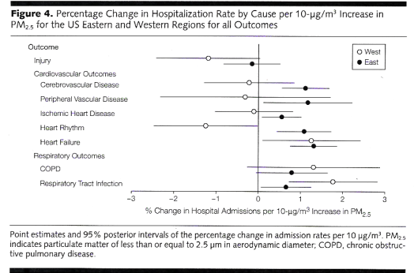
Health Impact of PM_{2.5} Varies by Region
Ref. Dominici, F. et al. JAMA 2006

Slide 4
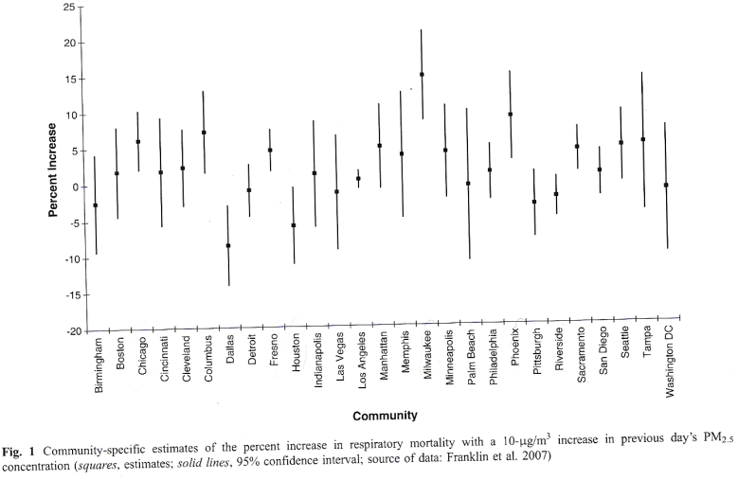
Within-Region Variability
Ref. Franklin, M. et al. JESEE 2007

Slide 5
Recent Investigations
Baxter, Franklin, Ozkaynak, et al. The use of improved exposure factors in the interpretation of PM_{2.5} epidemiological results, Air Qual. Atmos. Health, 2013.
Baxter, Duvall, & Sacks. Examining the effects of air pollution composition on within region differences in PM_{2.5} mortality risk estimates, JESEE, 2012.
Major obstacle:
Routine observations of PM_{2.5} composition are very limited. Of 139 U.S. cities with chemical speciation network (CSN) sites, only 15 have >1 site.

Slide 6
Hypothesis
For many locations and chemical species, the PM_{2.5} composition at a single CSN site is an inadequate estimate of the ambient concentrations across the metropolitan area, for assessing the compositional effects on within-region differences in PM_{2.5} mortality risk estimates

Slide 7
Methods
Ambient Measurements
  PM_{2.5} CSN measurements in 2006 (24h obs, 1-in-3 or 1-in-6)
  Subset data which are only site in their core-based statistical area (CBSA)
  Compute annual avg conc of each species at each site
Model Simulation
  CMAQ v5.0.1 with default options (e.g., CB05tucl, AERO6, ACM2)
  2006 calendar-year simulation
  12km ConUS domain – 459 ×299 × 35 layers
  Emissions: evaluation version D of 2008 NEI w. year-specific fire, mobile, biogenic, & point EGU
  Meteorology: WRF v3.4
  Computed annual avg con for each PM_{2.5} species (n = 15) in each surface-layer grid cell (n = 137,241) from hourly CMAQ output
  Multiplicative bias correction for each CBSA and species
  Excluded cases where model & obs differed by > 3×
Population Data
  2000 Census block-level data projected to 2005 and aggregated to 12km CMAQ grid cells

Slide 8
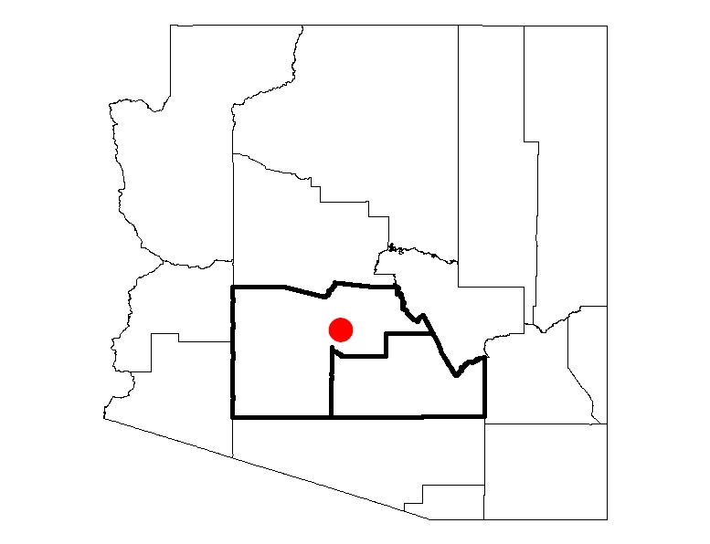
Example of Results
Phoenix-Mesa-Glendale contains exactly 1 CSN monitor.
At that site, the annual-average OC = 4.16 µg/m³ in 2006.
Raw Data
CSN Measurement 4.16 µg/m³

Slide 9
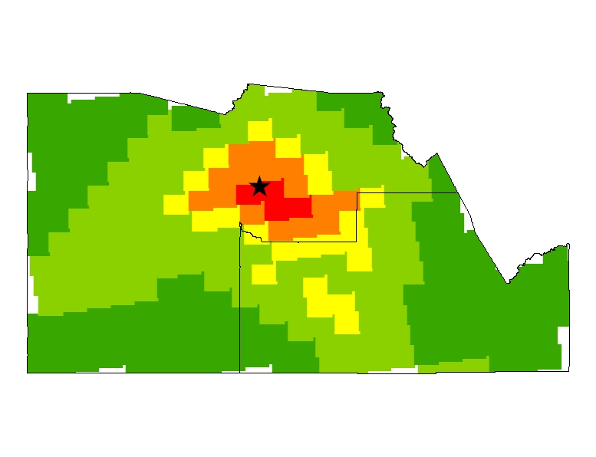
Example of Results
Raw Data
CSN Measurement 4.16 µg/m³
3.0 – 5.0
CMAQ model provides an estimate of spatial variability in OC across the metro area.
After bias correction, avg. conc. = 0.71 µg/m³.
much lower than CSN measurement!
1.5 – 3.0
1.0 – 1.5
0.5 – 1.0
CMAQ Model Output
0.3 – 0.5
Area average = 0.71 µg/m³

Slide 10
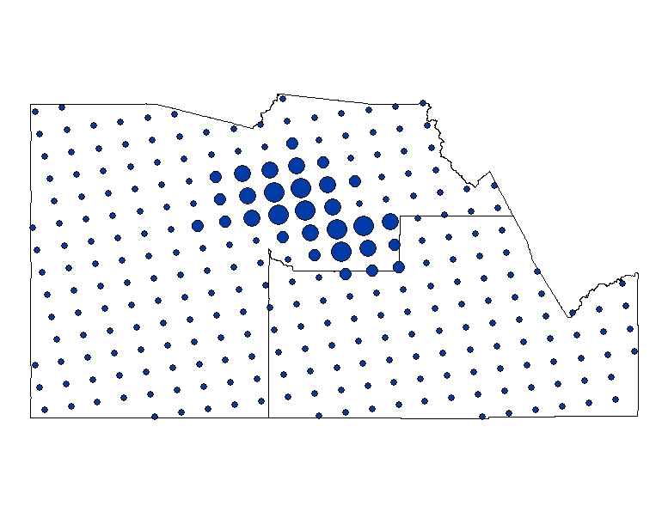
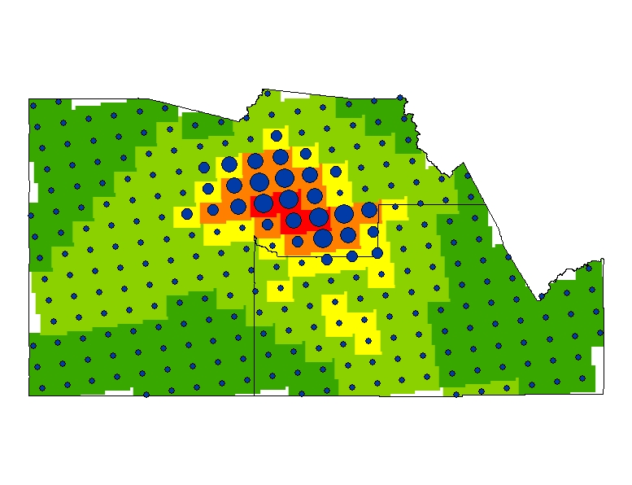
Example of Results
0 – 160
161 – 530
531 – 1107
1108 – 1863
Raw Data
CSN Measurement 4.16 µg/m³
Population Density (km⁻²)
But population density is correlated with OC concentration.
3.0 – 5.0
1.5 – 3.0
1.0 – 1.5
0.5 – 1.0
CMAQ Model Output
0.3 – 0.5
Area average = 0.71 µg/m³
Population average = 2.24 µg/m³
Accounting for spatial variation in air concentrations & population density, we obtain a more accurate estimate of the average exposure across this metro area.
Population-Averaged Exposure Measurement Error (due to spatial variability) = +1.92 µg/m³
*Using CMAQ, we calculate this error for 14 species across all metro areas with a single CSN site

Slide 11
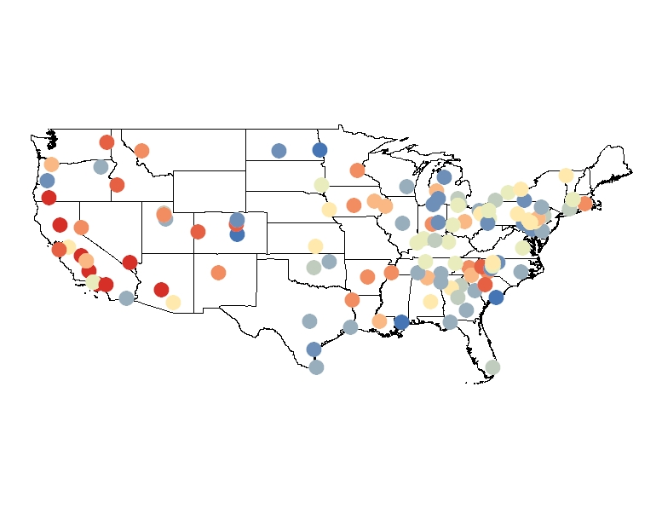
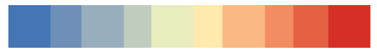
Exposure Measurement Error for Organic Carbon in PM_{2.5}
SO4_{err} = +0.63 µg/m³ in Baton Rouge, LA
NO3_{err} = +2.95 µg/m³ in Riverside, CA
Ti_{err} = -8.1 ng/m³ in Colorado Springs
-1.0
0
+1.0
(µg/m³)
* Substantial inter-city variability in exposure measurement error can now be accounted for in large-scale, population-based epidemiological studies

Slide 12
Summary & Future Work
Exposure measurement error due to spatial variability in ambient concs was estimated fro 15 PM_{2.5} species in >100 metro areas across the U.S.
Error was typically positive (871 out of 1280 cases studied), because most CSN monitors are in urban center
Errors can be quite large (e.g., OC_{err} = +1.92 μg/m³ in Phoenix)
Future work: incorporate these exposure errors in future epi studies that investigate the influence of PM_{2.5} composition on mortality risk.

