Slide 1
Modeling as an exposure estimation approach for use in epidemiologic studies: Guidance in choosing the appropriate model
Lisa K. Baxter, Kathie L. Dionisio, Janet Burke, and Halûk Özkaynak
National Exposure Research Laboratory, U.S. EPA
Office of Research and Development
National Exposure Research Laboratory
10/30/2013

Slide 2
Background
Many epidemiological studies use measurements from central-site monitors to estimate exposures.
Measurements from central-site monitors may lack sufficient spatial and temporal resolution.
More sophisticated methods may provide better estimates of exposure.
Produce less biased and more precise health effect estimates

Slide 3
Background
Examples:
Employing modeling techniques to increase the spatial resolution of exposure estimates
Fill in counties with no measurements to get more statistical power in epidemiological studies
Better capture “hot spots” or roadway impacts
Use models to increase temporal resolution by filling in for periods of time when central site measurements are not available
PM speciation data only measured 1-in-3 or 1-in-6 days
Exposure models which incorporate exposure factors such as time-location-activity budgets and penetration of ambient pollutants to the indoor environment

Slide 4
Tiers of exposure metrics relevant to air pollution epidemiology studies

Slide 5
Factors Influencing the Selection of the Optimal Exposure Metric
When would exposure estimates generated from more complex methods be an improvement over those generated from central site monitoring data?
Answer depends on:
Epidemiological study design
Pollutant(s)
Health outcome

Slide 6
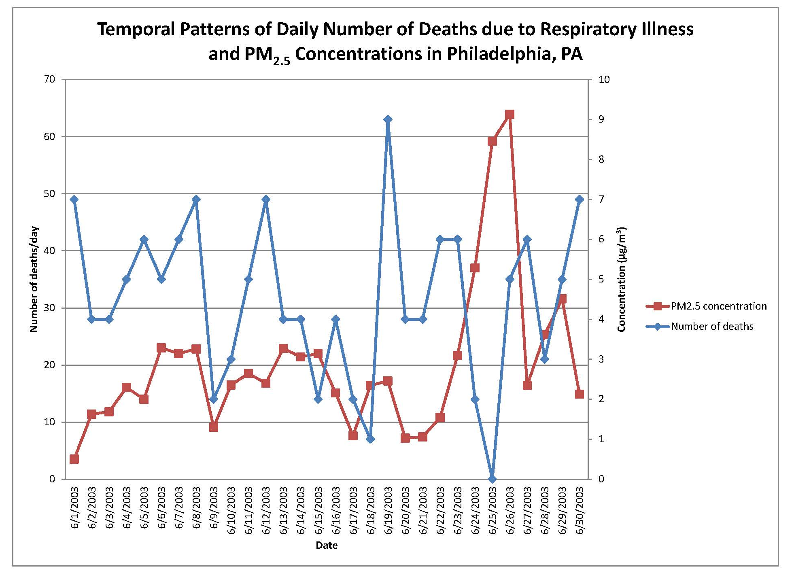
Factors Influencing the Selection of the Optimal Exposure Metric: Epidemiological Study Design
Time-Series Study
Number of deaths at the county level
Need to characterize the temporal variability
Is this adequately captured by the central-site monitor?

Slide 7
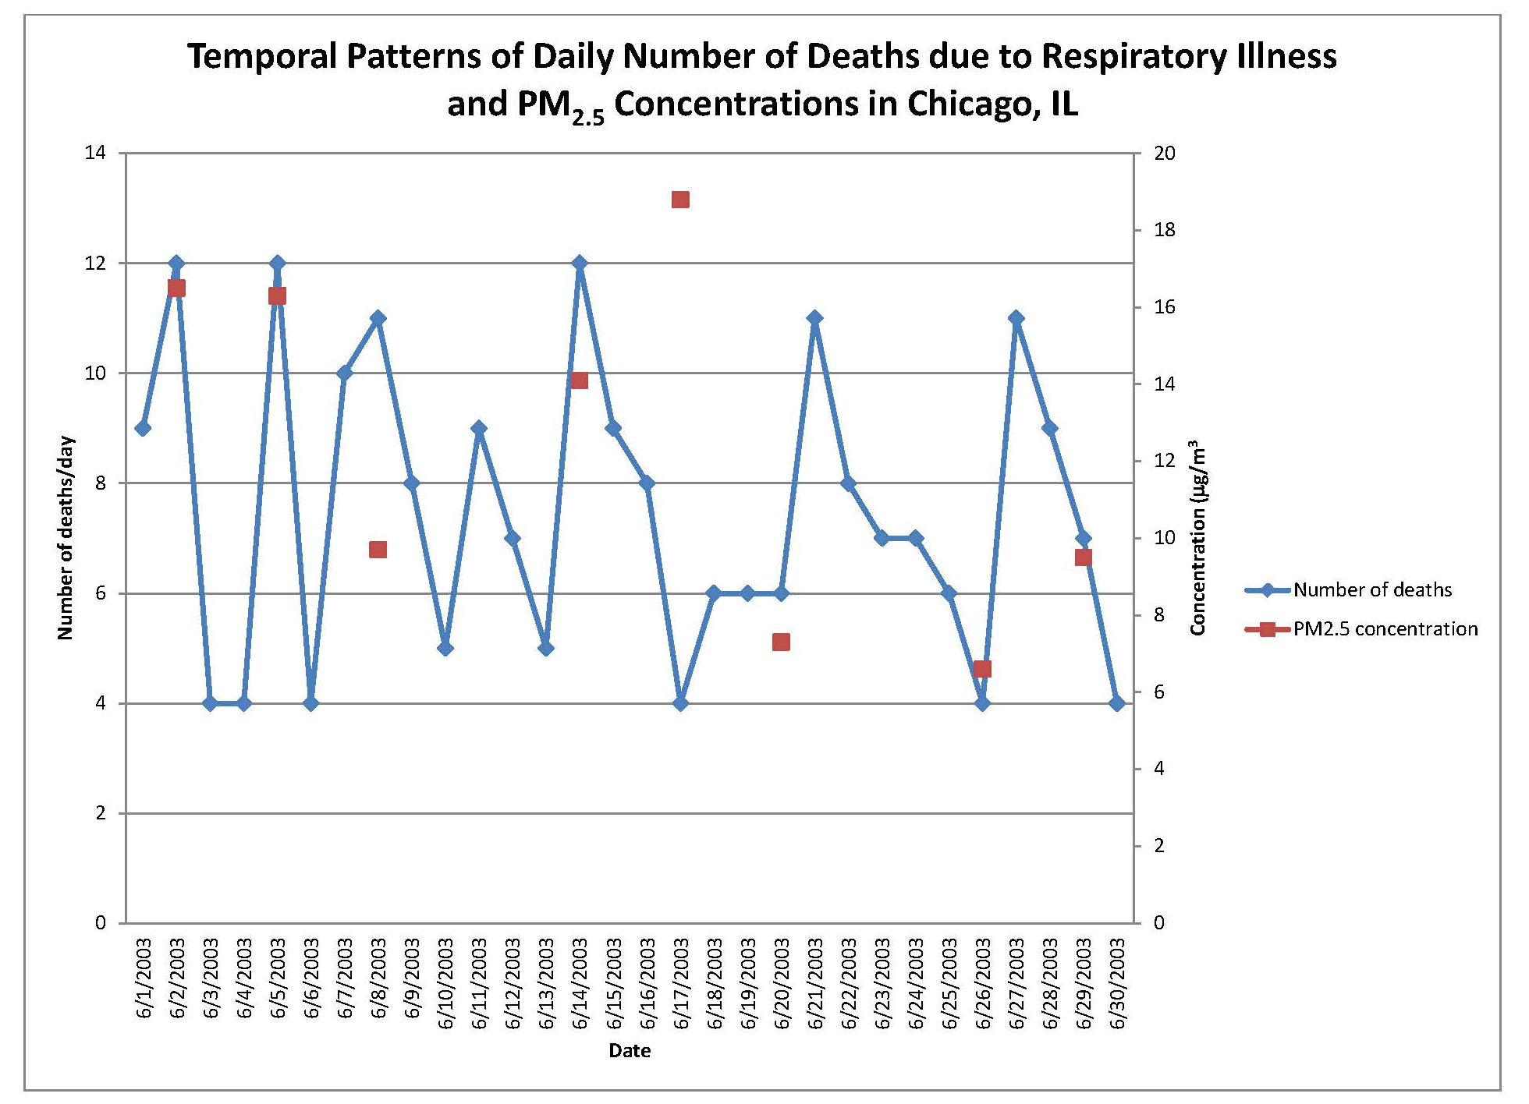
Factors Influencing the Selection of the Optimal Exposure Metric: Epidemiological Study Design
Time-Series
Measurements not taken daily
Characterizing temporal pattern more difficult because of missing days
Missing days may make it difficult to perform epidemiological analysis

Slide 8
Factors Influencing the Selection of the Optimal Exposure Metric: Epidemiological Study Design
Cohort Study
Know more specifics on the study participants
Concerned with both temporal and spatial variability
Central-site monitor may not be sufficient
Source: http://medanth.wikispaces.com/Cohort+Studies

Slide 9
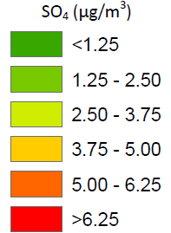
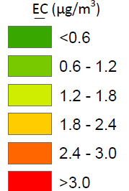
Factors Influencing the Selection of the Optimal Exposure Metric: Pollutant

Slide 10
Factors Influencing the Selection of the Optimal Exposure Metric: Health Outcome
CANCER
Exposure window: years
ASTHMA ATTACK
Exposure window: days
Some metrics may do a better job of estimating long-term exposures while others may be better estimating short-term exposures

Slide 11
Take Home Message
Exposure metric
There is not a one-size fits all approach
What is available for the study?
Will a modeling approach potentially improve exposure estimates in turn producing less biased health effects results?
Need to look at the combination of epidemiological study design, pollutant, and outcome to understand whether a modeling approach would be worth the additional effort/complexity
Modelers should be involved at the beginning to advise and decide on the approach

