Slide 1
Aircraft Emissions Contribution to Organic Aerosols using the Volatility Basis Set
Matthew Woody¹, Saravanan Arunachalam¹, J. Jason West¹, Francis S. Binkowski¹, B.H. Baek¹, Shantanu Jathar², Allen Robinson²
¹University of North Carolina at Chapel Hill
²Carnegie Mellon University
October 15-17, 2012
11th Annual CMAS User’s Conference, Chapel Hill, NC

Slide 2
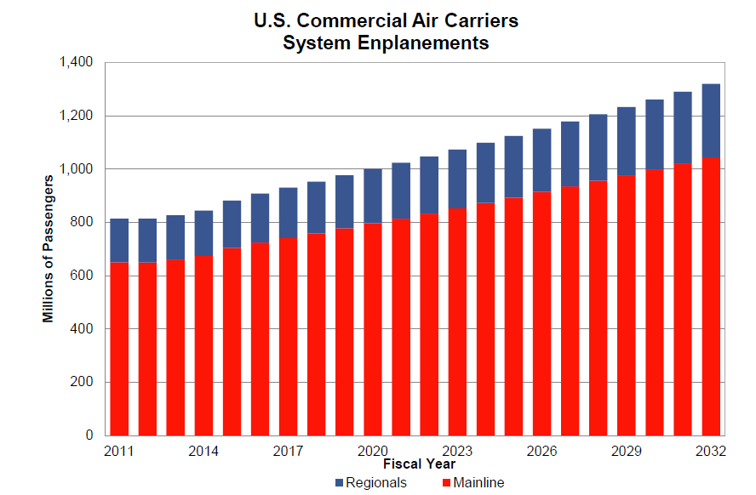
Background
725 million passengers, 67 million tons of cargo, 18 million flights in the U.S. in 2011 (FAA, 2012a).
3.1% per year passenger growth from 2011 to 2032 (FAA, 2012b)
1 billion passengers in 2024 (FAA, 2012b)
PM_{2.5} Non-attainment areas (1997 Standard) and Major U.S. Airports
Aircraft emissions include CO, NO_{x}, SO₂, VOCs (SOA precursors) and PM_{2.5} (primary organics, elemental carbon, sulfate aerosol)
Notes:
U.S. population = 311 million

Slide 3
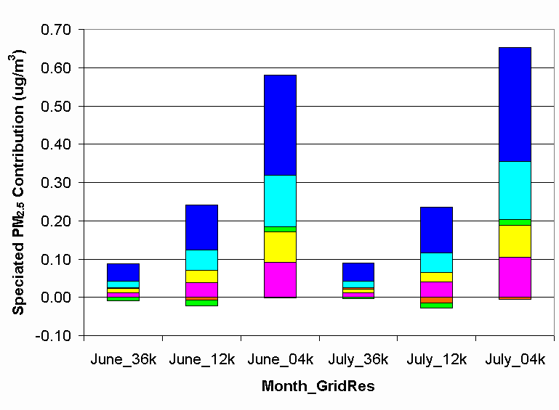
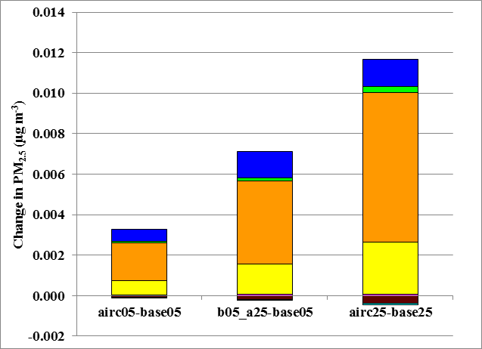
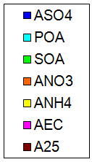
Local and U.S.-Wide PM_{2.5} Contributions from Aircraft
Atlanta Airport (Monthly Average)
U.S.-Wide (Annual Average)
Arunachalam et al., 2011
Woody et al., 2011
At Atlanta Airport: Aircraft emissions increased monthly average PM_{2.5} concentrations at the grid-cell containing the airport. However, aircraft emissions reduced SOA concentrations at 36k and 12k grid resolutions but increased concentrations at the 4k resolution.
U.S.-Wide: Majority of PM_{2.5} speciated contributions from aircraft emissions were to ammonium (ANH4), nitrate (ANO3), and sulfate (ASO4)

Slide 4
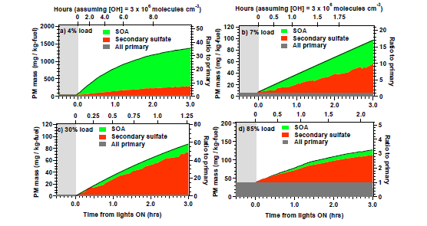
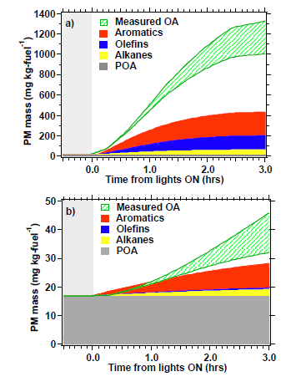
Organics from Aircraft - Measurements
Measurements
Measurements vs. Box Model
4%
85%
Miracolo, 2011
Significant portion of Aircraft PM at low power settings from SOA
Box model with 78 traditional precursors using the volatility basis set unable to accurately capture SOA formation from aircraft (right)
Suggests missing precursors
Green = measured OA (with uncertainty)
Red, blue, yellow = modeled OA
White = gap in modeled vs. measured OA
Notes:
Missing precursors? Measured unresolved hydrocarbons

Slide 5
Aircraft Non-Traditional SOA (NTSOA)
Idle
Takeoff
(Miracolo et al., 2011)
(Jathar et al., 2012)
Jathar et al. (2012) box model results (right) using new aircraft-specific NTSOA parameterization improves upon previous model estimates (left).

Slide 6
Motivation
Organics comprise significant fraction of total PM in atmosphere
Measurements suggest significant SOA formation from aircraft exhaust which models are unable to reproduce
Objective
Update CMAQ and its inputs to use VBS and include missing precursors to close the gap between measured and modeled SOA formed from aircraft emissions

Slide 7
CMAQ with VBS
Research version of CMAQ v4.7 with VBS provided by EPA
Includes VBS treatment for traditional SOA from all sources
VBS yields mapped to SAPRC-99 chemical mechanism (Murphy and Pandis, 2010)
Required coding changes to work, including issues with EBI solver and various other bugs
Updated to include NTSOA precursors and products from aircraft (Jathar et al., 2012)
Separate yields for idle and non-idle NTSOA precursors
Modeling will focus on assessing contributions of organic aerosols from aircraft emissions at the Atlanta airport
SAPRC-99 chemical mechanism
January and July, 2002 at 12-km grid resolution
For base case configuration see Hutzell et al. (2012)

Slide 8
CMAQ with VBS – Aircraft Emissions
Full Flight 2006 global aircraft emission database (Wilkerson et al., 2010)
High resolution flight specific information
Includes engine type, detailed spatial location, and emission estimates for all airports
Generated using FAA Aviation Environmental Design Tool (AEDT)
FAA recommended model to provide aircraft emission estimates
Uses First Order Approximation 3 (FOA3) for PM
Extracted LTO emissions at Atlanta airport below 1 km
Allocated using AEDTproc (see BH Baek’s presentation tomorrow)
NTSOA emissions
Estimated using load specific emission factors for CFM56-2B engine (Jathar et al.) scaled to other engines using International Civil Aviation Organization (ICAO) engine databank
CFM56 engine family account for ~12% of engines in use at ATL
Notes:
Note: Approach can be used to generate emission inventory (which includes NTSOA precursors) for any airport globally or cruise emissions

Slide 9
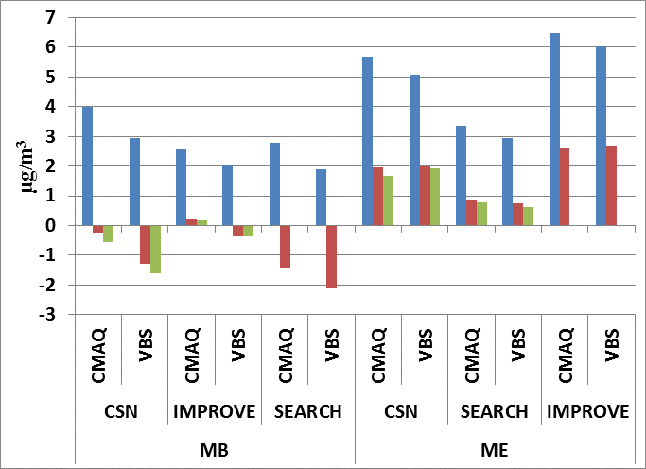
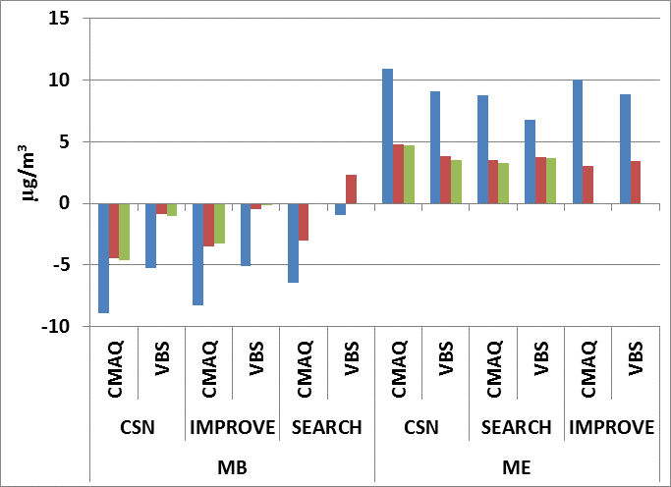
Model Evaluation
Jul
Jan
CMAQ_VBS (VBS) improves PM_{2.5} performance but for the right reasons?
CMAQ_VBS OC/TC performance not a clear improvement

Slide 10
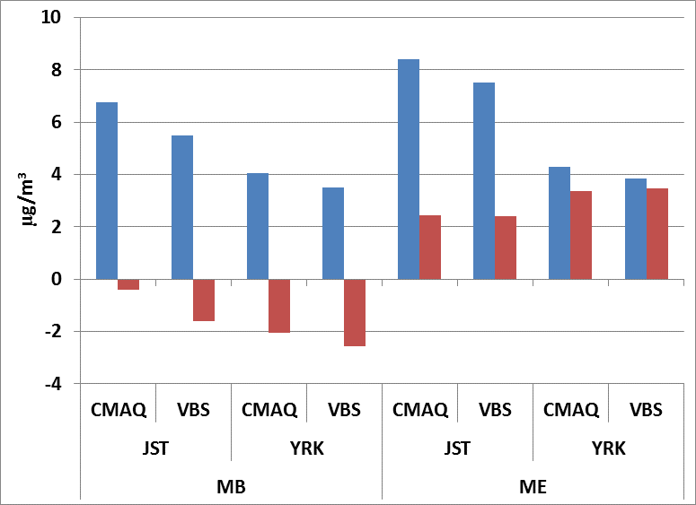
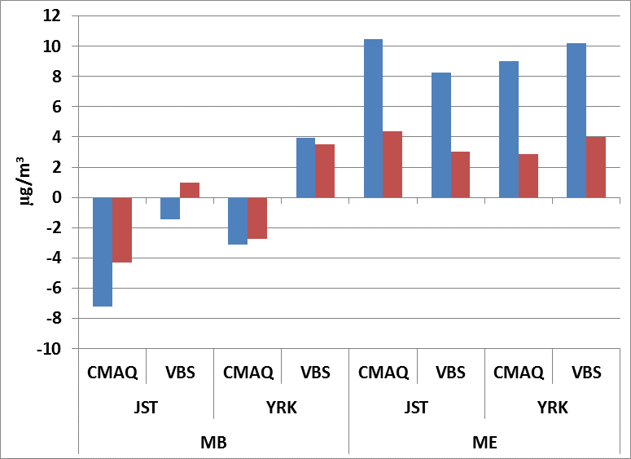
Model Performance – JST and YRK
Jan
CMAQ_VBS generally improves performance of PM_{2.5} in both Jan and Jul at JST and in Jan at YRK
Jul

Slide 11
Aircraft Contributions to PM_{2.5}: CMAQ vs. CMAQ_VBS
CMAQ
CMAQ_VBS
Jan
Jul
Higher impacts predicted by CMAQ_VBS, particularly during Jul.

Slide 12
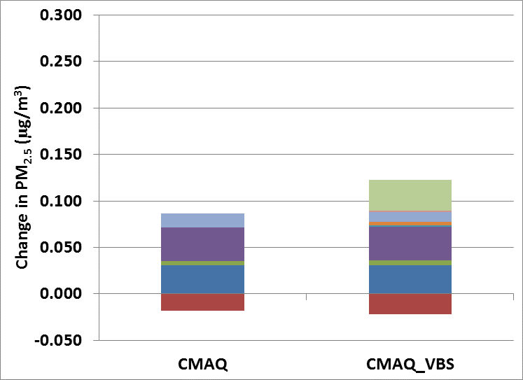
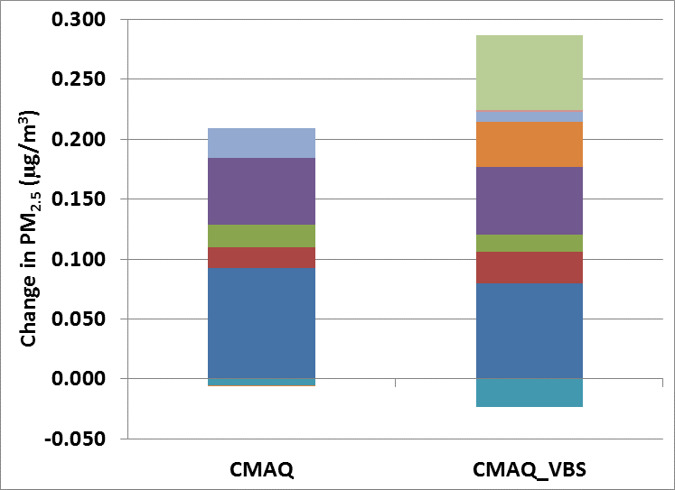
Average Hourly Contributions to PM_{2.5} from Aircraft Emissions at ATL
Jan
Jul
CMAQ_VBS predicts higher contributions from aircraft in both Jan (0.101 vs. 0.068 µg/m³) and Jul (0.263 vs. 0.204 µg/m³)
Non-typical SOA (NTSOA) contributes 0.033 µg/m³ in Jan (33% of PM_{2.5} contributions from aircraft) and 0.062 µg/m³ in Jul (24% of total PM_{2.5} contributions)

Slide 13
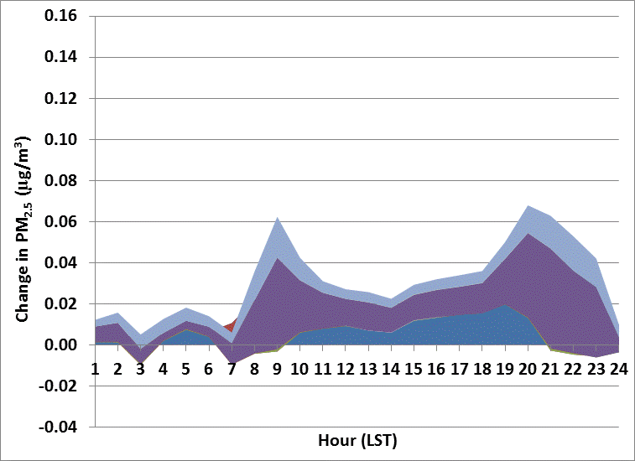
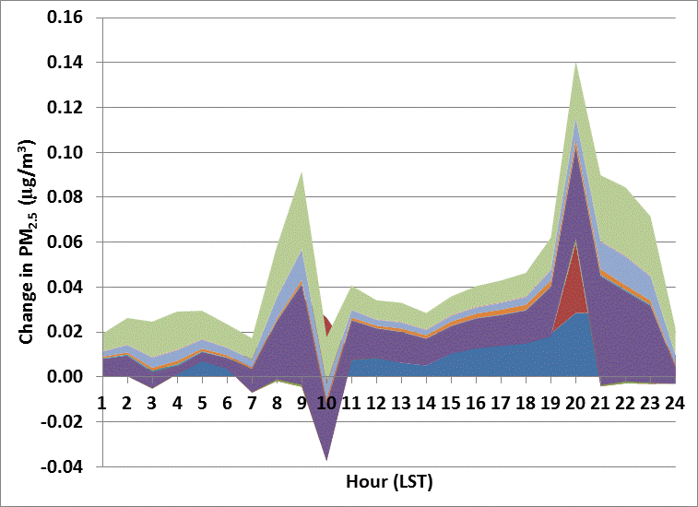
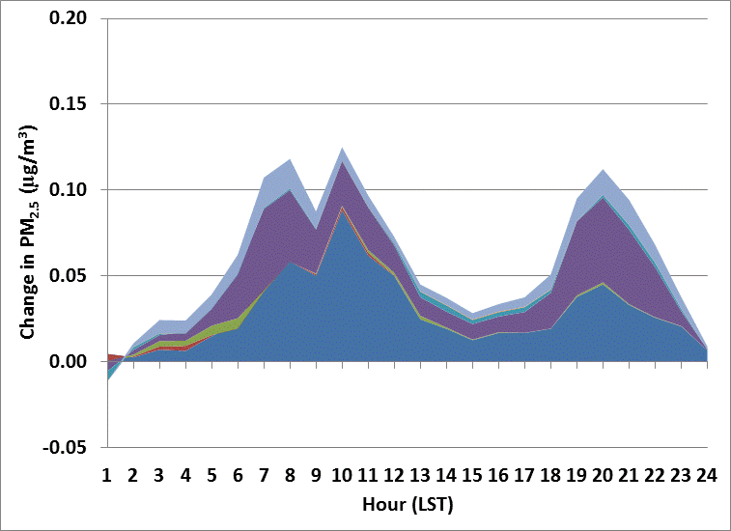
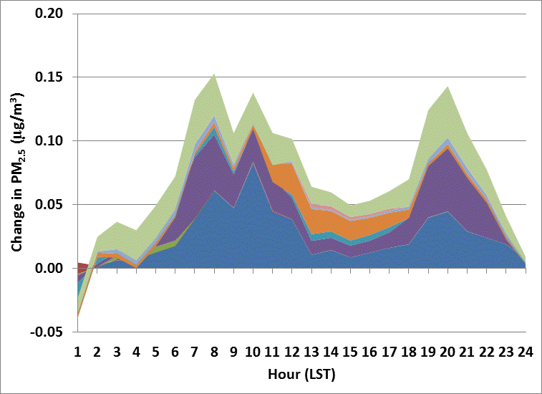
Hourly Contributions to PM_{2.5} from Aircraft Emissions at ATL
CMAQ
CMAQ_VBS
Jan 7
Jul 7
NTSOA contributions persist throughout the day in Jan and Jul
CMAQ_VBS predicts higher contributions from SOA during daytime hours on Jul 7 compared to CMAQ

Slide 14
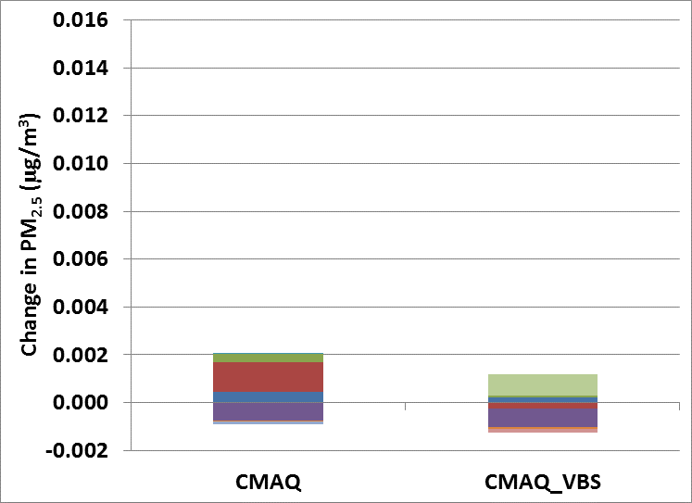
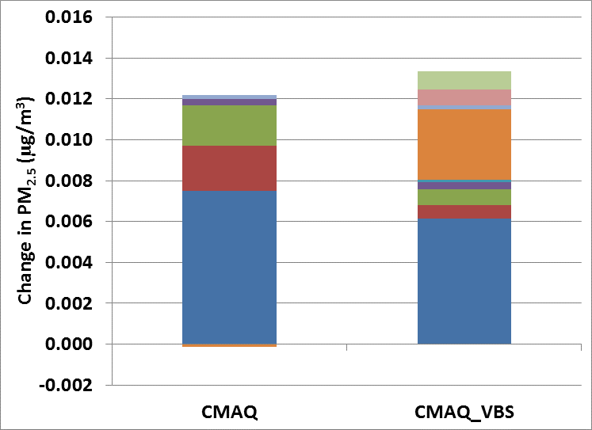
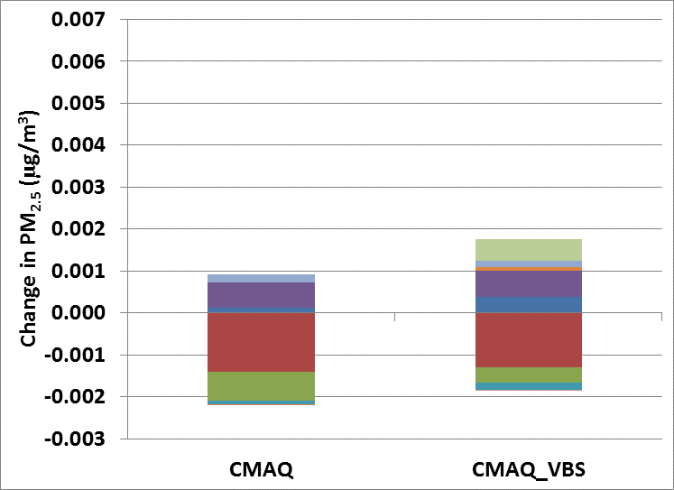
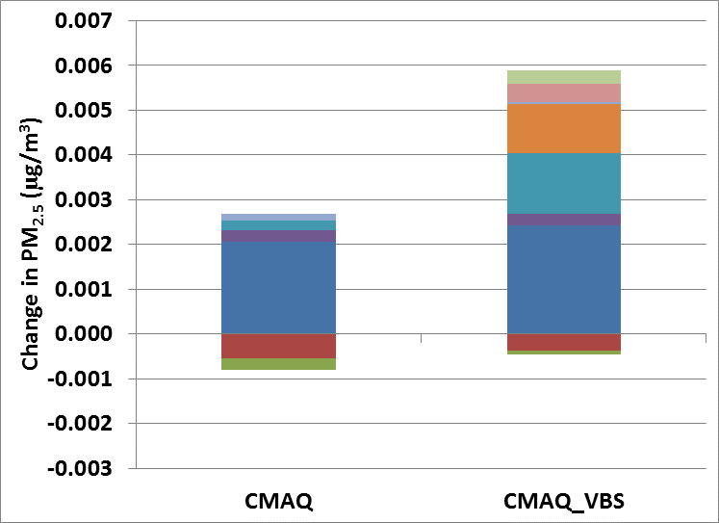
Average Hourly Contributions to PM_{2.5} from Aircraft Emissions at JST and YRK
Jan
Jul
JST
YRK
CMAQ_VBS predicts higher contributions of AORGA near the airport (JST) and downwind of it (YRK) in Jul and leads to higher overall contributions at YRK

Slide 15
Select PM Measurements from Aircraft
Study | PM Measurements | Aircraft Engines Measured | Measurement Distance from Aircraft | PM Emission Index (g PM per kg fuel burn)
Lobo et al. (2012) | Primary/Secondary | Takeoff and landings at Oakland Airport | 100-300 m | 0.1-0.7
Kinsey et al. (2010) | Volatile/Nonvolatile PM | 5 engines | 15-43 m | 0.010- 0.550
Herndon et al. (2008) | Total Particle Number and BC | Takeoff and landings at Atlanta Airport | 500 m
Agrawal et al. (2008) | Total PM, Organic Carbon, Elemental Carbon | 4 engines (stationary) | 1 m | 0.011-0.205
Mazaheri et al. (2008) | Total PM | Takeoff and landings at Brisbane Airport (Australia) | 80 m | 0.03−0.72
Herndon et al. (2005) | Total Particle Number | 100 aircraft plumes (various airports) | 200 m
Limited measurements of aircraft PM available for evaluation purposes. Currently no measurement standards in place and values typically reported as emission indices.
Notes:
Lack of measurement standard, values reported as emission factors (g of PM per kg fuel burn)

Slide 16
Conclusions
CMAQ_VBS base case (somewhat) improves PM_{2.5} performance
Framework developed to predict NTSOA from aircraft in CMAQ using VBS
CMAQ_VBS increases total aircraft contributions to PM_{2.5} primarily due to contributions from NTSOA
33% increase in PM_{2.5} in Jan (0.032 µg/m³)
NTSOA contribution = 0.033 µg/m³
23% increase in PM_{2.5} in Jul (0.060 µg/m³)
NTSOA contribution = 0.062 µg/m³
Enhance aircraft PM and NTSOA precursor emission estimates using Aerosol Dynamics Simulation Code (ADSC)
Use PinG to model aircraft plumes at sub-grid scales
Next Steps

Slide 17
Acknowledgements
Hsi-Wu Wong, Aerodyne Research
Sergey Napelenok, EPA
William Hutzell, EPA
The emissions inventories used for this work were provided by US DOT Volpe Center and are based on data provided by the US Federal Aviation Administration and EUROCONTROL in support of the objectives of the International Civil Aviation Organization Committee on Aviation Environmental Projection CO2 Task Group. Any opinions, finding, and conclusions or recommendations expressed in this material are those of the author(s) and do not necessarily reflect the views of the US DOT, Volpe Center, the US FAA, EUROCONTROL or ICAO.
The Partnership for Air Transportation Noise and Emissions Reduction is an FAA/NASA/Transport Canada/US DOD/EPA-sponsored Center of Excellence.
This work was funded by FAA and Transport Canada under 07-C-NE-UNC Amendment Nos. 001 to 004, and 09-CE-NE-UNC Amendment Nos. 001-004.
The Investigation of Aviation Emissions Air Quality Impacts project is managed by Christopher Sequeira.
Opinions, findings, conclusions and recommendations expressed in this material are those of the author(s), and do not necessarily reflect the views of PARTNER sponsor organizations.

