Slide 1
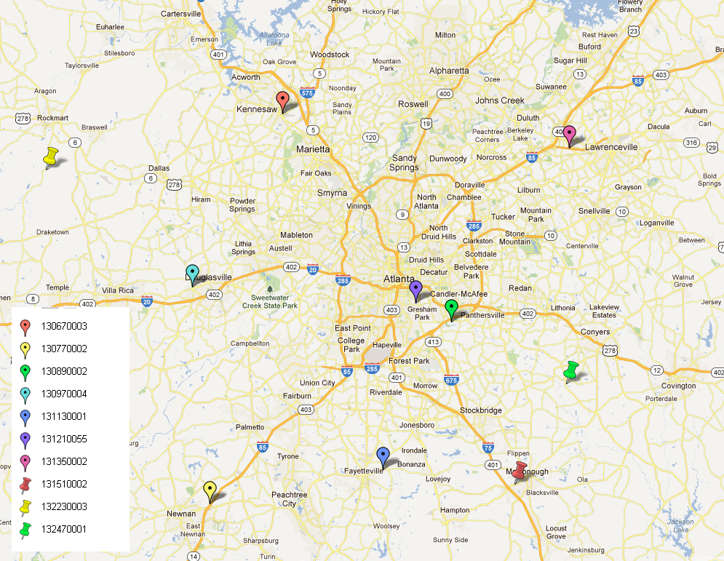
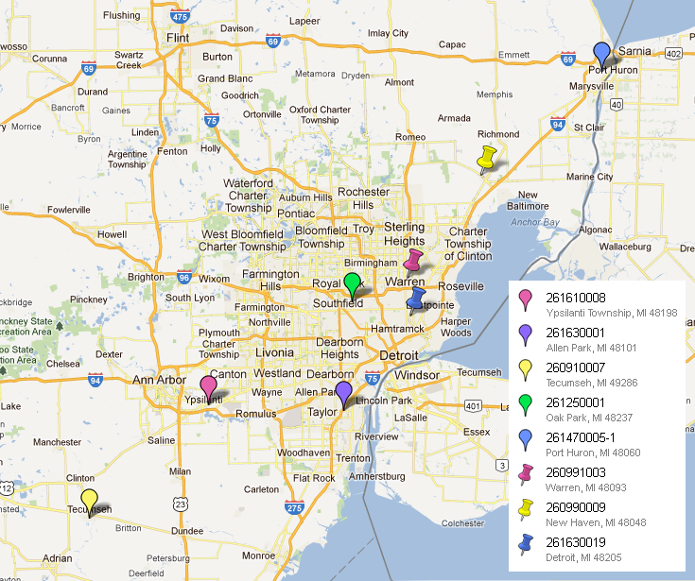
Application of DDM for Predicting Ozone Responses within Two Urban Areas
Heather Simon, Kirk Baker, Norm Possiel, Farhan Akhtar, Sergey Napelenok, Brian Timin, Benjamin Wells
Atlanta
Detroit

Slide 2
Ozone Risk and Exposure Assessment
Part of the NAAQS review process
“develop[s] quantitative characterizations of exposures and associated risks to human health or the environment associated with recent air quality conditions and with air quality estimated to just meet the current or alternative standard(s) under consideration”
Exposure assessment:
Based on controlled human exposure studies
Performed for past observed ozone levels and levels representing just meeting the current and alternate proposed standards
Will be performed for 16 cities in the current O₃ NAAQS review
Risk assessment
Based on epidemiology health impact functions:
Performed for past observed ozone levels, levels representing just meeting the current and alternate proposed standards
Will be performed for 12 cities in the current O₃ NAAQS review
∆ Y = Y_{o} (1-e ^{-ß∆ O3}) * Pop

Slide 3
City-Specific Analyses Quantify Exposure and Risk at Current and Alternate Levels of the Standard
The ozone NAAQS standard is based on the design value (DV): the 3-year average of the fourth highest 8-hr daily maximum ozone concentration
Epidemiological relationships are based on a variety of metrics/averaging periods
1-hr daily maximum ozone
24-hr daily average concentration
8-hr daily maximum
8-hr average (10am-6pm)
5-hr daily average concentrations
Clinical exposure analysis requires hourly ozone concentration inputs
In order to analyze the risk at various levels of the standard, the design value must be translated into these various metrics
How would meeting the standard affect ozone concentrations on low ozone days or during non-peak hours?
How would meeting the standard affect ozone concentrations throughout an urban area?
We present a modeling methodology using CMAQ/HDDM to address these questions

Slide 4
Higher Order Decoupled Direct Method (HDDM)
Provides gridded hourly sensitivities of ozone concentrations to VOC or NOX emissions
“Ozone sensitivity”: response in ozone concentrations to changes in emissions levels
First and second order sensitivities capture nonlinear response of ozone to emissions changes
HDDM allows modelers to estimate ozone at multiple emissions levels without rerunning the model simulation
Higher order DDM currently implemented for ozone in a recent version of CMAQ (CMAQv4.7.1).
We apply HDDM to estimate how ozone will change in response to emissions perturbations using average “sensitivities” based on monitor location, hour of day, and ozone concentration range.
Notes:
Consider cutting for time (with slide 7)

Slide 5
Test Case: Applying HDDM to Estimate Ozone Distributions Consistent with Meeting the NAAQS in an Urban Area
Ambient data
Modeled episode
Atlanta: 2006-2008
2 downtown sites
8 suburban/rural sites
Detroit: 2006-2008
3-4 urban sites
4-5 suburban/rural sites
July-August 2005
Eastern US
12km resolution
CMAQv4.7.1 using HDDM
Tracked first and second order sensitivities to:
US anthropogenic NOx emissions
US anthropogenic VOC emissions
Cannot directly apply modeled sensitivities on a location and day-specific basis
No overlap between modeled episode and ambient data range
DVs depend on 3 years of data
Not practical to model 3 years (constraints on available emissions inputs and computing resources)
Model doesn’t always capture exact timing of ozone episodes but does a reasonable job of capturing typical behavior on high and low days

Slide 6
Model-based Ozone Adjustment Approach
Step 1: Run CMAQ simulation with HDDM to determine hourly ozone sensitivities to NO_{x} emissions and VOC emissions for the grid cells containing monitoring sites in an urban area.
Inputs: emissions and meteorology data
Outputs: ozone concentrations and sensitivities at locations of monitoring sites for each hour in July/Aug 2005
Step 2: For each monitoring site, group days by predicted daily 8-hr max ozone and nighttime ozone conc. Calculate average (median) diurnal profiles for sensitivities in each group.
Inputs: step 1 outputs
Outputs: average sensitivities based on monitor location, ozone concentration range, and hour of day

Slide 7
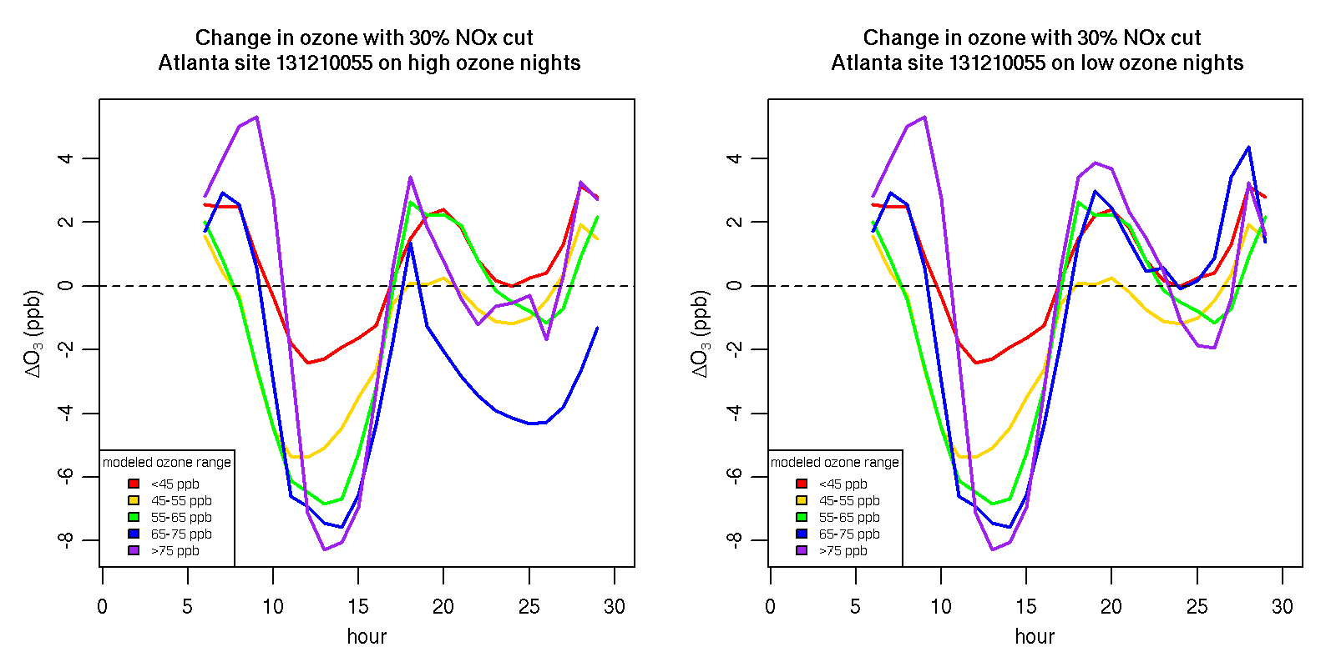
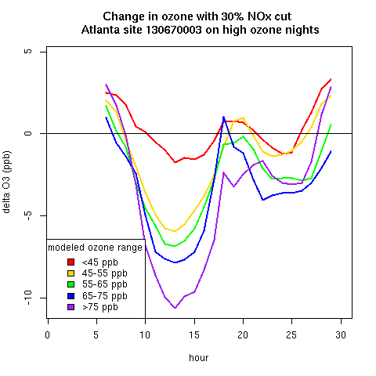
NOx Sensitivity Profiles for Two Atlanta Sites
Downtown Site
Rural Site

Slide 8
Model-based Ozone Adjustment Approach
Step 3: For each monitoring site, assign one of the diurnal sensitivity profiles calculated in Step 2 to each day in the period 2006 through 2008 based on measured 8-hr max ozone and measured nighttime ozone.
Inputs: hourly ozone monitor data for 2006-2008 and step 2 outputs
Outputs: hourly ozone observations paired with average modeled sensitivities for 2006-2008 at all monitor locations
Step 4: Adjust measured hourly ozone concentrations for incrementally increasing levels of emissions reductions using assigned sensitivities and then recalculate design values until all monitors in an urban area are in attainment of current and proposed alternative levels of the standard.
Inputs: step 3 outputs
Outputs: adjusted hourly ozone values for 2006-2008 at monitor locations to show attainment

Slide 9
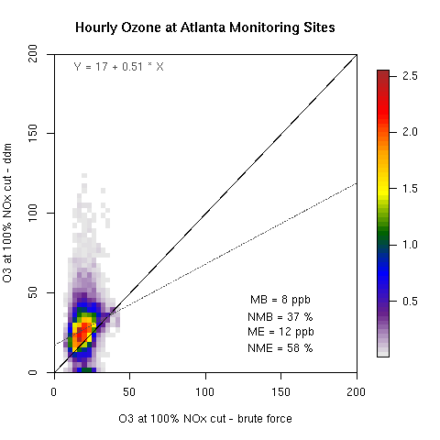
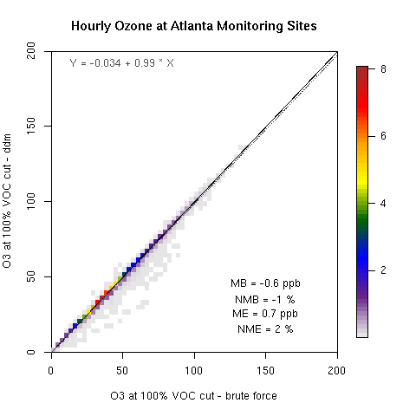
Over What Range of Emissions Perturbations can HDDM Accurately Replicate Brute Force Estimates?
we get poor replication of brute force runs for the most extreme case of 100% NOx cut scenario (VOC results look good)
Notes:
Consider cutting slides 11-15 for time

Slide 10
3 step HDDM Adjustment Methodology
50% NOx cut sensitivity
75% NOx cut sensitivity
Base sensitivity
0%
40%
75%
100%
Percent reduction in baseline NOx emissions
Perform DDM simulations at 3 NOx levels (base case, 50% NOx cut, 75% NOx cut)
Use base NOx sensitivity for the first 40% of NOx emissions reductions
Use 50% NOx cut sensitivity for next 35% of NOx emissions reductions
Use 75% NOx cut sensitivity for final 25% of NOx emissions reduction
Notes:
Consider cutting slides 11-15 for time

Slide 11
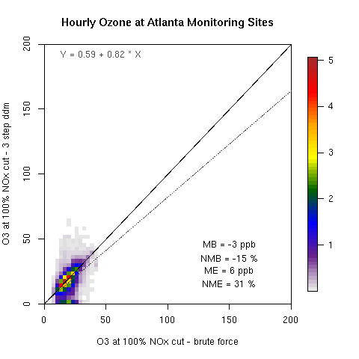
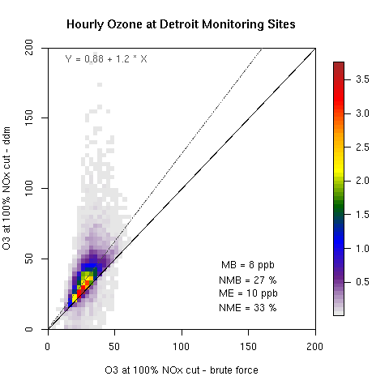
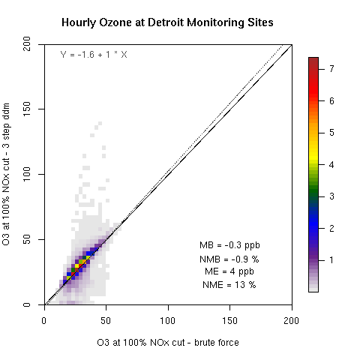
Comparison of 1 step and 3 step DDM versus BF performance: 100% NOx cut
Notes:
Consider cutting slides 11-15 for time

Slide 12
DDM Adjustment results for Atlanta to Reach the 75 ppb Standard: NOx Reductions Only
monitor | Measured 2006-2008 DV | HDDM Adjustment DV
130670003 | 85 | 65
130770002 | 84 | 63
130890002 | 93 | 75
130970004 | 87 | 66
131130001 | 86 | 65
131210055 | 91 | 73
131350002 | 88 | 65
131510002 | 94 | 73
132230003 | 80 | 59
132470001 | 95 | 71
The DDM-based adjustment predicts ozone at downtown sites to be less responsive to NOx emissions reductions than ozone at other sites in Atlanta
Urban sites
Downwind sites

Slide 13
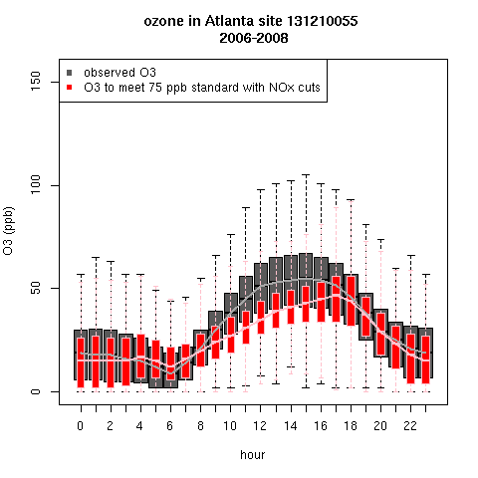
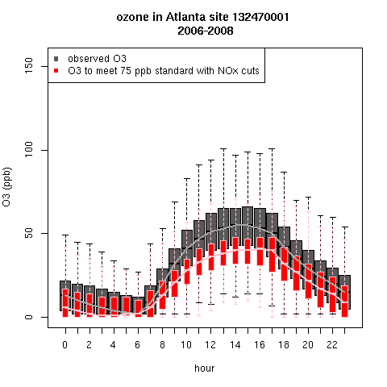
Change in Ozone Distribution with DDM Adjustment Approach at an Urban and a Downwind Atlanta Area Site
Urban Site
Downwind Site

Slide 14
DDM Adjustment Results for Detroit to Reach the 75 ppb standard: NOx and VOC Reductions
monitor | Measured 2006-2008 DV | HDDM adjustment DV (VOC reductions) | HDDM adjustment DV (NOx reductions)
261630001 | 71 | 65 | 65
261610008 | 74 | 68 | 65
260910007 | 75 | 71 | 63
261250001 | 77 | 72 | 70
261470005 | 78 | 74 | 67
260991003 | 80 | 73 | 75
260990009 | 81 | 75 | 72
261630019 | 82 | 74 | 71
Urban sites
Downwind sites
DVs at most sites are more responsive to NOx reductions, but DV at one site is more responsive to VOC reductions
Upwind sites

Slide 15
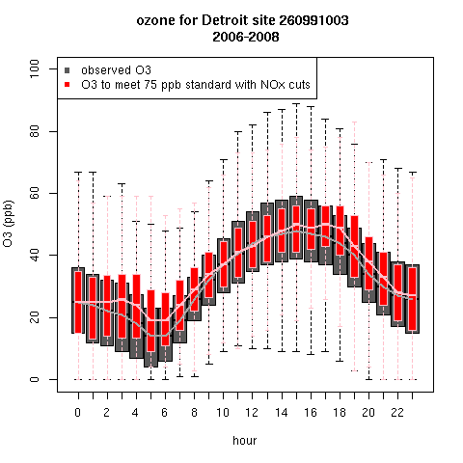
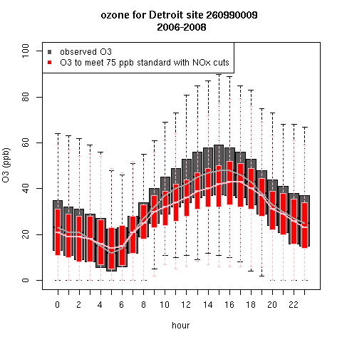
Change in Ozone Distribution with DDM Adjustment (NOx) at an Urban and a Downwind Detroit Site
Urban Site
Downwind Site
NOx reductions lead to ozone increases at all hours for midrange ozone, but substantial decreases for highest daytime values
Ozone decreases throughout the day with small disbenefits during morning rush hour

Slide 16
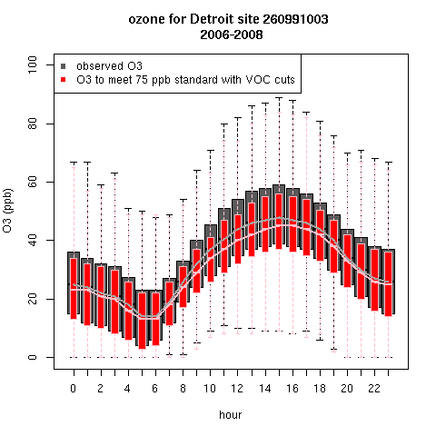
Change in Ozone Distribution with DDM Adjustment (VOC) at an Urban and a Downwind Detroit Site
Urban Site
Downwind Site
Ozone response is moderate, but ozone decreases at all times of day over the entire range of ozone. Ozone at downwind site does not decrease as much as in NOx control scenario

Slide 17
Conclusions
HDDM adjustment methodology provides a new approach for estimating the distribution of ozone concentrations in an urban area for various levels of the NAAQS
Captures differences in ozone response at urban versus non-urban sites
Captures differences in ozone response on high versus low ozone days
Captures ozone disbenefits under NOx-saturated conditions
Allows evaluation of NOx versus VOC control implications
Next steps:
Address comments from the Clean Air Science Advisory Committee and the public
Update to 2007 platform
Explore different binning techniques
Expand to 16 cities and 2008-2010 DV period
Feed results into exposure and risk calculations
Second draft analysis will be published and reviewed in the spring
More information available online: http://www.epa.gov/ttn/naaqs/standards/ozone/s_o3_2008_td.html

Slide 18
Questions?

Slide 19
Appendix

Slide 20
Previous Reviews Have Used Various “Rollback” Techniques
Techniques attempt to characterized distribution of ozone concentrations under a theoretical emissions control scenario that results in meeting the standard
Peak Shaving
Proportional Rollback: all hourly concentrations are adjusted by the same percentage
Quadratic Rollback: quadratic parameters are fit to data from the highest violating monitor. This method reduces higher concentrations at a greater rate than lower concentrations.
All are based solely on monitor data
Notes:
Consider cutting for time (with slide 5)

Slide 21
Weaknesses of Statistical Rollback Techniques
Reductions at all monitors in the area are determined based on ozone at the controlling monitor
No spatial variability in ozone response
Reductions at all hours are treated the same
No diurnal variability in ozone response
Rollback does not allow for ozone increases as a result of emissions reductions
Requires a “floor” or backstop value so that ozone is not reduced below “background”
Background is characterized on a monthly average for each city based on zero-out global modeling runs
Photochemical modeling can explicitly deal with each of these weaknesses
Notes:
Consider cutting for time (with slide 4)

Slide 22
Decoupled Direct Method (DDM)
DDM compared to Brute Force
Atmospheric diffusion equation
C_{A}
Sensitivity calculation
C_{B}
O₃
E_{B}
E_{A}
Emissions of NO_{x}
Taylor series expansion
Figure courtesy of: Sergey Napelenok
Notes:
Consider cutting for time (with slide 6)

Slide 23
Components of 2005 Modeling Platform
2005 National Emissions Inventory (NEI) v4
Criteria pollutants (CAPs)
2005 Meteorological Data
MM-5 v3.7.4 and MCIP v3.4
36km US, 12 km EUS, 12km WUS
Emissions Models, Tools and Ancillary Data
Emissions Modeling Framework (EMF)
Emissions processing: SMOKE version 2.3.2
Biogenics: BEIS 3.14
Onroad/nonroad emissions: NMIM (w/ draft MOVES & NONROAD2005)
EGU projections: IPM 3.0
Ancillary data: speciation, temporal, spatial allocation
Boundary Condition Concentrations
2005 simulations of GEOS-Chem: 2° x 2° grids & 30 layers up to stratosphere
Air Quality Model
CMAQ v4.7.1 - (http://www.cmascenter.org)
CB-05 chemical mechanism with mercury and chlorine chemistry

Slide 24
Detroit Monitoring Sites

Slide 25
Atlanta Monitoring Sites

Slide 26
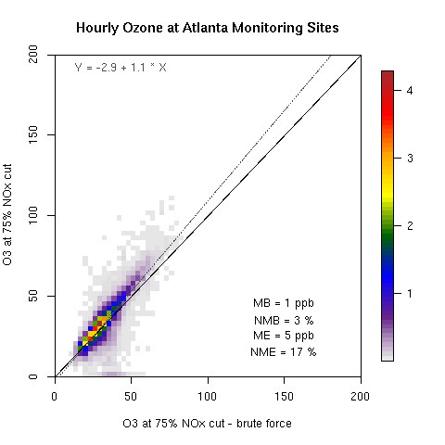
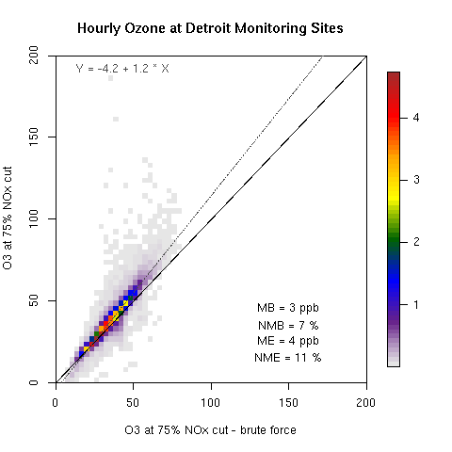
Comparison of 1 step and 3 step DDM versus BF performance: 75% NOx cut
Notes:
Consider cutting slides 11-15 for time

Slide 27
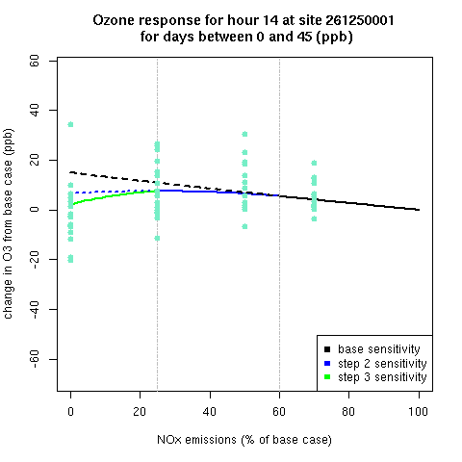
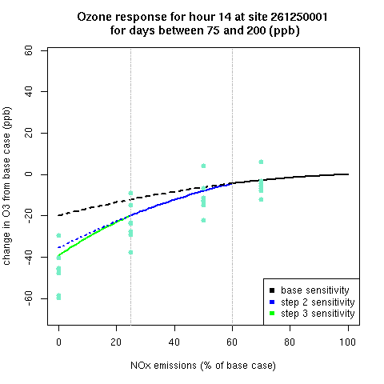
Application of 3-step DDM to Binned Profiles: Daytime Examples
Each plot shows ozone response to NOx cuts for one site, one hour, and one bin
Solid lines show actual profile used
Dotted lines show predicted change in ozone if base/50% NOX sensitivities were used down to 100% NOx cut
Dots show changes in ozone from brute force runs on the days that went into the bin being graphed
Notes:
Consider cutting slides 11-15 for time

Slide 28
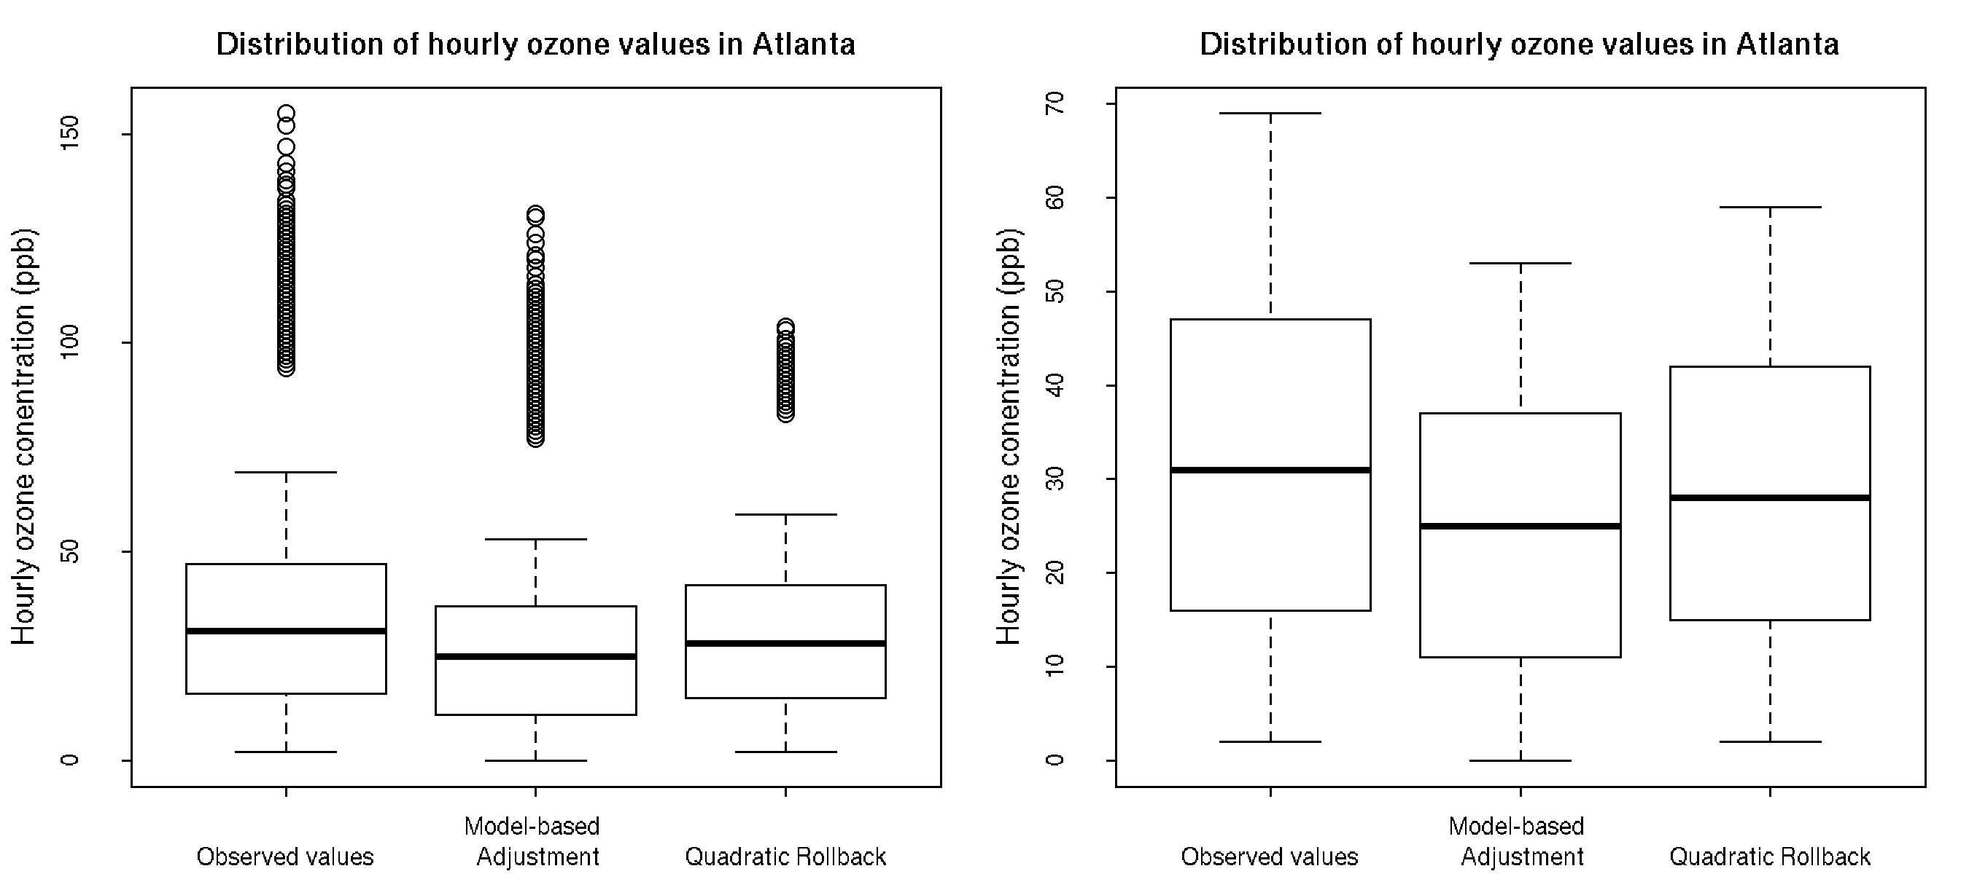
Ozone Distribution with DDM Adjustment versus Quadratic Rollback - Atlanta
DDM adjustment shifts 25th, 50th, 75th, and 95th percentile ozone values lower than quadratic rollback
Quadratic rollback shifts highest outlier values lower than DDM adjustment
Notes:
Consider cutting for time (with slide 22)

Slide 29
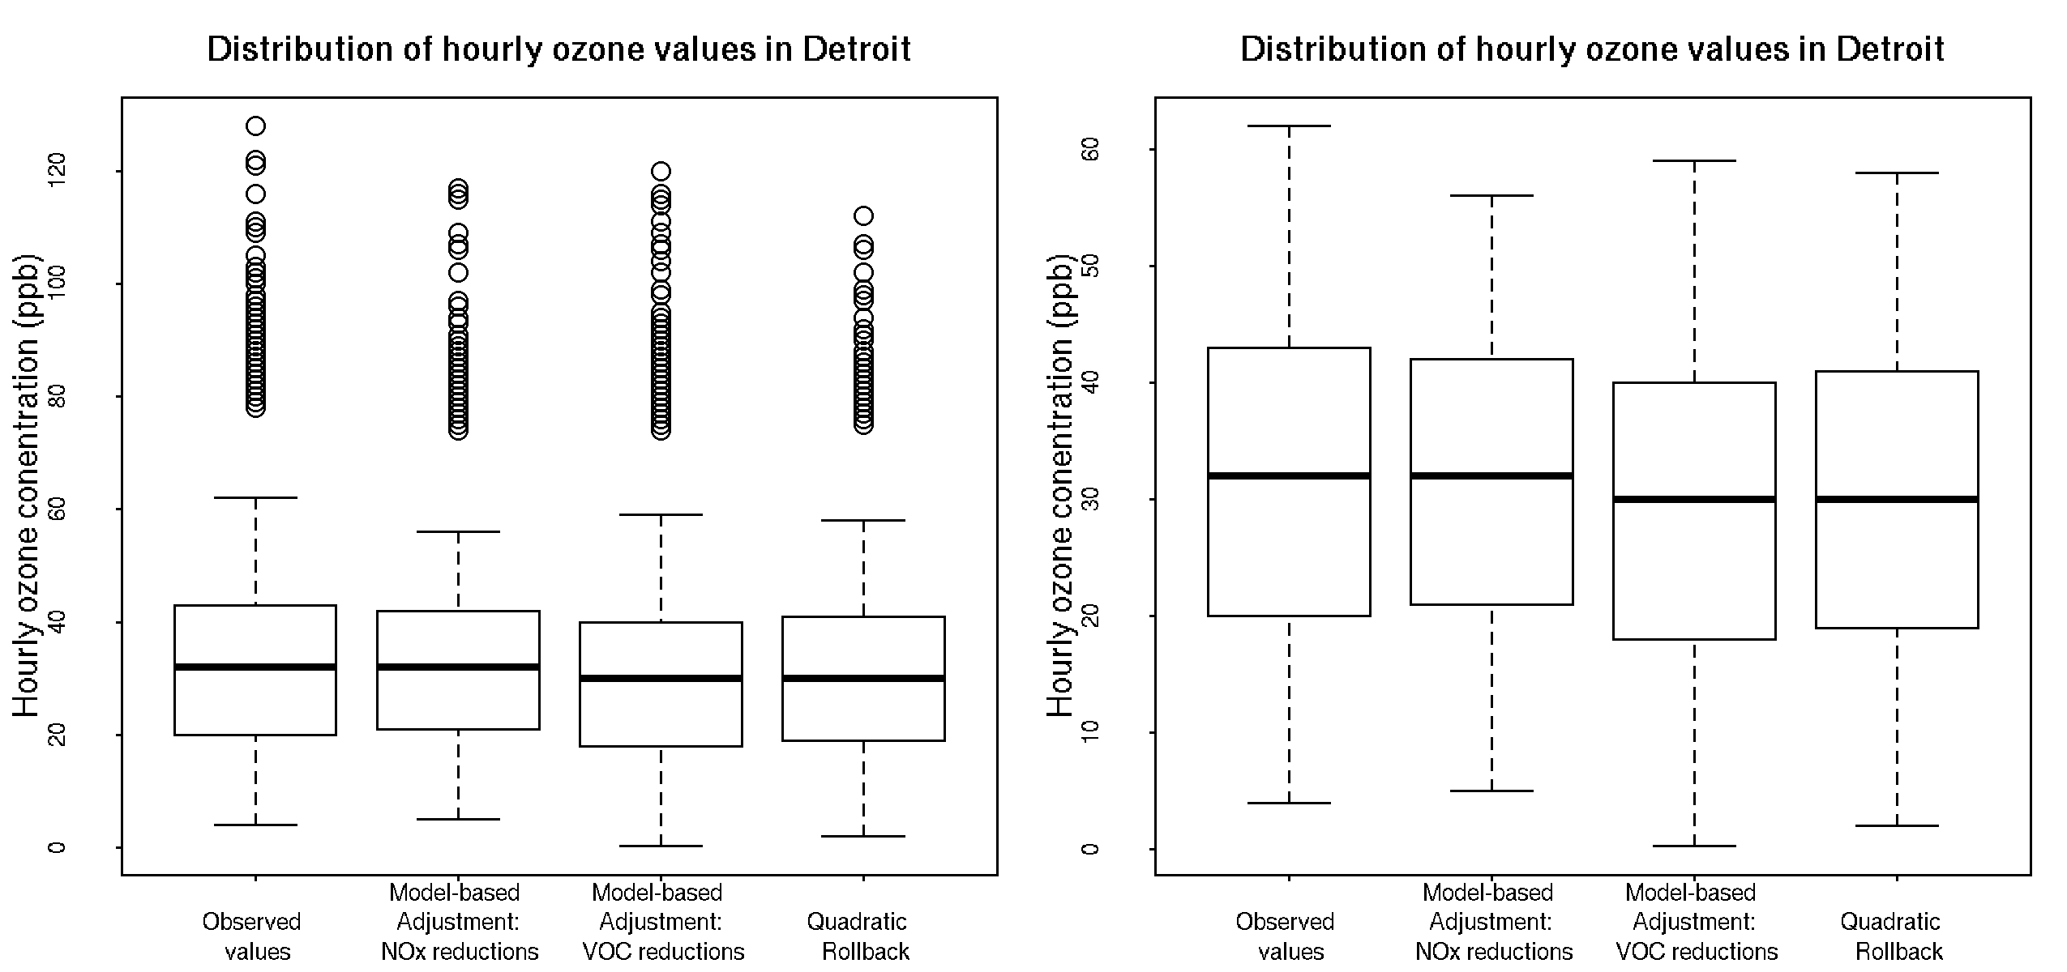
Ozone Distribution with DDM Adjustment versus Quadratic Rollback- Detroit
Ozone distributions for quadratic rollback and DDM adjustment (VOC) control scenario look similar
DDM adjustment NOx control scenario shifts 95th percentile ozone values lower, but 25th and 50th percentile ozone values slightly higher than for the DDM adjustment VOC control scenario
Notes:
Consider cutting for time (with slide 18)

