Slide 1
Estimating Emissions for the 2008 Evans Road Fire in North Carolina
George Pouliot, Ana Rappold, Amber Soja, Wayne Cascio
11th Annual CMAS Conference, Chapel Hill NC
Office of Research and Development
National Exposure Research Laboratory & National Health and Environmental Effects Research Laboratory
October 16, 2012

Slide 2
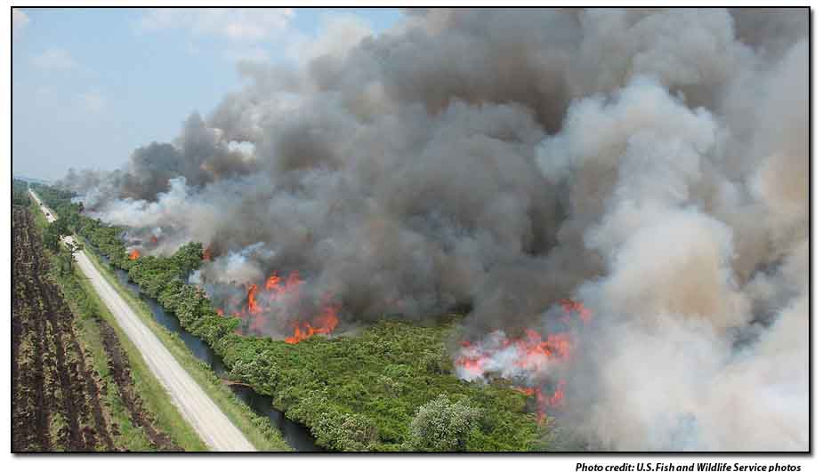
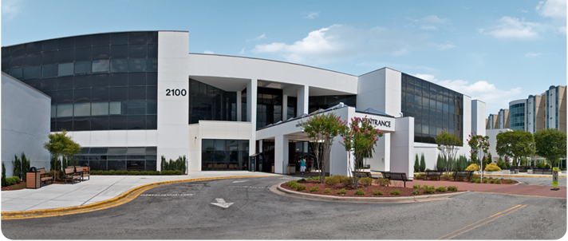
SMOKE produced by Evans Road Fire
Health Impacts

Slide 3
Motivation and Purpose
Evans road fire in North Carolina
Largest fire in NC in 22 years
Rich deposits of peat and poor oxygen produced extremely high levels of PM2.5
Health and wildfire study: characterize the impacts of wildfire on community health and economy
Linking health and economic outcomes with the exposure
Accurate estimates of emissions especially PM2.5, critical for this study as input into the chemical transport model

Slide 4
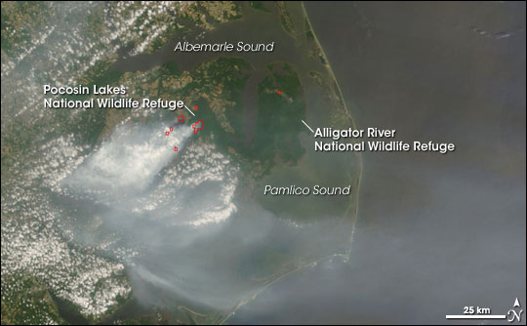
This natural-color image from the Moderate Resolution Imaging Spectroradiometer (MODIS) on NASA’s Terra satellite on June 11, 2008, shows the fire (active locations outlined in red) and smoke over the region. Photo Credit: NASA MODIS Rapid Response Team

Slide 5
Evans Road Fire
Started June 1, 2008 by lightning in eastern NC during a prolonged drought
On June 3rd , the fire broke containment into the Pocosin Lakes National Wildlife Refuge
40,704 acres (165 km²) of Pocosin Fuel in peatlands
Fire contained by August 7, 2008 but continued to smolder until Jan 9, 2009

Slide 6
Peat Depth Map

Slide 7
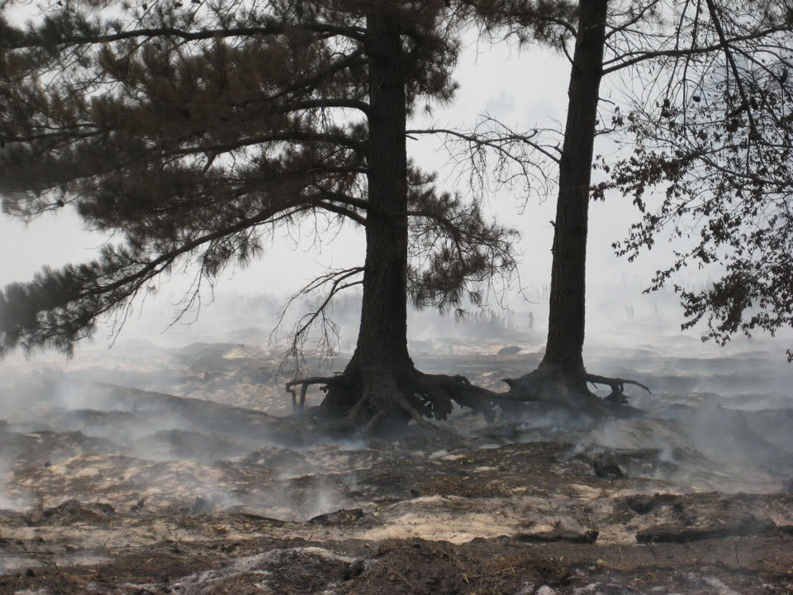
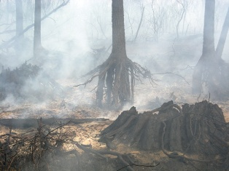
Evans Road Fire
Burned up to depths of 15ft (4.5 m)
Large amounts of Carbon in peat soil
released into atmosphere over several months
Photo Credits: USFWS
Notes:
15ft value came from

Slide 8
PM2.5 Exceedances from Evans Road Fire
Notes:
NCDENR

Slide 9
Goal of this work
Estimate realistic emissions of PM2.5 on an hourly basis for a 12km grid cell for a 3 month simulation of CMAQ
How well does the 2008 NEI capture this fire?

Slide 10
National Emissions Inventory Emission Estimate
Based on Satellite detections from NOAA Hazard Mapping System
Fuel model (FCCS) and Consumption Model (CONSUME)
Total PM2.5 of 26,490 tons

Slide 11
Plan of Modeling Effort
2008 NEI estimates do not characterize the smoldering component of fire very well since the fire burned below ground for most of its duration.
Use additional studies and estimates to determine the temporal, spatial, and chemical characteristics of Evans Road fire and to better characterize the organic portion of carbon emissions from smoldering

Slide 12
Ways to Better Characterize Emissions from Evans Road Fire
Total Carbon Estimate (place an upper limit on emissions)
Emission Factors and Speciation
Temporal Allocation
Spatial Allocation

Slide 13
Total Carbon Estimate: Provides an upper bound on the emissions
Mickler, Robert: Carbon Fluxes and Greenhouse Gas Emissions from Wildland Fires in the 2013 Supplement to the 2006 IPCC Guidelines for National Greenhouse Gas Inventories, 20th International Emission Inventory Conference, August 15, 2012
Using differenced Normalized Burn Ratio (dNBR) data associated with Carbon Consumption measurements in the Fire region, carbon consumption estimates were made for the Evans Road Fire
Estimate of 9.1Tg Carbon below ground and 0.3 Tg C above ground
97% of Carbon Emissions were below ground and 3% were above ground

Slide 14
Emission Factors and Speciation
Akagi, S. K., Yokelson, R. J., Wiedinmyer, C., Alvarado, M. J., Reid, J. S., Karl, T., Crounse, J. D., and Wennberg, P. O.: Emission factors for open and domestic biomass burning for use in atmospheric models, Atmos. Chem. Phys., 11, 4039-4072, doi:10.5194/acp-11-4039-2011, 2011.
Use the Supplemental tables S5 with average Emission Factors for Peat and average Tropical Evergreen Deforestation combined (97% and 3%) to get a custom emission factor for Evans Road Fire
Recommended way to get emission factors for peatland in the footnotes of Table S5 by Akagi

Slide 15
Emission Factors for Evans Road Fire (g/kg)
Carbon Dioxide (CO₂) | 1550.56
Carbon Monoxide (CO) | 206.54
Methane (CH₄) | 13.60
Nitric Oxide (NO) | 0.98
Ethylene (C₂H₄) | 1.95
Acetic Acid (CH₃COOH) | 8.01
Formaldehyde (HCHO) | 1.69
Methanol (CH₃OH) | 6.15
Hydrogen Cyanide (HCN) | 6.42
Ammonia (NH₃) | 13.94
Derived from table S5 in Akagi et. al.

Slide 16
Temporal Allocation for this study
Maintained mass balance of carbon consumption from Mickler and weighted the daily smoldering area burned emissions using ICS209 reports, fire fighter comments, daily GIS data, and changes in area burned
Estimated 140 tons of carbon/ha during early stages of fire: 6/3/08 to 6/10/08 and decreasing to 15-35 tons carbon/ha after 8/1/08

Slide 17
Daily area burned of both flaming and smoldering based on a set of 4 hierarchical rules
1) Daily GIS perimeter maps are used to estimate area burned and if these are not available, then ICS-209 reports are used.
(2) On the 4th day of burning, after area burned had reached >5336 ha (13,180 acres) and ground fires had been reported (“Ground Fire and Smoldering in Deep Organic Soils”) for 3 days, a smoldering area is included of 1215 ha (3000 acres). This number increased in accordance with rule #3 to 2024 ha (5000 acres) and decreased as the fire was controlled and ground reports changed.
(3) MODIS data are used to provide guidance in the minimal activity of the fire. If a day contained greater than 25 fire detections (FD), it is assumed 1417 ha (3500 acres) is the minimal area consumed (by flaming and smoldering areas; if > 50 FD, then 1619 ha (4000 acres) is consumed; if > 100 FD, then 2024 ha (5000 acres) is consumed; and if > 150 FD, then 2429 ha (6000 acres) is consumed.
(4) After June 14th, there is no appreciable burned area reported, however the fire was still substantially active (40% contained June 15th). In June, with only the guidance of the ground-based daily fire reports, between 1417 and 1822 ha (3500–4500 acres) of area is assumed to burn, primarily in smoldering peat. With only the guidance of the ground-based daily fire reports, area burned in early July is assumed to be 1417 ha and deceases to 709 ha (1750 acres); in early August 709 ha is assumed and decreases to 486 ha (1200 acres); and lastly, in early September, 486 ha is assumed burned and decreases to 405 ha (1000 acres) for most of that month

Slide 18
Temporal Allocation

Slide 19
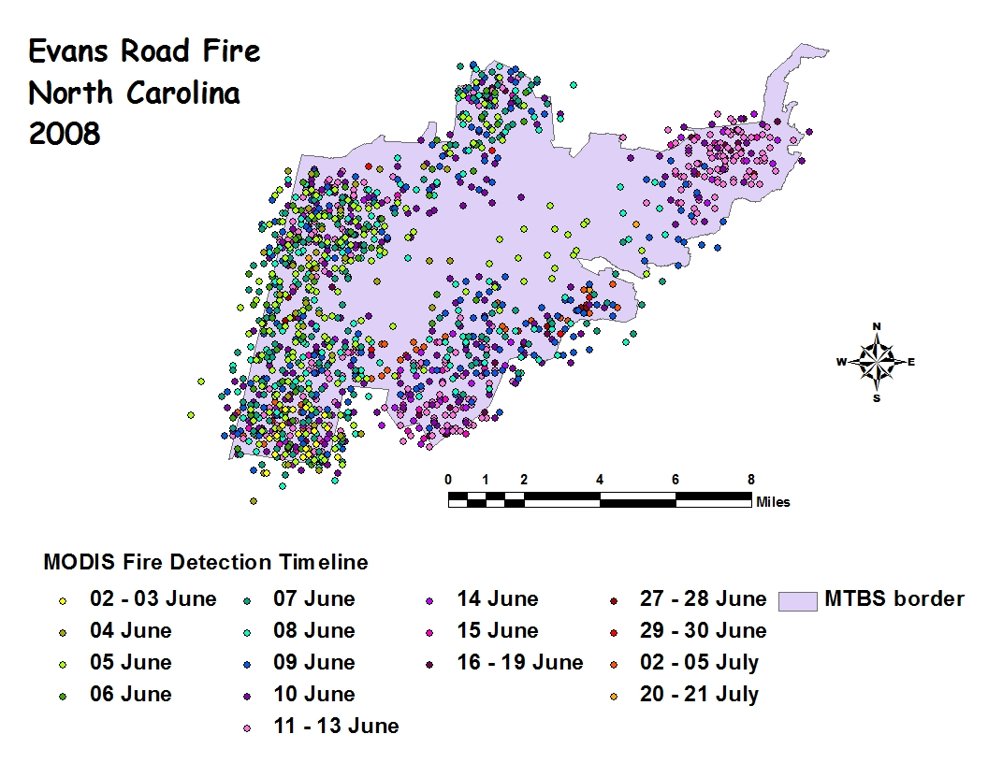
Spatial Allocation

Slide 20
Future Work
Relate carbon consumption estimates to criteria pollutants (e.g. CO emissions from carbon consumption)
Create & process emissions for CMAQ simulation
Run CMAQ for 3 scenarios
(1) Evans fire removed
(2) 2008 NEI emission estimate
(3) Revised estimate based on this work
Evaluate CMAQ model performance for three cases
Use PM2.5 Concentrations Estimates for Health Study

