Slide 1
Development of a 2007-Based Air Quality Modeling Platform
US EPA / Air Quality Modeling Group
Sharon Phillips, Heather Simon, Norm Possiel

Slide 2
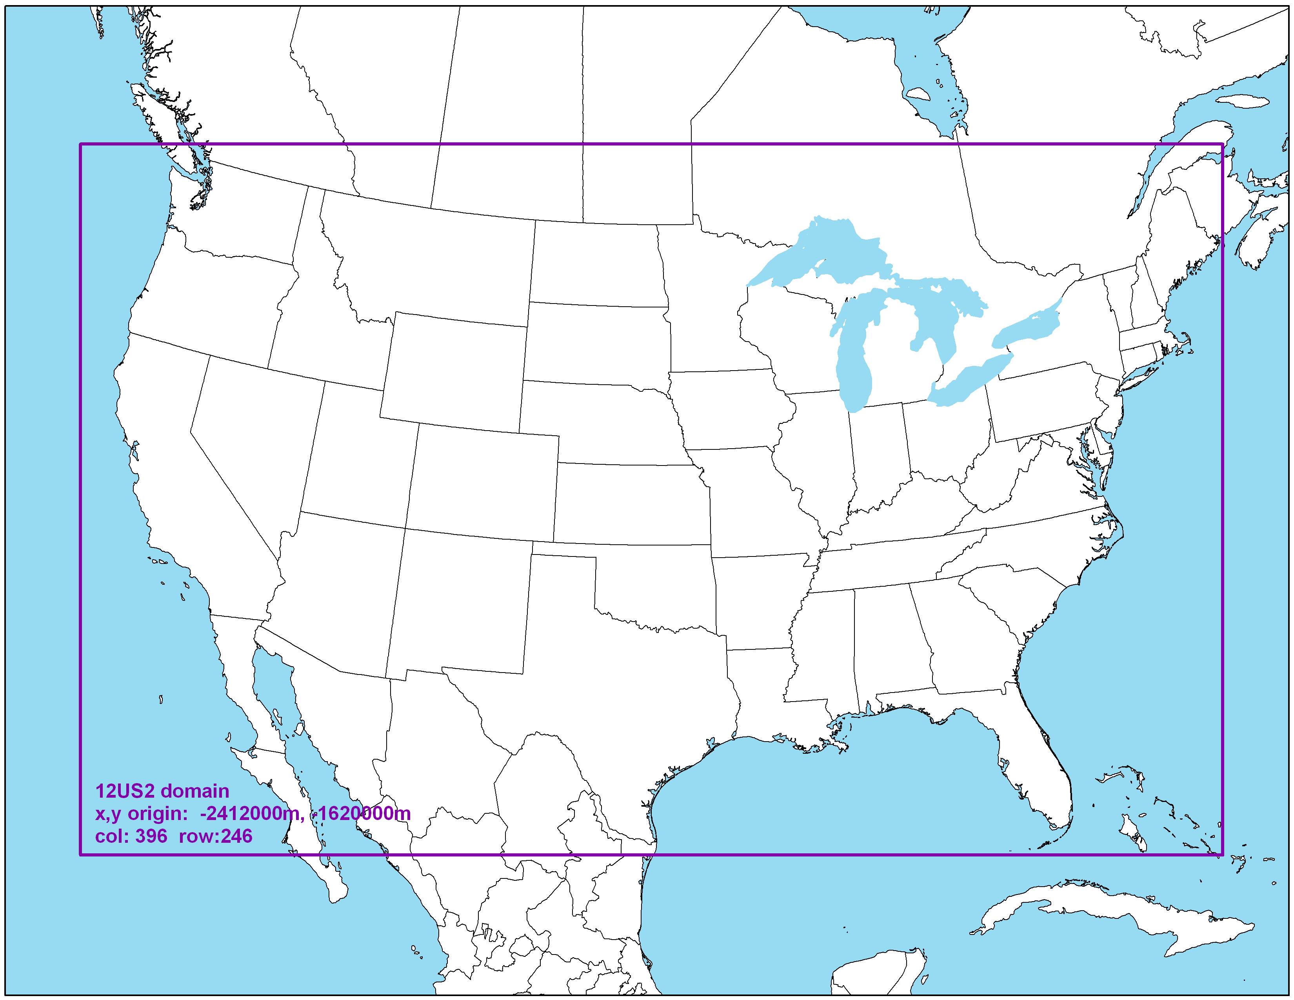
Model Configuration
2007 Emissions built off 2008 NEI v2
Mason et al., 9:30am Dogwood Room
2007 Meteorology WRF v3.1 with MCIP v3.6
Misenis et al, poster
12 km “national” US2 Domain
24 Vertical Layers
January and July monthly runs
10 ramp-up days
Notes:
Common model configuration for all incremental model sensitivities using CMAQ v5.0.1 for the development of the 2007 regulatory platform

Slide 3
Description of Current Model Sensitivities
Incremental simulations
 | Model | Meteorology | Emissions | IC /BC
2007 Benchmark | CMAQ v4.7.1 - CAPs - AERO5 - j-tables | 2007 WRF v3.1 MCIP v3.6 38 meter 1st layer thickness | 2007 Emissions built off 2008 NEI v2 | 2007 24-layer GEOS-Chem v8-02-03 Upper layer O3 adjusted downward based on ozonesonde data
Sensitivity 1 | CMAQ v5.0.1 - CAPs - AERO6 - inline photolysis | Same as above | Same as above | Same as above
Sensitivity 2 | Same as above | Same as above | Same as above | 2007 24-layer GEOS-Chem v8-03-02 using GEOS2CMAQ tool
Sensitivity 3 | Same as above | Same as above | 2007 Emissions built off 2008 NEI v2 Lightning NO emis | Same as above
Notes:
IC/BCs created using v8-03-02 and GEOS2CMAQ tool is equivalent to IC/BCs used by ORD for testing and implementing CMAQ v5.0.1. (Farhan Aktar poster)
Inline emissions calculation informed by lightning detection network data

Slide 4
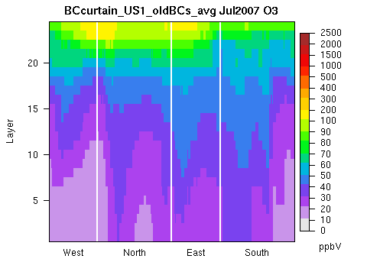
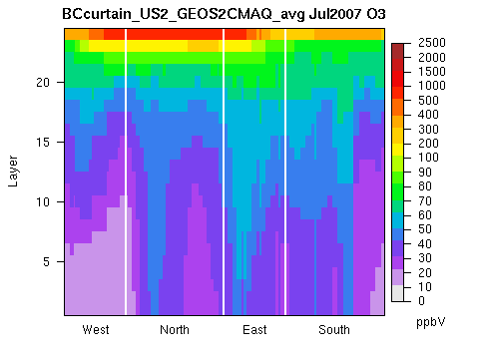
Characterization of new BCs for 2007 platform
Compare old and new 24 layer BCs July Monthly Average
Old BCs
New BCs
** Aktar et al., Poster

Slide 5
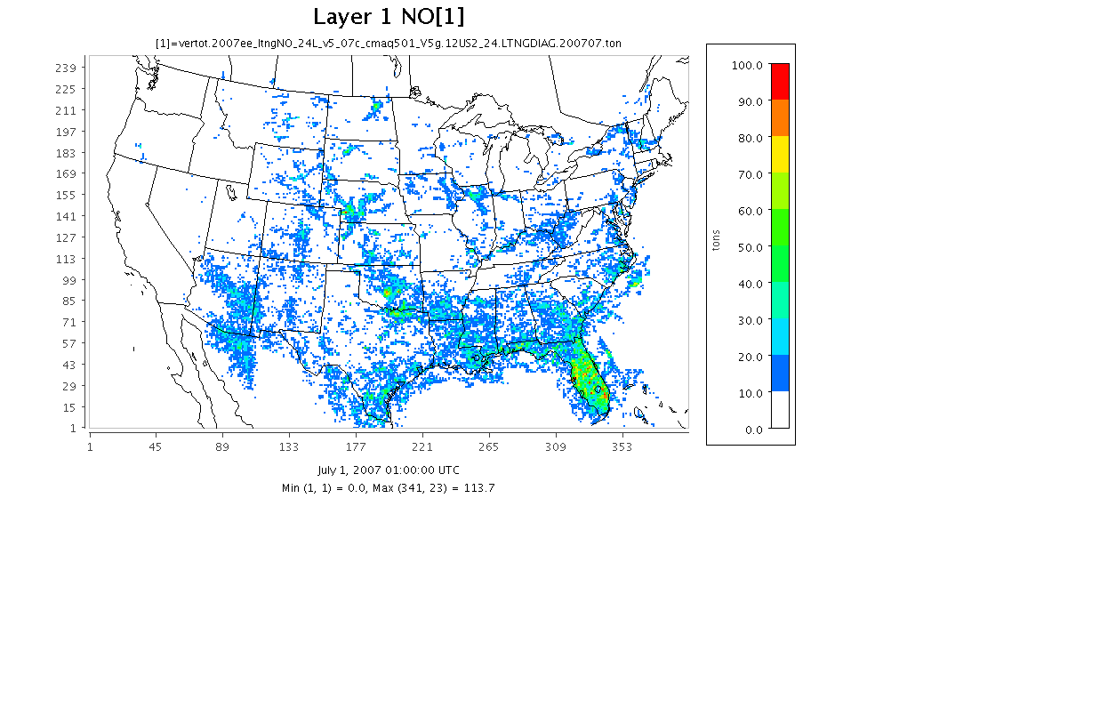
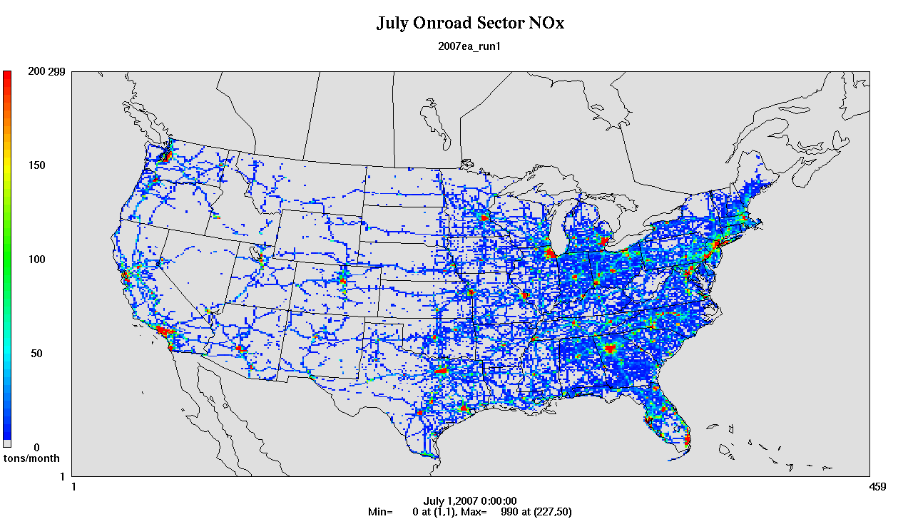
2007 July Total emissions (tons)
Lightning NO
2x larger
Onroad NOx
Note: July total lightning NO emissions domain wide is 471,493 tons
Notes:
Note that this lightning NO is not at ground level

Slide 6
Description of Future Model Sensitivities
Incremental simulations
 | Model | Meteorology | Emissions | IC /BC
Sensitivity 4 | CMAQ v5.0.1 - CAPs - AERO6 - inline photolysis | 2007 WRF v3.3 MCIP v3.6 20 meter 1st layer thickness | 2007 Emissions built off 2008 NEI v2 Lightning NO emis | 2007 24-layer GEOSChem v8-03-02 using GEOS2CMAQ tool
Sensitivity 5 | Same as above | Same as above | 2007 Emissions built off 2008 NEI v2 Lightning NO emis bi-directional flux for fertilizer NH3 emis | Same as above
Sensitivity 6 | Same as above | Same as above | 2007 Emissions built off 2008 NEI v2 Lightning NO emis bi-directional flux for fertilizer NH3 emis wind blown dust | Same as above

Slide 7
Model Performance Metrics Inter-comparison of Sensitivity Runs
Focus on January and July monthly average
Focus on 4 specific model species
Ozone
Elemental Carbon
Sulfate PM
Nitrate PM
Spatial concentration difference plots
Spatial bias plots
Mean Bias
∆ Absolute Bias
Diurnal hourly ozone time-series plots
Mean Bias of binned ozone concentration ranges

Slide 8
ozone

Slide 9
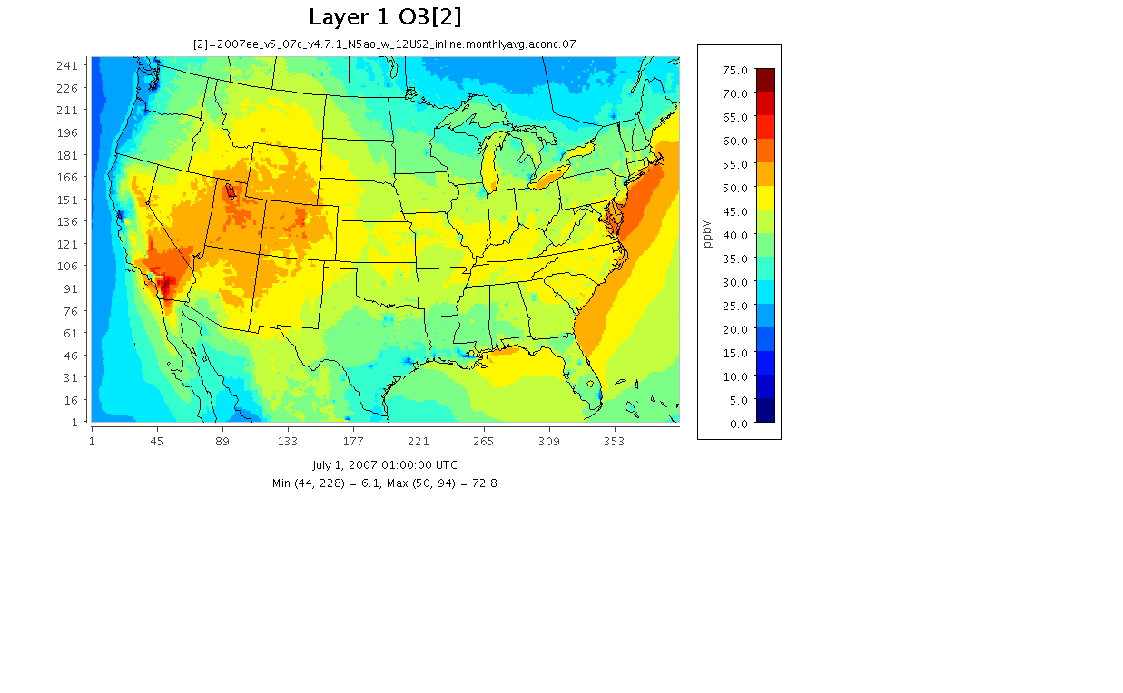
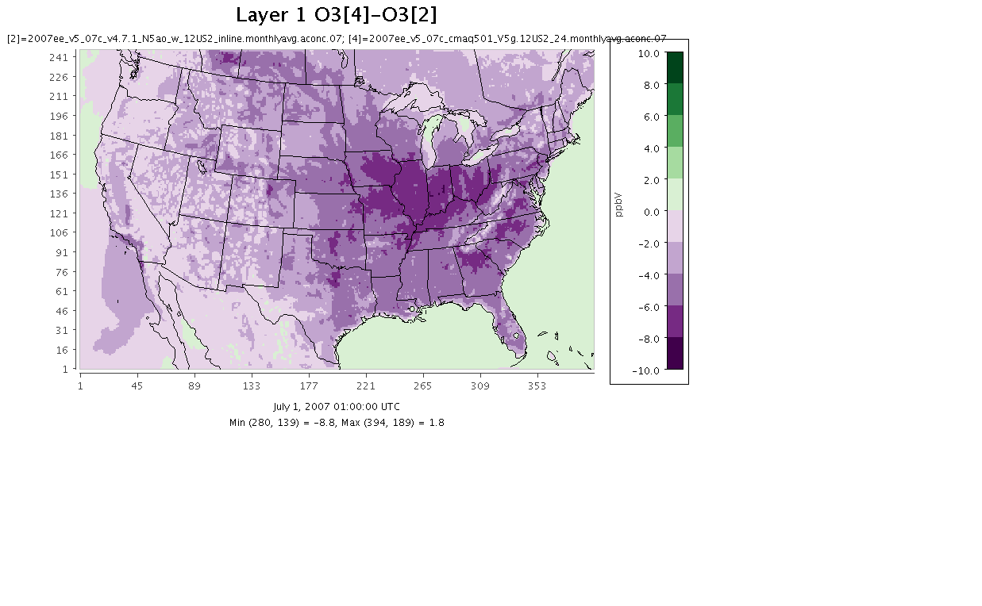
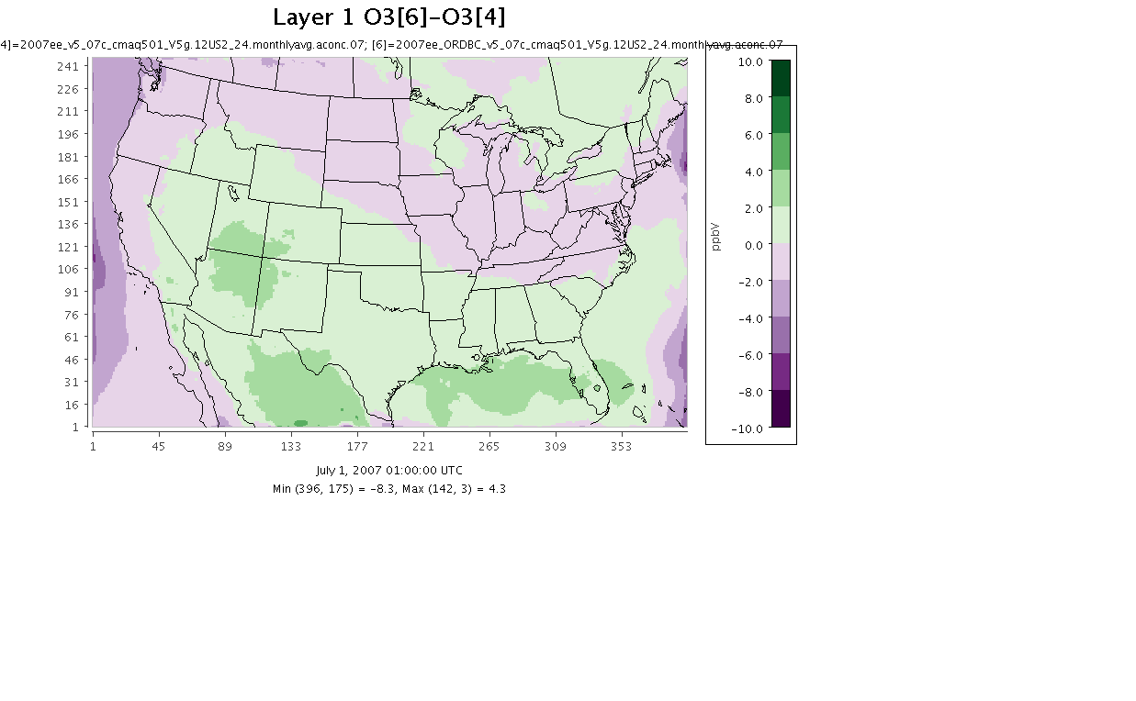
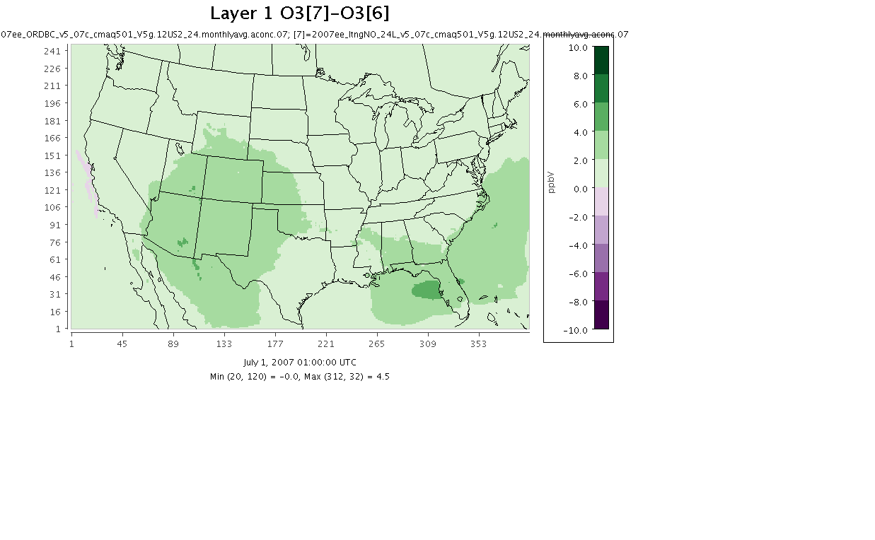
July Monthly Avg Ozone (all hours)
2007 Benchmark v4.7.1
v5.0.1 - v4.7.1
New IC/BC - v5.0.1
LTNG NO - New IC/BC

Slide 10
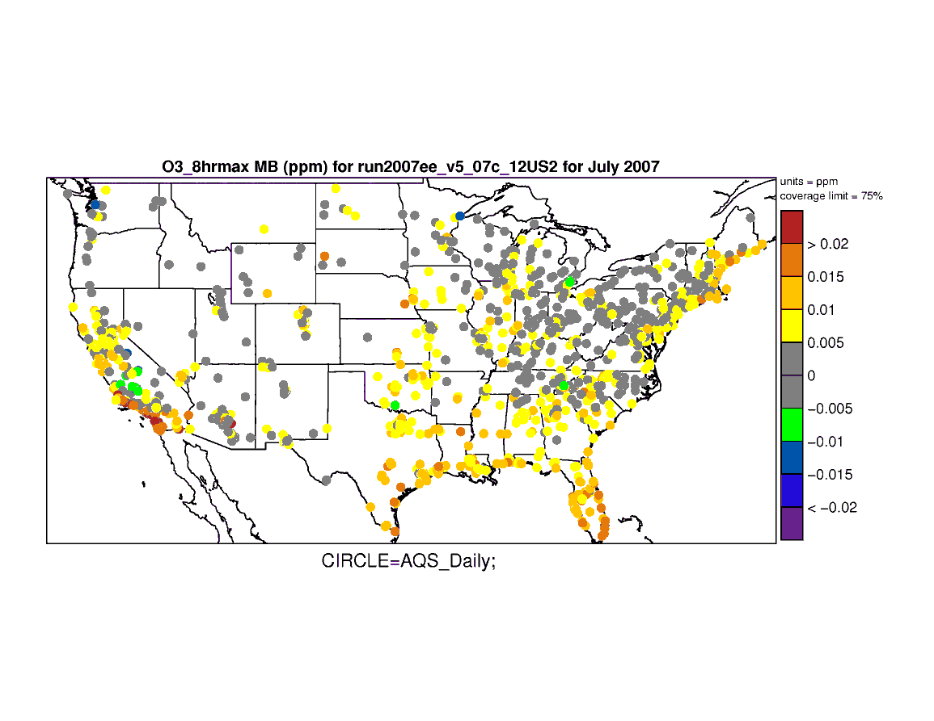
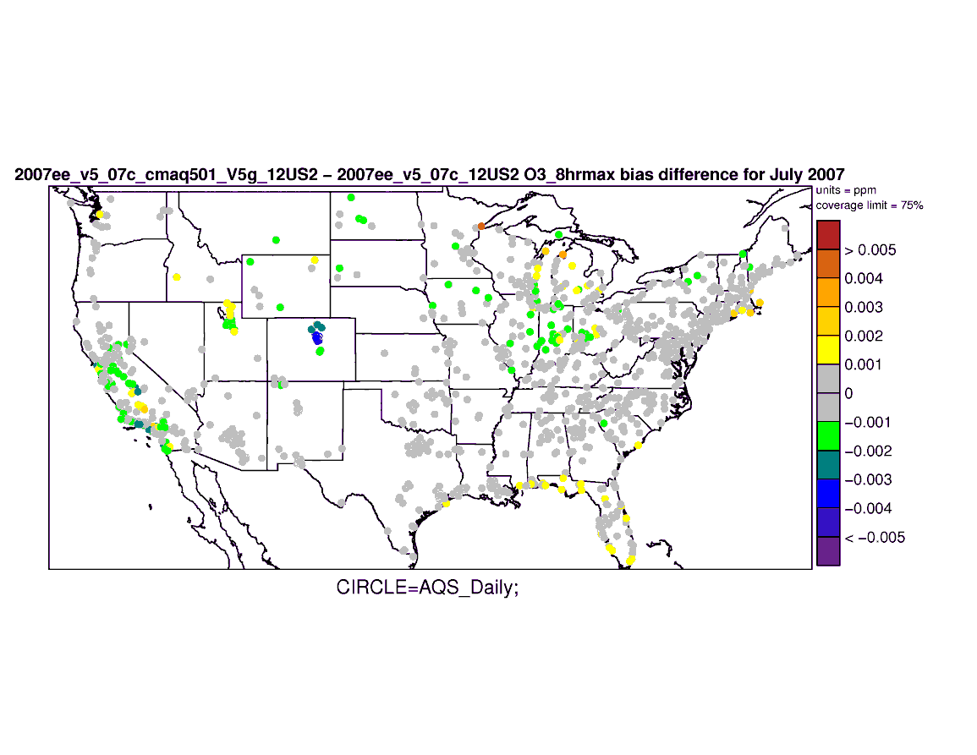
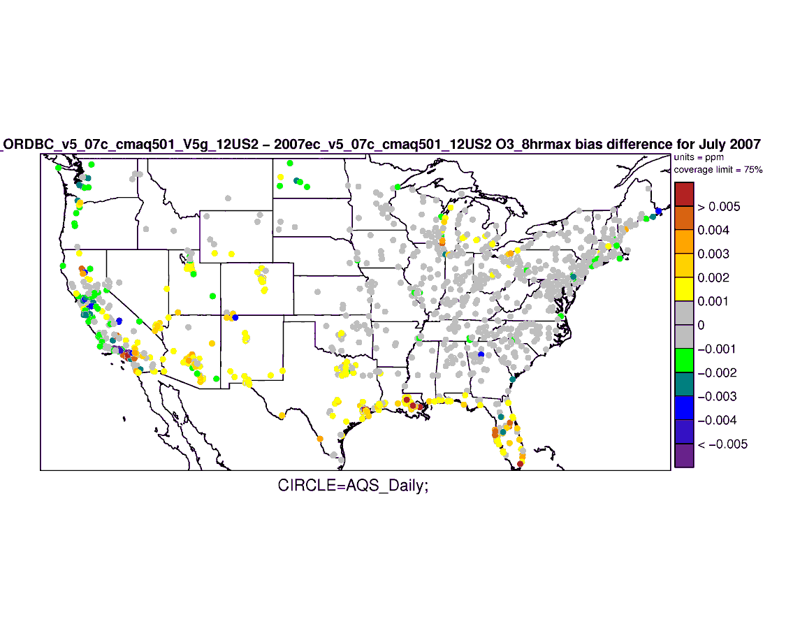
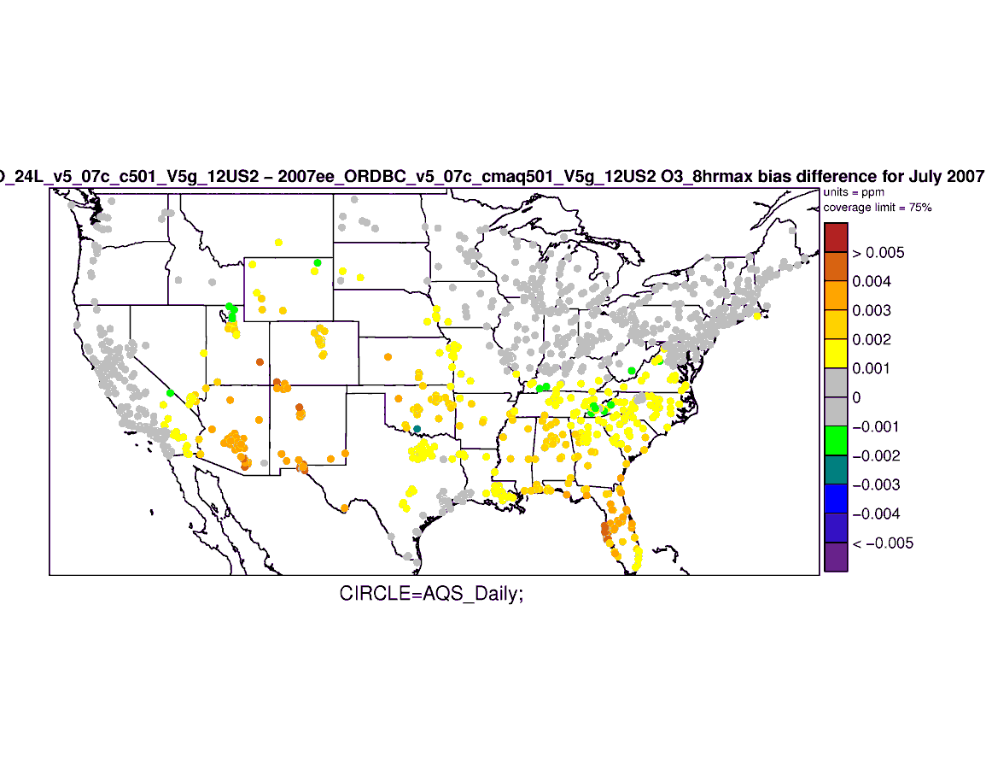
July 8-hr max Daily Ozone
∆ Absolute Bias
Mean Bias 2007 Benchmark v4.7.1
v5.0.1 - v4.7.1
New IC/BC - v5.0.1
LTNG NO - New IC/BC
Notes:
Note: this model eval is on 8 hr max daily ozone versus the previous slide which showed July Monthly avg ozone
Change in Absolute Bias – warm colors mean degradation in MB; cool colors mean improvement in MB

Slide 11
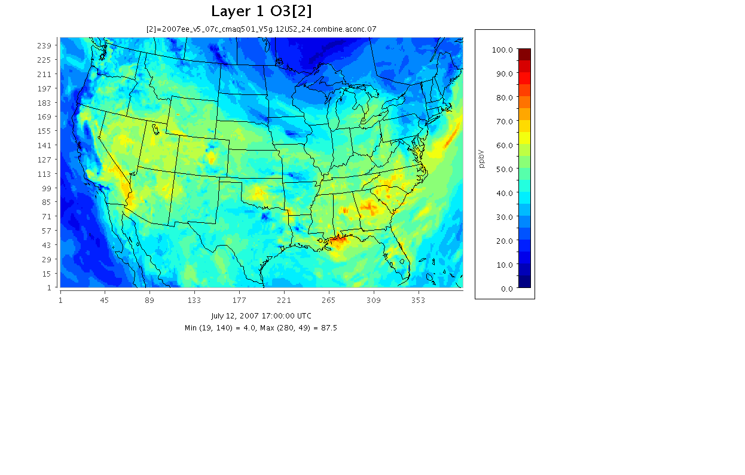
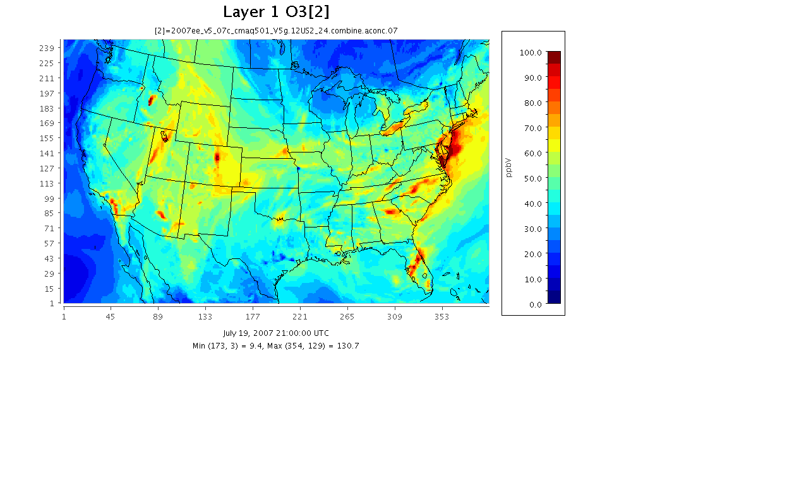
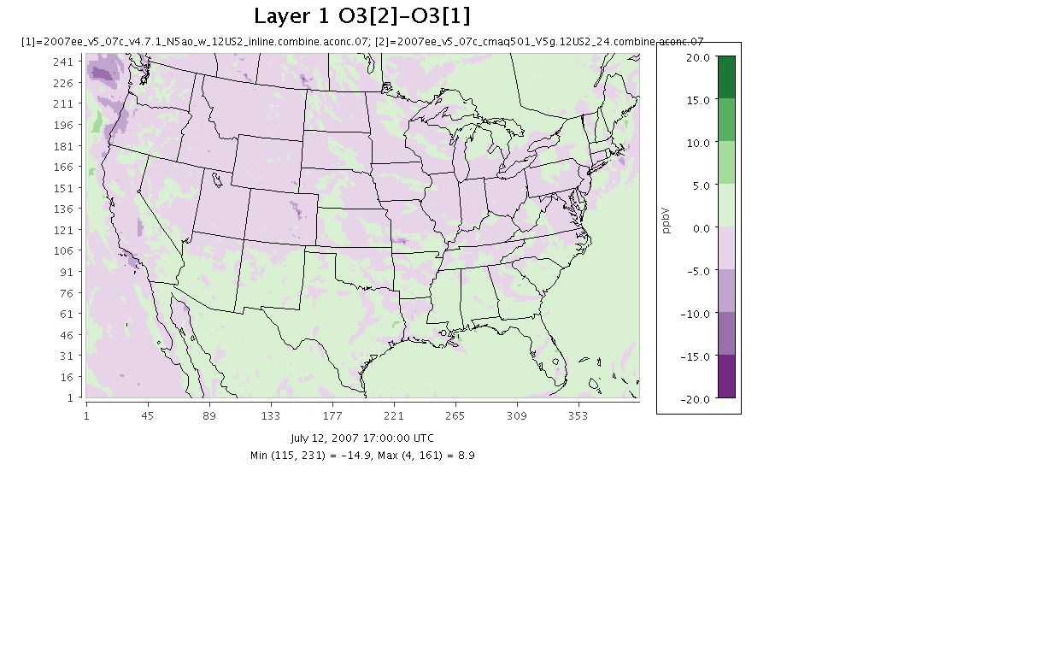
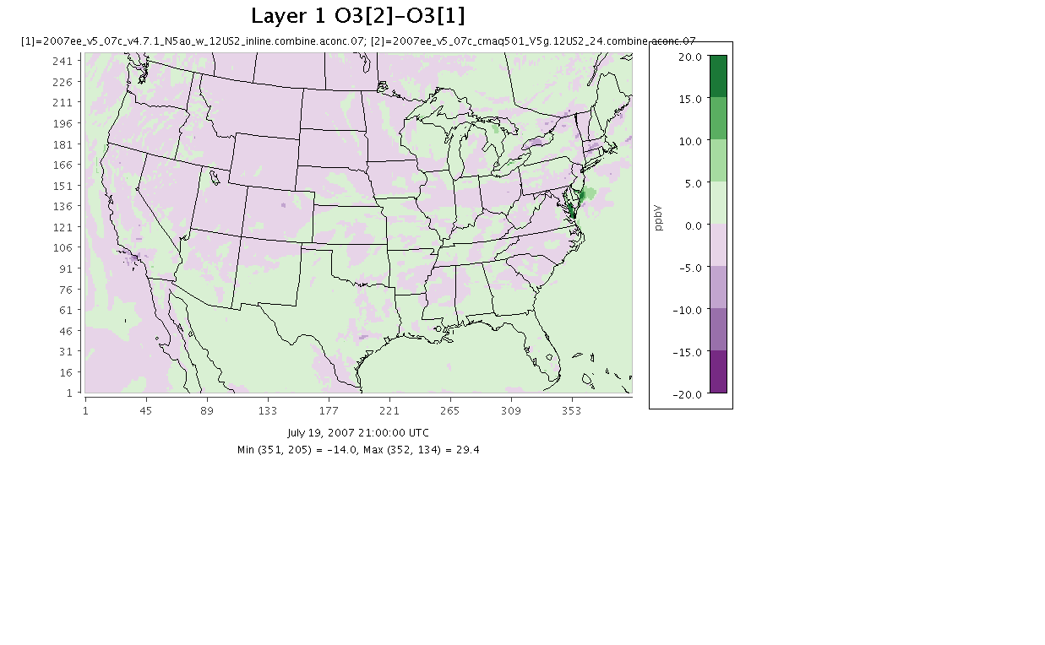
July Monthly Avg Ozone (2 specific day/hours)
Effect of CMAQ v5.0.1
v5.0.1– July 12th 17 UTC
v5.0.1 – July 19th 21 UTC
(v5.0.1 – v4.7.1) – July 12th 17 UTC
(v5.0.1 – v4.7.1) – July 19th 21 UTC

Slide 12
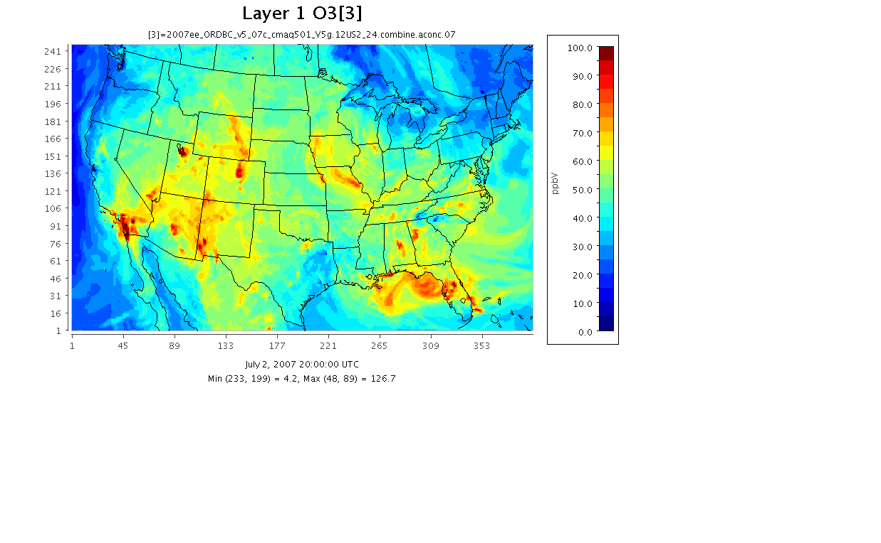
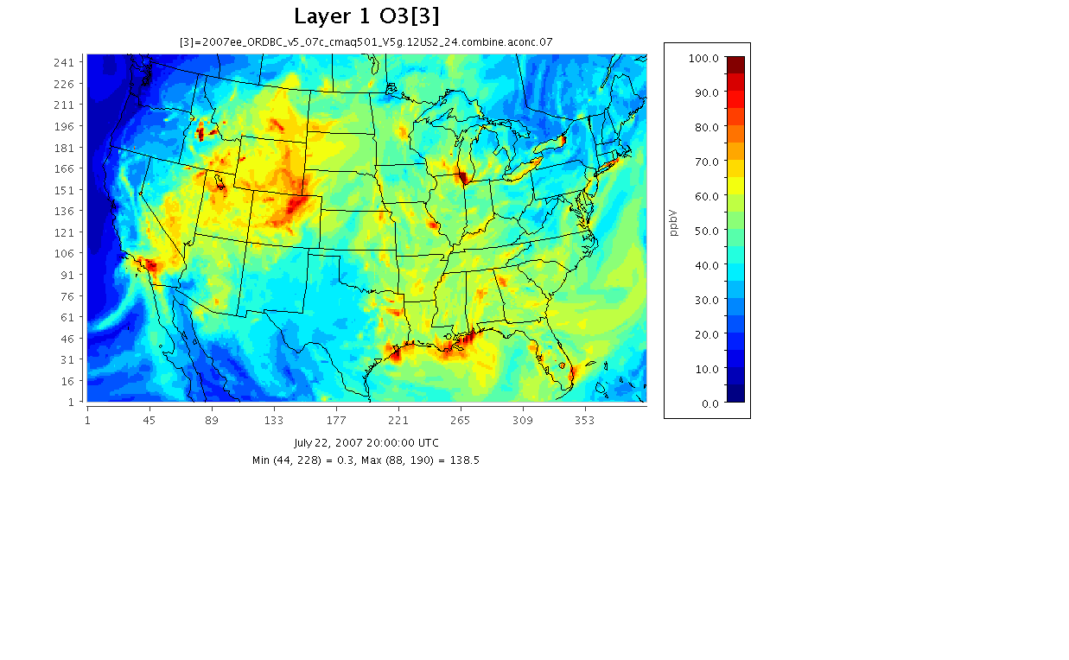
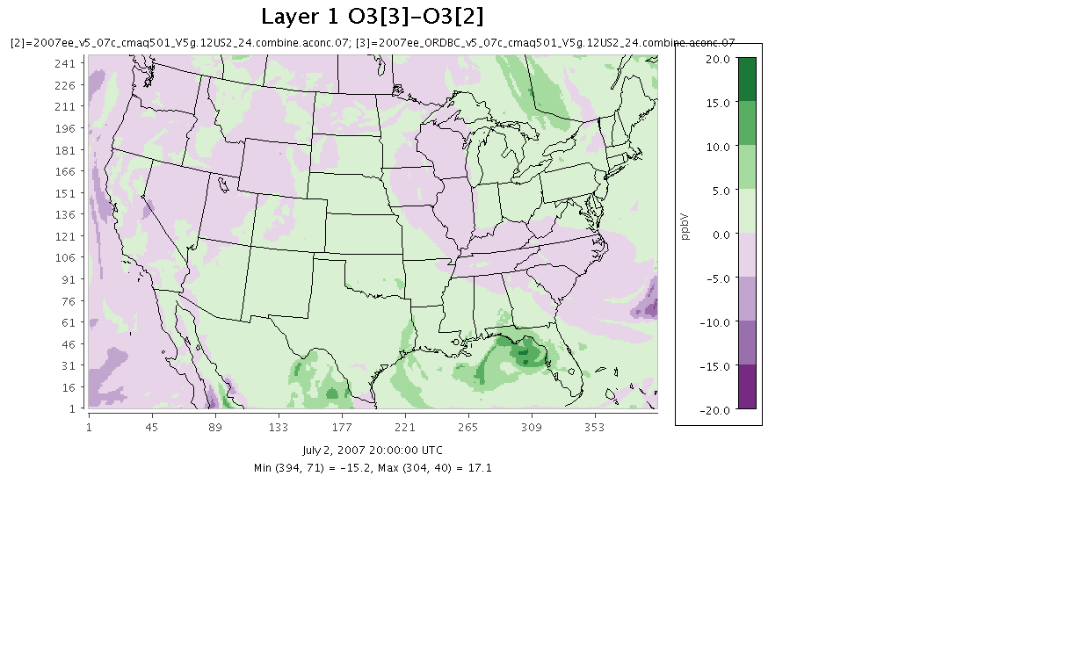
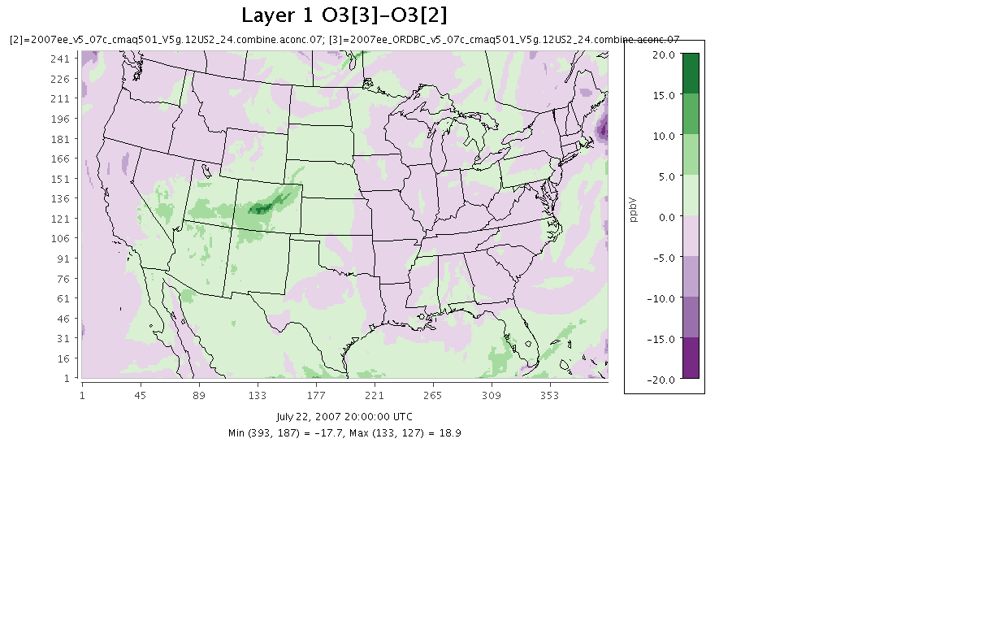
July Monthly Avg Ozone (2 specific days/hours)
Effect of new IC/BC
New IC/BC – July 2nd 0 UTC
New IC/BC – July 22nd 20 UTC
(New IC/BC – v5.0.1) – July 2nd 0 UTC
(New IC/BC – v5.0.1) – July 22nd 20 UTC

Slide 13
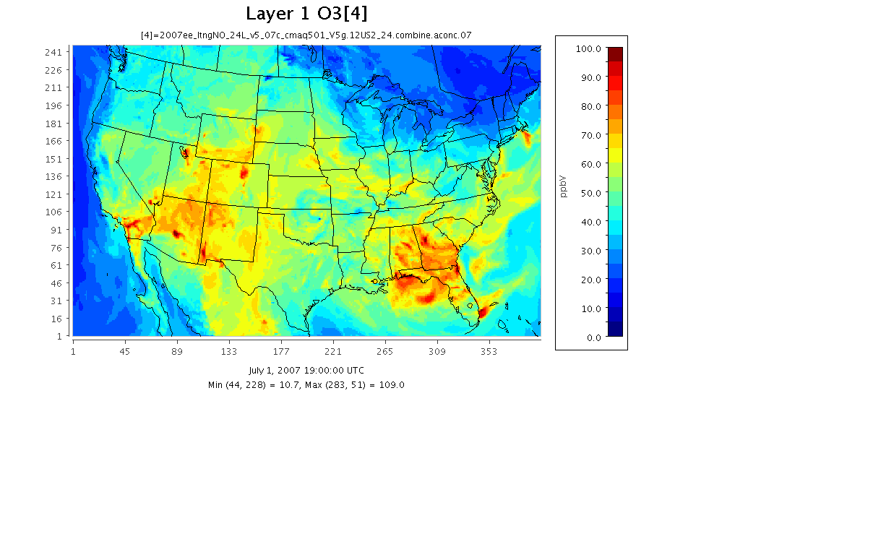
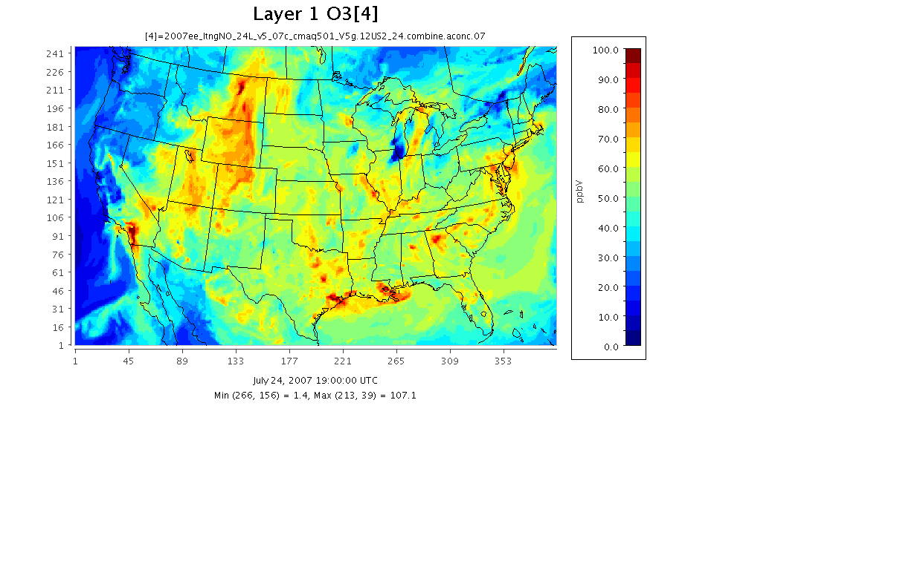
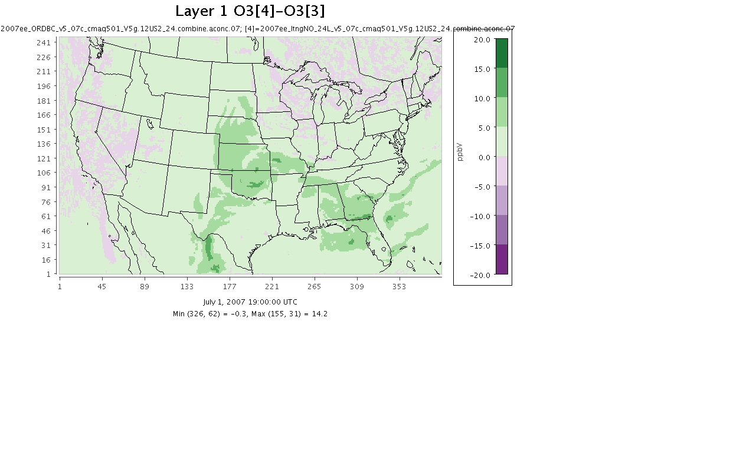
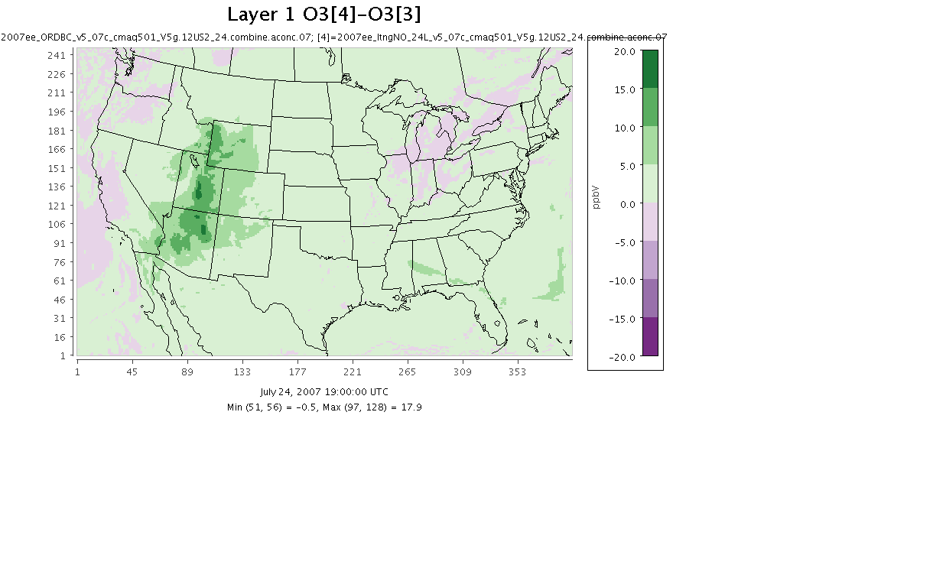
July Monthly Avg Ozone (2 specific days/hours)
Effect of Lightning NO
LTNG NO – July 1st 19 UTC
LTNG NO – July 24th 19 UTC
(LGTN NO – new BC) – July 1st 19 UTC
(LGTN NO – new BC) – July 24th 19 UTC

Slide 14
Atlanta - 2007 July Hourly Ozone
v4.7.1 vs v5.0.1 vs new IC/BC vs LTNG NO
July 1st – 9th
Model performance for hourly ozone is similar for the three CMAQ v5.0.1 sensitivity runs.
Nighttime differences between v5.0.1 and v4.7.1 runs reflect changes in the mixing in v5.0.1.
Daytime differences are much smaller between all the model runs.
July 14th – 21st

Slide 15
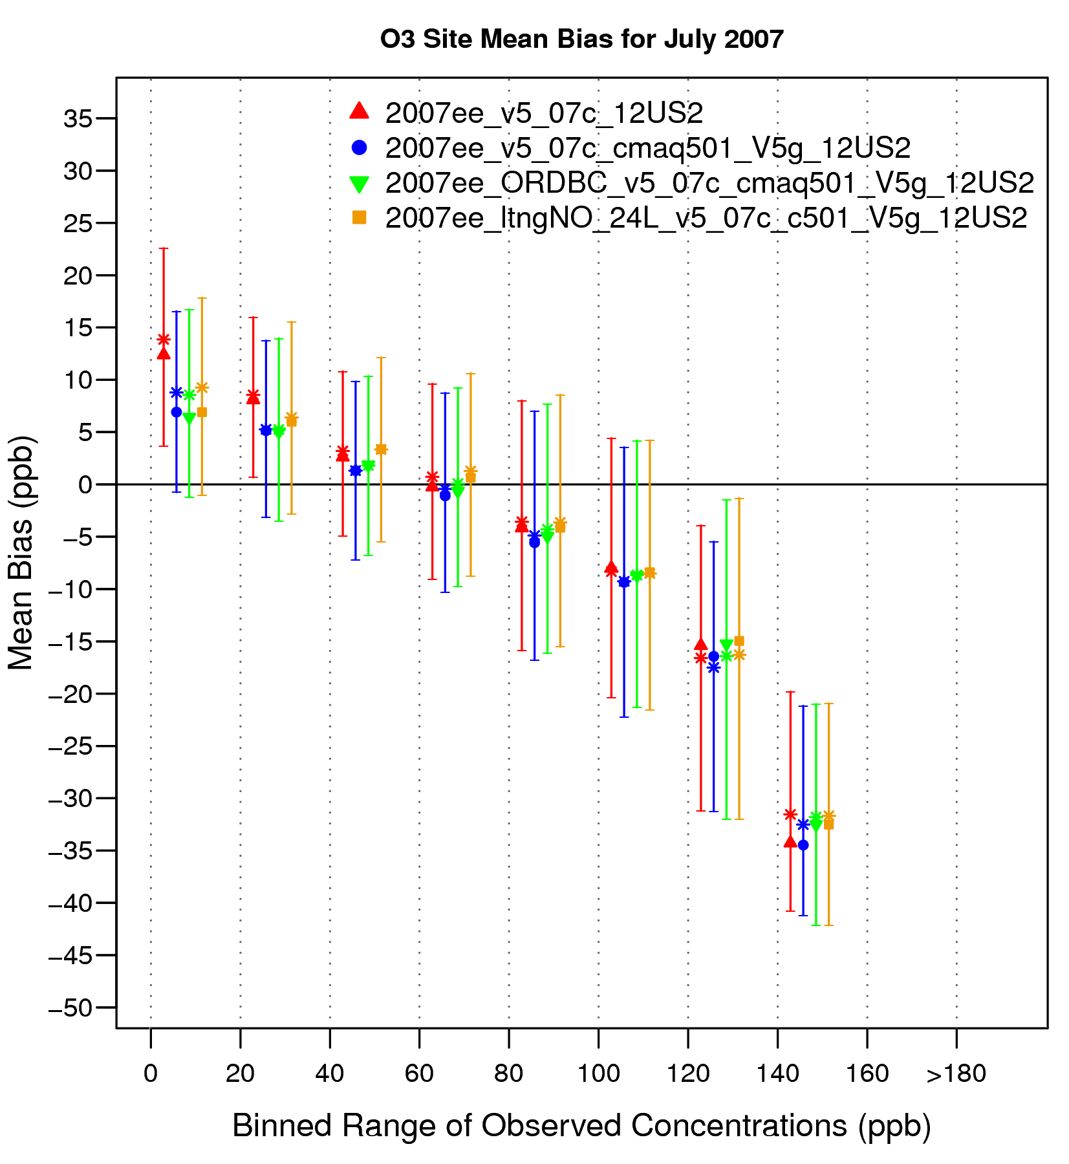
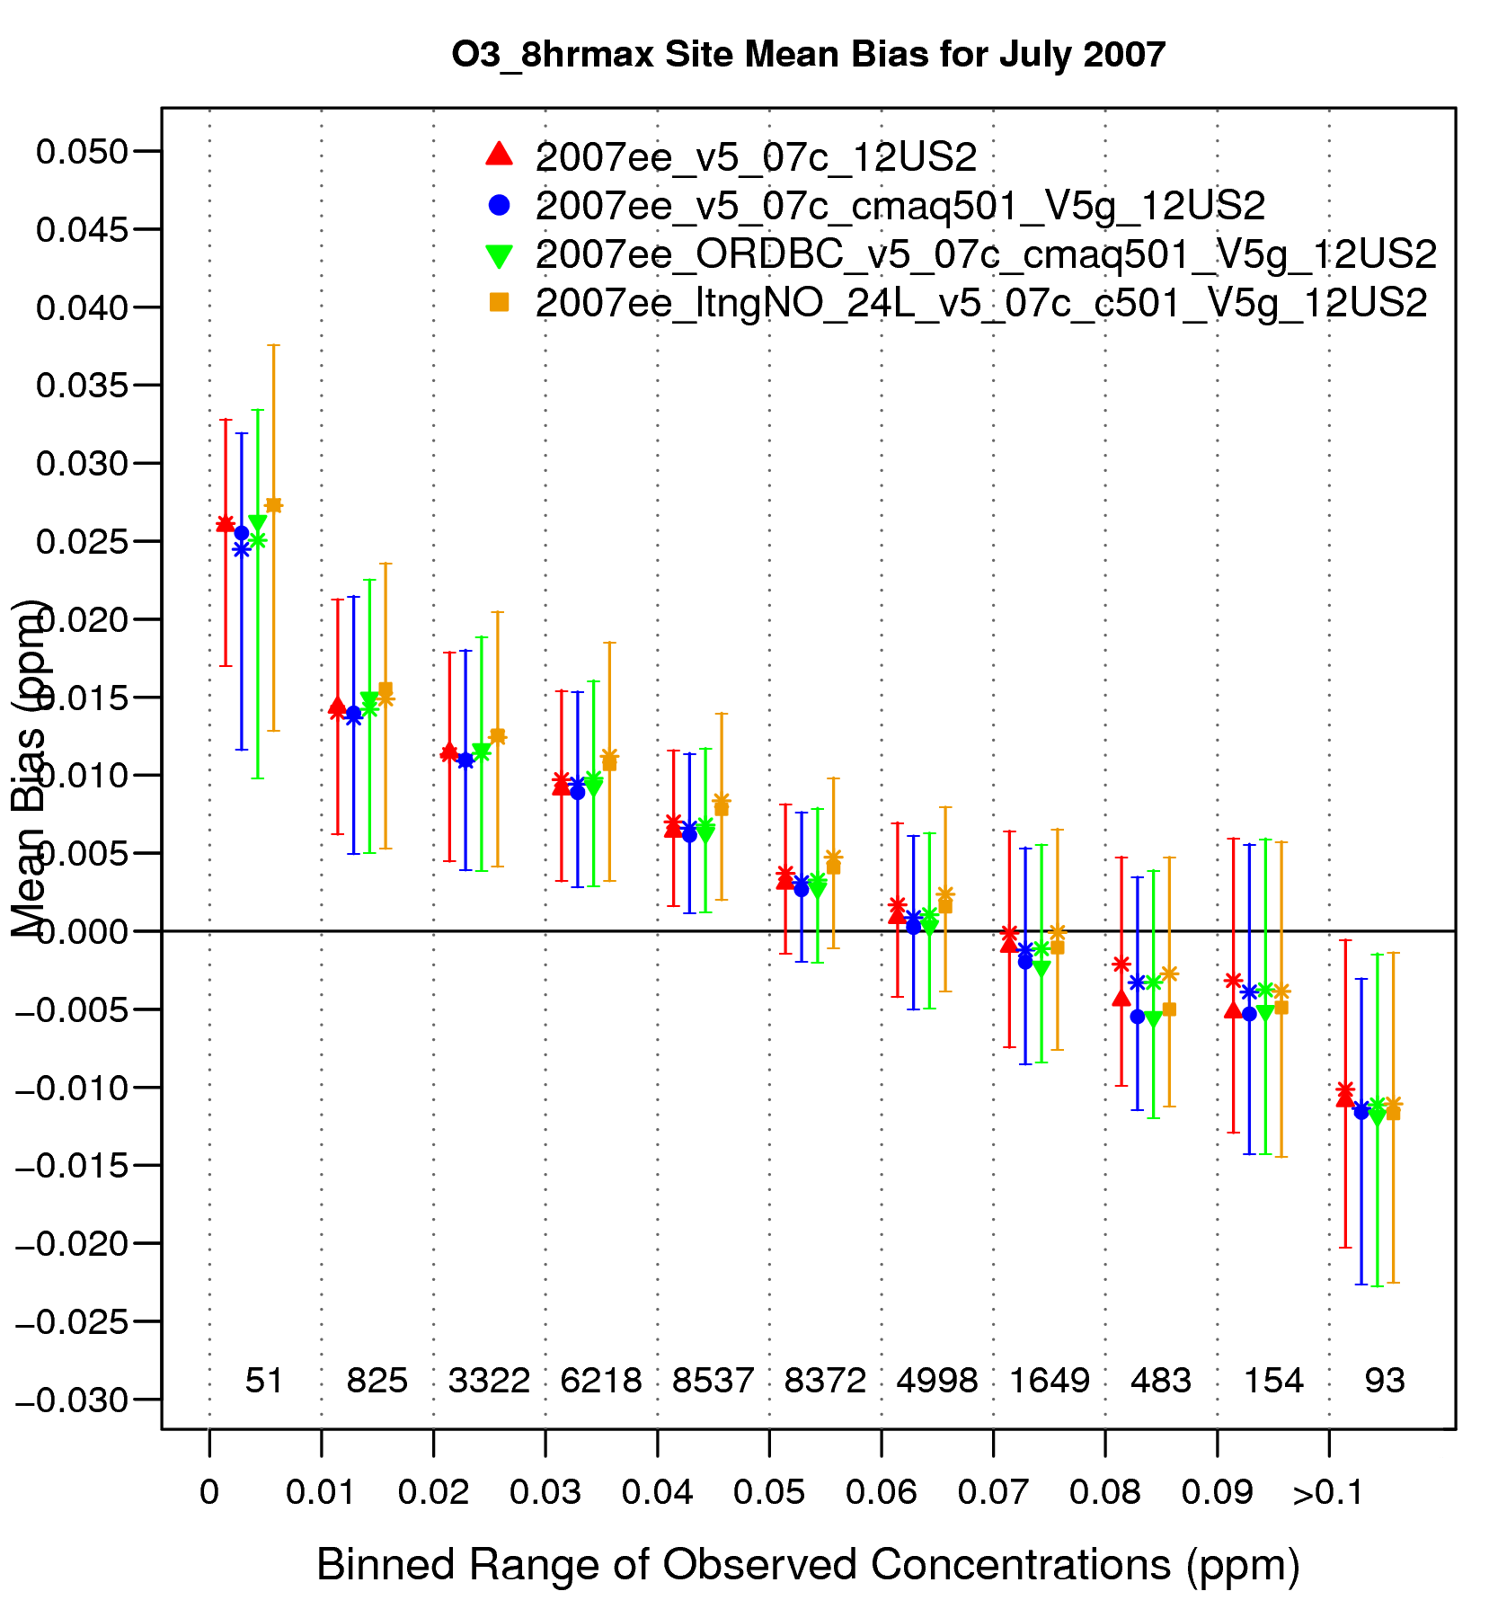
2007 July Ozone – Mean Bias (ppb) v4.7.1 vs v5.0.1 vs new IC/BC vs LTNG NO
Hourly Ozone
8-hr max daily Ozone
Notes:
Improvements in hourly ozone predictions in 3 CMAQ v5.0.1 runs due to mixing at nighttime

Slide 16
elemental Carbon

Slide 17
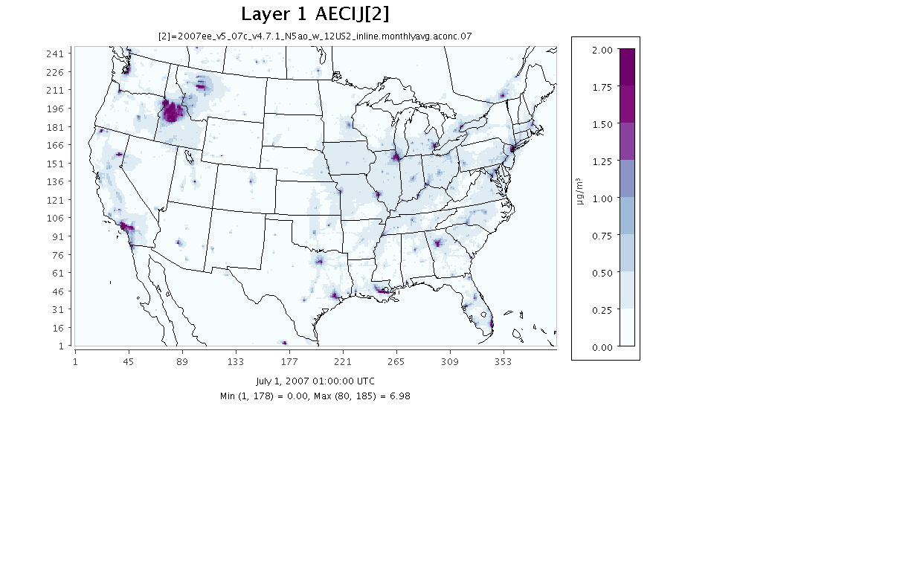
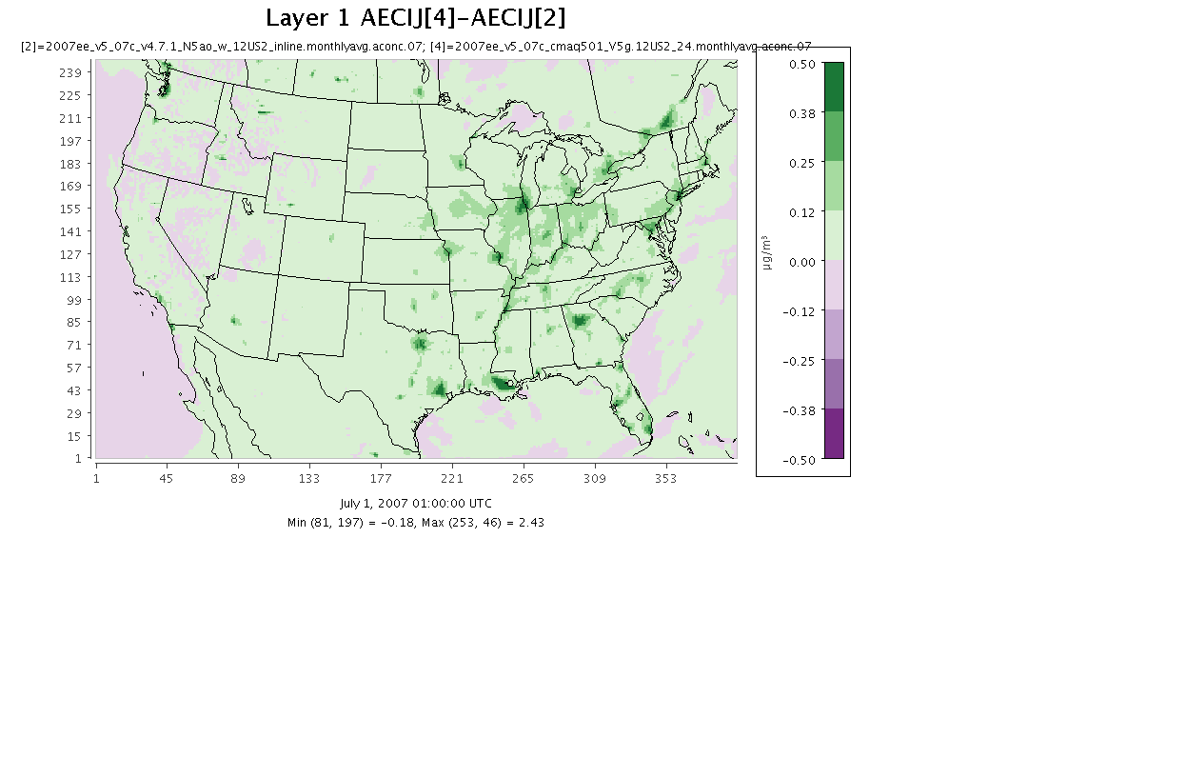
Benchmark v4.7.1
2007 July Monthly Avg
Elemental Carbon
v5.0.1 – v4.7.1

Slide 18
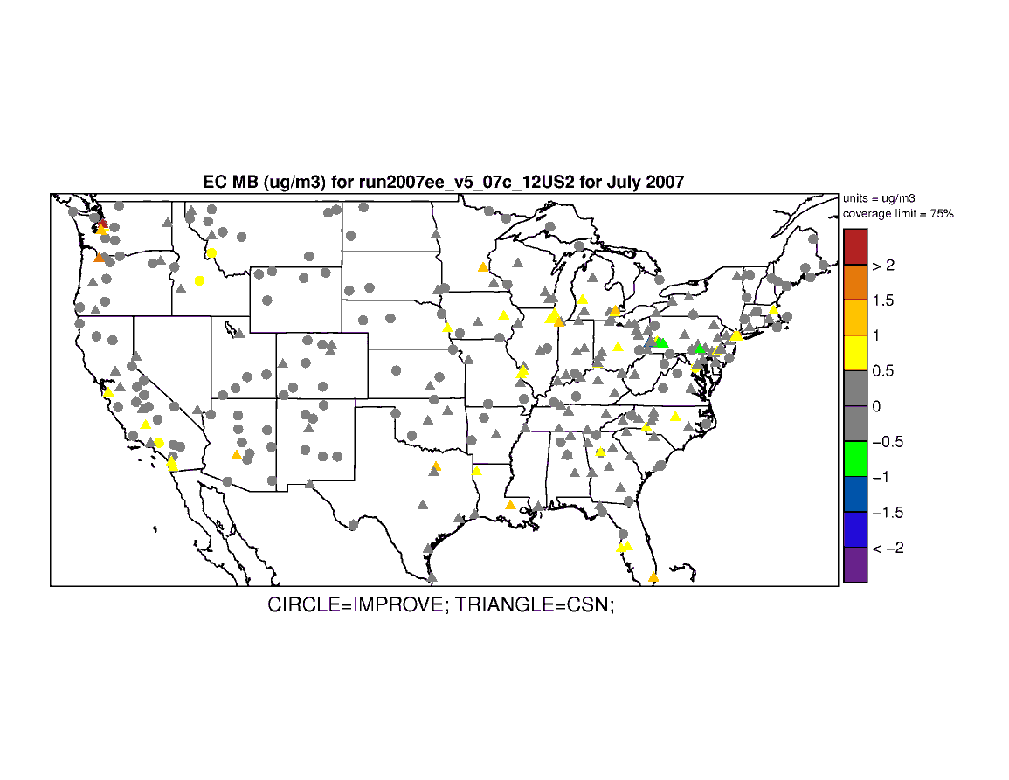
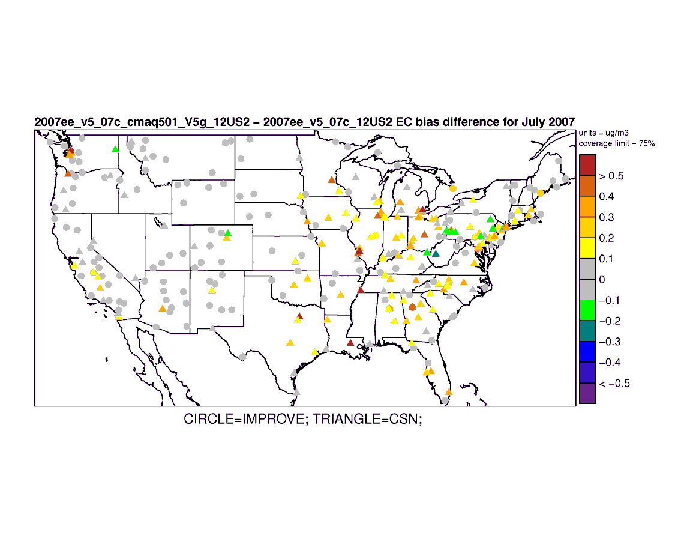
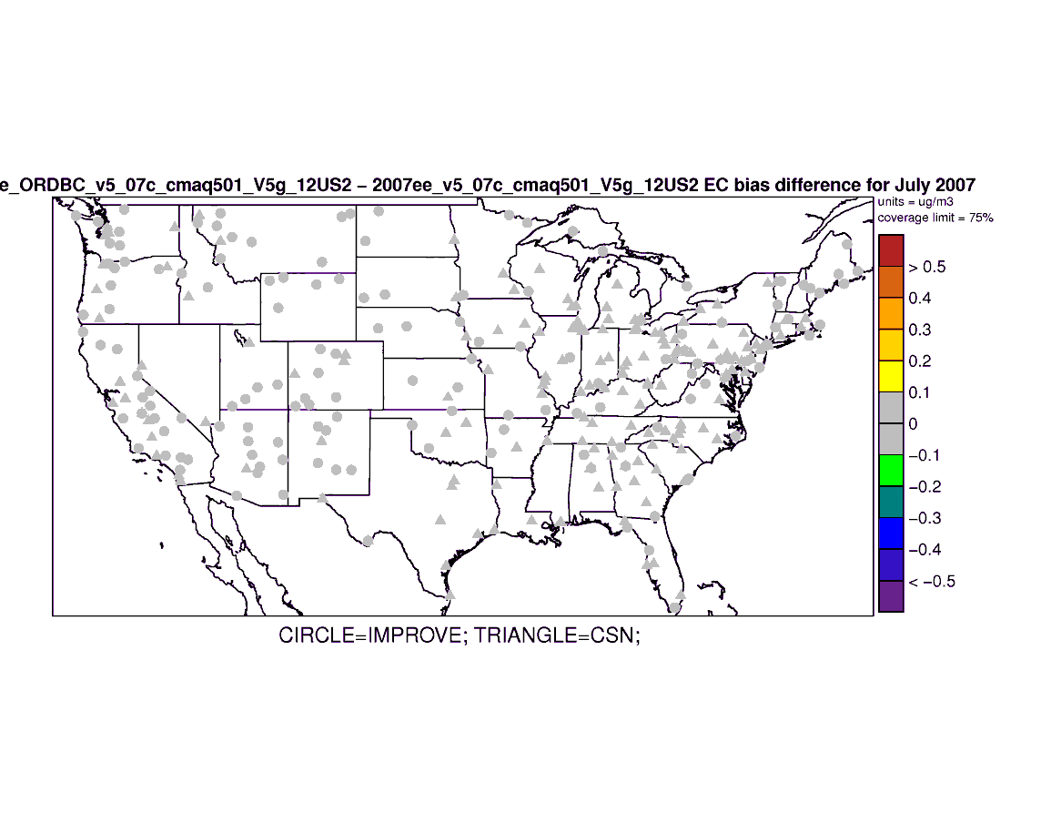
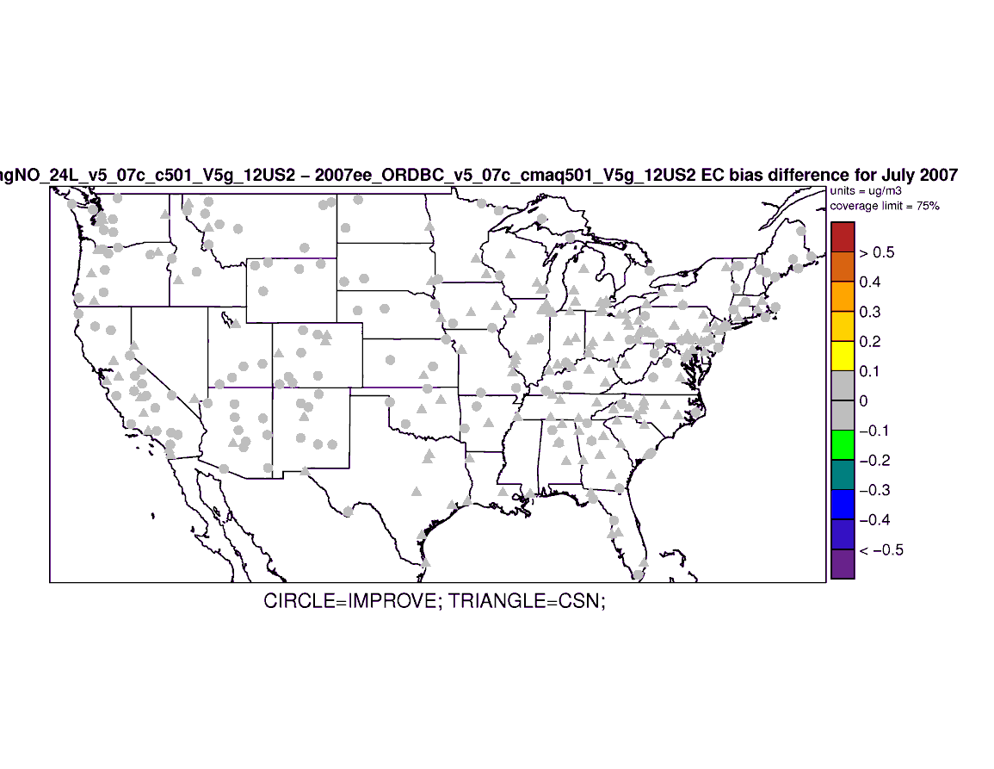
July Elemental Carbon
∆ Absolute Bias
Mean Bias 2007 Benchmark v4.7.1
v5.0.1 - v4.7.1
New IC/BC - v5.0.1
LTNG NO - New IC/BC
Notes:
Change in Absolute Value Bias – warm colors mean degradation in MB; cool colors mean improvement in MB

Slide 19
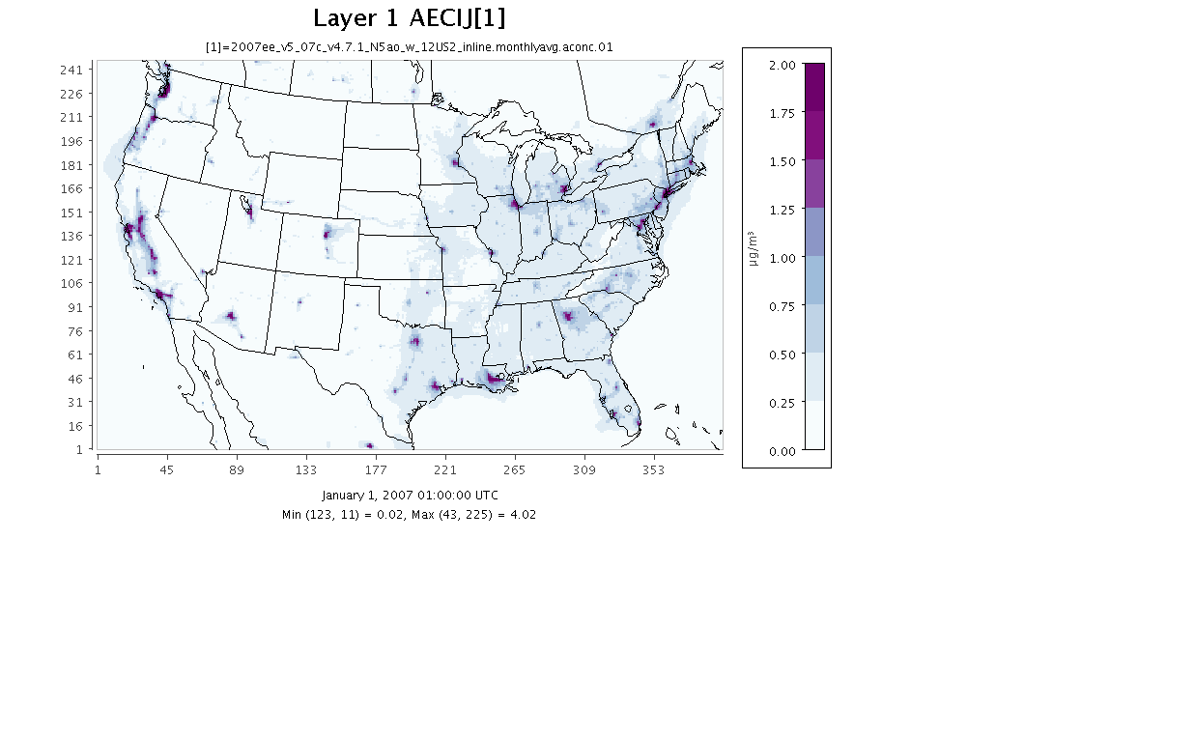
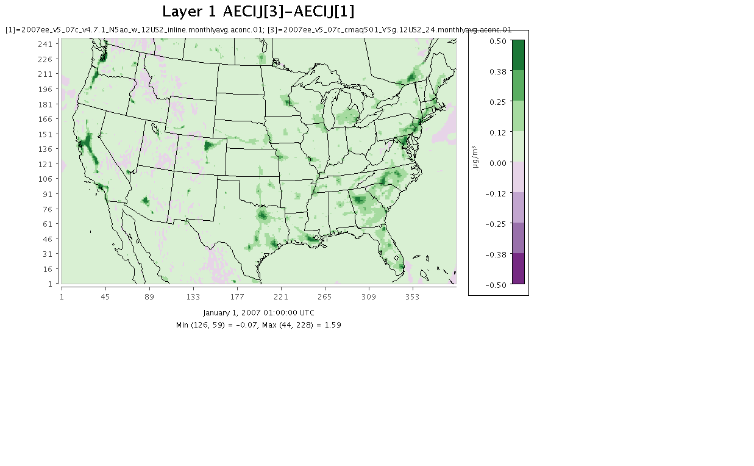
Benchmark v4.7.1
2007 January Monthly Avg
Elemental Carbon
v5.0.1 – v4.7.1

Slide 20
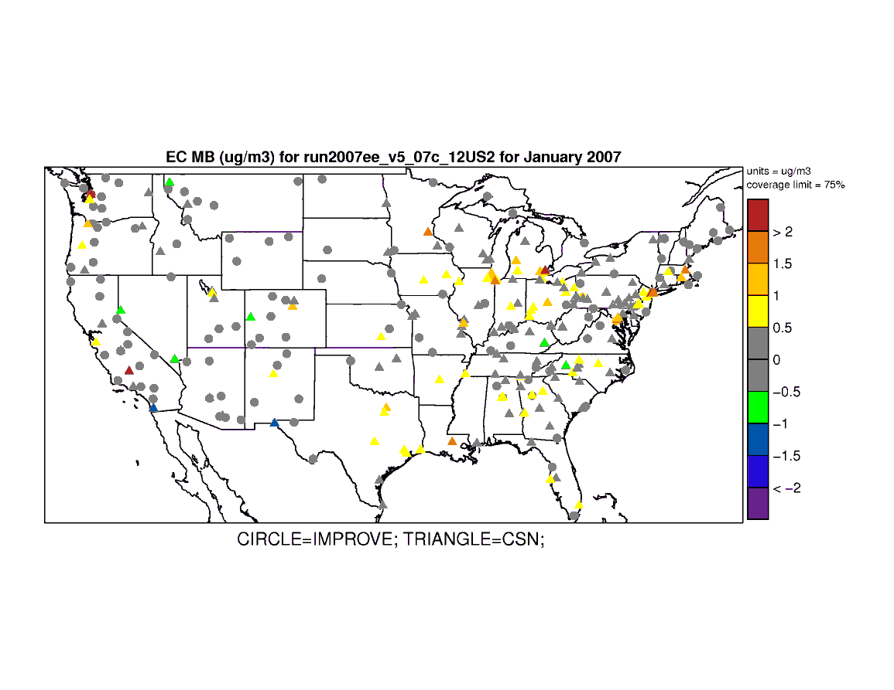
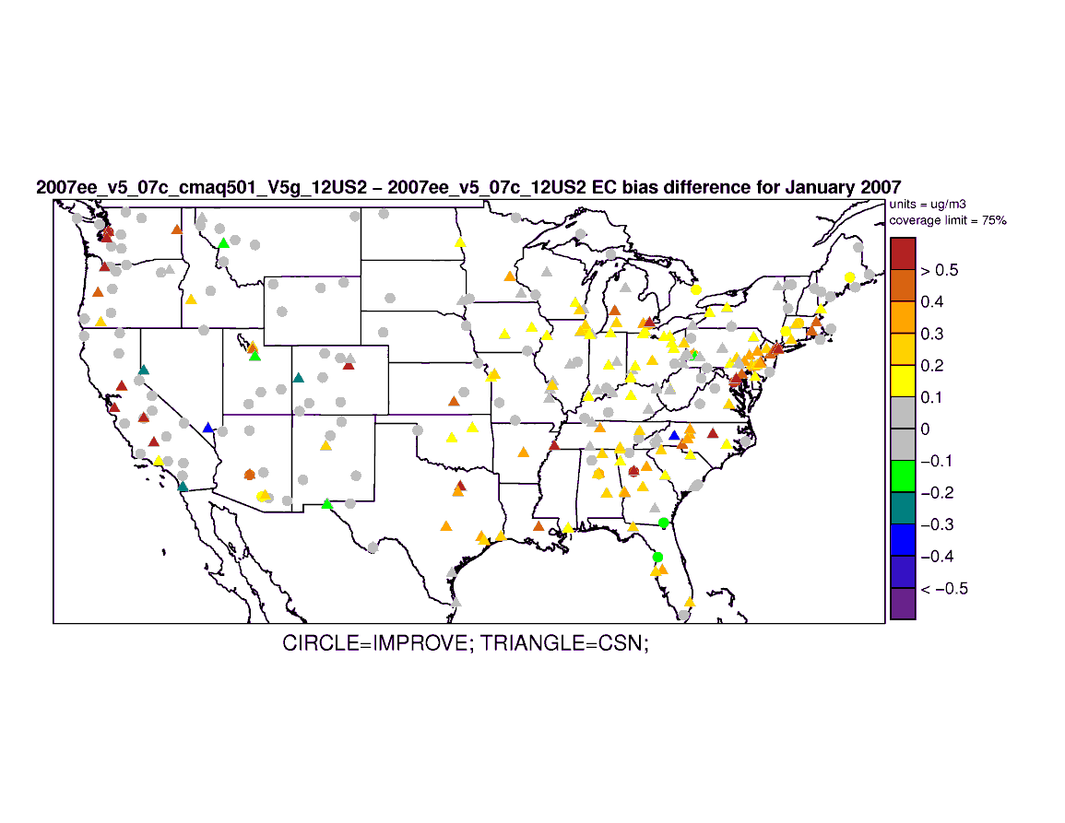
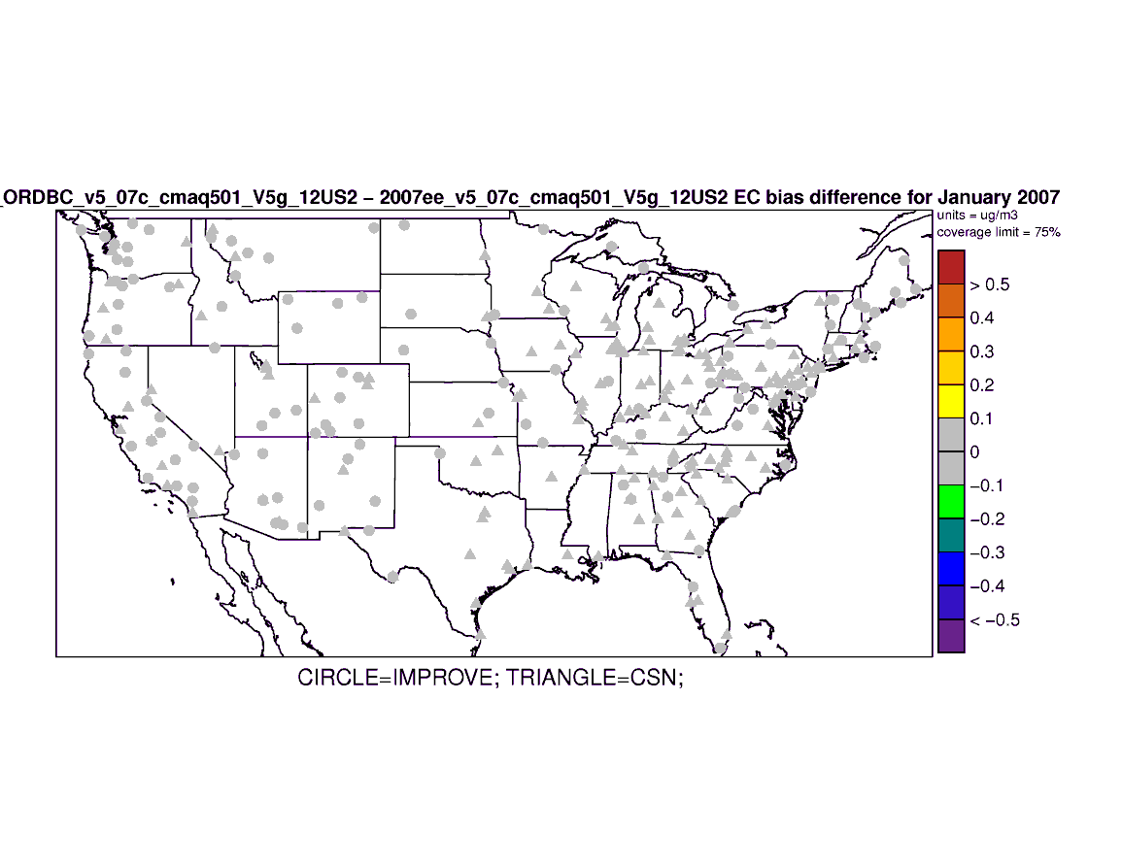
Mean Bias
Benchmark v4.7.1
2007 January
Elemental Carbon
∆ Absolute Bias
v5.0.1 - v4.7.1
New IC/BC - v5.0.1
Notes:
Change in Absolute Bias – warm colors mean degradation in MB; cool colors mean improvement in MB

Slide 21
Sulfate PM

Slide 22
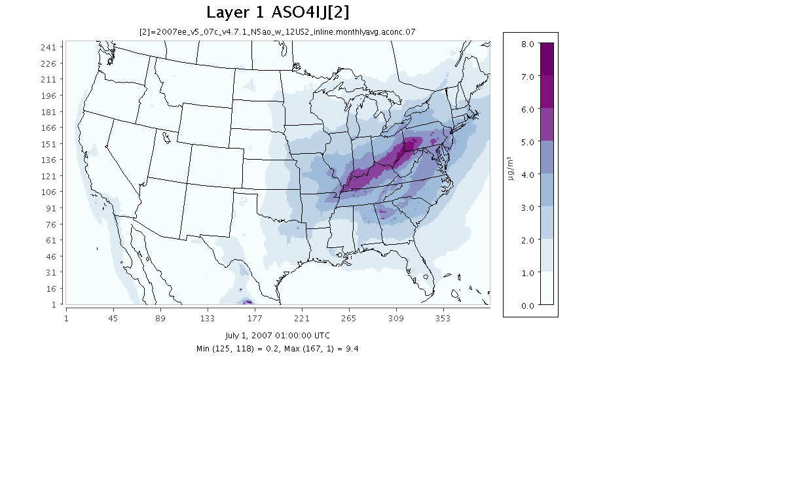
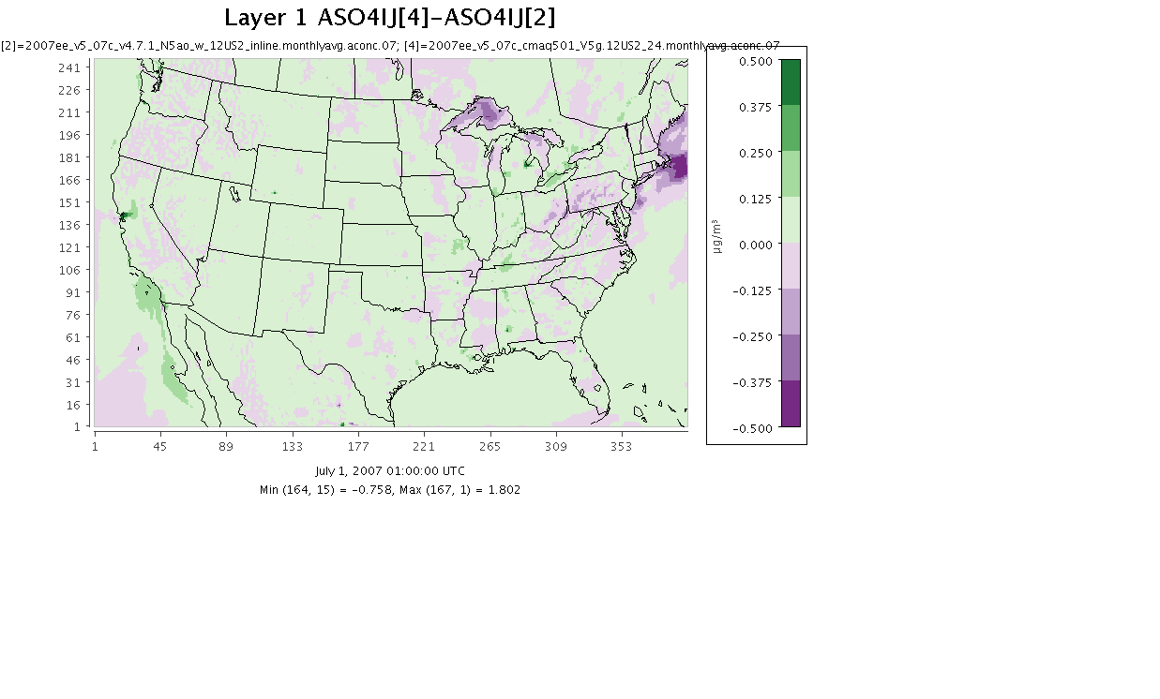
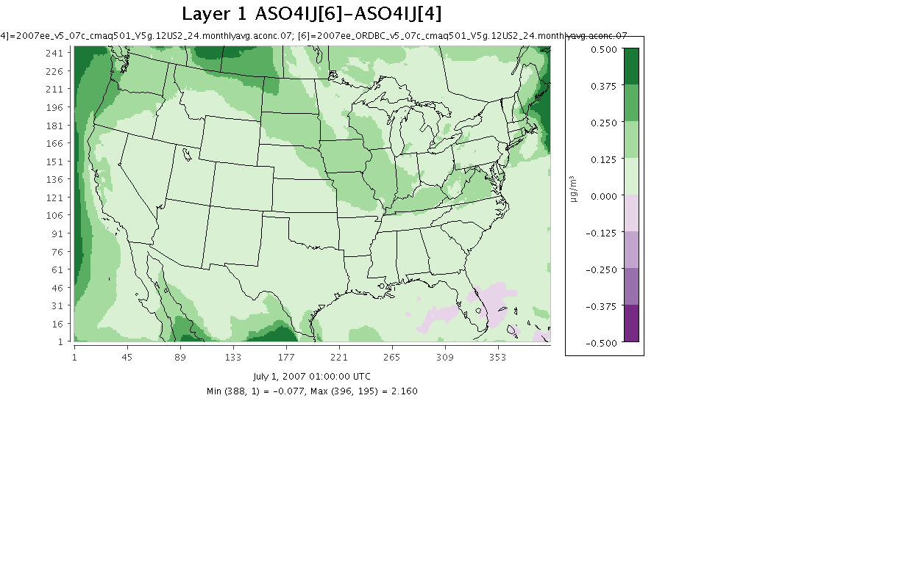
Benchmark v4.7.1
2007 July Monthly Avg
Sulfate PM
v5.0.1 – v4.7.1
New IC/BC - v5.0.1

Slide 23
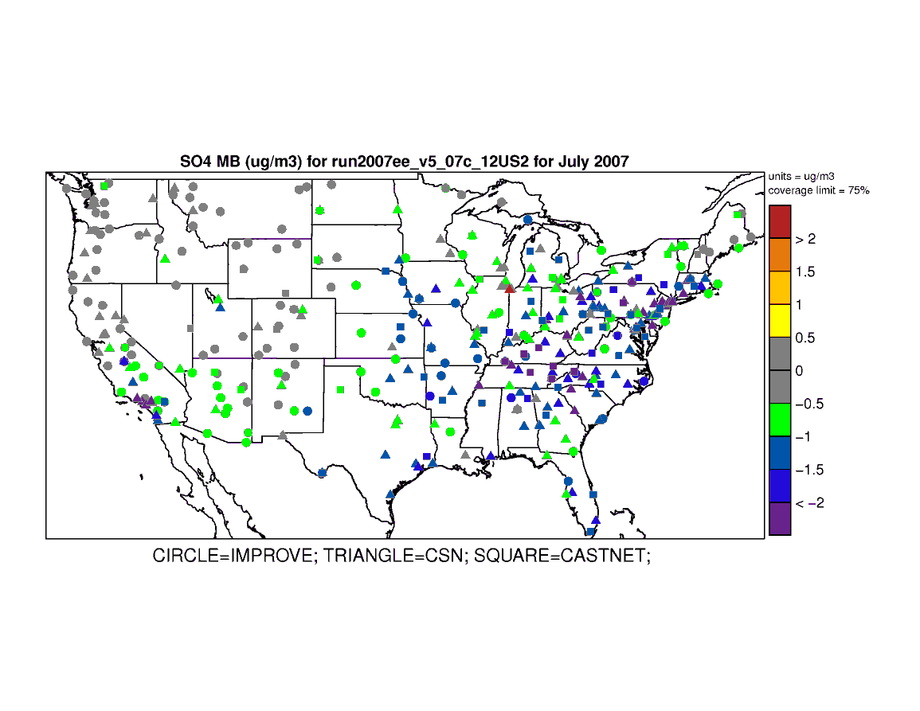
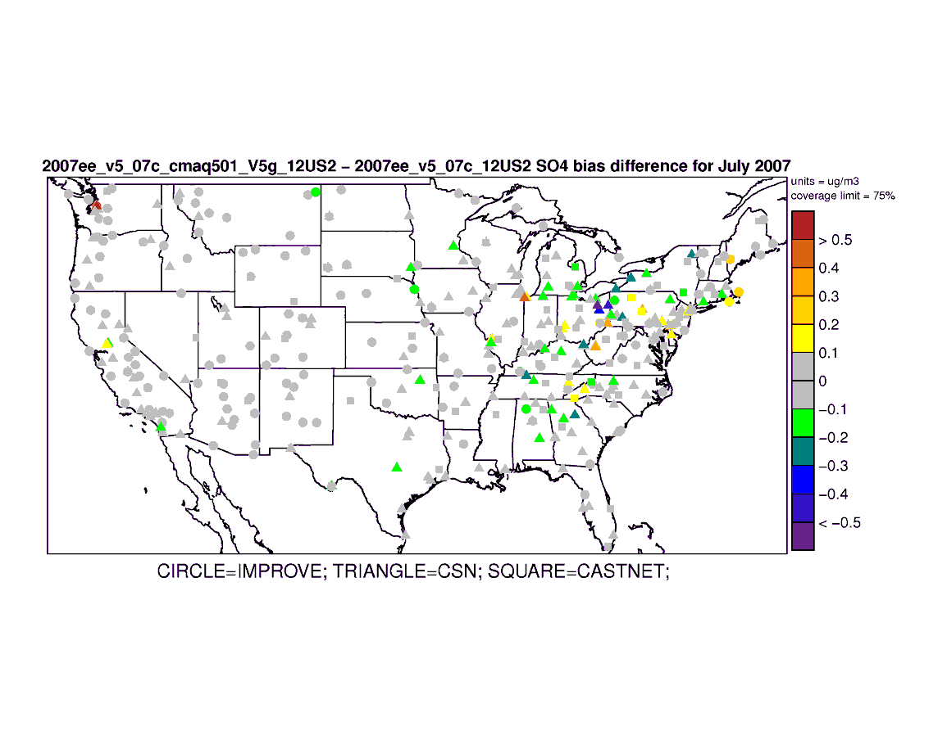
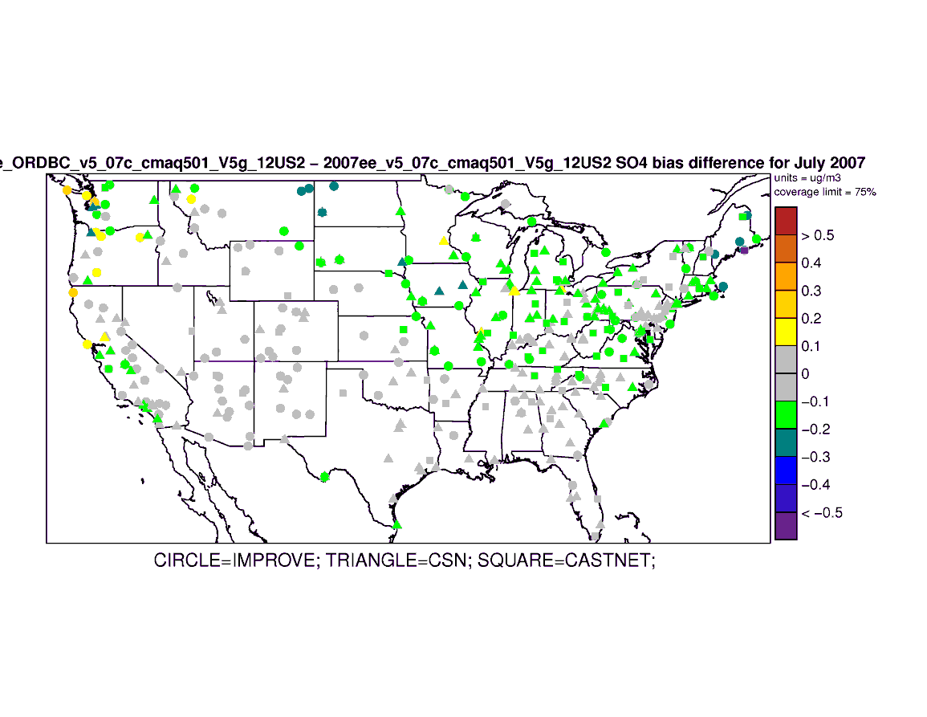
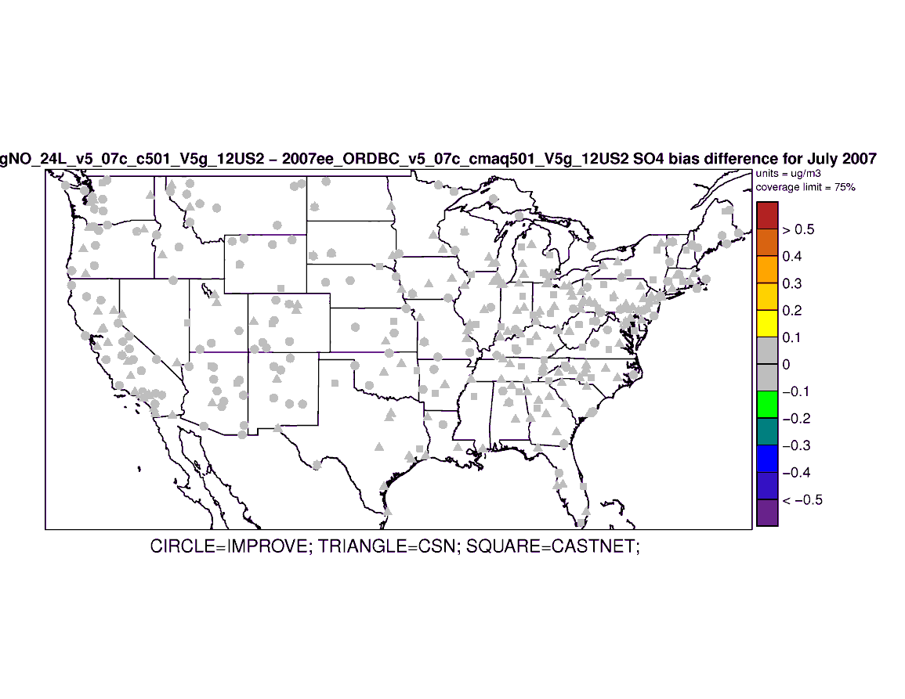
July Sulfate PM
∆ Absolute Bias
Mean Bias 2007 Benchmark v4.7.1
v5.0.1 - v4.7.1
New IC/BC - v5.0.1
LTNG NO - New IC/BC
Notes:
Change in Absolute Value Bias – warm colors mean degradation in MB; cool colors mean improvement in MB

Slide 24
Nitrate PM

Slide 25
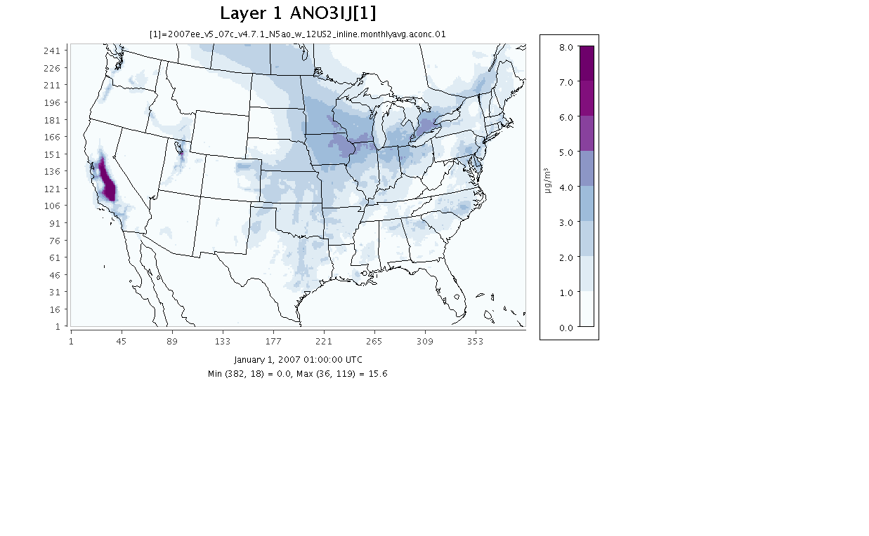
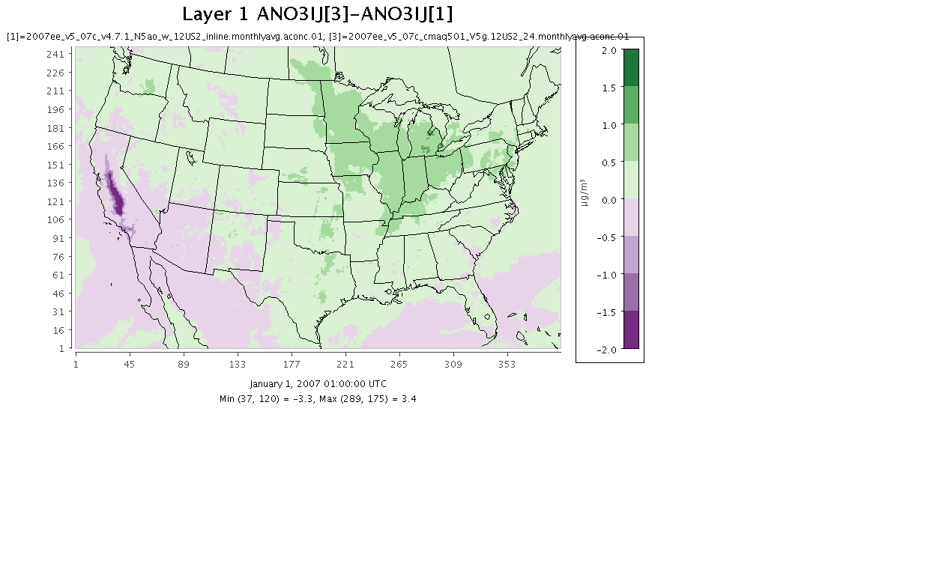
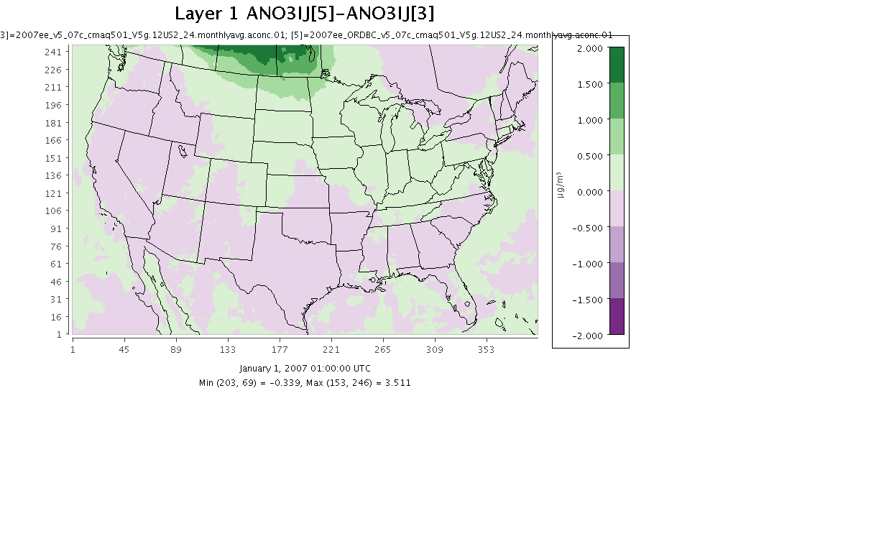
Benchmark v4.7.1
2007 January Monthly Avg
Nitrate PM
v5.0.1 – v4.7.1
New IC/BC – v 5.0.1

Slide 26
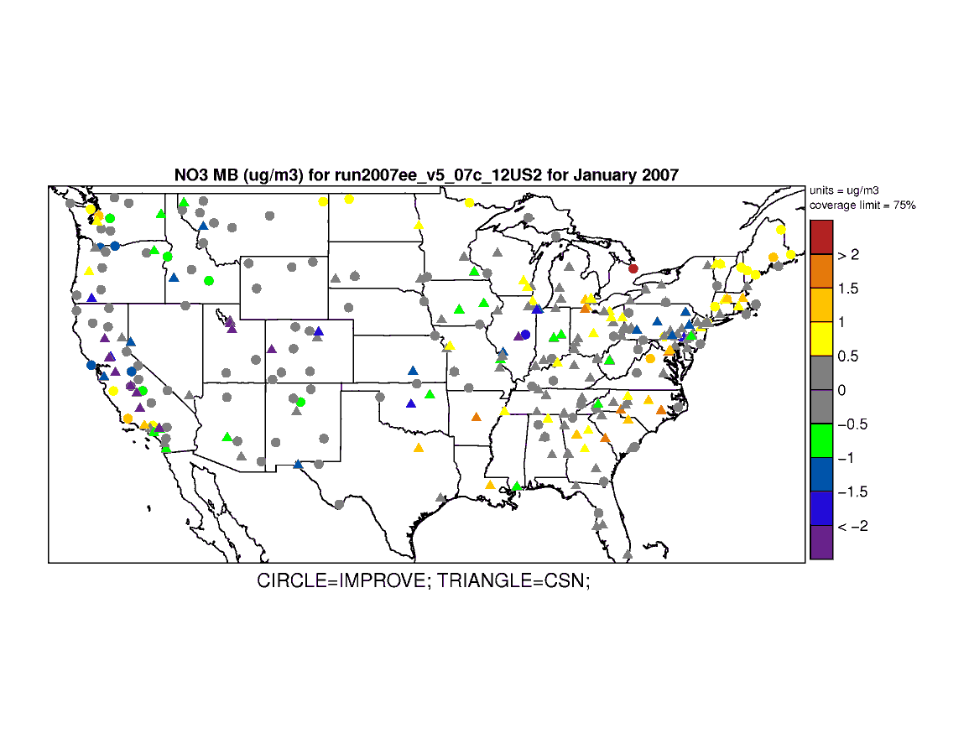
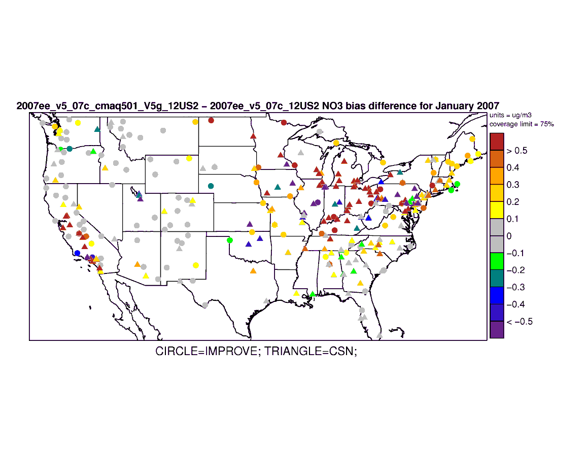
Mean Bias
Benchmark v4.7.1
2007 January Nitrate PM
∆ Absolute Bias
v5.0.1 - v4.7.1
New IC/BC - v5.0.1
Notes:
Change in Absolute Value Bias – warm colors mean degradation in MB; cool colors mean improvement in MB

Slide 27
Summary of Findings
Updates to mixing in v5.0.1 produced large effects in model predictions
Mostly at nighttime
Overall, new BCs and Lightning NO emissions produced small changes in model predictions
substantial changes at isolated locations and times (sporadic)
Future work will evaluate
WRF v3.3 meteorology
20 meter 1st layer thickness
Bi-directional flux for fertilizer NH3 emissions
Wind-blown dust emissions

Slide 28
APPENDIX

Slide 29
Characterization of new BCs for 2007 platform
Compare old and new 24 layer BCs July Monthly Maximum
Old BCs
New BCs

Slide 30
Benchmark v4.7.1
2007 January Monthly Avg Ozone (all hours)
v5.0.1 – v4.7.1
New IC/BC – v 5.0.1

Slide 31
Mean Bias
Benchmark v4.7.1
2007 January 8-hr max
Daily Ozone
∆ Absolute Bias
v5.0.1 - v4.7.1
New IC/BC - v5.0.1
Notes:
Change in Absolute Bias – warm colors mean degradation in MB; cool colors mean improvement in MB

Slide 32
Detroit - 2007 July Hourly Ozone
v4.7.1 vs v5.0.1 vs new IC/BC vs LTNG NO
July 1st – 9th
July 22nd – 31st

Slide 33
Los Angeles - 2007 July Hourly Ozone
v4.7.1 vs v5.0.1 vs new IC/BC vs LTNG NO
July 1st – 9th
July 24th – 31st

Slide 34
Denver - 2007 July Hourly Ozone
v4.7.1 vs v5.0.1 vs new IC/BC vs LTNG NO
July 1st – 9th
July 22nd – 31st

Slide 35
2007 July Hourly Ozone v4.7.1 vs v5.0.1 vs new IC/BC

Slide 36
Benchmark v4.7.1
2007 January Monthly Avg
Sulfate PM
v5.0.1 – v4.7.1
New IC/BC - v5.0.1

Slide 37
Mean Bias
Benchmark v4.7.1
2007 January Sulfate PM
∆ Absolute Bias
v5.0.1 - v4.7.1
New IC/BC - v5.0.1
Notes:
Change in Absolute Bias – warm colors mean degradation in MB; cool colors mean improvement in MB

Slide 38
Benchmark v4.7.1
2007 July Monthly Avg
Nitrate PM
v5.0.1 – v4.7.1
New IC/BC – v 5.0.1

Slide 39
Benchmark v4.7.1
2007 July Monthly Avg
Nitrate PM
2007 July Monthly Avg
Nitrate PM
LTNG NO – New IC/BC

