Slide 1
Coupled Energy Market Trading and Air Quality models for improved simulation of peak AQ episodes
Caroline M. Farkas,
Annmarie G. Carlton, Frank A. Felder,
Kirk Baker, Mark Rogers
Notes:
We are working on coupling the DAYZER model, which is an energy market trading model, with the CMAQ air quality model. Our hypothesis is that by including more accurate day-to-day emissions, we can more accurately model air quality episodes

Slide 2
EGU emissions affect air quality
  BACKGROUND
products can enter condensed phase
NO_{x} emissions: O₃ formation
SO₂ emissions: SO₄-PM and acid deposition
Primary PM emissions, Hg, toxics, VOCs
RO
+
hν
NO₂
VOC
NO
RO₂
O(³P)
O₃
O₂
NO₂; O₂
NO; O₃
O(¹D)
hν
HO₂
+
OH
SO₂
CO; CH₄
Notes:
NO2 reacts with sunlight through photolysis and this breaks it apart, making NO and an single oxygen. This single oxygen then binds with O2 to make ozone.
*****During the practice talk at Bloustein, this Figure was hard to read. Don’t you like my figure? We can add PM formation to it.****

Slide 3
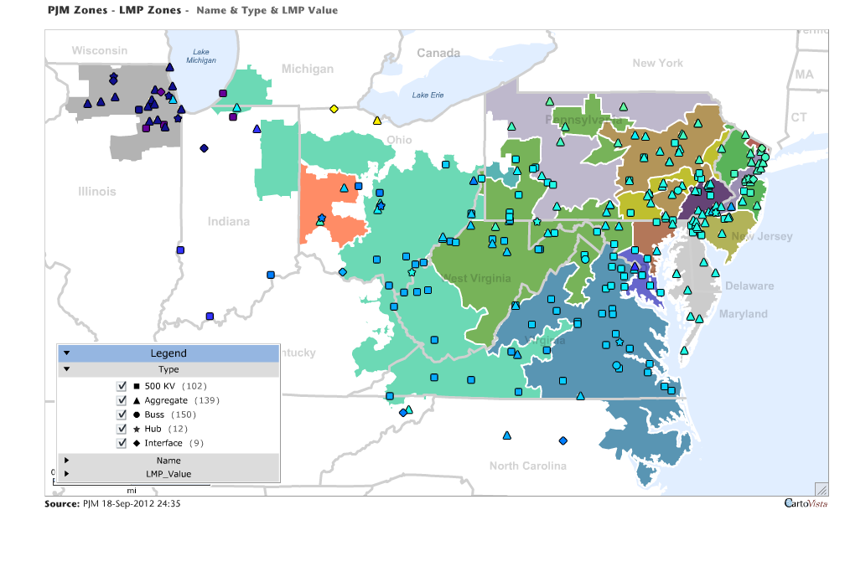
  BACKGROUND
  PJM Area
Regulations (CAIR, CSAPR) do not require EGUs with
≤ 25 MW capacity to report emissions (US EPA)
Peaking Units – EGUs that turn on only during highest electricity demand days (HEDD)
  Units are typically older, dirtier, less-regulated and in highly populated urban centers
  For PJM – typically occurs in July, August
Peaking unit power generation predicted one day ahead with DAYZER model used by energy traders.
Notes:
(there are local differences … have to have this straight for presentation … know the rule/law(s)
It is known that Electric Generating Units (EGUs) contribute to Nox emissions. That is why we have regulations in place that require EGUs that emit more than 26 MWh of electricity to report their emissions.
But what happens when a generating unit produces less than 26MWh? Most of these plants are known as Peaking Units, and they turn on during HEDD days, which are days when the forecasted electricity load is above a certain threshold. For the area that we are looking at, this sector is known as PJM – show map – and the threshold is…

Slide 4
Motivation
Strong potential for the EGU sector emissions to contribute to poor air quality
  Human health and welfare effects
Days most likely to have poor air quality are also the best candidates for HEDD and peaking unit use
  Hot, high solar intensity days are the best for photochemistry
On HED days accurate AQ prediction is critical but emissions inventories for the EGU sector are the least reliable.
CMAQ tends to underpredict peak AQ events for O₃ and PM
  (Foley et al., 2010)
hypothesis: CMAQ underestimation of peak AQ events is caused, in part, by under-represented EGU sector emissions

Slide 5
PJM Power Generation and AQ
PJM power generation correlates with measured O₃ and PM_{2.5} in NJ. Note: NAAQS Exceedances
35 ug/m3 NAAQS
O₃ (ppb_{v})
75 ppb_{v} NAAQS
PM_{2.5} (ug m⁻³)
15 ug/m3 NAAQS
Total PJM Power Generation (Mw Hr)
Notes:
As I said, EGUs effect Nox emissions, which affects ozone formation. In this graph showing Power generation in NJ correlated with Measured O3, we can see that there are several points above the NAAQS (national ambient air quality standard). We aren’t the only one’s noticing this problem.

Slide 6
Violation of O₃ - NOx
  Electricity Demand and O₃ Exceedence
Notes:
This shows Electricity demand versus Nox emissions from EGUs for region 1 of EPA, which is New England (Boston, Connecticut, Rhode Island, and stretches down to some of NYC and NJ). The Blue here are the non-ozone days and the red are the ozone days. And – show red box – we can see that there is a fairly strong correlation between high electricity demand and ozone days.

Slide 7
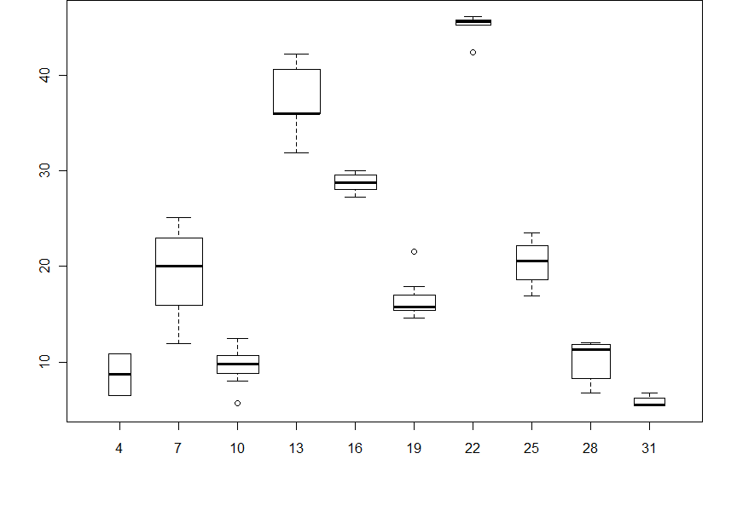
  Natural Experiment :: Blackout
During blackout change in measured
NJ PM_{2.5}
PM_{2.5} (ug m⁻³)
August, 2003

Slide 8
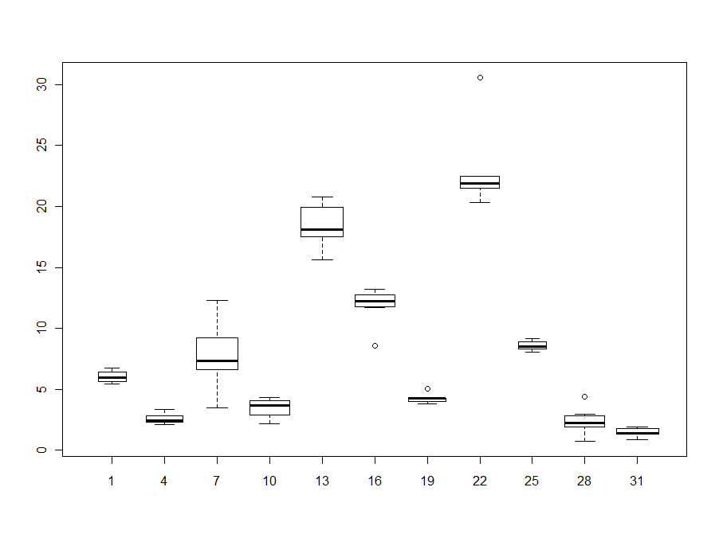
  Natural Experiment :: Blackout
Measured PM_{2.5} mass concentrations during blackout primarily due to sulfate
PM_{2.5} that is SO₄ (ug m⁻³)
August 2003
Notes:
This is nearly the same graph as the previous one, but this shows the PM2.5 that is **primarily** due to SO4, which we see is the majority of the PM2.5 we saw in the total graph.

Slide 9
DAYZER→SMOKE→CMAQ→BenMAP
  MODELING SYSTEM
Inline emissions for peak point sources
Meteorology Model (WRF)
Analysis
(MOVES)
Notes:
We are using several different models for this project. The first is the DAYZER model- next slide. (COME BACK) – with the DAYZER emissions, plus the emissions from other sectors (area, mobile, etc) and the meteorlogy, we can use a model known as SMOKE to get CMAQ model-ready data. Once we have the data, we can run CMAQ for our chosen time period and compare the output with NAMS/SLAMS observations. We plan to do this and compare the actual emissions from DAYZER and the peaking units with a “what-if” case of removing the dirty emissions from peaking units and replacing them with a clean energy source, like windmills. Using these simulations we can compare their societal costs using BenMAP.

Slide 10
DAYZER - Day Ahead Market Analyzer
  DAYZER MODEL
Simulates the day-to-day activity of the energy market
INPUTS:
Fuel
Prices
Generation Characteristics
Electricity Load Forecasts
DAYZER
(Day-Ahead Market Analyzer)
Total
Cost
Hourly Electricity Dispatch
Hourly Emissions
OUTPUTS:
Notes:
DAYZER gives us the emissions on a day-to-day basis at the boiler level – back a slide

Slide 11
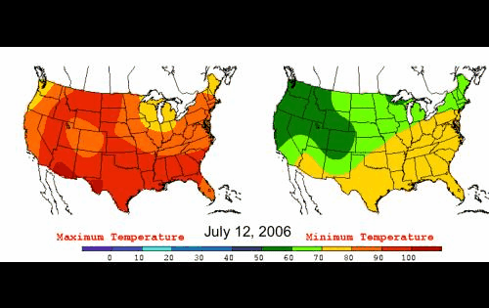
July 12, 2006 – July 25, 2006
  MODELED TIME PERIOD
Major heat wave over entire continental US
  Record temperatures (high and low)
Notes:
We chose the time period of July 12-August 7, 2006 for our model simulation, because this was one of the hottest heat waves on record in the US. It was such a big event, it even has its own wiki page, so it must be worth taking a look at right? The heat wave was mainly correlated with a continuous period of a line of high pressure systems that traversed the country, keeping temperatures at record highs both during the day and at night. This resulted in over 200 heat-related deaths during this time period. Since the temperatures were at record highs, we knew that nearly everyone would be running their Air conditions, and so this would be a good time to look at emissions.

Slide 12
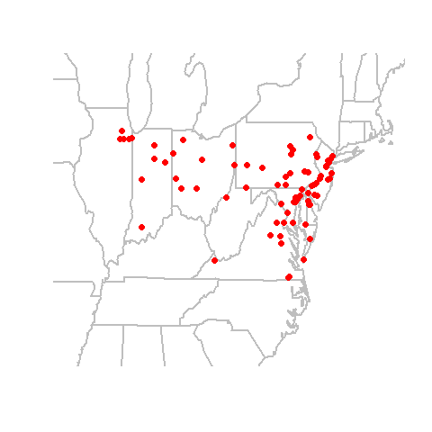
  PJM - Peaking Unit Locations
Units associated with ≤25MW-hr

Slide 13
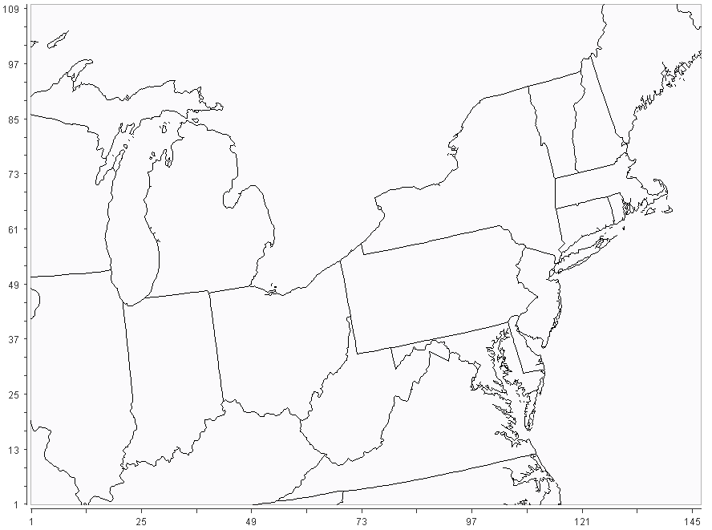
  CMAQ Model
CMAQv4.7
CB05-TU
BEISv3.14
WRFv3
12km x 12km
34 layers to 50mb
2005 NEIv4.2
- all EGU sector
emissions in inline
ptipm through
SMOKEv2.7
Notes:
34 layers to WHAT pressure?
Fix versions

Slide 14
DAYZER - Power generation
  RESULTS - DAYZER
Heat wave
Date
Notes:
These are results from the DAYZER model, just simply showing total power generation in PJM sector for the time period I discussed. The heat wave is clear and shows a distinct increase in generation.

Slide 15
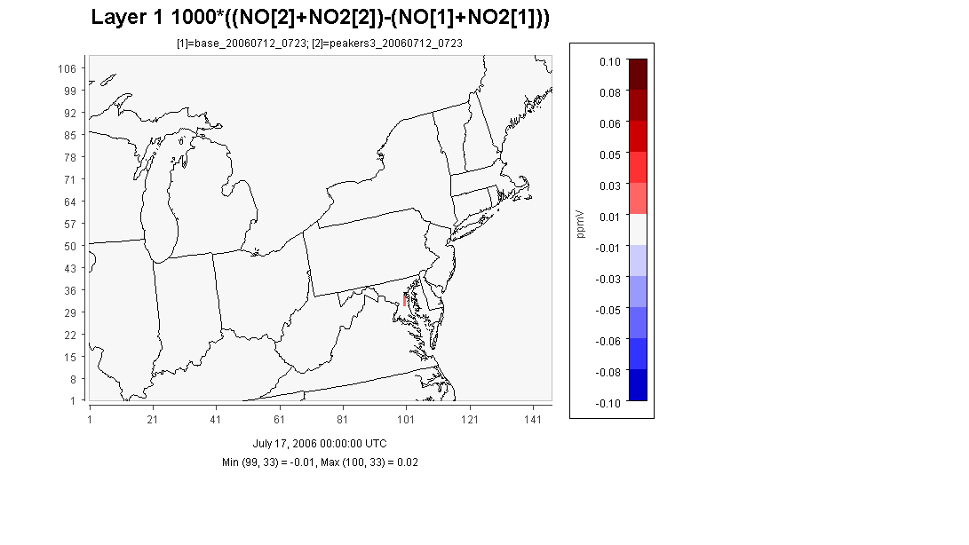
NOx Emissions from Peaking Units during height of Heat Wave
  RESULTS

Slide 16
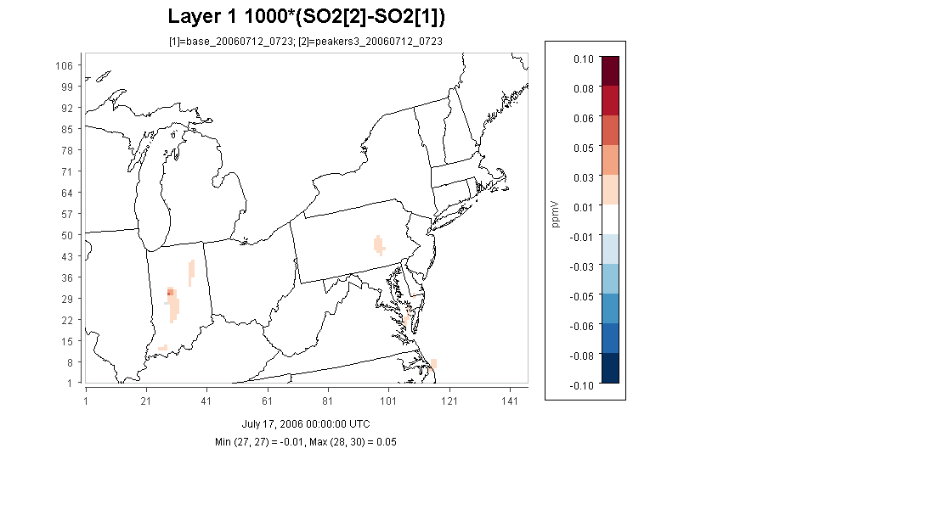
SO₂ Emissions from Peaking Units during height of Heat Wave
  RESULTS

Slide 17
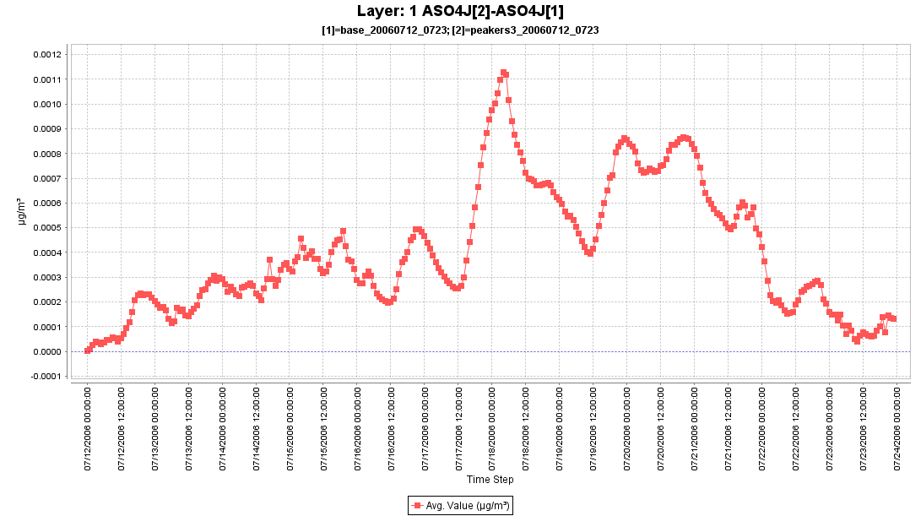
Increase in Sulfate Due to Peaking Units
  RESULTS

Slide 18
Summer time series:
Total PJM Power Generation and Measured PM_{2.5} in NJ
Heat wave
Total PJM Power Generation
(Mw Hr)
PM_{2.5} (ug m⁻³)
15 ug/m3 (24hr) NAAQS
Date

Slide 19
Summer time series:
Total PJM Power Generation and Measured O₃ in NJ
Heat wave
Total PJM Power Generation
(Mw Hr)
O₃ (ppb_{v})
75 ppb (8hr) NAAQS
Date

Slide 20
Conclusions:
Successfully translated DAYZER output to CMAQ input through SMOKE
Clear relationship between power generation and air quality
Future Directions:
Better estimate peaking unit contribution to air quality
Sensitivities of peaking unit stack characteristics and emission factors
BenMAP analysis for societal cost of unrestricted EGU emissions
Future predictions with clean energy replacing peaking units

Slide 21
Acknowledgments
Tonalee Key (NJ DEP) for her initial ideas on peaking units and their effect on air quality.
Rob Pinder and David Wong for their guidance on CMAQ
BH Baek for his assistance with the SMOKE model
Tyler Wibbelt for his contribution to emission factors
Emissions provided by EPA

