Slide 1
Uncertainties influencing dynamic evaluation of ozone trends
Wei Zhou and Daniel Cohan
Rice University
10th Annual CMAS Conference
October 26, 2011

Slide 2
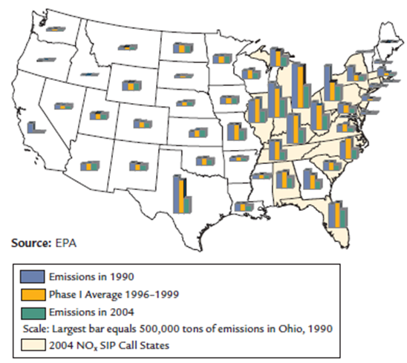
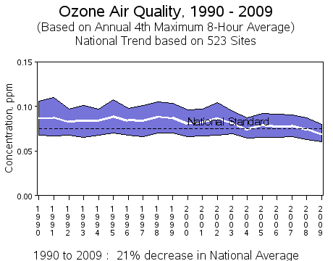
Emission reduction leads to the improvement of air quality
US EPA,2010

Slide 3
Objectives
Evaluate the performance of air quality model in modeling air quality trend
- identify the direction and magnitude of trend
- characterize the spatial feature
Investigate the impact of uncertain parameters on modeling O3 trend
- Meteorology
- Emission estimate and trend
- Chemical reactions

Slide 4
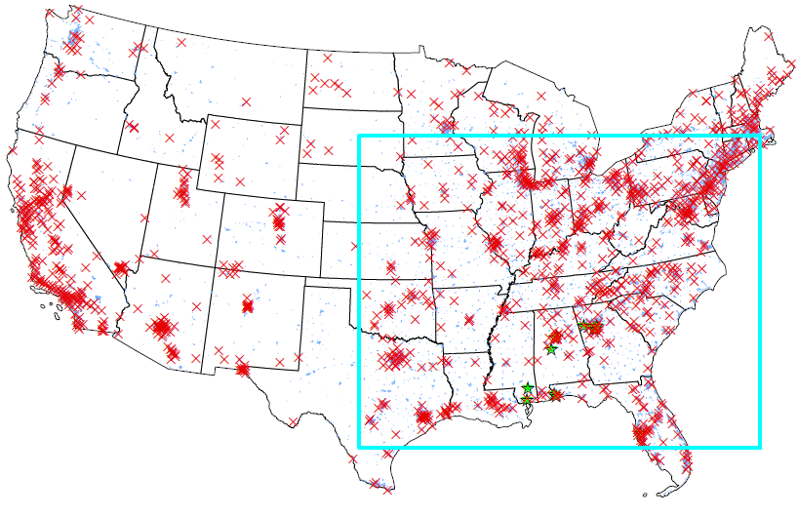
Modeling summer ozone change from 2002 to 2006
Substantial emission reduction and O3 decrease
Consistent modeling systems for both years
Observational data for modeling evaluation

Slide 5
Emission trend from 2002 to 2006
Year | Elevated emission (ktons) | Ground emission (ktons) | Total (ktons)
2002 | 1324 | 2193 | 3517
2006 | 930 | 2012 | 2942
Difference(2006-2002) | -29.8% | -8.3% | -16.3%
Elevated emission: greater reduction and relatively low uncertainty
Ground emission: less reduction and higher uncertainty
Notes:
Elevated emission: Electrical Generating Units (EGUs) and Non-EGUs
Ground emission: mobile, non-road, and other sources

Slide 6
Metrics to evaluate ozone change
Difference of concentration (DIF) = C(2006)-C(2002)
-Negative: downward trend
-Positive: upward trend
95th percentile of cumulatively distributed 8hr O3 concentration
Daily maximum 8hr O3 averaged over the episode

Slide 7
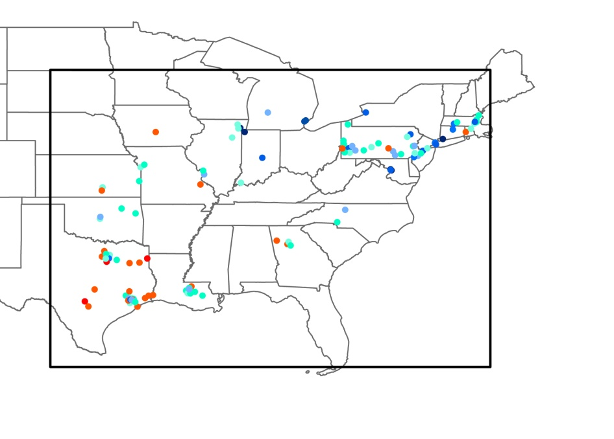
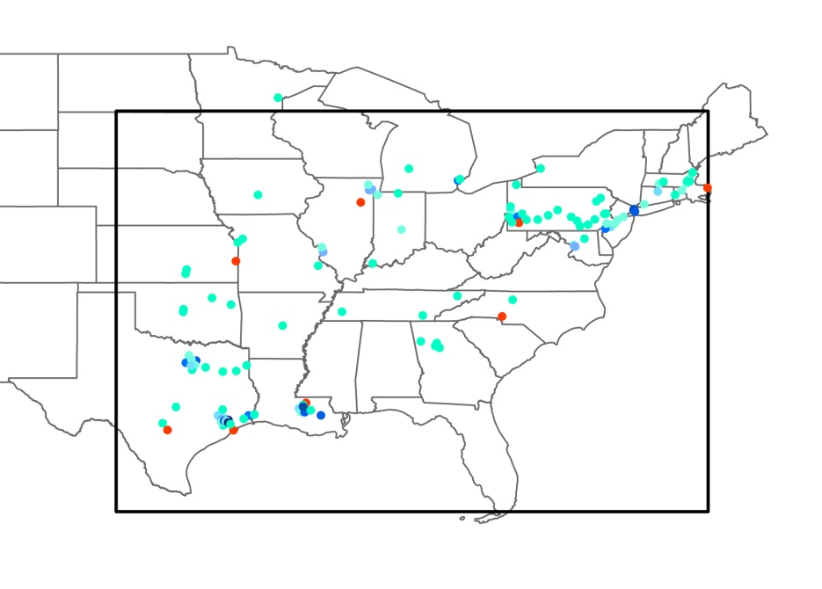
Comparison of NOx change between model and observation
DIF_OBS_NOx
DIF_NOx(ppb)
DIF_MOD_NOx

Slide 8
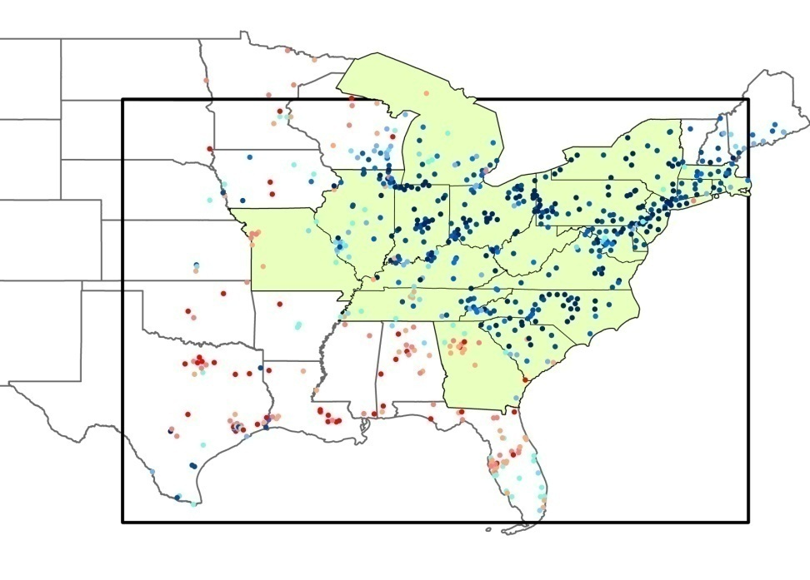
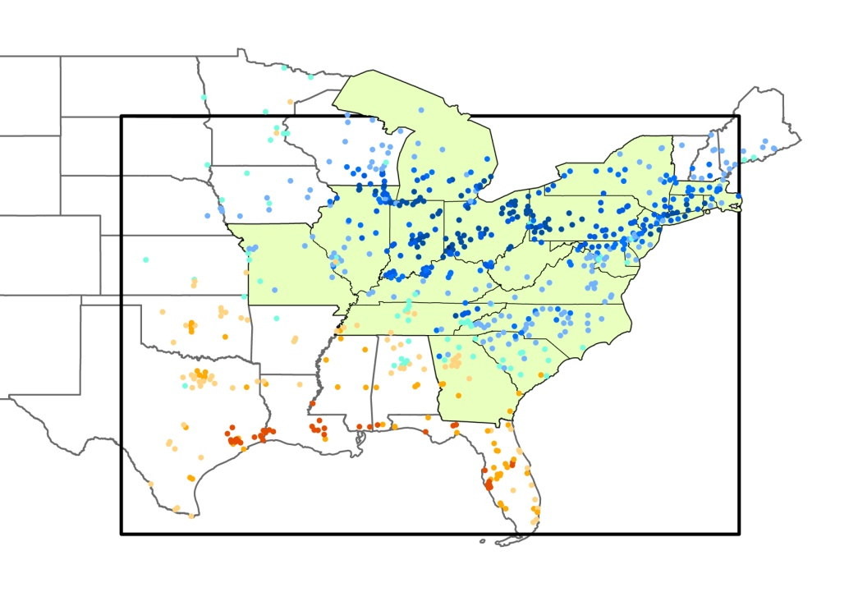
Comparison of O3 change between model and observation
DIF_OBS_O3
DIF_O3(ppb)
DIF_MOD_O3

Slide 9
No clear correlation between ozone trend and temperature variability
DIF_TEMP= daily maximum temperature in 2006- daily maximum temperature in 2002

Slide 10
Evaluating modeled NOx and O3 trend in large urban areas

Slide 11
Improvement of modeled O3 trend by adjusting NOx emission
NOx Adjustment factor= 1-OBS_NOx/MOD_NOx
 | Atlanta | Chicago | Houston | New York | Pittsburgh | Philadelphia
2002 | 0.14 | -0.09 | -0.3 | -0.26 | 0.3 | -0.05
2006 | 0.20 | -0.20 | -0.3 | -0.28 | 0.3 | -0.11

Slide 12
Uncertain parameters affecting the simulation of O3 trend
NOx emission
- emission estimate
- emission reduction trend
VOC emission
Chemical reaction
- photolysis rates
- reaction rate (e.g. OH+NO2->HNO3)

Slide 13
Perturbing uncertain parameters to improve the simulation of O3 trend
Decrease NOx estimate
Increase NOx reduction trend
Decrease VOC emission
Increase photolysis rates
Decrease the reaction rate of OH+NO2-> HNO3

Slide 14
Conclusion
Model generally captures the direction of O3 change but significantly underestimates the magnitude of O3 decrease
Adjusting NOx emission improves the modeling of O3 downward trend but the O3 decreases remain underestimated
Modeled O3 trend can be modestly improved by perturbing uncertainty in NOx emission and trend, VOC emission, photolysis and chemical reactions

Slide 15
Acknowledgement
National Science Foundation CAREER Award #0847386
Sergey Napelenok of US EPA
US EPA Air Quality System(AQS)

