Slide 1
Air Pollution Retention Within a Complex of Urban Street Canyons
Jennifer Richmond-Bryant, Adam Reff
U.S. EPA, RTP NC 27711

Slide 2
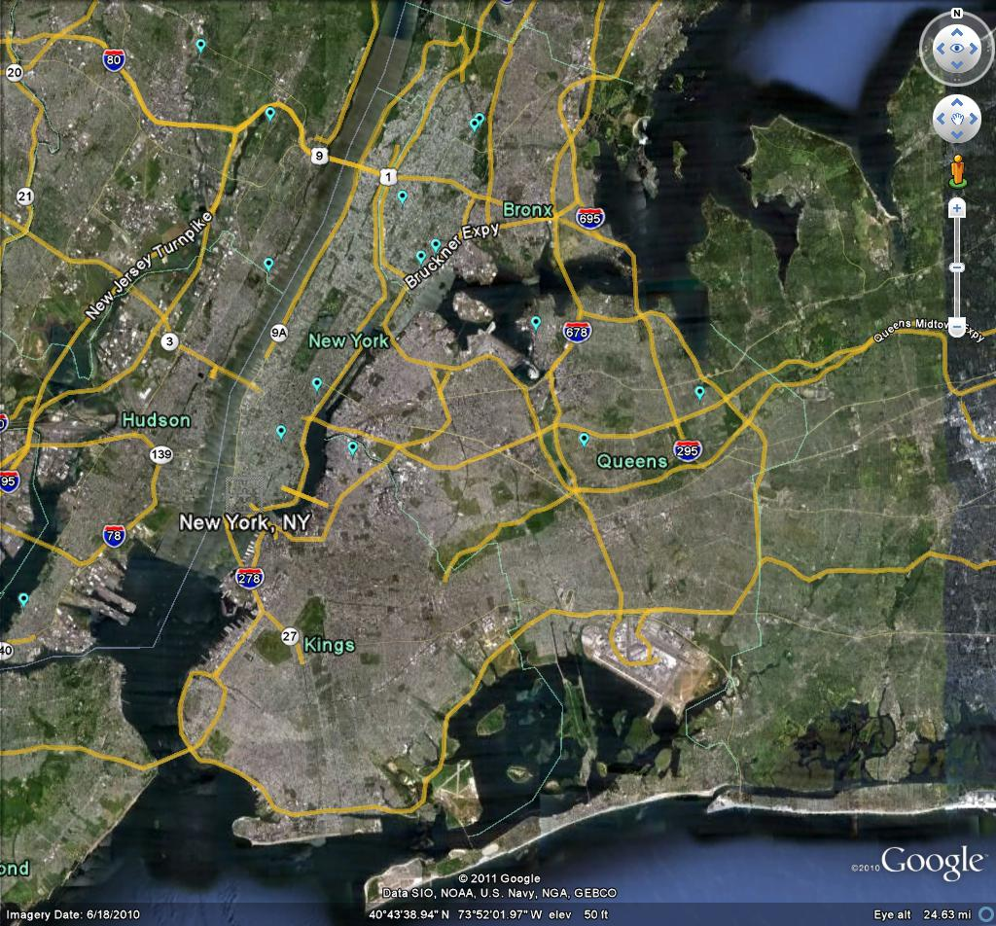
Introduction
Human exposure to air pollutants generally estimated by central site monitors
Central site monitors may not characterize spatial and temporal concentration variability
Use of central site data may cause error in health effects estimates
  Biases estimates towards the null
  Widens confidence intervals
Example: 11 NO₂ monitoring sites in NYC for population of 8 million

Slide 3
Hypothesis and Objective
Hypothesis: In dense urban areas, spatiotemporal variability in concentration can be estimated using data on:
  Building topography
  Meteorology
  Local source strength, duration, and location
Objective: Develop a simple modeling approach to estimate spatiotemporal variability in concentration in dense urban areas
  Spatiotemporal variability attributable to building topography and meteorology is studied here

Slide 4
Potential Applications
Estimate sub-grid scale variability for dense urban areas to be incorporated in chemical transport modeling
  Coarse resolution of 1-36 km
Estimate uncharacterized heterogeneity in human exposures for application in epidemiological models of the health effects of air pollution
Estimate short-term decay of contaminants in urban areas

Slide 5
Theory
WIND
WIND
Bluff body theory provides a simple model for contaminant transport in complex urban street canyons
Size of wake depends on Reynolds number
Contaminant can cross streamline bounding wake only by turbulent diffusion
Street canyon bounded by streamline of wind and by upstream buildings
Based on Humphries and Vincent (1976)

Slide 6
Theory
U
U
WIND
D
WIND
D
l
W
H = Uτ/D = f(UD/ν, k^{0.5}/U, l/D, D/W)
= f(Re, turbulence intensity, shape)
  H = nondimensional residence time of pollutant in canyon
  τ = residence time
  k = turbulence kinetic energy of the wind
  ν = kinematic viscosity
  Re = Reynolds number
Based on dimensional analysis and derived from the equation of scalar flux transport
Based on Humphries and Vincent (1976)

Slide 7
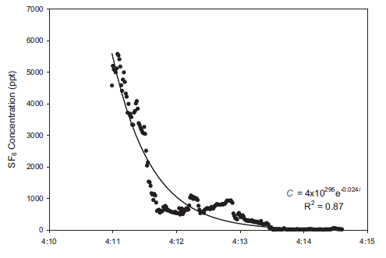
Data Analysis
SF₆ tracer gas released in large cities
  Concentration measured at various sites
Wind data from sonic anemometers or SODAR
Building height and street width data from GIS
Calculated H, Re, D/W, k^{0.5}/U
Plotted H vs. Re, D/W, k^{0.5}/U
Data validated by reserving data from select samplers
Example of exponential decay fit to concentration data to obtain τ

Slide 8
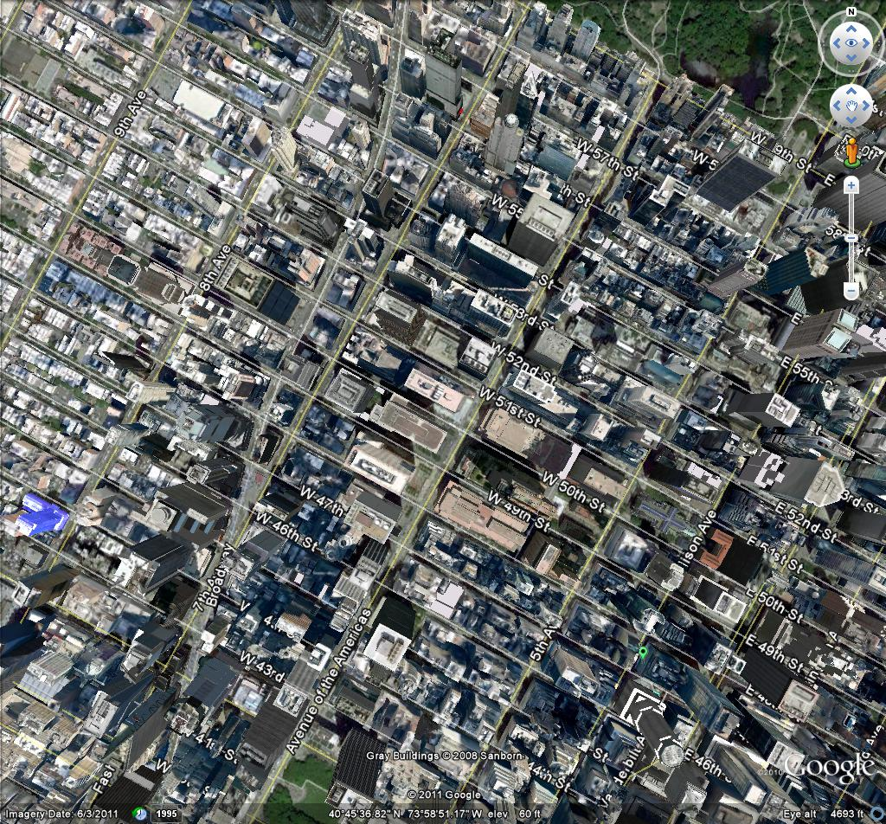
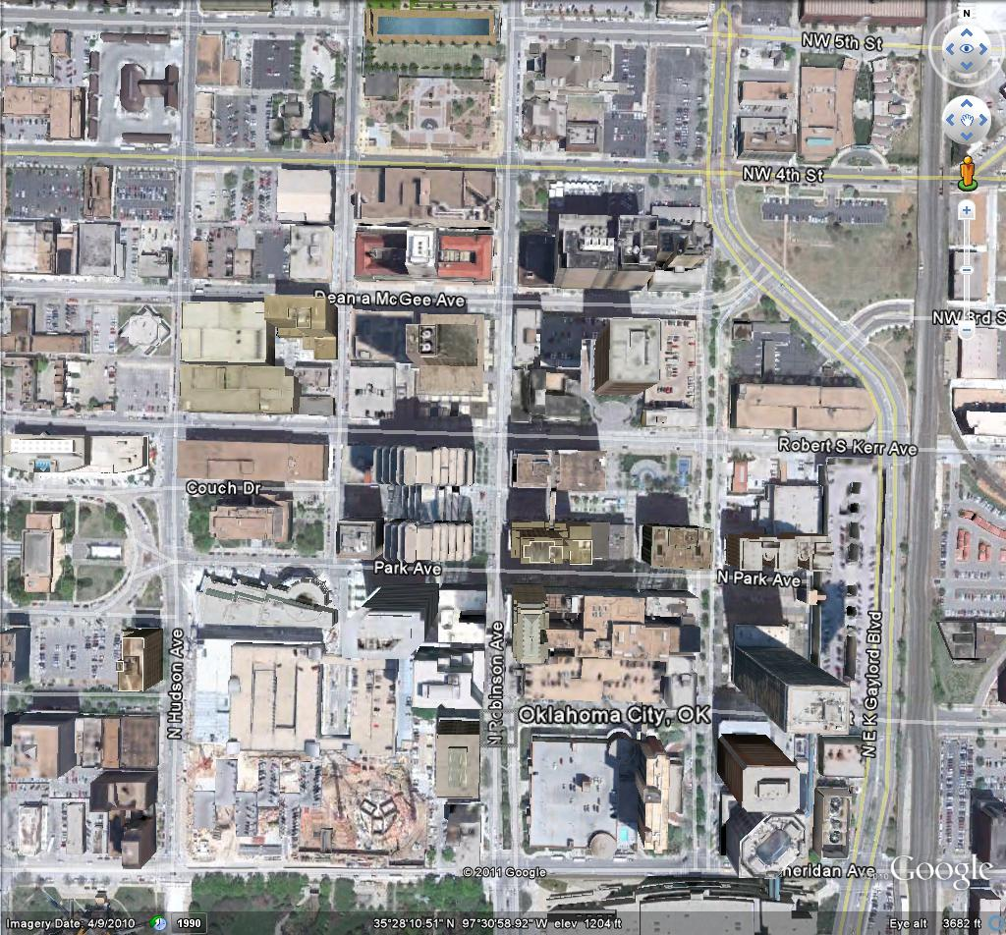
Study Sites
Mid-town Manhattan (MID05)
D: 9 – 261 m; D/W: 0.49 – 26.2
Oklahoma City (JU2003)
D: 4 – 119 m; D/W: 0.06 – 4.4

Slide 9
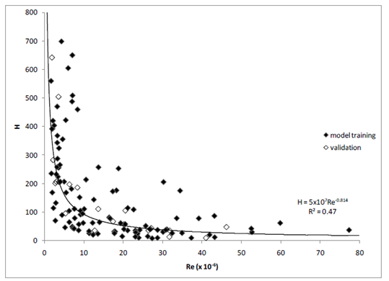
MID05: H vs. Re
Scatter visible
Significant fit:
  H = 5x10⁷Re^{-0.814}
  R² = 0.47
  p < 0.0001

Slide 10
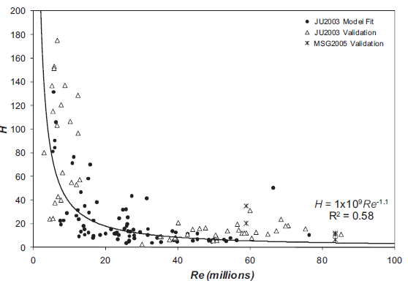
JU2003: H vs. Re
Significant fit:
  H = 1x10⁹Re^{-1.1}
  R² = 0.58
  p < 0.001

Slide 11
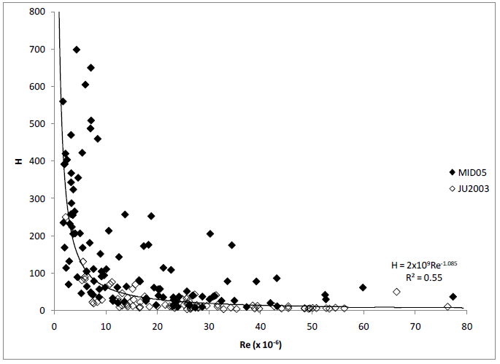
Two Cities: H vs. Re
Significant fit:
  H = 2x10⁹Re^{-1.085}
  R² = 0.55
  p < 0.0001
Comparison with single city models:
  H_{joint} = 2.5H_{JU2003} + 0.64
  H_{joint} = 0.81H_{MID05} – 24.37

Slide 12
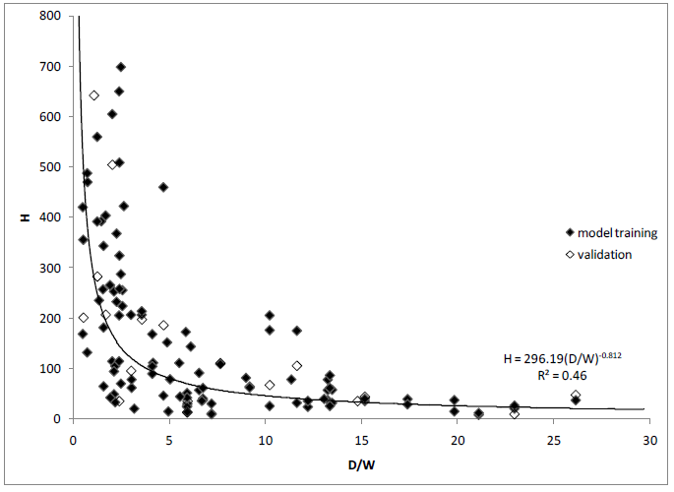
MID05: H vs. D/W
Scatter visible
Significant fit:
  H = 296(D/W)^{-0.812}
  R² = 0.48
  p < 0.0001

Slide 13
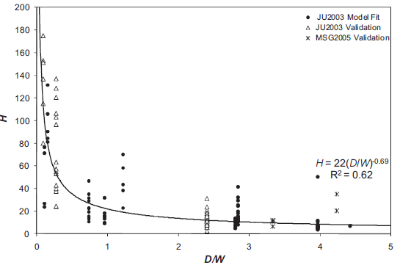
JU2003: H vs. D/W
Significant fit:
  H = 22(D/W)^{-0.69}
  R² = 0.62
  p < 0.001

Slide 14
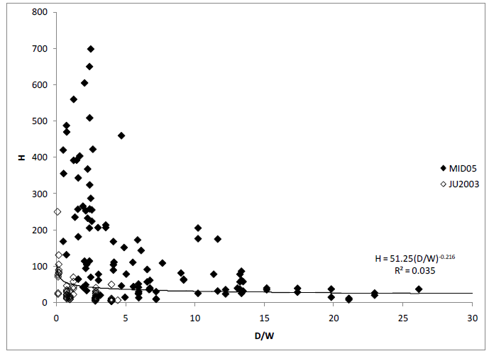
Two Cities: H vs. D/W
Poor fit:
  H = 51(D/W)^{-0.812}
  R² = 0.035
  p = 0.022

Slide 15
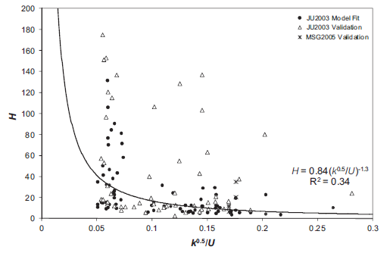
JU2003: H vs. k^{0.5}/U
Moderately poor fit:
  H = 0.84(k^{0.5}/U)^{-1.3}
  R² = 0.34
  p < 0.001

Slide 16
Discussion
For single city analyses, reasonable fit developed for H vs. Re and H vs. D/W
Multi-city models produced varying results
  H vs. Re model fit well, but was biased compared with the single city models, especially for JU2003
  H vs. Re model may be generalizable with inclusion of more cities
  H vs. D/W model fit poorly, not appropriate tool for estimating concentrations in other cities
  Maybe something about cities (e.g. heterogeneity of building design) causing poor multi-city fit for H vs. D/W model
Turbulence kinetic energy modeling produced poor fit for MID05 (not shown), moderately poor fit for JU2003
  Possible that turbulent wind data are less reliable than average wind data

Slide 17
Current Limitations
This analysis applies to a non-reactive gas
Need controlled releases for model development
  Expensive
Controlled releases in experiments do not replicate pollutant sources that vary in time and over space
Boundary layer winds are assumed to be constant over each decay period rather than fluctuating
Buildings assumed rectangular but have complex façades that affect airflow separation
Method only accounts for building immediately upwind of the sampler

Slide 18
Conclusions
Attributes of this approach:
  Based on fundamental fluid mechanics
  Simple to apply
  Provides insight into spatiotemporal variability in the concentration field
More investigation is needed to characterize generalizability of this method based on influence of:
  Building façade (and variability of architecture)
  Other meteorological conditions (e.g. urban boundary layer, temperature)

Slide 19
Future Work
Test models for more cities to determine if overall fit can be applied
Extend theory to reactive gases
Extend application to particulate matter
  Theory has already been developed by Humphries and Vincent (1978) for fine and larger PM
Use existing wind tunnel data to explore:
  Relationship between contaminant residence time and turbulence kinetic energy
  Effect of building façade

