Slide 1
Using CMAQ to Quantify the Climate Change Impacts of US Reactive Nitrogen Emissions: Source Attribution and Bounding Uncertainty
Robert W. Pinder |  | US EPA, Office of Research and Development
Eric Davidson |  | Woods Hole Research Center
Christine Goodale |  | Cornell University
Tara Greaver, Jeffrey Herrick, Lingli Liu |  | US EPA, Office of Research and Development

Slide 2
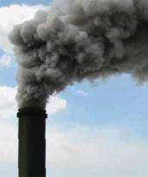
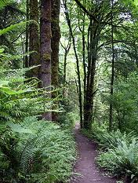
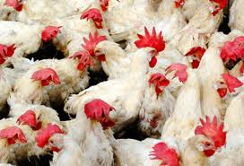
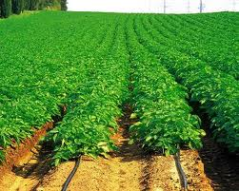
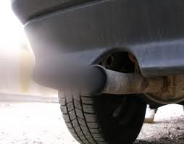
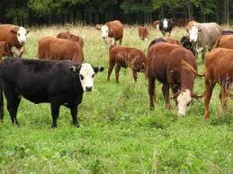
CH₄ (decade)
N₂O (century)
CO₂ (centuries)
Greenhouse gases
Short-lived forcers
Aerosols (days)
O₃ (weeks)
Combustion
Emissions: NO_{x},
N₂O, and NH₃
Natural Landscapes
Ag. Emissions: NH₃, N₂O, and NO_{x}
Uptake and emission of
(increase uptake) CO₂
(increase emission) CH₄
(increase emission) N₂O

Slide 3
How to compare impacts across multiple timescales?
How to quantify the myriad of multi-media interactions?
Need a common metric.

Slide 4
Metric: Global Temperature Potential
Change in temperature at time t due to a 1 kg pulse of emissions
Expressed in CO₂ equivalents
Calculated for a specific time t
GTP₂₀ or GTP₁₀₀
For short-lived species, GTP₂₀ >> GTP₁₀₀

Slide 5
Qualitative example adapted from Shine et al. 2006
20 years
20 years
100 years
100 years
20 years
100 years

Slide 6
Multi-media impacts of reactive N nitrogen |  | Calculation
1. | N₂O | Emissions × GTP
2. | N deposition → CO₂, CH₄, N₂O flux | Deposition × GHG flux × GTP
3. | N fertilizer → CO₂, CH₄, N₂O flux | Fertilizer × GHG flux × GTP
4. | Surface ozone → CO₂ flux | Felzer et al., 2004
5. | NO_{x} → reduce methane, increase ozone | Emissions × GTP
6. | NO_{x} → aerosols | Emissions × GTP
7. | NH₃ → aerosols | Emissions × GTP

Slide 7
Goal: Calculate climate change impact of anthropogenic N deposition Principles:
Empirical data where possible
Bounding exercise
Quantify uncertainties and propagate through analysis

Slide 8
Approach:
Calculate N deposition from CMAQ
Map to land cover: forest, grassland, cropland
Convert N deposition to GHG flux using two types of empirical studies
Meta-analysis of controlled experiments: (Liu and Greaver, 2009)
Gradient study of Northeastern US forests: (Thomas et al., 2010)

Slide 9
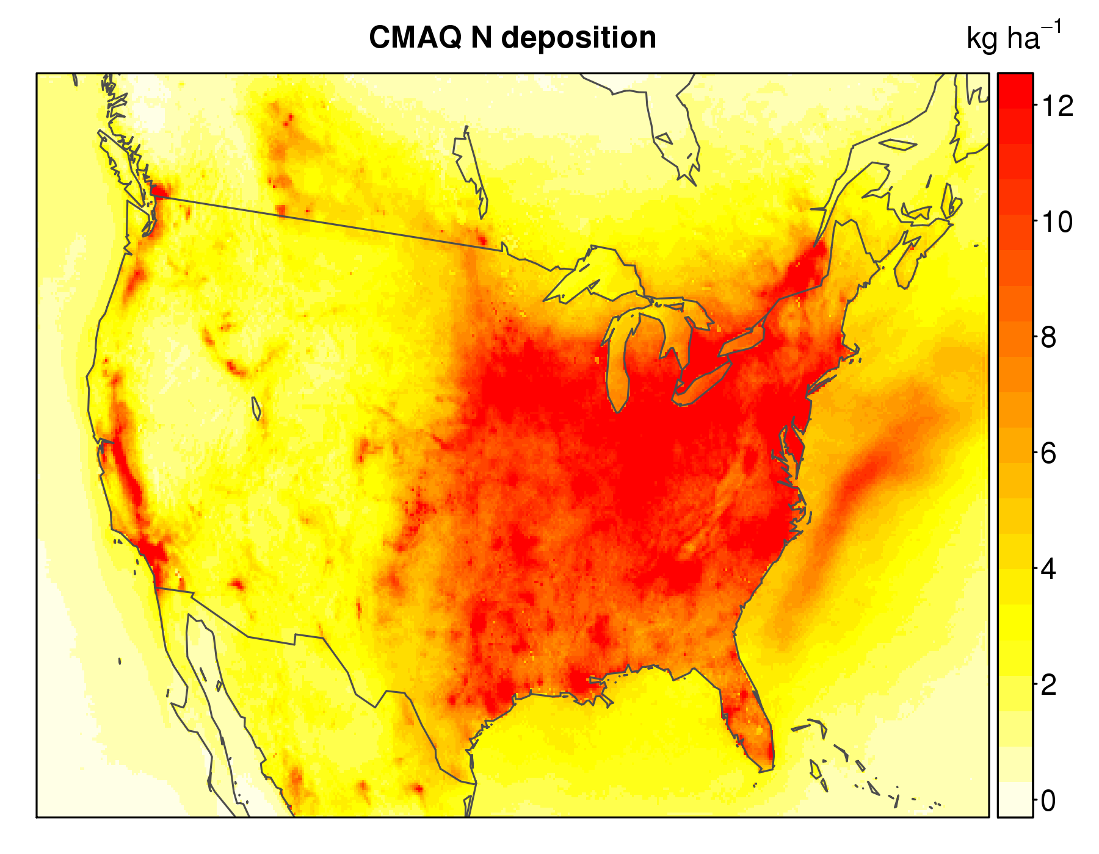

Slide 10
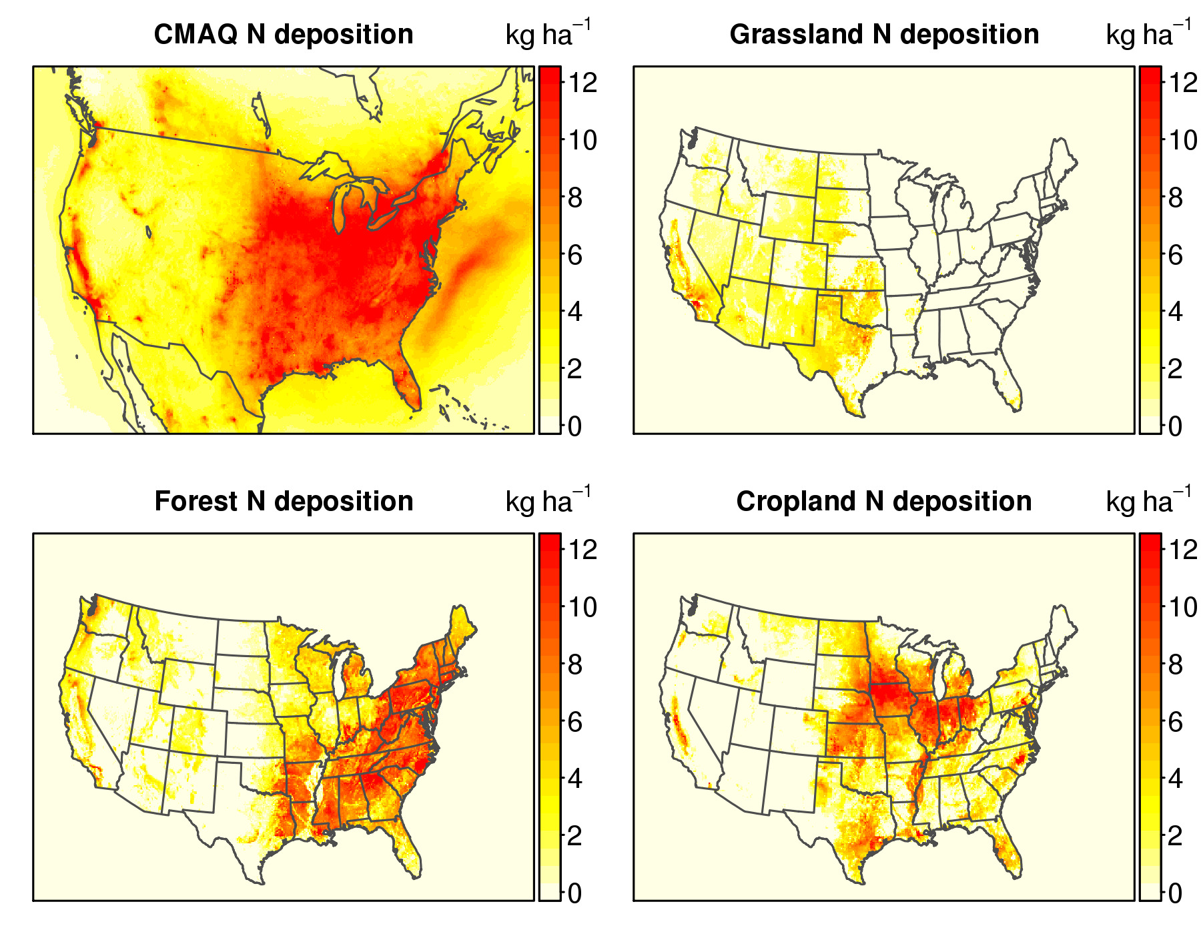

Slide 11
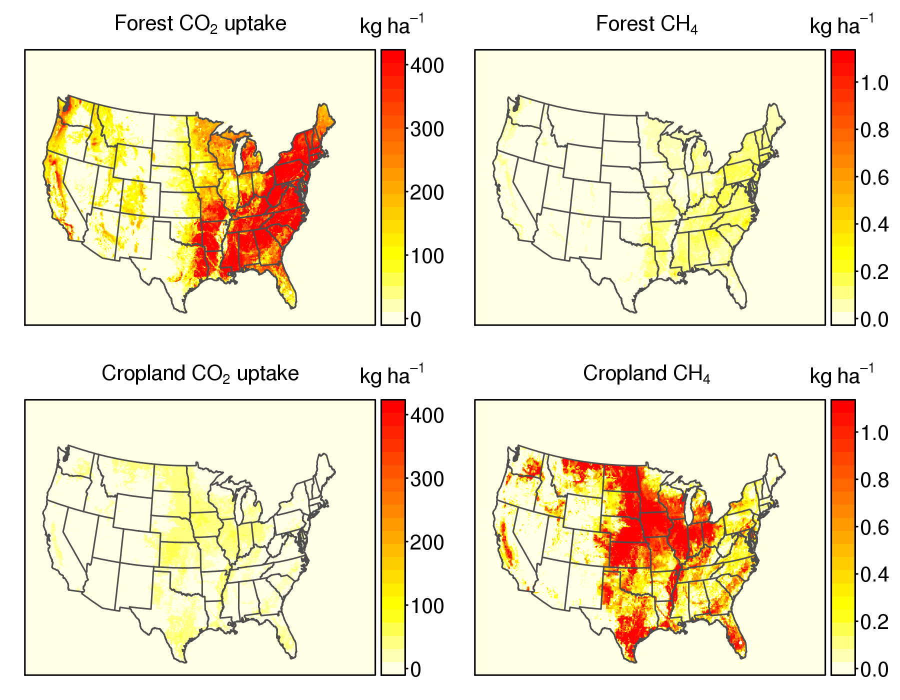

Slide 12
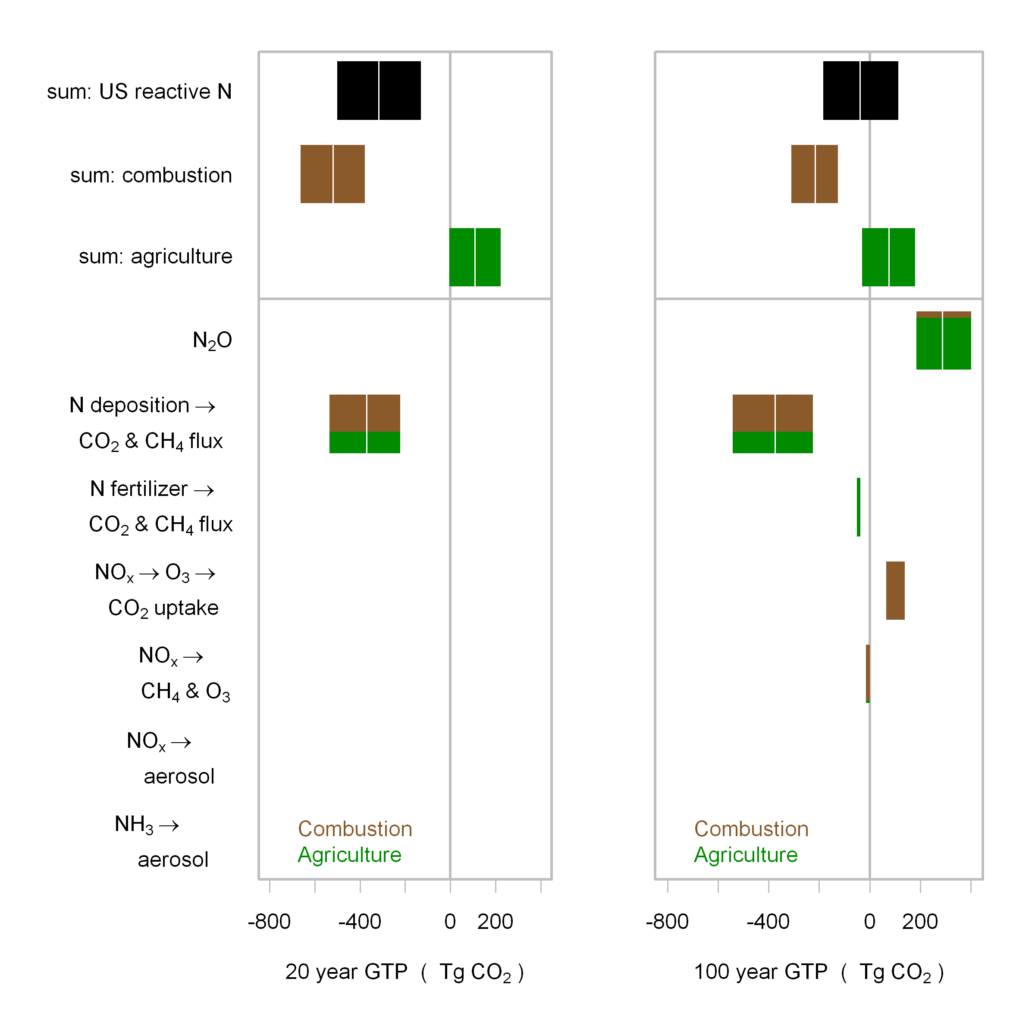

Slide 13
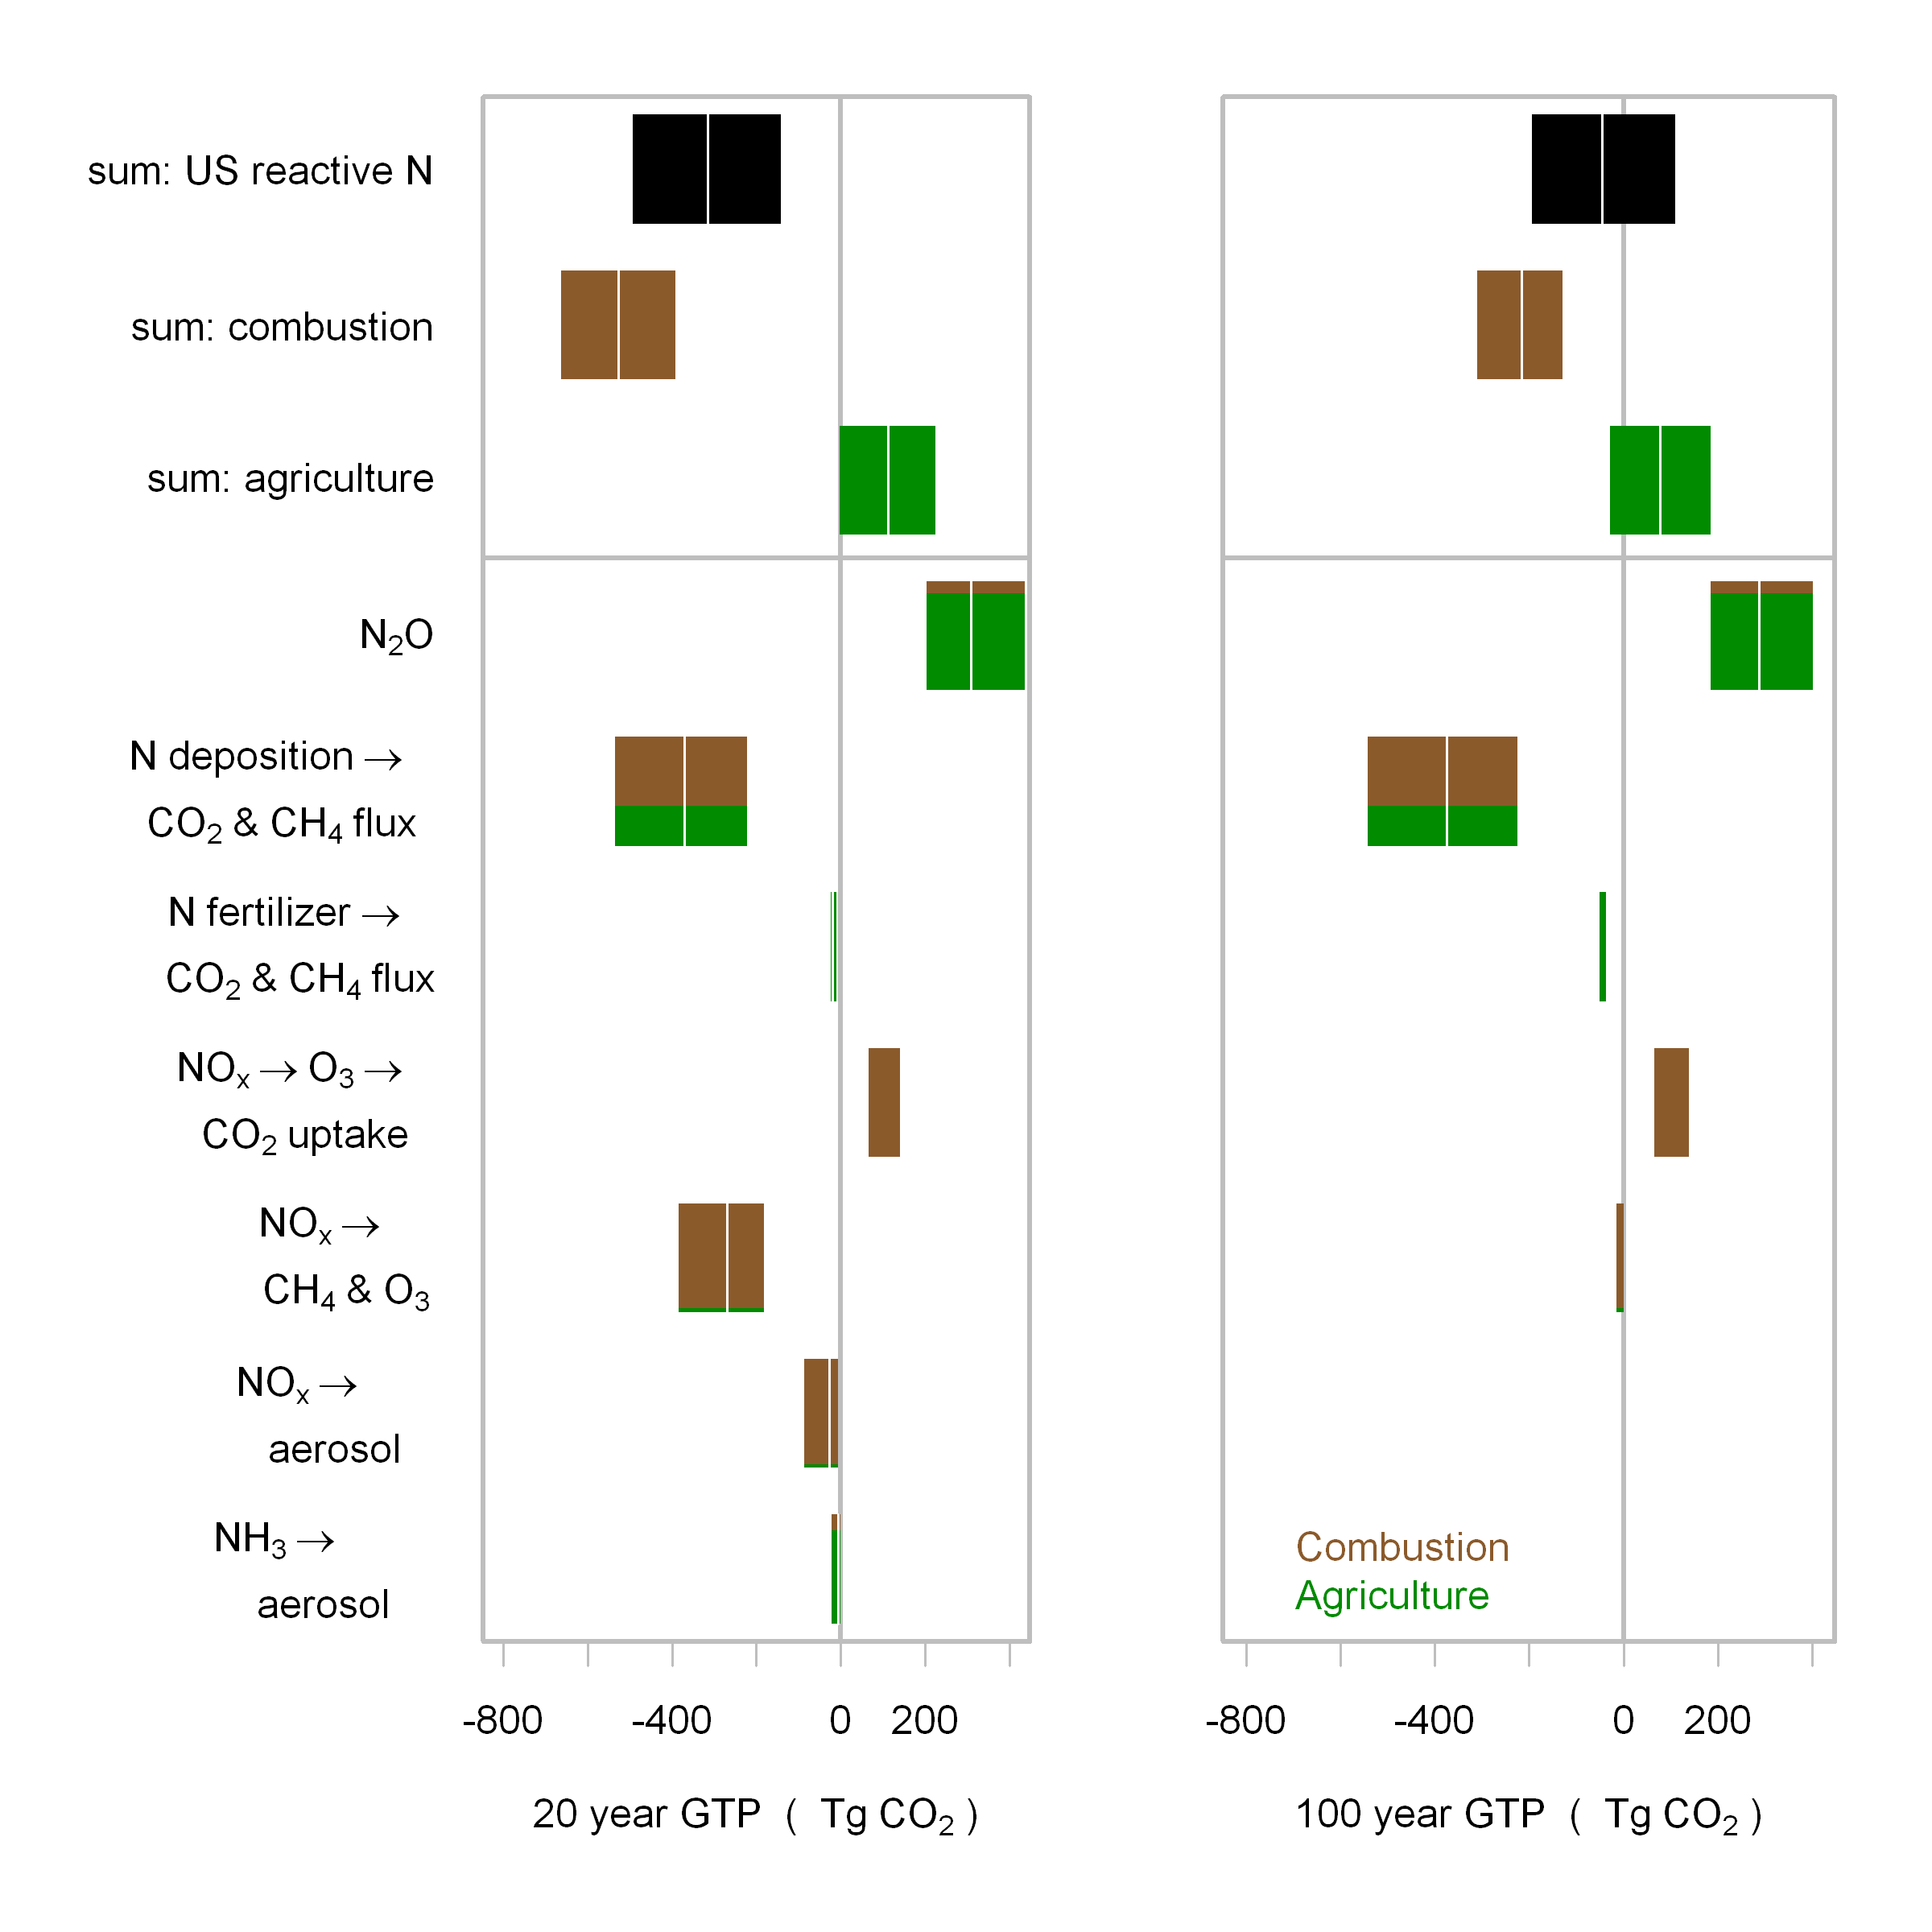

Slide 14
Conclusions
Reactive nitrogen from US combustion sources is likely causing cooling
Reactive nitrogen from US agricultural sources is likely causing warming
Combustion sources are declining
Agricultural sources are likely increasing, but best management practices are available

Slide 15
Motivation
We have substantially altered the nitrogen cycle
The nitrogen and carbon cycles are inter-connected
Critical to designing policies for
Climate change mitigation
Ecosystem health
Air quality management

