Slide 1
Effects of Grid Resolution and Perturbations in Meteorology and Emissions on Air Quality Simulations Over the Greater New York City Region
Christian Hogrefe^{1,2,*}, Prakash Doraiswamy², Brian Colle³, Ken Demerjian², Winston Hao¹, Mark Beauharnois², Michael Erickson³, Matthew Souders³, and Jia-Yeong Ku¹
¹New York State Department of Environmental Conservation, 625 Broadway, Albany, NY
²Atmospheric Sciences Research Center, University at Albany, 251 Fuller Road, Albany, NY
³School of Marine and Atmospheric Sciences, Stony Brook University, Stony Brook, NY
*Now at U.S. Environmental Protection Agency, RTP, NC
Acknowledgments and Disclaimer: The model simulations analyzed in this presentation were performed by the New York State Department of Environmental Conservation (NYSDEC) with partial support from the New York State Energy Research and Development Authority (NYSERDA) under agreement #10599. The views expressed here do not necessarily reflect the views or policies of U.S. EPA, NYSDEC or NYSERDA.

Slide 2
Objectives
Quantify and compare the relative impacts of perturbations in meteorology, emissions, and grid resolution on CMAQ predictions of 8-hr daily maximum O₃ and 24-hr average PM_{2.5}
How do these impacts vary in time and space?
How do these factors vary on a diurnal scale for wintertime PM_{2.5}?
Evaluate the overall ensemble and three sub-ensembles (meteorology, emissions, and grid resolution) using probabilistic metrics
How well do these ensembles capture threshold exceedance probabilities?

Slide 3
Overview
Meteorological Perturbations (12 members):
Use of twelve MM5 and WRF weather forecasts from the Stony Brook ensemble system to drive CMAQ4.7.1
36 km / 12 km domains
Emission Perturbations (100 members):
Use of a single MM5 ensemble member to drive CMAQ4.7.1 configured with DDM to calculate sensitivities towards perturbations in NO_{x}, VOC, and PM_{2.5} emissions
The NO_{x}, VOC, and PM_{2.5} emission perturbations considered in this study were sampled from a uniform distribution representing an uncertainty range of +/-50%
36 km / 12 km domains
Grid Resolution Perturbations (81 members):
Use of WRF-UCM 36km/12km/4km/1.33km to drive CMAQ4.7.1
Consider the 81 1.33 km cells within each 12 km cell as perturbations from the 12km base case
Caveat: There is no common “base” setup between these three sets of simulations

Slide 4
Overview (Continued)
All simulations were performed for August 1 – 31, 2010 and January 1- February 15, 2011
All analysis was performed for the smallest domain common to all simulations, i.e. the 1.33 km modeling domain (details next slide)
Analysis focuses on daily maximum 8-hr O₃ and 24-hr average PM_{2.5}

Slide 5
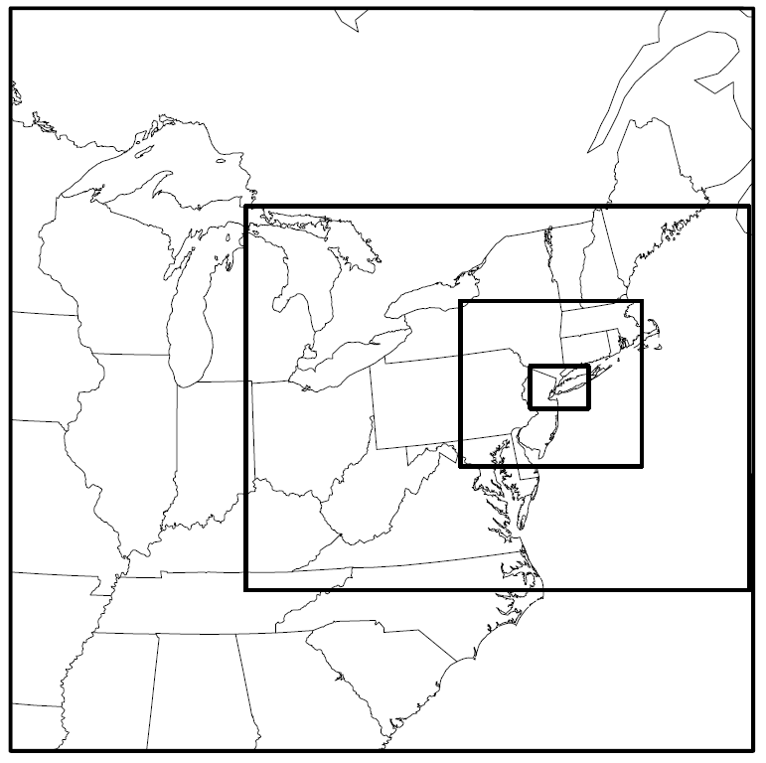
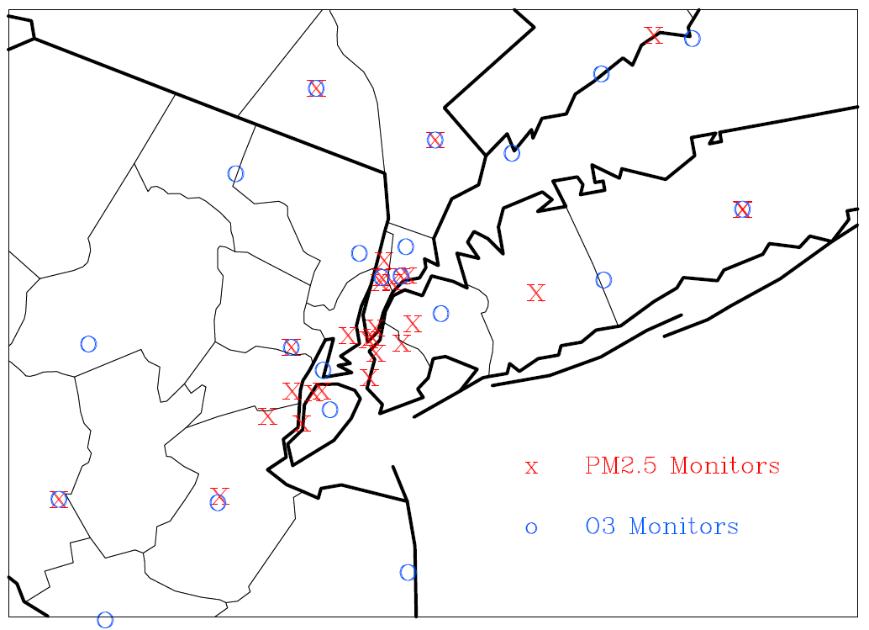
Location of Hourly O₃ and PM_{2.5} Monitors Within the Analysis Domain (Identical to the 1.33 km Domain Shown on the Left)
36 km , 12 km, 4 km, and 1.33 km Domains Used for the Grid Resolution Ensemble Simulations
Note: the meteorological and emission perturbation ensemble simulations were performed on nested 36 km / 12km domains. While similar in spatial extent to the 36 km / 12 km domains shown above, a slightly different projection center was used and the 12 km outputs from these simulations were regridded to the analysis domain shown on the right

Slide 6
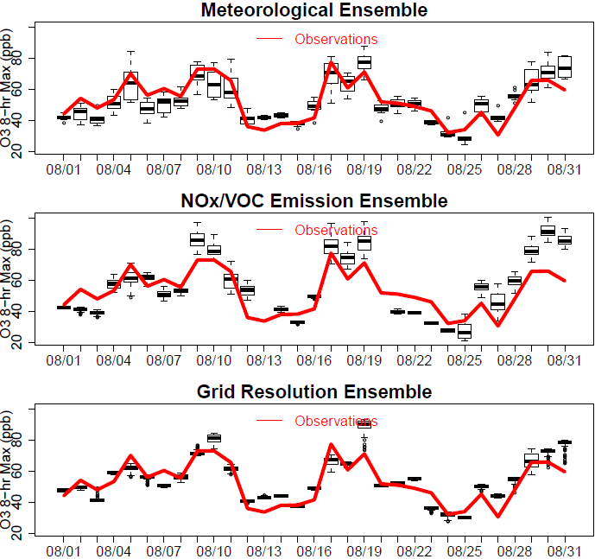
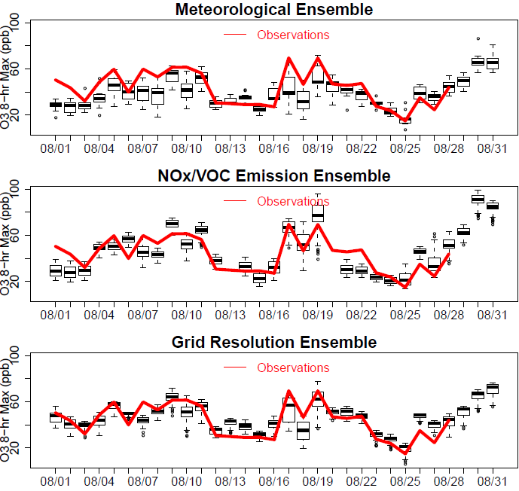
Example: Observed and Ensemble Daily Maximum 8-hr O₃, August 2010
Stratford, CT
Manhattan, NY
Qualitatively, ozone fluctuations during August 2010 were captured by the various ensembles
Grid resolution effects are more pronounced for the Manhattan monitor than the CT monitor
More generally, the effects of the various ensemble perturbations vary over space and time

Slide 7
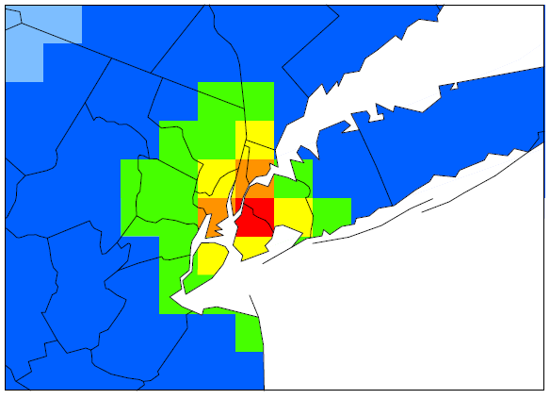
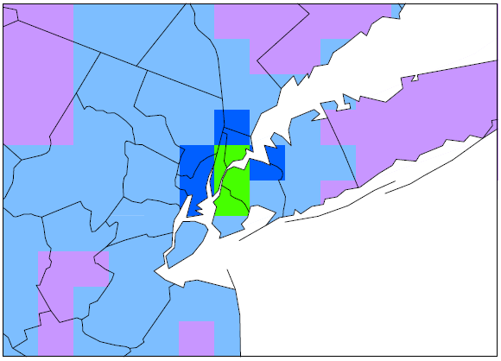
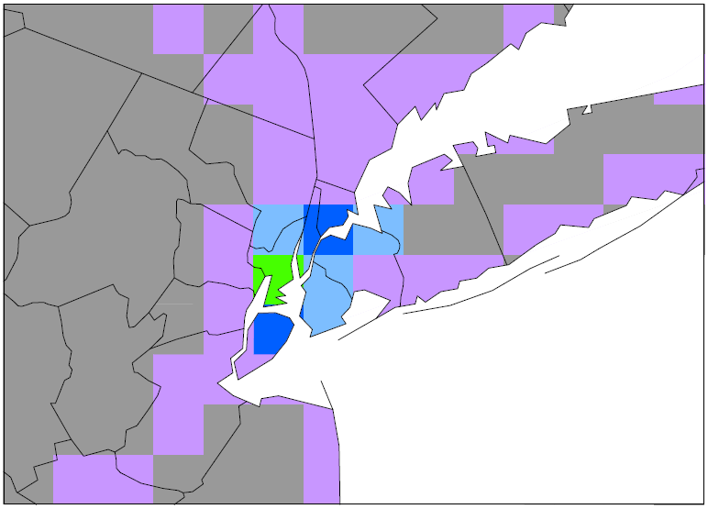
Ensemble Coefficient of Variation (CV), 8-Hr DM O₃, August 2010
(For each grid cell and day, calculated CV as ensemble standard deviation / ensemble mean, then calculated monthly average CV for each grid cell)
Meteorological Ensemble
Emissions Ensemble
Grid Resolution Ensemble
All ensembles have the largest CV over NYC (this is also true when looking at the ensemble standard deviation or ensemble range)
Average CV all O₃ Monitors: Meteorology 11.0%, Emissions 6.5%, Grid Resolution 4.3%

Slide 8
Relative Rank of Various Perturbations
Measured by the Coefficient of Variation, Averaged over August 2010, 8-hr DM O₃
Meteorology
NO_{x}/VOC Emissions
Grid Resolution
Meteorological perturbations are the dominant factor for the entire analysis domain
The ranking shown here is specific to the pollutant, time period, domain, and ensemble configuration used in this study

Slide 9
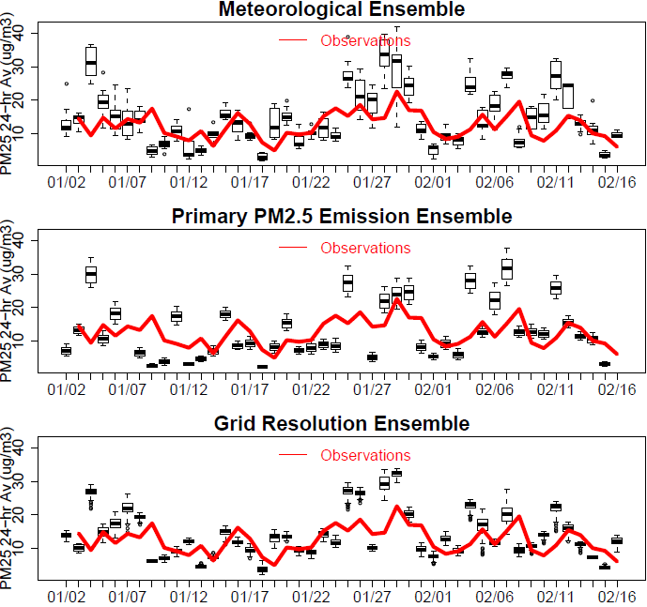
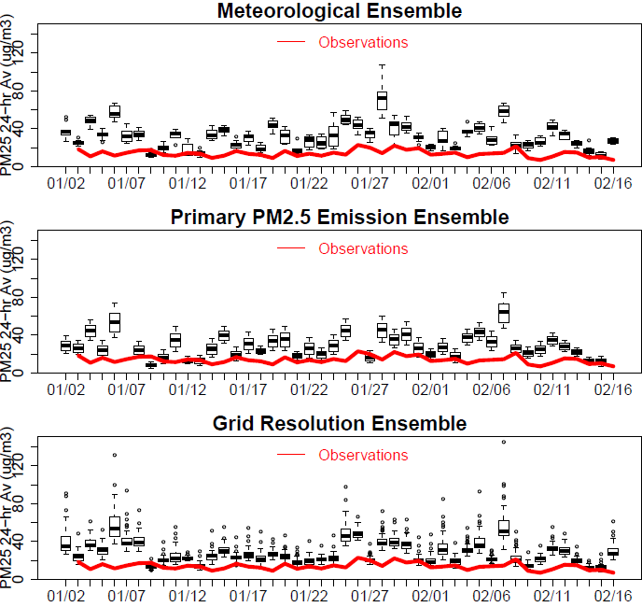
Example: Observed and Ensemble 24-Hr Average PM_{2.5}, Jan/Feb 2011
Holtsville, NY
Manhattan, NY
While mean observed PM_{2.5} levels appear to be roughly captured by all ensembles for the Holtsville monitor, they are overestimated for the Manhattan monitor
Grid resolution effects are more pronounced for the Manhattan monitor than the Holtsville monitor

Slide 10
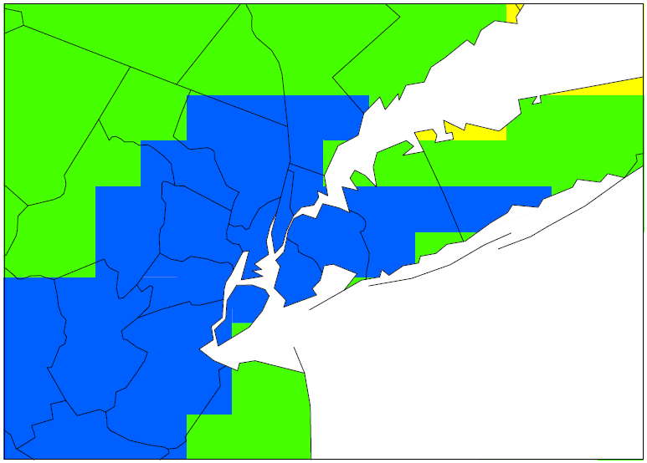
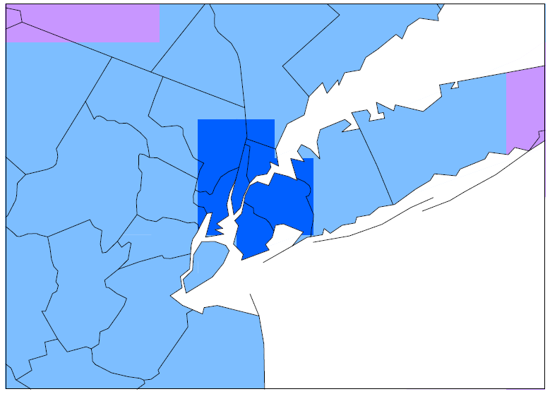
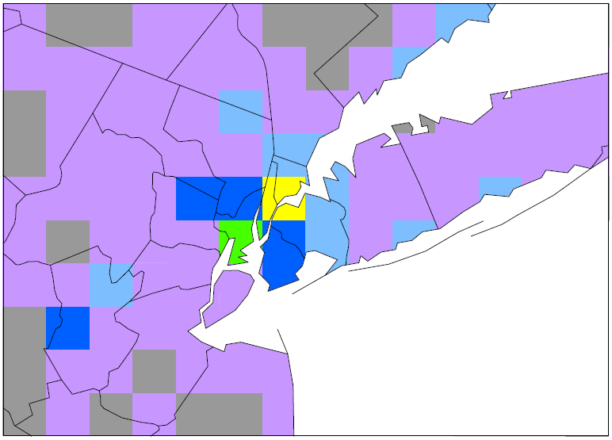
Ensemble Coefficient of Variation (CV), 24-Hr Average PM_{2.5}, Jan/Feb 2011
(For each grid cell and day, calculated CV as ensemble standard deviation / ensemble mean, then calculated monthly average CV for each grid cell)
Meteorological Ensemble
Emissions Ensemble
Grid Resolution Ensemble
The primary PM_{2.5} emission and grid resolution ensembles have the largest CV over NYC
Average CV all PM_{2.5} Monitors: Meteorology 17.8%, Emissions 15.9%, Grid Resolution 14.4%
The variations introduced by grid resolution effects show larger spatial gradients than those introduced by emission and meteorological perturbations

Slide 11
Relative Rank of Various Perturbations
Measured by the Coefficient of Variation, Averaged over Jan/Feb 2011, 24-Hr Average PM_{2.5}
Meteorology
Primary PM_{2.5} Emissions
Grid Resolution
In the 12km grid cells located over NYC, primary PM_{2.5} emission perturbations and grid resolution have a bigger impact than meteorological perturbations for simulated PM_{2.5} during this wintertime period.
The ranking shown here is specific to the pollutant, time period, domain, and ensemble configuration used in this study

Slide 12
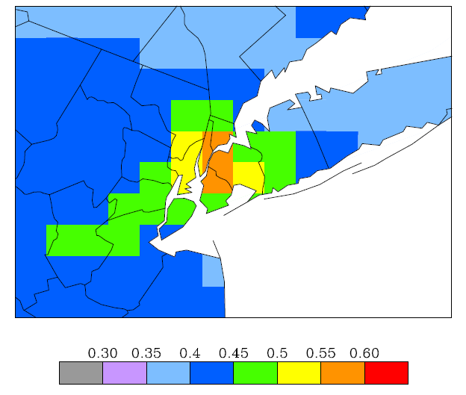
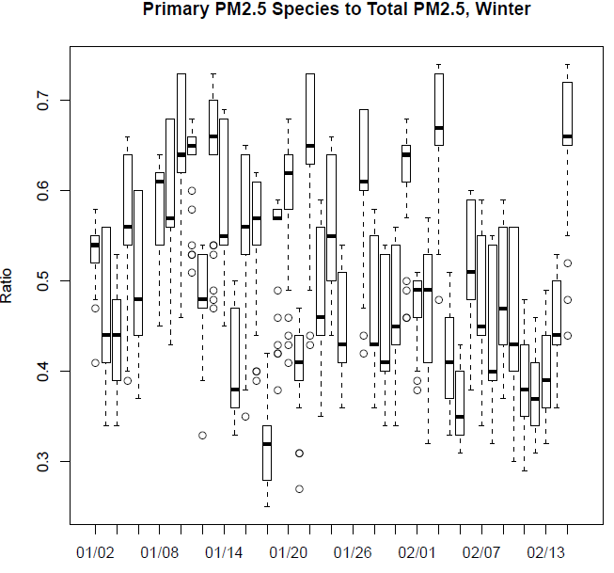
Ratio of Purely Primary PM_{2.5} (EC, POA, A25) to Total PM_{2.5}
(lower bound of total primary PM_{2.5} - primary sulfate and nitrate were not tracked separately in these model runs)
Time Series of Primary/Total PM_{2.5}
(Distribution Across All Sites)
Average Primary/Total PM_{2.5}, Jan/Feb 2011
Primary PM_{2.5} species account for roughly 50% of total PM_{2.5}
→perturbations in primary PM_{2.5} emissions and grid resolution (affecting the spatial distribution of these emissions) can have a strong impact on total PM_{2.5} predictions over the NYC area for this time period
→examine role of emissions, meteorology, and grid resolution from a diurnal perspective

Slide 13
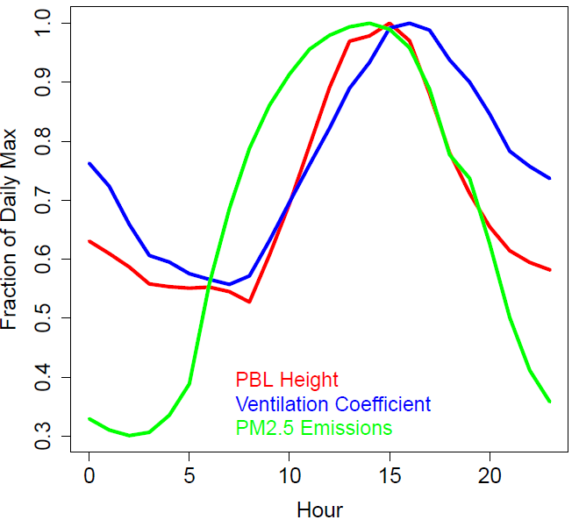
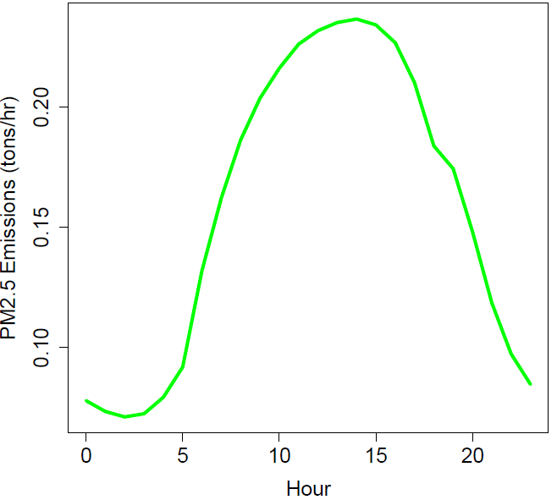
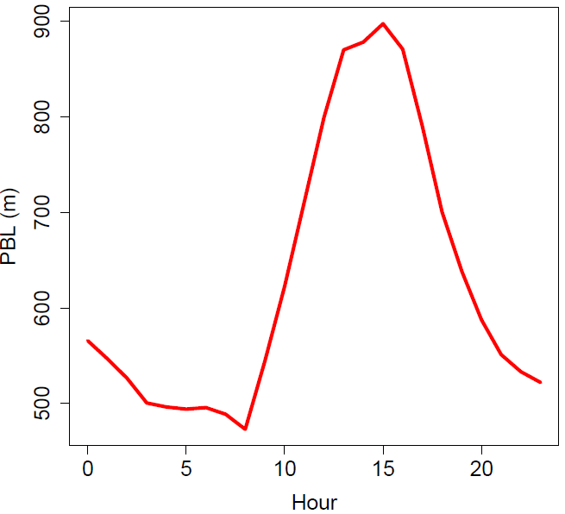
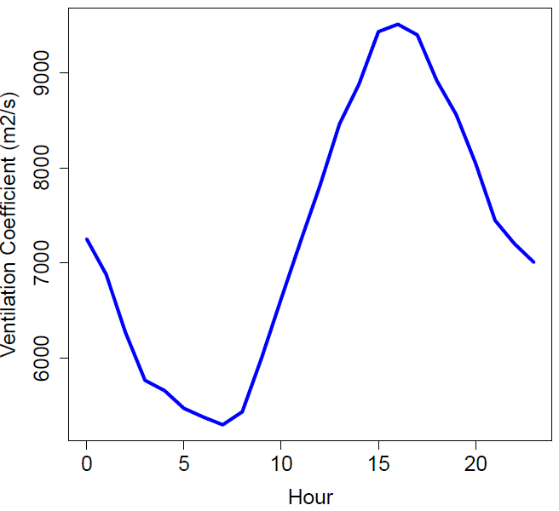
Diurnal Cycles of PM_{2.5} Emissions, PBL Height, and Ventilation Coefficient (VC)
Average Jan 1 – Feb 15, 2011, All PM_{2.5} Sites, 12km “Emission Ensemble” Base Simulation
There is a lag between the diurnal cycles of PM_{2.5} emissions on the one hand and PBL height and VC on the other hand
CMAQ PM_{2.5} concentrations are expected to be particularly sensitive towards PM_{2.5} emission perturbations during early morning and late afternoon
PM_{2.5} Emissions
PBL Height
Ventilation Coefficient

Slide 14
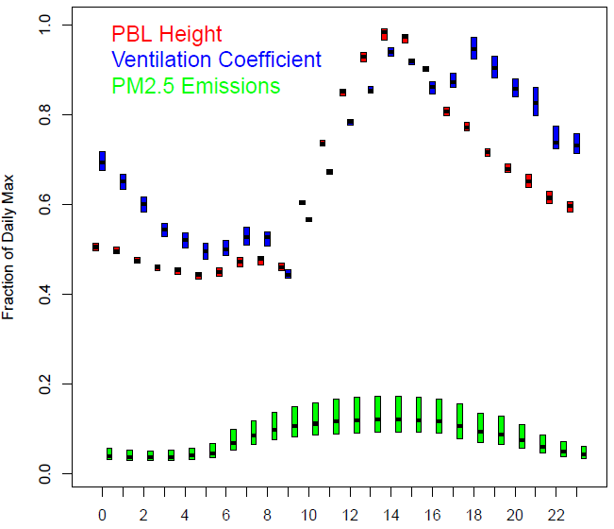
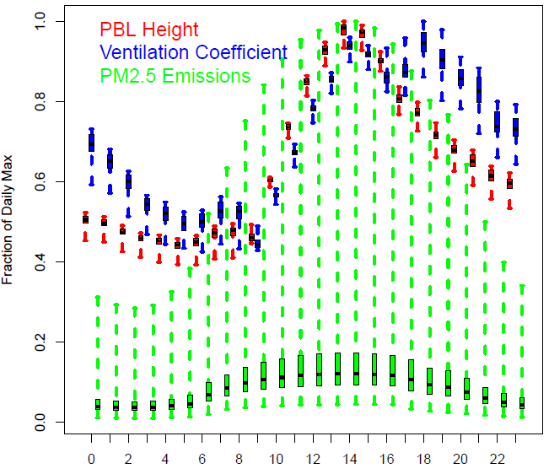
Subgrid Variability of PM_{2.5} Emissions, PBL Height, and Ventilation Coefficient (VC)
Average Diurnal Cycle Jan 1 – Feb 15, 2011, Variability of 81 1.33 km Grid Cells Within Each 12 km Grid Cell Corresponding to a PM_{2.5} Monitoring Site
Full Ensemble Range
Median and Interquartile Range Only
Moving from 12 km to 1.33 km grid spacing introduces more subgrid variability for PM_{2.5} emissions than PBL height or VC for this domain and wintertime study period
The subgrid distribution of PM_{2.5} emissions is assymetric
This subgrid scale variability of PM_{2.5} emissions likely has a significant impact on the spread of the PM_{2.5} concentrations predicted by the grid resolution ensemble, especially during early morning and late afternoon

Slide 15
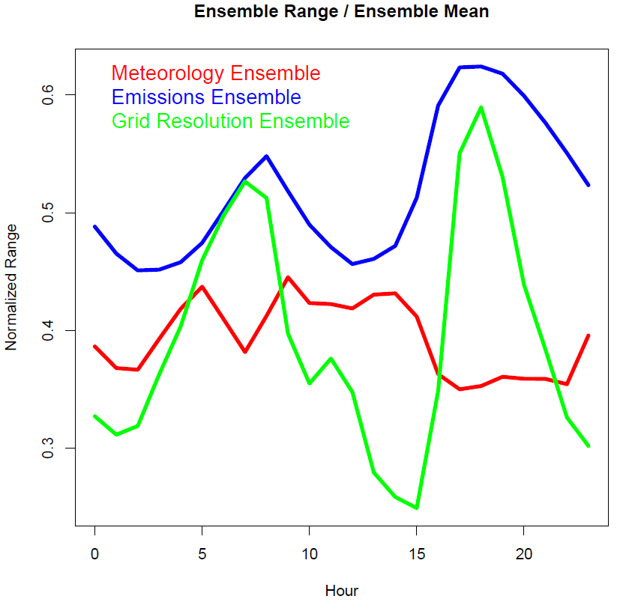
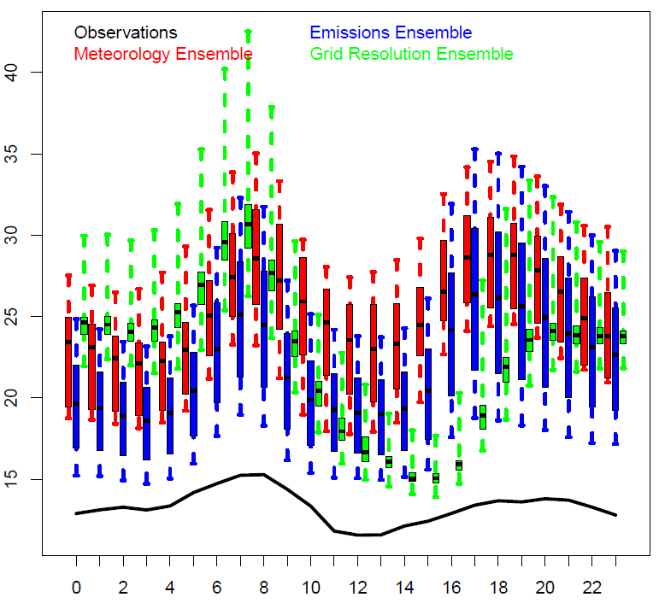
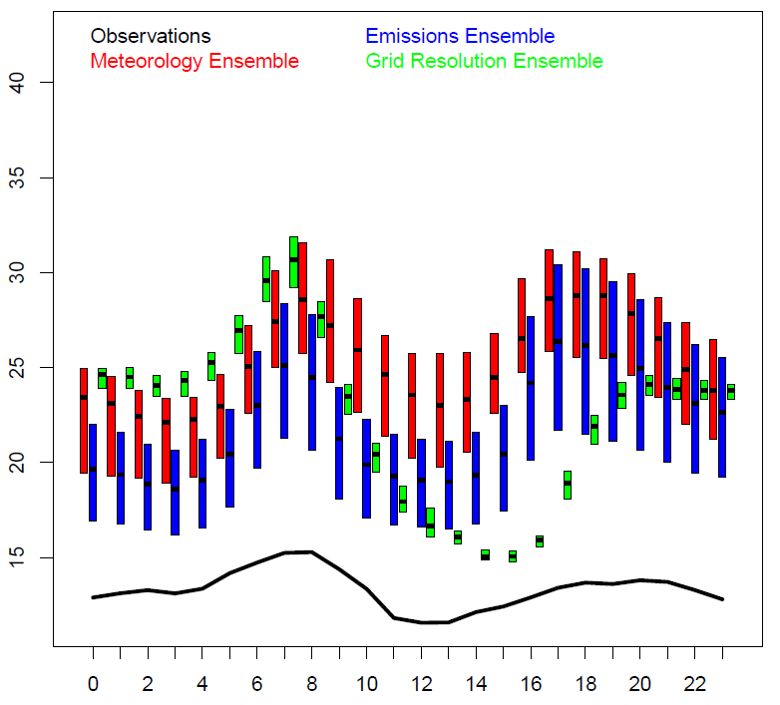
Diurnal Variation of Ensemble Spread for PM_{2.5} Concentrations
Average Diurnal Cycle Jan 1 – Feb 15, 2011, all PM_{2.5} Monitoring Site
Median and Interquartile Range Only
Full Ensemble Range
The range of the PM_{2.5} concentrations predicted by the two ensembles directly or indirectly affecting emissions (i.e. the PM_{2.5} emissions ensemble and grid resolution ensemble) exceeds the range predicted by the meteorological ensemble, especially during early morning and late afternoon
As shown previously, all ensembles are biased high with respect to observations

Slide 16
Probabilistic Model Evaluation

Slide 17
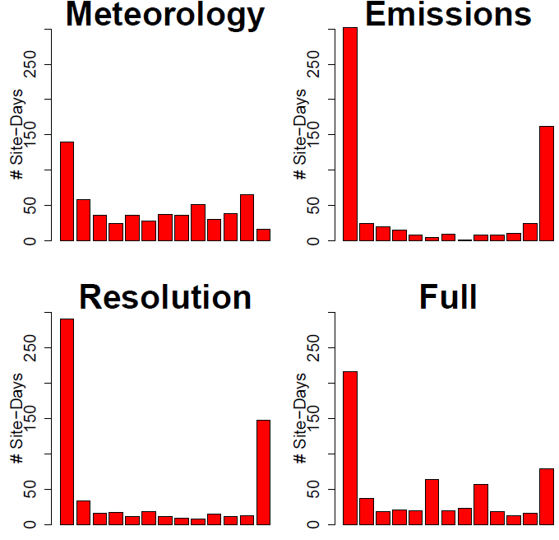
Talagrand Diagrams for Probabilistic Forecasts of 8-hr DM O₃, August 2010
All ensembles are underdispersed and exhibit some bias towards overprediction

Slide 18
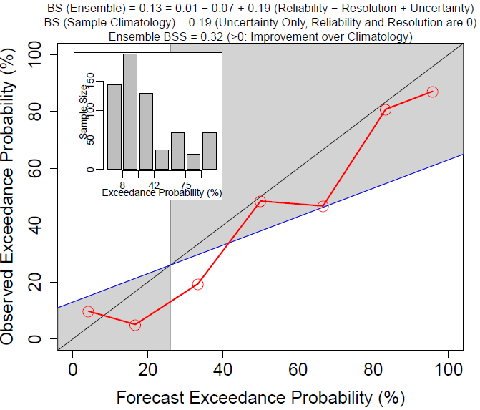
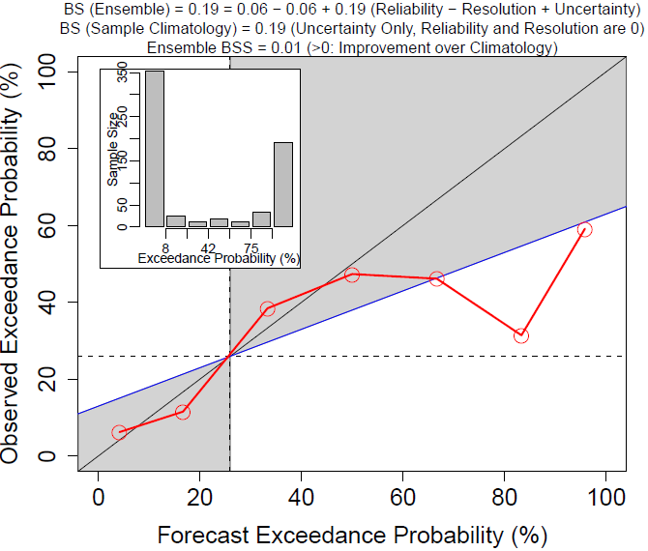
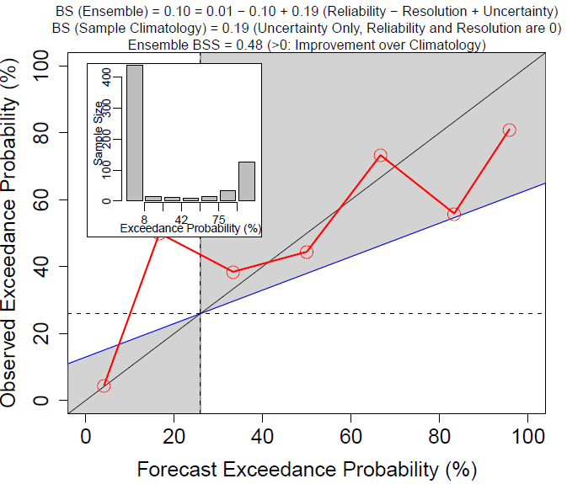
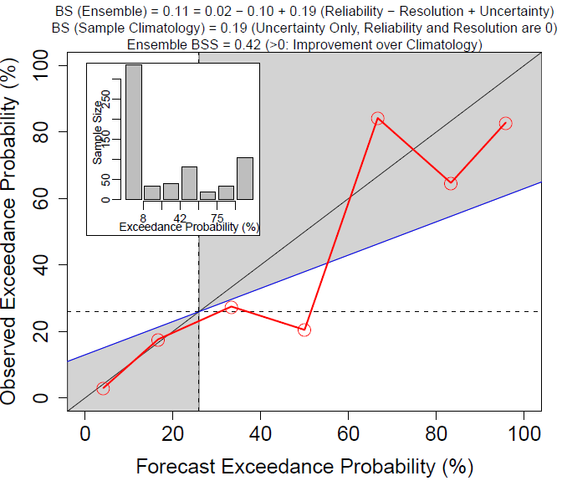
Reliability Diagrams for Probabilistic Forecasts of 8-hr DM O₃ > 60 ppb
August 2010
Met Ensemble
Emissions Ensemble
All ensembles show better probabilistic skill than climatology for this exceedance threshold which corresponds to the AQI transition from green to yellow
Brier Skill Scores for a range of exceedance thresholds are shown on the next slide
Grid Resolution Ensemble
Full Ensemble

Slide 19
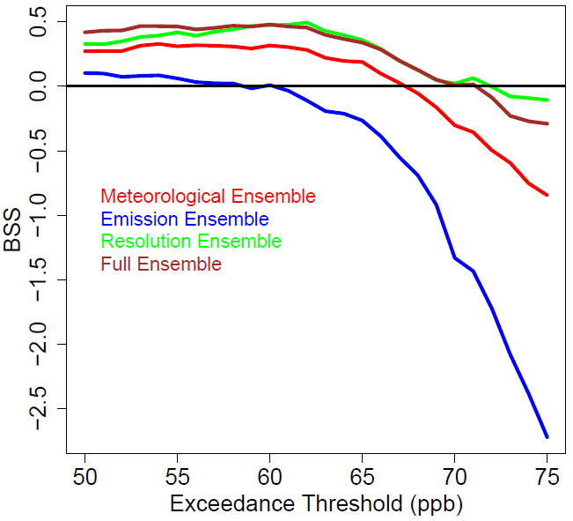
Brier Skill Score vs. Exceedance Threshold for Forecasts of 8-hr DM O₃
August 2010
BSS > 0 represent an improvement relative to climatology
All ensembles perform worse than climatology for exceedance thresholds greater than about 70 ppb (AQI orange threshold: 75 ppb)
The NO_{x}/VOC emission ensemble shows less probabilistic skill than the other members

Slide 20
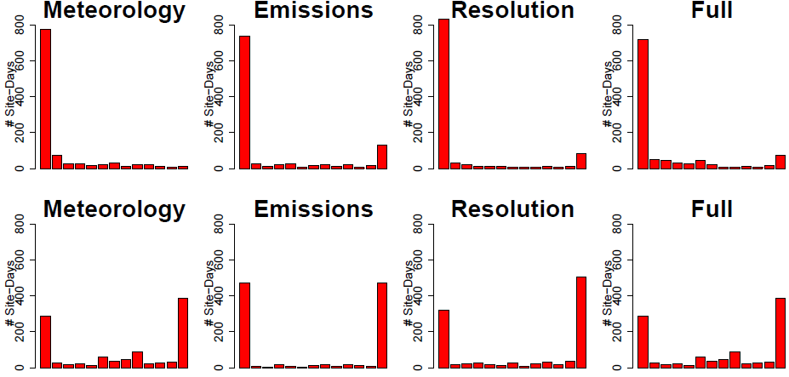
Rank Histograms for Probabilistic Forecasts of 24-hr Average PM_{2.5}
January 1 – February 15, 2011
No Bias Correction (top), Site/Member Specific Bias Removed (bottom)
No Bias Correction
Bias Correction

Slide 21
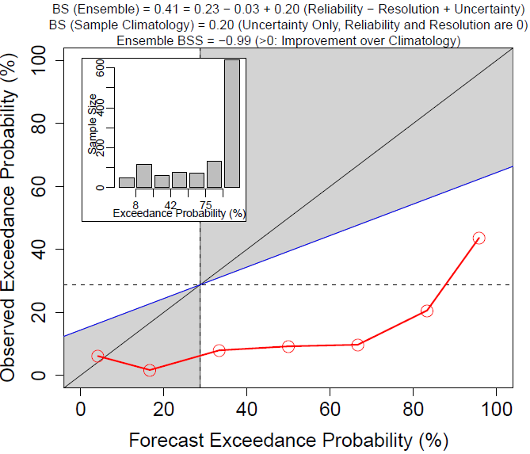
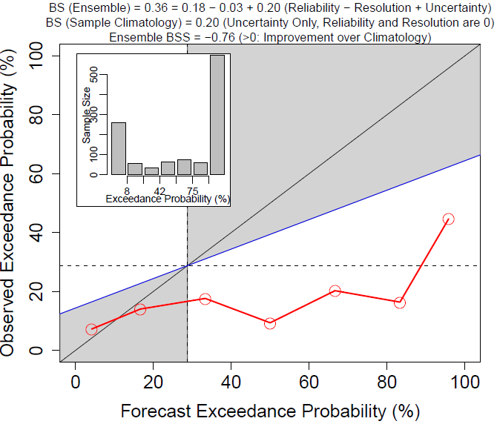
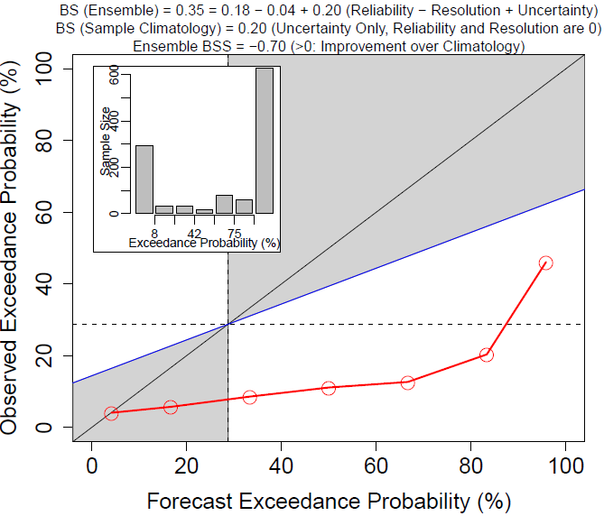
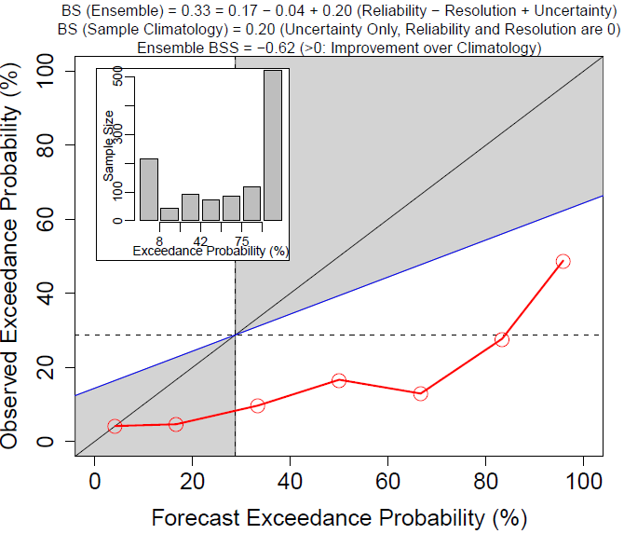
Reliability Diagrams for Probabilistic Forecasts of 24-hr Average PM_{2.5} > 15µg/m³
January 1 – February 15, 2011, No Bias Correction
Met Ensemble
Emissions Ensemble
Without bias correction, all ensembles show worse probabilistic skill than climatology for this exceedance threshold
The persistent overprediction of wintertime PM_{2.5} in the analysis domain likely is a major contributor to this poor probabilistic performance
Grid Resolution Ensemble
Full Ensemble

Slide 22
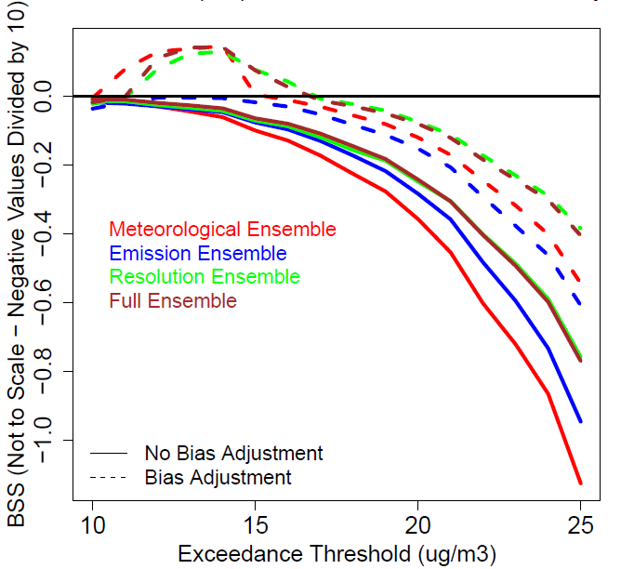
Brier Skill Score vs. Exceedance Threshold for Forecasts of 24-hr Average PM_{2.5}
January 1 – February 15, 2011 – Effects of Simple Bias Correction
A simple bias correction helps to improve ensemble performance
However, even after bias correction all ensembles still perform worse than climatology for exceedance thresholds greater than about 15 µg/m³ (AQI orange threshold: 35 µg/m³ )
Even after bias correction, the primary PM_{2.5} emission ensemble shows little probabilistic skill → indication that a significant fraction of the bias was caused by primary PM_{2.5} emissions in the first place – after removing the bias from the perturbed emission members, the corrected ensemble has insufficient spread

Slide 23
Summary
The relative importance of the three factors considered in this study varies by time, location, and species
Ozone model-to-model variability is dominated by meteorological effects, followed by emission and grid resolution effects
Meteorology also plays a dominant role for wintertime PM_{2.5}, except for the core NYC area where grid resolution and primary PM_{2.5} emission effects are more important
Strong indication that primary PM_{2.5} emissions are too high over the NYC area during wintertime → total mass and/or temporal allocation?
Predicted PM_{2.5} concentrations are particularly sensitive to PM_{2.5} emissions and grid resolution during the early morning and late afternoon periods when emissions are relatively high and ventilation is relatively low
Probabilistic model performance is better for ozone than PM_{2.5}, even after applying a simple bias correction to ensemble members

