Slide 1
Did the recession impact recent decreases in observed sulfate concentrations?
Shao-Hang Chu,
US EPA/OAQPS/AQAD
October, 2011

Slide 2
Introduction
Purpose: to examine whether the recent economic recession had an impact on the accelerated sulfate decreases observed in 2008 and 2009.
Since Sulfate = f (SO₂ emissions and meteorology), a meteorological adjustment technique was first applied to remove the influence of “atypical” meteorology conditions on sulfate concentrations.
Combustion of sulfur-containing fossil fuels, such as coal and oil, leads to
---> SO₂ formation, and oxidation of SO₂ results in
---> formation of sulfate aerosols in ambient air.
Fossil fuel consumption is closely related to various economic activities: such as electric energy usage, industrial production, transportation, etc.
Comparing the meteorologically-adjusted sulfate trend with observed SO₂ emission changes shed the light on whether the accelerated sulfate decline in 2008 and 2009 is a result of :
Non-conducive meteorological conditions, and/or
Reduced SO₂ emissions due to control measures, and/or
Decreased power demand in economic recessions, or
All of the above.

Slide 3
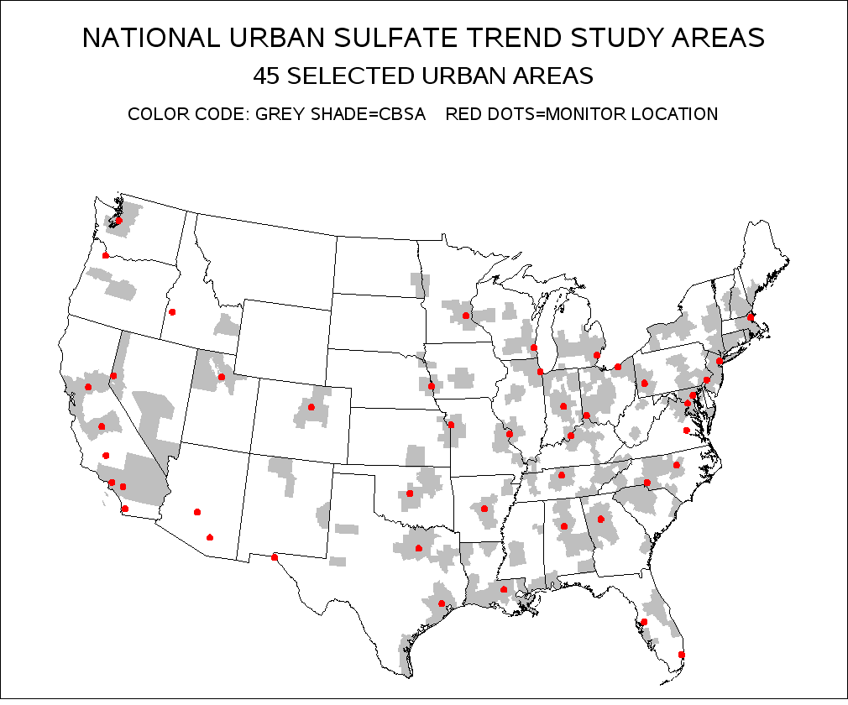

Slide 4
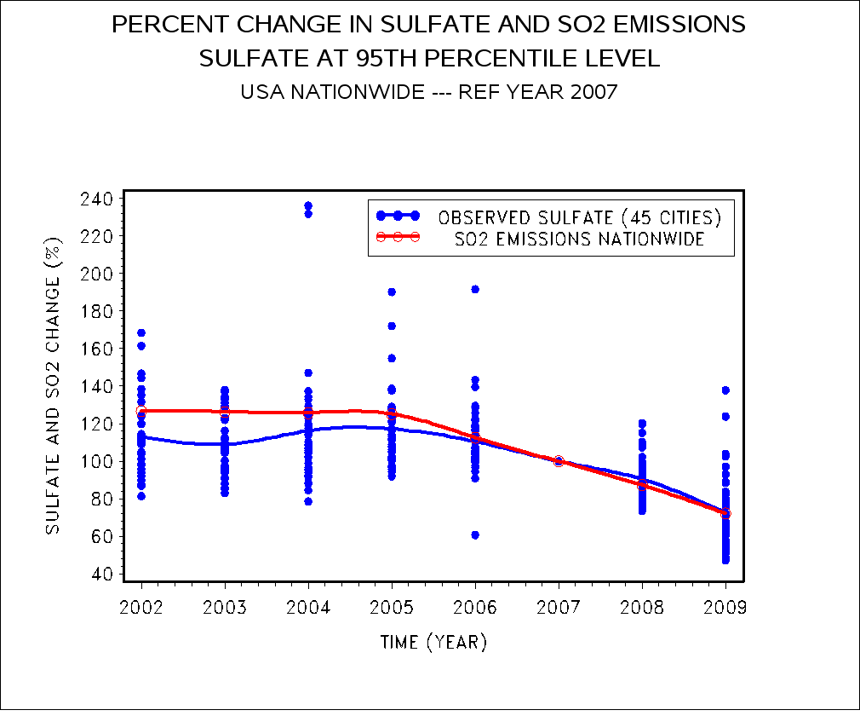
Percent Change in Sulfate Concentrations and SO₂ Emissions Nationwide Data: US EPA 2010

Slide 5
Data
In this study, we choose to analyze the annual 95th percentile of the daily sulfate concentrations because they tend to be more sensitive to the variation of meteorology and other influencing factors.
24-hour-average sulfate data collected by the CSN monitoring network from 2002 to 2009 in 45 major urban areas in the US were analyzed. The data collection frequency was 1-in-3 days.
2002-2009 meteorological data from NCDC were acquired for this analysis. Among them daily maximum temperature, daily average relative humidity, wind speed, dew point, precipitation, and one day pollutant transport distance were used in meteorology-adjustment calculations.
Acid Rain Program (ARP) and Clean Air Interstate Rule (CAIR) SO₂ emissions data, ARP heat input data, and Federal Reserve published Industrial Production Index data were also used in this analysis to assess how much impact lower demand of power in economic recession has on observed sulfate reduction.

Slide 6
Analysis Approach
In this study, a Quantile Regression model was used to adjust the influence of ‘atypical’ meteorology conditions on the observed annual 95th percentile of sulfate concentrations.
In this study, ARP heat input data of power generating units nationwide were used as a surrogate to reflect electric power demand.
To examine the potential factors influencing the accelerated sulfate decline in 2008 and 2009 in 45 major urban areas nationwide, the 2002-2009 meteorologically-adjusted sulfate concentrations were calculated and an “expected” 2009 sulfate level for each site was also estimated by linear extrapolation of the meteorology-adjusted values based only on 2002-2007 data.
Together with the nationwide SO₂ data, ARP and CAIR SO₂ data, ARP heat input data, and Federal Reserve published Industrial Production Index data, we studied the differences among the “expected”, meteorologically-adjusted, and observed sulfate concentrations to assess what the major factors were leading to the large decline in observed sulfate concentrations in 2008 and 2009.

Slide 7
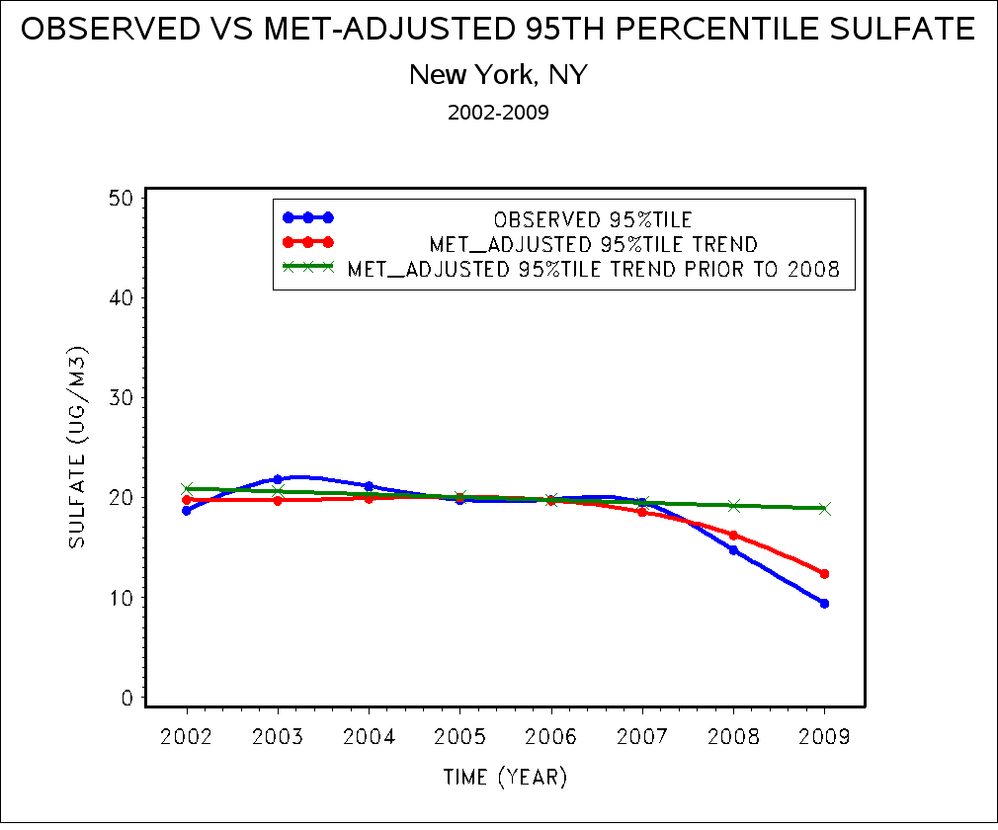
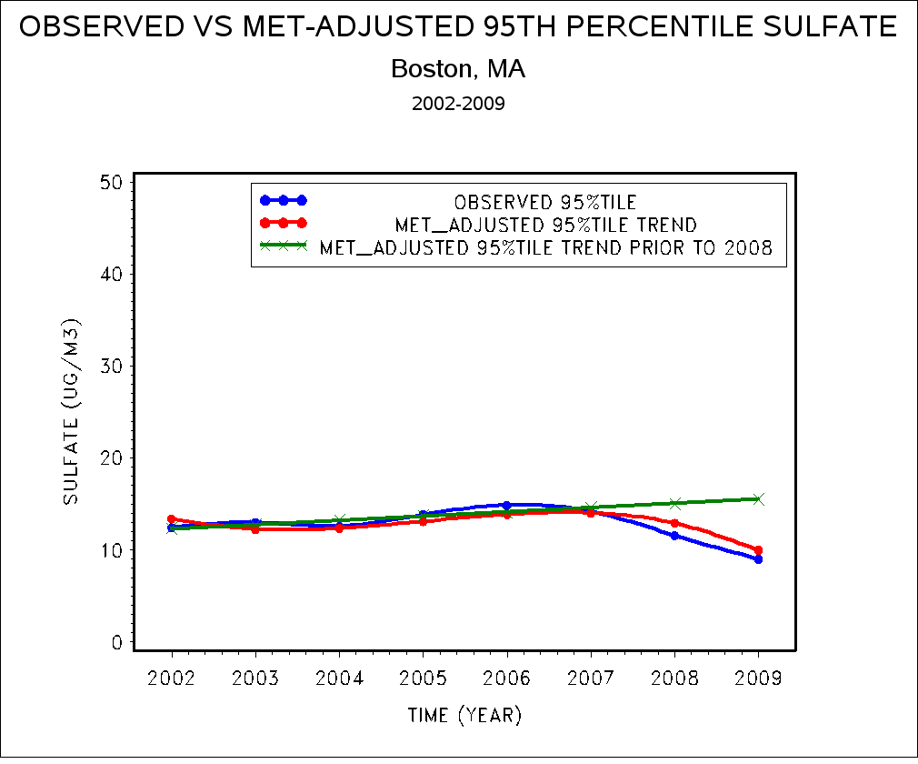
2007-2009 Sulfate Decrease in Eastern US Due to Meteorology and Emission Changes

Slide 8
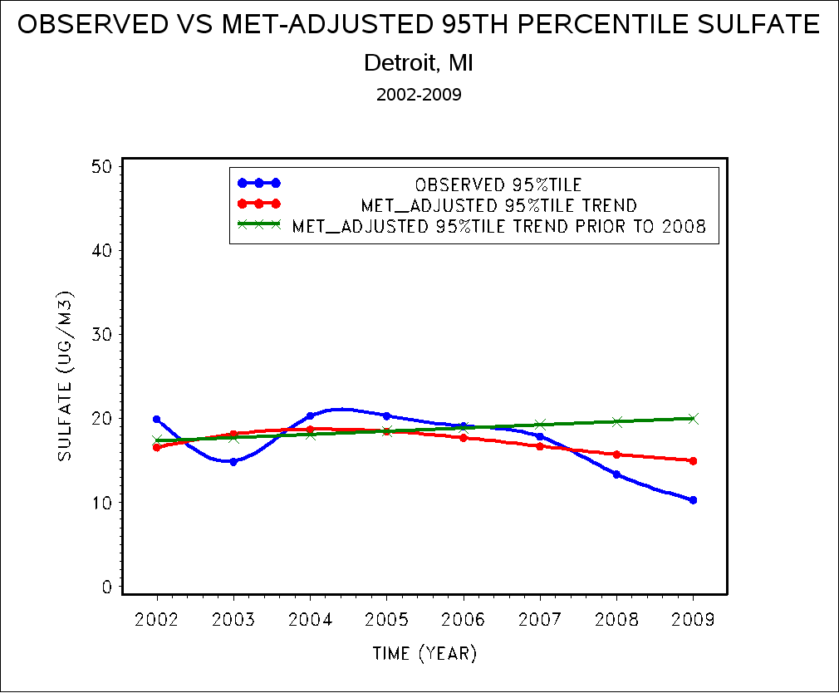
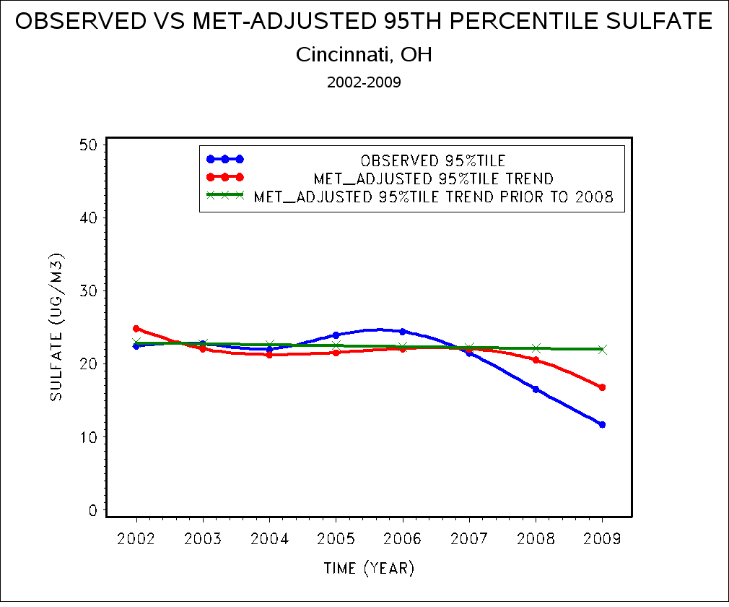
2007-2009 Sulfate Decrease in Eastern US Due to Meteorology and Emission Changes

Slide 9
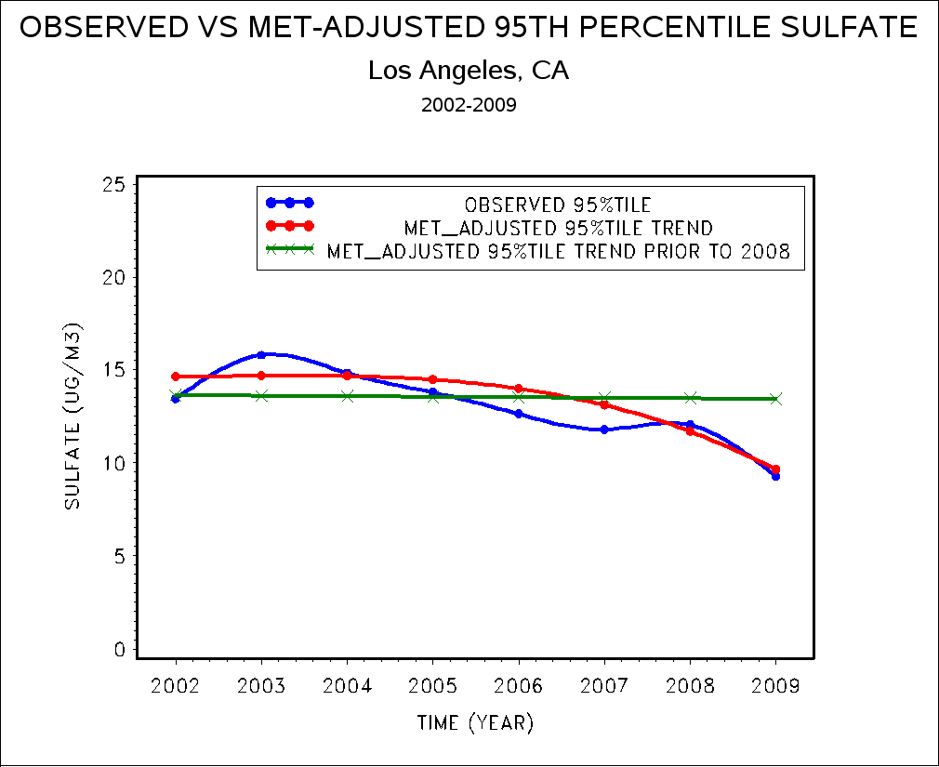
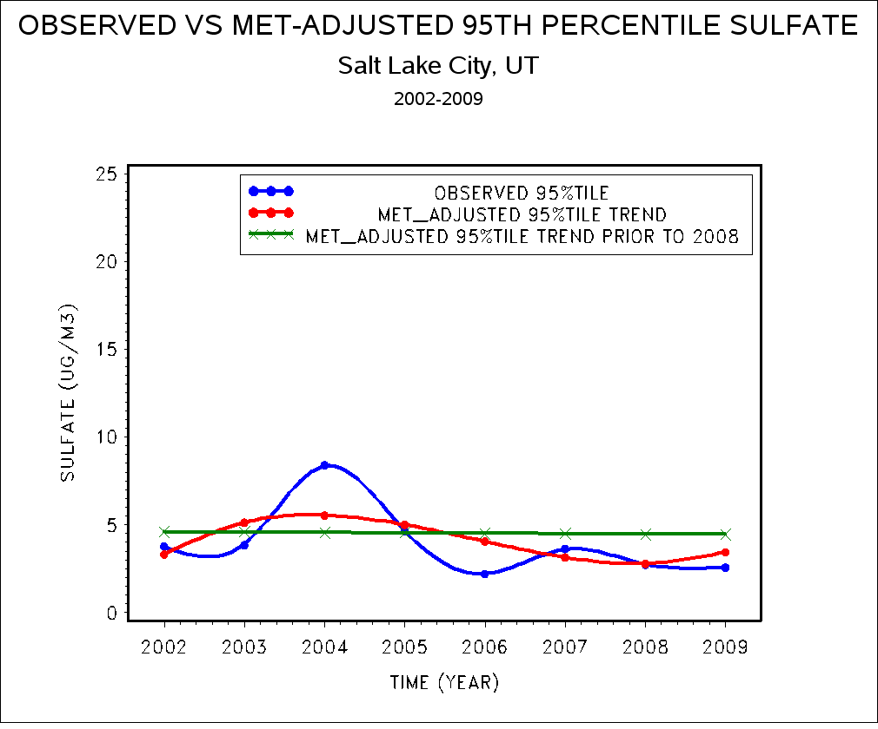
2007-2009 Sulfate Decrease in Western US Due to Meteorology and Emission Changes

Slide 10
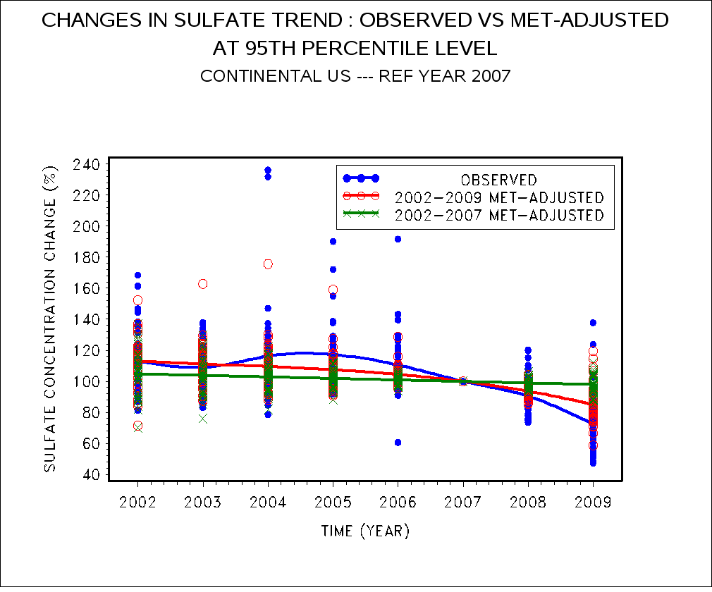
Changes in 95th Percentile Sulfate 45 Major Urban Areas, Nationwide

Slide 11
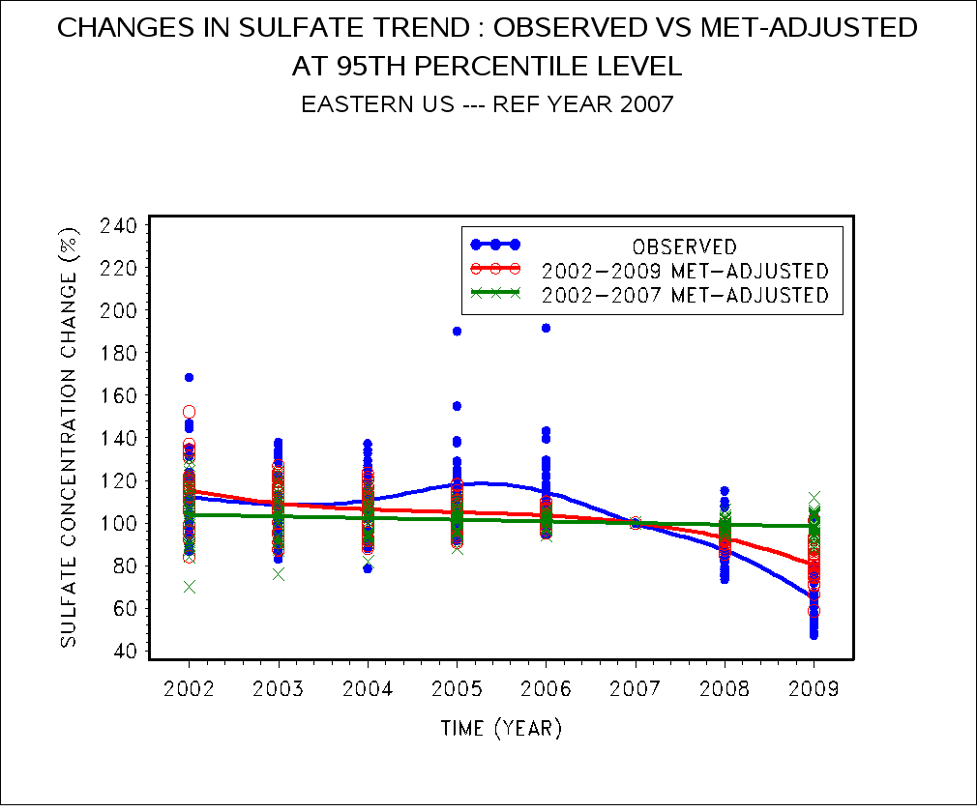
Changes in 95th Percentile Sulfate 30 Major Urban Areas, Eastern US

Slide 12
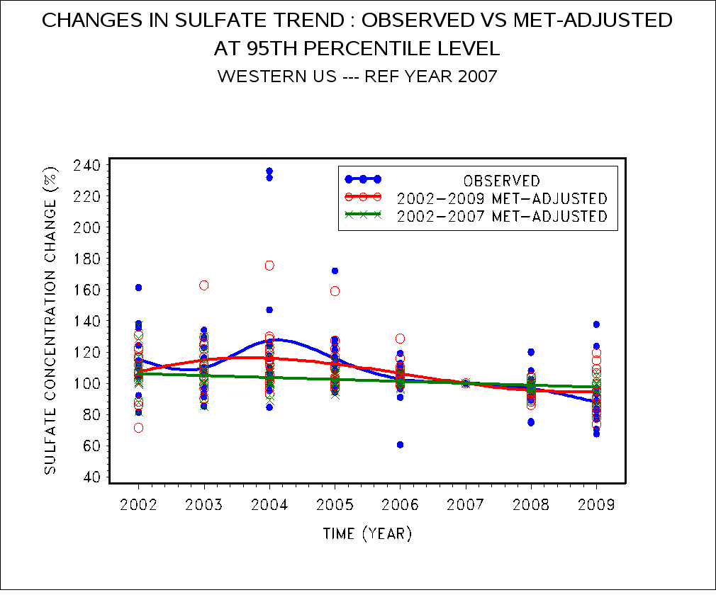
Changes in 95th Percentile Sulfate 15 Major Urban Areas, Western US

Slide 13
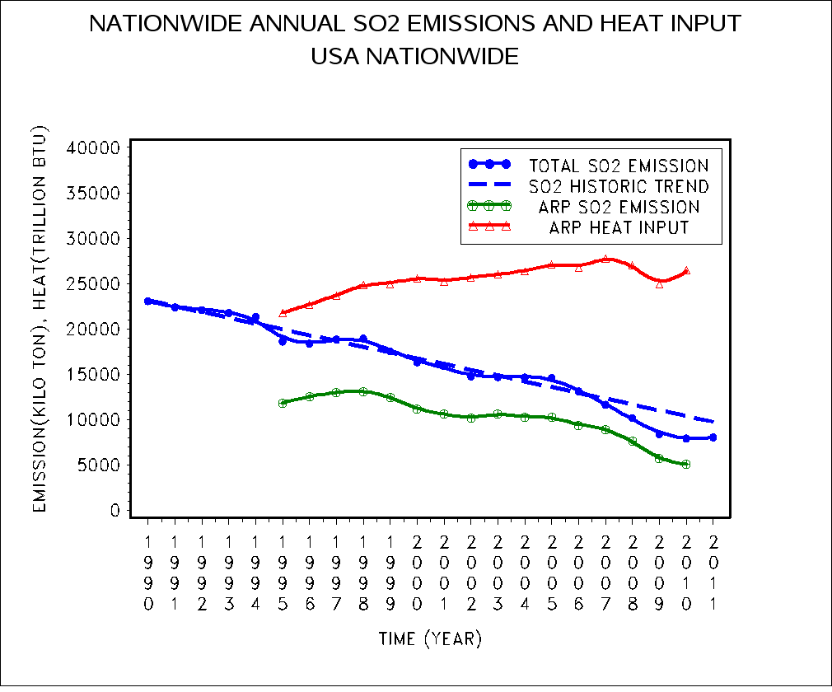
SO₂ Emissions and Heat Input Trend Nationwide Data: US EPA 2010, 2011

Slide 14
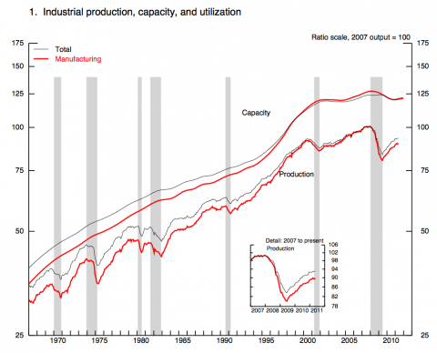
Federal Reserve's Monthly Index of Industrial Production

Slide 15
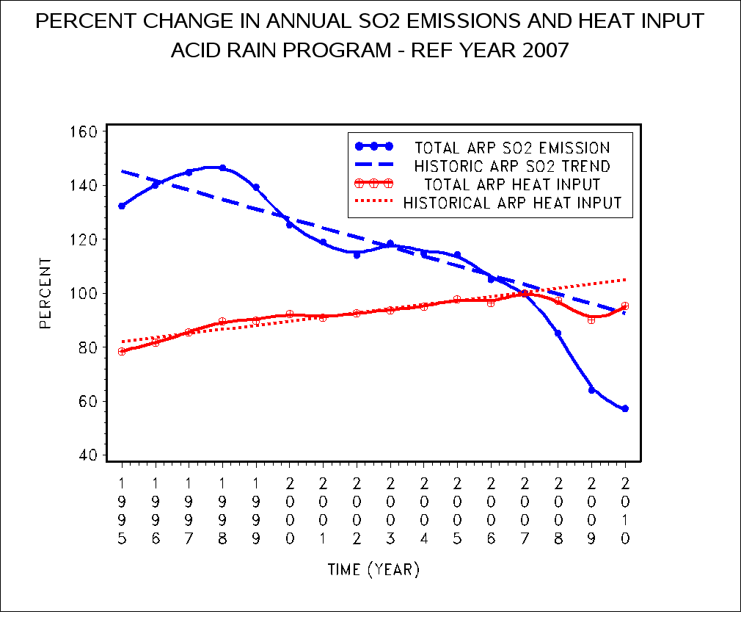
Actual and Projected Percent Changes in SO₂ Emissions and Heat Input Data: US EPA 2011

Slide 16
Impact of Lower Power Demand in 2008-2009 Recession on Accelerated SO₂ Emission Decline Data: US EPA 2010
2007 ARP SO₂ Emission Rate (ER)
ER₀₇ = 0.64 lb/MMBTU
= 3.2 x 10⁻⁴ TON/MMBTU
ARP Heat Input Change Nationwide from 2007 to 2009
D_{HI} = HI₂₀₀₉ - HI₂₀₀₇
= (24.971 – 27.744) x 10⁹ MMBTU
= - 2.773 x 10⁹ MMBTU --- Heat Input Reduction --> Reduced Power Demand
SO₂ Emission Change due to Heat Input Decrease from 2007 to 2009 (ER = ER₀₇)
DE_{HI} = ER₀₇ x D_{HI}
= - 8.8736 x 10⁵ TON --- SO₂ Emission Decrease due to Lower Power Demand
Observed Total ARP SO₂ Emission Decrease Nationwide from 2007 to 2009
DE_{TOT} = E₂₀₀₉ - E₂₀₀₇
= (5.724 – 8.934) x 10⁶ TON
= - 3.21 x 10⁶ TON
Percent SO₂ Reduction due to lower power Demand in 2008 and 2009 Nationwide
PR_{HI} = 100% x DE_{HI} / DE_{TOT}
= 27.64%

Slide 17
Summary and Discussions
2002-2009 sulfate concentration data in 45 major urban areas in the US have been analyzed. The results indicate that both meteorology and SO₂ emission decreases were responsible for the accelerated sulfate decline observed in most urban areas in the US in 2008 and 2009.
Comparing the long-term SO₂ trends with Industrial Production Index and heat input data nationwide, we find:
Regulations to curb excessive SO₂ emissions in the past have not prevented growth of industrial production and electric power usage nationwide.
An accelerated decline in SO₂ emissions from 2008 to 2009 was caused in part by a lower demand for power as evidence in the 10 percent drop in heat input nationwide.
Had the overall SO₂ emission rate remained unchanged from 2007 to 2009, the overall drop in power demand would have resulted in an approximately a 28 % reduction of the total SO₂ decreases during this period.

Slide 18
Summary and Discussions - Continued
Since SO₂ is the precursor to ambient sulfate formation, thus we believe that the reduced power demand during economic recession in 2008 and 2009 have resulted in an approximately 28% of the observed decreases in sulfate concentrations nationwide.
However, since the sulfate data length from the Chemical Speciation Network are relatively short, the uncertainty of this analysis could be large.
Further study of recession impact on air quality using longer data records, such as O₃ and SO₂, are in progress.

Slide 19
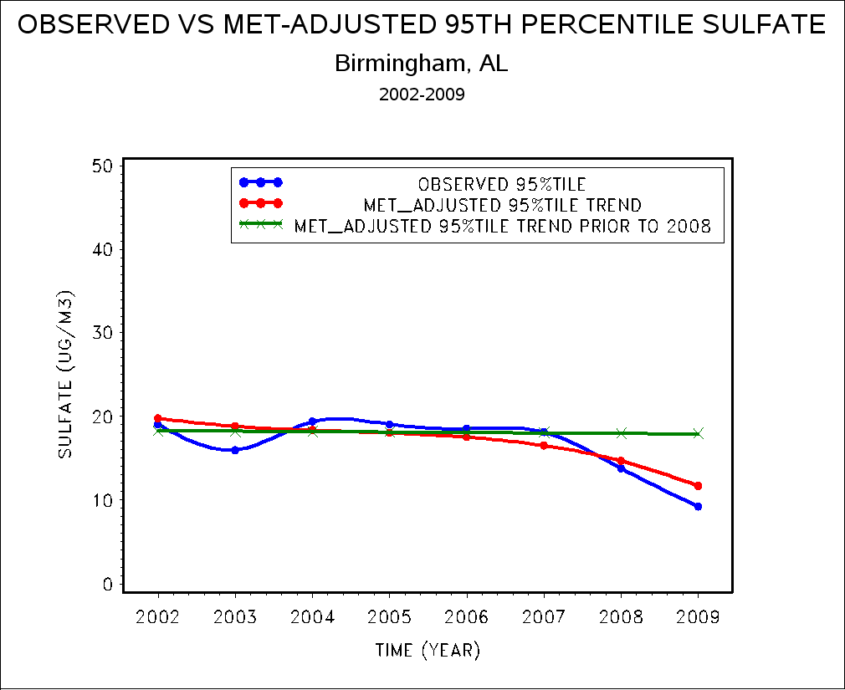
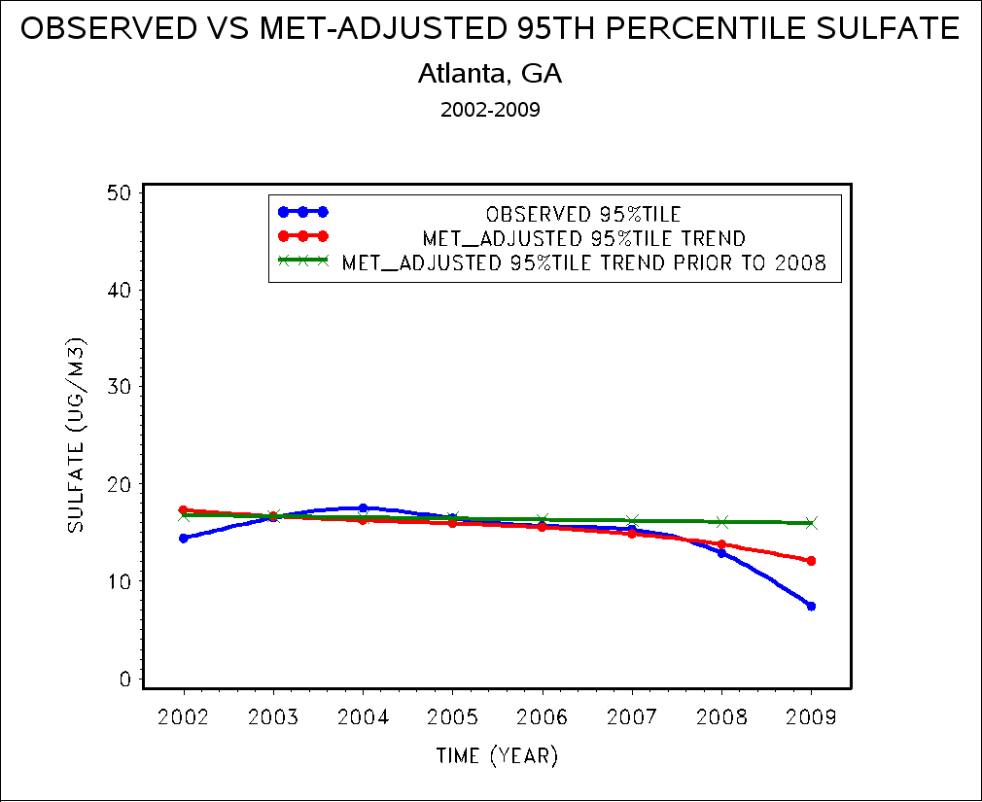
2007-2009 Sulfate Decrease in Eastern US Due to Meteorology and Emission Changes

Slide 20
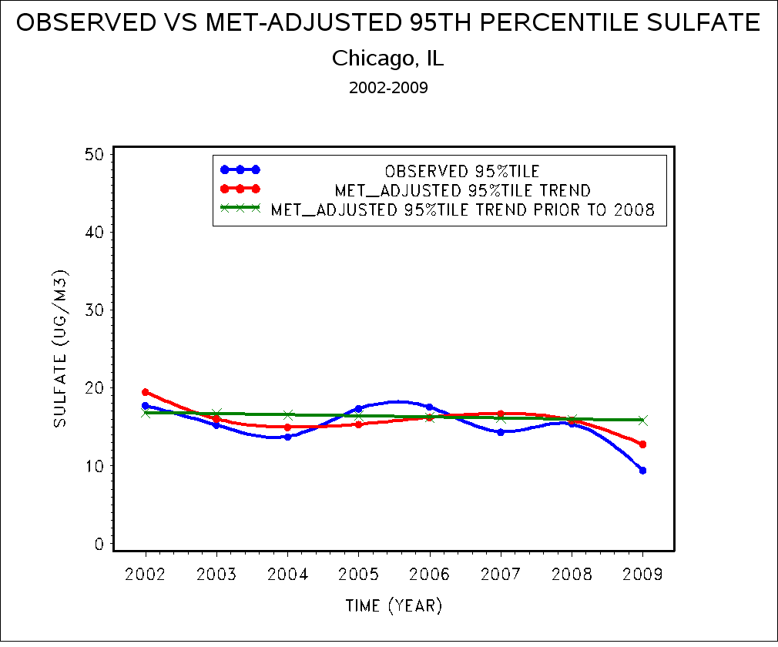
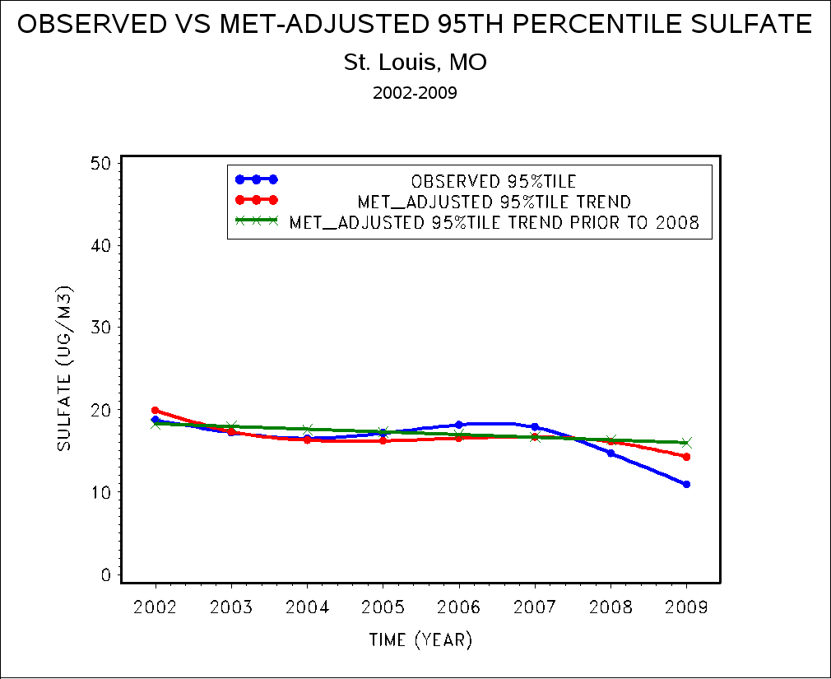
2007-2009 Sulfate Decrease in Eastern US Due to Meteorology and Emission Changes

Slide 21
Annual Emissions and Heat Input Acid Rain Program Data: US EPA 2011
YEAR P M SO2 NOX CO2 HEAT INPUT
TONS TONS TONS MMBTU
1995 ARP 12 11,829,936.3 5,839,018.8 2,157,600,978.2 21,755,824,833
1996 ARP 12 12,513,447.4 6,011,296.4 2,231,447,822.7 22,684,158,801
1997 ARP 12 12,942,514.1 6,026,523.6 2,298,376,051.2 23,692,782,506
1998 ARP 12 13,092,853.1 5,966,781.1 2,375,973,376.6 24,831,589,582
1999 ARP 12 12,452,657.2 5,497,118.4 2,385,362,558.9 24,941,902,496
2000 ARP 12 11,202,078.2 5,104,597.4 2,451,484,188.9 25,616,168,438
2001 ARP 12 10,638,086.3 4,707,296.0 2,394,618,120.0 25,244,784,760
2002 ARP 12 10,196,209.9 4,474,615.8 2,423,678,751.1 25,709,497,623
2003 ARP 12 10,594,972.2 4,169,664.6 2,465,544,529.9 26,005,443,914
2004 ARP 12 10,259,212.0 3,763,579.4 2,478,286,032.4 26,353,364,531
2005 ARP 12 10,222,639.0 3,633,349.7 2,539,935,930.3 27,139,944,551
2006 ARP 12 9,392,502.0 3,409,277.7 2,493,325,796.9 26,770,962,742
2007 ARP 12 8,933,517.1 3,283,722.5 2,565,234,238.1 27,744,783,726
2008 ARP 12 7,616,448.7 2,996,593.5 2,517,468,265.7 27,006,801,688
2009 ARP 12 5,724,185.2 1,984,338.9 2,295,922,096.6 24,971,425,330
2010 ARP 12 5,119,750.6 2,061,064.1 2,431,416,282.8 26,473,818,754

Slide 22
Emission Rate by Fuel Type Data: US EPA 2010
Fuel Type | 2005 |  | 2006 |  | 2007 |  | 2008 |  | 2009
 | SO₂ | NO_{x} | SO₂ | NO_{x} | SO₂ | NO_{x} | SO₂ | NO_{x} | SO₂ | NO_{x}
Coal | 0.95 | 0.32 | 0.90 | 0.31 | 0.84 | 0.30 | 0.74 | 0.28 | 0.63 | 0.20
Gas | 0.01 | 0.05 | <0.01 | 0.05 | <0.01 | 0.04 | <0.01 | 0.04 | <0.01 | 0.04
Oil | 0.70 | 0.26 | 0.47 | 0.22 | 0.49 | 0.22 | 0.35 | 0.19 | 0.30 | 0.17
Other | 0.27 | 0.42 | 0.29 | 0.29 | 0.26 | 0.20 | 0.28 | 0.16 | 0.27 | 0.11
Total | 0.75 | 0.27 | 0.70 | 0.25 | 0.64 | 0.24 | 0.56 | 0.22 | 0.46 | 0.16

Slide 23
Percent Change in Fuel Consumption and SO₂ Emissions Data: US EPA 2010, EIA 2010
YEAR |  | TOTAL FOSSIL FUEL CONSUMPTION | TOTAL SO₂ EMISSIONS | ARP SO₂ EMISSIONS
1990 |  | 84 | 179 | 176
2000 |  | 98 | 127 | 125
2005 |  | 100 | 114 | 114
2006 |  | 98 | 105 | 105
2007 |  | 100 | 100 | 100
2008 |  | 97 | 89 | 85
2009 |  | 91 | 73 | 64

