Slide 1

Effects of Climate Change and Greenhouse Gas Mitigation Strategies on Air Quality
R834284
Marc Carreras-Sospedra, Michael MacKinnon,
Jack Brouwer, Donald Dabdub
Advanced Power and Energy Program
Computational Environmental Sciences Laboratory
University of California, Irvine
October 26, 2011

Slide 2
Main Contributors to Greenhouse Gases
Year 2008
US GHG Emissions Trends
Source: US EIA 2011 Annual Energy Outlook Reference Case

Slide 3

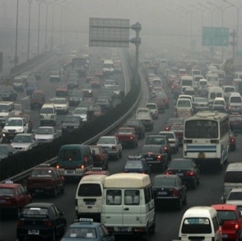
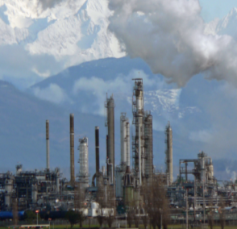
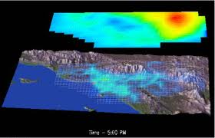
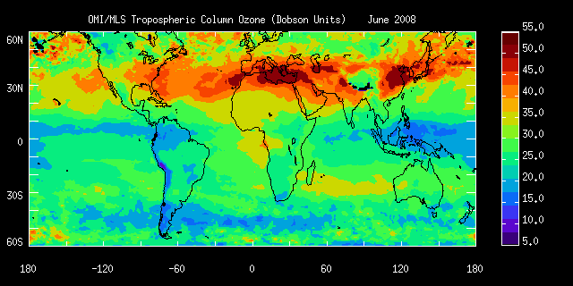
Project Overview
Technology assessment for GHG reduction strategies
  Focus on utilities and transportation sectors
Air quality impacts assessment of GHG reduction strategies
  Spatially and temporally resolved pollutant emissions due to GHG reduction strategies
  Impacts on ozone and particulate matter
Air quality model sensitivity
  Meteorological and boundary conditions affected by changes in global climate and the global economy

Slide 4
Transportation Sector Mitigation Strategies
Increase vehicular efficiency
  Improve the performance of conventional gasoline internal combustion engine vehicles (ICE)
  Paradigm shift to alternative propulsion systems utilizing some degree of drive train electrification
    HEVs, PHEVs, BEVs
    HFCVs
Decrease the carbon intensity of transportation fuels
  Hydrogen
  Electricity
  Biomass derived liquid fuels
Reduce the demand for transportation services via modal shift
  Ridesharing/carpooling programs
  Mass transit
  Compact development

Slide 5
Summary Transportation Strategies
Technology |  | Potential GHG Reduction (per mile) | Potential Air Quality Impacts
Efficiency Improvements |  | 5-50% | Positive- will reduce vehicle emissions
Electrification | HEVs | 37-87% | Positive- will reduce vehicle emissions
 | PHEVs | 15-68% | Positive/Negative –dependent on regional electricity mix used for charging
 | BEVS | 28-100% | Positive/Negative- dependent on regional electricity mix used for charging
 | HFCVs | 35-100% | Positive/Negative- dependent on hydrogen supply chain strategy
Biofuels | Cellulosic Ethanol | 75-100% | Positive/Negative- dependent on life cycle and direct vehicle emissions
 | Corn Ethanol | 10-67% | Positive/Negative-dependent on life cycle and direct vehicle emissions
Modal Shift(s) (VMT Reduction) | Compact Development | 1-11% | Positive- will reduce vehicle emissions
 | Transit Carpooling | .4-2% | Positive- will reduce vehicle emissions

Slide 6
Electric Power Mitigation Strategies
Improve electric infrastructure efficiency
  Generation
  Transmission and distribution
  End use
Generation from low emitting technologies
  Renewable energy technologies
  Nuclear power generation
  Fuel switching (i.e. coal to gas)
Carbon capture and sequestration (CCS)
  Not currently technologically mature or cost effective
    Requires large-scale demonstration projects

Slide 7
Summary Electricity Strategies
Technology |  | Potential GHG Reduction (Total Electricity Sector) | Potential Air Quality Impacts
Energy Efficiency Improvements | Generation | 2.5-3.7% | Positive –emissions reduction per unit electricity generated
 | Transmission & Distribution | 1-4.3% | Positive- positive energy gain results in less required generation
 | End Use | 7.6-30% | Positive – reduction in net electricity generation
Renewable Energy |  | 20-50% | Positive- Lowest emitting technologies
Nuclear Power |  | 5-75% | Positive- Low emissions relative to fossil alternatives
Carbon Capture & Storage |  | 11%-93% | Potentially Negative- criteria pollutants emitted by technologies
Fuel Switching (Natural Gas) |  | -50-45% | Emissions lower than coal but higher than other alternatives

Slide 8
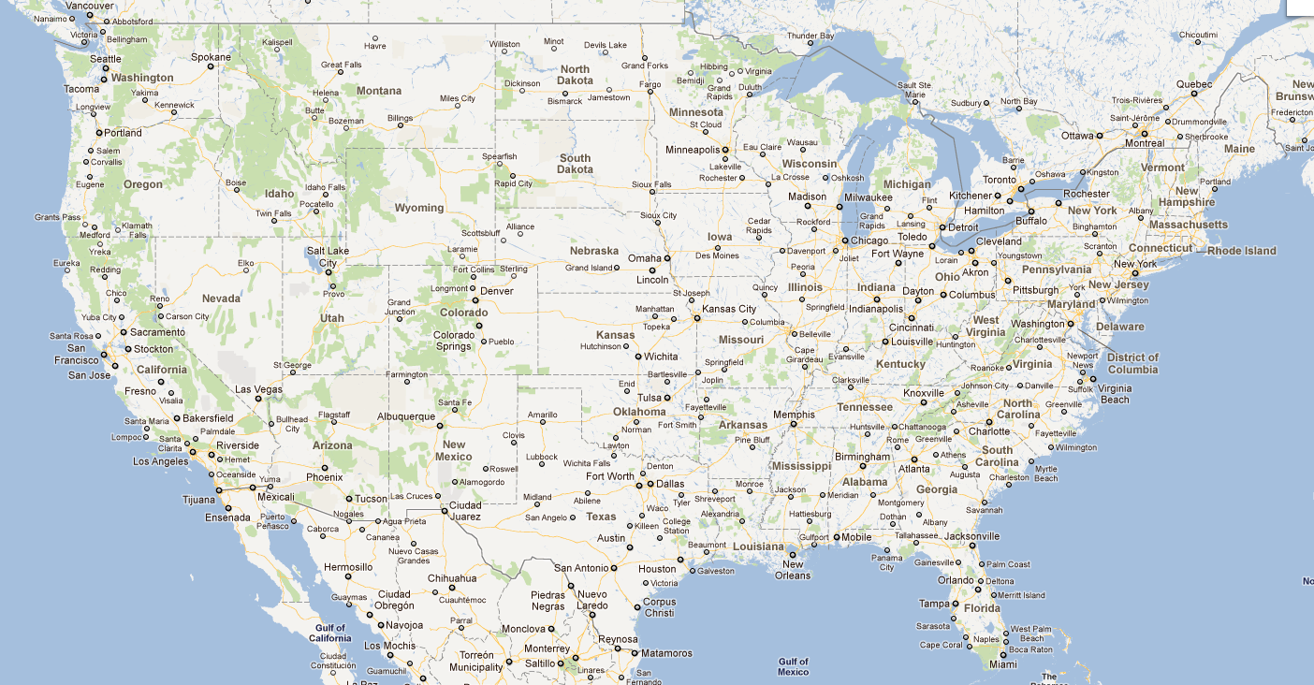
Air Quality Modeling – Regions of Interest
UCI-CIT Airshed Model
Resolution: 5km
Caltech Atmospheric Chemistry Mechanism (CACM)
Bin size aerosol mechanism
  SOA aerosol module
CMAQ Model
Nested domain
Resolution: 36km, 12km, 4km
Modular chemical mechanisms
Modal aerosol mechanism

Slide 9

Examples of Future Scenarios
Example: Eastern Texas
Variations in technology mix for electricity generation
Variations in fuel path for vehicles

Slide 10
Alternative Transportation Projection
Light Duty Vehicle Fleet
  Mix of advanced technologies (i.e. no singular “winner”)
    20% Battery Electric Vehicles (BEVs)
    20% Hydrogen Fuel Cell Vehicles (HFCVs)
    30% Plug-in Hybrid Electric Vehicles (PHEVs)
    30% Hybrid Electric Vehicles
Heavy Duty Vehicle Fleet
  Efficiency gains via technology improvements offset growth in emissions from increased demand

Slide 11
GHG Estimates for Transportation
Total GHG emissions dependent on fuel supply chain strategy
  Electric
  Hydrogen
    Steam Methane Reformation (SMR)
    Renewable Electrolysis
    Coal
  Liquid Fuel for HEVs
    Fossil- traditional motor gasoline
    E85C-corn based
    E85R- cellulosic sources

Slide 12
Electricity Generation Mix Scenarios
Reference
Coal Based
Renewable Based
Notes:
Source for 2009 ERCOT Grid Mix- U.S. EIA

Slide 13
Vehicle Emissions with Coal Grid
Grid dominated by coal electricity production
Electric train vehicles dominate emissions
40
30
20
MMTons CO₂ eq
10
HEV Fuel: → Gasoline → E85C → E85R → 70/30C → 70/30R
HFCV H₂ Path: → SMR → Renewable → 50/50 SMR/Ren → Coal

Slide 14
Vehicle Emissions with Renewable Grid
Grid dominated by renewable electricity production
Contribution of fossil H₂ production and fossil fuels increase
Reductions of 50-80% only with high renewable penetration
40
30
20
MMTons CO₂ eq
10
HEV Fuel: → Gasoline → E85C → E85R → 70/30C → 70/30R
HFCV H₂ Path: → SMR → Renewable → 50/50 SMR/Ren → Coal

Slide 15
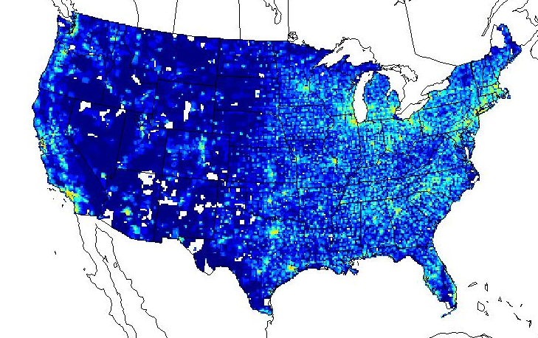
Development of Emissions
Baseline Emissions
2030 EPA National Emissions Inventory
Growth and Control File
FIPS | SCC | Factor | Pollutant
23001 | 1-01-001-00 | 0.50 | NOX
23001 | 2-01-001-00 | 0.70 | ROG
23002 | 1-01-003-00 | 1.20 | NOX
24001 | 2-01-002-00 | 1.00 | CO
24002 | 2-01-002-00 | 0.80 | SOX
24002 | 1-01-003-00 | 0.78 | NOX
…
GHG
Mitigation Strategies Scenarios
Sparse Matrix Operator Kernel Emissions (SMOKE) Model
Spatial Surrogates
CMAQ-ready Emissions

Slide 16
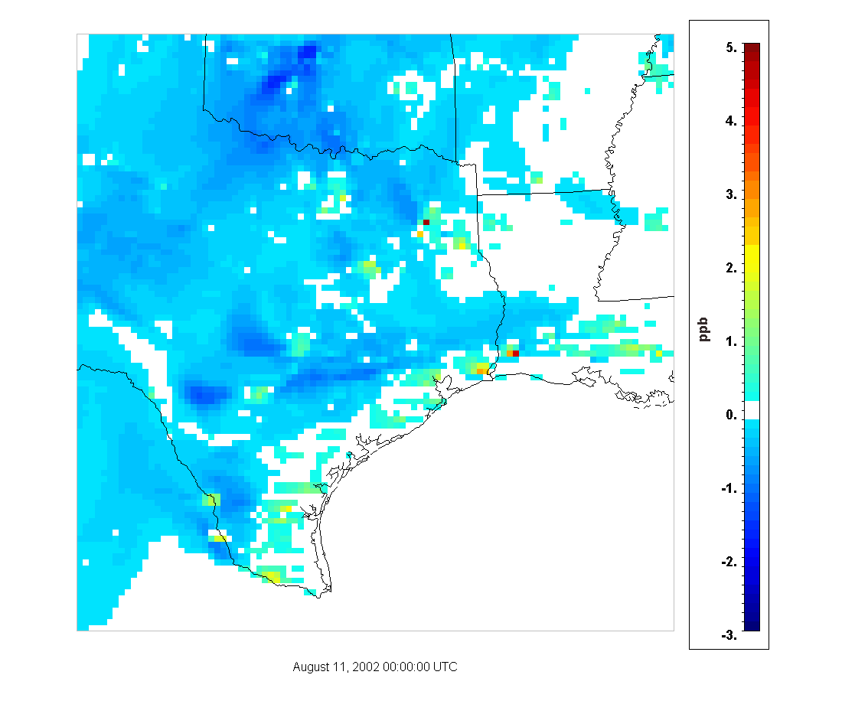
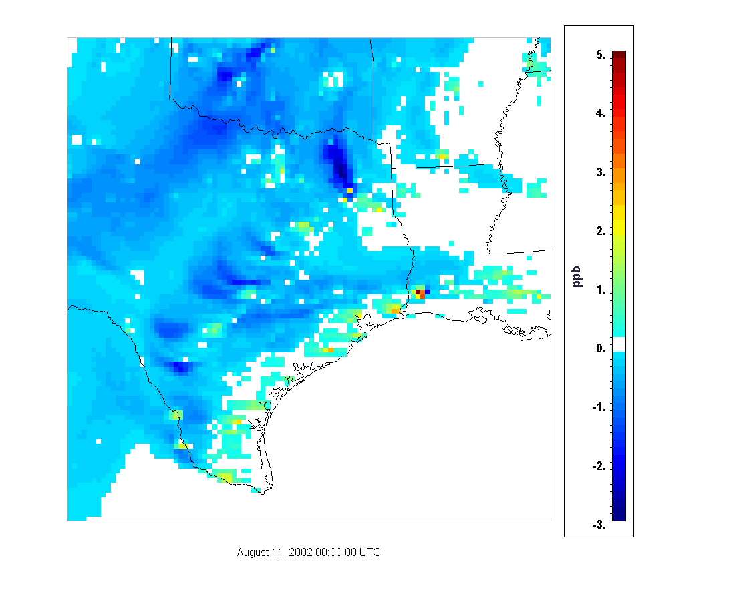
Impact on O₃ concentrations
Reductions dominated by the reduction in vehicle emissions:
  Overall O₃ reductions similar in both cases
Largest differences due to removal of emissions from coal electricity
Coal based - Reference
Renewable based - Reference

Slide 17
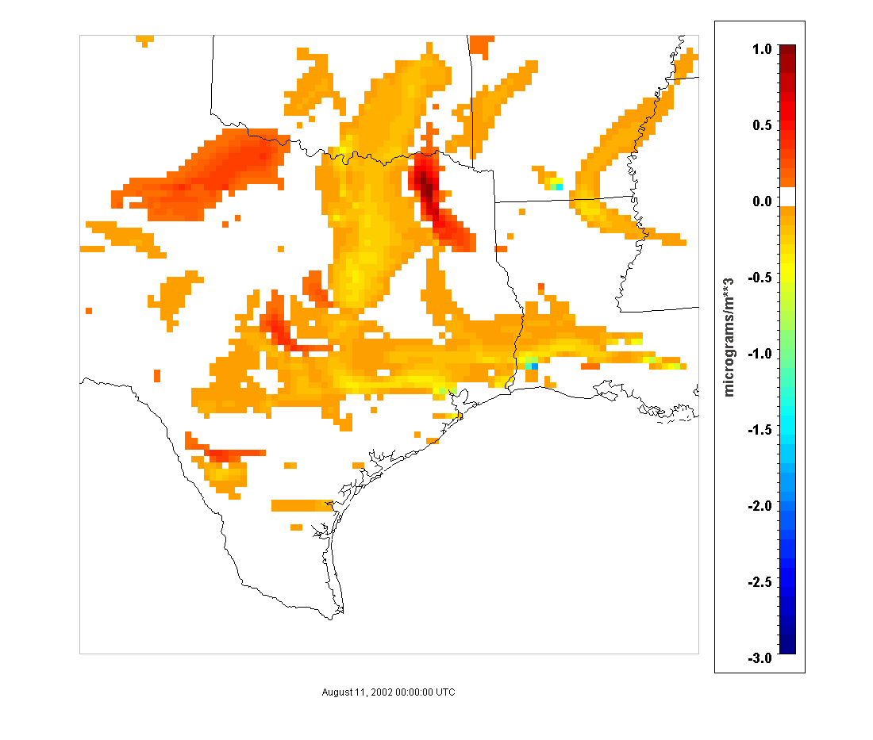
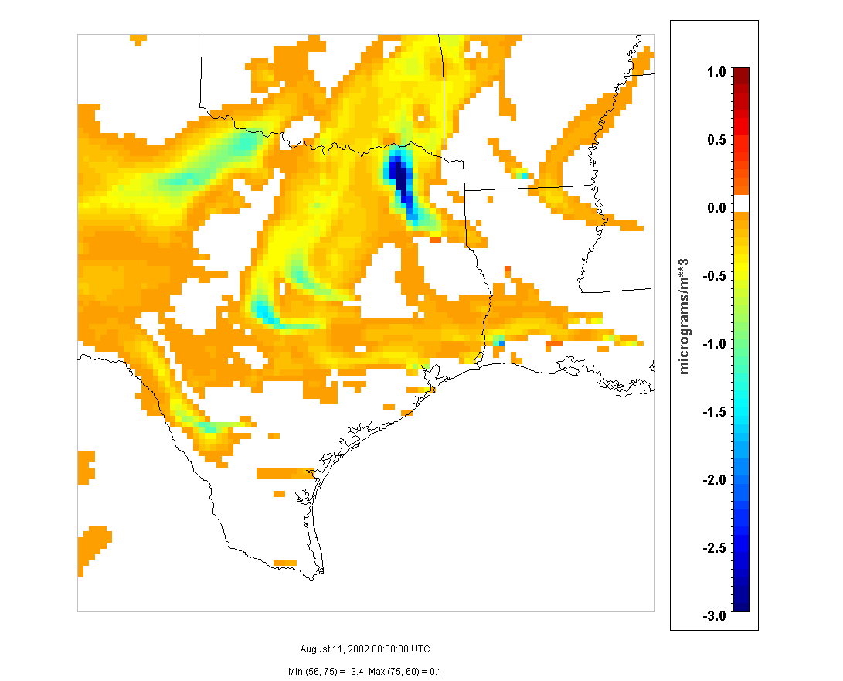
Impact on PM_{2.5} concentrations
Largest impacts are due to emissions from coal electricity
Reduction of vehicle emissions produce moderate decreases in PM_{2.5}
Coal based - Reference
Renewable based - Reference

Slide 18
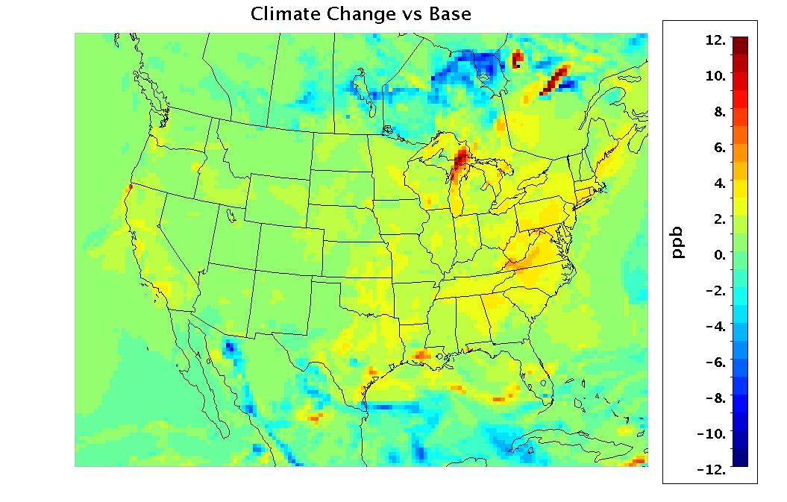
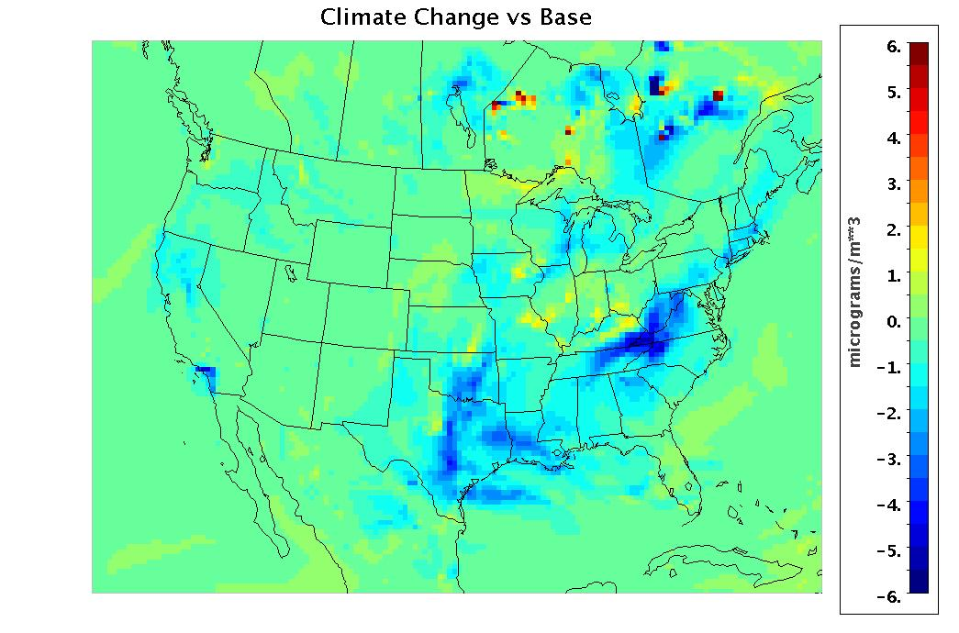
Effects of Global Warming
Sensitivity of ozone and PM_{2.5} formation with temperature in the US
  Increase of 2 ºC in air and soil temperature
Impacts on peak O₃
Impacts on 24-hour PM_{2.5}

Slide 19
Summary
GHG and air quality co-benefits will depend on future fuel and technology paths
Changes in transportation are the dominant to obtain GHG and air quality co-benefits
High penetration of renewable electricity production is essential to achieve GHG reduction targets
Effects of global warming may offset the air quality benefits
  Need to consider including global warming effects on baseline case

Slide 20
Acknowledgments
Boyan Kartolov, Shane Stephens-Romero, Tim Brown – APEP
John Dawson – EPA
Marla Mueller – CEC
Eladio Knipping – EPRI
Ajith Kaduwela – CARB
Uarporn Nopmongcol – ENVIRON
R834284

Slide 23
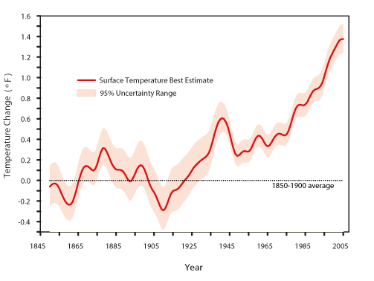
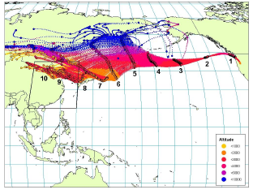
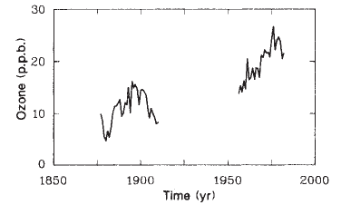
Model Sensitivity
Modeling air quality sensitivity for future scenarios in 2050:
Effects of global climate change on air quality:
  Changes in biogenic emissions and evaporative emissions
  Increased formation of ozone
  Uncertainty on PM formation
Effects of global industrial activity on background concentrations:
  Increased levels of methane globally
  Increased levels of NO_{X} from Asian industrial development
  Increased ozone in air masses across the Pacific from Asian pollution

Slide 24
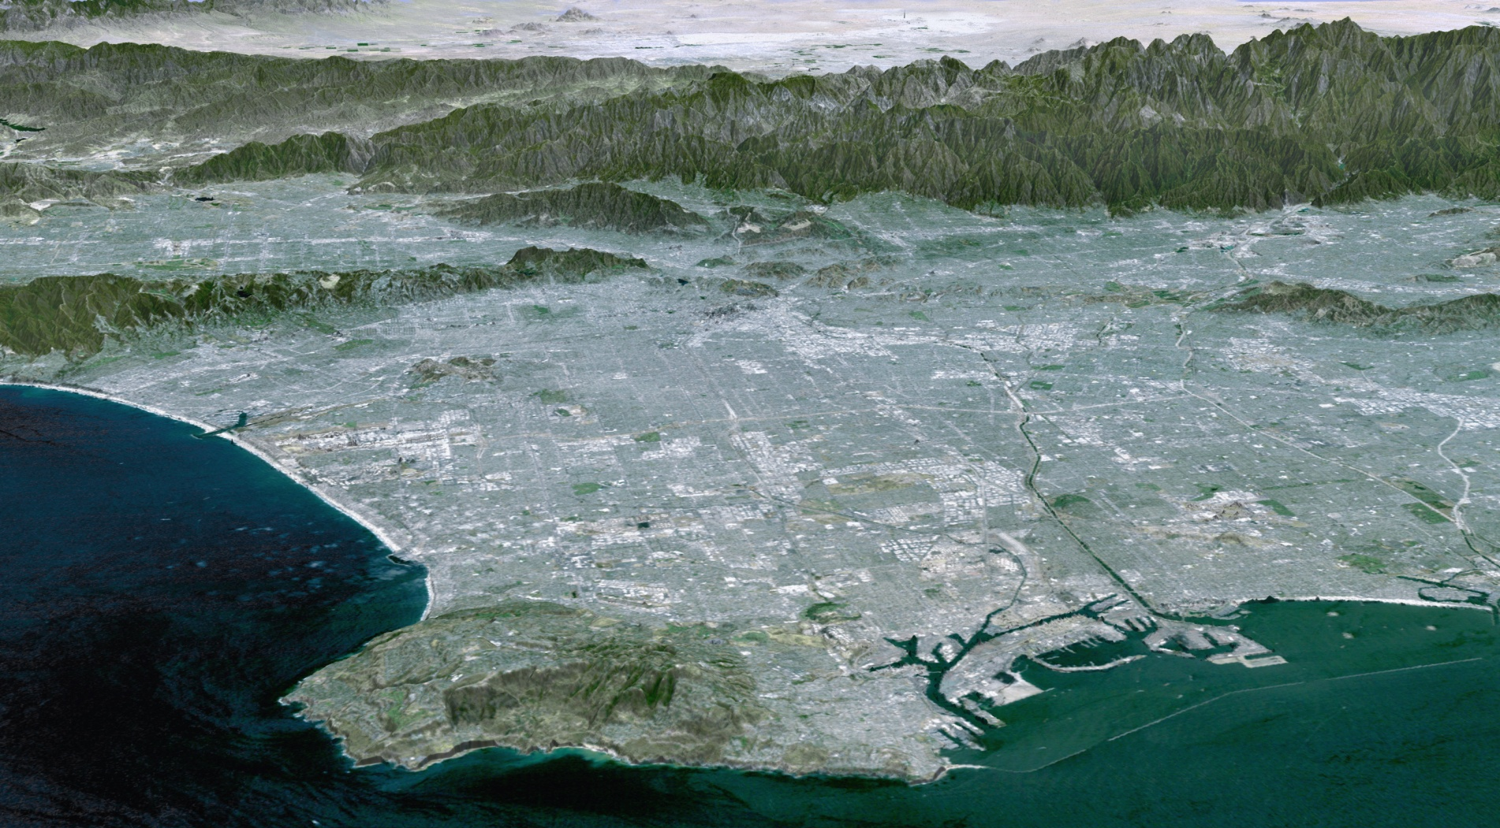
Examples of Future Scenarios
Example 1: Houston-Galveston, Texas
Variations in technology mix for electricity generation
Variations in fuel path for vehicles
Example 2: Los Angeles basin, California
Hydrogen infrastructure deployment with fuel cell cars

Slide 25
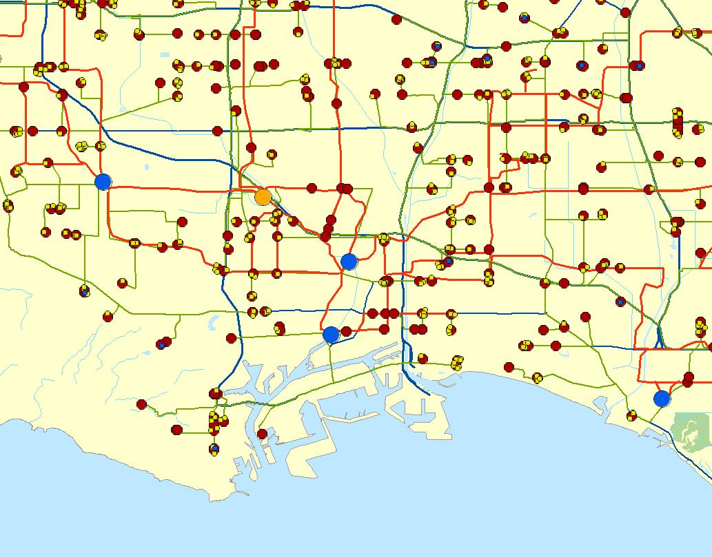
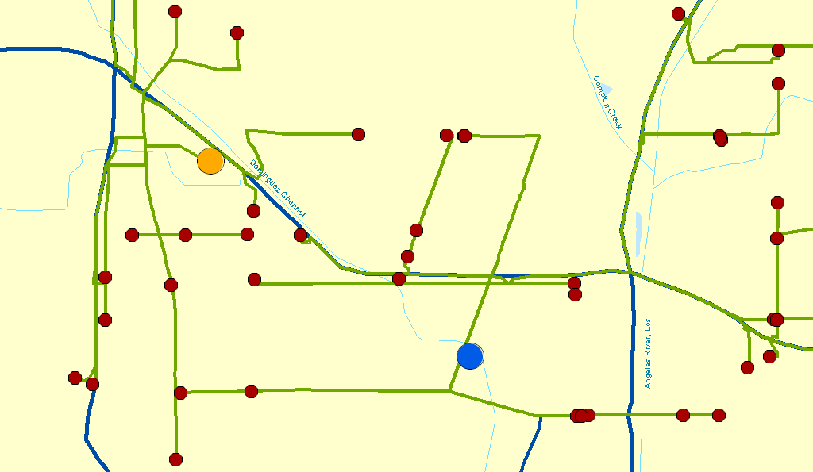

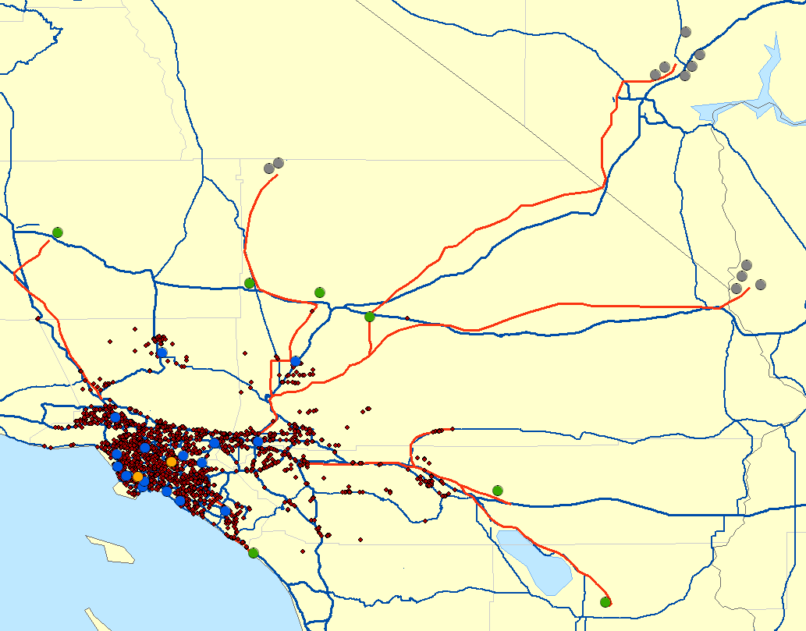


H₂ Infrastructure and FCV
Los Angeles
Trucking Routes
405
710
110
Long Beach
NV
CA
Interstates & Freeways
H₂ Fueling Stations
Central SMR Facilities
Central Petroleum Coke
Central Coal IGCC
Central Electrolysis (Renewable & some Nuclear)
Stationary Fuel Cells
Distributed SMR Facilities
H₂ Pipelines
H₂ Truck Delivery Routes
AZ

Slide 26
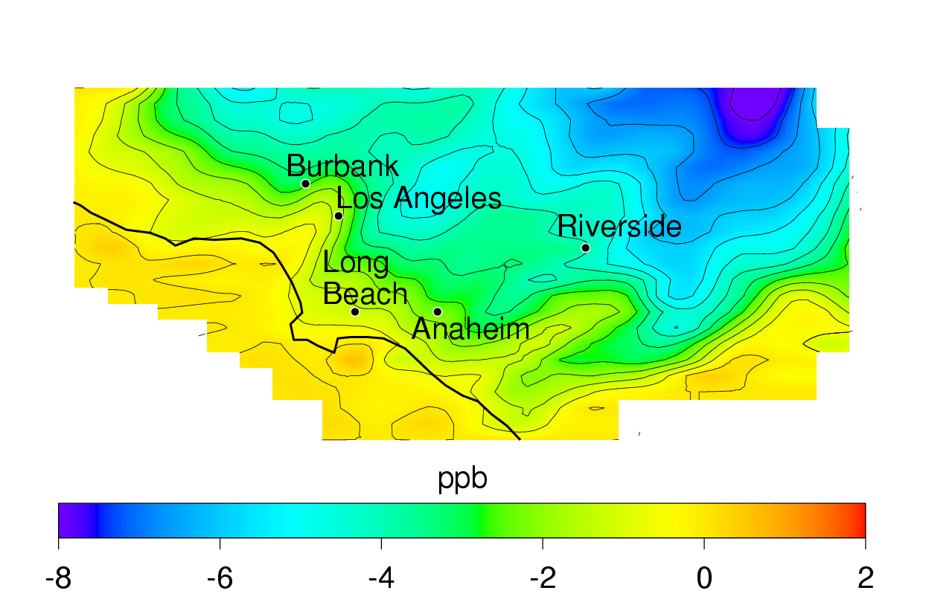
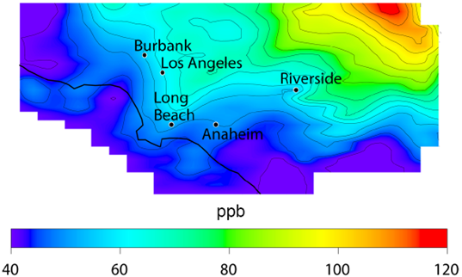
Hydrogen Fuel Cell Vehicles
Effects on 8-hour O₃
Effects on GHG emissions
Baseline O₃
ΔO₃ Scenario FCV – Baseline

Slide 27
Conclusions

Slide 28
Development of Emission Scenarios
Baseline Emissions
2030 EPA National Emissions Inventory
Growth and Control File
FIPS | SCC | Factor | Pollutant
23001 | 1-01-001-00 | 0.50 | NOX
23001 | 2-01-001-00 | 0.70 | ROG
23002 | 1-01-003-00 | 1.20 | NOX
24001 | 2-01-002-00 | 1.00 | CO
24002 | 2-01-002-00 | 0.80 | SOX
24002 | 1-01-003-00 | 0.78 | NOX
…
GHG
Mitigation Strategies Scenarios
Sparse Matrix Operator Kernel Emissions (SMOKE) Model
Spatial Surrogates
CMAQ-ready Emissions

Slide 29
Source Classification Codes
Source Classification Code | Data Category | SCC Level One | SCC Level Two | SCC Level Three
101001AA | Point | External Combustion Boilers | Electric Generation | Anthracite Coal
101002AA | Point | External Combustion Boilers | Electric Generation | Bituminous/Subbituminous Coal
101003AA | Point | External Combustion Boilers | Electric Generation | Lignite
101004AA | Point | External Combustion Boilers | Electric Generation | Residual Oil
101005AA | Point | External Combustion Boilers | Electric Generation | Distillate Oil
101006AA | Point | External Combustion Boilers | Electric Generation | Natural Gas
201001AA | Point | Internal Combustion Engines | Electric Generation | Distillate Oil (Diesel)
201002AA | Point | Internal Combustion Engines | Electric Generation | Natural Gas
201003AA | Point | Internal Combustion Engines | Electric Generation | Gasified Coal
201007AA | Point | Internal Combustion Engines | Electric Generation | Process Gas
201008AA | Point | Internal Combustion Engines | Electric Generation | Landfill Gas

Slide 30
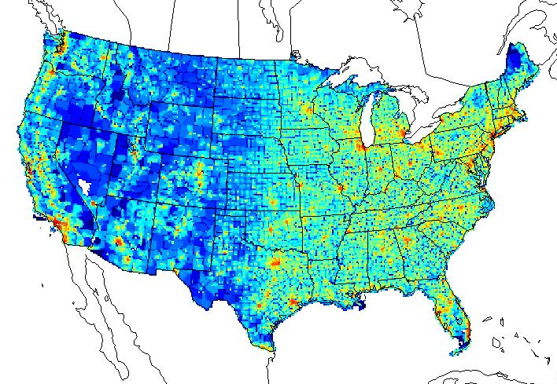
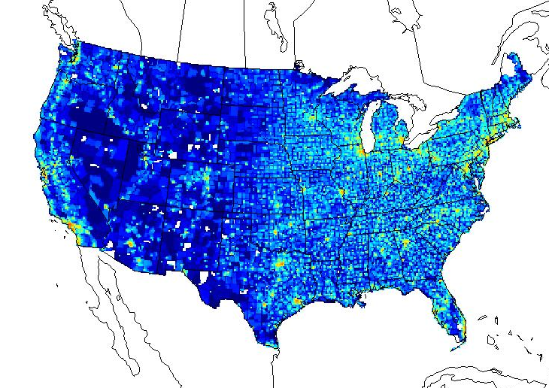
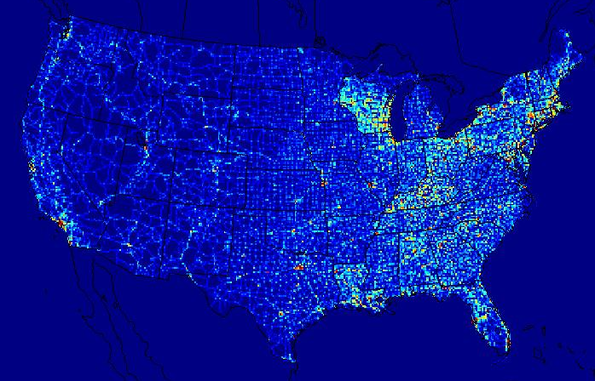
Spatial Surrogates
Population
Commercial Sector
Industrial Sector
Roads

Slide 31
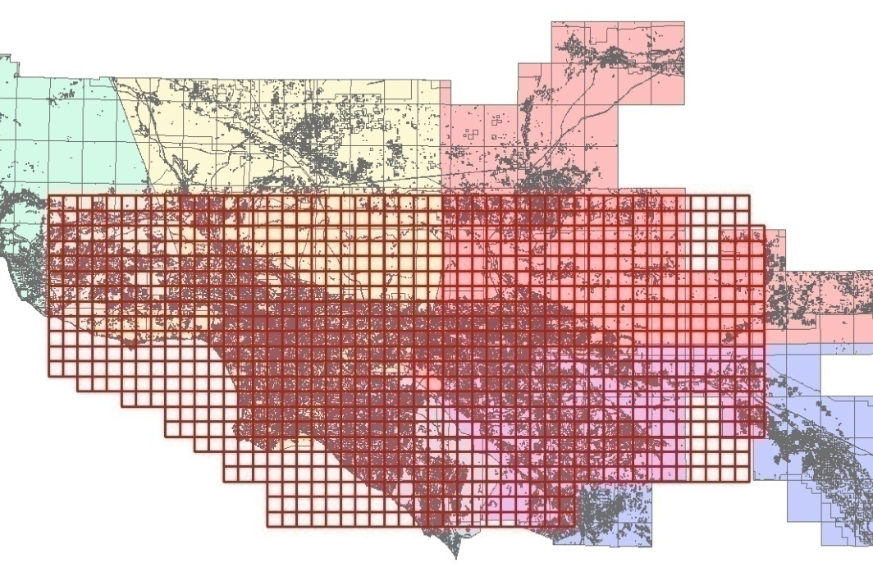
Development of Emission Scenarios
Baseline Emissions
2023 Baseline Air Quality Management Plan Inventory
Growth and Control File
FIPS | SCC | Factor | Pollutant
06001 | 1-01-001-00 | 0.50 | NOX
06001 | 2-01-001-00 | 0.70 | ROG
06002 | 1-01-003-00 | 1.20 | NOX
06001 | 2-01-002-00 | 1.00 | CO
06002 | 2-01-002-00 | 0.80 | SOX
06002 | 1-01-003-00 | 0.78 | NOX
…
Spatially and Temporally Resolved Energy and Environment Tool (STREET) Model
GHG
Mitigation Strategies Scenarios
Spatial Surrogates
CIT Airshed-ready Emissions

Slide 32
Impacts of H₂ Infrastructure and FCV
Los Angeles
Trucking Routes
405
710
110
Long Beach
NV
CA
Interstates & Freeways
H₂ Fueling Stations
Central SMR Facilities
Central Petroleum Coke
Central Coal IGCC
Central Electrolysis (Renewable & some Nuclear)
Stationary Fuel Cells
Distributed SMR Facilities
H₂ Pipelines
H₂ Truck Delivery Routes
AZ

Slide 33
Effects of Hydrogen Fuel Cell Vehicles
Effects on 8-hour O₃
Effects on GHG emissions
Baseline O₃
ΔO₃ Scenario FCV – Baseline

Slide 34
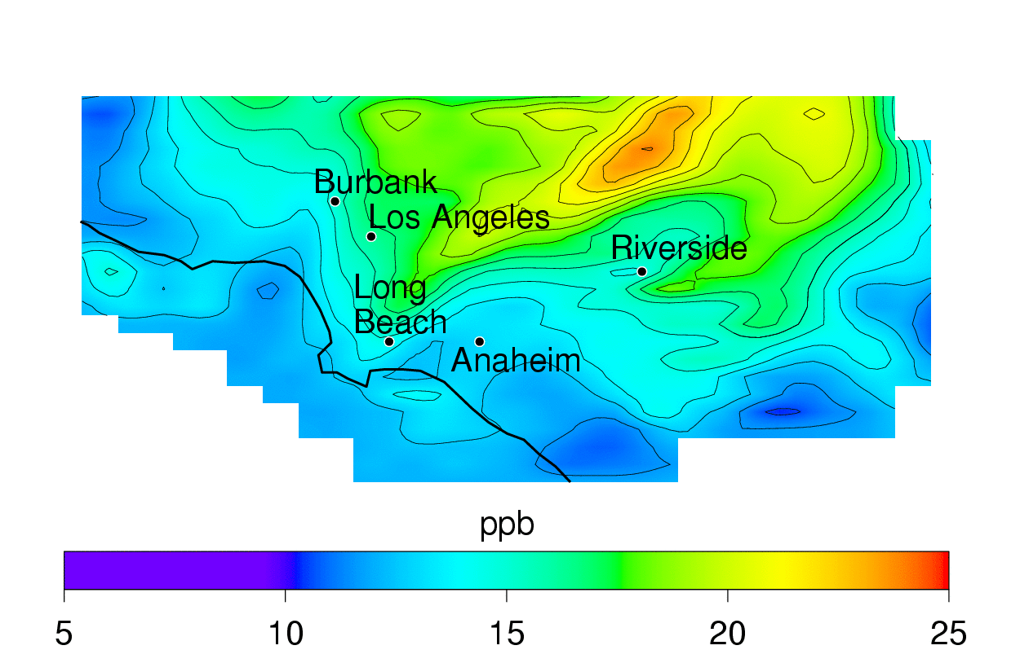
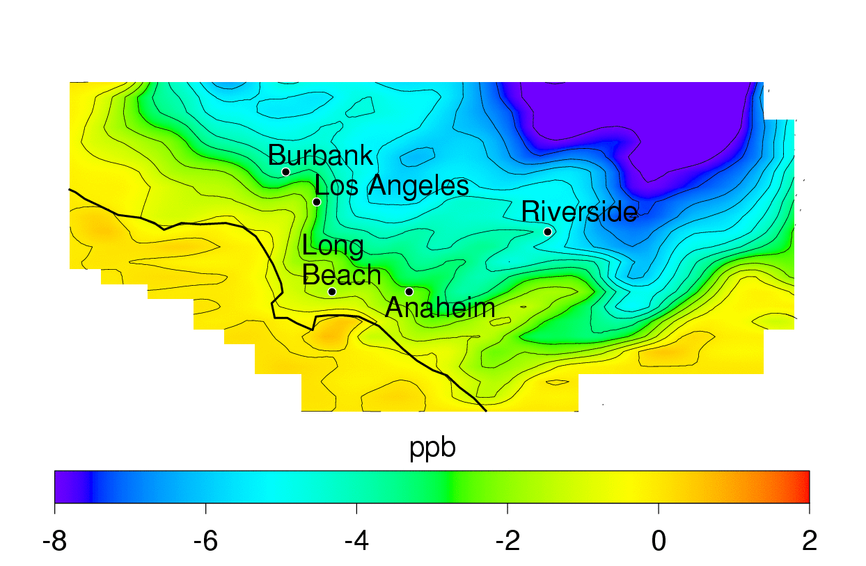
Effects of HFCV with Climate Change
Effects on 8-hour O₃
ΔO₃: Baseline CC – Baseline
ΔO₃: Scenario FCV w/CC – Baseline CC
Baseline O₃

Slide 35
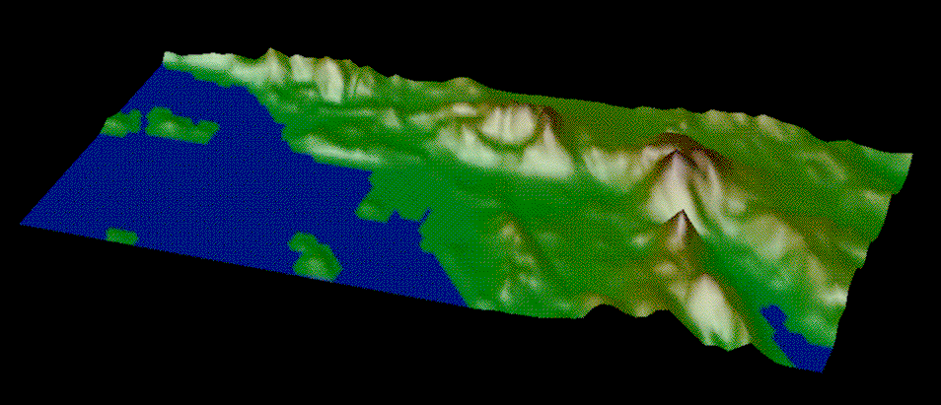
The UCI-CIT Airshed Model
Governing Dynamic Equation:
Quintic-spline Taylor-series expansion (QSTSE) advection solver
Caltech Atmospheric Chemistry Mechanism (CACM)
Aerosol Modules:
  Inorganic: Simulating Compositions of Atmospheric Particles at Equilibrium (SCAPE2)
  Organic: Model to Predict the Multiphase Partitioning of Organics (MPMPO)
123 Gas Species
296 Aerosols: 37 species, 8 sizes
361 Reactions
1100 m
670 m
310 m
150 m
40 m
0 m
30
Cells
80 Cells
Each Cell: 5 x 5 km²
Notes:
35
The CIT Airshed model is based on the numerical solution of the atmospheric diffusion equation in a grid of 994 columns with 5 vertical layers of variable height. The equation includes advective transport, sources and sinks, such as area or point emissions and dry deposition, chemical production/losses and size-resolved and chemically-resolved aerosol formation.
Meteorological conditions were obtained by processing the measurements acquired during the SACQS (Southern California Air Quality Study), in Sept. 27-29. During this period, a complete set of meteorological data was compiled. These measurements encompass temperature field, wind field, uv radiation field, and information of the terrain such as surface roughness to calculate deposition velocities, etc…
The chemical Mechanism is the LCC mechanism, and it includes 121 reactions, with 47 gas species and 19 aerosol species partitioned into 8 different size bins.

Slide 36
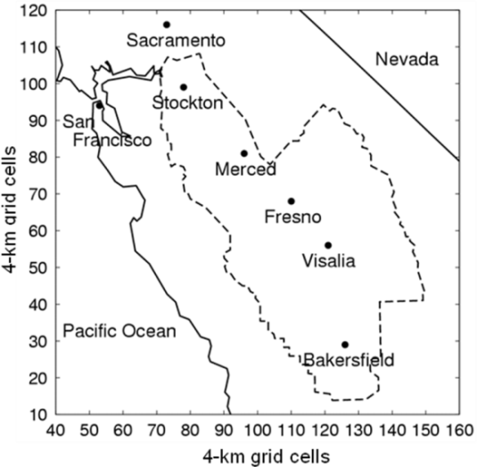
CMAQ Model
Community Multiscale Air Quality Model (CMAQ)
Widespread use in air
quality modeling community
Adapted to model entire US
Modular chemical mechanisms
  CBIV, SAPRC99, CB05
Modal approach to PM formation
Emissions readily available
from USEPA
Notes:
36
The CIT Airshed model is based on the numerical solution of the atmospheric diffusion equation in a grid of 994 columns with 5 vertical layers of variable height. The equation includes advective transport, sources and sinks, such as area or point emissions and dry deposition, chemical production/losses and size-resolved and chemically-resolved aerosol formation.
Meteorological conditions were obtained by processing the measurements acquired during the SACQS (Southern California Air Quality Study), in Sept. 27-29. During this period, a complete set of meteorological data was compiled. These measurements encompass temperature field, wind field, uv radiation field, and information of the terrain such as surface roughness to calculate deposition velocities, etc…
The chemical Mechanism is the LCC mechanism, and it includes 121 reactions, with 47 gas species and 19 aerosol species partitioned into 8 different size bins.

Slide 37
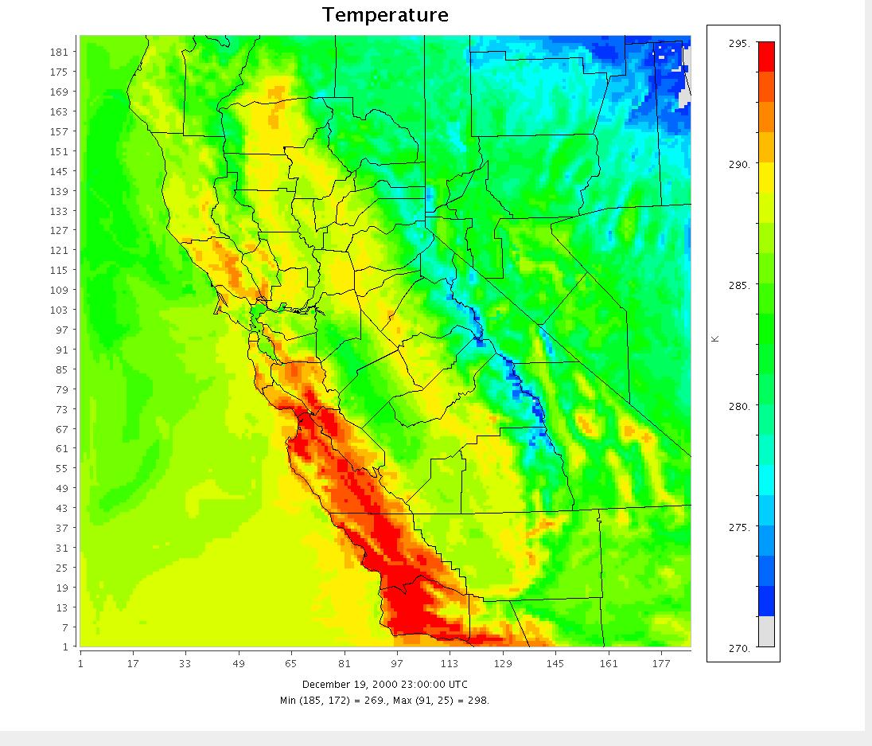
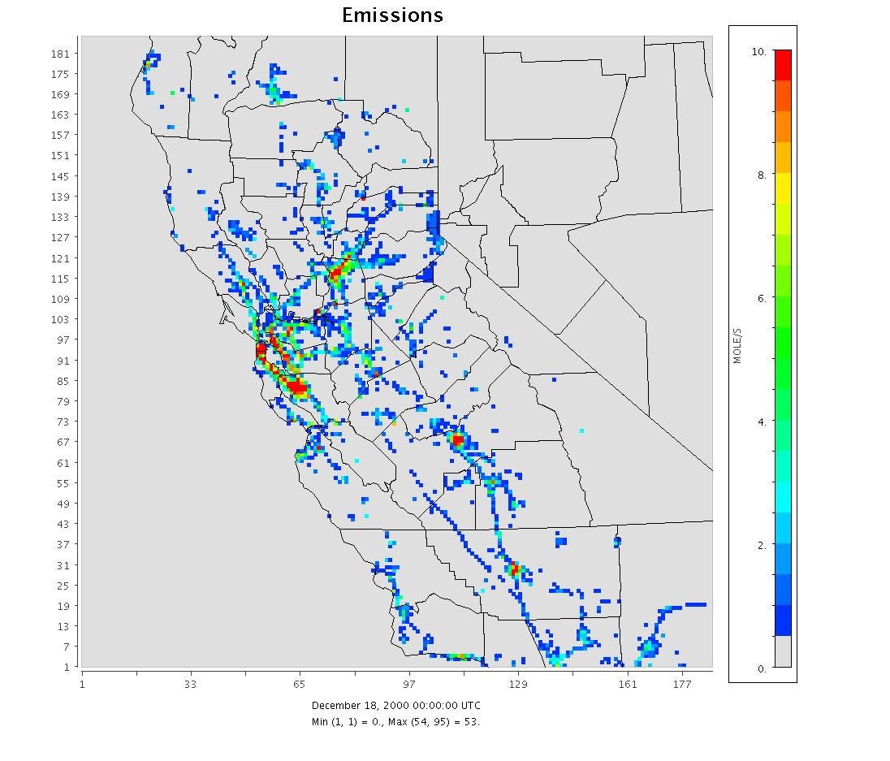
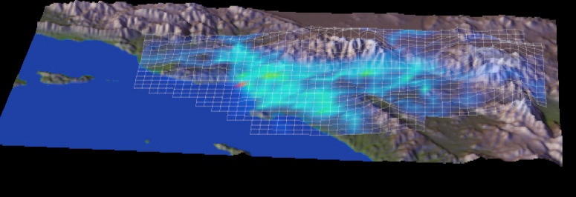
California Model Inputs
Meteorological Conditions:
Typical meteorological episodes:
summer (SoCal, SJV), winter (SJV)
Model resolution of 4-5km
Emissions:
Spatial and temporal resolution
tied to meteorology
Detailed emissions apportionment
based on Standard Classification
Code (SCC)
In-house emissions modeling
tools
Notes:
37
The CIT Airshed model is based on the numerical solution of the atmospheric diffusion equation in a grid of 994 columns with 5 vertical layers of variable height. The equation includes advective transport, sources and sinks, such as area or point emissions and dry deposition, chemical production/losses and size-resolved and chemically-resolved aerosol formation.
Meteorological conditions were obtained by processing the measurements acquired during the SACQS (Southern California Air Quality Study), in Sept. 27-29. During this period, a complete set of meteorological data was compiled. These measurements encompass temperature field, wind field, uv radiation field, and information of the terrain such as surface roughness to calculate deposition velocities, etc…
The chemical Mechanism is the LCC mechanism, and it includes 121 reactions, with 47 gas species and 19 aerosol species partitioned into 8 different size bins.

Slide 38
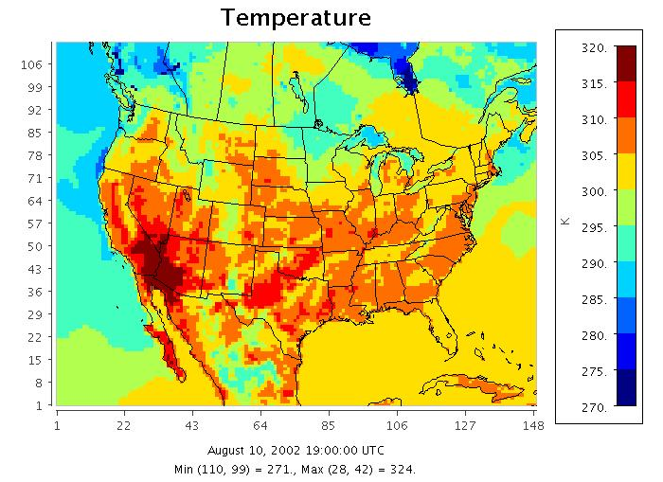
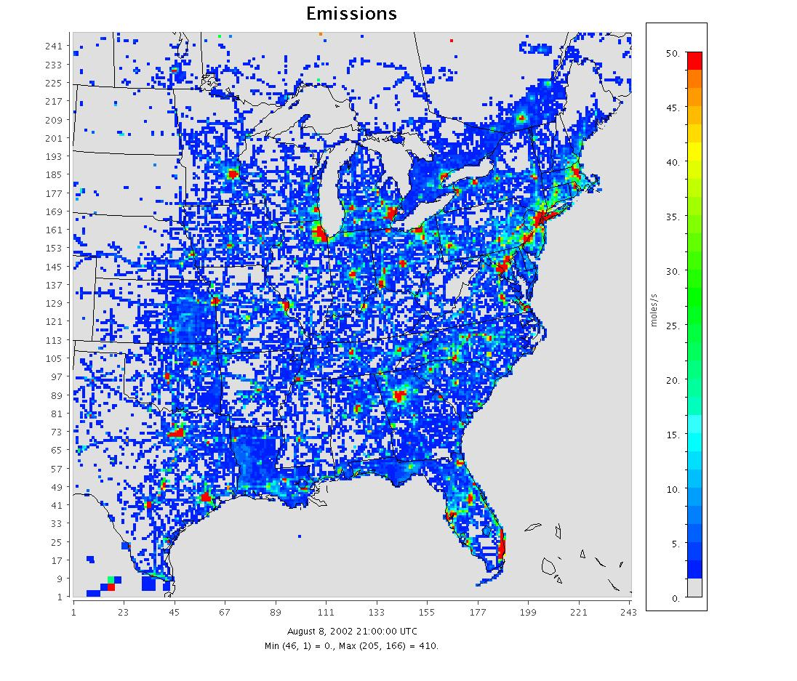
Eastern US Model Inputs
Meteorological Conditions:
Meteorological fields for
entire year 2002
Resolution of 36km for entire US
and 12km for eastern US
Emissions:
Spatial and temporal resolution
tied to meteorology
Additional future year projections
that span to year 2030 by EPA
Emissions resolved by Standard
Classification Codes
  Can be manipulated with SMOKE
Notes:
38
The CIT Airshed model is based on the numerical solution of the atmospheric diffusion equation in a grid of 994 columns with 5 vertical layers of variable height. The equation includes advective transport, sources and sinks, such as area or point emissions and dry deposition, chemical production/losses and size-resolved and chemically-resolved aerosol formation.
Meteorological conditions were obtained by processing the measurements acquired during the SACQS (Southern California Air Quality Study), in Sept. 27-29. During this period, a complete set of meteorological data was compiled. These measurements encompass temperature field, wind field, uv radiation field, and information of the terrain such as surface roughness to calculate deposition velocities, etc…
The chemical Mechanism is the LCC mechanism, and it includes 121 reactions, with 47 gas species and 19 aerosol species partitioned into 8 different size bins.

Slide 39
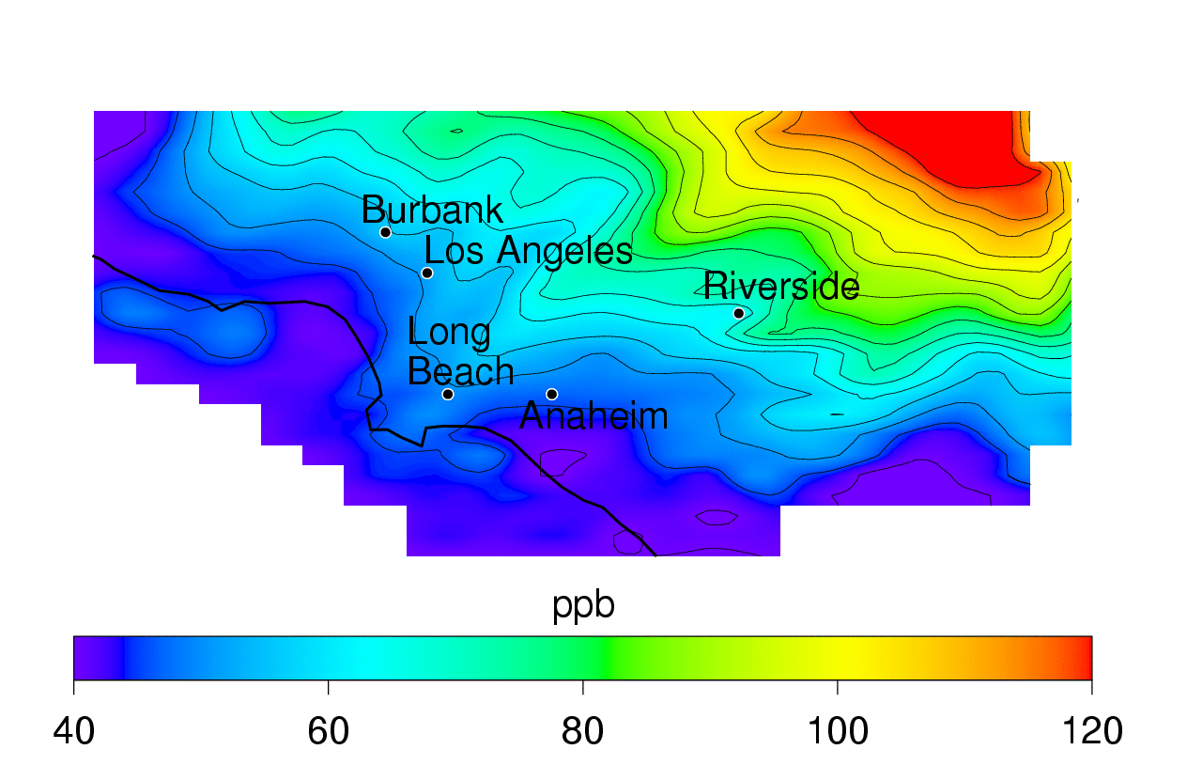
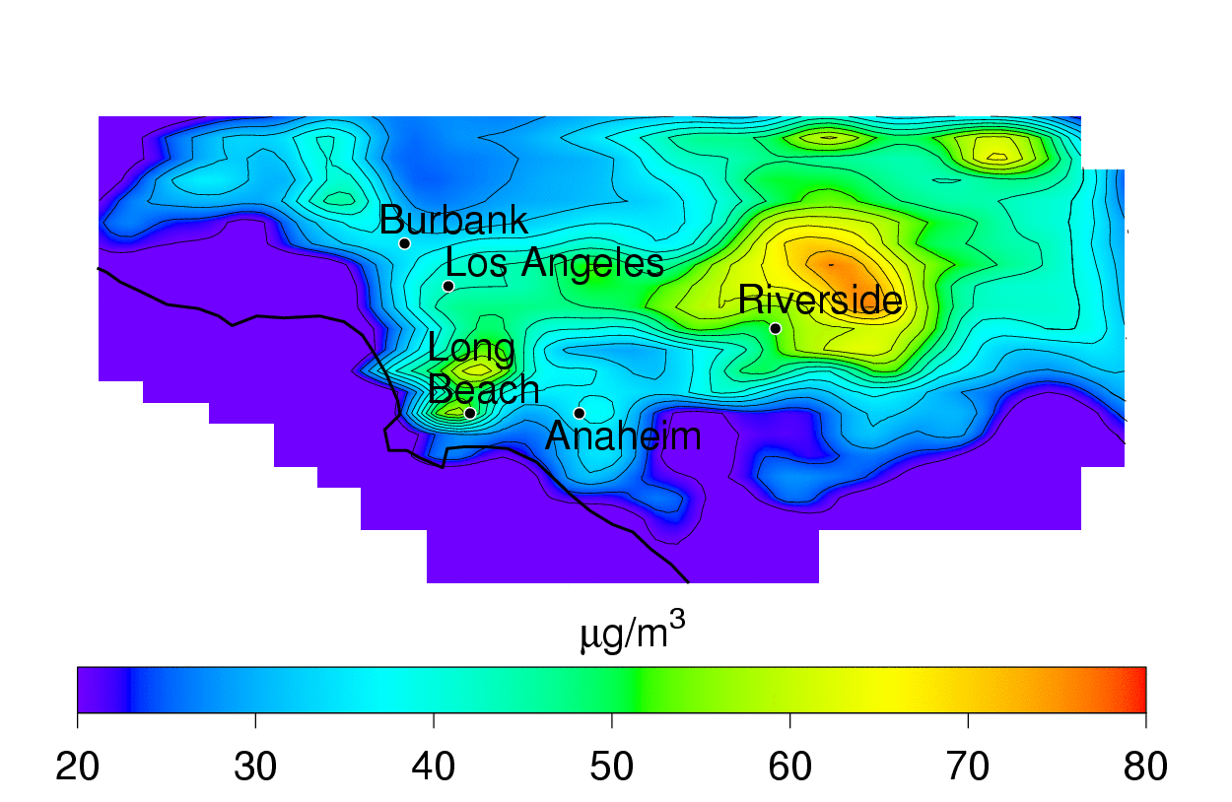
Simulation Results – Southern California
Southern California
Summer Episode
Future emissions for 2023
8-hour average O₃
24-hour average PM_{2.5}

Slide 40
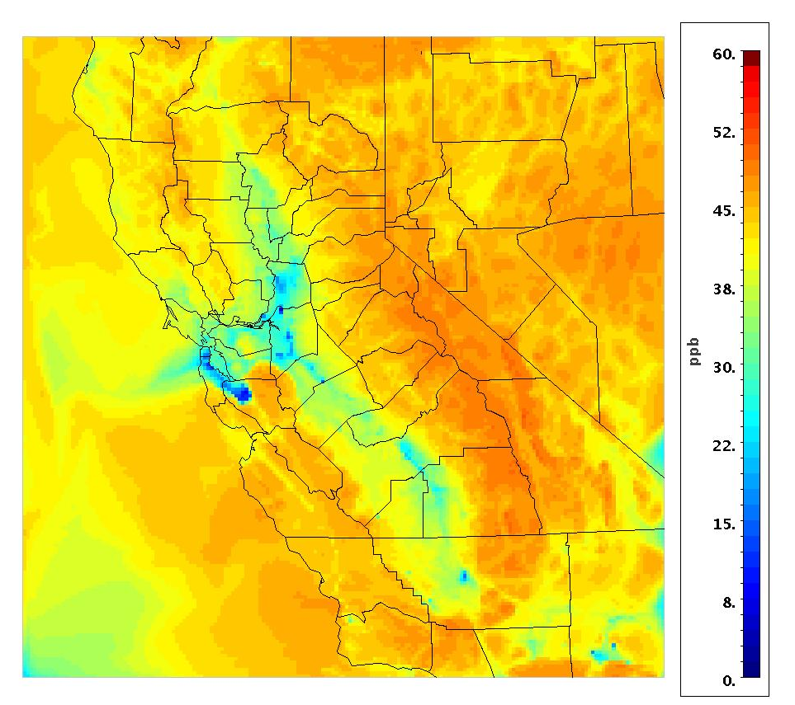
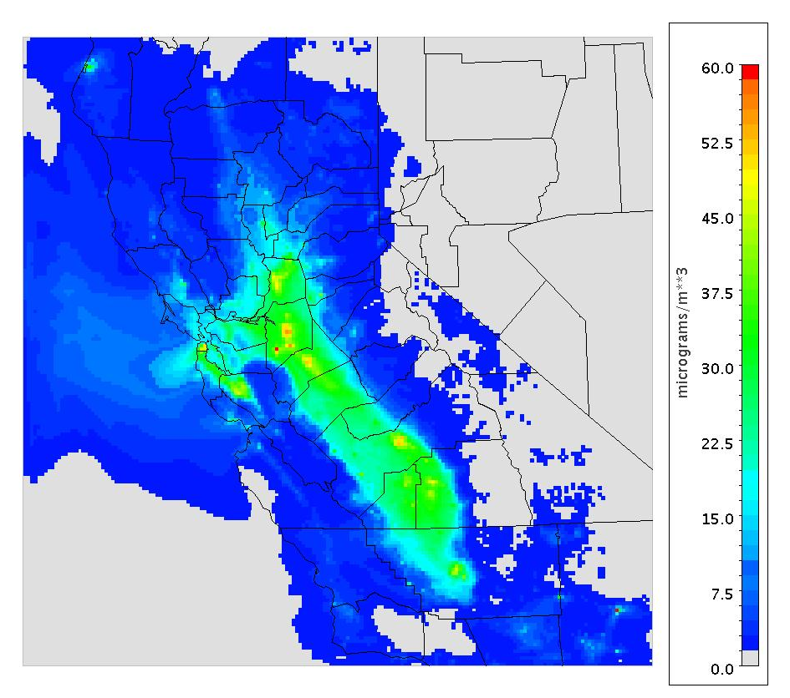
Simulation Results – Central California
Central California
December, 2000
Peak Ozone
24-hour average PM_{2.5}

Slide 41
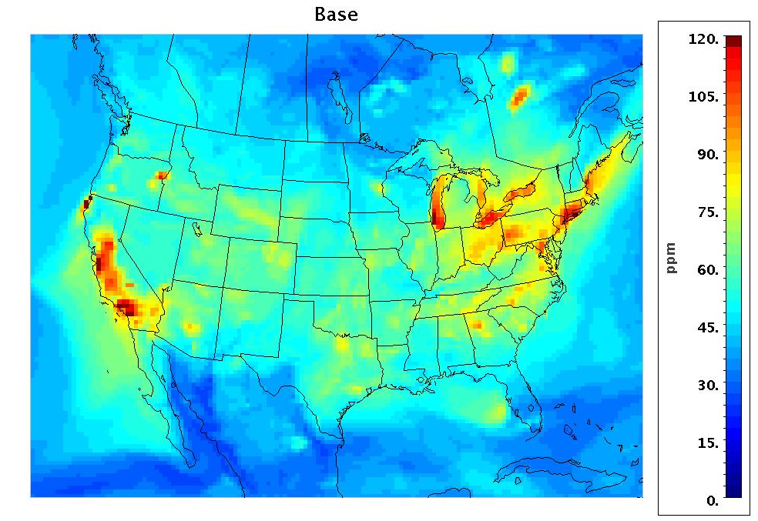
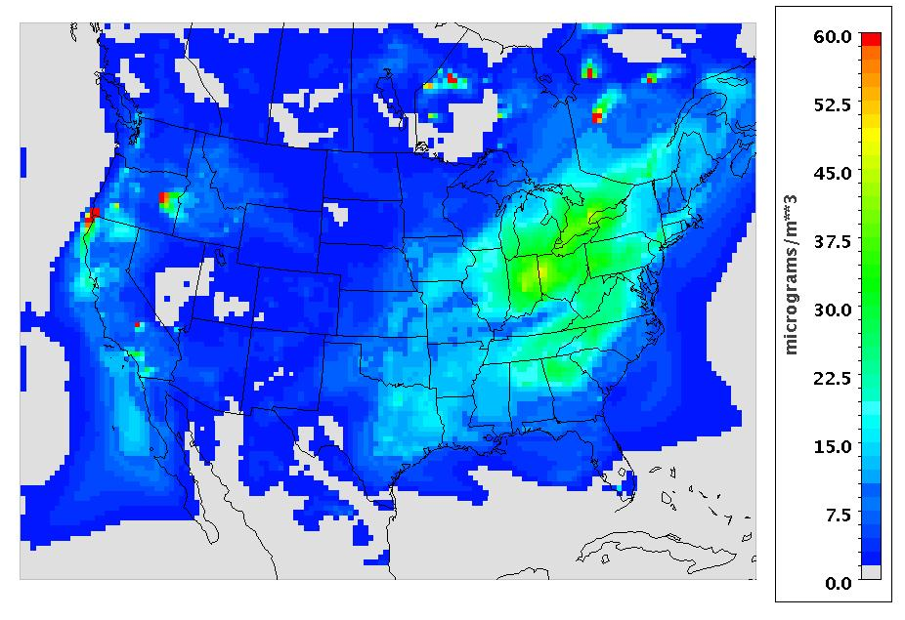
Simulation Results – Continental US
Parent domain
Continental US
August, 2002
Peak Ozone
24-hour average PM_{2.5}

Slide 42
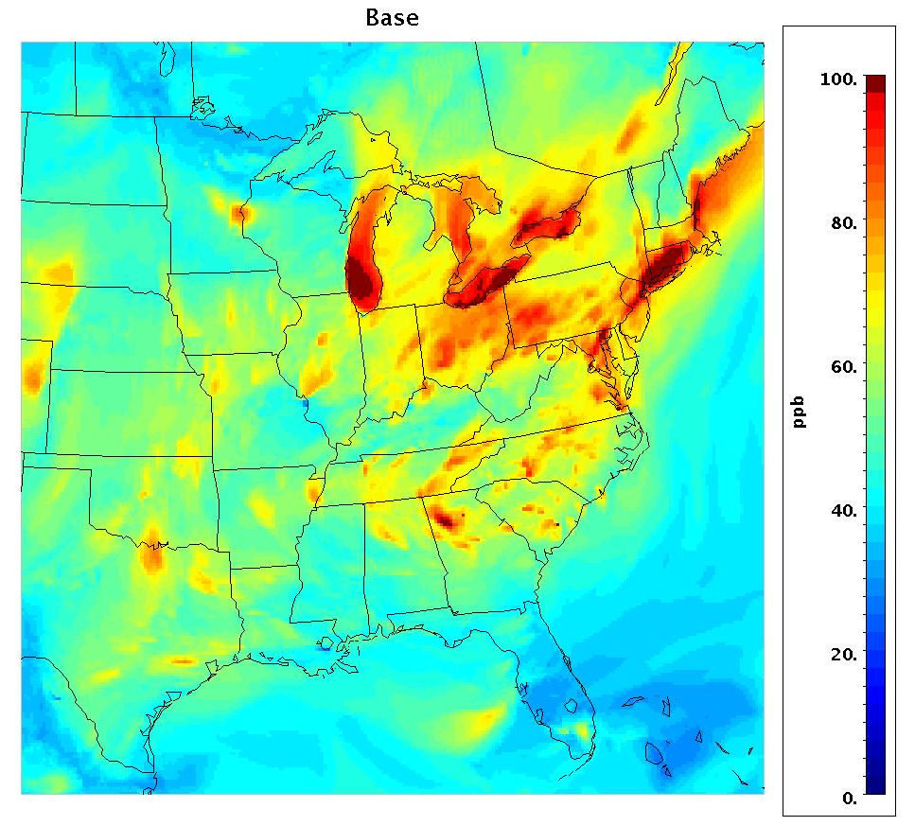
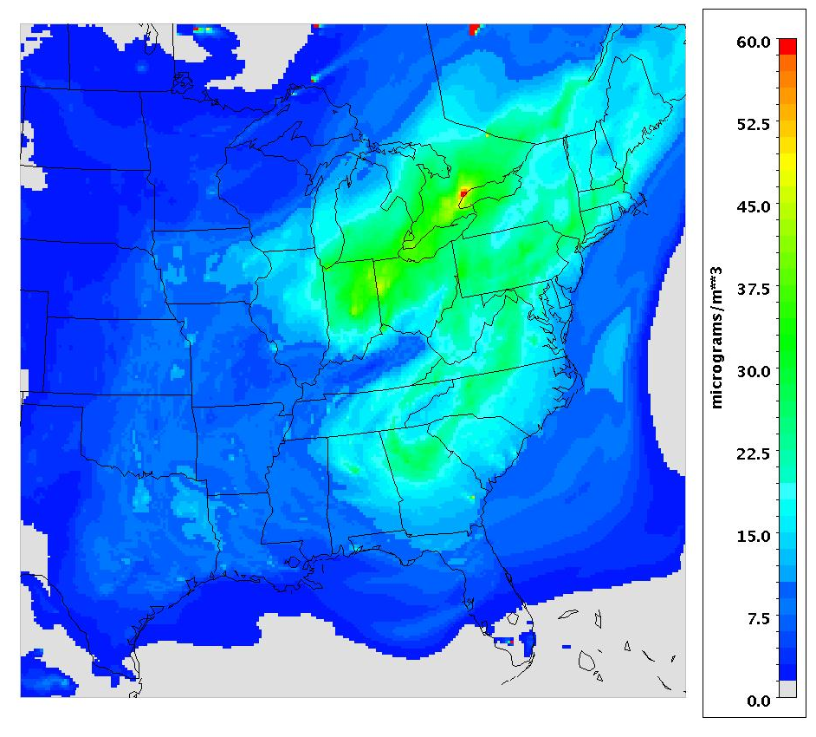
Simulation Results – Eastern US
Nested domain
Eastern US
August, 2002
Peak Ozone
24-hour average PM_{2.5}

Slide 43
Outline
Modeling Regions of Interest
  Air Quality Models
  Model Inputs
  Sample Simulation Results
Sensitivity Analyses
  Effects of global warming
  Effects of industrial growth in Southeast Asia
Initial Simulations
  Development of emission scenarios
  Effects of long term changes on air quality predictions

Slide 44
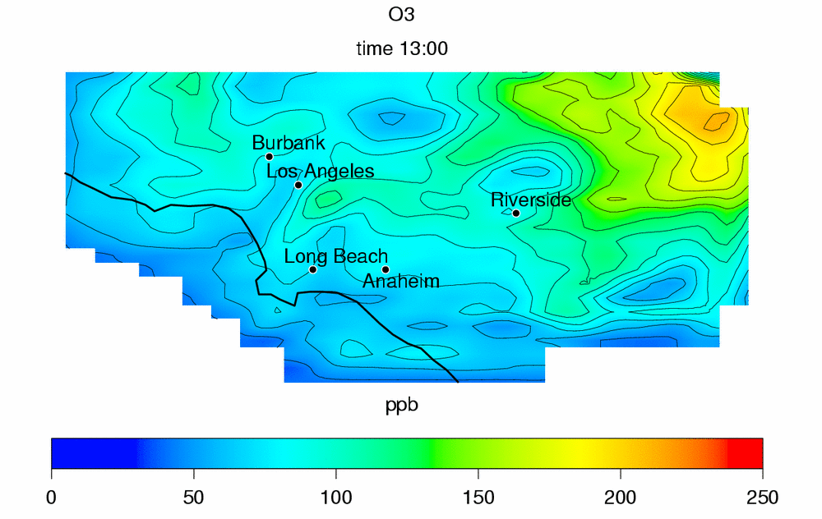
Model Sensitivity to Input Parameters
Baseline Simulations:
Emissions: Baseline 2010
Meteorology: August 27-29th, 1987
Determination of sensitivity of model predictions to input:
Changes in meteorological conditions:
  Temperature: -10 ºC, -5 ºC, +5 ºC and +10 ºC
  UV radiation and mixing height: -20% and +20%
  Wind velocity: x0.5 and x2.0
Changes in boundary conditions (BC) for NO_{X}, VOC and O₃
Changes in initial conditions (IC)
O₃ at hour 13

Slide 45
Input Parameters: Sensitivity Results
Meteorological conditions:
Temperature shows the strongest effect on peak ozone:
  Peak ozone changes ~8ppb/ºC
Wind velocity, UV radiation and mixing height also affect ozone
Sensitivity of peak ozone to meteorology suggests that multiple episodes should be used to assess air quality impacts
Initial conditions (IC):
The effect of IC on ozone concentration persists for up to 3 days of simulation, at downwind locations
Meteorological episodes of ≥ 3 days are recommended
Boundary conditions (BC):
BC do not affect peak ozone significantly

Slide 46
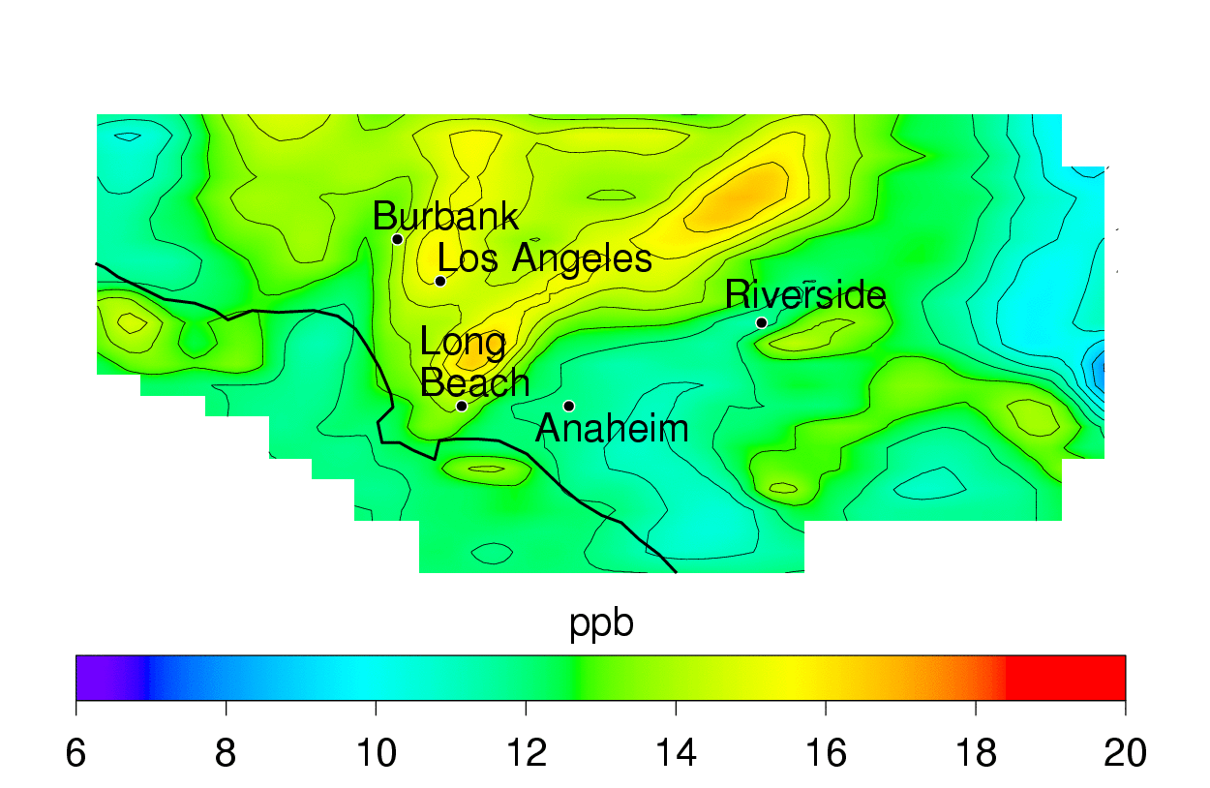
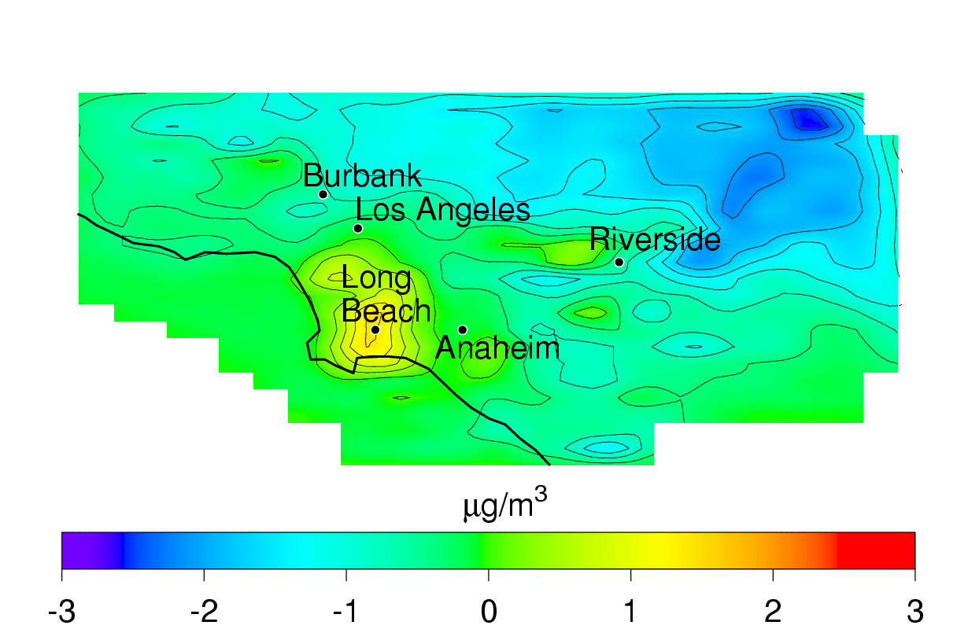
Effects of Industrial Growth (1/2)
Sensitivity of ozone and PM_{2.5} formation with background concentrations in Southern California
  Increase of 30% in O₃ and CO on western boundary
  Increase of 30% in CH₄ background concentrations
Impacts on 8-hour O₃
Impacts on 24-hour PM_{2.5}

Slide 47
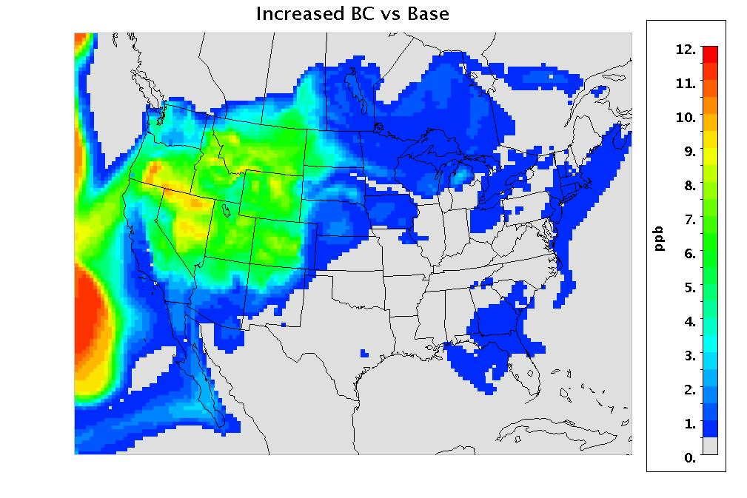
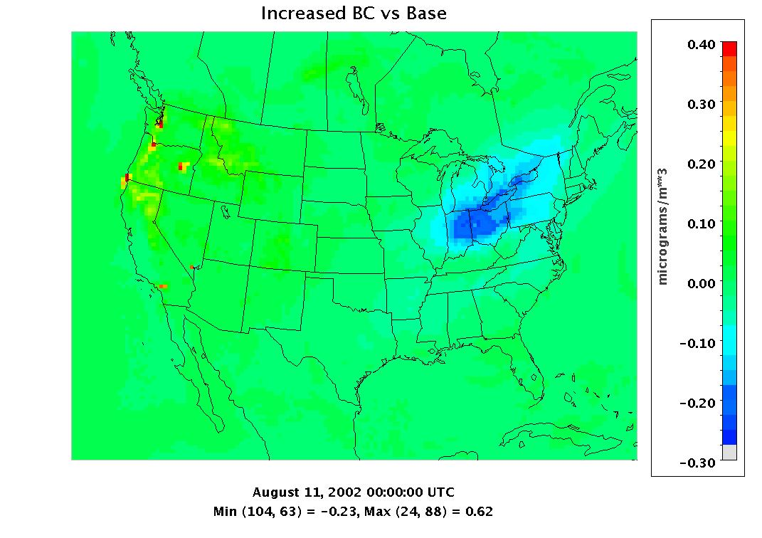
Effects of Industrial Growth (2/2)
Sensitivity of ozone and PM_{2.5} formation with background concentrations in the US
  Increase of 30% in O₃ and CO on western boundary
Impacts on peak O₃
Impacts on 24-hour PM_{2.5}

Slide 48
Outline
Modeling Regions of Interest
  Air Quality Models
  Model Inputs
  Sample Simulation Results
Sensitivity Analyses
  Effects of global warming
  Effects of industrial growth in Southeast Asia
Initial Simulations
  Development of emission scenarios
  Effects of long term changes on air quality predictions

Slide 49
Project Overview – Tasks
Technology assessment for GHG reduction strategies
  Focus on utilities and transportation sectors
Air quality impacts assessment of GHG reduction strategies
  Spatially and temporally resolved pollutant emissions due to GHG reduction strategies
  Spatially and temporally resolved changes in ozone and particulate matter
Air quality model sensitivity
  Meteorological and boundary conditions affected by changes in global climate and the global economy

Slide 50
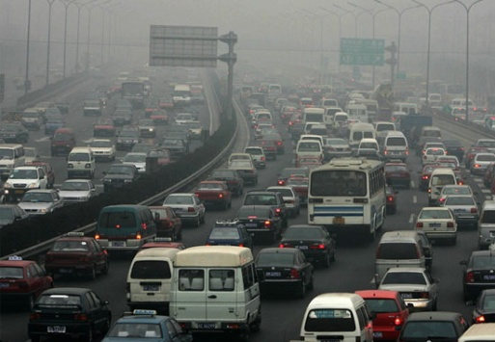
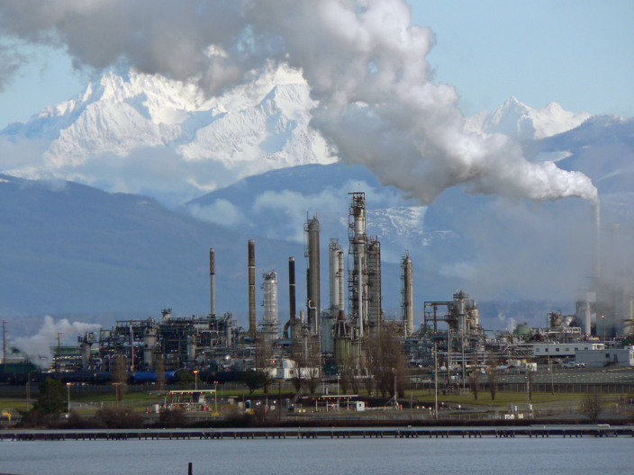
Project Overview – Tasks
Technology assessment for GHG reduction strategies
  Focus on utilities and transportation sectors
Air quality impacts assessment of GHG reduction strategies
  Spatially and temporally resolved pollutant emissions due to GHG reduction strategies
  Spatially and temporally resolved changes in ozone and particulate matter
Air quality model sensitivity
  Meteorological and boundary conditions affected by changes in global climate and the global economy

Slide 51
Outline
Modeling Regions of Interest
  Air Quality Models
  Model Inputs
  Sample Simulation Results
Sensitivity Analyses
  Effects of global warming
  Effects of industrial growth in Southeast Asia
Initial Simulations
  Development of emission scenarios
  Effects of long term changes on air quality predictions

Slide 52
Outline
Modeling Regions of Interest
  Air Quality Models
  Model Inputs
  Sample Simulation Results
Sensitivity Analyses
  Effects of global warming
  Effects of industrial growth in Southeast Asia
Initial Simulations
  Development of emission scenarios
  Effects of long term changes on air quality predictions

Slide 53
Projected LDV VMT

Slide 54
Reference Case
 | 2010 | 2050
Population [million persons] | 6.1 | 10.89
LDV Fleet [million vehicles] | 5.0 | 9.4
Annual VMT [billion VMT] | 57.8 | 127.5
Average Fuel Economy [mpg] | 20.15 | 26.30
Annual Gasoline Use [ million gallons] | 2.87 | 4.85
Annual GHG Emissions [mmt CO₂eq] | 25.22 | 42.59

Slide 55
Reference Case
Population projections to 2050 based on socioeconomic modeling conducted by the Houston-Galveston Area Council (HGAC)
Vehicle population and vehicle miles traveled (VMT) estimates based on factors derived from transportation sector modeling (Thomas, 2007)
  Values compared to other estimate methodologies, represents a middle value
Reference case assumes ICE CVs continue to meet LDV VMT demand with no large-scale deployment of alternative vehicle technologies
  30% gain in on-road vehicle fuel economy
Reference case projects for 2050
  annual consumption of 4.8 billion gallons of motor gasoline
  emissions of 42.59 million metric tons (mmt) of CO₂eq,
    69% increase in LDV sector GHG emissions from 2010 levels

Slide 56
Reference Case LDV GHG Emissions

