Slide 1
Use of Surface Measurements and MODIS Aerosol Optical Depth for Improved Model Based PM_{2.5} Prediction in the United States
Sinan Sousan^{(a,b)}, Jaemeen Baek^{(b)}, Naresh Kumar^{(c)}, Jacob Oleson^{(d)}, Scott Spak^{(b)}, Gregory Carmichael^{(a,b)}, and Charles Stanier^{(a,b)}
a) Chemical and Biochemical Engineering Department
b) Center for Global and Regional Environmental Research
c) Geography Department
d) Biostatistics Department
University of Iowa
October 12, 2010

Slide 2
Overview
Background
Objectives
Methods
Results and discussion
Conclusion
Acknowledgment

Slide 3
Background: Improving air quality PM_{2.5} model estimates
Optimal interpolation (OI) is a computationally efficient data assimilation method, which combines the available observations with model data to improve the model estimates.¹
IMPROVE
STN
10km
MODIS
OI
Posterior PM_{2.5}
Evaluation
CMAQ
Temporal Averaging
Settings
Focus
¹ KALNAY, E. 2002. Atmospheric Modeling, Data Assimilation and Predictability (Book).

Slide 4
Methods: Model settings
CMAQ v. 4.6
MM5¹
SMOKE v.2.3.4
Emissions: 2002 National Emission inventory
Modeling domain
Domain: United States
Run time: 2002 (10 days spin up time was used from 2001)
Number of grid cells(x,y):162x126
Grid resolution: 36km x 36km
Vertical layers: 14
Evaluation of CMAQ's 2002 prior and posterior aerosol estimates for the United States domain was performed on a monthly basis dividing the country into six regions based on the U.S. Census division²
¹Grell, et al(1995), (Available at http://www.mmm.ucar.edu/mm5/documents/mm5-descdoc. html)
²References are found from the U.S. Census at http://www.census.gov/geo/www/us_regdiv.pdf

Slide 5
Methods: CMAQ-derived AOD
AOD was calculated based on EPA¹ of the collimated extinction coefficient (m²/g) for each layer
bext = 3.0 * f(RH) * (1.375 * Sulfate) + 3.0 * f(RH) * 1.29 * Nitrate) +
4.0 * (Organic Carbon) + 10.0 * (Elemental Carbon) + 1.0 * (Unspecified PM2.5)
+ 0.6 * (Coarse PM) +Fine Sea Salt + Coarse Sea Salt
b_{ext}(RH) : extinction coefficient as a function of relative humidity
bext(0%) : extinction coefficient at dry conditions.
Z:layer heights for the column.
AOD:aerosol optical depth for the column.
ƒ(RH) for ammonium sulfate and ammonium nitrate, was taken from the IMPROVE website.²
ƒ(RH) values for sea salt were taken from Pitchford, et al. ³
1CMAQ Model Performance Evaluation for 2001: Updated March 2005
2 http://vista.cira.colostate.edu/improve/Data/IMPROVE/Data_IMPOptical.aspx viewed from in 2009
³PITCHFORD, et al., 2007. Revised algorithm for estimating light extinction from IMPROVE particle speciation data. Air & Waste Management Association, Pittsburgh, PA, ETATS-UNIS.

Slide 6
Methods: Optimal interpolation¹
K is the optimal weight or the Kalman gain matrix.
H is a linear operator that transforms the model grid to the location of the observations.
B & O are the error covariance matrices for the model and observations respectively.
fm,fo fractional uncertainty in model and observation respectively
em ,eo minimum RMS error in model and observation respectively
dx horizontal distance between two model grid points in the x directions,
lmx horizontal correlation length scale in the x direction for errors in the model fields.
dy and lmy are the corresponding horizontal distance and horizontal correlation length-scale in the y-direction respectively.
¹Eugenia Kalnay: Atmospheric Modeling, Data Assimilation and Predictability (Book), 2003
Notes:
I used the same OI equations as Collins and Adihkary, the difference is they changed four different settings and there changed independently, but I have four settings and change lmxy =1-5

Slide 7
Optimal interpolation case studies (Methods)
 | Averaging Method (Monthly AOD)
 | MODIS | CMAQ
Case a | Average all available data in grid cell (i,j) | Average all CMAQ-derived AODs in grid cell (i,j) | PM_{2.5}’=f•PM_{2.5}
Case b |  | Average only CMAQ-derived AODs with paired MODIS values
Case e | Same as case b |  | PM_{2.5}’=PM_{2.5}((1-w)+fw)): w=1 during MODIS overpass hours, transitioning to PM_{2.5}’=PM_{2.5} during non overpass hours with a transition time of ±8, ±12, or ±16 hours, with
Average and correct all hours
Average overpass hours and correct all hours
Average and correct the overpass hours
Satellite Over Pass
Case b
Hours
Scaling Factor
MODIS
Case e hours are corrected exponentially
Case a
8
12
16
Case b
time
Cases c and d did not manage to improve the model output compared to other cases and have NOT been shown here

Slide 8
Methods: Optimal interpolation settings
Fractional and RMS error values were taken as tunable parameters (denoted 1-4) and tested in the assimilation scheme for all of the approaches in the previous slide
 |  | MODIS |  | CMAQ
 |  | Fractional | RMS | Fractional | RMS
1 | low error MODIS | 0.2 | 0.04 | 0.35 | 0.1
2 | low error MODIS | 0.2 | 0.04 | 0.45 | 0.05
3 | high error MODIS | 0.4 | 0.04 | 0.35 | 0.1
4 | high error MODIS | 0.4 | 0.04 | 0.45 | 0.05

Slide 9
Results and discussion
CMAQ performance evaluation for PM_{2.5}
Optimal interpolation results

Slide 10
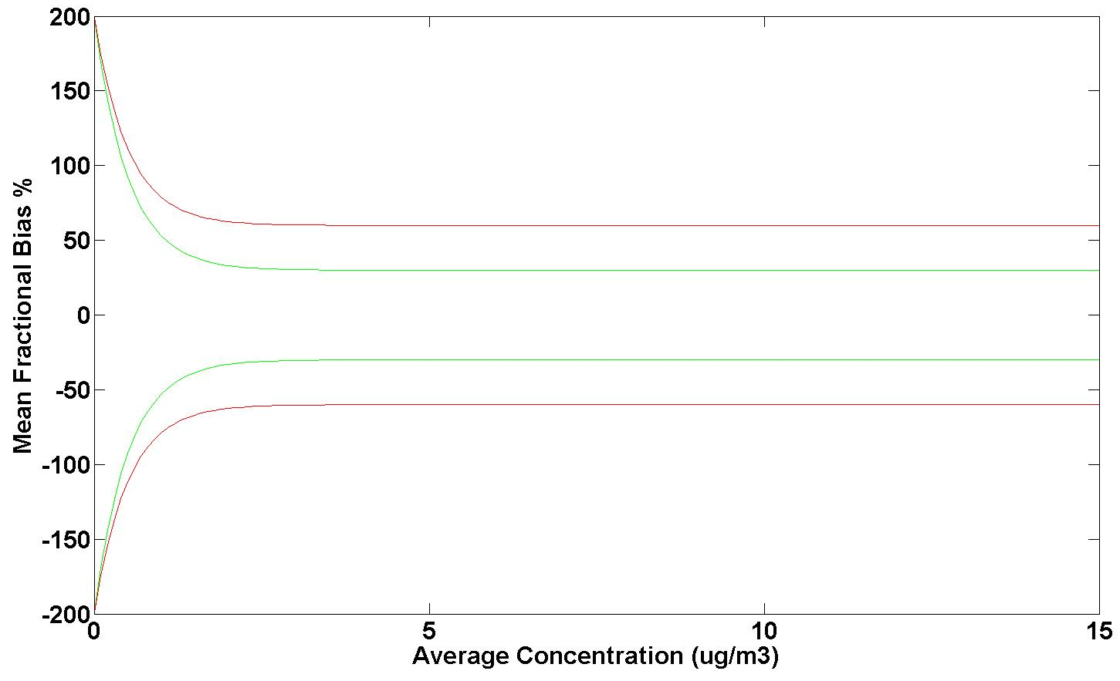
Model Performance Metric
.
CMAQ estimates were compared to surface measurements from both IMPROVE and STN networks.
Bugle plots¹ that show the Mean Fractional Bias (MFB) were used
Problematic
60
Average
30
Excellent - Good
-30
Average
-60
Problematic
¹BOYLAN, et al., 2006a. PM and light extinction model performance metrics, goals, and criteria for three-dimensional air quality models. Atmospheric Environment 40, 4946-4959.

Slide 11
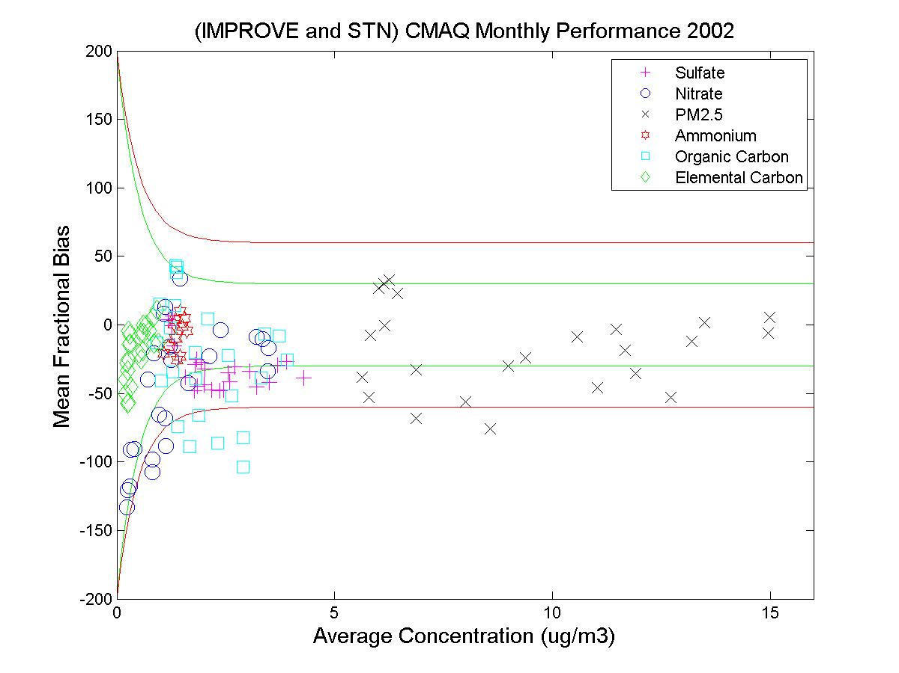
PM_{2.5} performance evaluation
For both IMPROVE and STN networks in 2002 (Independent of location)
%
Excellent - Good
Average
Problematic
Compared to IMPROVE sites the model show less PM_{2.5} estimate correlation than STN sites.
Major PM_{2.5} species that contribute to model biases are OC, sulfate, and nitrate.
PM_{2.5} bias is due to OC and nitrate.

Slide 12
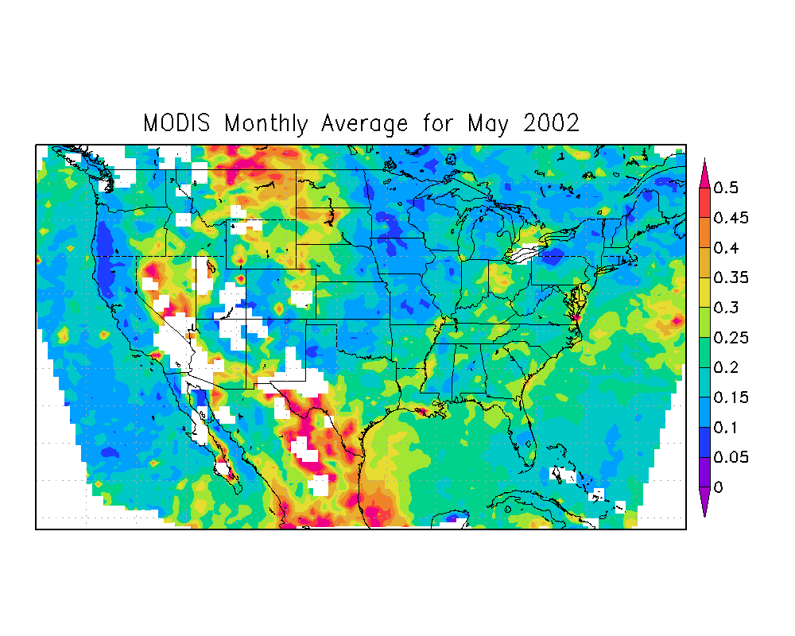
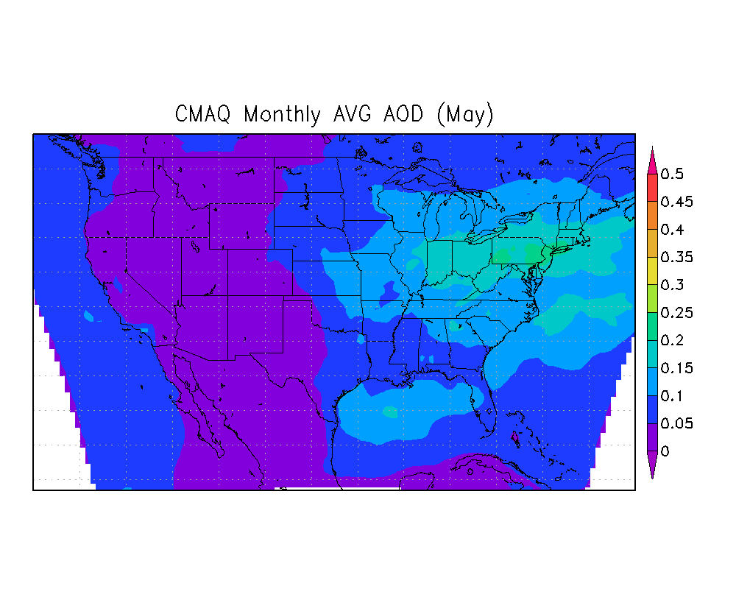
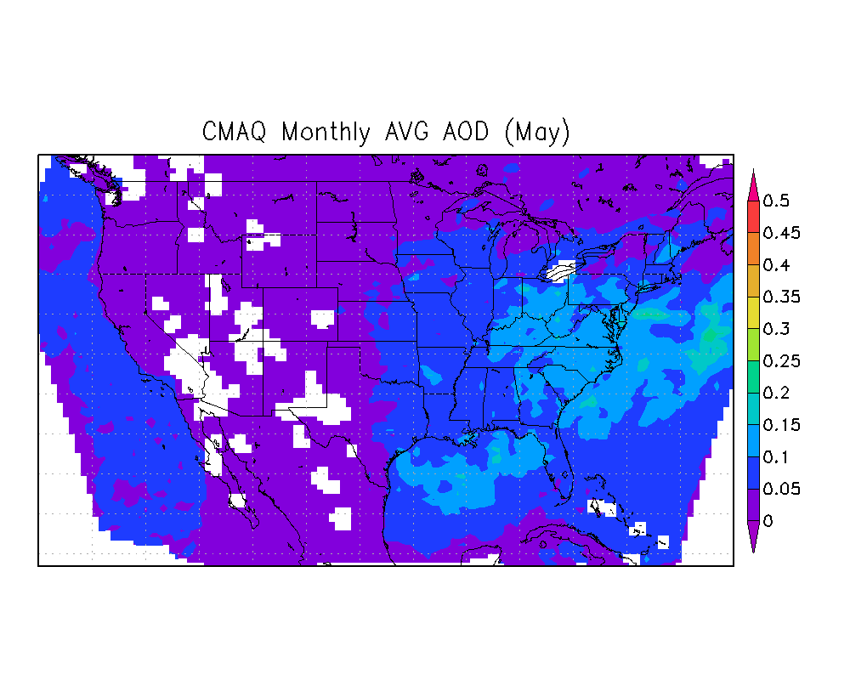
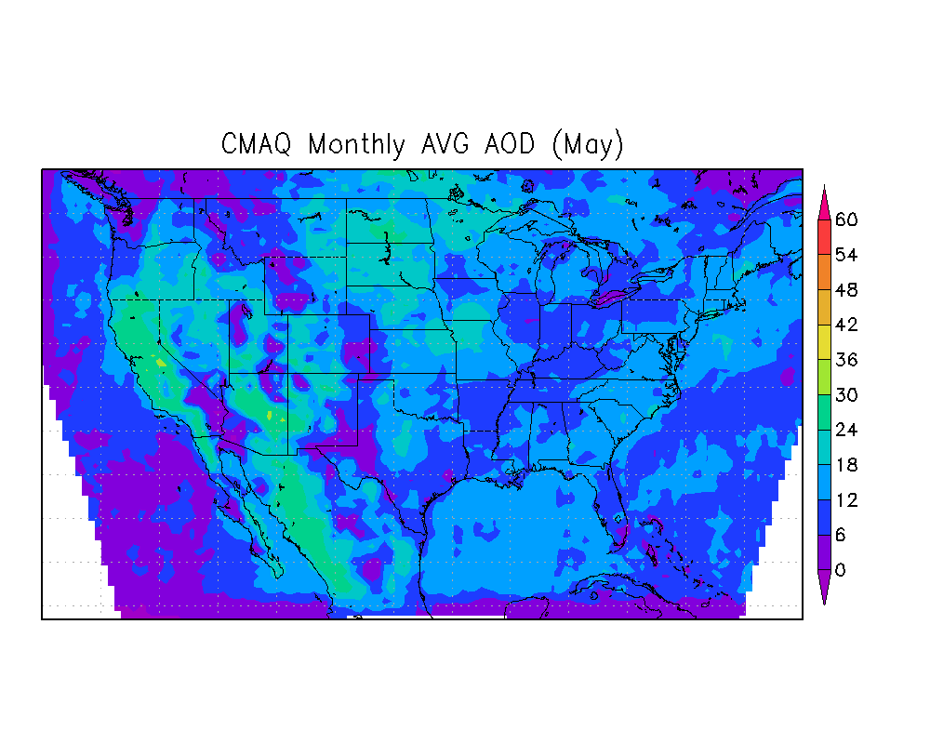
OI results for May: Case a: Average and correct all hours Case b: Average overpass hours and correct all hours
MODIS AOD
CMAQ AOD (Case a)
AOD
0.22
AOD
0.07
CMAQ AOD (Case b)
Number of MODIS points
AOD
0.05
MODIS AOD values are higher than CMAQ AOD values
Notes:
AOD is high. It is highest in the west over mountain and desert regions
Mean AOD
Spatial of AOD from CMAQ is traditional high in the east, plus LA and central valley of CA.
when only use modis overpass hours, AOD in NE US goes down.

Slide 13
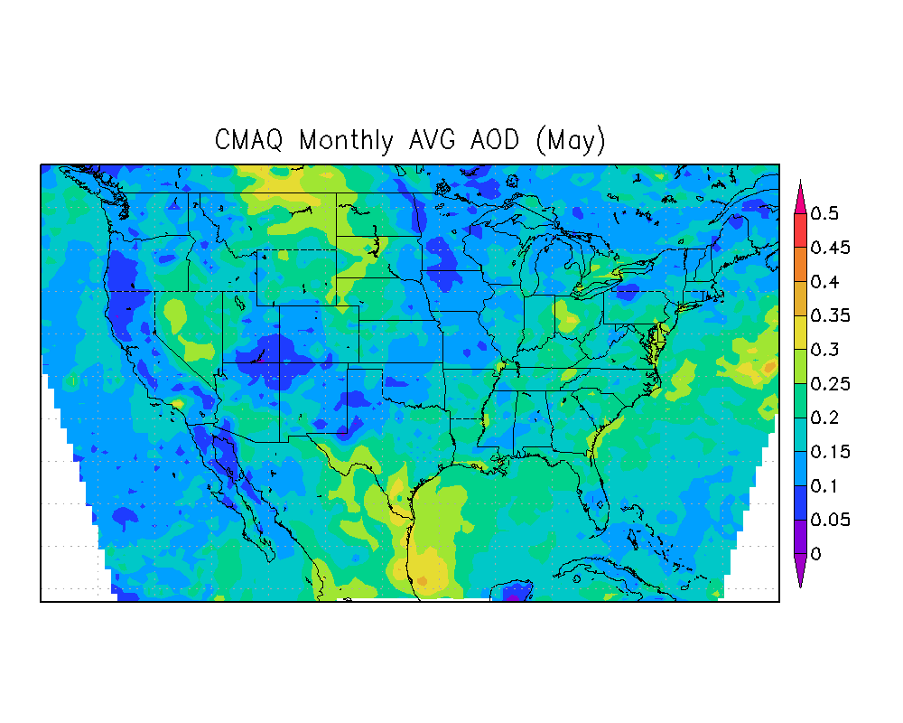
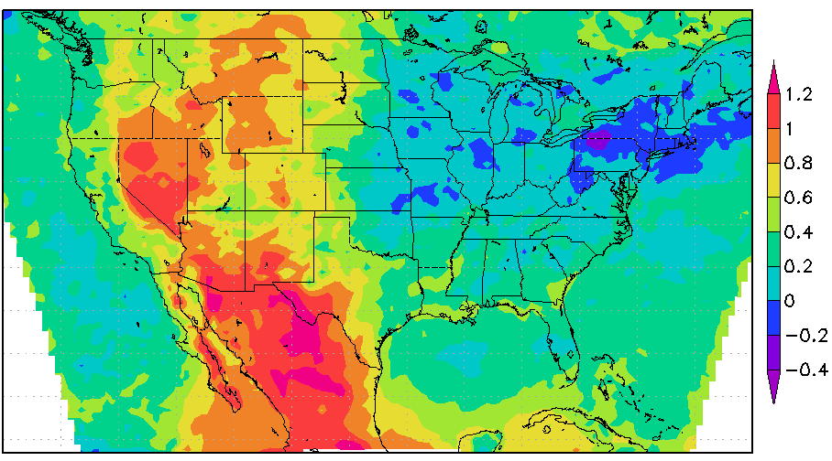
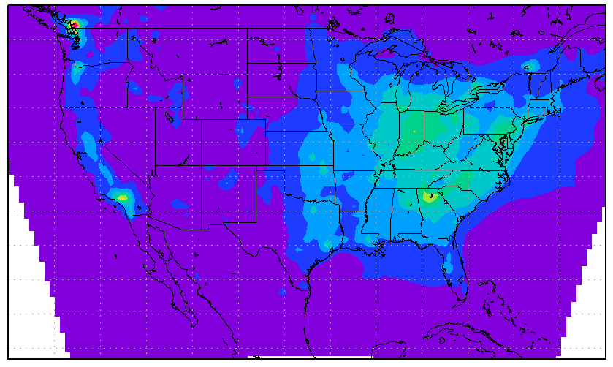
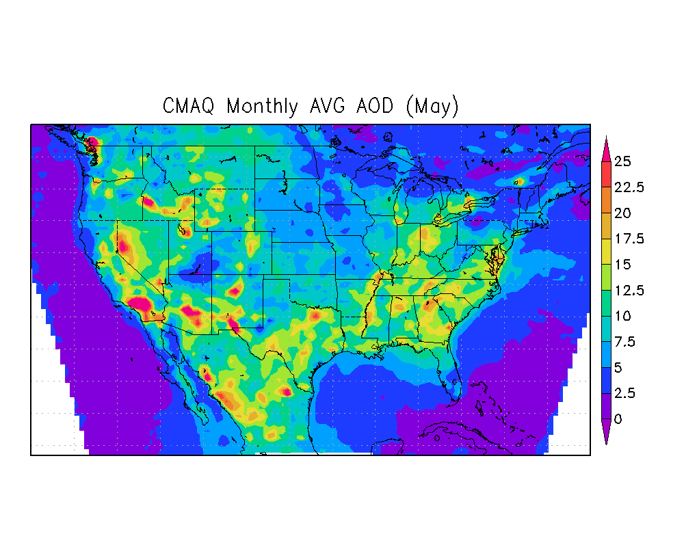
OI Result for May 2002 Case: 2a, lmxlmy 1 (Average and correct all hours)
Posterior CMAQ-derived AOD
CMAQ-derived AOD logarithmic scaling factors
16
4
1
0.3
Prior CMAQ PM_{2.5}
Posterior CMAQ PM_{2.5}
Notes:
Posterior looks more like MODIS.
Since modis was high on average, PM up on average.

Slide 14
OI Result for May 2002 Case: 2a, lmxlmy: 1 (Average and correct all hours)
Posterior CMAQ PM_{2.5}
MFB (Mountain)
IMPROVE: -86% to 67%
STN : -41% to 95%
MFB (Midwest)
IMPROVE: -49% to 17%
STN : -12% to 24%
MFB (North East)
IMPROVE: -31% to -21%
STN : -24% to 21%
MFB (Pacific)
IMPROVE: -19% to 85%
STN : -4% to 91%
MFB (South Central)
IMPROVE: -76% to 1%
STN : -59% to 9%
MFB (South Atlantic)
IMPROVE: -56% to -7%
STN : -38% to 6%

Slide 15
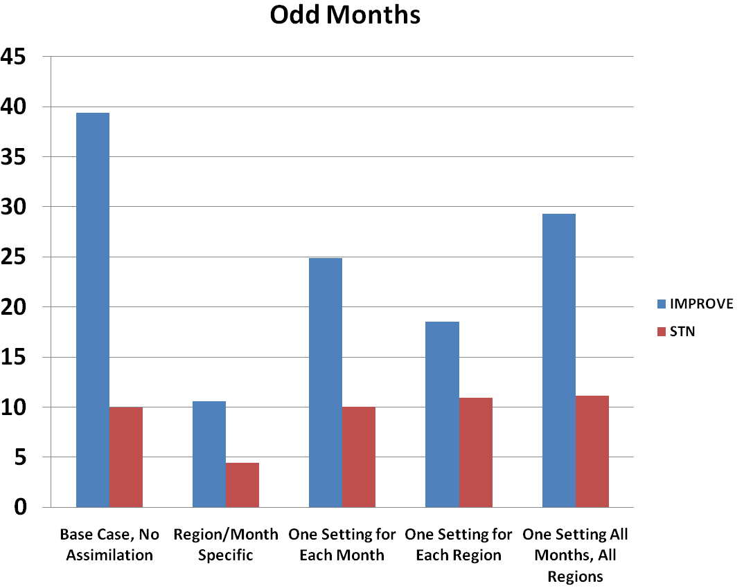
Case a: Average and correct all hours
Optimal interpolation: Performance evaluation (Based on MFB)
|MFB(%)|
Case b:
Average overpass hours and correct all hours
Case a: 47
Case e: 38
Case b: 11
Case e:
Average and correct overpass hours
Case A was the best case

Slide 16
Conclusions
The best cases were correct and average all hours (Case a) and average and correct the overpass hours (Case e).
OI performance over rural is better than urban areas.
Where for IMPROVE, the assimilation has shown an overall improvement in model PM_{2.5} estimates in the Northeast, South Atlantic, Southwest, and Midwest, then over the Pacific and Mountains.
Physical changes that are happening in these locations is that one settings is possible to improve MFB at the North East Region from %67 to %37 in winter and %53 to %41 in summer.
Simulated PM_{2.5} has smaller error in urban areas than in rural areas before assimilation.
Averaging and correcting the overpass hours (Case e) often improved the model estimates, which could indicate that CMAQ PM_{2.5} OI correction is sensitive to the time of the satellite overpass.
The results show that the assimilation has different impacts in different regions as well as on different months of the year, therefore further assessment is needed.

Slide 17
Acknowledgments
This research has been supported by a grant from the U.S. Environmental Protection Agency's Science (USEPA) to Achieve Results (STAR) program grant R833865. Although the research described in the article has been funded wholly or in part by the U.S. Environmental Protection Agency's STAR program through grant (number), it has not been subjected to any EPA review and therefore does not necessarily reflect the views of the Agency, and no official endorsement should be inferred.
Fulbright Foreign Student Program

Slide 18
Questions?

Slide 19
Supplement slides

Slide 20
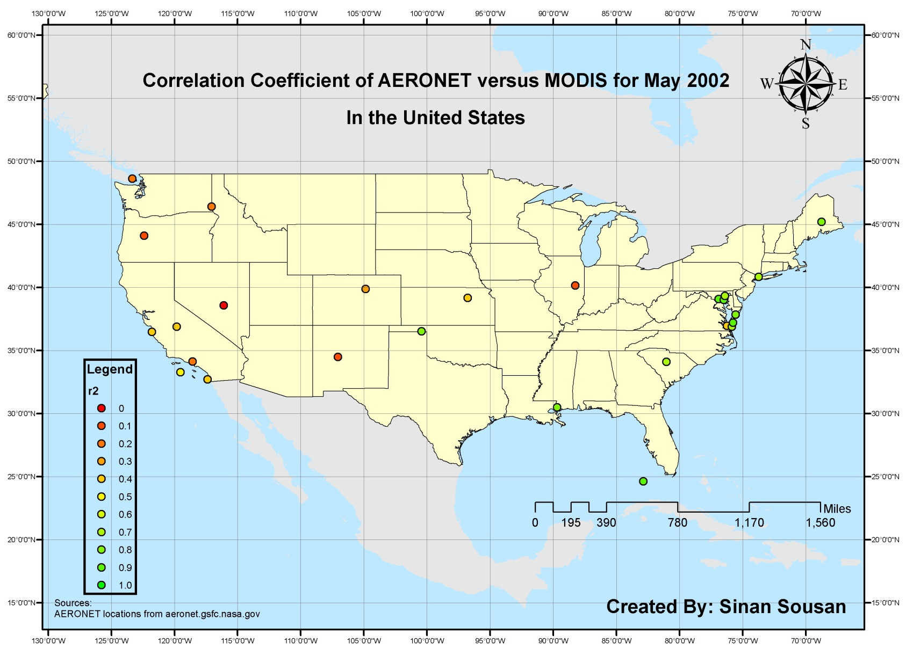
Evaluation of MODIS retrieval compared to AERONET
MODIS AOD showed a higher correlation with AERONET for the
Northeast, South Atlantic, and South West regions
Over the Midwest, Pacific and Mountains regions.
Correlation Coefficient of AERONET versus MODIS for May 2002

Slide 21
PM_{2.5} performance evaluation
In all regions CMAQ biases exist when compared to both networks with a better performance compared to STN sites
Mean Fractional Error (FE)
Pacific
Mean Fractional Error (FE)
Mountain
Mean Fractional Bias (FB)
Mean Fractional Bias (FB)
Compared to STN sites: Average performance

Slide 22
PM_{2.5} performance evaluation
In all regions both networks are consistent, showing negative or positive biases.
Mean Fractional Error (FE)
Midwest
Mean Fractional Error (FE)
South Atlantic
Mean Fractional Bias (FB)
Mean Fractional Bias (FB)
Compared to STN sites: Good performance

Slide 23
PM_{2.5} performance evaluation
Mean Fractional Error (FE)
North East
Mean Fractional Error (FE)
South Central
Mean Fractional Bias (FB)
Mean Fractional Bias (FB)
Compared to STN sites: Average to excellent performance.

Slide 24
PM_{2.5} speciated performance evaluation
Species | Key performance | Possible Causes
Sulfate | Winter: Good performance Spring and Summer. Average performance Fall: Good to Average. Regions (all accept Pacific): Good-Average | biases could be due to the chemical equilibrium partitioning of sulfate, aqueous sulfuric acid and gaseous SO₂¹.
Nitrate | Pacific and Mountain regions: Problematic Central and East parts of U.S. (urban) : Excellent to Average, Over the U.S: Modeled nitrate has a better performance in urban areas from rural parts. | Differences between measured nitrate aerosol and modeled nitrate aerosol could be potentially caused by both measurement and model errors on total ammonia and sulfate².
Organic Carbon | Summer: Problematic for the whole U.S. (except for the Pacific and rural areas at the Mountain region) Spring and Fall: Excellent to Average, Winter: variable. | Underestimation of secondary organic carbon from isoprene oxidation³.
Elemental Carbon | Urban areas in U.S.: excellent (except Mountain region). All regions (rural areas) and seasons: excellent to average | Accurate representation of soot in the emission inventory that is measured at urban areas.
Ammonium | Excellent to average estimations of ammonium concentrations | Agrees with previous studies^{1,4}
¹SPAK, S.N. AND HOLLOWAY, T. 2009. Seasonality of speciated aerosol transport over the Great Lakes region. Journal of Geophysical Research-Atmospheres 114
²YU, S., DENNIS, et al., 2005. An assessment of the ability of three-dimensional air quality models with current thermodynamic equilibrium models to predict aerosol NO3. J. Geophys. Res. 110, D07S13.
³YU, S, et al., 2007. Seasonal and regional variations of primary and secondary organic aerosols over the Continental United States: Semi-empirical estimates and model evaluation. Environmental Science & Technology 41, 4690-4697.
⁴MORRIS, et al. 2005. Preliminary evaluation of the community multiscale air, quality model for 2002 over the southeastern United States. Journal of the Air & Waste Management Association 55, 1694-1708

Slide 25
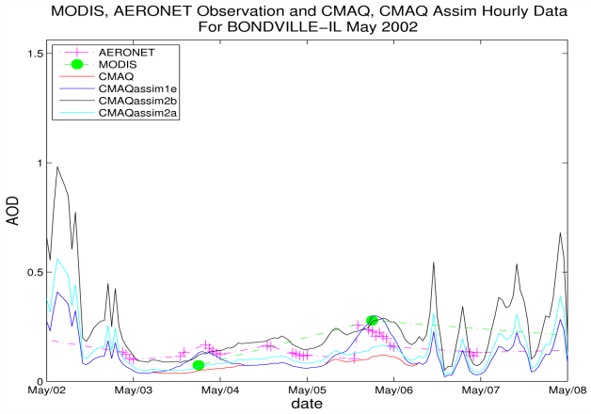
AOD correlation between model and observation
This is caused by low prior AOD values for case-b.
the prior AOD difference is 60%, lower in case b causing the scaling factor to be higher (i.e. 2.3 case b and 1.369 case a), and the model-derived AOD is pushed further from case a.

Slide 26
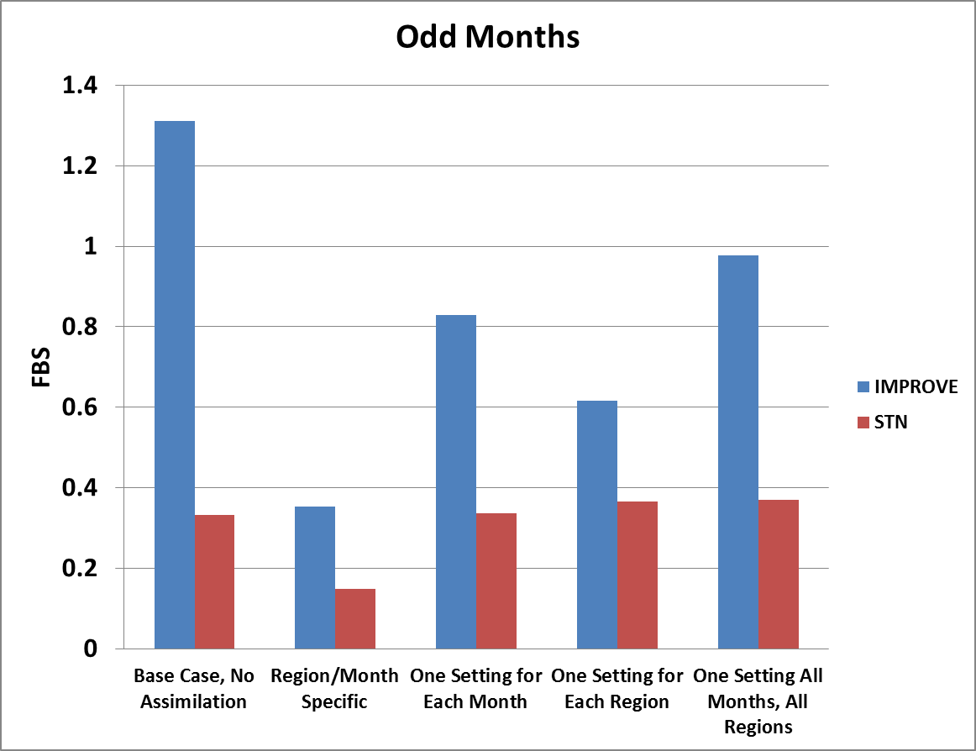
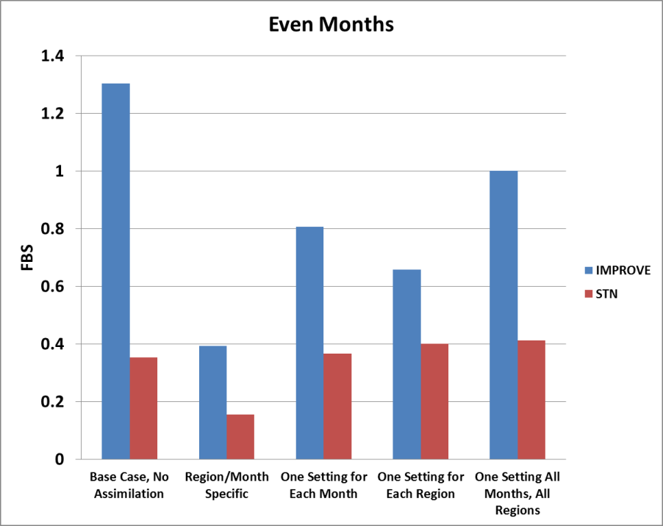
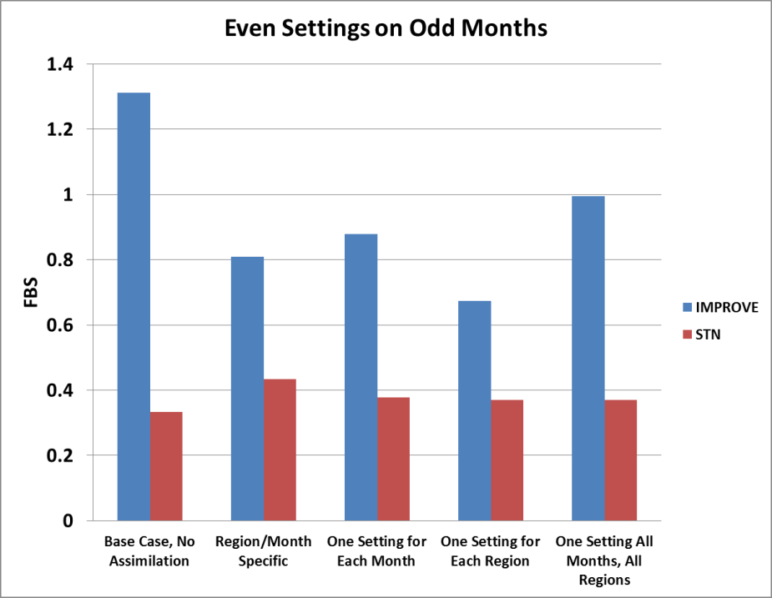
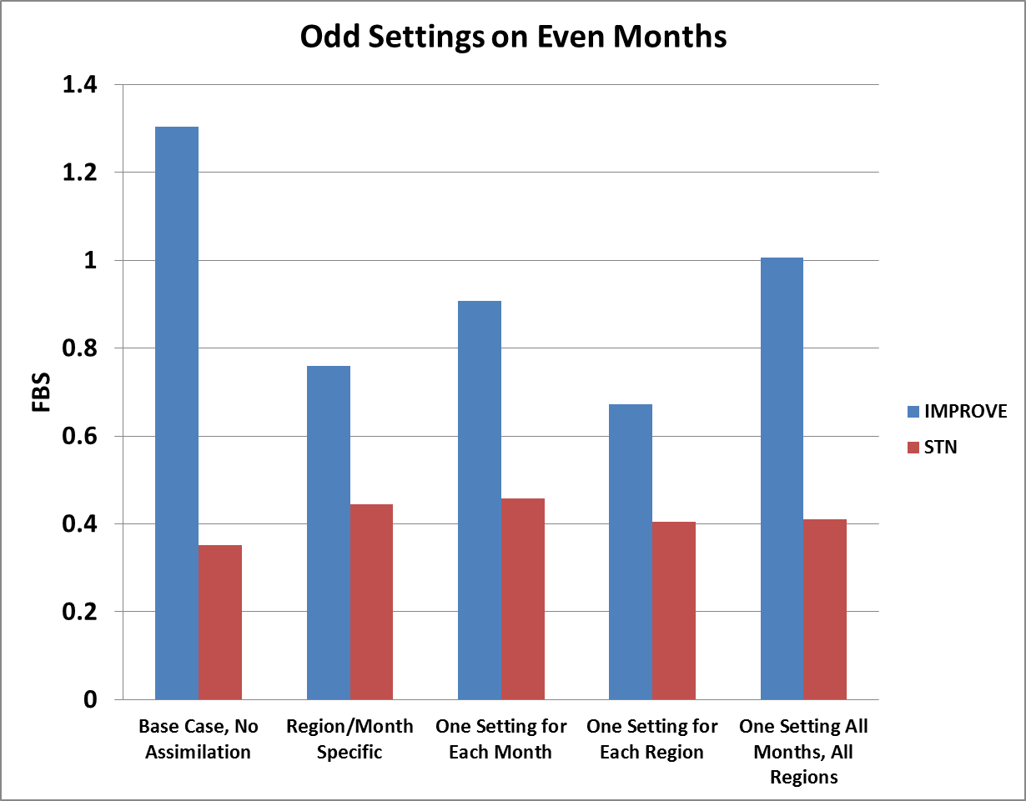
Optimal interpolation performance for odd and even months of the year
E
e
e
E
E
E
E
E

Slide 27
Methods: Algorithmic workflow
Aeronet AOD
Compare
MODIS L2 AOD
Regrid to CMAQ 36km domain
Gridded monthly satellite AOD
Error estimates for both datasets and spatial error covariance for model
Simple Temporal average
Optimal Interpolation
Emissions (SMOKE 2.3) & Boundary Conditions
CMAQ (4.6)
PM2.5 to AOD calculation
Gridded monthly to CMAQ model AOD
MCIP Meteorology Preprocessor
Temporal average scheme (simple monthly, or only values with pairs in MODIS dataset)
Posterior (optimal) AOD
Take ratio
MM5 Meteorology
Gridded hourly PM2.5 values
Monthly scaling factors
Multiply
Posterior Gridded hourly PM2.5 values
IMPROVE PM2.5 measurements
Model-measurement Comparison
STN PM2.5 measurements
Notes:
CMAQ model was implemented to produce 3D PM_{2.5} data, speciated hourly over the United States in 2002.
Model estimates were compared and evaluated with surface PM_{2.5} speciated measurements.
Model-derived AOD was calculated using optical properties.
Aerosol information from MODIS and AERONET was mapped to the model domain and evaluated.
Temporal averaging methods for both model and observational data were assessed to determine the best input to the assimilation.
OI was used with model-derivded AOD and MODIS-AERONET AOD.
Assimilation results were compared to surface measurements to evaluate effects on both urban and rural areas.

Slide 28
Optimal interpolation case studies
 | Construction of MODIS Monthly Average AOD for OI Algorithm | Construction of CMAQ Monthly Average AOD for OI Algorithm | Use of scaling factor( f) $$f=\frac{CMAQ posterior AOD }{CMAQ prior AOD }$$
Case A | Average all available data in grid cell i,j | Average all CMAQ-derived AODs in grid cell i,j | PM_{2.5}’=f•PM_{2.5}
Case B |  | Average only CMAQ-derived AODs with paired MODIS values
Case C | Average all available data in grid cell i,j. Adjust MODIS error term according to # of AOD values in grid cell I,j. | Average all CMAQ-derived AODs in grid cell i,j
Case D |  | Average only CMAQ-derived AODs with paired MODIS values
Case E | Same as case B

Slide 29
Correction with respect to satellite overpass-case e (8, 12, and 16 hours difference-continued)
The best time interval was chosen based on a number of criteria
Test | Criteria for FBS | Best | Middle | Worst
1 | Based on the Difference of “Actual FBS – Perfect FBS” (for improvement cases only) | 16 | 12 | 8
2 | Based on the number of improvement cases | 8 | 12 | 16
3 | Based on the total number of improvement and degrade cases | 8 | 12 | 16
4 | Based on improvement cases when the model was already biased low (requested FBS > 0.6) | 16 | 12 | 8
5 | Based on improvement cases only, by difference of sqrt( delta FBS - perfect delta FBS) | 16 | 12 | 8
Both 8 and 16 hours show that they are the best and worst time intervals in all tests and 12 hours is always on average. For this reason 12 hours was chosen as the optimal normal distribution time to correct model estimates.

Slide 30
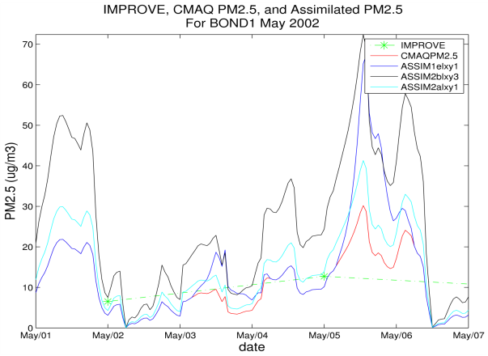
PM_{2.5} correlation between model and observation

